Slide 1
Backtracking
In this lecture, I want to describe another recursive algorithm strategy called backtracking. A backtracking algorithm tries to build a solution to a computational problem incrementally. Whenever the algorithm needs to decide between multiple alternatives to the next component of the solution, it simply
tries all possible options recursively.

Slide 2
Backtracking
n Queens
The prototypical backtracking problem is the classical n Queens Problem, ﬁrst proposed by German
chess enthusiast Max Bezzel in 1848 for the standard 8 × 8 board, and both solved and generalized to
larger boards by Franz Nauck in 1850. The problem is to place n queens on an n × n chessboard, so that
no two queens can attack each other. For readers not familiar with the rules of chess, this means that no
two queens are in the same row, column, or diagonal.

Slide 3
Backtracking
Obviously, in any solution to the n-Queens problem, there is exactly one queen in each row. So we will represent our possible solutions using an array Q[1 .. n], where Q[i] indicates which square in row i
contains a queen, or 0 if no queen has yet been placed in row i. To ﬁnd a solution, we put queens on the board row by row, starting at the top. A partial solution is an array Q[1 .. n] whose ﬁrst r − 1 entries are positive and whose last n − r + 1 entries are all zeros, for some integer r.

Slide 4
Backtracking
The following recursive algorithm recursively enumerates all complete n-queens solutions that are consistent with a given partial solution. The input parameter r is the ﬁrst empty row. Thus, to compute
all n-queens solutions with no restrictions, we would call RECURSIVENQUEENS(Q[1 .. n], 1).

Slide 5
Backtracking
RECURSIVENQUEENS(Q[1 .. n], r):
if r = n + 1
print Q
else
for j ← 1 to n
legal ← TRUE
for i ← 1 to r − 1
if (Q[i] = j) or (Q[i] = j + r − i) or (Q[i] = j − r + i)
legal ← FALSE
if legal
Q[r] ← j
RECURSIVENQUEENS(Q[1 .. n], r + 1)

Slide 6
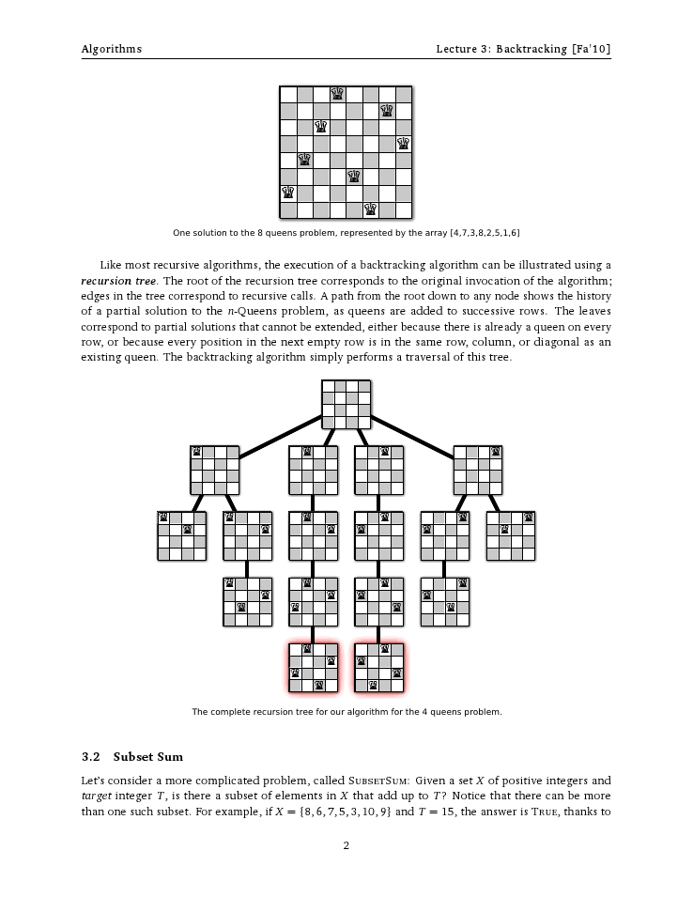
Backtracking

Slide 7
Backtracking
Subset Sum
Let’s consider a more complicated problem, called SUBSETSUM: Given a set X of positive integers and
target integer T , is there a subset of elements in X that add up to T ? Notice that there can be more
than one such subset. For example, if X = {8, 6, 7, 5, 3, 10, 9} and T = 15, the answer is TRUE,

