Slide 1
Making algorithms efficient
Leap year algorithms
LpYr(n) LpYr1(n)
If n is not divisible by 4 then If n is divisible by 400 then
n is not a leap year n is a leap year
Elseif n is not divisible by 100 then Elseif n is divisible by 100 then
It is a leap year n is a not leap year
Elseif it is not divisible by 400 then Elseif it is divisible by 4 then
It is not a leap year n is a leap year
Else Else
It is a leap year. n is not a leap year.
Endif endif

Slide 2
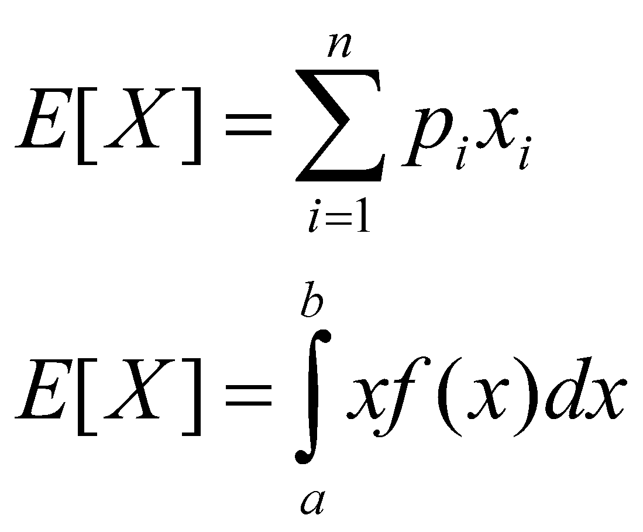
Expected number of comparisons

Slide 3
Expected number of comparisons
X- random variable denoting # of comparisons
It assumes values 1,2 and 3 so is discrete random variable. For the first algorithm
E[X]=1.300/400+2.96/400+3.4/400≈1.25
For the 2nd algorithm
E[X]=1.1/400+2.3/400+3.396/400 ≈3
First algorithm is better. In if and case statements conditions having higher probability of being satisfied should be put earlier.

Slide 4
Complexity
Worst-Case Complexity
The worst case complexity of an algorithm is the function deﬁned by the maximum number of steps taken on any instance of size n.
Best-Case and Average-Case Complexity
The best case complexity of an algorithm is the function
deﬁned by the minimum number of steps taken on any
instance of size n.
The average-case complexity of the algorithm is the function
deﬁned by an average number of steps taken on any instance
of size n.
Each of these complexities deﬁnes a numerical function: time
vs. size!

Slide 5
Exact Analysis is Hard!
Best, worst, and average are difﬁcult to deal with precisely because the details are very complicated:
It is easier to talk about upper and lower bounds of the function.
Asymptotic notation (O(n)) are as well as we can practically deal with complexity functions.

Slide 6
Names of Bounding Functions
g(n) = O(f(n)) means cf(n) is an upper bound on
g(n) for some c>0 and all n>n₀.
g(n) = (f(n)) means cf(n) is a lower bound on g(n).
g(n) = Ѳ(f(n)) means c₁f(n) is an upper bound on
g(n) and cf(n) is a lower bound on g(n).
c,c₁,c₂ are all constants independent of n.

Slide 7
Formal Deﬁnitions
f(n) = O(g(n)) if there are positive constants n₀ and c
such that to the right of n₀, the value of f(n) always lies
on or below cg(n).
f(n) =Ω (g(n)) if there are positive constants n₀ and c
such that to the right of n₀, the value of f(n) always lies
on or above c Ω g(n).
f(n) = Ѳ (g(n)) if there exist positive constants n₀, c₁, and
c₂ such that to the right of n₀, the value of f(n) always lies
between c₁ Ѳ g(n) and c₂ Ѳ g(n) inclusive.

Slide 8
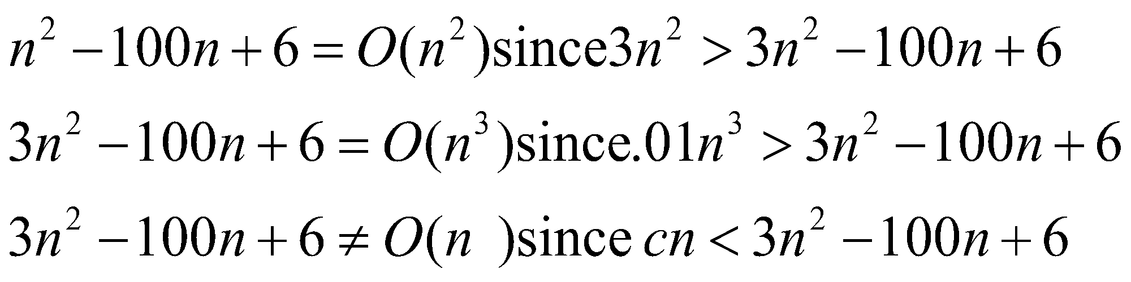
Big Oh Examples
Equality means in the set of functions.

Slide 9
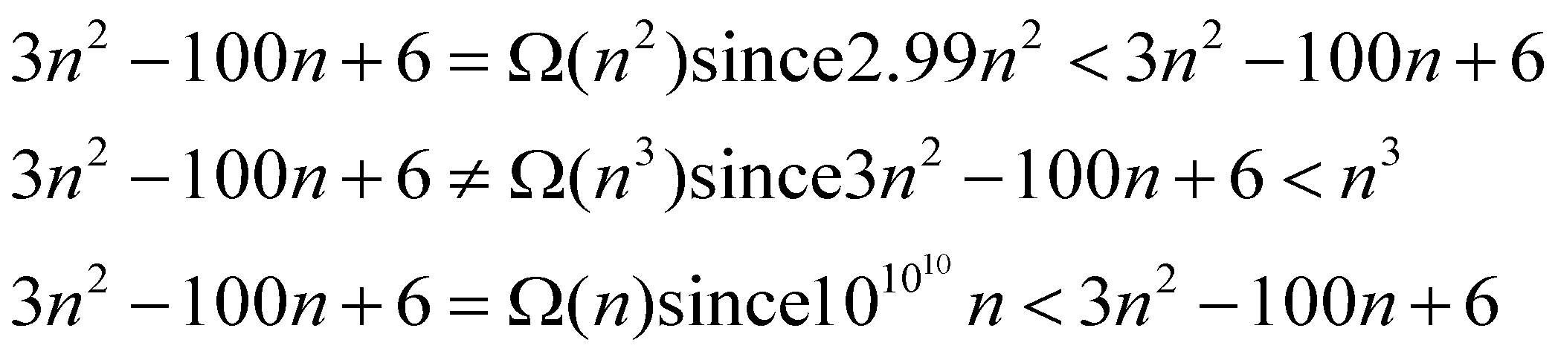
Big Oh Examples
Equality as meaning in the set of functions.

Slide 10
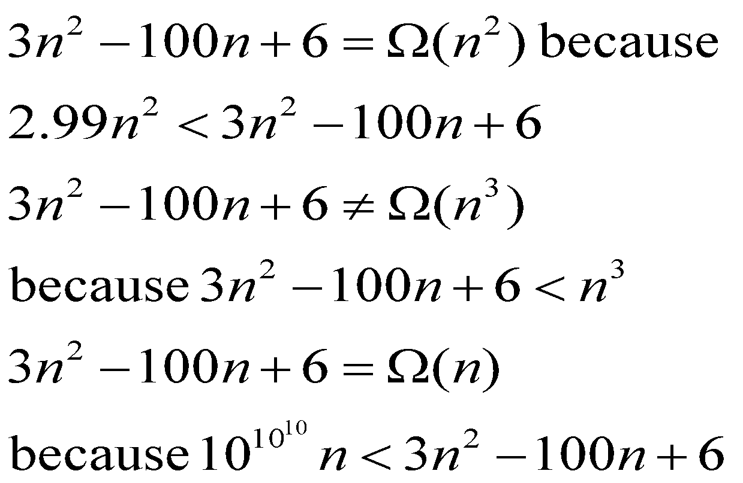

Big Omega Examples

Slide 11
Big Oh Addition/Subtraction
Suppose f(n)=O(n²) and g(n)=O(n²)
What do we know about g’(n)=f(n)+g(n)? Adding the bounding constants shows g’(n)= O(n²)
What do we know about g’’(n)=f(n)-g(n)? Since the bounding constants don’t necessarily cancel g’’(n)= O(n²)

Slide 12
Data Structure helps algorithm
Given a set of numbers (not necessarily positive) find a consecutive subset having maximum sum.
Easily can be solved in O(n³) operations
Keeping some intermediate results can be solved in O(n²) operations
However adding an extra data structure results in a linear time algorithm

Slide 13
Maximum Sum of Consecutive Subsequence
MSCS(A,n,maxsum)
maxsum=suffixmax=0
For i=1 to n do
if suffixmax+A(i) > maxsum then
maxsum=suffixmax+A(i)
suffixmax=maxsum
elseif suffixmax+A(i) > 0 then
suffixmax=suffixmax+A(i)
else
suffixmax=0
endif
enddo

Slide 14
Simulation of the algorithm
n | 1 | 2 | 3 | 4 | 5 | 6 | 7
n | 1 | 2 | 3 | 4 | 5 | 6 | 7 | 8 | 9
A | 2 | -1 | 3 | -6 | 5 | 2 | -1 | 7 | -8
Maxsum 0 | 2 | 2 | 4 | 4 | 5 | 7 | 7 | 13 | 5
Suffixmax 0 | 2 | 1 | 4 | 0 | 5 | 7 | 6 | 13 | 13

Slide 15
Celebrity Problem
Celebrity is a person in a collection whom everybody knows but who does not know anybody. There can be at most 1 celebrity in any group. Let the relation be expressed by the following matrix:
Know(i,j)=1 if I knows j, otherwise 0
While there are n² elements computation will be simply O(n) since comparing an element of a row will either throw a row away or a column away. So we will be left with a row and a column whose elements will have to be checked for compatibility with celebrity conditions. Initially assume that know(i,i)=0 for all i

Slide 16
Celebrity Problem
Celebrity(Know,n) j=1 if i ≤ n then
i=1,j=2,k=3 while j ≤ n do cand is celebrity
While k<n+2 do if know(cand,j)=0 then endif
if know(i,j)=1 then j++
i=k else
else no celebrity
j=k j=n+1
Endif endif
k++ enddo know(cand,cand)=1
if i ≤ n then if j≤n then
cand=i i=1
else while(i ≤ n) do
cand=j if know(i,cand)=1 then
endif i++
enddo else
i=n+2, no celebrity
endif
enddo
endif

