Slide 1
Efficiency from recursion
Consider the problem of finding minimum and maximum of the same array having n elements. We may have the following program segments
Minmax(A,n,min,max) minmax1(A,n,min,max)
min=max=A(1) min=max=A(1)
For i=2 to n do for i=2 to n do
if A(i)<min then if A(i)<min then
min=A(i) min=A(i)
endif elseif A(i)>max then
if A(i)>max then max=A(i)
max=A(i) endif
endif enddo
Enddo
For minmax number of comparisons is 2(n-1), number of assignments random, for minmax1 both are random. Assuming each element to be equally likely to be the kth smallest(largest) element of the array. Number of assignments in the minmax is 2H_{n}. For minimax1 number of comparisons will be 2(n-1)-H_{n-1} and number of assignments will be 2H_{n}. Not an impressive or effective trick.

Slide 2
Efficiency from recursion
Rminmax(A,1,n,fmin,fmax) Let T(n) be number of comparisons, n=2^{k}
Low=1, high=n Then T(n)=2T(n/2)+2=2+2²+2²T(n/2²)=
If low=high then =2+2²+2³+…+2^{k}+2^{k}T(n/2^{k})
fmin=fmax=A(1) =2+2²+2³+…+2^{k}
Elseif low=high-1 then =3/2n-2
if A(low)<A(high) then A better algorithm that reduced complexity by25%
fmin=A(low), fmax=A(high)
else fimn=A(high), fmax=A(low)
Else
rminmax(A,low,(low+high)/2,gmin,gmax)
rminmax(A,n/2+1,n,hmin,hmax)
fmin=minimum(gmin, hmin)
fmax=maximum(gmax,hmax)
endif

Slide 3
Number problems
Modular exponentiation.
function modexp(x, y, N )
Input: Two n-bit integers x and N, an integer exponent y
Output: x^{y} mod N
if y = 0: return 1
z = modexp(x, ⌊y/2⌋, N )
if y is even:
return z ² mod N
else:
return x · z ² mod N

Slide 4
Number problems
Euclid’s algorithm for ﬁnding the greatest common divisor of two numbers.
function Euclid(a, b)
Input: Two integers a and b with a ≥ b ≥ 0
Output: gcd(a, b)
if b = 0: return a
return Euclid(b, a mod b)

Slide 5
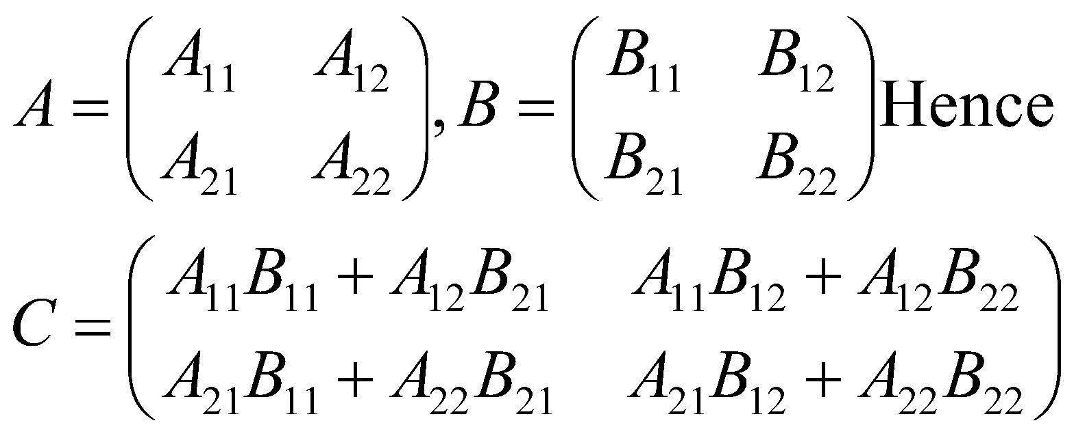
Divide-and-conquer based techniques
In initial days this technique was used to fight against low primary memory. Say we want to multiply 2 matrices C=A*B. A and B are so large that they cannot be stored in primary memory. So each matrix is divided as

Slide 6
Divide-and-conquer based techniques
Now submatrices are smaller and can be stored in primary memory.
But recursion is being used to devise more efficient algorithms. For example sorting using bubble sort requires O(n²) comparisons, whereas recursively dividing the array results in a better algorithm known as mergesort, quicksort etc

Slide 7
Divide-and-conquer based techniques
Now submatrices are smaller and can be stored in primary memory.
But recursion is being used to devise more efficient algorithms. For example sorting using bubble sort requires O(n²) comparisons, whereas recursively dividing the array results in better algorithms like mergesort, quicksort etc

Slide 8
Divide-and-conquer based techniques
Matrix multiplication, by division as above, comes out to an unimpressive O(n ³ ), the same as for the default algorithm. But the efﬁciency can be further improved, and as with integer multiplication, the key is some clever
algebra. It turns out XY can be computed from just seven n/2 × n/2 subproblems, via a decomposition so tricky and intricate that one wonders how Strassen was ever able to discover it!

Slide 9
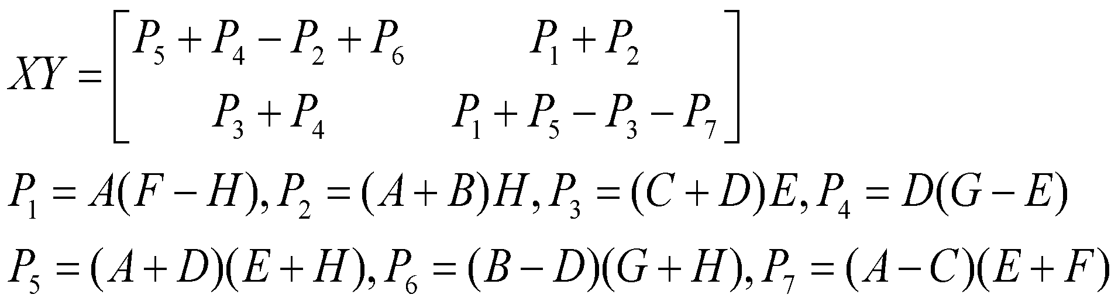
Divide-and-conquer based techniques
The new running time is T (n) = 7T (n/2) + O(n² ),
which by the master theorem works out to O(n log₂ 7 ) ≈ O(n^{2.81} ).

Slide 10
Divide-and-conquer based techniques
We have so far seen how divide-and-conquer gives fast algorithms for multiplying integers and matrices; our next target is polynomials. The product of two degree-d polynomials is a polynomial of degree 2d, for example:
(1 + 2x + 3x² ) · (2 + x + 4x² ) = 2 + 5x + 12x² + 11x³ + 12x⁴ .
More generally, if A(x) = a₀ + a₁ x + · · · + a_{d} x^{d} odd and B(x) = b₀ + b₁ x + · · · + b_{d} x^{d} , their product
C(x) = A(x) · B(x) = c₀ + c₁ x + · · · + c_{2d} x^{2d} has coefﬁcients

Slide 11
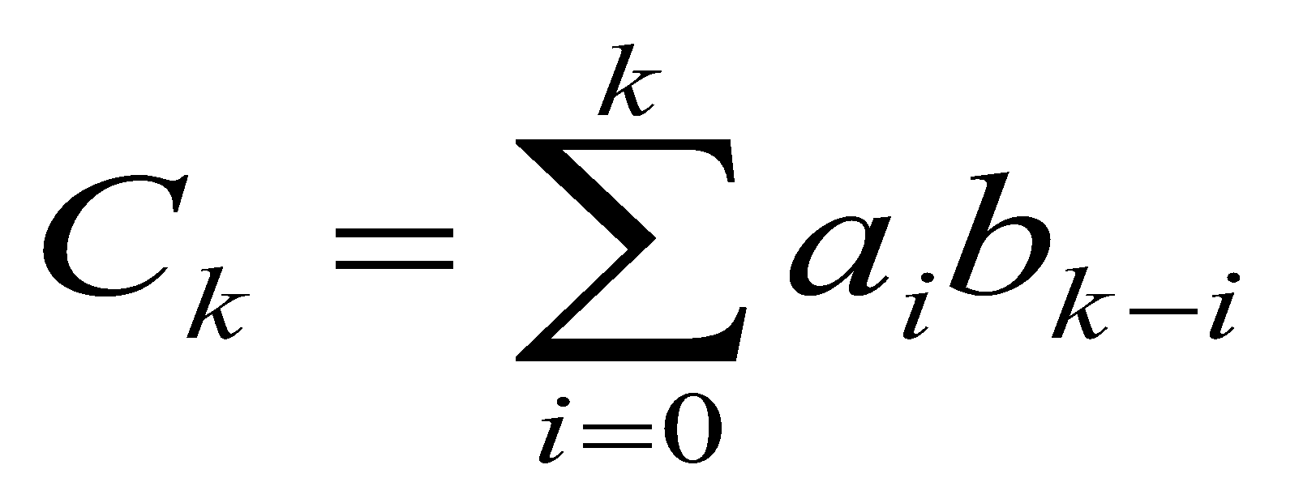
Divide-and-conquer based techniques
(for i > d, take a_{i} and b_{i} to be zero). Computing c_{k} from this formula takes O(k) steps, and ﬁnding all 2d + 1 coefﬁcients would therefore seem to require Θ(d ² ) time. Can we possibly multiply polynomials faster than this? FFT exactly does this.

Slide 12
Divide-and-conquer based techniques
An alternative representation of polynomials to arrive at a fast algorithm for polynomial multiplication
we take inspiration from an important property of polynomials.
Fact A degree-d polynomial is uniquely characterized by its values at any d + 1 distinct points.
A familiar instance of this is that “any two points determine a line.” We will later see why the more general statement is true (page 76), but for the time being it gives us an alternative representation of polynomials. Fix any distinct points x₀ , . . . , x_{d} . We can specify a degree-d polynomial A(x) = a₀ + a₁ x + · · · + a_{d} x_{d} by either one of the following:
1. Its coefﬁcients a₀ , a₁ , . . . , a_{d}.

Slide 13
Divide-and-conquer based techniques
2. The values A(x₀ ), A(x₁ ), . . . , A(x_{d} )
Of these two representations, the second is the more attractive for polynomial multiplication. Since the product C(x) has degree 2d, it is completely determined by its value at any 2d + 1 points. And its value at any given point z is easy enough to ﬁgure out, just A(z) times B(z). Thus polynomial multiplication takes linear time in the value representation. The problem is that we expect the input polynomials, and also their product, to be speciﬁed by coefﬁcients. So we need to ﬁrst translate from coefﬁcients to values—which is just a matter of evaluating the polynomial at the chosen points—then multiply in the value representation, and ﬁnally translate back to coefﬁcients, a process called interpolation

Slide 14
Divide-and-conquer based techniques
Polynomial multiplication
Input: Coefficients of two polynomials, A(x) and B(x), of degree d
Output: Their product C = A · B
Selection
Pick some points x₀ , x₁ , . . . , x_{n−1} , where n ≥ 2d + 1
Evaluation
Compute A(x₀ ), A(x₁ ), . . . , A(x_{n−1} ) and B(x₀ ), B(x₁ ), . . . , B(x_{n−1} )
Multiplication
Compute C(x_{k} ) = A(C(x_{k} )B(C(x_{k} ) for all k = 0, . . . , n − 1
Interpolation
Recover C(x) = c₀ + c₁ x + · · · + c_{2d} x_{2d}

Slide 15
Divide-and-conquer based techniques
Evaluation by divide-and-conquer Here’s an idea for how to pick the n points at which to evaluate a polynomial A(x) of degree ≤ n − 1. If we choose them to be positive-negative pairs, that is, ±x₀ , ±x₁ , . . . , ±x_{n/2−1} ,
then the computations required for each A(x_{i} ) and A(−x_{i} ) overlap a lot, because the even
powers of x_{i} coincide with those of −x_{i} . To investigate this, we need to split A(x) into its odd and even powers, for instance
3 + 4x + 6x² + 2x³ + x⁴ + 10x⁵ = (3 + 6x² + x⁴ ) + x(4 + 2x² + 10x⁴ ).

Slide 16
Divide-and-conquer based techniques
Notice that the terms in parentheses are polynomials in x 2 . More generally, A(x) = A_{e} (x² ) + xA_{o} (x² ), where A_{e} (·), with the even-numbered coefﬁcients, and A _{o} (·), with the odd-numbered coefﬁcients, are polynomials of degree ≤ n/2 − 1 (assume for convenience that n is even). Given paired points ±x_{i} , the calculations needed for A(x_{i} ) can be recycled toward computing A(− x_{i} ):
A(x_{i} ) = A_{e} (x2 ) + x_{i} A_{o} (x2 )
A(− x_{i} ) = A_{e} (x2 ) − x_{i} A_{o} (x2 ).
In other words, evaluating A(x) at n paired points ±x₀ , . . . , ±x_{n/2−1} reduces to evaluating A_{e} (x) and A_{o} (x) (which each have half the degree of A(x)) at just n/2 points, x₀ ² , . . . , x_{n/2-1}²

Slide 17
Divide-and-conquer based techniques
The original problem of size n is in this way recast as two subproblems of size n/2, followed by some linear-time arithmetic. If we could recurse, we would get a divide-and-conquer procedure with running time
T (n) = 2T (n/2) + O(n), which is O(n log n), exactly what we want.
But we have a problem: The plus-minus trick only works at the top level of the recursion. To recurse at the next level, we need the n/2 evaluation points x₀² , x₁² , x₂²,…, x_{n/2−1}² to be themselves plus-minus pairs. But how can a square be negative? The task seems impossible! Unless, of course, we use complex numbers. Fine, but which complex numbers? To ﬁgure this out, let us “reverse engineer” the process.
At the very bottom of the recursion, we have a single point. This point might as well be 1, in √ which case the level above it must consist of its square roots, ± 1 = ±1.

Slide 18
Divide-and-conquer based techniques
The original problem of size n is in this way recast as two subproblems of size n/2, followed by some linear-time arithmetic. If we could recurse, we would get a divide-and-conquer procedure with running time
T (n) = 2T (n/2) + O(n),
which is O(n log n), exactly what we want.

Slide 19
Divide-and-conquer based techniques
The next level up then has ± +1 = ±1 as well as the complex numbers ± −1 = ±i, where I is the imaginary unit. By continuing in this manner, we eventually reach the initial set of n points. Perhaps you have already guessed what they are: the complex nth roots of unity, that is, the n complex solutions to the equation z n = 1.
the nth roots of unity: the complex numbers 1, ω, ω ² , . . . , ω ^{n−1} , where ω = e^{2πi/n} . If n is even,
1. The nth roots are plus-minus paired, ω _{n/2+j} = −ω _{j} .

Slide 20
Divide-and-conquer based techniques
The fast Fourier transform (polynomial formulation) function FFT(A, ω)
Input: Coefficient representation of a polynomial A(x) of degree ≤ n − 1, where n is a power of 2 ω, an nth root of unity
Output: Value representation A(ω ₀ ), . . . , A(ω _{n−1} )
if ω = 1: return A(1)
express A(x) in the form A _{e} (x² ) + xA ₀ (x² )
call FFT(A _{e}, ω ² ) to evaluate A _{e} at even powers of ω
call FFT(A ₀, ω ² ) to evaluate A ₀ at even powers of ω
for j = 0 to n − 1:
compute A(ω j ) = A _{e} (ω ^{2j} ) + ω ^{j} A ₀ (ω ^{2j} )
return A(ω ⁰ ), . . . , A(ω ^{n−1} )

Slide 21
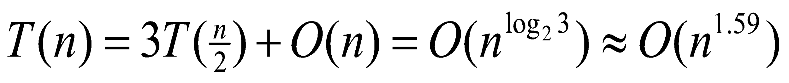
Divide-and-conquer based techniques
The mathematician Carl Friedrich Gauss (1777–1855) once noticed that although the product of two complex numbers
(a + bi)(c + di) = ac − bd + (bc + ad)i seems to involve four real-number multiplications, it can in fact be done with just three: ac,bd, and (a + b)(c + d), since
bc + ad = (a + b)(c + d) − ac − bd.
In our big-O way of thinking, reducing the number of multiplications from four to three seems wasted ingenuity. But this modest improvement becomes very signiﬁcant when applied recursively. So if T(n) is complexity then T(n) is no longer O(n²)

Slide 22
Divide-and-conquer based techniques
A divide-and-conquer algorithm for integer multiplication.
function multiply(x, y)
Input: Positive integers x and y, in binary
Output: Their product
n = max(size of x, size of y)
if n = 1: return xy
xL , xR = leftmost ⌈n/2⌉, rightmost ⌊n/2⌋ bits of x
yL , yR = leftmost ⌈n/2⌉, rightmost ⌊n/2⌋ bits of y
P1 = multiply(xL , yL )
P2 = multiply(xR , yR )
P3 = multiply(xL + xR , yL + yR )
return P1 × 2n + (P3 − P1 − P2 ) × 2n/2 + P2

