Slide 1
Mergesort
We divide the array into 2 equal parts and sort them. Then we merge it. The routine goes as follows
Mergesort(A,1,n) merge(A,low,mid,high)
Low=1, high=n k=low
If low<high then while i<=mid and j<=high do
mid=(low+high)/2 if A(i)<A(j) then
mergesort(A,low,mid) B(k)=A(i), i++
mergesort(A, mid+1,high) else
merge(A,low,mid,high) B(k)=A(j), j++
endif
k++
enddo
If i<mid then Complexity: Let T(n) be number of comparisons n=2^{k}
for k=i to mid do
B(k)=A(k) T(n)=2T(n/2)+an=an+2(an/2)+2²T(n/2²)
enddo =(an+an+…+an) k summands
Else =akn=anlog₂n
for k=j to high do
B(k)=A(k)
enddo
endif
Too much of overhead in I/O and is not an in-place sorting algorithm

Slide 2
Quicksort
Now we have an in-place D&C based algorithm for sorting
Quicksort(A,1,n) partition(A,low,high,j)
Low=1, high=n z=A(low), i=low+1, j=n+1, A(n+1)=infinity
If low<high then while i<j do
partition(A,low,high,j) while A(i)<z do
quicksort(A,low,j-1) i++
quicksort(A,j+1,high) enddo
Endif while A(j)>z do
j- -
enddo
if i<j then
A(i)↔A(j)
endif
enddo

Slide 3
Complexity Analysis of Quicksort
If partitioning element is eccentric too small or too large then one subarray will be empty. So in that case in each call # of comparisons will be equal to number of elements in a partition.

Slide 4
Complexity Analysis of Quicksort
So total number of comparisons is n+(n-1)+…+1=O(n²). But this algorithm of Hoare works much faster than the above complexity suggests. Let us do average case analysis assuming that partitioning element can occupy any position with equal probability.

Slide 5
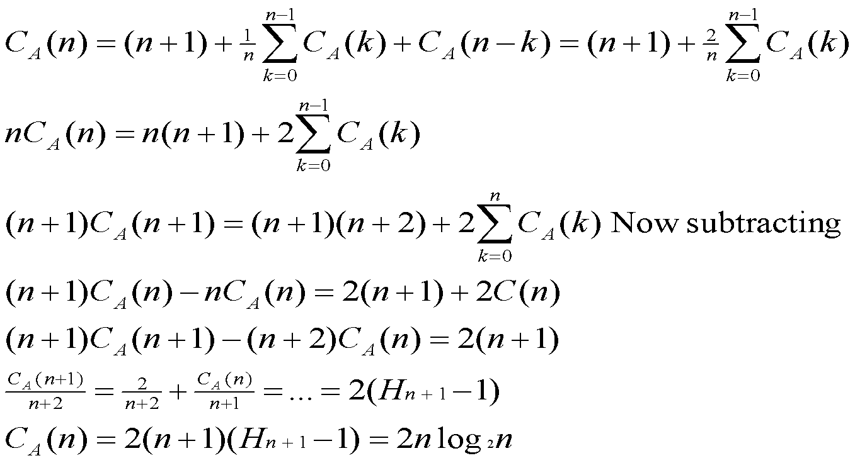
Complexity Analysis of Quicksort
Let C_{A}(n) be average # of comparisons

Slide 6
Complexity Analysis of Quicksort
For quicksort to be more efficient we need to have good partitioning element that can partition the array into nontrivial subarrays. Median of medians is a good example that exactly does that. If we have 49 elements that are divided into 7 subarrays of 7 elements, and all these subarrays are arranged in such a way that there medians are placed in ascending order then median of medians will be greater/less than at least 15 elements. Now this median of medians can be used as a partitioning element.
This partitioning algorithm can be used to select any number of elements of an array in probable linear time.

Slide 7
Heapsort
Heap is a data structure efficient to delete the maximum(minimum) element in O(logn) computation, insertion of an element also requires similar operations. Heap is implemented in a complete binary tree in which nodes are located top to bottom and left to right. If we number nodes from 1 to n with 1 being the root, then number of a node is twice that of its father if it happens to be left son or +1 if right. Similarly if number of a node is divided by 2 then we get number of the father.
Heap is a DS in which son values are less than or equal to father values. We can construct heap in two different ways- by insertion and by adjustment.

Slide 8
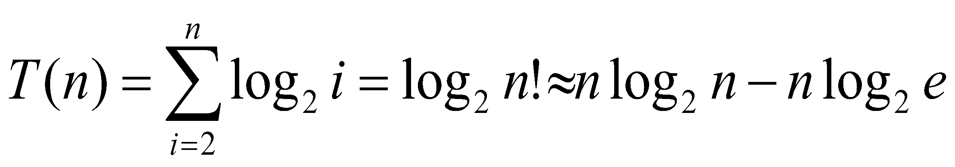
Heap Construction
Insertintoheap(A,n,z)//inserting z into a heap having n-1 elements
A(n)=z, A(0)=infinity Complexity
While z>A(n/2) do
A(n)↔A(n/2), n=n/2
enddo

Slide 9
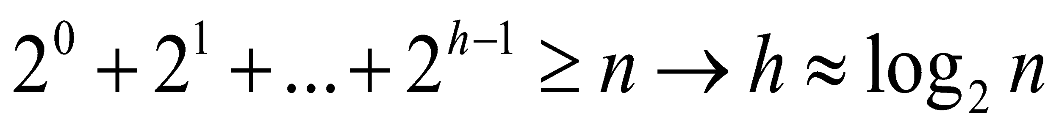
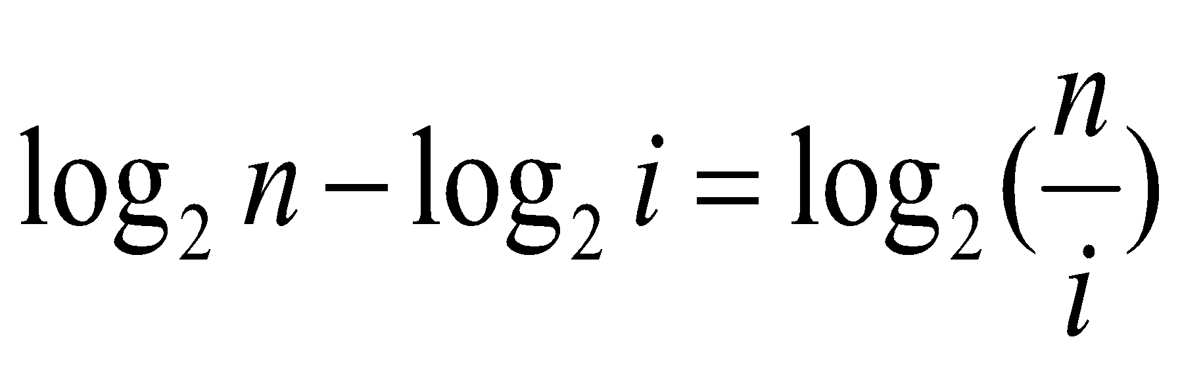
Heap Construction
Heap_byadjustment(A,n)
For i=n/2 downto 1 do
adjust(A,i)
Enddo
Adjust(A,i)
Construct chain of elder sons
Insert A(i) in this sorted chain of elder sons using binary search in a file of length

Slide 10
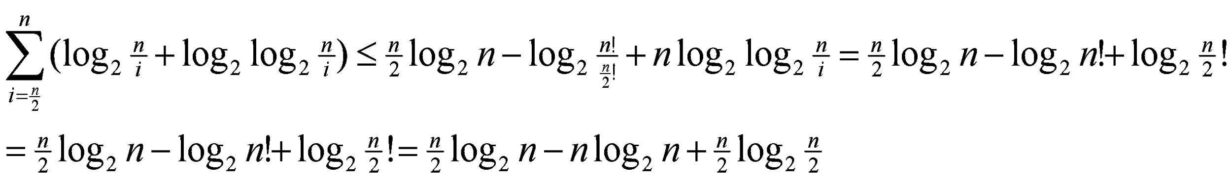
Heap Construction

Slide 11
Lower Bound Theory on Sorting
What is the least number of comparisons in the worst case to be required by any comparison-based sorting algorithm?
There are n! possibilities for sorted sequence. So a binary decision tree must have n! leaves. Average height of the tree must be

