Slide 1
Greedy Techniques
Simplest of all techniques for finding the best possible solution of a problem is greedy technique. In greedy techniques at each step the best possible decision is made based upon the information available. Not necessarily such a technique will always yield the best result.

Slide 2
Greedy Techniques
For example, in the notorious Travelling Salesman Problem in which a salesman wants to visit a given set of cities and returns to home city traversing minimum distance or in minimum time or at minimum cost a greedy criterion could be : visit nearest(requiring minimum time or cost) unvisited city. However good the strategy may look like there are examples in which it will not find the best solution. However, there are problems in which greedy techniques will give the best possible solution.

Slide 3
Fractional Knapsack Problem
Fractional knapsack- Given a set of items with profits and weights (p_{i},w_{i}),i=1,…, n, and a weight bound W what are the items to be selected to maximize profit? An item can be chosen fractionally as well, like amount of food and so on.

Slide 4
Fractional Knapsack Problem
Choosing large p_{i}s will not do { counterexample (10,9), (8,3),(5,7),(1,1) W=10} since they may exhaust weight bound quickly, neither should choosing small w_{i}s will do since corresponding profits may also be unnecessarily small. The winning criterion is choosing items based on large values of p_{i} / w_{i}

Slide 5
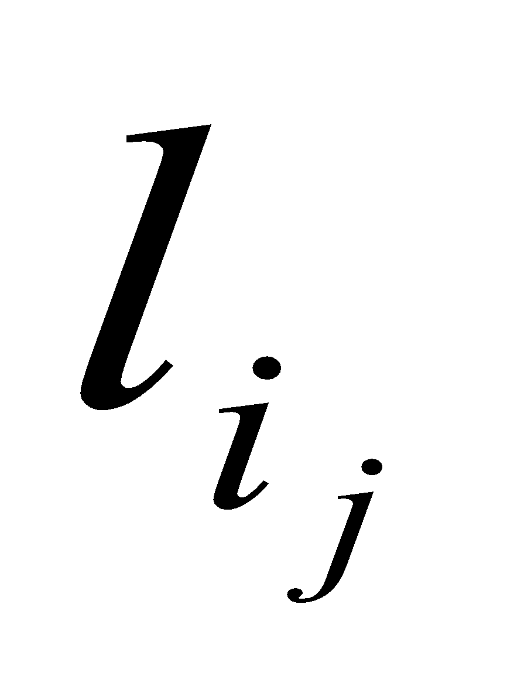
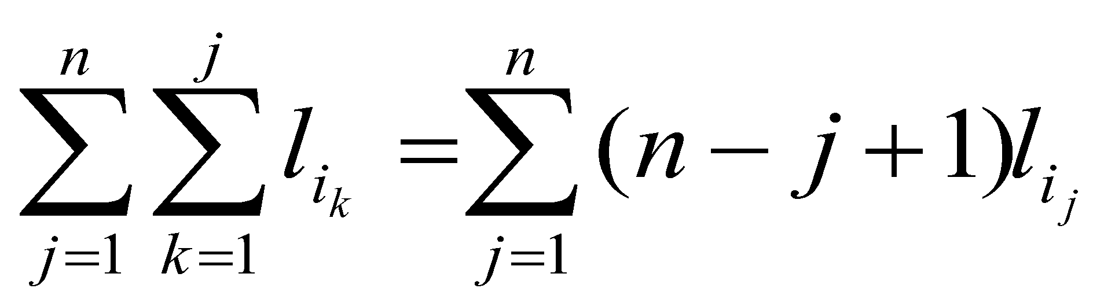
Storing files in tapes
Let us have n files of length l_{i} , i=1,…,n. Store them in a tape so that total retrieval time is as small as possible. One greedy criterion may be storing the smallest file first.
Let file of length be stored in jth order then total retrieval time will be

Slide 6
Storing files in tapes
Given two arrays (n-j+1), and l_{ij}, j=1,…,n of positive numbers sum of products is minimum when one is in ascending order and the other is in descending order.
Greedy criterion does exactly do it. So the solution must be optimal. One can also prove it by assuming contradiction that a larger file of length l_{i} is placed before a smaller file l_{j}.

Slide 7
Two-way merging of files
Given a set of files of length l_{i} , i=1,…,n file the order in which they should be merged into a single file where cost of merging is proportional to the sum total of length of files to be merged.
A greedy criterion could be to merge the smallest two files so that increase of cost is as small as possible.

Slide 8
Scheduling jobs in a processor
Given a set of jobs with start and finish times
(s_{i},f_{i}),i=1,…, n, our job is to schedule as many jobs as possible.
One greedy criterion may be choosing jobs requiring lesser time. Counter example is the following
With the above jobs choosing the smallest job will not give us the best solution.

Slide 9
Scheduling jobs in a processor
Choosing job having early start time will also not lead to optimal solution since
Winning greedy criterion is choosing job with the earliest finish time. Greedy strategy will stay ahead since whatever else we do greedy will stay ahead freeing the processor early as a result any job that can be processed in other than a greedy strategy can also be processed in greedy strategy.

Slide 10
Scheduling lectures in minimum no. of classes
Given a set of lectures l_i with start and finish times (s_i,f_i) schedule them using minimum number of classes. Lectures are not necessarily of the same duration.
Starting with lecture with the earliest start we should start scheduling it in a class. Now disregarding lectures that cannot be scheduled in that class room again select the lecture having earliest start among the remaining ones.

Slide 11
Scheduling lectures in minimum no. of classes
Once classroom 1 has been scheduled completely start with class room 2 in the same manner with the lectures not yet scheduled. This will result in a schedule that will require as many class rooms as many lectures will have to be scheduled at a particular time. It can be easily shown that no schedule can do better since if at a particular moment there are m lectures then at least m classrooms will be required.

Slide 12
Minimum spanning tree
Given a connected graph G=(V,E) with weight w_{i} on edge e_{i} finding the spanning tree of minimum weight.
Spanning tree is an acyclic subgraph. A greedy criterion could be choosing smallest edge so that it does not form cycle with already selected edges. This strategy indeed gives optimal solution and the algorithm is named after Kruskal.

Slide 13
Kruskal’s algorithm
Kruskal's algorithm is a greedy algorithm in graph theory that finds a minimum spanning tree for a connected weighted graph. This means it finds a subset of the edges that forms a tree that includes every vertex, where the total weight of all the edges in the tree is minimized. If the graph is not connected, then it finds a minimum spanning forest (a minimum spanning tree for each connected component).
This algorithm first appeared in Proceedings of the American Mathematical Society, pp. 48–50 in 1956, and was written by Joseph Kruskal.
Other algorithms for this problem include Prim's algorithm, Reverse-Delete algorithm, and Borůvka's algorithm.

Slide 14
Kruskal’s algorithm
Description
create a forest F (a set of trees), where each vertex in the graph is a separate tree
create a set S containing all the edges in the graph
while S is nonempty and F is not yet spanning
remove an edge with minimum weight from S
if that edge connects two different trees, then add it to the forest, combining two trees into a single tree
otherwise discard that edge.
At the termination of the algorithm, the forest has only one component and forms a minimum spanning tree of the graph.

Slide 15
Kruskal’s algorithm
G=(V,E), T=empty, F=E
While F is not empty
choose edge e with minimum weight
if TUe does not form a cycle
T=TUe
endif
F=F-e
Enddo
Here main challenge is to test for cycle which has to be done very efficiently. Sets and disjoint set union algorithm does this job in a great way.

Slide 16
Prim’s algorithm
The algorithm was developed in 1930 by Czech mathematician Vojtěch Jarník and later independently by computer scientist Robert C. Prim in 1957 and rediscovered by Edsger Dijkstra in 1959. Therefore it is also sometimes called the DJP algorithm, the Jarník algorithm, or the Prim–Jarník algorithm.
In this algorithm starting from an arbitrary vertex(termed connected and remaining disconnected) vertex nearest to the connected set is sequentially added updating information on the nearest vertex in the connected set from each member of the disconnected set.

Slide 17
Prim’s algorithm
The only spanning tree of the empty graph (with an empty vertex set) is again the empty graph. The following description assumes that this special case is handled separately.
The algorithm continuously increases the size of a tree, one edge at a time, starting with a tree consisting of a single vertex, until it spans all vertices.
Input: A non-empty connected weighted graph with vertices V and edges E (the weights can be negative).

Slide 18
Prim’s algorithm
Initialize: V_{new} = {x}, where x is an arbitrary node (starting point) from V, E_{new} = {}
Repeat until V_{new} = V:
For each vertex not in V_{new} find nearest vertex in V_{new}
Choose an edge (u, v) with minimal weight such that u is in V_{new} and v is not (if there are multiple edges with the same weight, any of them may be picked)
Add v to V_{new}, and (u, v) to E_{new,} Update nearest array
Output: V_{new} and E_{new} describe a minimal spanning tree

Slide 19
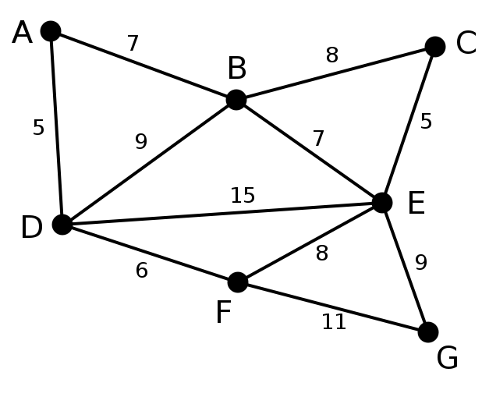
Prim’s algorithm

Slide 20
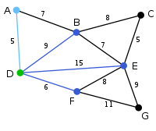
Prim’s algorithm

Slide 21
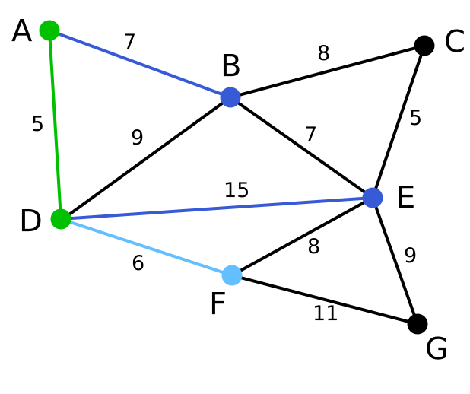
Prim’s algorithm

Slide 22
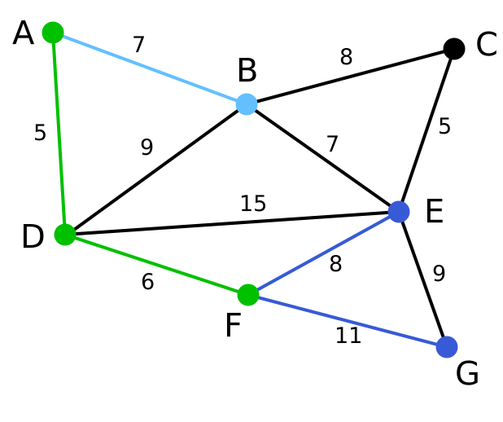
Prim’s algorithm

Slide 23
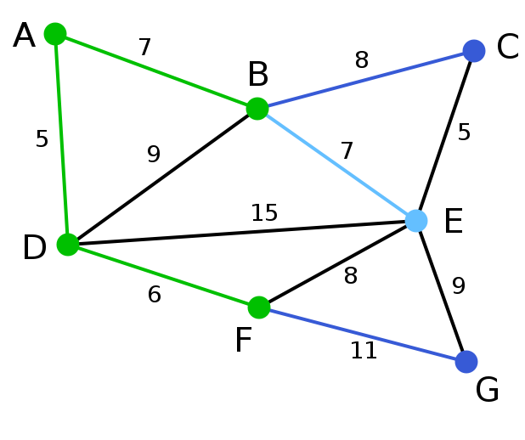
Prim’s algorithm

Slide 24
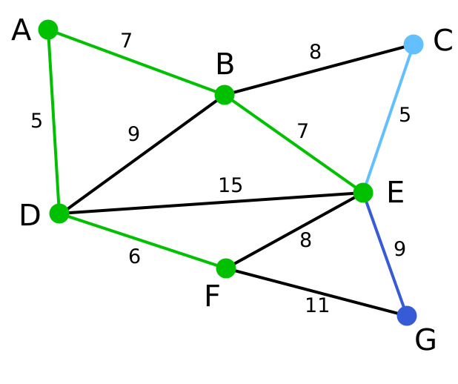
Prim’s algorithm

Slide 25
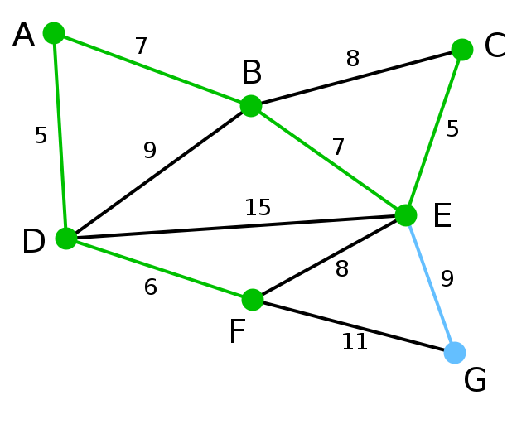
Prim’s algorithm

Slide 26
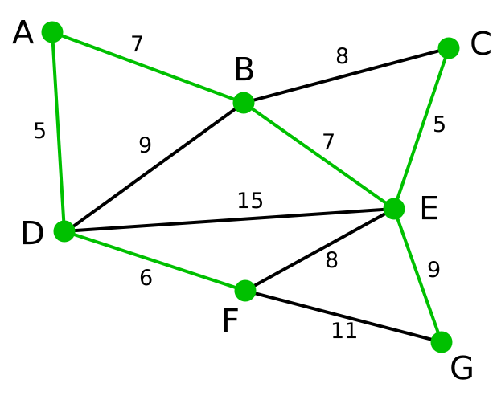
Prim’s algorithm

Slide 27
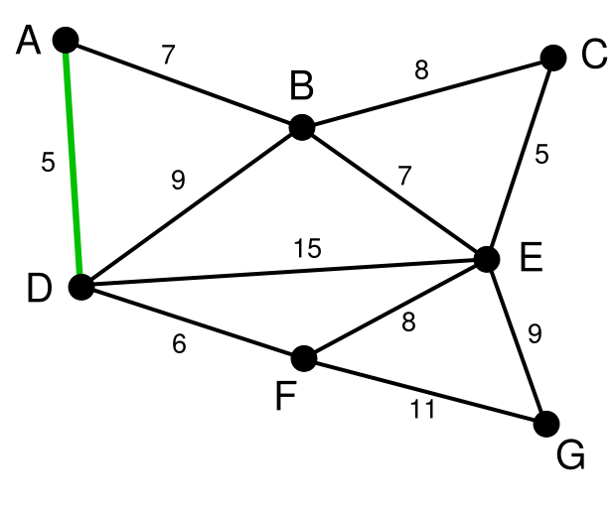
Kruskal’s algorithm

Slide 28
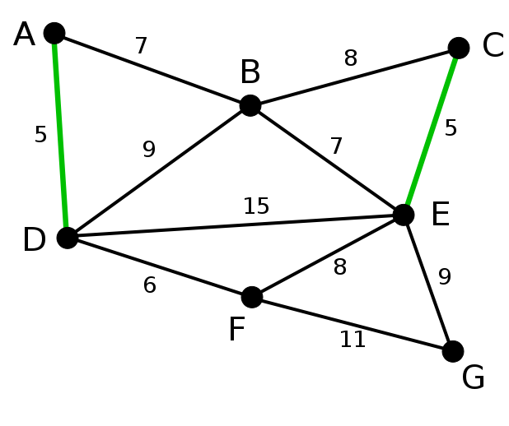
Kruskal’s algorithm

Slide 29
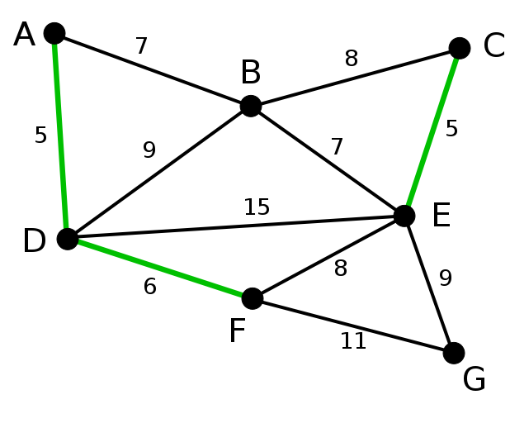
Kruskal’s algorithm

Slide 30
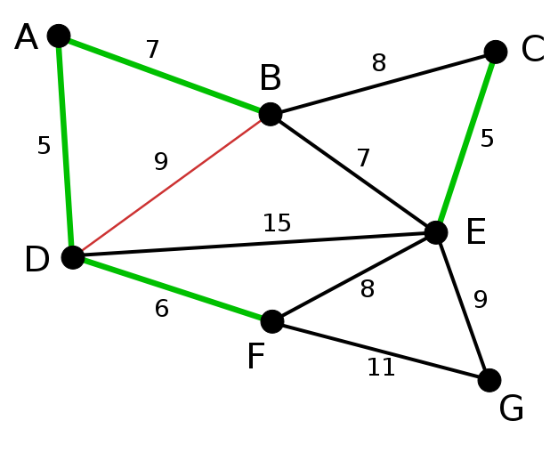
Kruskal’s algorithm

Slide 31
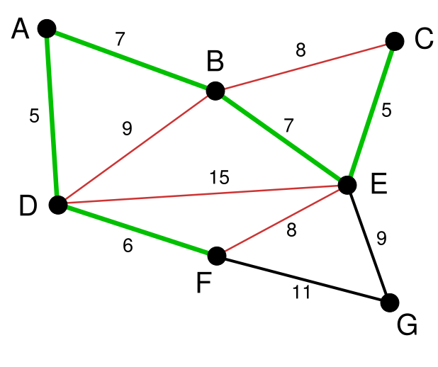
Kruskal’s algorithm

Slide 32
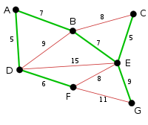
Kruskal’s algorithm

Slide 33
Prim’s algorithm
Time complexity
Minimum edge weight data structure Time complexity (total) adjacency matrix, searching O(V²) binary heap and adjacency list O((V + E) log V) = O(E log V) Fibonacci heap and adjacency list O(E + V log V) A simple implementation using an adjacency matrix graph representation and searching an array of weights to find the minimum weight edge to add requires O(V²) running time. Using a simple binary heap data structure and an adjacency list representation, Prim's algorithm can be shown to run in time O(E log V) where E is the number of edges and V is the number of vertices. Using a more sophisticated Fibonacci heap, this can be brought down to O(E + V log V), which is asymptotically faster when the graph is dense enough that E is Ω(V).

Slide 34
Prim’s algorithm
Time complexity
Minimum edge weight data structure Time complexity (total) adjacency matrix, searching O(V²) binary heap and adjacency list O((V + E) log V) = O(E log V) Fibonacci heap and adjacency list O(E + V log V) A simple implementation using an adjacency matrix graph representation and searching an array of weights to find the minimum weight edge to add requires O(V²) running time.

Slide 35
Prim’s algorithm
Using a simple binary heap data structure and an adjacency list representation, Prim's algorithm can be shown to run in time O(E log V) where E is the number of edges and V is the number of vertices. Using a more sophisticated Fibonacci heap, this can be brought down to O(E + V log V), which is asymptotically faster when the graph is dense enough that E is Ω(V).

Slide 36
Kruskal’s algorithm
Proof of correctness
The proof consists of two parts. First, it is proved that the algorithm produces a spanning tree. Second, it is proved that the constructed spanning tree is of minimal weight.
Spanning Tree
Let be a connected, weighted graph and let be the subgraph of produced by the algorithm. cannot have a cycle, since the last edge added to that cycle would have been within one subtree and not between two different trees. cannot be disconnected, since the first encountered edge that joins two components of would have been added by the algorithm. Thus, is a spanning tree of .

Slide 37
Kruskal’s algorithm
Minimality
We show that the following proposition P is true by induction: If F is the set of edges chosen at any stage of the algorithm, then there is some minimum spanning tree that contains F.
Clearly P is true at the beginning, when F is empty: any minimum spanning tree will do, and there exists one because a weighted connected graph always has a minimum spanning tree.

Slide 38
Kruskal’s algorithm
Now assume P is true for some non-final edge set F and let T be a minimum spanning tree that contains F. If the next chosen edge e is also in T, then P is true for F + e. Otherwise, T + e has a cycle C and there is another edge f that is in C but not F. (If there were no such edge f, then e could not have been added to F, since doing so would have created the cycle C.)

Slide 39
Kruskal’s
Then T − f + e is a tree, and it has the same weight as T, since T has minimum weight and the weight of f cannot be less than the weight of e, otherwise the algorithm would have chosen f instead of e. So T − f + e is a minimum spanning tree containing F + e and again P holds.
Therefore, by the principle of induction, P holds when F has become a spanning tree, which is only possible if F is a minimum spanning tree itself.

Slide 40
Mincost arborescence problem
Given a digraph D = (V, A) and a root vertex r in V , an r -arborescence (or an arborescence with root r ) is a subset of arcs B in A such that for each vertex v in V \ {r}, there is a unique. In(v) is the set of edges incoming to v
path from r to v in (V,B). There is an equivalent way to define arborescences:
Lemma 1. The set B in A is an r -arborescence in a digraph D = (V, A) if and only if (V,B) has
no cycles, and |B intersection in(v)| = 1 for each v in V \ {r }.

Slide 41
Mincost arborescence problem
Lemma 2. A digraph D contains an r -arborescence if and only if each vertex in D is reachable from r.
Proof. If each vertex in D is reachable from r , the breadth-first search (started at r ) will find an r -arborescence. The converse is trivial.
We consider the following minimum cost r -arborescence problem:
Given a digraph D = (V, A), a root vertex r ε V , and a cost function c : f(A)→R, find an r -arborescence of minimum cost in D.

Slide 42
Mincost arborescence problem
The relationship between arborescences and spanning trees might give an impression that the same techniques can be applied here, too. The following algorithm is a complete analogue of the Prim’s method for spanning trees:

Slide 43
Mincost arborescence problem
(1) Set U := {r }, B :=Φ;
(2) While ≠ V ;
(3) find a = (u, v) ∈ δ^{out}(U) with c(a’) =min {c(a’) : a’ ∈ δ^{out}(U)
(4) setU :=U U{v}, B := B U {e};
(5) output B.
Unfortunately, this algorithm fails on a rather trivial digraph:

Slide 44
Mincost arborescence problem
c(r,v)=2, c(r,u)=3, c(u,v)=1
Nonetheless, it is still possible to design a
“greedy-type” algorithm to find a minimum
cost r -arborescence. First, for each v ∈ V \ {r },
select a cheapest arc a ∈ δ^{in}(v)
(with ties broken arbitrarily); let B* be the set of
those arcs.

Slide 45
Mincost arborescence problem
Then B* is a cheapest set of arcs satisfying |δ^{in}(v)∩B∗| = 1 for all v ∈ V \ {r }. In particular, c(B*)≤c(B) for any r -arborescence B, since B must also have |δ^{in}(v)∩B∗| = 1(see Lemma 1). Now, if (V,B*) does not contain a cycle, then B* is an r -arborescence itself (again, see Lemma 1), and hence a minimum cost r -arborescence. Some problems arise when B* does contain a cycle.

Slide 46
Mincost arborescence problem
α(v) := min{c(a): a ∈ δ^{in}(v)}. Following properties hold for new costs:
(1)c’(a)≥0 for all a ∈A;
(2) α’(v) =min {c’(a) : a ∈ δ^{in}(v) for all v ∈ V \ {r };
(3)c’(a)=0 for all a ∈B*
Following lemma asserts asserts equivalence of problems after redefinition of costs

Slide 47
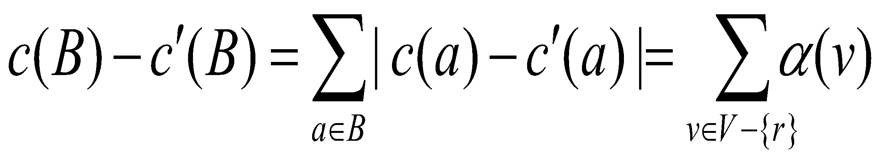
Mincost arborescence problem
Lemma 3. An r -arborescence in a digraph D has the minimum cost with respect to c if and
only if it has the minimum cost with respect to c’
Proof: Let B be an r -arborescence in D. Then

Slide 48
Mincost arborescence problem
The main idea is now to shrink a cycle in (V,B*), if there is one, into one super-vertex and
continue searching for a minimum cost r -arborescence on the smaller digraph.
Lemma 4. Let D = (V, A) be a digraph, r ∈ V a root vertex and c : A → R+ a cost function. Let
C be a cycle of zero cost, not containing r . If D contains an r -arborescence, then there is one of
minimum cost that enters C exactly once.

Slide 49
Mincost arborescence problem
Proof. “=)”: The only arc in B that enters v is the last arc on a directed path from r to v. If (V,B) contained a cycle, there would be arbitrary many paths from r to any vertex on that cycle.
“(=”: Let v 2 V \ {r }. Since |B intersection in(v)| = 1, there is an arc (u, v) in B. If u ≠r , there must
be an arc (w,u) in B. Continuing this way we eventually get to r, as (V,B) contains no cycles
and therefore we cannot return to a vertex we have previously considered.
Remark.

Slide 50
Mincost arborescence problem
The above proof also implies that |in(r )| = 0, as otherwise we could follow arcs in backward direction arbitrarily many times, eventually obtaining a cycle.
Thus, an r -arborescence can be viewed as a “directed spanning tree” rooted at r . In fact, if
we ignore the directions of the arcs in D, it becomes just a spanning tree.

