Slide 1
Graphs
G=(V,E) is said to be a graph where V is the set of vertices and E is the set of edges. If members of E are directed then we call it a directed graph or digraph. If G does not have a cycle then it is called acyclic. If G is connected and does not have a cycle then it is called a tree. Number of edges incident to a vertex u is said to be degree of u and denoted d(u).

Slide 2
Graphs
A graph is connected if for every pair u,v of its vertices there is a sequence of edges that start at u and end at v. H=(V’,E’) is a subgraph of G if V’ is a subset of V and E’ is the subset of E endpoint of each member of which is in V. Maximally connected subgraph of a graph is said to be component. A connected acyclic subgraph of G is called a minimum spanning tree. Occasionally a weight is attached to each edge of a graph.

Slide 3
Shortest Paths: Unweighted Graphs
In an unweighted graph, the cost of a path is just the number of edges on the shortest path, which can be found in O(n+m) time via breadth-ﬁrst search.
In a weighted graph, the weight of a path between two vertices is the sum of the weights of the edges on a path.

Slide 4
Shortest Paths: Unweighted Graphs
BFS will not work on weighted graphs because sometimes visiting more edges can lead to shorter distance, ie. 1 + 1 + 1 + 1 + 1 + 1 + 1 < 10.
Note that there can be an exponential number of shortest paths between two nodes – so we cannot report all shortest paths efﬁciently.

Slide 5
Negative Edge Weights
Note that negative cost cycles render the problem of ﬁnding the shortest path meaningless, since you can always loop around the negative cost cycle more to reduce the cost of the path.
Thus in our discussions, we will assume that all edge weights are positive. Other algorithms deal correctly with negative cost edges.
Minimum spanning trees are unaffected by negative cost edges.

Slide 6
Dijkstra’s Algorithm
The principle behind Dijkstra’s algorithm is that if s,.., x,…,t is the shortest path from s to t, then s,…, x had better be the shortest path from s to x.
This suggests a dynamic programming-like strategy, where we store the distance from s to all nearby nodes, and use them to ﬁnd the shortest path to more distant nodes.

Slide 7
Initialization and Update
The shortest path from s to s, d(s, s) = 0. If all edge weights are positive, the smallest edge incident to s, say (s, x), deﬁnes d(s, x).
We can use an array to store the length of the shortest path to each node. Initialize each to infinity to start.
Soon as we establish the shortest path from s to a new node x, we go through each of its incident edges to see if there is a better way from s to other nodes thru x.

Slide 8
Pseudocode: Dijkstra’s Algorithm
known[s]=1
for v = 1 to n, dist[v] = infinity
for each edge (s, v), dist[v] = d(s, v)
last=s
while (last ≠t) do
select v such that dist(v) = min{unknown dist(i)}
for each (v, x), dist[x] = min(dist[x], dist[v] + d(v; x))
last=v, known[v] = 1
enddo
Complexity ! O(n²).
This is essentially the same as Prim’s algorithm.

Slide 9
All-Pairs Shortest Path
Notice that ﬁnding the shortest path between a pair of vertices
(s, t) in worst case requires ﬁrst ﬁnding the shortest path from
s to all other vertices in the graph.
Many applications, such as ﬁnding the center or diameter of
a graph, require ﬁnding the shortest path between all pairs of
vertices.
We can run Dijkstra’s algorithm n times (once from each
possible start vertex) to solve all-pairs shortest path problem
in O(n³). Can we do better?

Slide 10
All Pairs Shortest Path Algorithm(DP)
// C++ Program for Floyd Warshall Algorithm
#include <bits/stdc++.h>
using namespace std;
// Number of vertices in the graph
#define V 4
/* Define Infinite as a large enough
value.This value will be used for
vertices not connected to each other */
#define INF 99999
// A function to print the solution matrix
void printSolution(int dist[][V]);
// Solves the all-pairs shortest path
// problem using Floyd Warshall algorithm
void floydWarshall (int graph[][V])
{
/* dist[][] will be the output matrix
that will finally have the shortest
distances between every pair of vertices */
int dist[V][V], i, j, k;

Slide 11
Floyd-Warshall Code
/* Initialize the solution matrix same
as input graph matrix. Or we can say
the initial values of shortest distances
are based on shortest paths considering
no intermediate vertex. */
for (i = 0; i < V; i++)
for (j = 0; j < V; j++)
dist[i][j] = graph[i][j];
/* Add all vertices one by one to
the set of intermediate vertices.
---> Before start of an iteration,
we have shortest distances between all
pairs of vertices such that the
shortest distances consider only the
vertices in set {0, 1, 2, .. k-1} as
intermediate vertices.
----> After the end of an iteration,
vertex no. k is added to the set of
intermediate vertices and the set becomes {0, 1, 2, .. k} */
for (k = 0; k < V; k++)
{
// Pick all vertices as source one by one
for (i = 0; i < V; i++)
{
// Pick all vertices as destination for the
// above picked source

Slide 12
for (j = 0; j < V; j++)
{
// If vertex k is on the shortest path from
// i to j, then update the value of dist[i][j]
if (dist[i][k] + dist[k][j] < dist[i][j])
dist[i][j] = dist[i][k] + dist[k][j];
}
}
}
// Print the shortest distance matrix
printSolution(dist);
}
/* A utility function to print solution */
void printSolution(int dist[][V])
{
cout<<"The following matrix shows the shortest distances"
" between every pair of vertices \n";
for (int i = 0; i < V; i++)
{
for (int j = 0; j < V; j++)
{
if (dist[i][j] == INF)
cout<<"INF"<<" ";
else
cout<<dist[i][j]<<" ";
}
cout<<endl;
}
}

Slide 13
// Driver code
int main()
{
/* Let us create the following weighted graph
10
(0)------->(3)
| /|\
5 | |
| | 1
\|/ |
(1)------->(2)
3 */
int graph[V][V] = { {0, 5, INF, 10},
{INF, 0, 3, INF},
{INF, INF, 0, 1},
{INF, INF, INF, 0}
};
// Print the solution
floydWarshall(graph);
return 0;
}

Slide 14
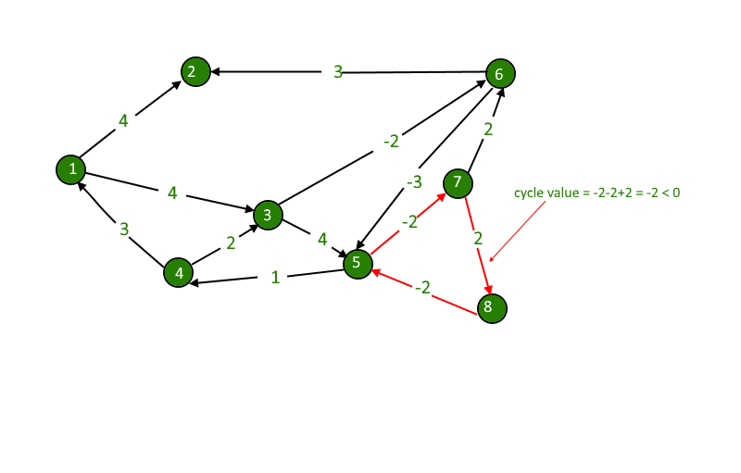
Discovering negative cycle using Floyd-Warshall

Slide 15
Dynamic Programming and Shortest Paths
The four-step approach to dynamic programming is:
1. Characterize the structure of an optimal solution.
2. Recursively deﬁne the value of an optimal solution.
3. Compute this recurrence in a bottom-up fashion.
4. Extract the optimal solution from computed information.

Slide 16
Initialization
From the adjacency matrix, we can construct the following
matrix:
d⁰[i, j] = infinity, if i not =j and (v_{i}, v_{j} ) is not in E
d⁰[i[i, j] = w(i, j), if (v_{i} , _{j}) is in E
d⁰[i[i, j] = 0, if i = j
This gives us the shortest path going through no intermediate nodes.

Slide 17
Characterization Based on Path Length
There are several ways to characterize the shortest path between two nodes in a graph. Note that the shortest path from i to j, i not = j, using at most M edges consists of the shortest path from i to k using at most M -1 edges+W(k, j) for some k.
This suggests that we can compute all-pair shortest path with an induction based on the number of edges in the optimal path.

Slide 18
Recurrence on Path Length
Let d^{m} (i,j) be the length of the shortest path from i to j using at most m edges. What is d⁰(I,j) ? d⁰ (i,j) =0 if i=j, infinity otherwise.
What if we know d^{m-1} (i,j) for all i,j?
d(i,j)^{m}=min(d(i,j)^{m-1},min(d^{m-1}(i,k) +w(k,j)))

