Slide 1
Binary Search Trees
CS 302 – Data Structures
Chapter 8

Slide 2
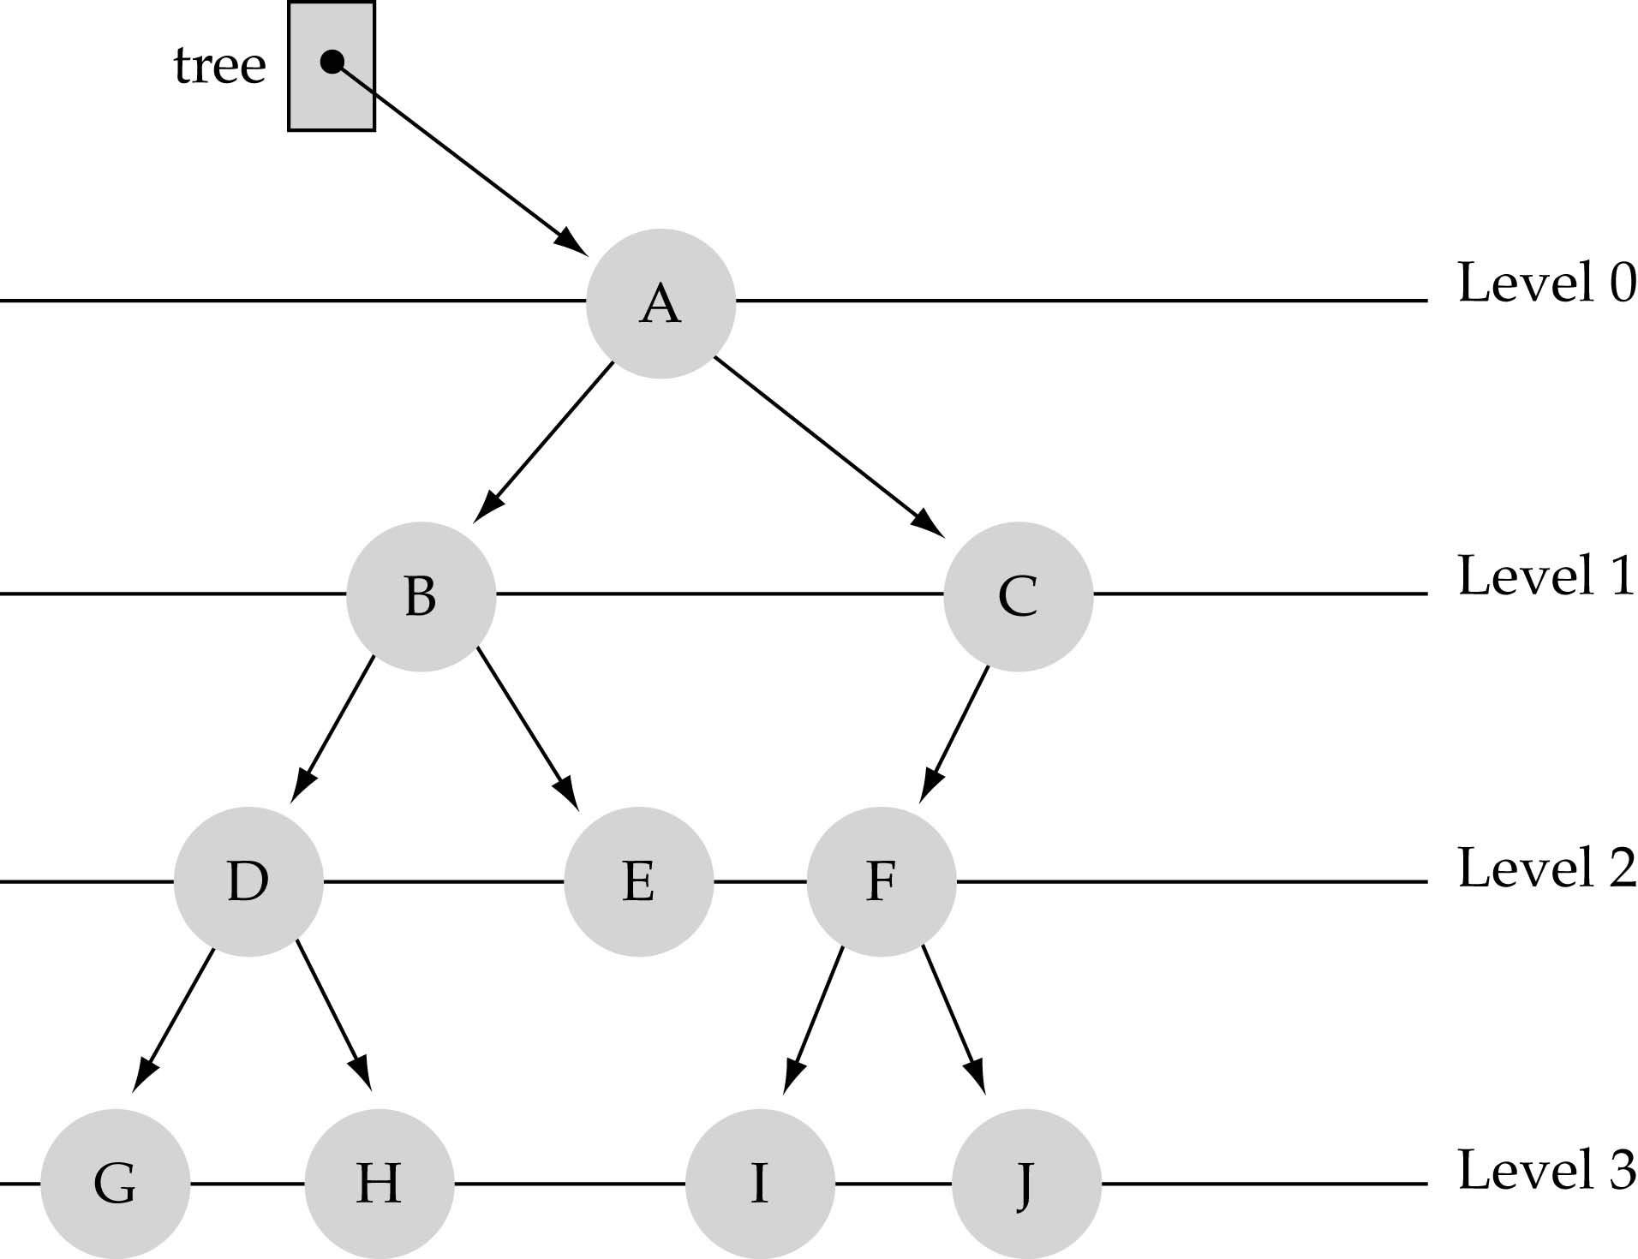
What is a binary tree?
Property 1: each node can have up to two successor nodes.

Slide 3
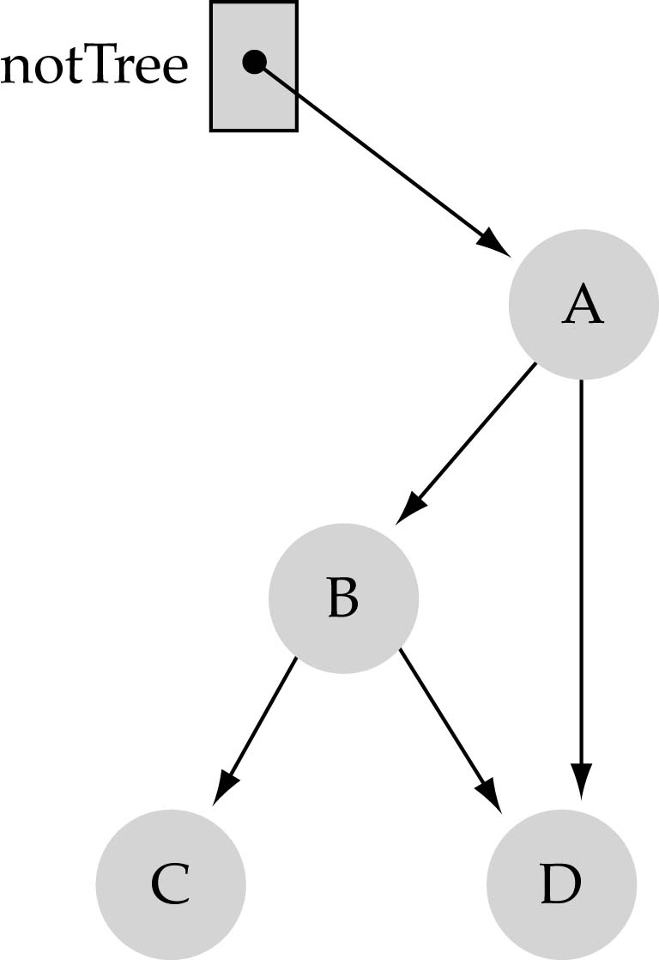
What is a binary tree? (cont.)
Property 2: a unique path exists from the root to every other node
Not a valid binary tree!

Slide 4
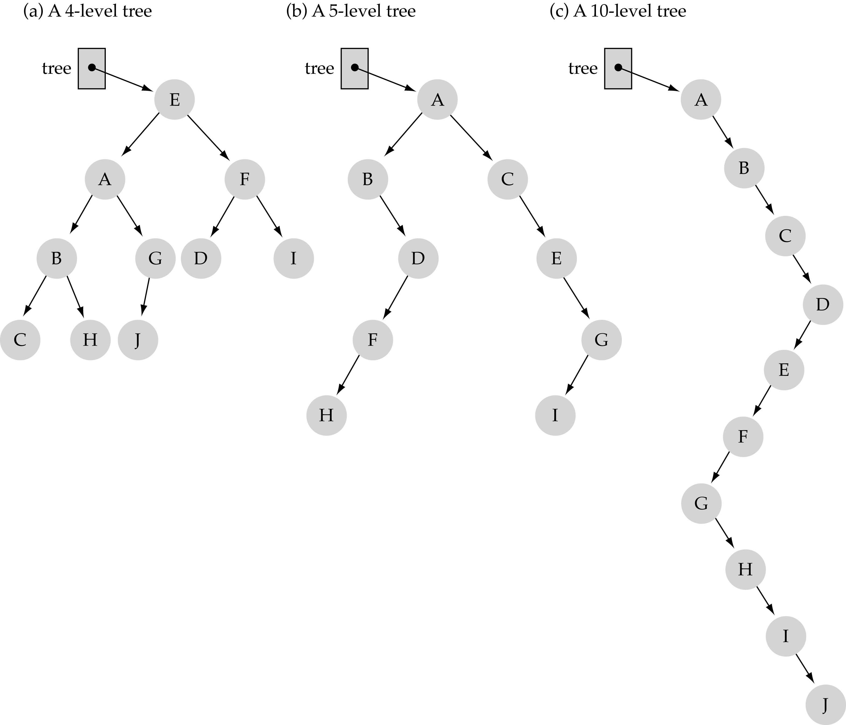
Some terminology
The successor nodes of a node are called its children
The predecessor node of a node is called its parent
The "beginning" node is called the root (has no parent)
A node without children is called a leaf

Slide 5
Some terminology (cont’d)
Nodes are organize in levels (indexed from 0).
Level (or depth) of a node: number of edges in the path from the root to that node.
Height of a tree h: #levels = L
(Warning: some books define h
as #levels-1).
Full tree: every node has exactly
two children and all the
leaves are on the same level.
not full!

Slide 6
What is the max #nodes at some level l?
The max #nodes at level is
where l=0,1,2, ...,L-1

Slide 7
What is the total #nodes N of a full tree with height h?
l=0
l=1
l=h-1
using the geometric series:

Slide 8
What is the height h of a full tree with N nodes?

Slide 9
Why is h important?
Tree operations (e.g., insert, delete, retrieve etc.) are typically expressed in terms of h.
So, h determines running time!

Slide 10
What is the max height of a tree with N nodes?
N (same as a linked list)
What is the min height of a tree with N nodes?
log(N+1)

Slide 11

How to search a binary tree?
(1) Start at the root
(2) Search the tree level
by level, until you find
the element you are
searching for or you reach
a leaf.
Is this better than searching a linked list?
No → O(N)

Slide 12
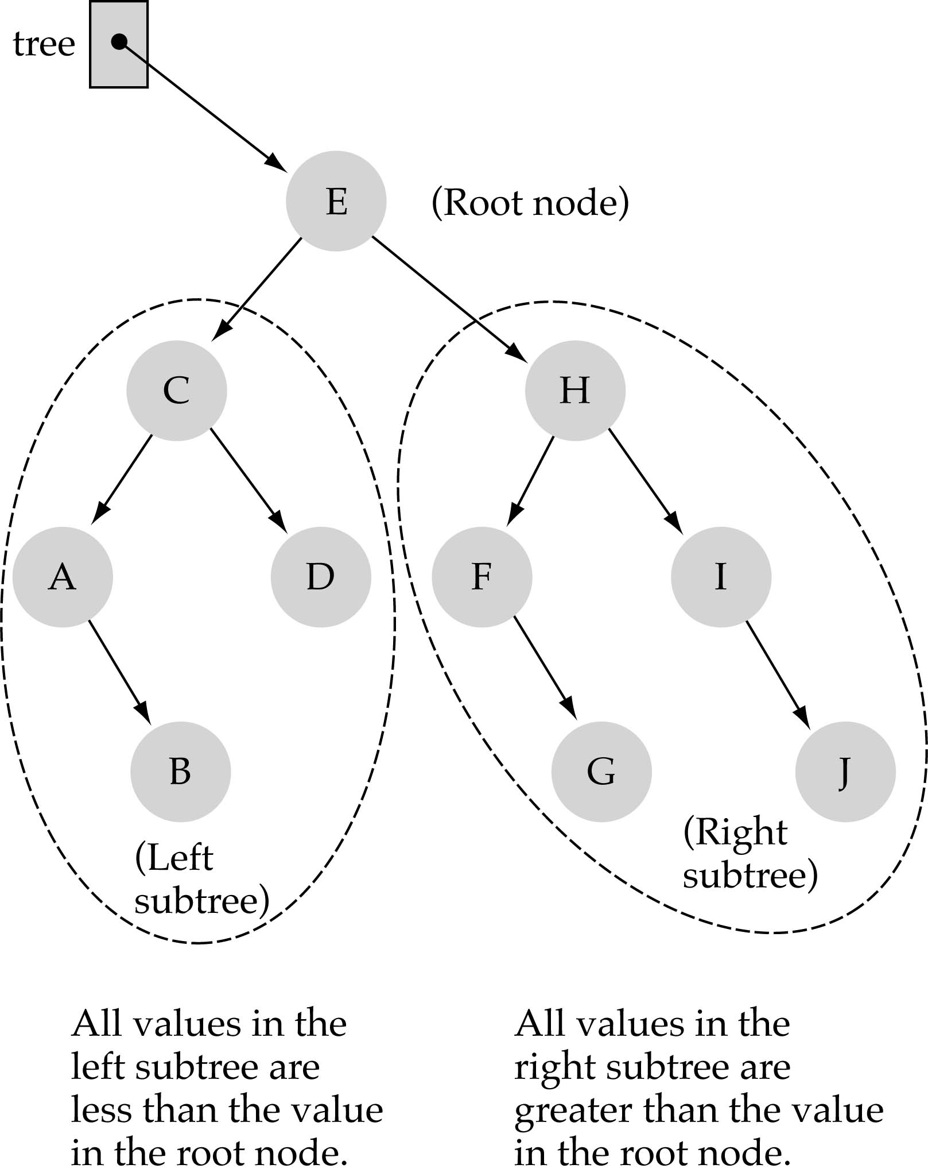
Binary Search Trees (BSTs)
Binary Search Tree Property:
The value stored at
a node is greater than
the value stored at its
left child and less than
the value stored at its
right child

Slide 13
Binary Search Trees (BSTs)
In a BST, the value stored at the root of a subtree is greater than any value in its left subtree and less than any value in its right subtree!

Slide 14
Binary Search Trees (BSTs)
Where is the smallest element?
Ans: leftmost element
Where is the largest element?
Ans: rightmost element

Slide 15
How to search a binary search tree?
(1) Start at the root
(2) Compare the value of the item you are searching for with the value stored at the root
(3) If the values are equal, then item found; otherwise, if it is a leaf node, then not found

Slide 16
How to search a binary search tree?
(4) If it is less than the value stored at the root, then search the left subtree
(5) If it is greater than the value stored at the root, then search the right subtree
(6) Repeat steps 2-6 for the root of the subtree chosen in the previous step 4 or 5

Slide 17
How to search a binary search tree?
Is this better than searching
a linked list?
Yes !! ---> O(logN)

Slide 18
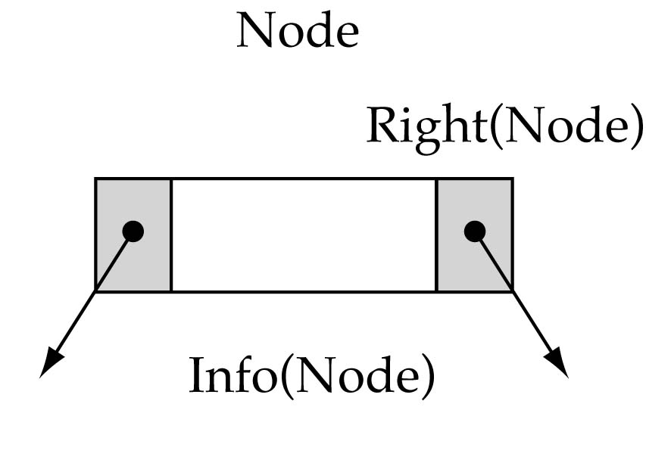
Tree node structure
template<class ItemType>
struct TreeNode<ItemType> {
ItemType info;
TreeNode<ItemType>* left;
TreeNode<ItemType>* right;
};

Slide 19
Binary Search Tree Specification
#include <fstream.h>
struct TreeNode<ItemType>;
enum OrderType {PRE_ORDER, IN_ORDER, POST_ORDER};
template<class ItemType>
class TreeType {
public:
TreeType();
~TreeType();
TreeType(const TreeType<ItemType>&);
void operator=(const TreeType<ItemType>&);
void MakeEmpty();
bool IsEmpty() const;
bool IsFull() const;
int NumberOfNodes() const;

Slide 20
Binary Search Tree Specification
(cont.)
void RetrieveItem(ItemType&, bool& found);
void InsertItem(ItemType);
void DeleteItem(ItemType);
void ResetTree(OrderType);
void GetNextItem(ItemType&, OrderType, bool&);
void PrintTree(ofstream&) const;
private:
TreeNode<ItemType>* root;
};

Slide 21
Function NumberOfNodes
Recursive implementation
#nodes in a tree =
#nodes in left subtree + #nodes in right subtree + 1
What is the size factor?
Number of nodes in the tree we are examining
What is the base case?
The tree is empty
What is the general case?
CountNodes(Left(tree)) + CountNodes(Right(tree)) + 1

Slide 22
Function NumberOfNodes (cont.)
template<class ItemType>
int TreeType<ItemType>::NumberOfNodes() const
{
return CountNodes(root);
}
template<class ItemType>
int CountNodes(TreeNode<ItemType>* tree)
{
if (tree == NULL)
return 0;
else
return CountNodes(tree->left) + CountNodes(tree->right) + 1;
}
Running Time?
O(N)

Slide 23
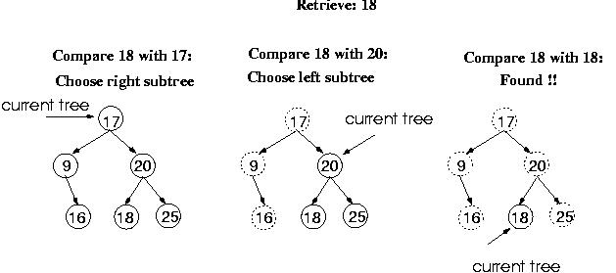
Function RetrieveItem

Slide 24
Function RetrieveItem
What is the size of the problem?
Number of nodes in the tree we are examining
What is the base case(s)?
When the key is found
The tree is empty (key was not found)
What is the general case?
Search in the left or right subtrees

Slide 25
Function RetrieveItem (cont.)
template <class ItemType>
void TreeType<ItemType>:: RetrieveItem(ItemType& item, bool& found)
{
Retrieve(root, item, found);
}
template<class ItemType>
void Retrieve(TreeNode<ItemType>* tree, ItemType& item, bool& found)
{
if (tree == NULL) // base case 2
found = false;
else if(item < tree->info)
Retrieve(tree->left, item, found);
else if(item > tree->info)
Retrieve(tree->right, item, found);
else { // base case 1
item = tree->info;
found = true;
}
}
Running Time?
O(h)

Slide 26
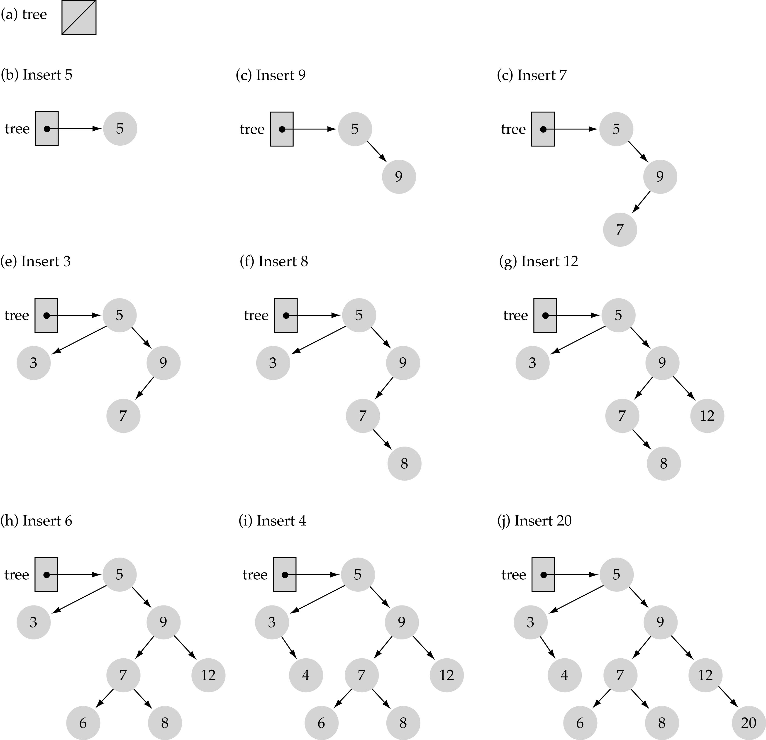
Function InsertItem
Use the binary search tree property to insert the new item at the correct place

Slide 27
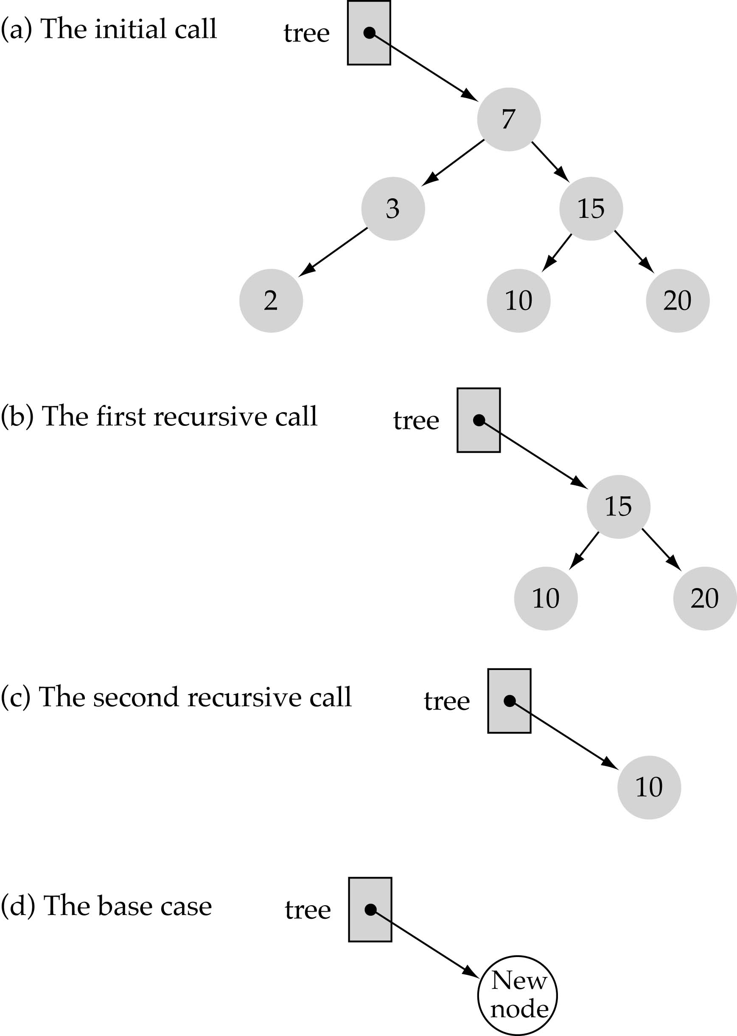
Function InsertItem
(cont.)
Implementing insertion resursively
e.g., insert 11

Slide 28
Function InsertItem (cont.)
What is the size of the problem?
Number of nodes in the tree we are examining
What is the base case(s)?
The tree is empty
What is the general case?
Choose the left or right subtree

Slide 29
Function InsertItem (cont.)
template<class ItemType>
void TreeType<ItemType>::InsertItem(ItemType item)
{
Insert(root, item);
}
template<class ItemType>
void Insert(TreeNode<ItemType>*& tree, ItemType item)
{
if(tree == NULL) { // base case
tree = new TreeNode<ItemType>;
tree->right = NULL;
tree->left = NULL;
tree->info = item;
}
else if(item < tree->info)
Insert(tree->left, item);
else
Insert(tree->right, item);
}
Running Time?
O(h)

Slide 30
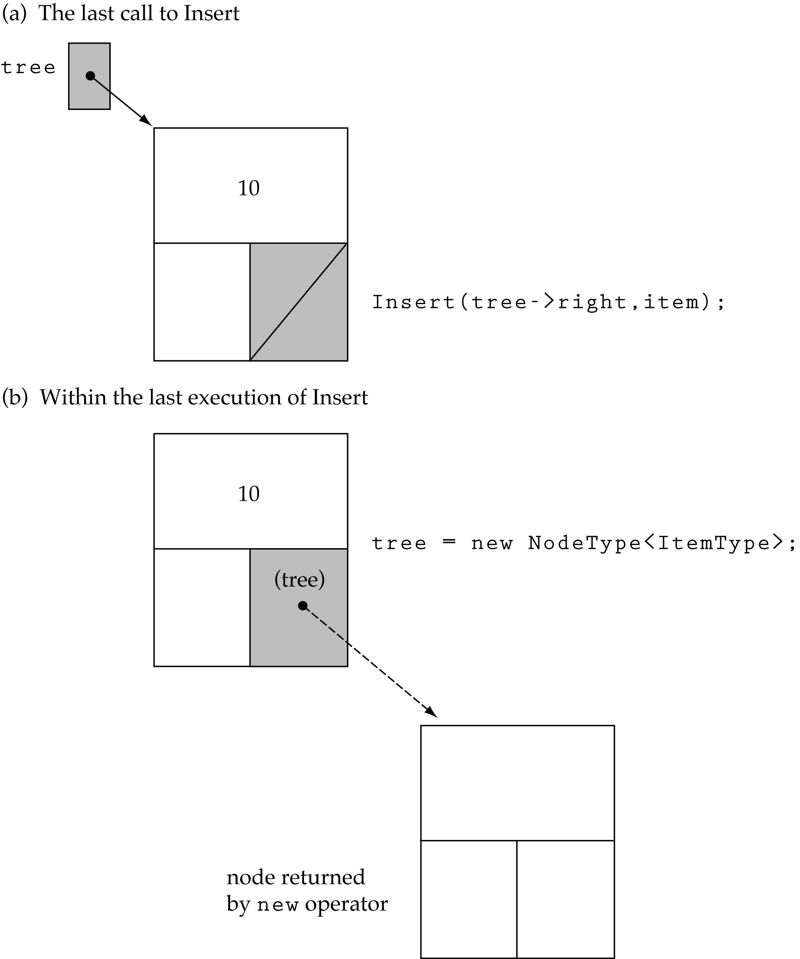
Function InsertItem (cont.)
Insert 11

Slide 31
Does the order of inserting elements into a tree matter?
Yes, certain orders might produce very unbalanced trees!

Slide 32
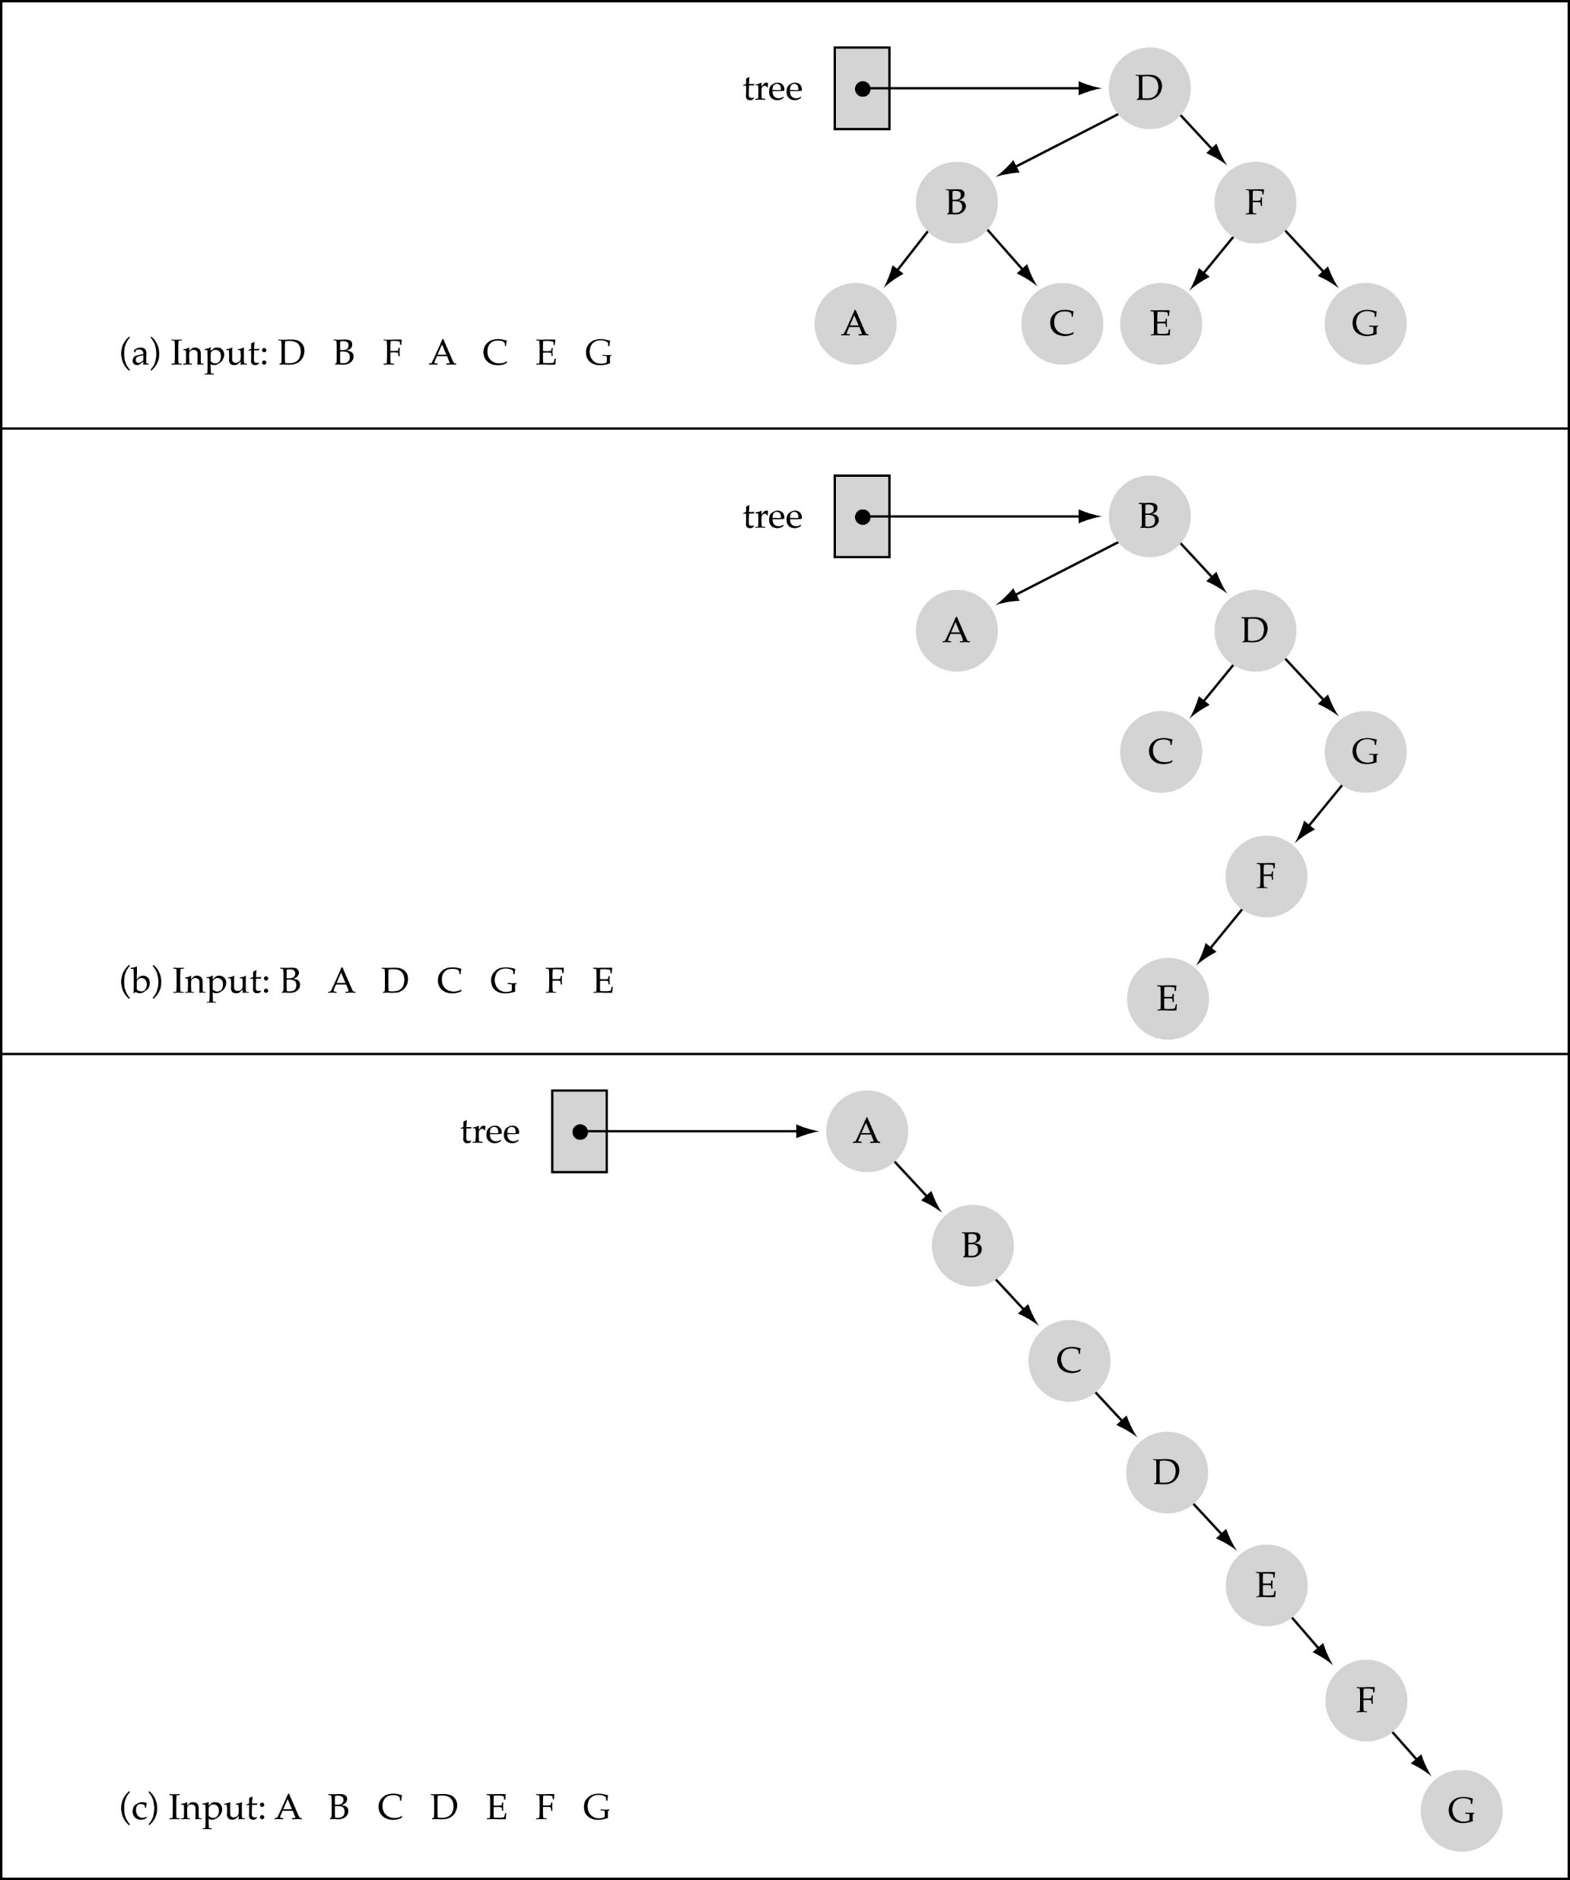
Does the order of inserting elements into a tree matter?
(cont.)

Slide 33
Does the order of inserting elements into a tree matter? (cont’d)
Unbalanced trees are not desirable because search time increases!
Advanced tree structures, such as red-black trees, guarantee balanced trees.

Slide 34
Function DeleteItem
First, find the item; then, delete it
Binary search tree property must be preserved!!
We need to consider three different cases:
(1) Deleting a leaf
(2) Deleting a node with only one child
(3) Deleting a node with two children

Slide 35
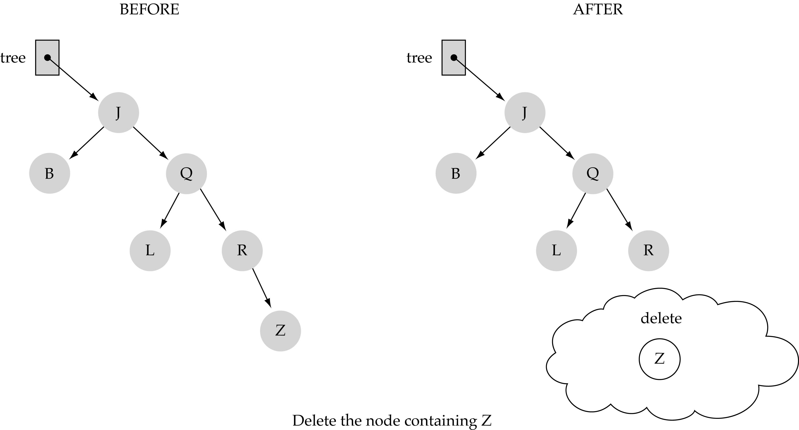
(1) Deleting a leaf

Slide 36
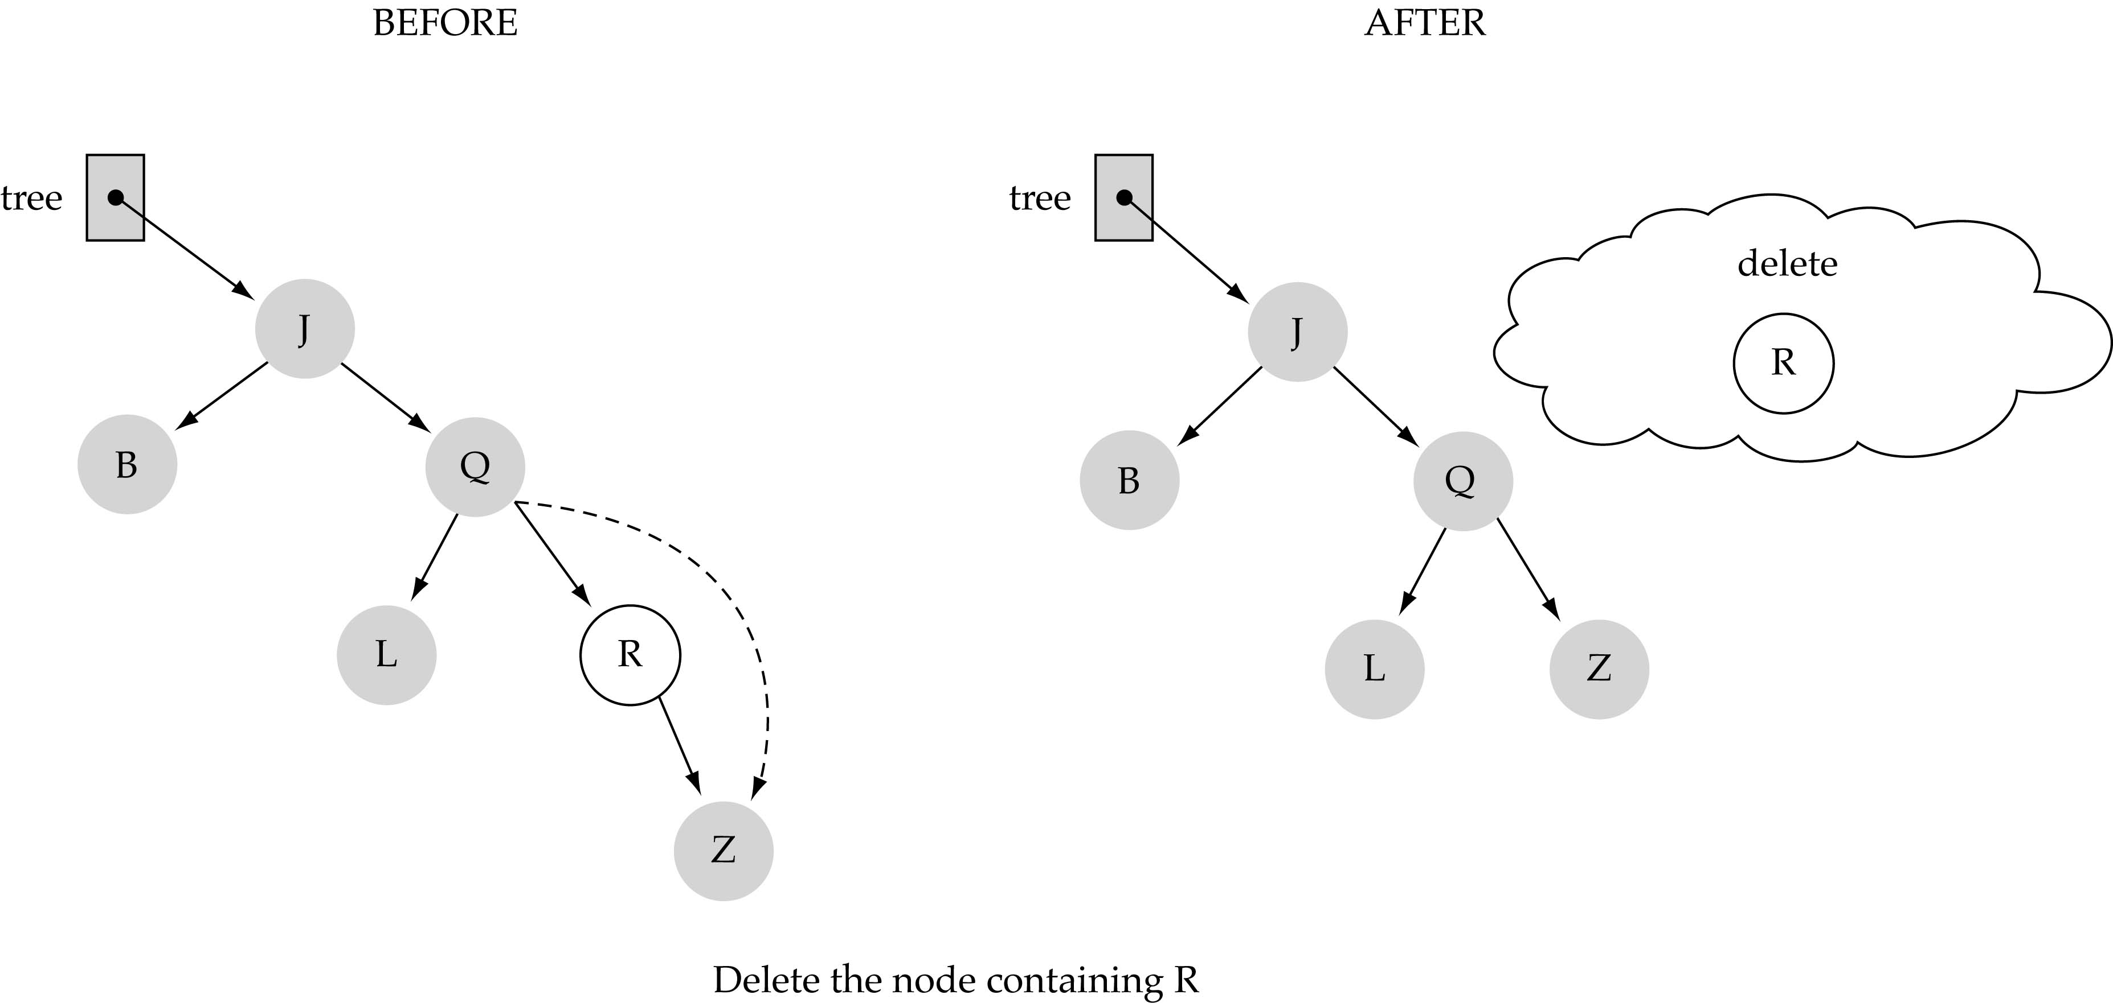
(2) Deleting a node with only one child

Slide 37
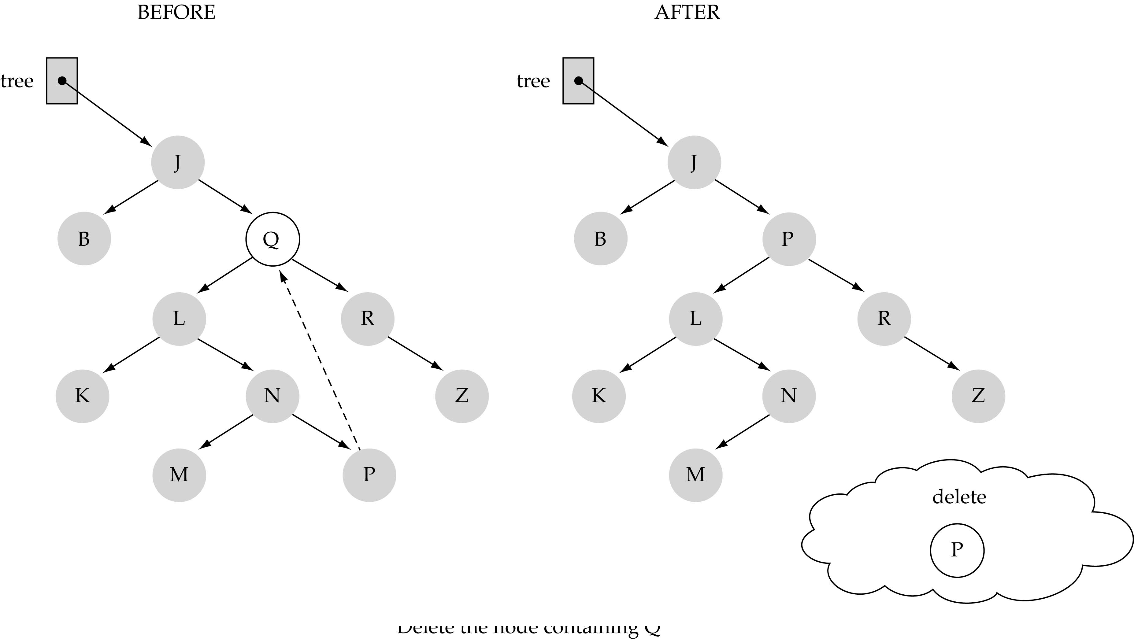
(3) Deleting a node with two children

Slide 38
(3) Deleting a node with two children (cont.)
Find predecessor (i.e., rightmost node in the left subtree)
Replace the data of the node to be deleted with predecessor's data
Delete predecessor node

Slide 39
Function DeleteItem (cont.)
What is the size of the problem?
Number of nodes in the tree we are examining
What is the base case(s)?
Key to be deleted was found
What is the general case?
Choose the left or right subtree

Slide 40
Function DeleteItem (cont.)
template<class ItemType>
void TreeType<ItmeType>::DeleteItem(ItemType item)
{
Delete(root, item);
}
template<class ItemType>
void Delete(TreeNode<ItemType>*& tree, ItemType item)
{
if(item < tree->info)
Delete(tree->left, item);
else if(item > tree->info)
Delete(tree->right, item);
else
DeleteNode(tree);
}

Slide 41
Function DeleteItem (cont.)
template <class ItemType>
void DeleteNode(TreeNode<ItemType>*& tree)
{
ItemType item;
TreeNode<ItemType>* tempPtr;
tempPtr = tree;
if(tree->left == NULL) { // right child
tree = tree->right;
delete tempPtr;
}
else if(tree->right == NULL) { // left child
tree = tree->left;
delete tempPtr;
}
else {
GetPredecessor(tree->left, item);
tree->info = item;
Delete(tree->left, item);
}
}
0 children or
1 child
0 children or
1 child
2 children

Slide 42
Function DeleteItem (cont.)
template<class ItemType>
void GetPredecessor(TreeNode<ItemType>* tree, ItemType& item)
{
while(tree->right != NULL)
tree = tree->right;
item = tree->info;
}

Slide 43
Function DeleteItem (cont.)
template<class ItemType>
void TreeType<ItmeType>::DeleteItem(ItemType item)
{
Delete(root, item);
}
template<class ItemType>
void Delete(TreeNode<ItemType>*& tree, ItemType item)
{
if(item < tree->info)
Delete(tree->left, item);
else if(item > tree->info)
Delete(tree->right, item);
else
DeleteNode(tree);
}
Running Time?
O(h)

Slide 44
Function DeleteItem (cont.)

Slide 45
Tree Traversals
There are mainly three ways to traverse a tree:
Inorder Traversal
Postorder Traversal
Preorder Traversal

Slide 46
Inorder Traversal: A E H J M T Y
Visit second
tree
‘J’
‘E’
‘T’
‘A’
‘H’
‘M’
‘Y’
Visit left subtree first
Visit right subtree last

Slide 47
Inorder Traversal
Visit the nodes in the left subtree, then visit the root of the tree, then visit the nodes in the right subtree
Inorder(tree)
If tree is not NULL
Inorder(Left(tree))
Visit Info(tree)
Inorder(Right(tree))
Warning: "visit" implies do something with the value at the node (e.g., print, save, update etc.).

Slide 48
Preorder Traversal: J E A H T M Y
Visit first
tree
‘J’
‘E’
‘T’
‘A’
‘H’
‘M’
‘Y’
Visit left subtree second
Visit right subtree last

Slide 49
Preorder Traversal
Visit the root of the tree first, then visit the nodes in the left subtree, then visit the nodes in the right subtree
Preorder(tree)
If tree is not NULL
Visit Info(tree)
Preorder(Left(tree))
Preorder(Right(tree))

Slide 50
Postorder Traversal: A H E M Y T J
Visit last
tree
‘J’
‘E’
‘T’
‘A’
‘H’
‘M’
‘Y’
Visit left subtree first
Visit right subtree second

Slide 51
Postorder Traversal
Visit the nodes in the left subtree first, then visit the nodes in the right subtree, then visit the root of the tree
Postorder(tree)
If tree is not NULL
Postorder(Left(tree))
Postorder(Right(tree))
Visit Info(tree)

Slide 52
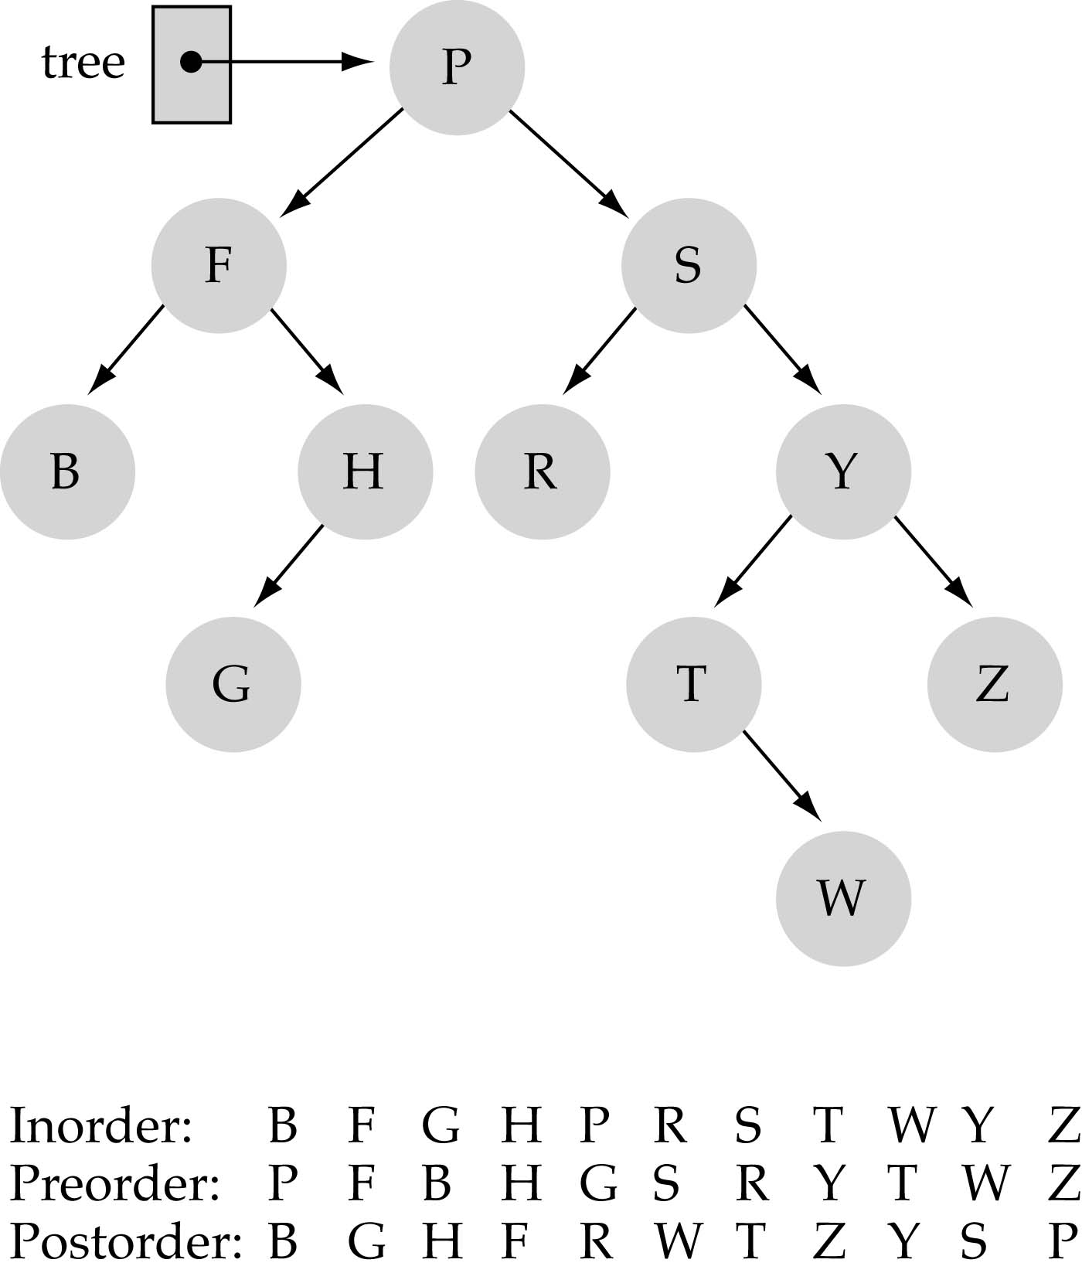
Tree Traversals: another example

Slide 53
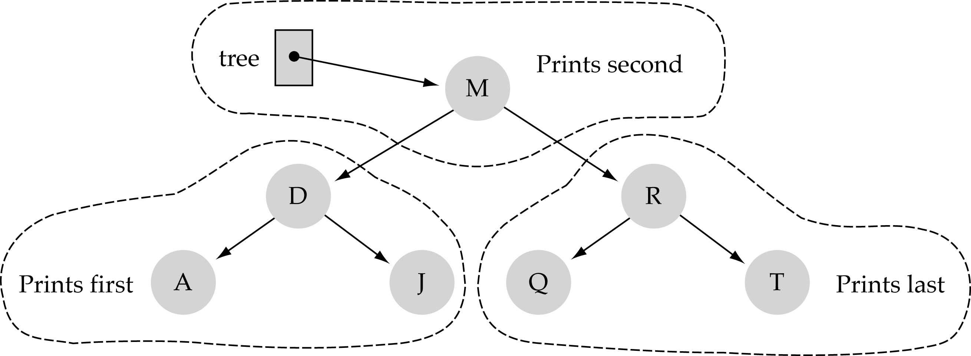
Function PrintTree
We use "inorder" to print out the node values.
Keys will be printed out in sorted order.
Hint: binary search could be used for sorting!
A D J M Q R T

Slide 54
Function PrintTree (cont.)
void TreeType::PrintTree(ofstream& outFile)
{
Print(root, outFile);
}
template<class ItemType>
void Print(TreeNode<ItemType>* tree, ofstream& outFile)
{
if(tree != NULL) {
Print(tree->left, outFile);
outFile << tree->info; // “visit”
Print(tree->right, outFile);
}
}
to overload “<<“ or “>>”, see:
http://www.fredosaurus.com/notes-cpp/oop-friends/overload-io.html

Slide 55
Class Constructor
template<class ItemType>
TreeType<ItemType>::TreeType()
{
root = NULL;
}

Slide 56
Class Destructor
How should we
delete the nodes
of a tree?
Use postorder!
Delete the tree in a
"bottom-up" fashion

Slide 57
Class Destructor (cont’d)
TreeType::~TreeType()
{
Destroy(root);
}
void Destroy(TreeNode<ItemType>*& tree)
{
if(tree != NULL) {
Destroy(tree->left);
Destroy(tree->right);
delete tree; // “visit”
}
}
postorder

Slide 58
Copy Constructor
How should we
create a copy of
a tree?
Use preorder!

Slide 59
Copy Constructor (cont’d)
template<class ItemType>
TreeType<ItemType>::TreeType(const TreeType<ItemType>&
originalTree)
{
CopyTree(root, originalTree.root);
}
template<class ItemType)
void CopyTree(TreeNode<ItemType>*& copy, TreeNode<ItemType>* originalTree)
{
if(originalTree == NULL)
copy = NULL;
else {
copy = new TreeNode<ItemType>;
copy->info = originalTree->info;
CopyTree(copy->left, originalTree->left);
CopyTree(copy->right, originalTree->right);
}
}
preorder
// “visit”

Slide 60
ResetTree and GetNextItem
User needs to specify the tree traversal order.
For efficiency, ResetTree stores in a queue the results of the specified tree traversal.
Then, GetNextItem, dequeues the node values from the queue.
void ResetTree(OrderType);
void GetNextItem(ItemType&, OrderType, bool&);

Slide 61
Revise Tree Class Specification
enum OrderType {PRE_ORDER, IN_ORDER, POST_ORDER};
template<class ItemType>
class TreeType {
public:
// previous member functions
void PreOrder(TreeNode<ItemType>, QueType<ItemType>&)
void InOrder(TreeNode<ItemType>, QueType<ItemType>&)
void PostOrder(TreeNode<ItemType>, QueType<ItemType>&)
private:
TreeNode<ItemType>* root;
QueType<ItemType> preQue;
QueType<ItemType> inQue;
QueType<ItemType> postQue;
};
new member
functions
new private data

Slide 62
ResetTree and GetNextItem (cont.)
template<class ItemType>
void PreOrder(TreeNode<ItemType>tree, QueType<ItemType>& preQue)
{
if(tree != NULL) {
preQue.Enqueue(tree->info); // “visit”
PreOrder(tree->left, preQue);
PreOrder(tree->right, preQue);
}
}

Slide 63
ResetTree and GetNextItem (cont.)
template<class ItemType>
void InOrder(TreeNode<ItemType>tree, QueType<ItemType>& inQue)
{
if(tree != NULL) {
InOrder(tree->left, inQue);
inQue.Enqueue(tree->info); // “visit”
InOrder(tree->right, inQue);
}
}

Slide 64
ResetTree and GetNextItem (cont.)
template<class ItemType>
void PostOrder(TreeNode<ItemType>tree, QueType<ItemType>& postQue)
{
if(tree != NULL) {
PostOrder(tree->left, postQue);
PostOrder(tree->right, postQue);
postQue.Enqueue(tree->info); // “visit”
}
}

Slide 65
ResetTree
template<class ItemType>
void TreeType<ItemType>::ResetTree(OrderType order)
{
switch(order) {
case PRE_ORDER: PreOrder(root, preQue);
break;
case IN_ORDER: InOrder(root, inQue);
break;
case POST_ORDER: PostOrder(root, postQue);
break;
}
}

Slide 66
GetNextItem
template<class ItemType>
void TreeType<ItemType>::GetNextItem(ItemType& item, OrderType order, bool& finished)
{
finished = false;
switch(order) {
case PRE_ORDER: preQue.Dequeue(item);
if(preQue.IsEmpty())
finished = true;
break;
case IN_ORDER: inQue.Dequeue(item);
if(inQue.IsEmpty())
finished = true;
break;
case POST_ORDER: postQue.Dequeue(item);
if(postQue.IsEmpty())
finished = true;
break;
}
}

Slide 67
Iterative Insertion and Deletion
Reading Assignment (see textbook)

Slide 68
Comparing Binary Search Trees to Linear Lists
Big-O Comparison
Operation | Binary Search Tree | Array-based List | Linked List
Constructor | O(1) | O(1) | O(1)
Destructor | O(N) | O(1) | O(N)
IsFull | O(1) | O(1) | O(1)
IsEmpty | O(1) | O(1) | O(1)
RetrieveItem | O(logN^{)*} | O(logN) | O(N)
InsertItem | O(logN^{)*} | O(N) | O(N)
DeleteItem | O(logN)* | O(N) | O(N)
*assuming h=O(logN)

Slide 69
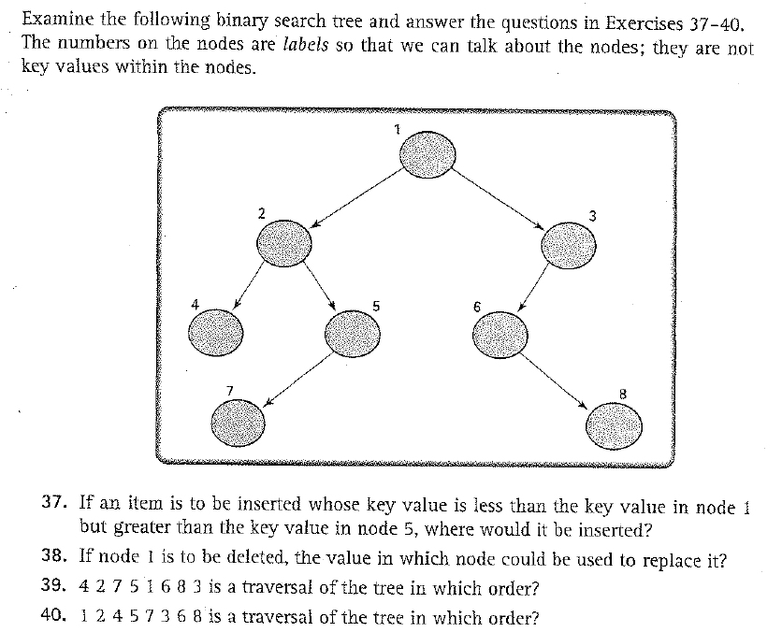
Exercises 37-41 (p. 539)

Slide 70
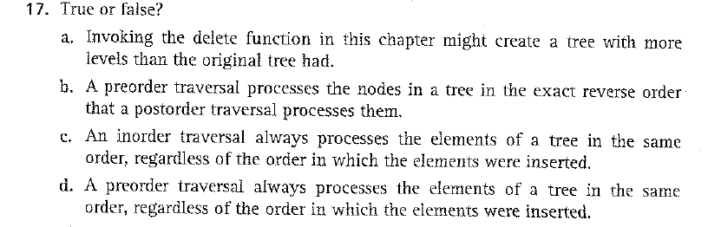
Exercise 17 (p. 537)

Slide 71

Exercise 18 (p. 537)

