Slide 1
Disjoint Set
Tanjina Helaly

Slide 2
Disjoint set
A data structure to keep track of set of elements partitioned into different disjoint (non overlapping) subset
Each set is represent by a representative
In some applications, it doesn’t matter which member is used as the representative
Other applications may require a pre-specified rule for choosing the representative, such as choosing the smallest member in the set (assuming, of course, that the elements can be ordered)

Slide 3
Disjoint set
Representative of the respective set
A
C
X
Y
D
B
Z
Set1
Set3
P
Set2

Slide 4
How to represent
Can be represented by Linked list.
But usually implemented as tree like structure.

Slide 5
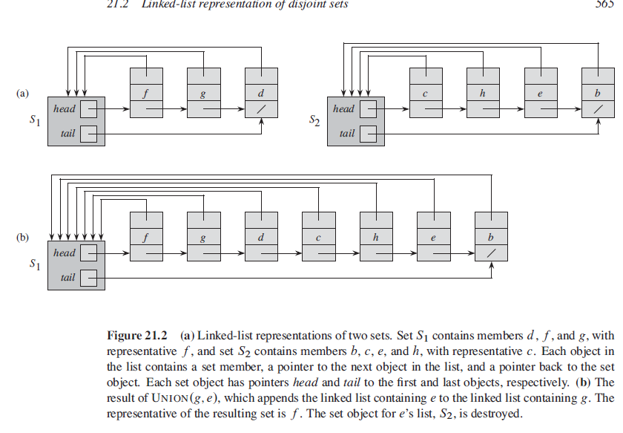
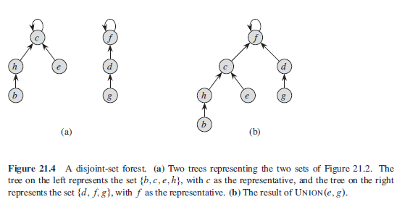
How to represent
Linked Link
Tree
Representative (The element head points to)
Representative
- the node that is its own parent
- root node

Slide 6
3 operations
Make-Set(X)
Create a set with just one node x
condition – x can’t be in any other set (as the sets are disjoint)
Find-Set(X)
Find the representative of the set X belong to.
Union(X,Y)
Combine the 2 sets x and y belongs to.

Slide 7
Create-Set
Create a set with just one node x
condition – x can’t be in any other set (as the sets are disjoint)
Complexity: O(1)
function MakeSet(x)
if x is not already present:
add x to the disjoint-set tree
x.parent := x
x.rank := 0

Slide 8
Find-Set
int find(int x)
{
if (x.parent == x)
return x;
return find(x.parent);
}
Representative of the respective set
A
C
X
Y
B
D
Z
Set1
Set3
Find(A)->A
Find(B)->A
Find(C)->A
Find(D)->A
P
Set2

Slide 9
Union
Combines the dynamic sets that contain x and y into a new set that is the union of these two sets.
We assume that the two sets are disjoint prior to the operation.
Choose representative from any set.
Reduce the number of set by 1.
Representative of the respective set
Representative of the respective set
A
C
X
Y
X
Y
D
Union(P,Y)
A
C
B
Z
Z
P
B
D
Set1
Set3
Set3
P
Set1
Set2

Slide 10
Union
Union(x,y)
x-set = Find-Set(x) y-set = Find-Set(y)
if(x-set !=y-set) x-set.Parent = y-set;

Slide 11
Union using tree structure

Slide 12
Union using Linked List

Slide 13
Union Problem
For linked list
Need at most n-1 union operation
Each union will cause all members of the newly appended list to be updated with the new representative and also need to update the tail pointer.
O(n²)
For tree structure
Tree could get unbalance if we keep adding the tree with more depth as a leaf of smaller depth tree. Worst case would be creating a linear tree with one child at every level.
Operation for unbalanced tree is really slow.

Slide 14
How to solve
Use heuristics
Union-by-rank
Add the lower rank set at the end of higher rank set so that minimum updates are required.
For linked list, rank is the length
For tree, rank is the depth of the tree.
Path compression
Flattening the structure of the tree.

Slide 15
Path Compression
Set every visited node to be connected to the root node directly
This is modified version of the Find method
Find(x):
If x.parent != x // x is not root node
x.parent = Find(x.parent);
return x.parent;
Once the tree is flattened, all nodes will be directly connected to root/representative. And Find(any node) will take constant time complexity.

Slide 16
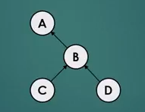
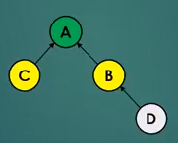
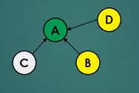
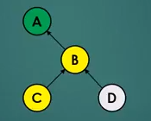
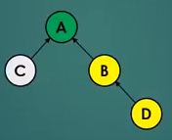
Path Compression - example
Find(C) – with path compression
Find(C) – with path compression

Slide 17
Applications

Slide 18
Applications
Main application is creating connected component.
Involve manipulating objects from wide range e.g.
Pixels in digital image
Computers in network
Friends in social network
Transistors in computer chip
…..
Reachability checking
Cycle checking
Connected component counting
Connected component size calculation,
Component labeling for vertices,

Slide 19
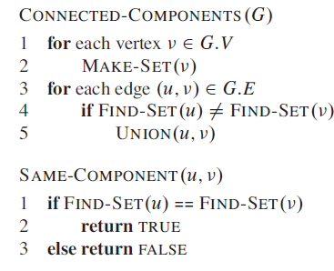
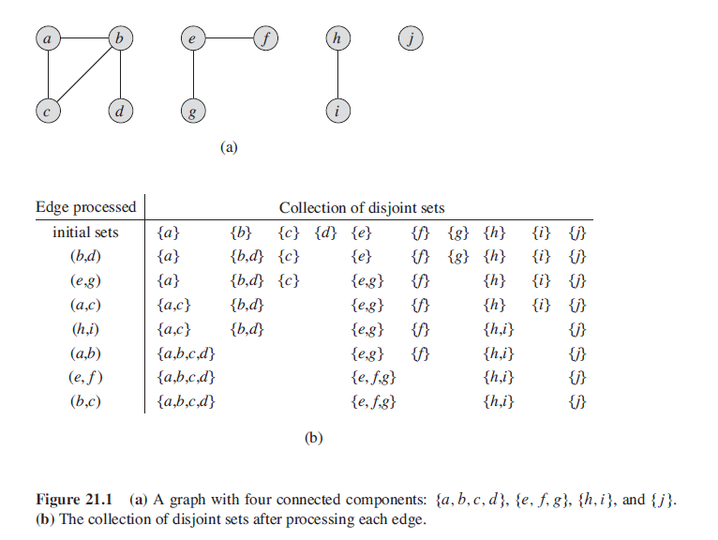
Connected Component

Slide 20
Cycle detection
During the union process if 2 vertices belong to the same disjoint set -> there is a cycle
Union(X,Y) | Union(X,Y) – for cycle checking
x-root = Find-Set(x) y-root = Find-Set(y) if(x-root !=y-root) x-root.Parent = y-root; | x-root = Find-Set(x) y-root = Find-Set(y) if(x-root==y-root) there is a cycle else x-root.Parent = y-root;

Slide 21
Reachability/Connectivity checking
If 2 vertices belong to the same set then they are connected to each other.
Pre-processing
Need to create the connected component before calling this method.
IsConnected(X,Y)
x-root = Find-Set(x)
y-root = Find-Set(y)
if(x-root==y-root)
y is reachable from x or vice versa.

Slide 22
To Find the following
Connected Component Count
Connectivity in Constant time
Id of the set a component belongs to
Size of Connected Component
Need to create another data structure similar to disjoint set

Slide 23
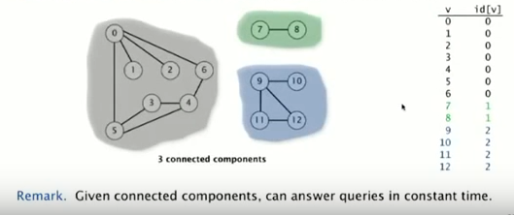
Each Subset is map to a unique number.

Slide 24
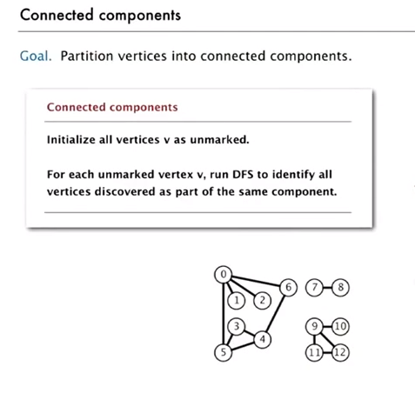
Find Connected Component

Slide 25
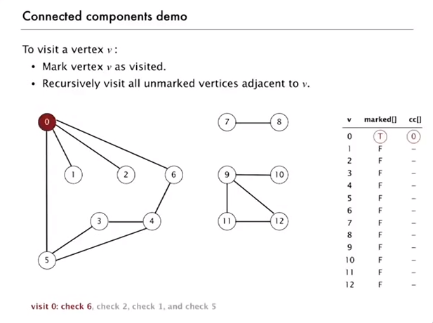
Find Connected Component

Slide 26
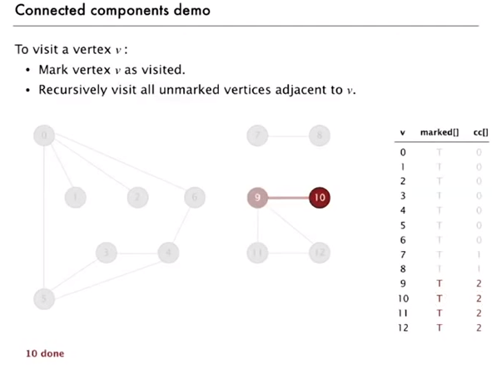
Find Connected Component

Slide 27
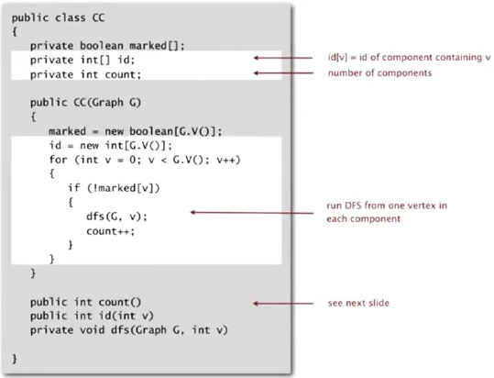
Code

Slide 28
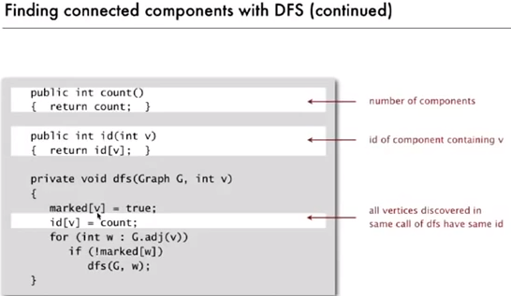
Code

Slide 29
Reference
Chapter 21 (Cormen) -> 21.1, 21.3

