Slide 1
Divide and Conquer
Tanjina Helaly

Slide 2
Divide and Conquer
Divide and Conquer is an algorithm design paradigm.
Divide and conquer approach has 3 steps
Division - the problem is divided into smaller sub-problems of similar type
Conquer -each sub-problem is solved independently.
Merge - The solution of all sub-problems is finally merged in order to obtain the solution of an original problem.
How far should we divide?
When we keep on dividing until you reach a stage where no more division is possible or solution is straight forward.

Slide 3
Recurrence
A recurrence is an equation or inequality that describes a function in terms of its value on smaller inputs.
E.g. fact(n) = n*fact(n-1)
Recurrences go hand in hand with the divide-and-conquer paradigm,
because both of them are described/solved in terms of a smaller problem.

Slide 4
Example of Divide and Conquer
Binary Search
Divide- divide in to 2 halves and select lower of upper half
Conquer – Search in selected half
Combine - None
Merge Sort
Divide- divide in to 2 halves.
Conquer – Sort each half recursively.
Combine – Combine the 2 sorted list
Quick Sort
Calculate power (x,n)
Divide – divide the power term n to half n/2
Conquer – Find the x^{n/2}
Combine – multiply the x^{n/2} with x^{n/2}
Find Minimum of an array
Divide – Divide the array into 2 halves
Conquer – Find the minimum of the 2 subArray
Combine – take the minimum of the minimum of 2 subarray

Slide 5
Binary Search
Binary-Search(A, low, high, item):
if (low>high) return false;
else
mid = (low+high)/2;
if (item == A[mid])
return true;
if(item<A[mid])
Binary-Search(A, low, mid-1, item)
else
Binary-Search(A, mid+1, high, item)
constant time: c₁
constant time: c₂
constant time: c₃
Same problem of size n/2
Same problem of size n/2

Slide 6
Calculate Power
Time Complexity of optimized solution: O(logn)
#include<stdio.h>
int power(int x, int y) {
int temp;
if( y == 0) return 1;
temp = power(x, y/2);
if (y%2 == 0) return temp*temp;
else return x*temp*temp;
}

Slide 7
Merge Sort
MERGE(A, low, mid, high)
1 n1 = mid – p + 1
2 n2 = r - q
3 let L[0… n1] and R[0… n2] be new arrays
4 for i = 1 to n1
5 L[i ]= A[low+ i -1]
6 for j = 1 to n2
7 R[j]= A[mid+ j]
8 L[n1 + 1] = ∞ , R[n2 + 1] = ∞
9 i = 1, j = 1
10 for k = low to mid
11 if L[i] ≤ R[j]
12 A[k] = L[i]
13 i = i + 1
14 else A[k] = R[j]
15 j = j + 1
MERGE-SORT(A, p, r)
1 if p < r
2 q = (p + r)/2
3 MERGE-SORT(A, p, q)
4 MERGE-SORT(A, q, r)
5 MERGE(A, p, q, r)

Slide 8
Merge Sort
Problem:
Given 2 sorted array, need to merge these 2 arrays in one sorted array.
The key operation of the merge sort algorithm is the merging of two sorted sequences to one sorted sequence in the “combine” step
Algorithm of Merge
Keep track of the smallest element in each sorted half.
Choose smaller of two elements
Repeat until done

Slide 9
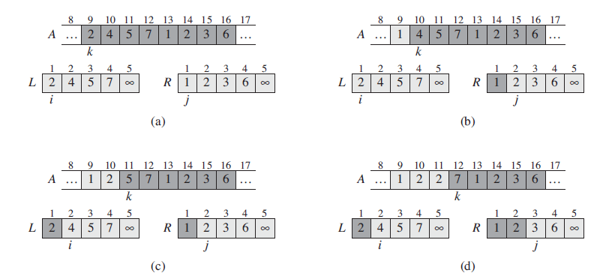
Merge Sort

Slide 10
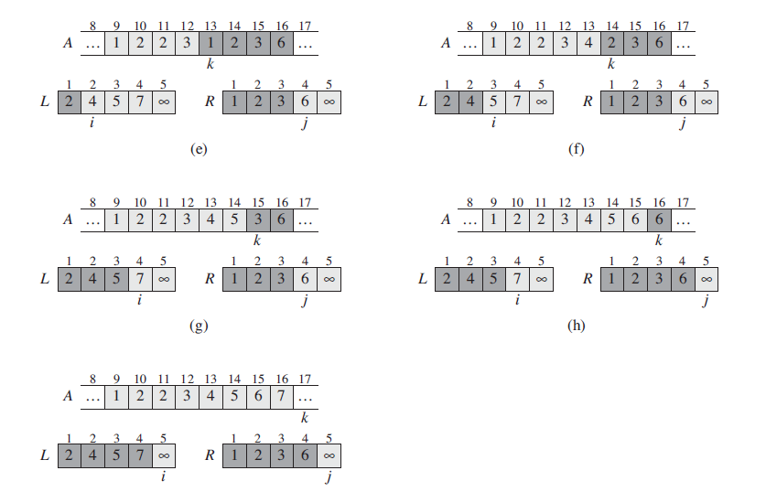
Merge Sort

Slide 11
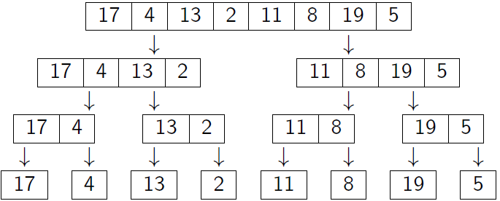
Merge Sort - Divide

Slide 12
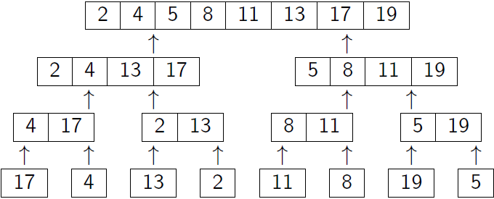
Merge Sort – Merge/Combine

Slide 13
Analysis
For any Divide and Conquer algorithm if the original problem of size n is divided into a number of subproblems, each of size n=b, then the running time T(n) can be expressed as the following:
Here,
c is a small constant and
D(n) is the time needed to divide the problem and
C(n) is the time needed to combine them back.

Slide 14
Analysis – Merge Sort
For Merger Sort
D(n) = (1)
a = 2
b = 2
c = 1
So, Time Complexity of Merge Sort

Slide 15
Analysis – Merge Sort
Or we can replace (1) with constant, c and (n) with cn. For small constant c, we can rewrite the whole equation as,

