Slide 1
Graph Algorithms
Tanjina Helaly

Slide 2
Main Topics
Graph representation
Graph traversal
- Breadth-first search
- Depth-first search

Slide 3
Graphs
Graph G = (V, E)
V = set of vertices
E = set of edges ⊆ (V×V)
Types of graphs
Undirected: edge (u, v) = (v, u); for all v, (v, v) ∉ E (No self loops.)
Directed: (u, v) is edge from u to v, denoted as u → v. Self loops are allowed.
Weighted: each edge has an associated weight, given by a weight function w : E → R.
Dense: |E| ≈ |V|².
Sparse: |E| << |V|².
|E| = O(|V|²)

Slide 4
Graphs
If (u, v) ∈ E, then vertex v is adjacent to vertex u.
Adjacency relationship is:
Symmetric if G is undirected.
Not necessarily so if G is directed.
Path
a path in a graph is a finite sequence of edges which connect a sequence of vertices.
Sequence of alternating vertices and edges.
Start from a vertex and ends to a vertex.
Simple path
All vertices and edges are distinct.
Cycle
A path whose start and end vertex is same.

Slide 5
Representation of Graphs
Two standard ways.
Adjacency Lists.
Adjacency Matrix.
a
b
a
b
d
c
b
a
c
c
d
c
d
a
b
d
a
c
1
2
1 2 3 4
1 0 1 1 1
2 1 0 1 0
3 1 1 0 1
4 1 0 1 0
a
b
c
d
3
4

Slide 6
Adjacency Lists
Consists of an array Adj of |V| lists.
One list per vertex.
For u ∈ V, Adj[u] consists of all vertices adjacent to u.
a
b
a
b
d
c
b
c
If weighted, store weights also in adjacency lists.
c
d
c
d
d
a
b
a
b
d
c
b
a
c
c
d
c
d
a
b
d
a
c

Slide 7
Storage Requirement
For directed graphs:
Sum of lengths of all adj. lists is
∑out-degree(v) = |E|
^{v∈V}
Total storage: Θ(V+E)
For undirected graphs:
Sum of lengths of all adj. lists is
∑degree(v) = 2|E|
^{v∈V}
Total storage: Θ(V+E)
No. of edges leaving v
No. of edges incident on v. Edge (u,v) is incident on vertices u and v.

Slide 8
Pros and Cons: adj list
Pros
Space-efficient, when a graph is sparse.
Can be modified to support many graph variants.
Cons
Determining if an edge (u,v) ∈G is not efficient.
Have to search in u’s adjacency list. Θ(degree(u)) time.
Θ(V) in the worst case.

Slide 9
Adjacency Matrix
|V| × |V| matrix A.
Number vertices from 1 to |V| in some arbitrary manner.
A is then given by:
1
2
1 2 3 4
1 0 1 1 1
2 0 0 1 0
3 0 0 0 1
4 0 0 0 0
1
2
1 2 3 4
1 0 1 1 1
2 1 0 1 0
3 1 1 0 1
4 1 0 1 0
a
b
a
b
c
d
4
3
c
d
4
3
A = A^{T} for undirected graphs.

Slide 10
Space and Time
Space: Θ(V²).
Not memory efficient for large graphs.
Time: to list all vertices adjacent to u: Θ(V).
Time: to determine if (u, v) ∈ E: Θ(1).
Can store weights instead of bits for weighted graph.

Slide 11
Graphs
Reachable checking
If a path exists
Cycle checking
a vertex is reachable from itself.

Slide 12
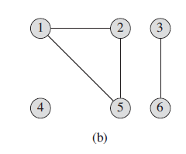
Connected Component
An undirected graph is connected if there is a path between every pair of vertices.
A connected component of an undirected graph is a maximal set of nodes such that each pair of nodes is connected by a path.

Slide 13
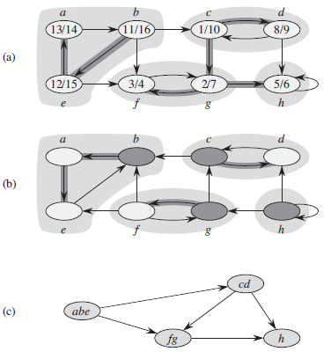
Strongly Connected Components
A graph is strongly connected if every vertex is reachable from every other vertex.
The strongly connected components of a directed graph is the subgraph where every vertex is reachable from every other vertices.

Slide 14
Connected Components
Connected (Strongly or not) components form a partition of the set of graph vertices, meaning
connected components are non-empty,
they are pair-wise disjoints, and
the union of connected components forms the set of all vertices.
Algorithm to find the strong connectivity of a graph takes linear time ( Θ(V+E)).

Slide 15
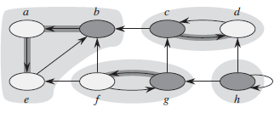
Connected Components
Connected components count
Count of disjoint connected components
Size of connected component
number of vertices in a component
Figure
Fig 1: has 3 connected components with 3 different sizes
Fig 2: has 4 connected components with 3 different sizes
Fig 1
Fig 2

Slide 16
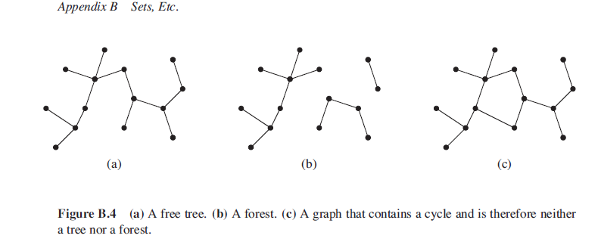
Tree
Tree: Connected Acyclic undirected graph
Forest: If an undirected graph is acyclic but possibly disconnected, it is a forest
Spanning Tree: is a tree which includes all of the vertices of the graph.

Slide 17
Properties of free trees
Let G ={V;E} be an undirected graph. The following statements are equivalent.
Any two vertices in G are connected by a unique simple path.
G is connected, acyclic and |E|=|V| - 1.
G is connected, but if any edge is removed from E, the resulting graph is disconnected.
G is acyclic, but if any edge is added to E, the resulting graph contains a cycle.

Slide 18
Graph-searching Algorithms
Given: a graph G = (V, E), directed or undirected
Goal: methodically explore every vertex and every edge
Ultimately: build a tree on the graph
Pick a vertex as the root
Choose certain edges to produce a tree
Note: might also build a forest if graph is not connected
Used to discover the structure of a graph.

Slide 19
Graph-searching Algorithms
Standard graph-searching algorithms.
Breadth-first Search (BFS).
Depth-first Search (DFS).
“Search as deep as possible first.”

Slide 20
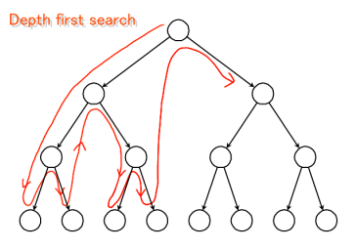
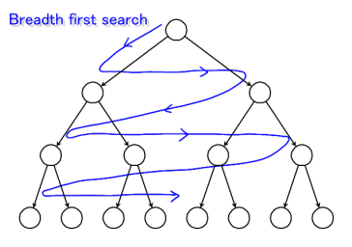
Graph Traversals
Both take time: O(V+E)

Slide 21
BFS(G,s)
1. for each vertex u in V[G] – {s}
2 do color[u] ← white
3 d[u] ← ∝
4 π[u] ← nil
5 color[s] ← gray
6 d[s] ← 0
7 π[s] ← nil
8 Q ← Φ
9 enqueue(Q,s)
10 while Q ≠ Φ
11 do u ← dequeue(Q)
12 for each v in Adj[u]
13 do if color[v] = white
14 then color[v] ← gray
15 d[v] ← d[u] + 1
16 π[v] ← u
17 enqueue(Q,v)
18 color[u] ← black
white: undiscovered
gray: discovered
black: finished
Q: a queue of discovered vertices
color[v]: color of v
d[v]: distance from s to v
π[u]: predecessor of v

Slide 22
Example (BFS)
r
s
t
u
∞
0
∞
∞
∞
∞
∞
∞
v
w
x
y
Q: s
0

Slide 23
Example (BFS)
r
s
t
u
1
0
∞
∞
∞
1
∞
∞
v
w
x
y
Q: w r
1 1

Slide 24
Example (BFS)
r
s
t
u
1
0
2
∞
∞
1
2
∞
v
w
x
y
Q: r t x
1 2 2

Slide 25
Example (BFS)
r
s
t
u
1
0
2
∞
2
1
2
∞
v
w
x
y
Q: t x v
2 2 2

Slide 26
Example (BFS)
r
s
t
u
1
0
2
3
2
1
2
∞
v
w
x
y
Q: x v u
2 2 3

Slide 27
Example (BFS)
r
s
t
u
1
0
2
3
2
1
2
3
v
w
x
y
Q: v u y
2 3 3

Slide 28
Example (BFS)
r
s
t
u
1
0
2
3
2
1
2
3
v
w
x
y
Q: u y
3 3

Slide 29
Example (BFS)
r
s
t
u
1
0
2
3
2
1
2
3
v
w
x
y
Q: y
3

Slide 30
Example (BFS)
r
s
t
u
1
0
2
3
2
1
2
3
v
w
x
y
Q: ∅

Slide 31
Example (BFS)
r
s
t
u
1
0
2
3
2
1
2
3
v
w
x
y
BF Tree

Slide 32
Application of BFS
Finding Shortest Path
network (Computer, transportation[highway, flight])
GPS finding direction with shortest distance
Broadcasting of network node
Social network find people within k distance
Crawlers in Search Engines

Slide 33
DEPTH-FIRST SEARCH

Slide 34
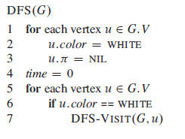
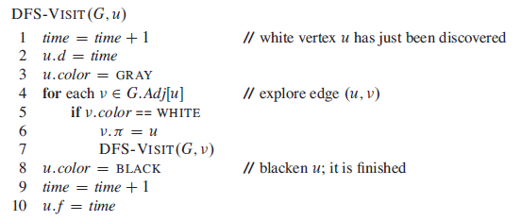
Pseudo-code
Uses a global timestamp time.

Slide 35
Example (DFS)
u
v
w
1/
x
y
z

Slide 36
Example (DFS)
u
v
w
1/
2/
x
y
z

Slide 37
Example (DFS)
u
v
w
1/
2/
3/
x
y
z

Slide 38
Example (DFS)
u
v
w
1/
2/
4/
3/
x
y
z

Slide 39
Example (DFS)
u
v
w
1/
2/
B
4/
3/
x
y
z

Slide 40
Example (DFS)
u
v
w
1/
2/
B
4/5
3/
x
y
z

Slide 41
Example (DFS)
u
v
w
1/
2/
B
4/5
3/6
x
y
z

Slide 42
Example (DFS)
u
v
w
1/
2/7
B
4/5
3/6
x
y
z

Slide 43
Example (DFS)
u
v
w
1/
2/7
F
B
4/5
3/6
x
y
z

Slide 44
Example (DFS)
u
v
w
1/8
2/7
F
B
4/5
3/6
x
y
z

Slide 45
Example (DFS)
u
v
w
1/8
2/7
9/
F
B
4/5
3/6
x
y
z

Slide 46
Example (DFS)
u
v
w
1/8
2/7
9/
F
B
C
4/5
3/6
x
y
z

Slide 47
Example (DFS)
u
v
w
1/8
2/7
9/
F
B
C
4/5
3/6
10/
x
y
z

Slide 48
Example (DFS)
u
v
w
1/8
2/7
9/
F
B
C
4/5
3/6
10/
B
x
y
z

Slide 49
Example (DFS)
u
v
w
1/8
2/7
9/
F
B
C
4/5
3/6
10/11
B
x
y
z

Slide 50
Example (DFS)
u
v
w
1/8
2/7
9/12
F
B
C
4/5
3/6
10/11
B
x
y
z

Slide 51
Application of DFS
Finding path between 2 vertices.
Finding connected components
Topological sorting (Dependency resolution)
mainly used for scheduling a sequence of jobs or tasks based on their dependencies.

