Slide 1
Greedy Algorithm
Tanjina Helaly
CSI 227: Algorithms, Fall 2017
Department of Computer Science & Engineering
United International University

Slide 2
designing and analyzing efficient algorithms
important techniques used
divide-and-conquer,
randomization,
solve recurrences.
dynamic programming (Chapter 15),
greedy algorithms (Chapter 16), and
amortized analysis (Chapter 17).
Among these the last 3 are use for optimization
What is optimization?
the action of making the best or most effective use of a situation or resource.

Slide 3
Greedy algorithm
A greedy algorithm is a mathematical process that
looks for simple, easy-to-implement solutions to complex, multi-step problems
by deciding which next step will provide the most obvious benefit.
Such algorithms are called greedy because
it always makes the choice that looks best at the moment.
the algorithm doesn’t consider the larger problem as a whole.
Once a decision has been made, it is never reconsidered.

Slide 4
Greedy algorithm
A greedy algorithm makes a locally optimal choice in the hope that this choice will lead to a globally optimal solution.
Greedy algorithms do not always yield optimal solutions, but for many problems they do.

Slide 5
How do you decide which choice is optimal?
For any optimization there are 2 key things.
An objective function
Normally maximize or minimize something
A set of constraints
What resources and limitation we have.

Slide 6
How do you decide which choice is optimal?
Assume that you have an objective function that needs to be optimized (either maximized or minimized) at a given point.
A Greedy algorithm makes greedy choices at each step to ensure that the objective function is optimized.
The Greedy algorithm has only one shot to compute the optimal solution so that it never goes back and reverses the decision.

Slide 7
Steps of Greedy algorithm
Make greedy choice at the beginning of each iteration
Create sub problem
Solve the sub problem
How?
Continue first two steps until the all the sub-problems are solved.

Slide 8
Activity selection problem

Slide 9
Activity Selection Problem
The activity selection problem is a classic optimization problem concerning the selection of non-conflicting activities to perform within a given time frame.
The problem is to select the maximum number of activities that can be performed by a single person or machine, assuming that a person can only work on a single activity at a time.
A classic application of this problem is in scheduling a room for multiple competing events, each having its own time requirements (start and end time).

Slide 10
Activity Selection Problem- Example
Suppose we have a set of activities {a₁; a₂; … ;a_{n} } that wish to use a resource, such as a lecture hall, which can serve only one activity at a time.
Each activity a_{i} has a start time s_{i} and a finish time f_{i}, where 0 <s_{i} < f_{i} < α .
We have to select the maximum-size subset of activities that are mutually compatible.
Two activities are compatible if their intervals do not overlap.

Slide 11

Activity Selection Problem- Example
We assume that the activities are sorted in monotonically increasing order of finish time:
f₁ <= f₂ <= f₃ <= …. <= f_{n-1} <= fn :
Subset {a₁; a₄; a₈; a₁₁} is better than the subset {a₃; a₉; a₁₁}

Slide 12

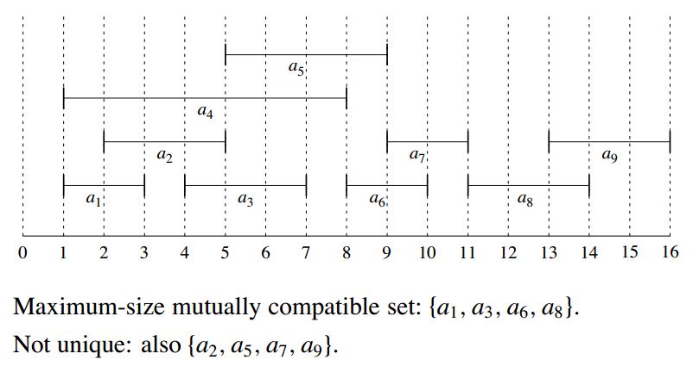
Activity Selection Problem- Another Example

Slide 13
How to solve?
Brute force
Generate all possible subsets of non-conflicting activities
Choose the largest subset
Greedy algorithm
Steps:
Make greedy choice at the beginning of each iteration
Create sub problem
Solve the sub problem

Slide 14
Activity Selection Problem- Greedy Algorithm
Make greedy choices: select a job to start with. Which one?
Select the job that finishes first
Assumption: Jobs are sorted according to finishing time.
Create sub problems: leaving this job, leaves you with a smaller number of jobs to be selected.
Solve Sub problems: Continue first two steps until the all the jobs are finished. (recursion!)

Slide 15
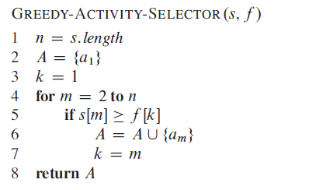
Activity Selection Problem –iterative solution
s -> the set of start time
f -> the set of finish time.

Slide 16
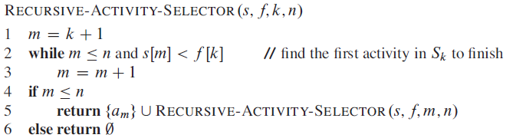
Activity Selection Problem – recursive solution
s -> the set of start time
f -> the set of finish time.
k -> index of last selected activity
n -> number of activities

Slide 17
Coin changing problem

Slide 18
Another example – coin changing problem
Suppose you have different kinds of coin of quarters(25 cents), dimes(10 cents), nickels (5 cents) , and pennies(1 cent).
Consider the problem of making change for n cents using the fewest number of coins. Assume that each coin’s value is an integer.
So, we need to find the minimum number of coins that add up to a given amount of money.

Slide 19
Solution
Make greedy choices: Select the coin with max value smaller or equal to the amount, this should lead to minimum number of coins.
Try the 25 cent first!
Create sub problems: Giving out the first coin, leaves you with a smaller amount.
Solve Sub problems: Continue first two steps until the change is not given. (recursion!)

Slide 20
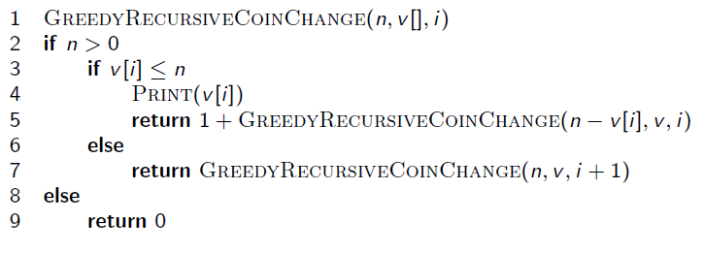
Coin Changing problem – recursive solution
n -> The change needed
v -> the list of coins sorted in descending order. So, the max value coin will be at first index, then the next smaller and so on.
i -> index

Slide 21
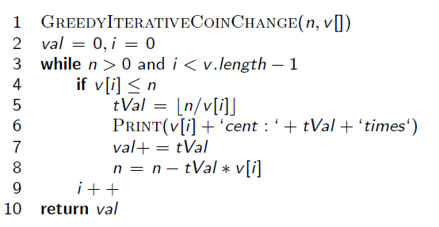
Coin Changing problem – iterative solution
n -> The change needed
v -> the list of coins sorted in descending order. So, the max value coin will be at first index, then the next smaller and so on.

Slide 22
Try the following
Case 1:
Make a change for 12 cents when you have only 4 kinds of coins - 10, 8, 4, and 1
Does it give you optimal solution?
Case 2:
You do not have the 5 cent coin. So, the coin set has 25 cent, 10 cent and 1 cent. Now give a change for 30 cent.
Does it give you optimal solution?
What can you conclude to?
Is greedy algorithm good for coin changing problem?

Slide 23
Knapsack problem

Slide 24
What is knapsack problem
A thief robbing a store finds n items.
The i^{th} item is worth v_{i} dollars and weighs w_{i} pounds, where i and w_{i} are integers.
The thief wants to take as valuable a load as possible, but he can carry at most W pounds in his knapsack, for some integer W .
Which items should he take?

Slide 25
2 types of knapsack problems
2 versions of this problem
0-1 knapsack problem
for each item, the thief must either take it or leave it behind; he cannot take a fractional amount of an item or take an item more than once.
Fractional knapsack problem
the thief can take fractions of items, rather than having to make a binary (0-1) choice for each item.

Slide 26
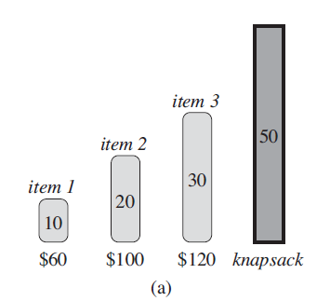
0-1 knapsack problem
Assume the following knapsack problem, there are 3 items and a knapsack that can hold 50 pounds.

Slide 27
0-1 knapsack problem
Here is the value per pound table.
Greedy choice – first take the item with most value per pound. So, take item 1 first, then item 2 and then item 3.
Item # | Value | Weight | Value/Weight
1 | 60 | 10 | 6(most valuable)
2 | 100 | 20 | 5
3 | 120 | 30 | 4

Slide 28
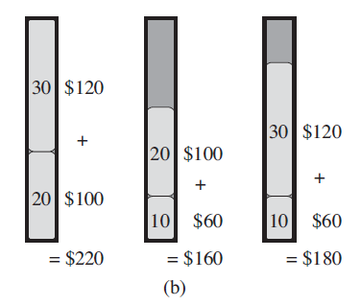
0-1 knapsack problem
Greedy choice – first take the item with most value per pound. So, take item 1 first, then item 2 and then item 3.
What is the total value worth?
$160

Slide 29
0-1 knapsack problem
Lets see what total value we get if we take other items.
Conclusion:
Including item 1 doesn’t give optimal solution. Rather excluding does.
Greedy algorithm doesn’t give optimal solution for 0-1 knapsack problem.

Slide 30
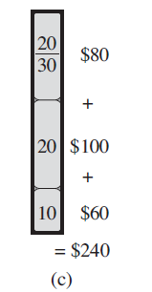
Fractional knapsack problem
For the fractional knapsack problem, taking the items in order of greatest value per pound yields an optimal solution.

Slide 31
Another Example
Assume you are a busy person. You have exactly T time to do some interesting things and you want to do maximum such things.
Objective:
Maximize the number of interesting things to complete.
Constraint:
Need to finish the works at T time.

Slide 32
Solution of Example
You are given an array A of integers, where each element indicates the time a thing takes for completion. You want to calculate the maximum number of things that you can do in the limited time that you have.
This is a simple Greedy-algorithm problem.
In each iteration, you have to greedily select the things which will take the minimum amount of time to complete.
Steps
Sort the array A in a non-decreasing order.
Select one item at a time
Complete the item if you have enough time (item’s time is less than your available time.)
Add one to numberOfThingsCompleted.

Slide 33
So when should we use greedy algorithm?

Slide 34
Elements of Greedy Strategy
An greedy algorithm makes a sequence of choices, each of the choices that seems best at the moment is chosen
NOT always produce an optimal solution
Problems that has the following 2 properties are good candidates for greedy algorithm.
Greedy-choice property
Optimal substructure

Slide 35
Greedy-Choice Property
A globally optimal solution can be arrived at by making a locally optimal (greedy) choice
Make whatever choice seems best at the moment and then solve the sub-problem arising after the choice is made
The choice made by a greedy algorithm may depend on choices so far, but it cannot depend on any future choices or on the solutions to sub-problems
Of course, we must prove that a greedy choice at each step yields a globally optimal solution

Slide 36
Optimal Substructures
A problem exhibits optimal substructure if an optimal solution to the problem contains within it optimal solutions to sub-problems
If an optimal solution A to S begins with activity 1, then A’ = A – {1} is optimal to S’={i ∈S: s_{i} ≥ f₁}

Slide 37
Application
Activity selection problem
Interval partitioning problem
Job sequencing problem
Fractional knapsack problem
Prim’s minimum spanning tree

Slide 38
Try at home
Why selecting the job with earliest starting time or shortest duration does not work?

Slide 39
Reference
Chapter 16 (16.1 and 16.2) (Cormen)

