Slide 1
Minimum Spanning Tree
Tanjina Helaly

Slide 2
Minimum Spanning Tree
Tree: Connected Acyclic Graph
Spanning Tree: A tree that contains all vertices.
Formal definition: Given an connected weighted graph G, a Spanning tree is a subgraph that connects all vertices and acyclic.
Minimum Spanning tree:
Given a graph(V,E) and edge weights function w: E -> R, find the spanning tree of minimum weight.

Slide 3
Example
B
8
C
7
D
4
9
2
A
11
I
4
14
E
6
8
7
10
H
G
F
1
2
B
8
C
7
D
4
9
2
A
11
I
4
14
E
6
8
7
10
H
G
F
1
2

Slide 4
Application
Cluster analysis
Face verification
Avoid cycle in network
Network design(communication, electrical, computer, road)
Reducing data storage in sequencing amino acid in protein.

Slide 5
Brute Force
Find all spanning tree and select the one with minimum total weight.
Complexity: Exponential

Slide 6
Greedy Algorithm
It grows one edge at a time
Assume, prior to each iteration, A is a subset of some minimum spanning tree.
At each step, we determine an edge (u, v) that we can add to A [A U (u,v)] and A still remain a subset of minimum spanning tree
This edge is called safe edge.
Algorithm
GENERIC-MST(G, w)
1 A =Ǿ ;
2 while A does not form a spanning tree
3 find an edge .u; / that is safe for A
4 A = A U {(u, v)}
5 return A

Slide 7
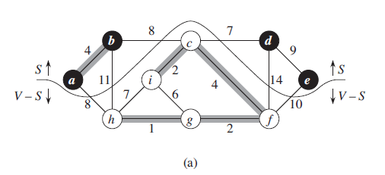
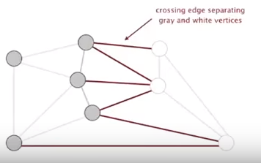
Cut Property
A Cut in a graph is a partition of its vertices into 2 non-empty set.
A crossing edge connects a vertex in one set with a vertex in the other set.
Cut property: Given any cut, the crossing edge of min weight is in MST.

Slide 8
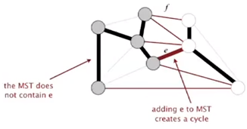
Proof
Suppose min-weight crossing edge e is not in MST
Some other crossing edge f should be in MST otherwise the graph will not be connected.
So, adding e to MST creates a cycle
Removing f and adding e is also a spanning tree
Since weight of e<weight of f
ST with e will have lower weight than ST with f.
This is a contradiction. So, f can’t be in MST

Slide 9
Greedy MST Algorithm
Start with all edge colored gray. [No edge is selected to be in MST]
Find a cut with no black crossing edge; color the min-weight crossing edge black.
Repeat until v-1 edges are colored black
B
8
C
7
D
4
9
2
A
11
I
4
14
E
6
8
7
10
H
G
F
1
2

Slide 10
Greedy MST Algorithm
Start with all edge colored gray. [No edge is selected to be in MST]
Find a cut with no black crossing edge; color the min-weight crossing edge black.
Repeat until v-1 edges are colored black
B
8
C
7
D
4
9
2
A
11
I
4
14
E
6
8
7
10
H
G
F
1
2

Slide 11
Greedy MST Algorithm
Start with all edge colored gray. [No edge is selected to be in MST]
Find a cut with no black crossing edge; color the min-weight crossing edge black.
Repeat until v-1 edges are colored black
B
8
C
7
D
4
9
2
A
11
I
4
14
E
6
8
7
10
H
G
F
1
2

Slide 12
Greedy MST Algorithm
Start with all edge colored gray. [No edge is selected to be in MST]
Find a cut with no black crossing edge; color the min-weight crossing edge black.
Repeat until v-1 edges are colored black
B
8
C
7
D
4
9
2
A
11
I
4
14
E
6
8
7
10
H
G
F
1
2

Slide 13
Greedy MST Algorithm
Start with all edge colored gray. [No edge is selected to be in MST]
Find a cut with no black crossing edge; color the min-weight crossing edge black.
Repeat until v-1 edges are colored black
B
8
C
7
D
4
9
2
A
11
I
4
14
E
6
8
7
10
H
G
F
1
2

Slide 14
Greedy MST Algorithm
Start with all edge colored gray. [No edge is selected to be in MST]
Find a cut with no black crossing edge; color the min-weight crossing edge black.
Repeat until v-1 edges are colored black
B
8
C
7
D
4
9
2
A
11
I
4
14
E
6
8
7
10
H
G
F
1
2

Slide 15
Greedy MST Algorithm
Start with all edge colored gray. [No edge is selected to be in MST]
Find a cut with no black crossing edge; color the min-weight crossing edge black.
Repeat until v-1 edges are colored black
B
8
C
7
D
4
9
2
A
11
I
4
14
E
6
8
7
10
H
G
F
1
2

Slide 16
Greedy MST Algorithm
Start with all edge colored gray. [No edge is selected to be in MST]
Find a cut with no black crossing edge; color the min-weight crossing edge black.
Repeat until v-1 edges are colored black
B
8
C
7
D
4
9
2
A
11
I
4
14
E
6
8
7
10
H
G
F
1
2

Slide 17
Greedy MST Algorithm
Start with all edge colored gray. [No edge is selected to be in MST]
Find a cut with no black crossing edge; color the min-weight crossing edge black.
Repeat until v-1 edges are colored black
B
8
C
7
D
4
9
2
A
11
I
4
14
E
6
8
7
10
H
G
F
1
2

Slide 18
Greedy MST Algorithm
Start with all edge colored gray. [No edge is selected to be in MST]
Find a cut with no black crossing edge; color the min-weight crossing edge black.
Repeat until v-1 edges are colored black
B
8
C
7
D
4
9
2
A
11
I
4
14
E
6
8
7
10
H
G
F
1
2

Slide 19
Greedy MST Algorithm
Start with all edge colored gray. [No edge is selected to be in MST]
Find a cut with no black crossing edge; color the min-weight crossing edge black.
Repeat until v-1 edges are colored black
B
8
C
7
D
4
9
2
A
11
I
4
14
E
6
8
7
10
H
G
F
1
2

Slide 20
Greedy MST Algorithm
Start with all edge colored gray. [No edge is selected to be in MST]
Find a cut with no black crossing edge; color the min-weight crossing edge black.
Repeat until v-1 edges are colored black
B
8
C
7
D
4
9
2
A
11
I
4
14
E
6
8
7
10
H
G
F
1
2

Slide 21
Greedy MST Algorithm
Start with all edge colored non-black. [No edge is selected to be in MST]
Find a cut with no black crossing edge; color the min-weight crossing edge black.
Repeat until v-1 edges are colored black
B
8
C
7
D
4
9
2
A
11
I
4
14
E
6
8
7
10
H
G
F
1
2

Slide 22
Greedy MST Algorithm
Start with all edge colored non-black. [No edge is selected to be in MST]
Find a cut with no black crossing edge; color the min-weight crossing edge black.
Repeat until v-1 edges are colored black
B
8
C
7
D
4
9
2
A
11
I
4
14
E
6
8
7
10
H
G
F
1
2

Slide 23
Greedy MST Algorithm
Start with all edge colored non-black. [No edge is selected to be in MST]
Find a cut with no black crossing edge; color the min-weight crossing edge black.
Repeat until v-1 edges are colored black
B
8
C
7
D
4
9
2
A
11
I
4
14
E
6
8
7
10
H
G
F
1
2

Slide 24
Greedy MST Algorithm
Start with all edge colored gray. [No edge is selected to be in MST]
Find a cut with no black crossing edge; color the min-weight crossing edge black.
Repeat until v-1 edges are colored black
B
8
C
7
D
4
9
2
A
11
I
4
14
E
6
8
7
10
H
G
F
1
2

Slide 25
Greedy MST Algorithm
Start with all edge colored gray. [No edge is selected to be in MST]
Find a cut with no black crossing edge; color the min-weight crossing edge black.
Repeat until v-1 edges are colored black
B
8
C
7
D
4
9
2
A
11
I
4
14
E
6
8
7
10
H
G
F
1
2

Slide 26
Greedy MST Algorithm
Start with all edge colored gray. [No edge is selected to be in MST]
Find a cut with no black crossing edge; color the min-weight crossing edge black.
Repeat until v-1 edges are colored black
B
8
C
7
D
4
9
2
A
11
I
4
14
E
6
8
7
10
H
G
F
1
2

Slide 27
Kruskal’s ALgorithm

Slide 28
Kruskal’s Algorithm
Select the shortest edge in a graph
Select the next shortest edge which does not create a cycle
Repeat step 2 until all vertices have been connected.

Slide 29

Kruskal’s Algorithm - pseudocode
Algorithm
$$Kruskal\left(G\right):$$
$$1 A=∅$$
$$2 foreach v ∈G.V$$
$$3 Make−Set\left(v\right)$$
$$4 sort G.E in ascending order$$
$$5 foreach \left(u, v\right)in G.E$$
$$6 if Find−Set\left(u\right)≠Find−Set\left(v\right)$$
$$7 A=A∪\left\{\left(u,v\right)\right\}$$
$$8 Union\left(u,v\right)$$
$$9 return$$

Slide 30
Kruskal’s Algorithm - Example
Given the graph below, create the MST using Kruskal’s algorithm.
B
8
C
7
D
4
9
2
A
11
I
4
14
E
6
8
7
10
H
G
F
1
2

Slide 31
Kruskal’s Algorithm - Example
Initial Set.
One vertex in each node
Edges are arranged in ascending order of cost.
Edge | Cost
G-H | 1
G-F | 2
C-I | 2
A-B | 4
C-F | 4
G-I | 6
C-D | 7
H-I | 7
A-H | 8
B-C | 8
D-E | 9
E-F | 10
B-H | 11
D-F | 14
B
C
D
A
I
E
H
G
F

Slide 32
Kruskal’s Algorithm - Example
Check G-H.
As G and H are not in same component, connect those.
Edge | Cost
G-H | 1
G-F | 2
C-I | 2
A-B | 4
C-F | 4
G-I | 6
C-D | 7
H-I | 7
A-H | 8
B-C | 8
D-E | 9
E-F | 10
B-H | 11
D-F | 14
B
C
D
A
I
E
H
G
F
1

Slide 33
Kruskal’s Algorithm - Example
Check G-F.
As G and F are not in same component, connect those.
Edge | Cost
G-H | 1
G-F | 2
C-I | 2
A-B | 4
C-F | 4
G-I | 6
C-D | 7
H-I | 7
A-H | 8
B-C | 8
D-E | 9
E-F | 10
B-H | 11
D-F | 14
B
C
D
A
I
E
H
G
F
1
2

Slide 34
Kruskal’s Algorithm - Example
Check C-I.
As C and I are not in same component, connect those.
Edge | Cost
G-H | 1
G-F | 2
C-I | 2
A-B | 4
C-F | 4
G-I | 6
C-D | 7
H-I | 7
A-H | 8
B-C | 8
D-E | 9
E-F | 10
B-H | 11
D-F | 14
B
C
D
2
A
I
E
H
G
F
1
2

Slide 35
Kruskal’s Algorithm - Example
Check A-B.
As A and B are not in same component, connect those.
Edge | Cost
G-H | 1
G-F | 2
C-I | 2
A-B | 4
C-F | 4
G-I | 6
C-D | 7
H-I | 7
A-H | 8
B-C | 8
D-E | 9
E-F | 10
B-H | 11
D-F | 14
B
C
D
4
2
A
I
E
H
G
F
1
2

Slide 36
Kruskal’s Algorithm - Example
Check C-F.
As C and F are not in same component, connect those.
Edge | Cost
G-H | 1
G-F | 2
C-I | 2
A-B | 4
C-F | 4
G-I | 6
C-D | 7
H-I | 7
A-H | 8
B-C | 8
D-E | 9
E-F | 10
B-H | 11
D-F | 14
B
C
D
4
2
A
I
4
E
H
G
F
1
2

Slide 37
Kruskal’s Algorithm - Example
Check G-I.
As G and I are in same component, do not connect those.
Edge | Cost
G-H | 1
G-F | 2
C-I | 2
A-B | 4
C-F | 4
G-I | 6
C-D | 7
H-I | 7
A-H | 8
B-C | 8
D-E | 9
E-F | 10
B-H | 11
D-F | 14
B
C
D
4
2
A
I
4
E
H
G
F
1
2

Slide 38
Kruskal’s Algorithm - Example
Check C-D.
As C and D are not in same component, connect those.
Edge | Cost
G-H | 1
G-F | 2
C-I | 2
A-B | 4
C-F | 4
G-I | 6
C-D | 7
H-I | 7
A-H | 8
B-C | 8
D-E | 9
E-F | 10
B-H | 11
D-F | 14
B
C
7
D
4
2
A
I
4
E
H
G
F
1
2

Slide 39
Kruskal’s Algorithm - Example
Check H-I.
As H and I are in same component, do not connect those.
Edge | Cost
G-H | 1
G-F | 2
C-I | 2
A-B | 4
C-F | 4
G-I | 6
C-D | 7
H-I | 7
A-H | 8
B-C | 8
D-E | 9
E-F | 10
B-H | 11
D-F | 14
B
C
7
D
4
2
A
I
4
E
H
G
F
1
2

Slide 40
Kruskal’s Algorithm - Example
Check A-H.
As A and H are not in same component, connect those.
Edge | Cost
G-H | 1
G-F | 2
C-I | 2
A-B | 4
C-F | 4
G-I | 6
C-D | 7
H-I | 7
A-H | 8
B-C | 8
D-E | 9
E-F | 10
B-H | 11
D-F | 14
B
C
7
D
4
2
A
I
4
E
8
H
G
F
1
2

Slide 41
Kruskal’s Algorithm - Example
Check B-C.
As B and C are in same component, do not connect those.
Edge | Cost
G-H | 1
G-F | 2
C-I | 2
A-B | 4
C-F | 4
G-I | 6
C-D | 7
H-I | 7
A-H | 8
B-C | 8
D-E | 9
E-F | 10
B-H | 11
D-F | 14
B
C
7
D
4
2
A
I
4
E
8
H
G
F
1
2

Slide 42
Kruskal’s Algorithm - Example
Check D-E.
As D and E are in not same component, connect those.
Edge | Cost
G-H | 1
G-F | 2
C-I | 2
A-B | 4
C-F | 4
G-I | 6
C-D | 7
H-I | 7
A-H | 8
B-C | 8
D-E | 9
E-F | 10
B-H | 11
D-F | 14
B
C
7
D
4
9
2
A
I
4
E
8
H
G
F
1
2

Slide 43
Kruskal’s Algorithm - Example
Check the last 3 edges.
E & F, B & H, D & F are in same component, no need to connect those.
Edge | Cost
G-H | 1
G-F | 2
C-I | 2
A-B | 4
C-F | 4
G-I | 6
C-D | 7
H-I | 7
A-H | 8
B-C | 8
D-E | 9
E-F | 10
B-H | 11
D-F | 14
B
C
7
D
4
9
2
A
I
4
E
8
H
G
F
1
2

Slide 44
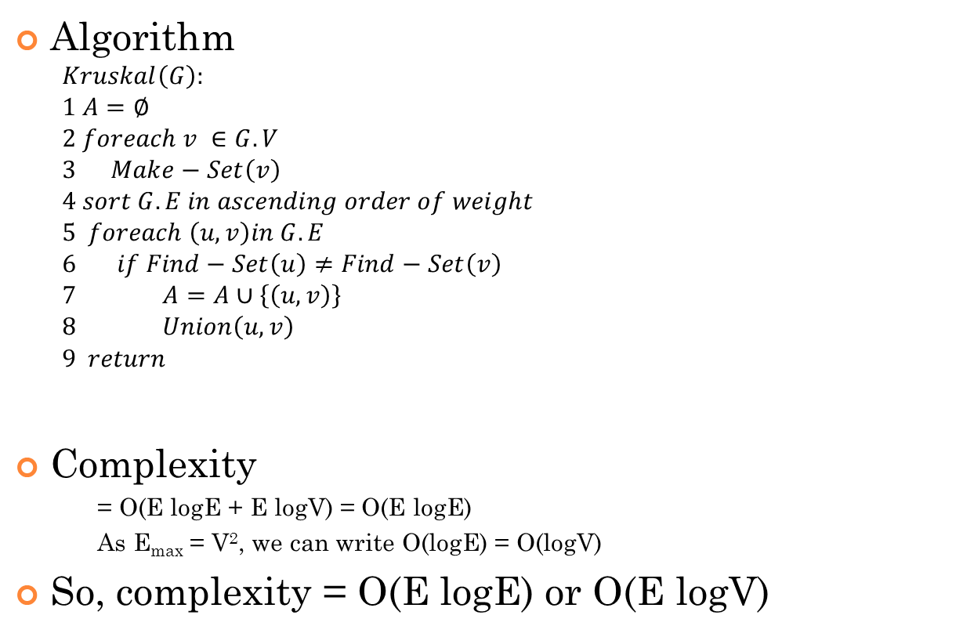
Kruskal’s Algorithm - Complexity
Algorithm
$$Kruskal\left(G\right):$$
$$1 A=∅$$
$$2 foreach v ∈G.V$$
$$3 Make−Set\left(v\right)$$
$$4 sort G.E in ascending order of weight$$
$$5 foreach \left(u, v\right)in G.E$$
$$6 if Find−Set\left(u\right)≠Find−Set\left(v\right)$$
$$7 A=A∪\left\{\left(u,v\right)\right\}$$
$$8 Union\left(u,v\right)$$
$$9 return$$
Complexity
= O(E logE + E logV) = O(E logE)
As E_{max} = V², we can write O(logE) = O(logV)
So, complexity = O(E logE) or O(E logV)
V
E logE
E
E logV
E logV
V logV

Slide 45
Try at home
Is MST always unique for a graph?
Hints: 2 components can be connected via multiple edges.
Is minimum weight edge always included in MST?
Hints: think about non-unique weight edges.
Negate the weights
Increase all weights by a fixed number.

Slide 46
Reference
Chapter 23 (Cormen) -> 23.1, 23.2

