Slide 1
String Matching
Tanjina Helaly
CSI 227: Algorithms, Fall 2017
Department of Computer Science & Engineering
United International University

Slide 2
String Matching
Also known as
Substring matching
Pattern matching
Find pattern of length M in a text of length N.
Text
A A C A B A B A A B A B A A B
A B A A A B A A
Pattern

Slide 3
Applications
Particular patterns in DNA sequences.
Text editors
Search engines
web crawling: finding strings inside other strings
Spam detection
Look for pattern e.g. profit & bankaccount, lose weight
Screen scraping
Plagiarism Detection

Slide 4
Formal definition
We formalize the string-matching problem as follows.
We assume that
Text T[1…n] -> an array of length n.
Pattern P[1….m] -> an array of length m <= n.
The elements of P and T are characters drawn from a finite alphabet ∑.
For example, we may have ∑ = {0,1, …} or ∑={a, b, …} or ∑={ASCII values}
Given strings T (text) and P (pattern), the pattern matching problem consists of finding a substring of T equal to P.

Slide 5
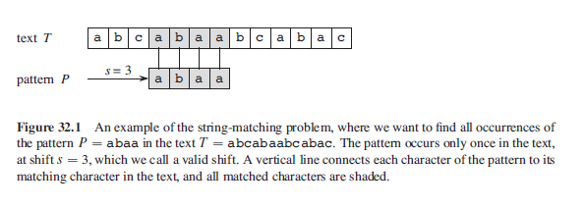
What is Shift
The pattern P occurs with shift s in text T
if 0 <= s <= n-m and T [s+1… s+m]= P[1…m]
(that is, if T[s+j]=P[j], for 1 <= j <= m).
If P occurs with shift s in T , then we call s a valid shift;
The string-matching problem is the problem of finding all valid shifts with which a given pattern P occurs in a given text T .

Slide 6
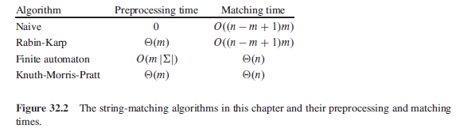
Pattern matching algorithms
Brute-force algorithm
Rabin-Karp algorithm
Boyer-Moore algorithm
Knuth-Morris-Pratt algorithm

Slide 7
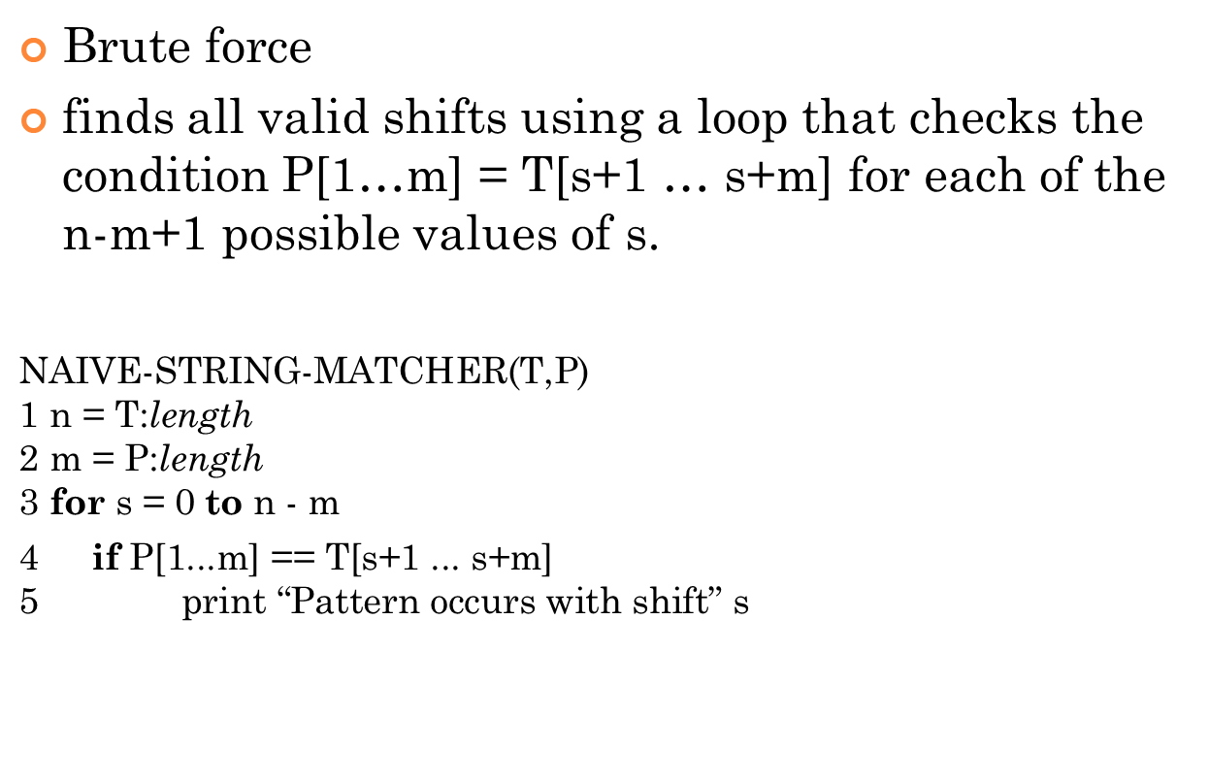
The naive string-matching algorithm
Brute force
finds all valid shifts using a loop that checks the condition P[1…m] = T[s+1 … s+m] for each of the n-m+1 possible values of s.
$\text{NAIVE}\text{−}\text{STRING}\text{−}\text{MATCHER}\text{(}\text{T}\text{,}\text{P}$)
$$\text{1 }\text{n}\text{ = }\text{T}\text{:}\text{length}$$
$$\text{2 }\text{m}\text{ = }\text{P}\text{:}\text{length}$$
$$\text{3 }\text{for} \text{s}\text{ = 0 }\text{to} \text{n}\text{ − }\text{m}$$
$\text{4 } \text{if} \text{P}\text{[}\text{1}\text{...}\text{m}\text{]}\text{ == }\text{T}\text{[}\text{s}\text{+1 ...} \text{s}\text{+}\text{m}$]
$$\text{5 } \text{print}\text{ “}\text{Pattern} \text{occurs} \text{with} \text{shift}\text{” }\text{s}$$

Slide 8
Complexity -> O((n-m+1)m)
For each of the n-m+1 possible values of the shift s, the implicit loop on line 4 to compare corresponding characters must execute m times to validate the shift.
Why need to compare all m even if there is a mismatch before m?
Has some room to improve
Worst case. See the example below.
T = aaaaaaaa
P = aaaa

Slide 9
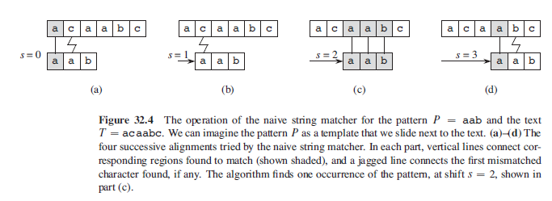

Slide 10
The naive string-matcher is inefficient because
it entirely ignores information gained about the text for one value of s when it considers other values of s.
Such information can be quite valuable, however.
For example, if P = aaab and we find that s = 0 is valid, then none of the shifts 1, 2, or 3 are valid, since T[4] = b.

Slide 11
The Rabin-Karp algorithm

Slide 12
The Rabin-Karp algorithm
Rabin and Karp proposed a string-matching algorithm that
performs well in practice and
also generalizes to other algorithms for related problems, such as
two-dimensional pattern matching.
The Rabin-Karp algorithm uses (m) preprocessing time, and its worst-case running time is ((n-m+1)m).
however, its average-case running time is better.

Slide 13
The Rabin-Karp algorithm
Assume we have to find for a match of the following patter in the text below.
Text – BALLTHEBALL length -> N = 11
Pattern – BALL length -> M = 4 (M<=N)
Assume hash(BALL) = x
Now
Take a window of size M in the Text from beginning
Calculate the hash
If the hash of the window and the pattern is same.
Compare each character of the window and the pattern.
Slide the window 1 position right.
Repeat until the window contains <M character.

Slide 14
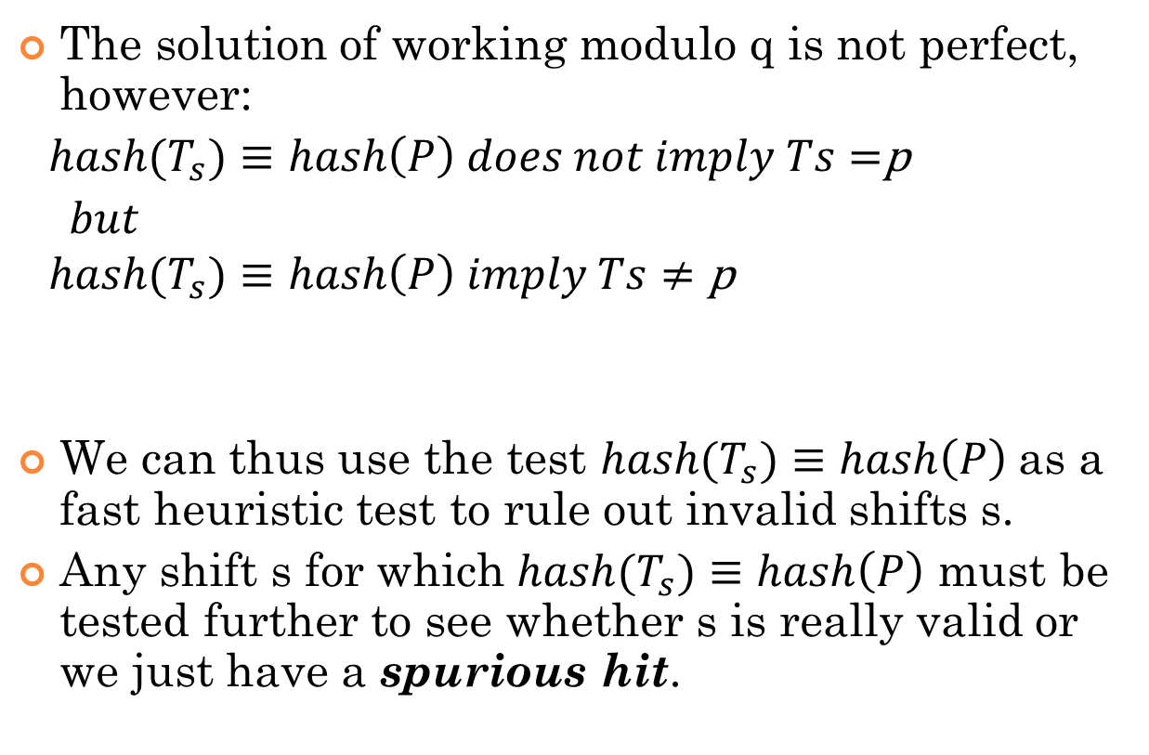
The Rabin-Karp algorithm
The solution of working modulo q is not perfect, however:
${ hash(T}_{s})≡hash\left(P\right) does not imply Ts=$p
$but$
$${ hash(T}_{s})≡hash\left(P\right) imply Ts≠\text{p}$$
We can thus use the test ${hash(T}_{s})≡hash\left(P\right)$as a fast heuristic test to rule out invalid shifts s.
Any shift s for which ${hash(T}_{s})≡hash\left(P\right)$ must be tested further to see whether s is really valid or we just have a spurious hit.

Slide 15
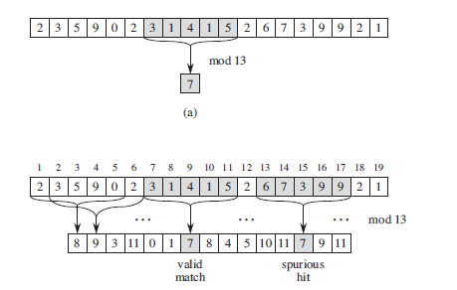
The Rabin-Karp algorithm

Slide 16
Example
Window (red text) | Hash(window) - | 2 hashes equals | Text matches?
BALLTHEBALL | X | Yes | Yes
BALLTHEBALL | x1 | No | NA
BALLTHEBALL | x2 | No | NA
BALLTHEBALL | X | Yes | No
BALLTHEBALL | x3 | No | NA
BALLTHEBALL | x4 | No | NA
BALLTHEBALL | x5 | No | NA
BALLTHEBALL | X | Yes | Yes

Slide 17
Can we improve
Use the hash value to current window calculate the hash value of next window.
Will reduce the time complexity of hash function from (m) to (1)

Slide 18
Improvement
Where
t_{s} = hash value at shift s
t_{s+1} = hash value at shift s+1 (next window)
d = radix. (number of character in the alphabet system)
For numerical d =10
For binary d =2
For ASCII d = 256
q = a prime number
h = d^{m-1} mod q
T[s+1] = leading character of current window
T[s+m+1] = trailing character that will be brought in in next window.

Slide 19
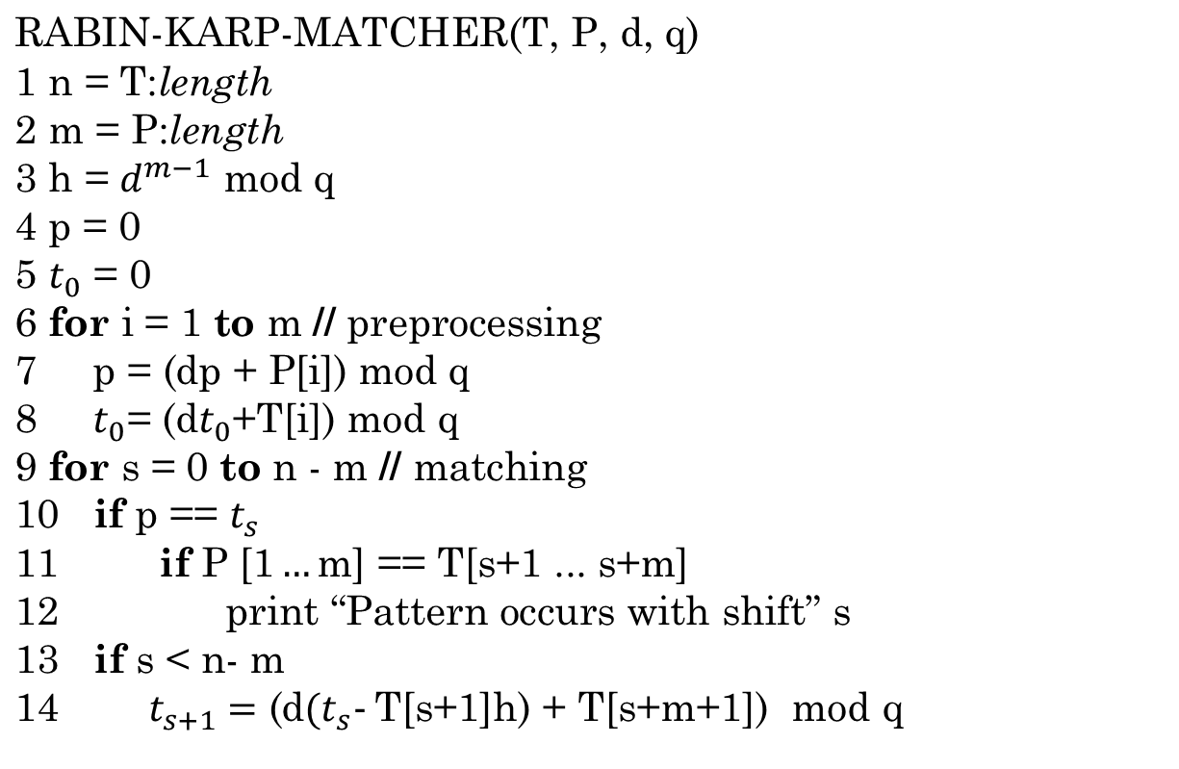
The Rabin-Karp algorithm

Slide 20
Example
P = BALL, q = 29 (prime number)
Calculate hash, p
Repeat for each character and calculate p=dp+P[i]
p=(dp+P[1]) mod q = 256*0+66 mod 29 = 8
p=(dp+P[2]) mod q = 256*8+65 mod 29 = 25
p=(dp+P[3]) mod q = 256*25+76 mod 29 = 9
p=(dp+P[4]) mod q = 256*9+76 mod 29 = 2
Calculate hash, t₀
Repeat for each character and calculate t₀ =dt₀ +T[i]
t₀ =dt₀ +T[1]) mod q = 256*0+66 mod 29 = 8
t₀ =dt₀ +T[2]) mod q = 256*8+65 mod 29 = 25
t₀ =dt₀ +T[3]) mod q = 256*25+76 mod 29 = 9
t₀ =dt₀ +T[4]) mod q = 256*9+76 mod 29 = 2

Slide 21
Example
P = 2, t₀ =2, m=4, n=11,
q=29, h=256³ mod 29 = 20
Window (red text) | t_{s} | 2 hashes equals | Text matches?
BALLTHEBALL | 2 | Yes | Yes
BALLTHEBALL | (256*(2-66*20) +84) mod 29 = 4 | No | NA
BALLTHEBALL | (256*(4-65*20) +72) mod 29 = 27 | No | NA
BALLTHEBALL | (256*(27-76*20) +69) mod 29 = 23 | No | NA
BALLTHEBALL | (256*(23-76*20) +66) mod 29 = 11 | No | NA
BALLTHEBALL | (256*(11-84*20) +65) mod 29 = 0 | No | NA
BALLTHEBALL | (256*(0-72*20) +76) mod 29 = 26 | No | NA
BALLTHEBALL | (256*(26-69*20) +76) mod 29 = 2 | Yes | Yes

Slide 22
Time Complexity
Best Case: (N+M)
Worst Case: (NM)
Text = “aaaaaaaa”
Pattern = “aaaa”;

Slide 23
Advantage:
generalizes to other algorithms for related problems, such as
Extends to 2D pattern.
Extends to find multiple pattern.
Disadvantage
Arithmetic operation is slower than char comparison.

Slide 24
Try at home
How would you extends Rabin-Karp to efficiently search for any one of P possible patterns in a text of length n?

Slide 25
Reference
Chapter 32 (Cormen) -> 32.1, 32.2

