Slide 1
Introduction to OOP using Java
Tanjina Helaly

Slide 2
Programming & Programming Language
Programming is instruction to computer/device to perform task.
A programming language is a formal constructed language designed to communicate instructions to a machine

Slide 3
Classification/Evolution Of Programming
Machine level programming
Send instruction in binary format
Assembly Programming
send code instead of binary code.
Need assembler to convert to binary
High level programming
Code is close to English Language
Need Compiler to convert to binary
3 types
Non structured
Structured/Procedural
Object Oriented Programming

Slide 4
Classification/Evolution Of Programming
Non structured
Generate spaghetti code
Sequential and has GoTo
COBOL, BASIC, FORTRAN
Structured/Procedural
Use Subroutine/Function
improving the clarity, quality, and development time
C, PASCAL
Object Oriented Programming
Object-oriented programming (OOP) is a programming language model organized around objects rather than "actions" and data rather than logic.
Historically, a program has been viewed as a logical procedure that takes input data, processes it, and produces output data.
Java, C++, C#

Slide 5
Our Goal Learn Object Oriented Programming using Java

Slide 6
Java’s Lineage
Java is related to C++, which is a direct descendent of C.
Much of the character of Java is inherited from these two languages.
From C, Java derives its syntax.
Many of Java’s object-oriented features were influenced by C++.

Slide 7
Java - Characteristics
Uses C/C++ basic syntax and basic data types -int, char, float, double, long, short, byte etc.
Uses standard C/C++ control structures
“Pure” OO language
No stand alone functions -All code is part of a class
No explicit pointers - uses references
Uses garbage collection
Java is strongly typed
Java is normally compiled to a bytecode.
Java bytecode is a machine language for an abstract machine
Makes Java secure and Portable
Each platform (or browser) that runs Java has a Java Virtual Machine (JVM) . The JVM executes Java bytecodes

Slide 8
Java – The Platform
Java has a large API (application programming interface) covering a wide range of areas The following list of Java APIs and applications from Sun show the range of applications of Java .
For reference http://java.sun.com/products/index.html
Java Foundation Classes (JFC) – GUI
JDBC Database Access
Java Web Server
EmbeddedJava - Java on embedded devices
Notes:
A software platform that encompasses all the necessary components, applicationprogramming interfaces and libraries required by programmers and developers to author, compile, debug and execute language-specific applications. Programming platforms are typically accompanied with development tools that enable effortless application development.

Slide 9
Why Java
Platform Independent - Code once run anywhere
Byte code
Easy to learn
Secure
Byte code & VM
Free……….

Slide 10
Tools/Set-Up

Slide 11
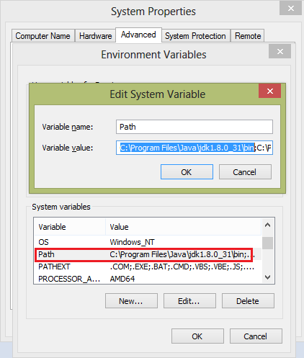
Step1: Install Java and Path Set-up
Need to install Java(JDK and JRE). Get the latest version from Java Standard Edition(SE) from http://www.oracle.com/technetwork/java/javase/downloads/index.html
After installing Java you need to set-up the “Path” environment variable which is available from My Computer under Advanced Properties tab.
Note: Do not delete anything in “Path” variable. Just add your path “C:\Program Files\Java\jdk1.8.0_31\bin;” (Depending on your version the path will change) at the beginning of the existing value.

Slide 12
Step 2: Install IDE
Need an IDE: Eclipse or NetBeans or IntelliJ IDEA.
Or
A Text Editor e.g. TextPad
You can install
eclipse from : http://www.eclipse.org/downloads/packages/eclipse-ide-java-developers/mars1
NetBeans: http://www.oracle.com/technetwork/java/javase/downloads/index.html
IntelliJ IDEA: https://www.jetbrains.com/idea/download/#section=windows

Slide 13
Compile & Run Java Application

Slide 14
Without IDE
Using JDK you can compile and run java program from command line.
c:> javac HelloWorld. Java
compiling here and
it will produce HelloWorld.class i.e. bytecode.
c:>java HelloWorld
It runs java byte code on native machine

Slide 15
With JAVA IDE
Creating, Compiling, Debugging and Execution for these four steps JDK is not user friendly. IDE is provided for that. A list of IDEs are:
Eclipse
Netbeans.
IntelliJ IDEA

Slide 16
An Example HelloWorld
public class HelloWorldExample
{
public static void main( String[] args )
{
System.out.println("Hello World");
}
}

Slide 17
Java Source Code Naming Conventions
All java source file should end with .java
Each .java file can contain only one public class
The name of the file should be the name of the public class plus ".java"
Do not use abbreviations in the name of the class
If the class name contains multiple words then capitalize the first letter of each word ex. HelloWorld.java

Slide 18
Naming Convention
Class Naming
Uses Capitalized word(s) i.e. Title case
Examples:- HelloWorld, MyList, StudentMark
Variable and method names
starts with a lowercase letter and after that use Title case
Examples:- variableAndMethodNames, aFloat, studentName
Names of constants
All are capital letters and separated by underscore.
Example: NAMES_OF_CONSTANTS

Slide 19
Java Identifiers Rules
Identifier is a name given to a variable, class, or method.
Java identifier
Can contain letter, number, underscore ( ), or dollar sign ($).
Cannot start with number.
Identifiers are case sensitive
have no maximum length.
cannot be a keyword, but it can contain a keyword as part of its name.
Example:
Legal: csi211
Illegal: 211csi, #csi211

Slide 20
Data Types- Primitive Types
In Java technology, data are divided into two broad categories: primitive types and class/reference types.
Primitive data are eight types in four categories:
Logical: boolean (true or false)
Textual: char (16 bits)
Integral: byte (8 bits), short (16 bits), int (32 bits), and long (64 bits)
Floating point: oat (32 bits) and double (64 bits)
Class or reference data used to create objects which are two types:
Textual: String
All classes that declare by yourself

Slide 21
Operator
Assignment =
Arithmetic + - * / %
Equality == !=
Relational < <= > >=
Logical &&, ||
increment/decrement ++ --
Shift << >>

Slide 22
Control Statement
if –else
switch
Loop
for
while
do-while

Slide 23
Reference
Java:Complete Reference Chapter 1-5

