Slide 1
CSE 303 Data Communications
Reference Book: Data Communications and Networking
Behrouz A. Forouzan, 4th Edition
McGraw-Hill

Slide 2
Syllabus
Chapter 1 Introduction
Chapter 2 Network Models
Chapter 3 Data and Signals
Chapter 4 Digital Transmission
Chapter 5 Analog Transmission
Chapter 6 Bandwidth Utilization
Chapter 7 Transmission Media
Chapter 8 Switching
Chapter 10 Error Detection and Correction

Slide 3
Chapter 1. Introduction
Data communications
Networks
The Internet
Protocols and standards

Slide 4
Data Communications
Data
Information presented in whatever form is agreed upon by the parties creating and using the data
Data communication
Exchange of data between two devices
Via some form of transmission medium
Fundamental characteristics of data communication
Delivery
Accuracy
Timeliness
Jitter : Variation in the packet arrival time
Telecommunication: communication at a distance
(‘tele’ in Greek=‘far”)

Slide 5
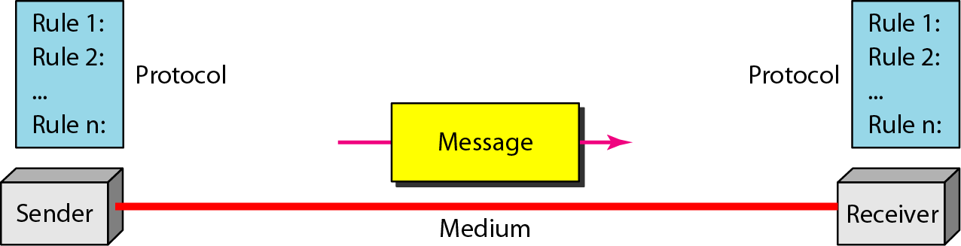
Five Components of Data Communication
Message: Information(data) to be communicated
Sender
Receiver
Transmission medium: Physical path by which a message travels
Protocol: A set of rules that govern data communication

Slide 6
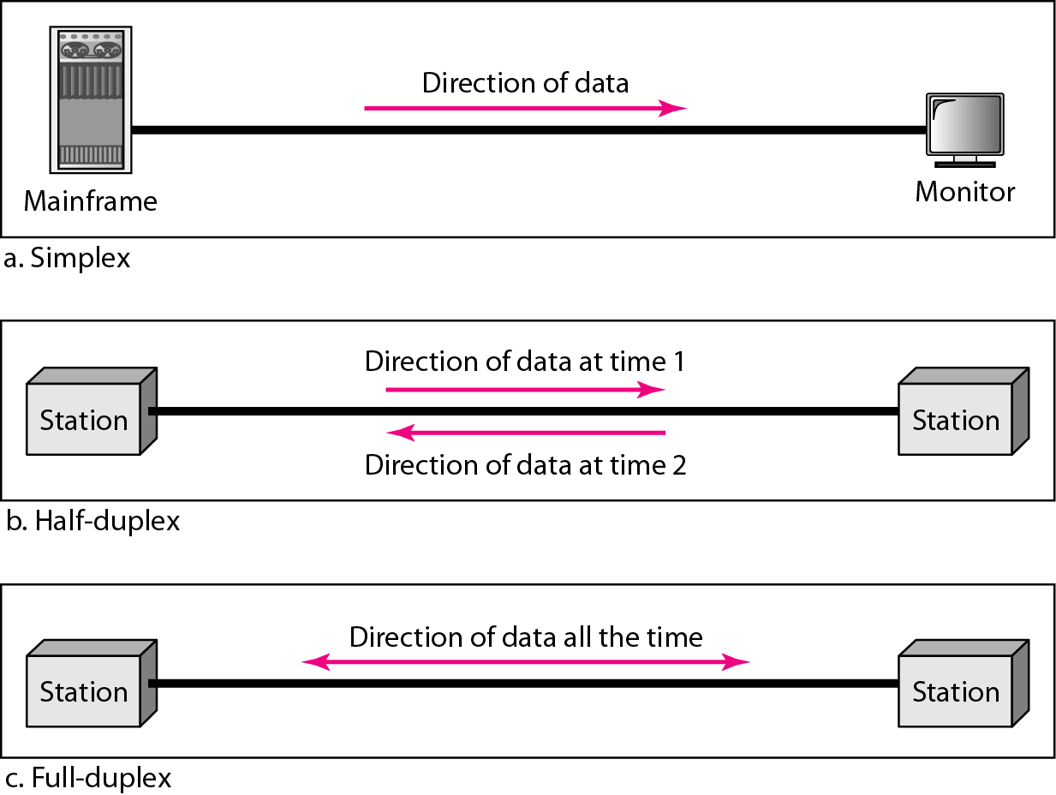
Direction of Data Flow

Slide 7
Data Flow
Simplex
Unidirectional
As on a one-way street
Half-duplex
Both transmit and receive possible, but not at the same time
Like a one-lane road with two-directional traffic
Walkie-talkie, CB radio
Full-duplex
Transmit and receive simultaneously
Like a two-way street, telephone network
Channel capacity must be divided between two directions

Slide 8
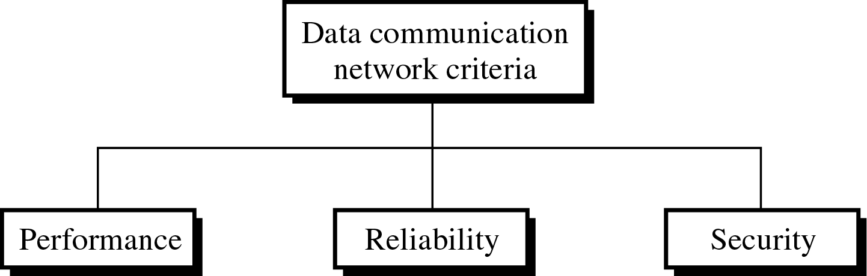
Network
Network: A set of devices (nodes) connected by communication links
Node: Computer, printer, or any device capable of sending and/or receiving data
To be considered effective and efficient, a network must meet a number of criteria

Slide 9
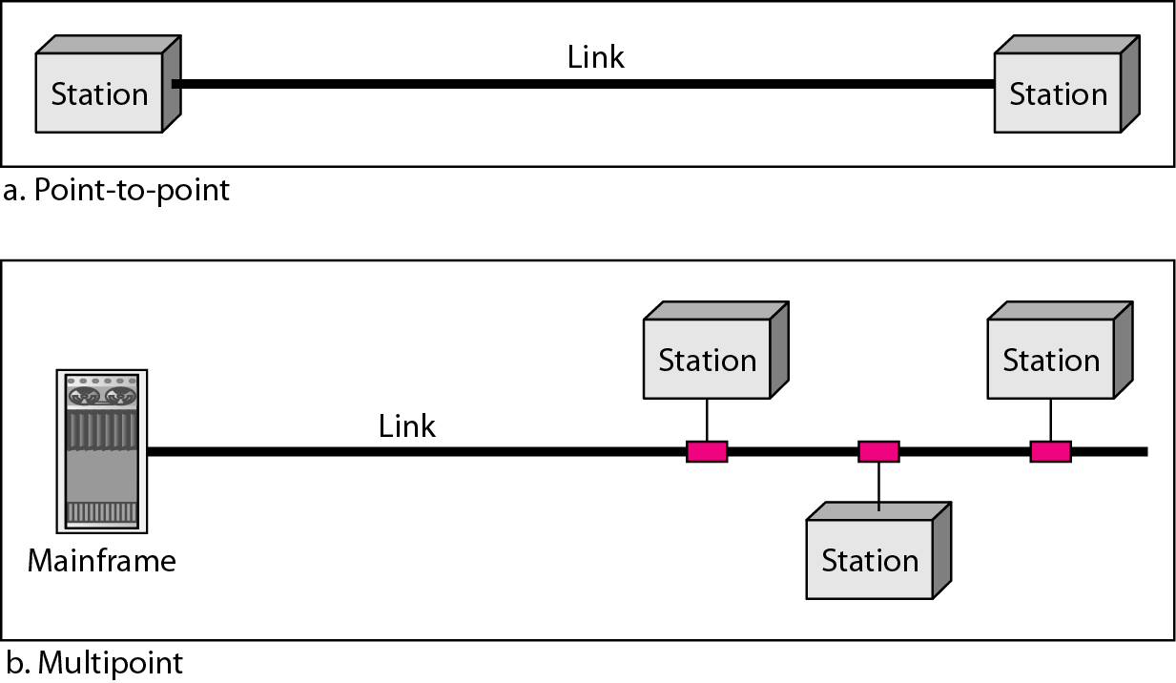
Type of Connection

Slide 10
Type of Connection
Point-to-point
Dedicated link between two devices
The entire capacity of the channel is reserved
Ex) Microwave link, TV remote control
Multipoint
More than two devices share a single link
Capacity of the channel is either
Spatially shared: Devices can use the link simultaneously
Timeshare: Users take turns

Slide 11
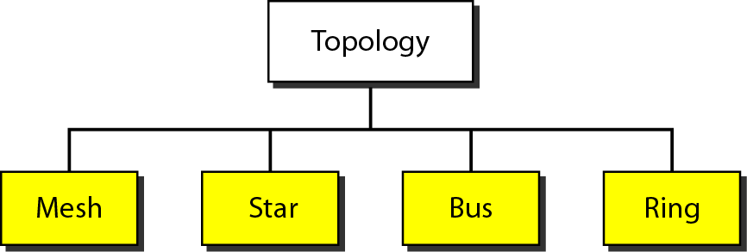
Physical Topology

Slide 12
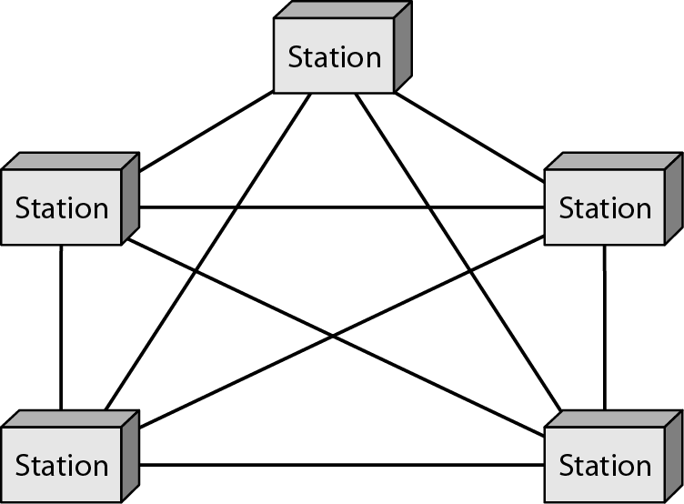
Mesh Topology
Dedicated point-to-point link to every other nodes
A mesh network with n nodes has n(n-1)/2 links. A node has n-1 I/O ports (links)
Advantages: No traffic problems, robust, security, easy fault identification & isolation
Disadvantages: Difficult installation/reconfiguration, space, cost

Slide 13
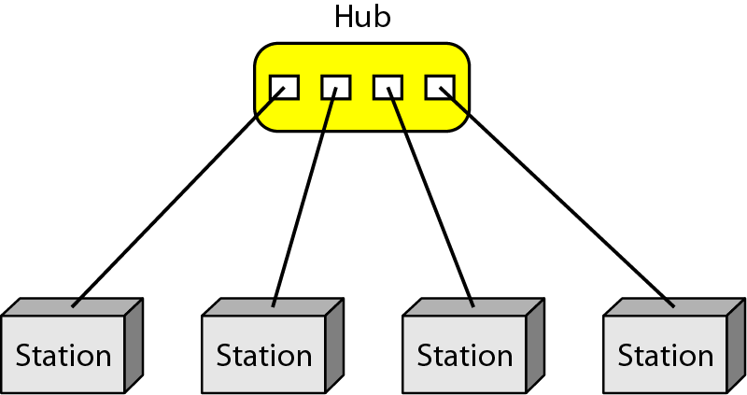
Star Topology
Dedicated point-to-point link only to a central controller, called a hub
Hub acts as an exchange: No direct traffic between devices
Advantages: Less expensive, robust
Disadvantages: dependency of the whole on one single point, the hub

Slide 14
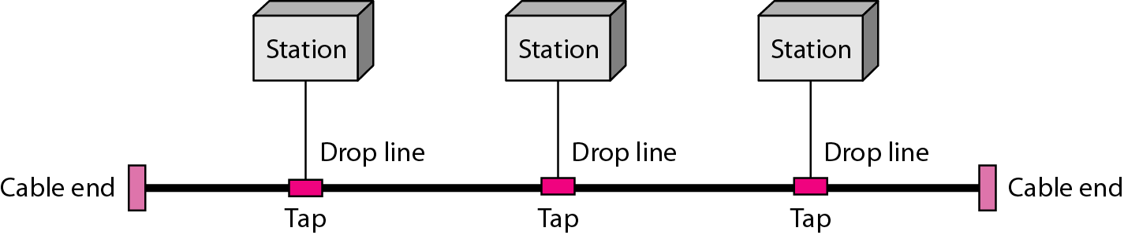
Bus Topology
One long cable that links all nodes
tap, drop line, cable end
limit on the # of devices, distance between nodes
Advantages: Easy installation, cheap
Disadvantages: Difficult reconfiguration, no fault isolation, a fault or break in the bus stops all transmission

Slide 15
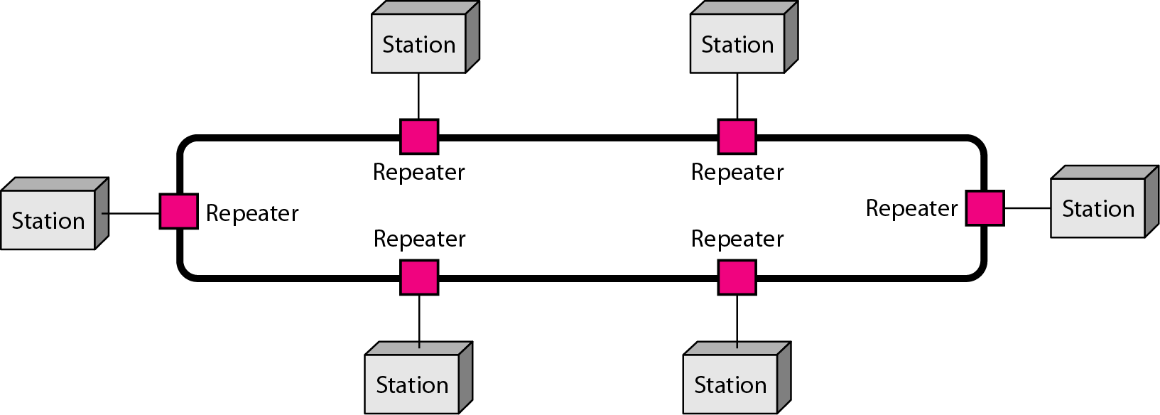
Ring Topology
Dedicated point-to-point link only with the two nodes on each sides
One direction, repeater
Advantages: Easy reconfiguration, fault isolation
Disadvantage: Unidirectional traffic, a break in the ring cab disable the entire network

Slide 16
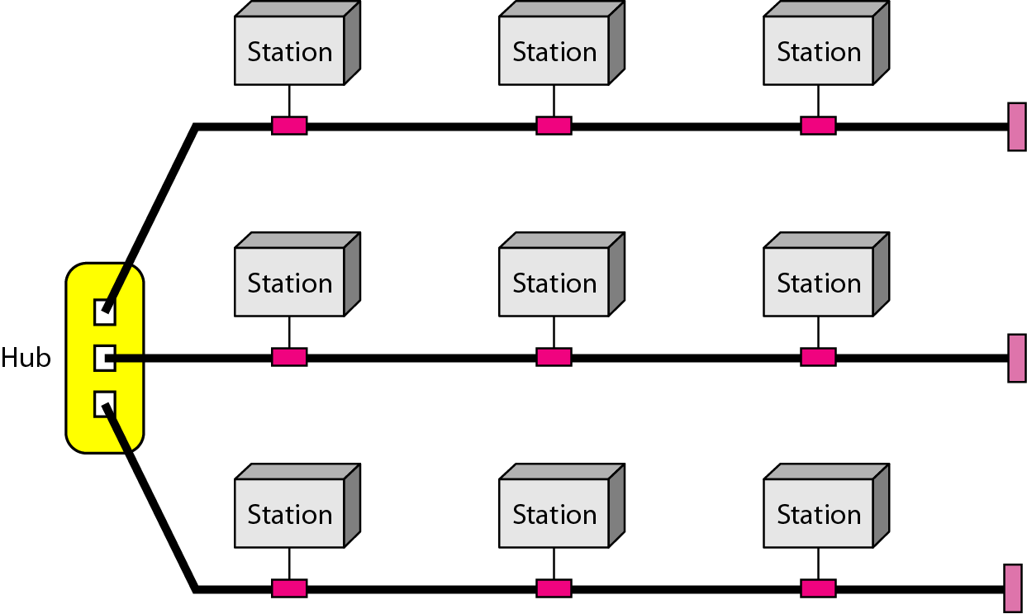
Hybrid Topology
Example: Main star topology with each branch connecting several stations in a bus topology
To share the advantages from various topologies

Slide 17
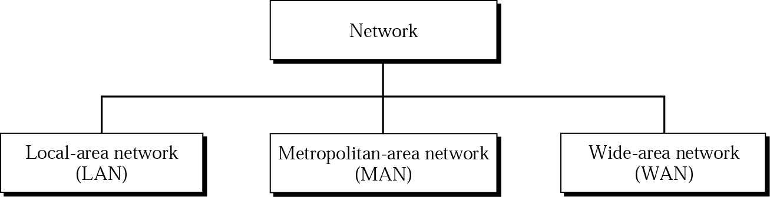
Categories of Networks

Slide 18
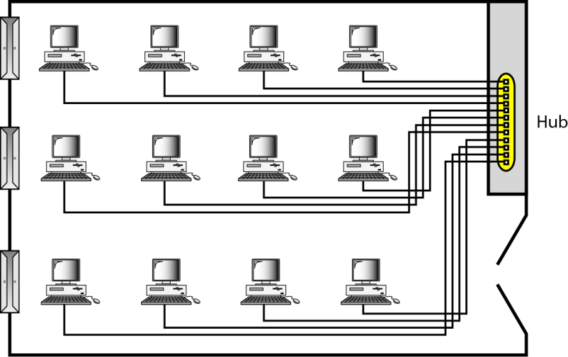
LAN
Usually privately owned
A network for a single office, building, or campus ≤ a few Km
Common LAN topologies: bus, ring, star
An isolated LAN connecting 12 computers to a hub in a closet

Slide 19
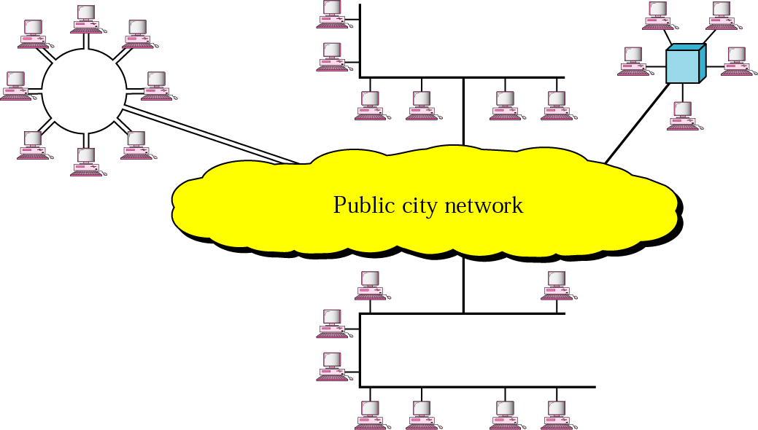
MAN
Designed to extend to an entire city
Cable TV network, a company’s connected LANs
Owned by a private or a public company

Slide 20
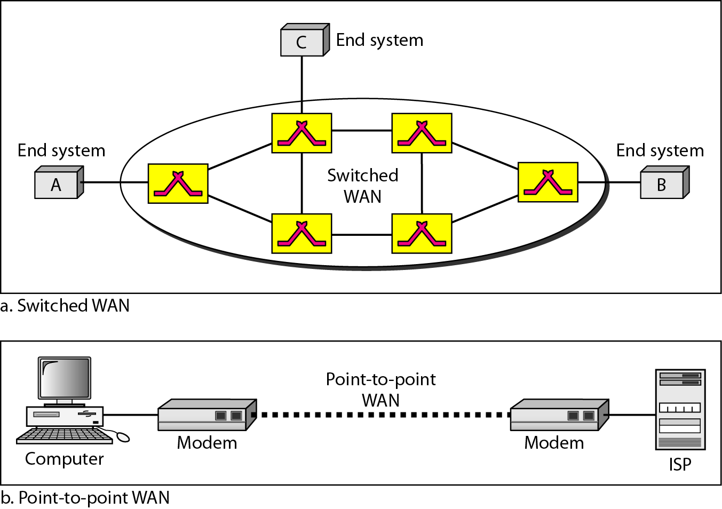
WAN
Long distance transmission, e.g., a country, a continent, the world
Enterprise network: A WAN that is owned and used by one company

Slide 21
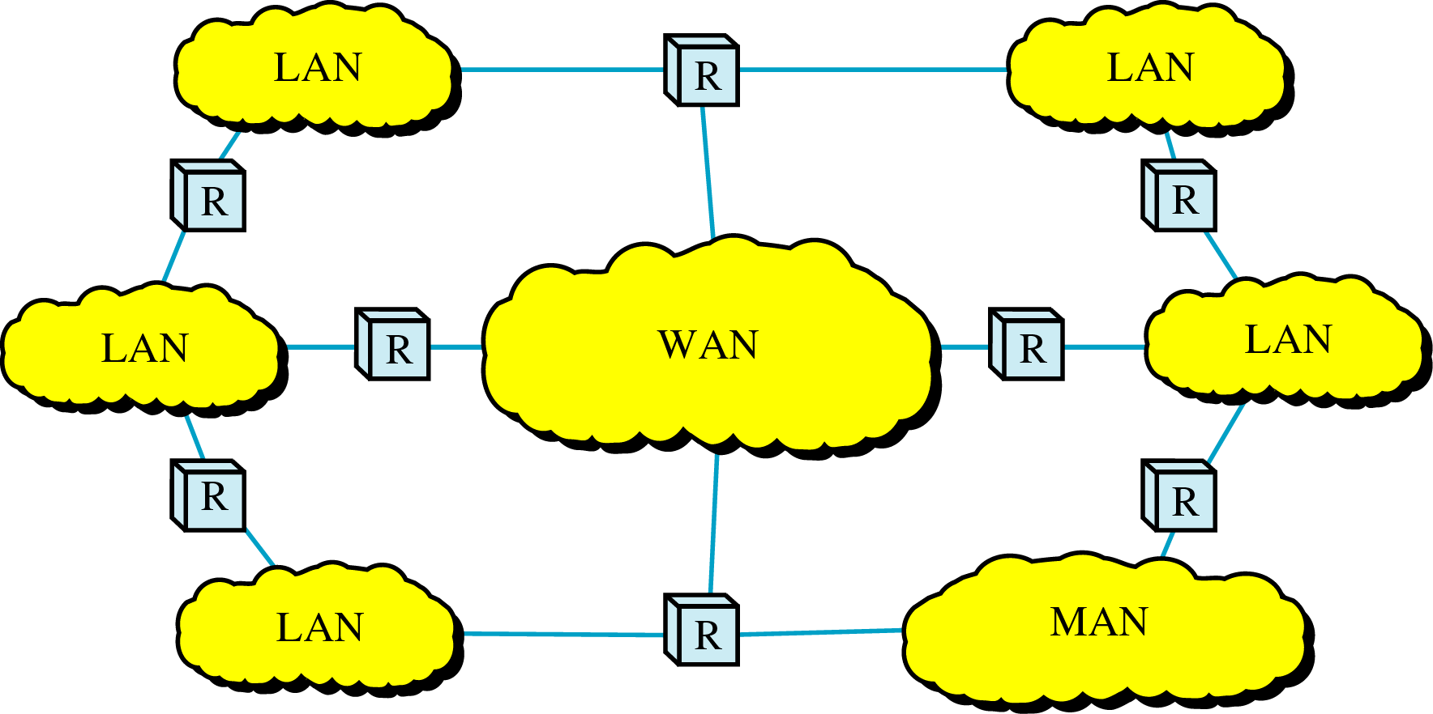
Internetwork
Internetwork (internet) : two or more networks are connected by internetworking devices
Internetworking devices: router, gateway, etc.
The Internet: a specific worldwide network

Slide 22
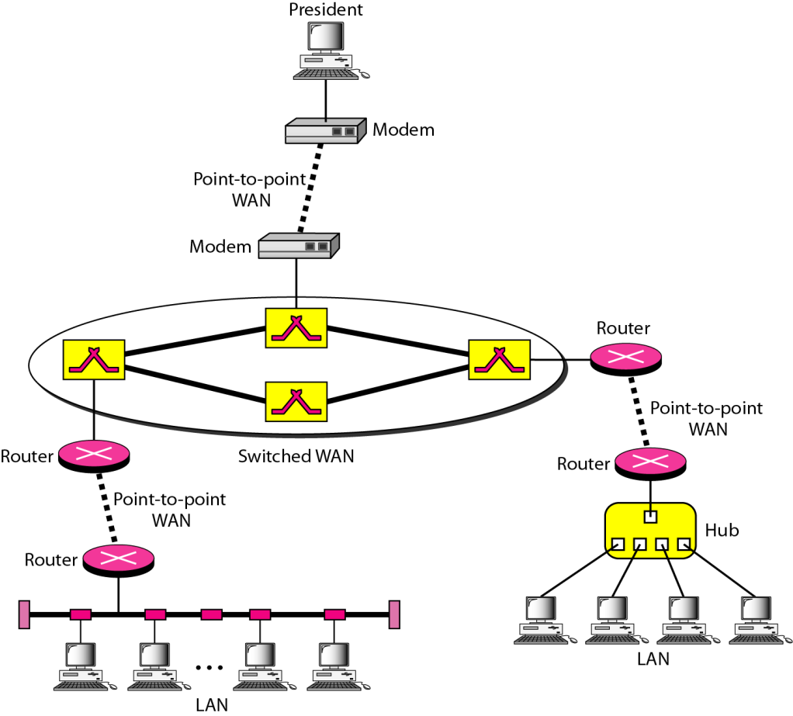
Internetwork Example
A heterogeneous network : four WANs and two LANs

Slide 23
The Internet
The Internet has revolutionized many aspects of our daily lives. It has affected the way we do business as well as the way we spend our leisure time. The Internet is a communication system that has brought a wealth of information to our fingertips and organized it for our use.
1967: ARPANET proposed by DoD’s ARPA(Advanced Research Project Agency)
1969: ARPANET in a reality: UCLA, UCSB, SRI, U. of Utah
1973: Vint Cerf and Bob Kahn propose TCP,
To split TCP into two protocols TCP and IP

Slide 24
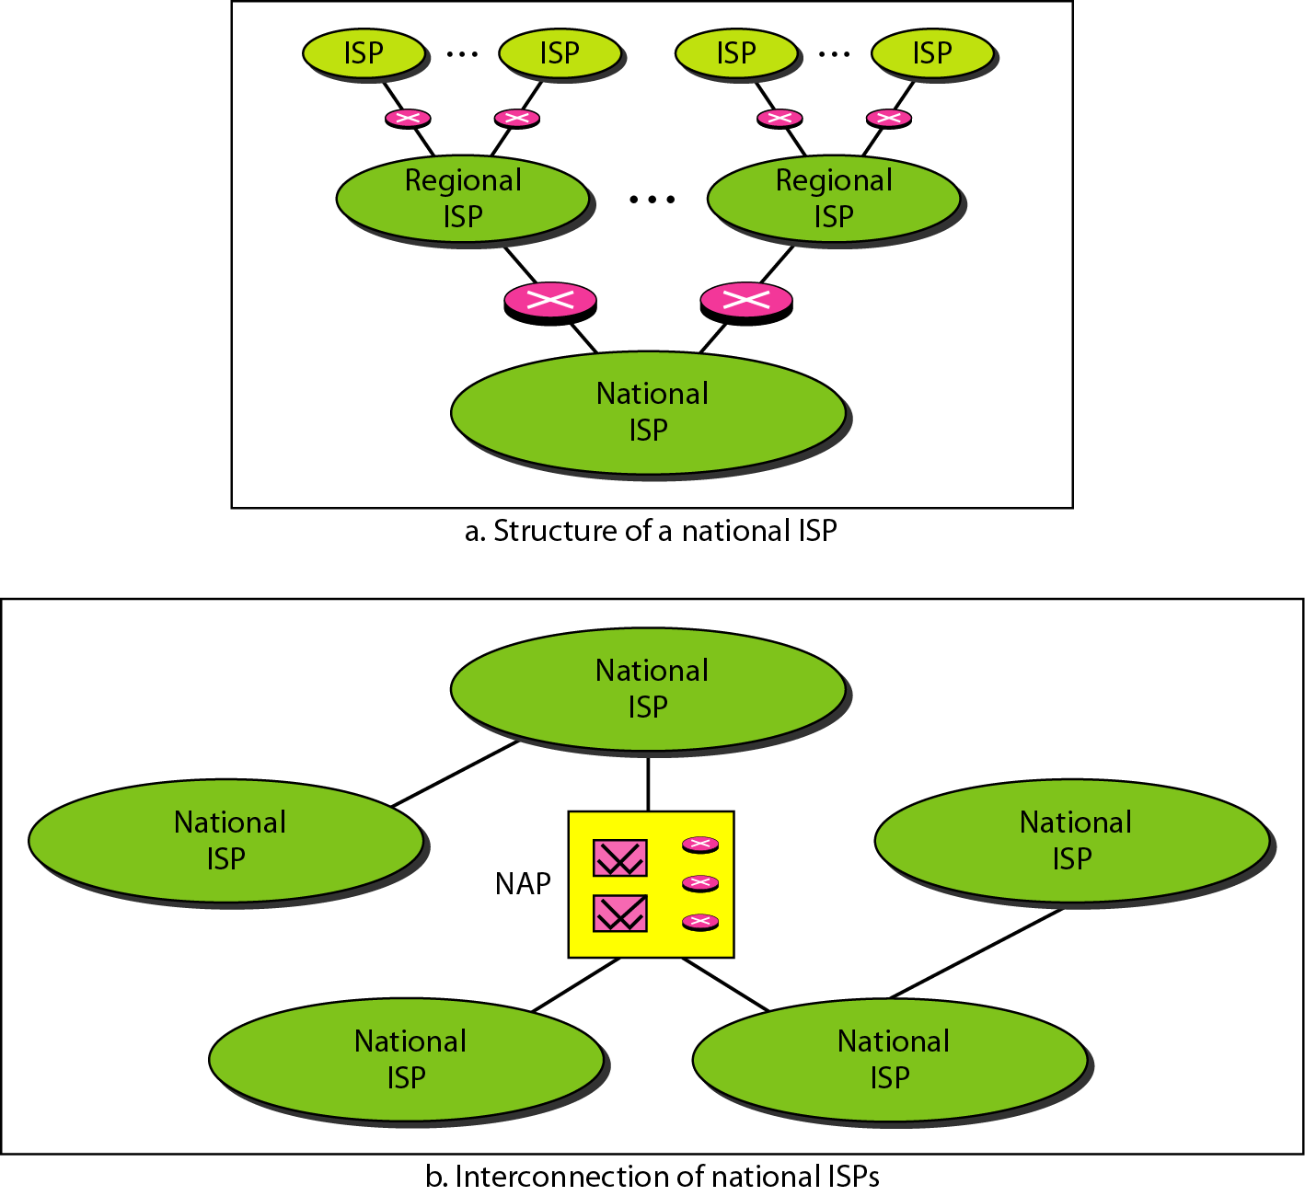
Internet Today
ISP (Internet service providers)
NISP (national ISP)
NAP (network access point)

Slide 25
Protocols
Protocol : rule
A set of rules that govern data communication
For communication to occur, entities must agree upon a protocol
Key elements of a protocol
Syntax: structure or format of data
Semantics: meaning of each section in the structure
Timing: when and how fast data should be sent

Slide 26
Standards: agreed-upon rules
Standards is essential in
Creating/maintaining open and competitive markets
Guaranteeing national/international interoperability
Two categories
De jure (“by law” or “by regulation’) standards
De facto (“by fact” or ‘by convention’) standards
Proprietary standards: closed standards
Nonproprietary standards: open standards

Slide 27
Standards Organizations
Standards are developed by
Standards creation committees
Forums
Regulatory agencies
Standards committees & forums
Standards committees are slow moving
Forums are made up of interested corporations
Forum are able to speed acceptance of a particular technology

Slide 28
Standards Committees
ISO
Voluntary international organization
ITU-T
Formerly, CCITT formed by UN
ANSI
Private non-profit corporation in the US
IEEE
The largest engineering society in the world
EIA
Non-profit organization in the US

Slide 29
Internet Standards
IETF (Internet Engineering Task Force)
Internet Draft
working document with no official status
with a 6-month lifetime
RFC (Request for Comment)
Edited, assigned a number, and made available to all interested parties

Slide 30
Home Works
Page 24
Problems – 15, 16, 17, 19
Page 25
Problems – 20, 22, 25, 26, 28, 29

