Slide 1
Chapter 2. Network Models
Layered Tasks
The OSI Model
Layers in the OSI Model
TCP/IP Protocol Suite
Addressing

Slide 2
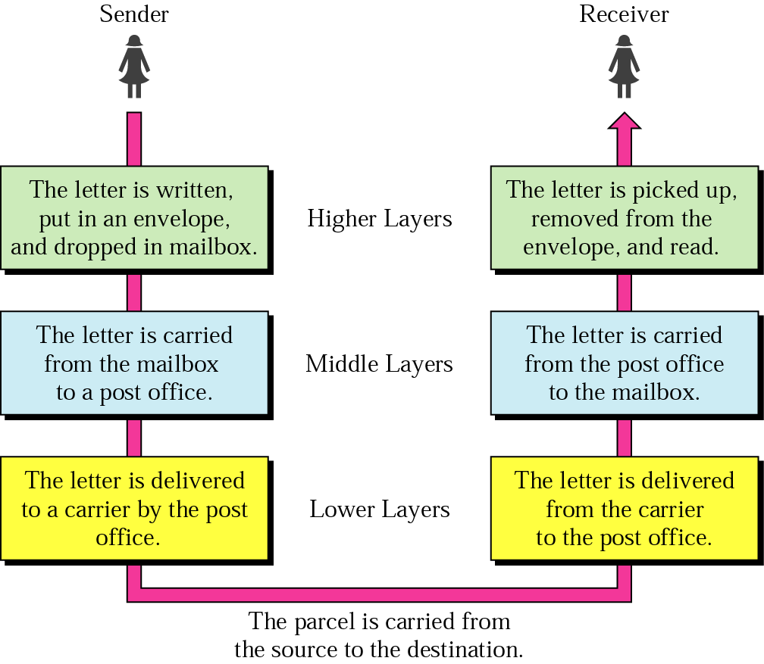
Layered Model: Sending a Letter

Slide 3
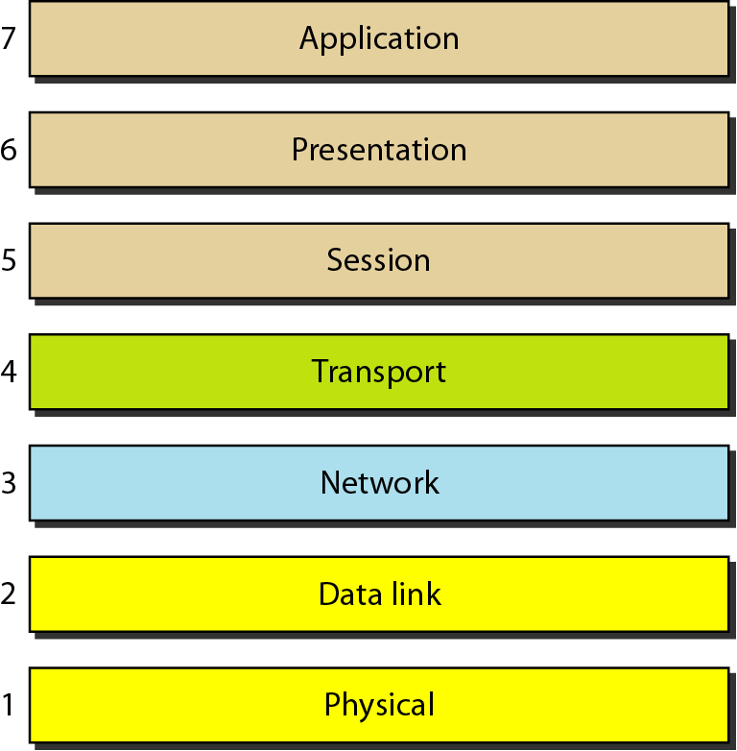
OSI Model
ISO is the organization. OSI is the model

Slide 4
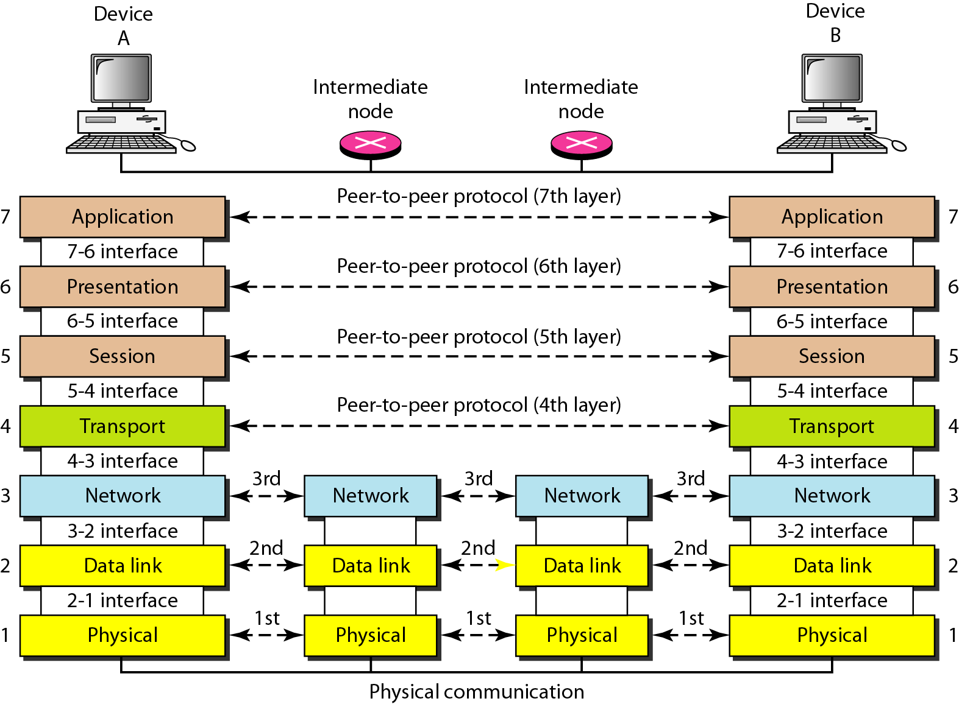
Interaction between layers in the OSI model
Layer and interface

Slide 5
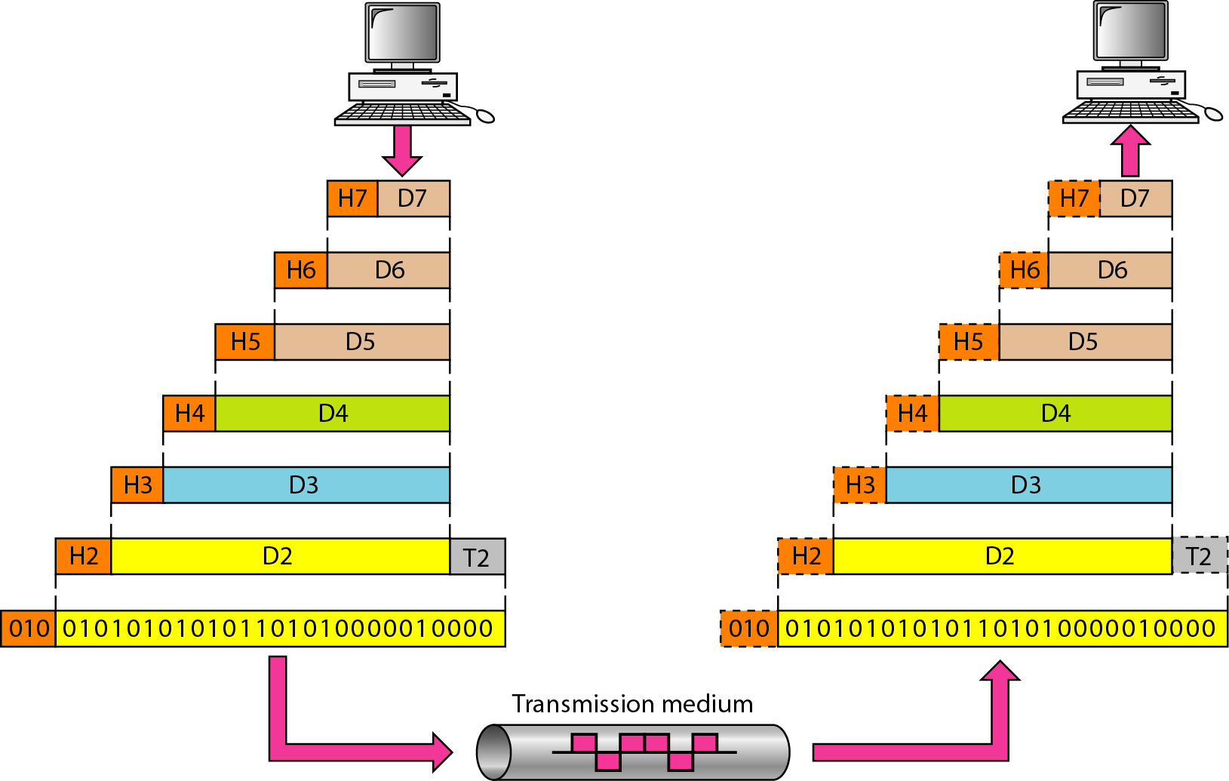
An exchange using the OSI model
Encapsulation with header and possibly trailer

Slide 6
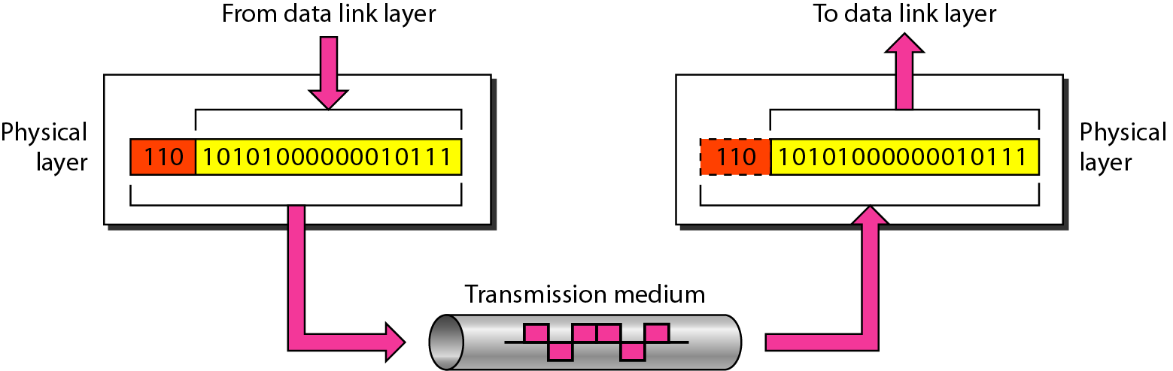
Physical Layer
The physical layer is responsible for movements of individual bits from one hop (node) to the next
Mechanical and electrical specification, the procedures and functions

Slide 7
Physical Layer: Duties
Physical characteristics of interfaces and media
Representation of bits
Encoded into signals – electrical or optical
Data rate
Synchronization of bits
Line configuration
Physical topology
Transmission mode

Slide 8
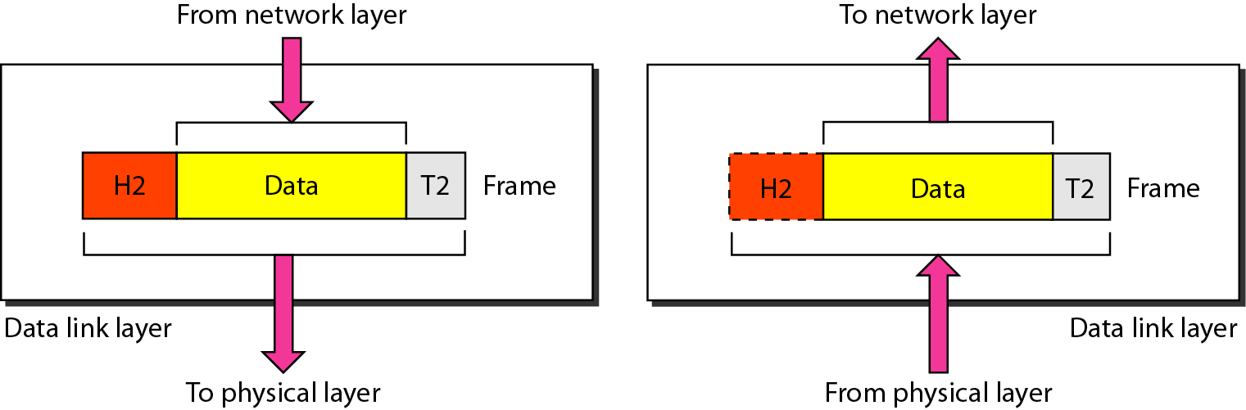
Data Link Layer
The data link layer is responsible for moving frames from one hop (node) to the next
Transform the physical layer to a reliable (error-free) link

Slide 9
Data Link Layer: Duties
Framing
Physical addressing
Flow control
Error control
Access control

Slide 10
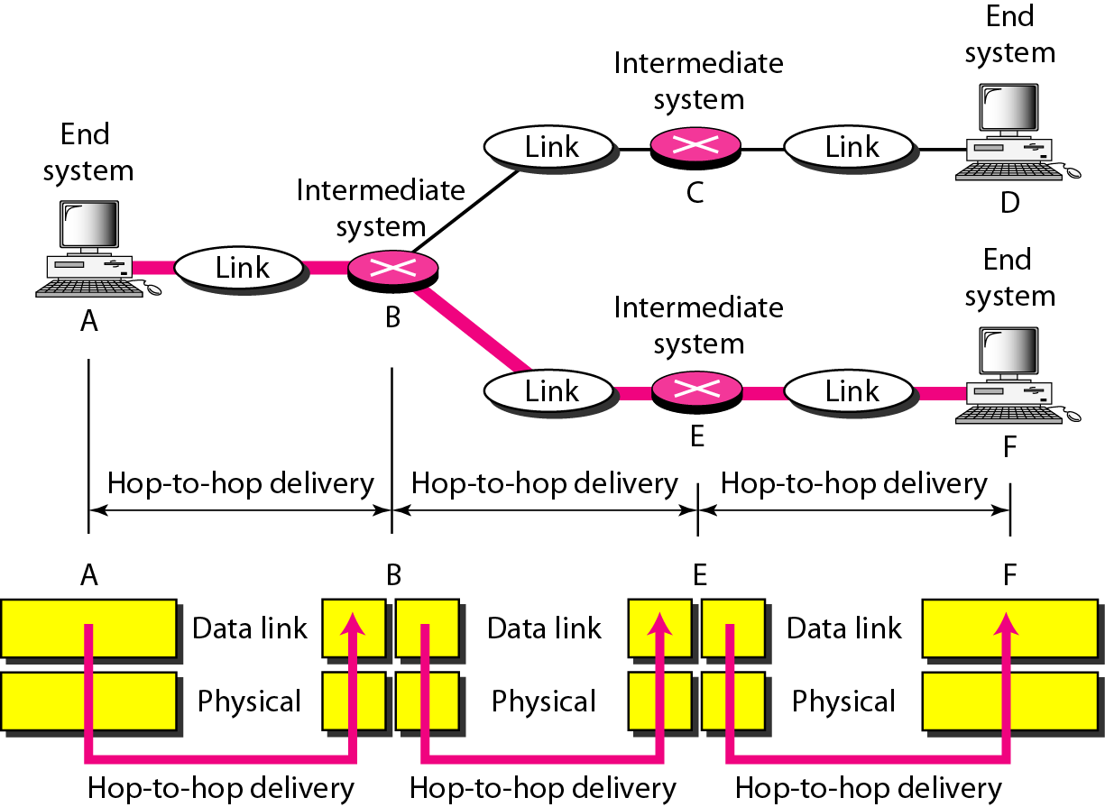
Hop-to-Hop Delivery

Slide 11
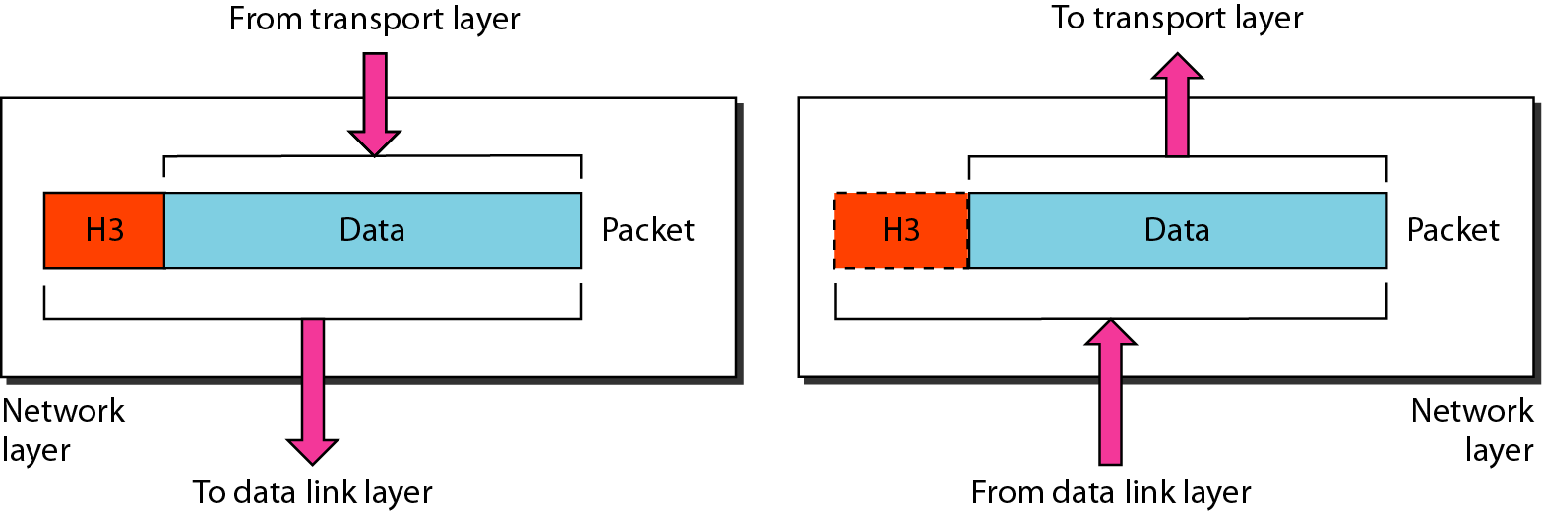
Network Layer
The network layer is responsible for the delivery of packets from the source host to the destination host

Slide 12
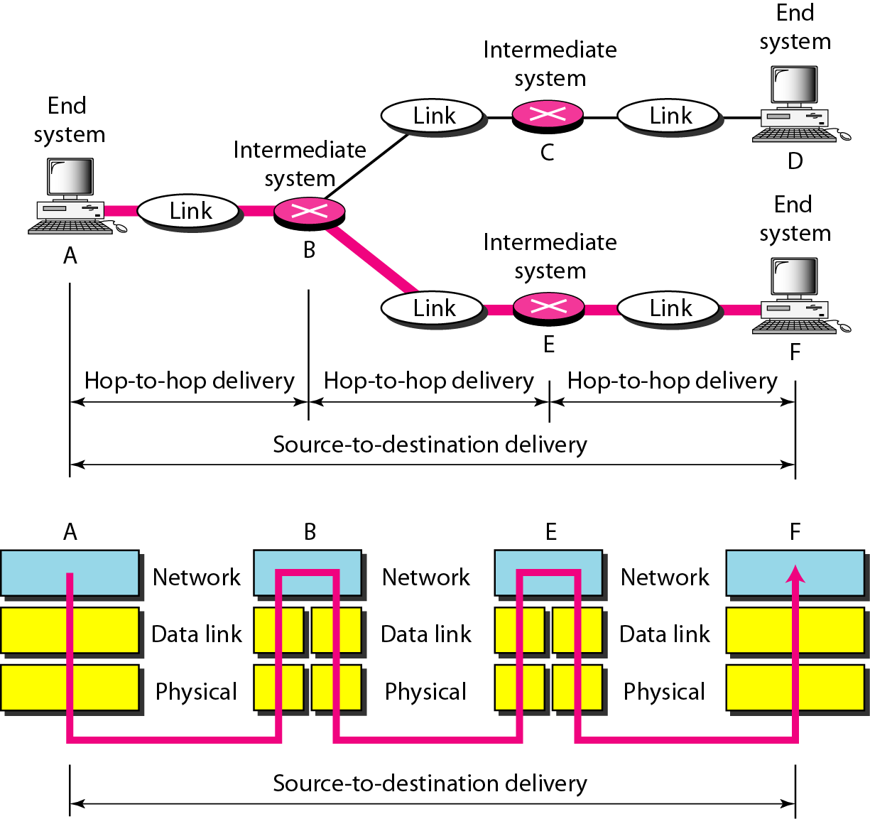
Network Layer: Duties
Logical addressing and routing

Slide 13
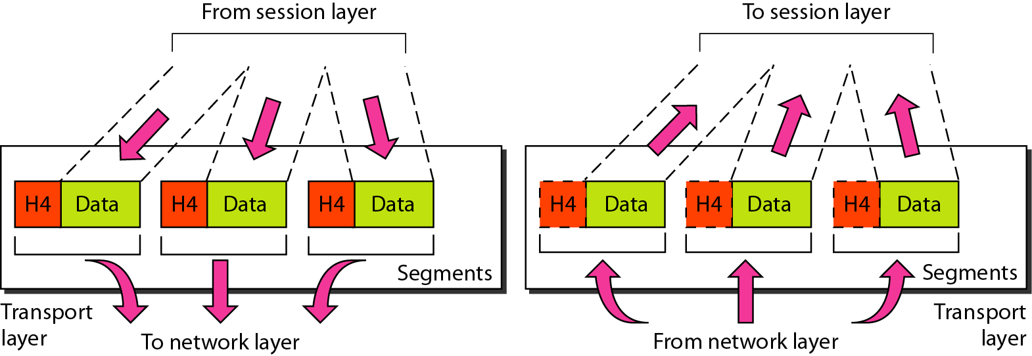
Transport Layer
The transport layer is responsible for delivery of a message from one process to another

Slide 14
Transport Layer: Duties
Service-point (port) addressing
Segmentation and reassembly
Connection control
Flow control
Error control

Slide 15
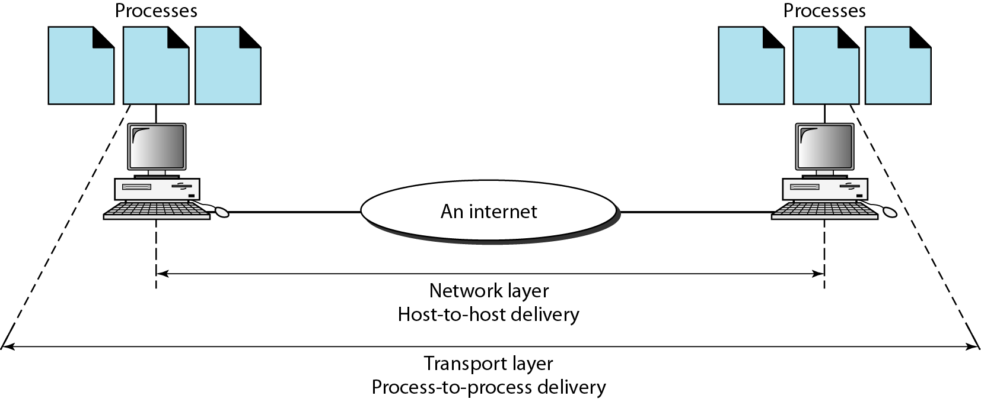
Reliable Process-to-Process Delivery of a Message

Slide 16
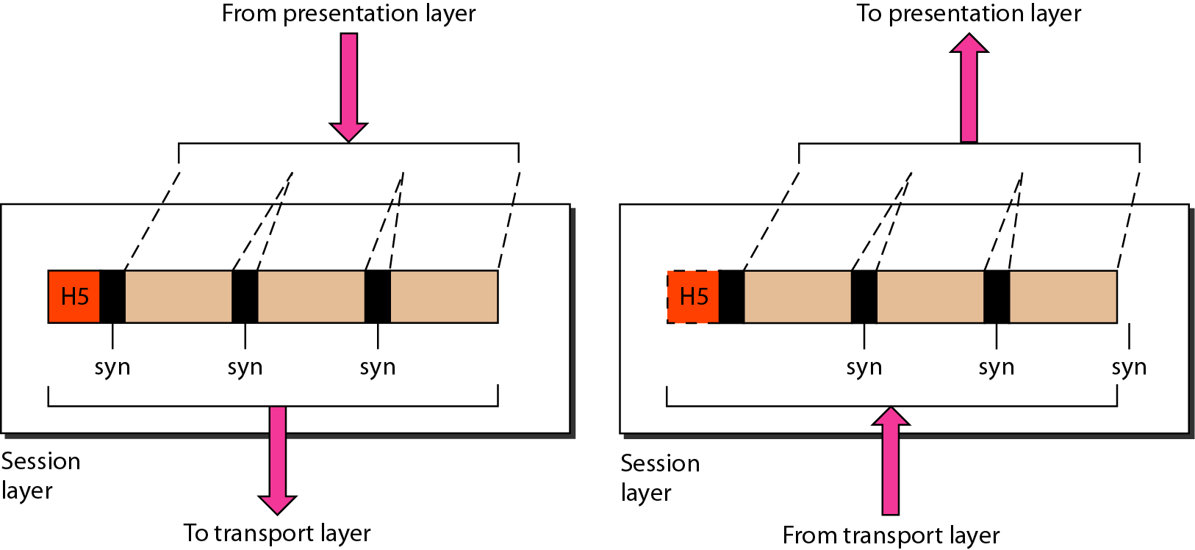
Session Layer
Session layer is responsible for dialog control and synchronization

Slide 17
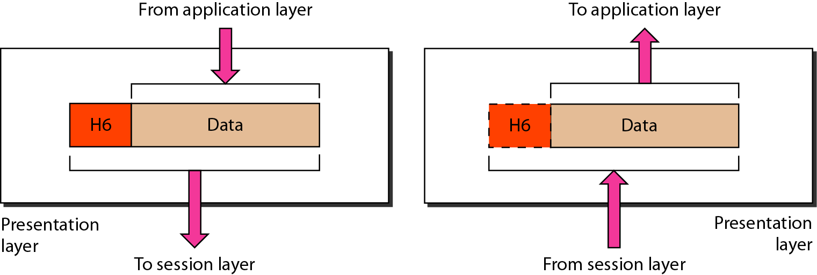
Presentation Layer
Presentation layer is responsible for translation, compression, and encryption

Slide 18
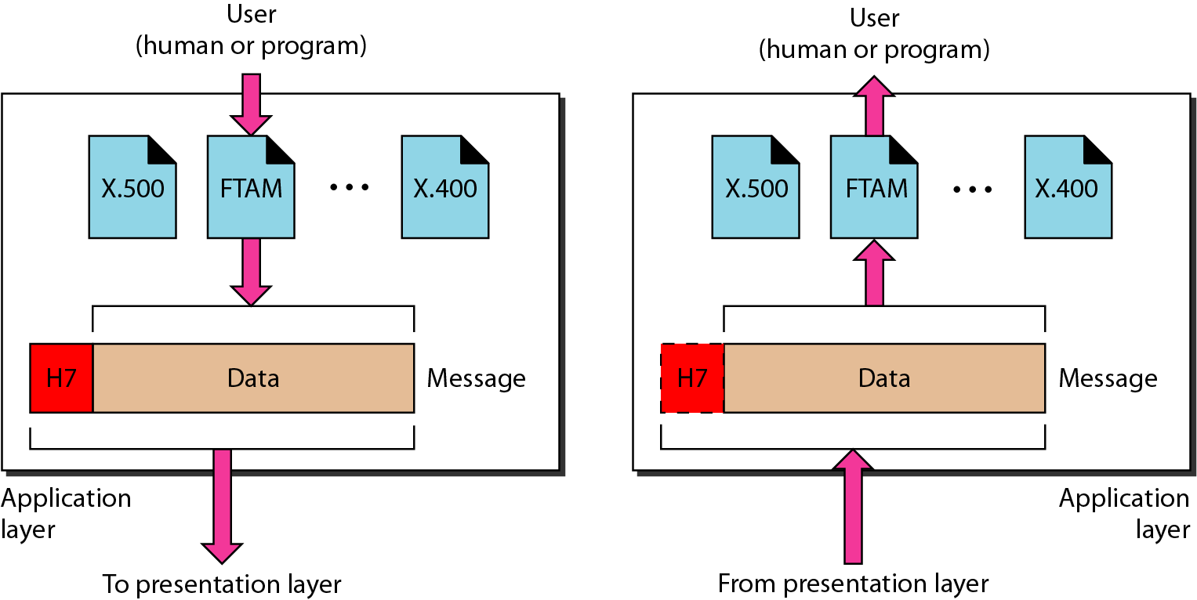
Application Layer
Application layer is responsible for providing services to the user

Slide 19
Application Layer: Services
Network virtual terminal
Mail services
File transfer, access, and management
Directory services

Slide 20
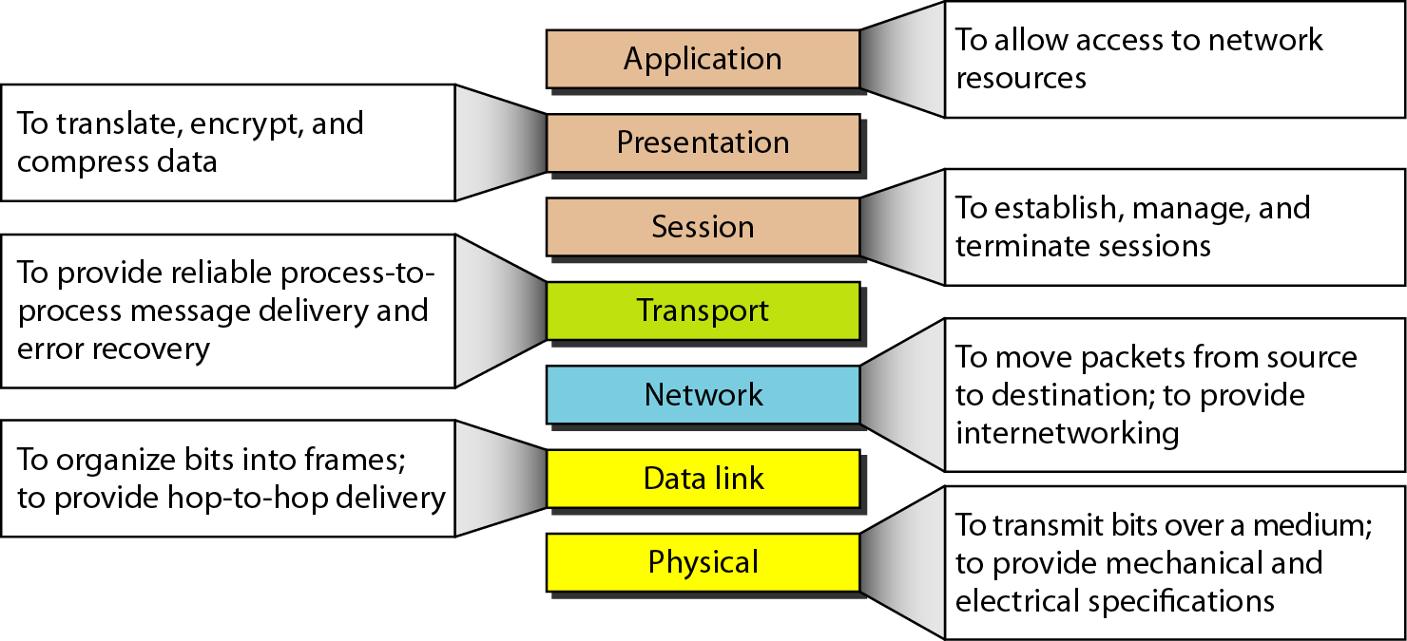
Summary of Layers

Slide 21
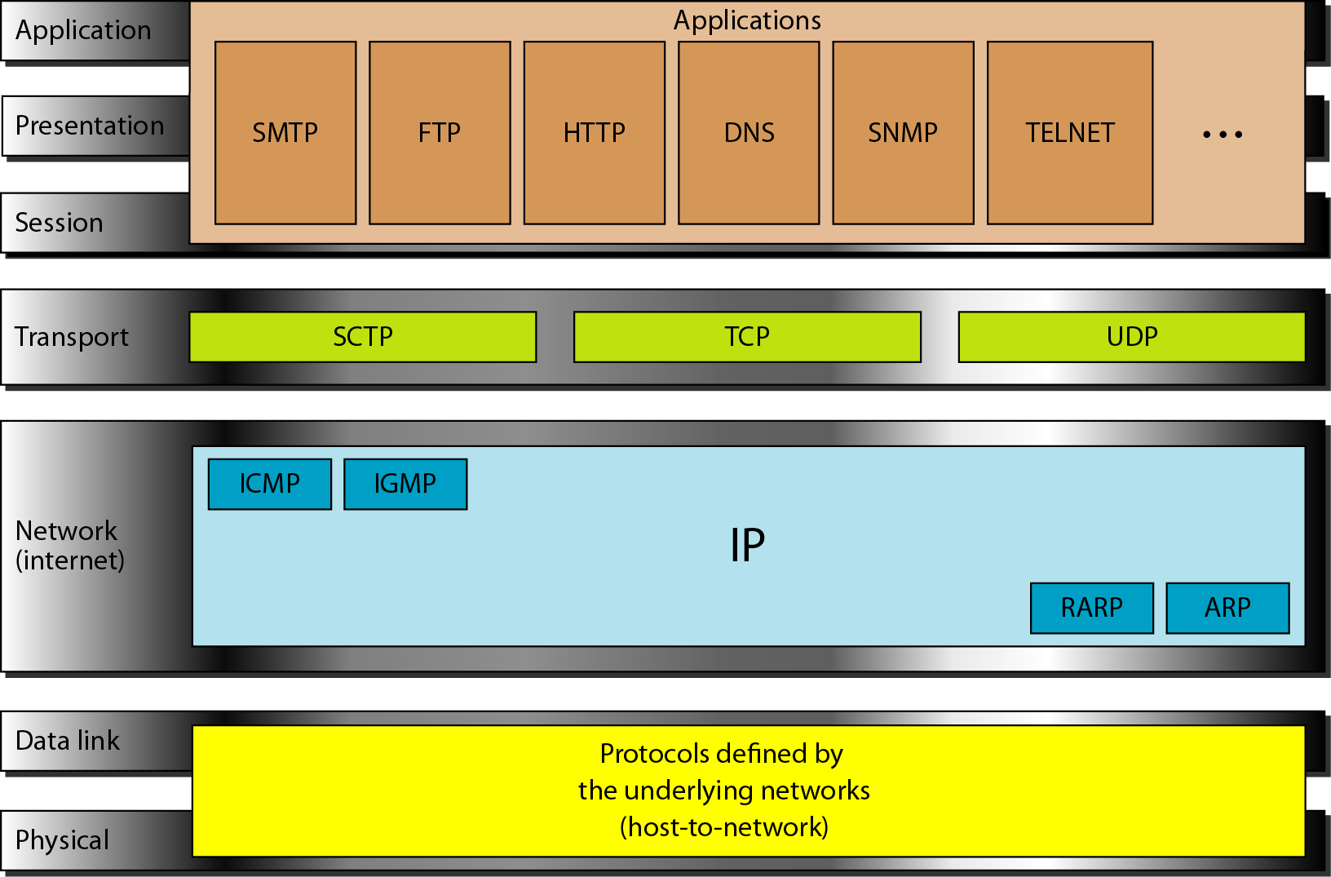
TCP/IP and OSI Model

Slide 22
TCP/IP Protocol Suite
Host-to-network : Physical and data link layer
No specific protocol
Network layer
IP(Internet Protocl), ARP(Address Resolution Protocol), RARP(Reverse ARP), ICMP(Internet Control Message Protocol), IGMP(Internet Group Message Protocol)
Transport layer
TCP(Transmission Control Protocol), UDP(User Datagram Protocl), SCTP(Stream Control Transmission Protocol),
Application Layer
Combined session, presentation, and application layers

Slide 23
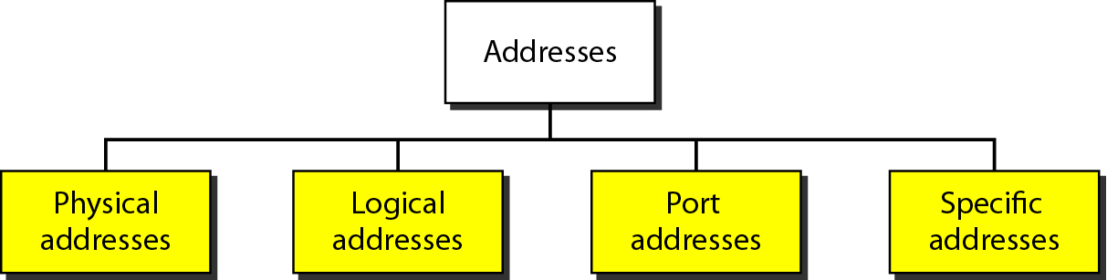
Addressing
Four levels of addresses in TCP/IP protocols
Physical (link), logical (IP, network), port, and specific addresses

Slide 24
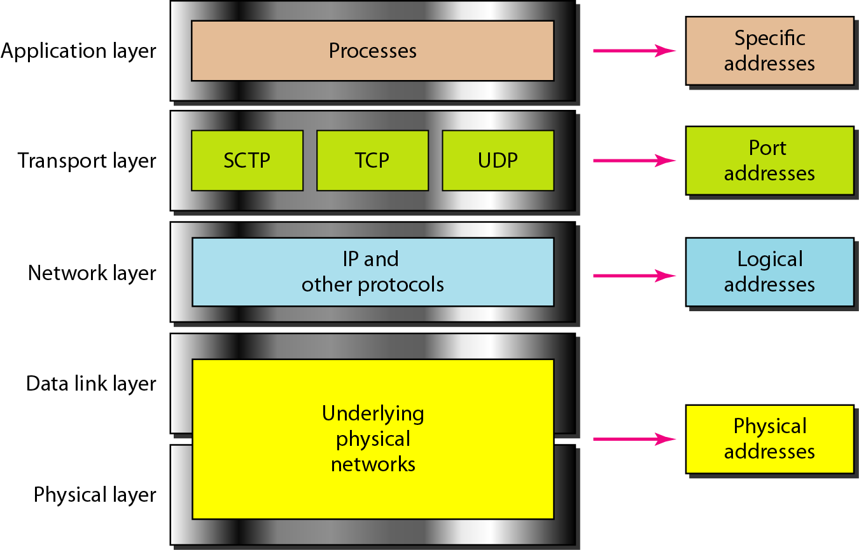
Relationship of Layers and Addresses

Slide 25
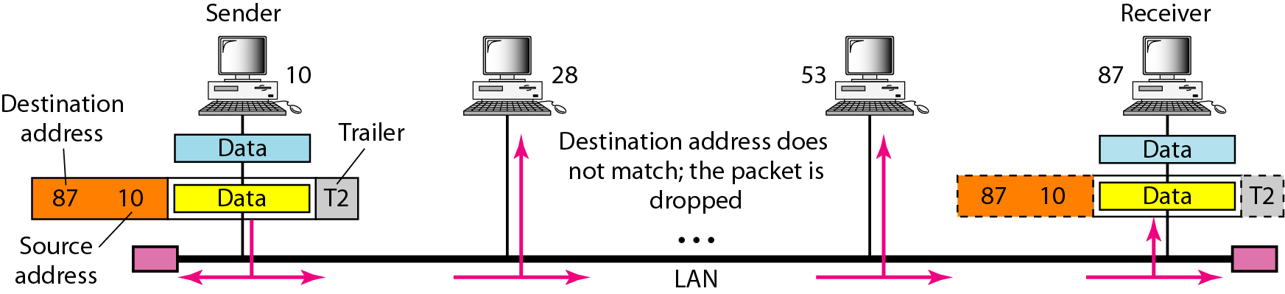
Physical Address
A node with physical address 10 sends a frame to a node with physical address 87. The two nodes are connected by a link (bus topology LAN). As the figure shows, the computer with physical address 10 is the sender, and the computer with physical address 87 is the receiver.
07:01:02:01:2C:4B A 6-byte (12 hexadecimal digits) physical address.

Slide 26
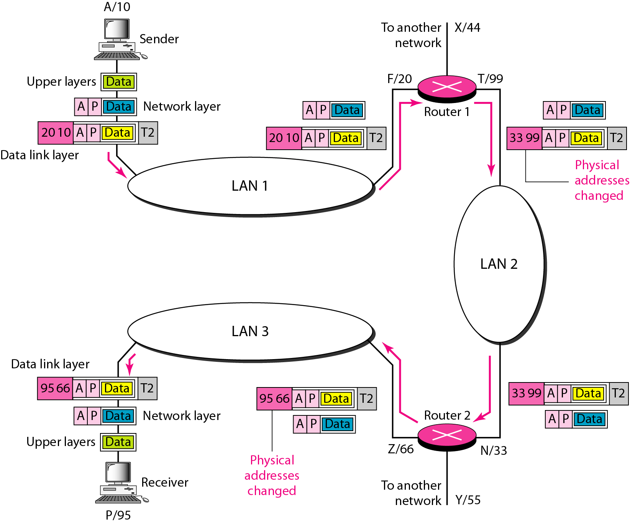
Logical (IP) Address
The physical addresses will change from hop to hop, but the logical addresses usually remain the same

Slide 27
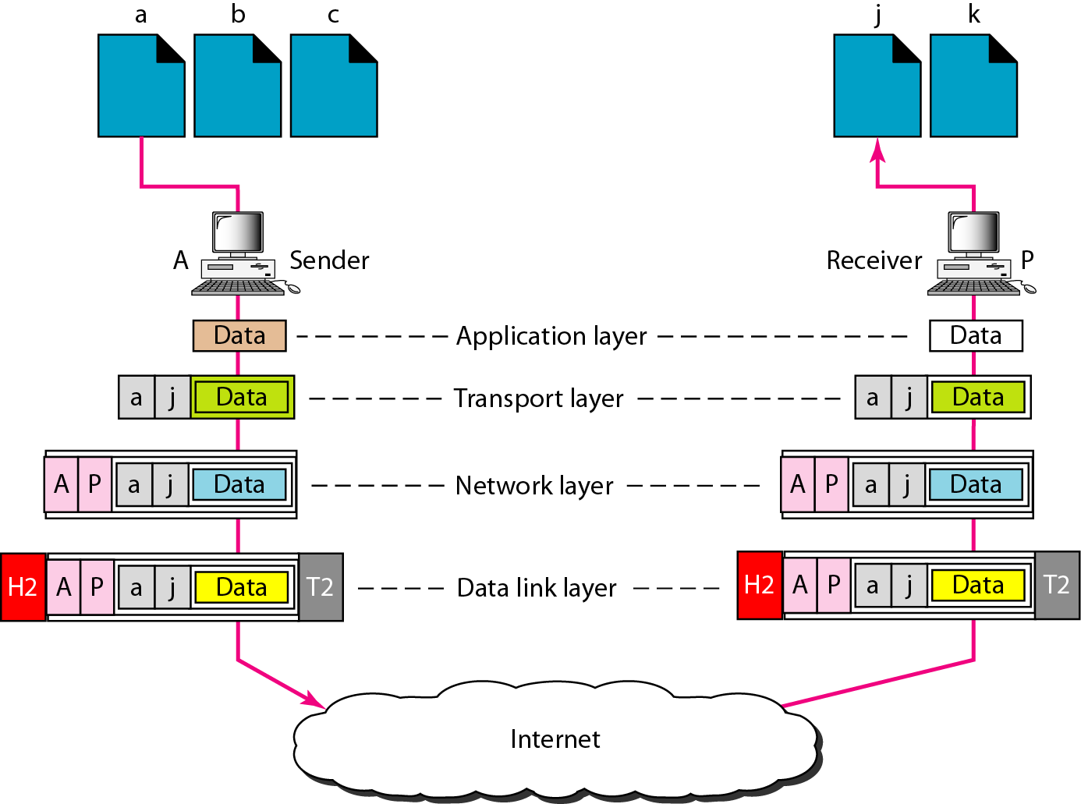
Port Address
The physical addresses change from hop to hop, but the logical and port addresses usually remain the same

Slide 28
Specific Address
Some application have user-friendly addresses that are designed for that specific address
Example 1: e-mail address: nayeema.cse@diu.edu.bd
Defines the recipient of an e-mail
Example 2: URL (Universal Resource Locator) : www.cse.univdhaka.edu
Used to find a document on the WWW

Slide 29
Home Works
Page 53
Problems: 16 - 19
Page 54
Problems: 20, 21, 23, 24, 25, 26, 27, 28

