Slide 1
Chapter 5. Analog Transmission
Digital-to-Analog Conversion
Analog-to-Analog Conversion

Slide 2
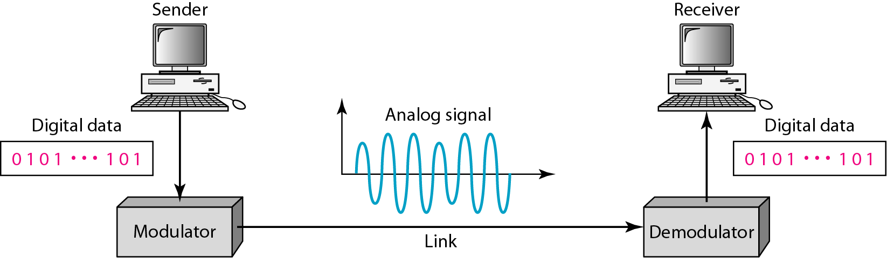
Digital-to-Analog Conversion
3-2
Digital-to-analog conversion is the process of changing one of the characteristics of an analog signal based on the information in digital data

Slide 3
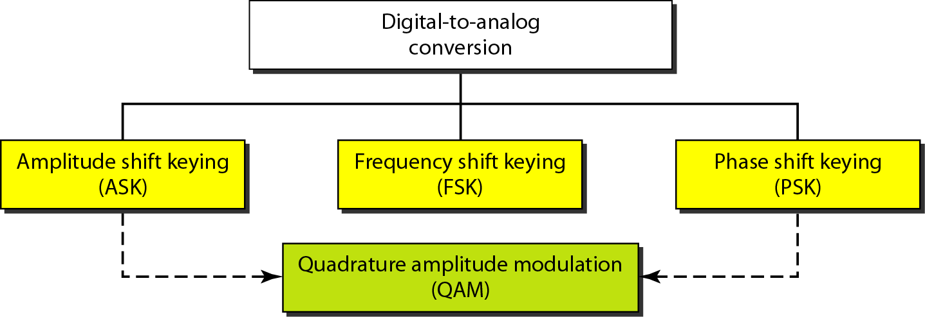
Types of Digital-to-Analog Modulation
3-3

Slide 4
Aspects of D/A Conversion
3-4
Data element versus signal element
Data rate (bit rate) versus signal rate (baud rate)
S = N x 1/r baud
S (signal rate), N (data rate),
r (number of data element in one signal element)
Bit rate: bits per second (in bps)
Baud rate: signal elements per second (in baud)
Bit rate ≥ baud rate
Carrier signal (carrier frequency)
High-frequency signal used to modulate the information
Modulated signal: information modulated by the carrier signal

Slide 5
Examples 5.2
3-5
An analog signal has a bit rate of 8000 bps and a baud rate of 1000 baud. How many data elements are carried by each signal element? How many signal elements do we need?
Solution
S = 1000, N = 8000, and r and L are unknown. We find first the value of r and then the value of L.

Slide 6
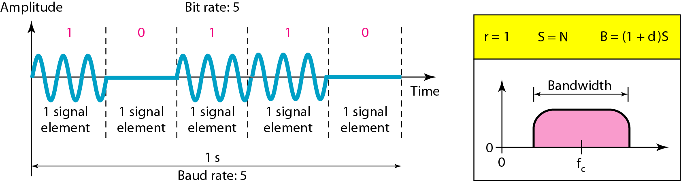
ASK : Binary ASK
3-6
BASK or OOK (on-off keying)
Bandwidth for ASK: B = (1 + d) x S

Slide 7
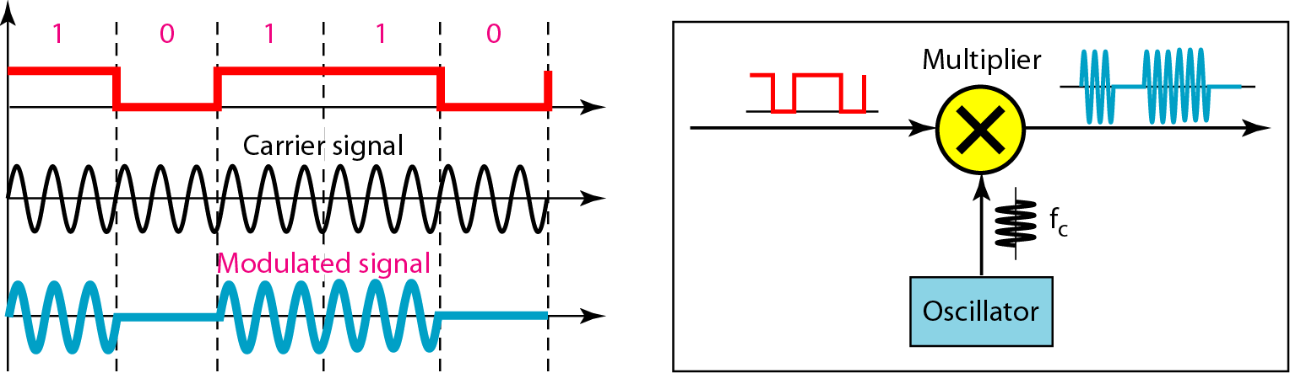
Implementation of Binary ASK
3-7

Slide 8
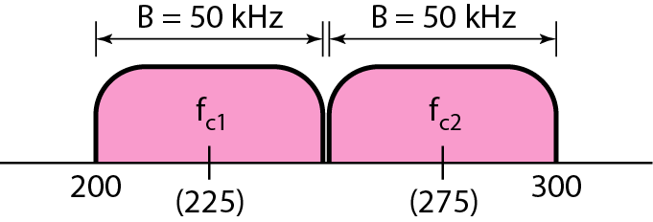
Full-duplex ASK: Example
3-8
In data communications, we normally use full-duplex links with communication in both directions. We need to divide the bandwidth into two with two carrier frequencies. In this example, the available bandwidth for each direction is now 50 kHz, which leaves us with a data rate of 25 kbps in each direction.

Slide 9
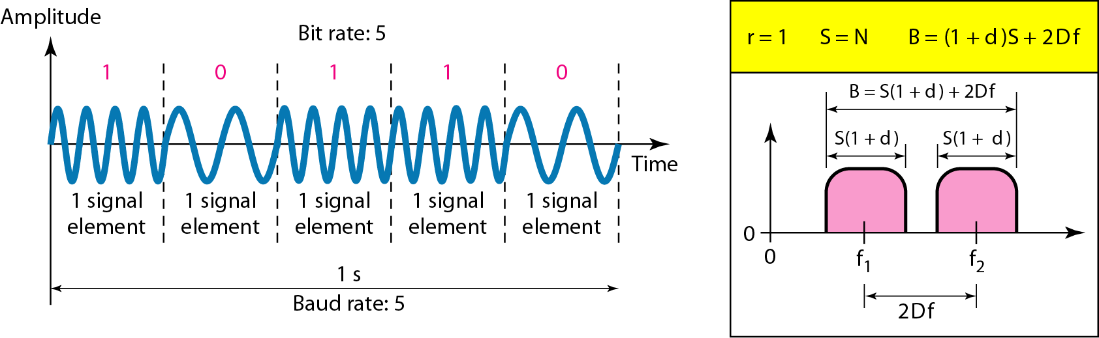
FSK: Binary FSK
3-9
Bandwidth for ASK: B = (1 + d) x S + 2Δf

Slide 10
BFSK: Example
3-10
We have an available bandwidth of 100 kHz which spans from 200 to 300 kHz. What should be the carrier frequency and the bit rate if we modulated our data by using FSK with d = 1?
The midpoint of the band is at 250 kHz. We choose 2Δf to be 50 kHz; this means

Slide 11
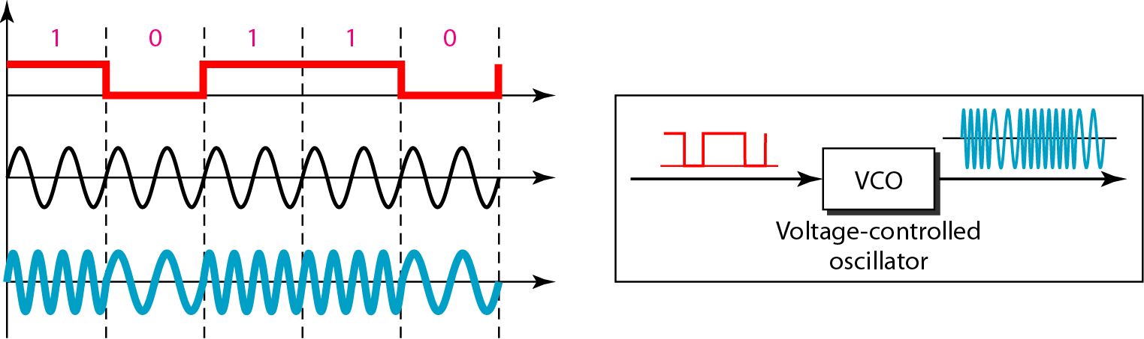
Implementation of Binary FSK
3-11

Slide 12
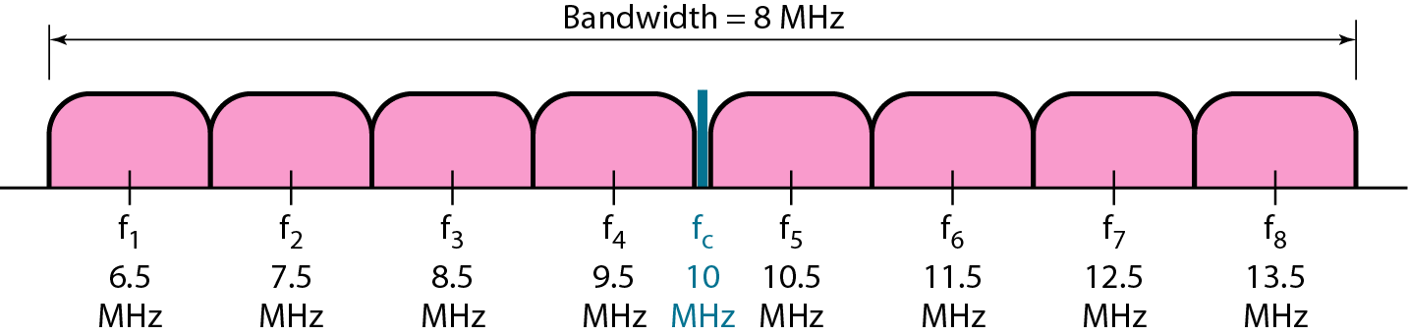
Multilevel FSK
3-12
The frequencies need to be 2Δf apart. Min. value 2Δf needs to be S.
B = (1 + d) x S + (L – 1) 2Δf → B = L x S with d = 0
Example: We need to send data 3 bits at a time at a bit rate of 3 Mbps. The carrier frequency is 10 MHz. Calculate the number of levels (different frequencies), the baud rate, and the bandwidth
L = 2³ = 8. The baud rate is S = 3 MHz/3 = 1000 Mbaud. This means that the carrier frequencies must be 1 MHz apart (2Δf = 1 MHz). The bandwidth is B = 8 × 1000 = 8000.

Slide 13
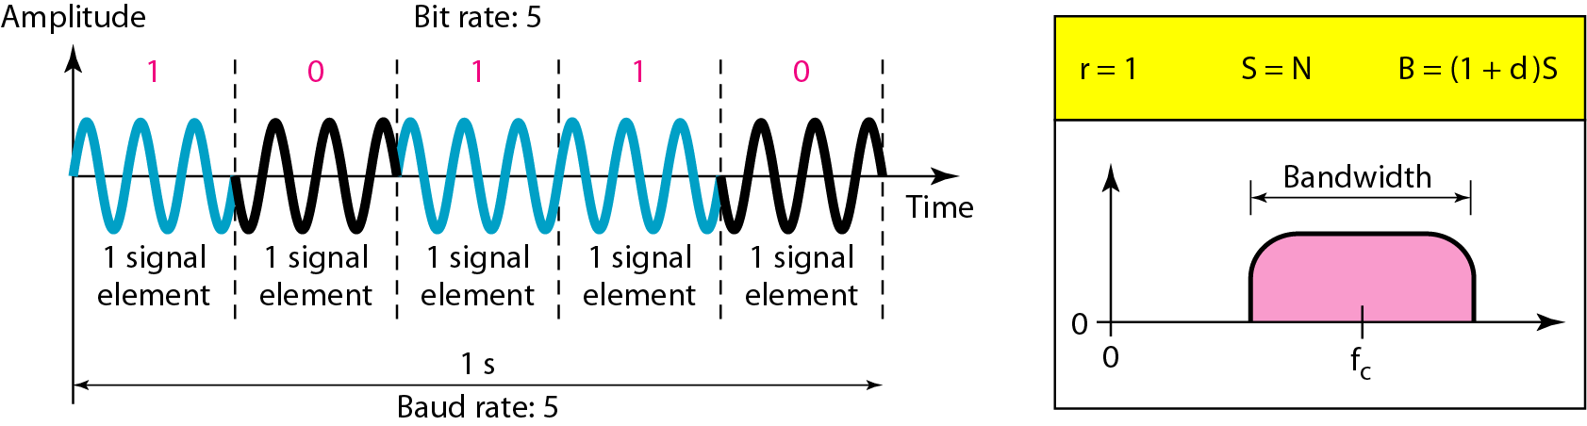
PSK: Binary PSK
3-13
Bandwidth : the same as BASK, B = (1 + d) x S
Less than that for BFSK

Slide 14
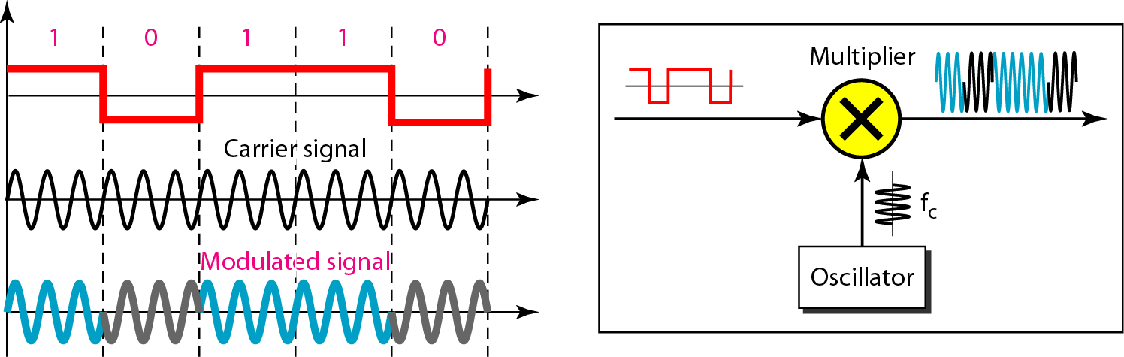
Implementation of Binary PSK
3-14

Slide 15
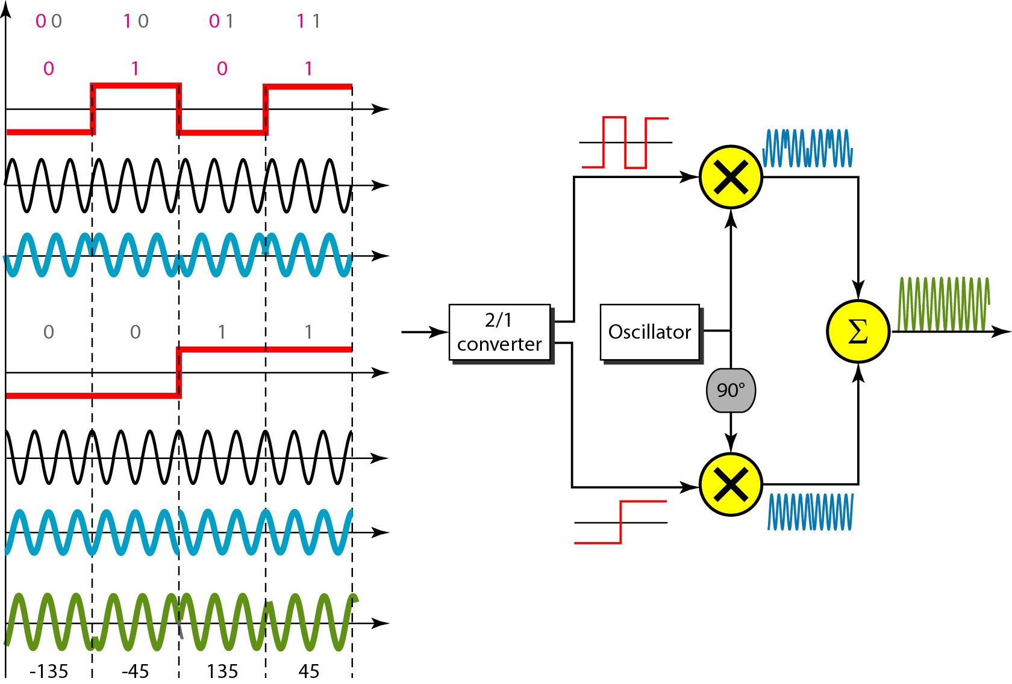
Quadrature PSK
3-15

Slide 16
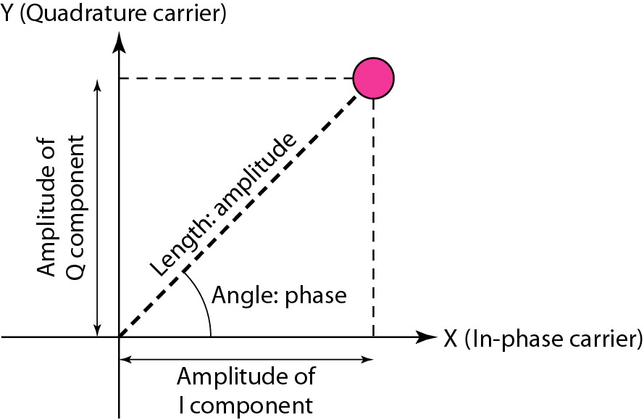
Constellation Diagram
3-16
Define the amplitude and phase of a signal element

Slide 17
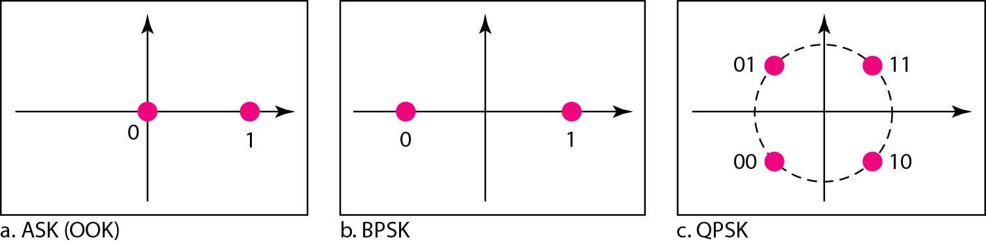
Constellation Diagram: Examples
3-17

Slide 18
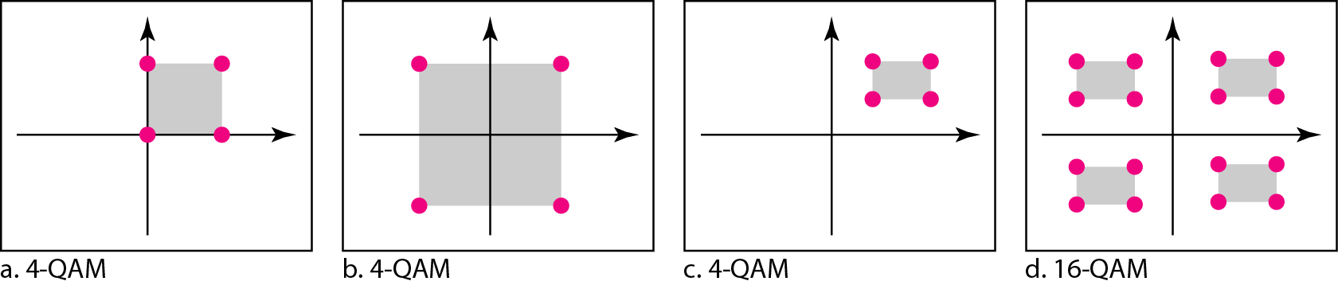
QAM
3-18
Quadrature amplitude modulation
Combination of ASK and PSK
Bandwidth : the same as that required for ASK and PSK

Slide 19
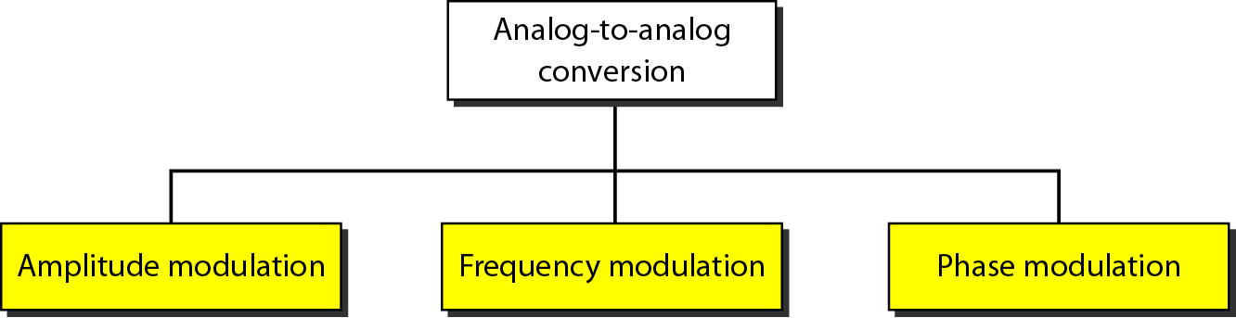
Analog-to-Analog Modulation
3-19
Analog-to-analog conversion is the representation of analog information by an analog signal
Modulation is needed if the medium is bandpass in nature or if only a bandpass channel is available to us

Slide 20
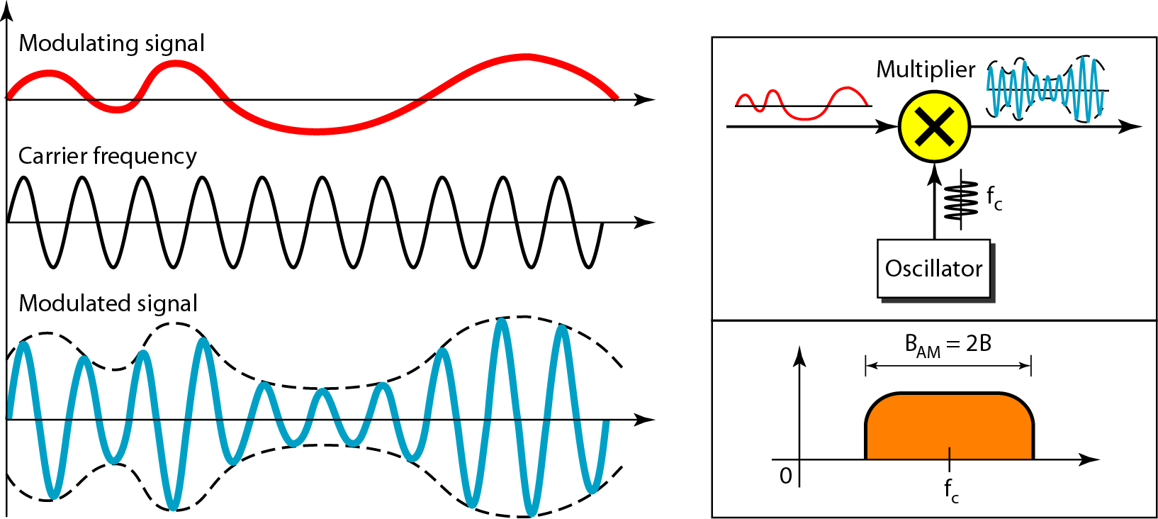
Amplitude Modulation
3-20
The total bandwidth required for AM can be determined from the bandwidth of the audio signal: B_{AM} = 2B.

Slide 21
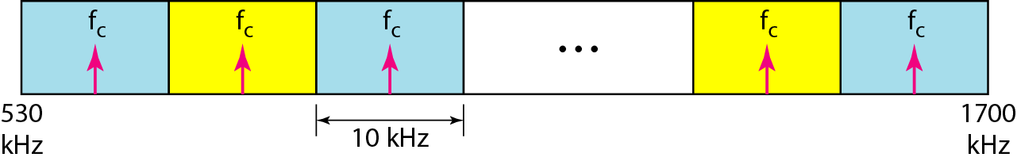
AM Band Allocation
3-21
Bandwidth of an audio signal (speech and music) is usually 5 kHz

Slide 22
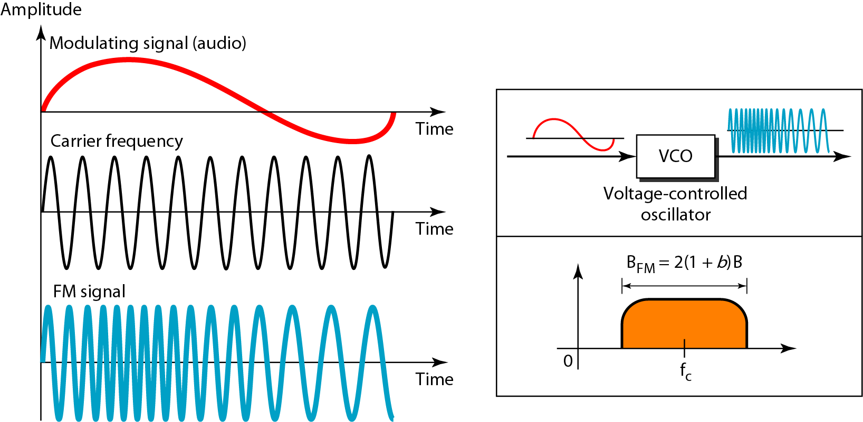
Frequency Modulation
3-22
The total bandwidth required for FM can be determined from the bandwidth of the audio signal: B_{FM} = 2(1 + β)B.

Slide 23
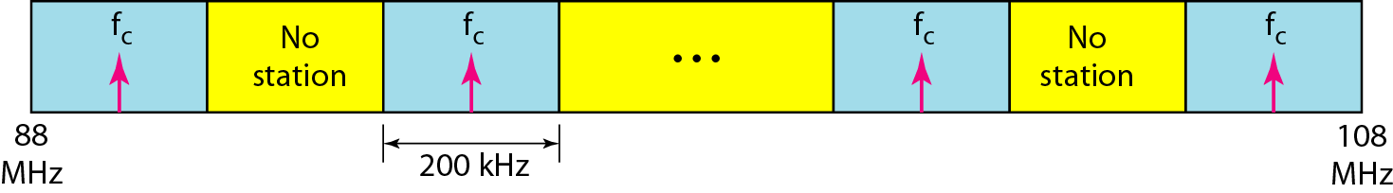
FM Band Allocation
3-23
Bandwidth of an audio signal (speech and music) broadcast in stereo is almost 15 kH
FCC allows 200 kHz for each station (β =4 with some extra guard band)
Separated by at least 200 kHz

Slide 24
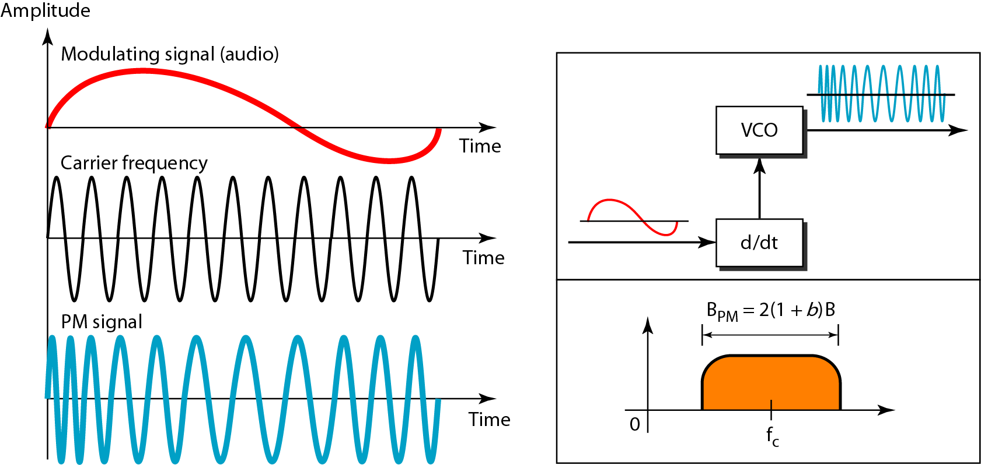
Phase Modulation
3-24
The total bandwidth required for PM can be determined from the bandwidth and maximum amplitude of the modulating signal: B_{PM} = 2(1 + β)B.

