Slide 1
Chapter 8 Switching
Circuit-Switched Networks
Datagram Networks
Virtual-Circuit Networks
Structure of a Switch

Slide 2
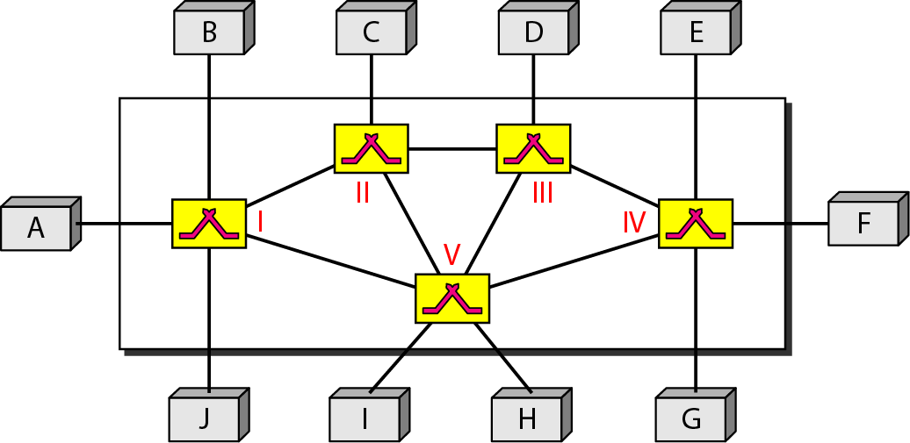
Switching
8-2
Switches are devices capable of creating temporary connections between two or more devices linked to the switch

Slide 3
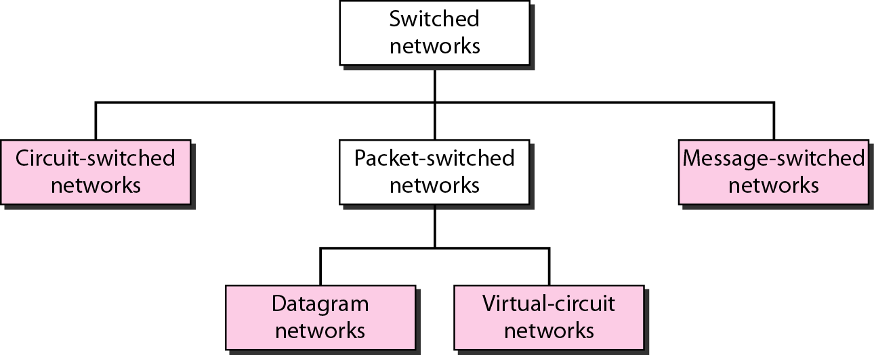
Taxonomy of Switched Networks
8-3

Slide 4
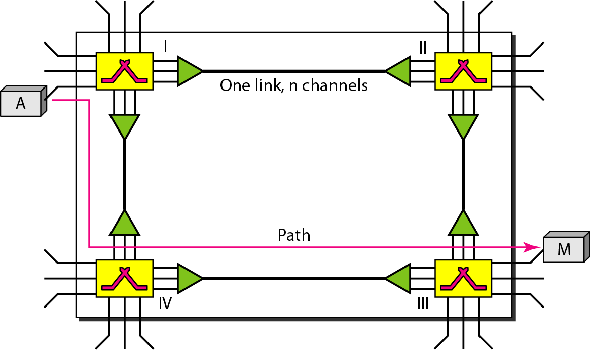
Circuit-switched Network
8-4
A circuit-switched network is made of a set of switches connected by physical links, in which each link is divided into n channels
In circuit switching, the resources need to be reserved during the setup phase; the resources remain dedicated for the entire duration of data transfer until the teardown phase.

Slide 5
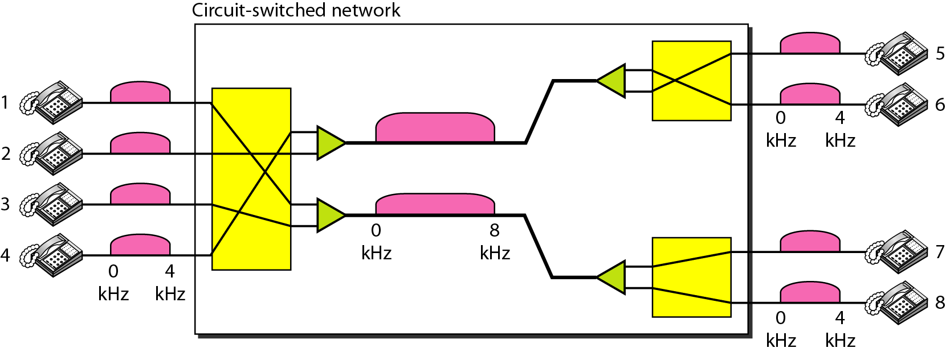
Circuit-Switched Network: Example 1
8-5

Slide 6
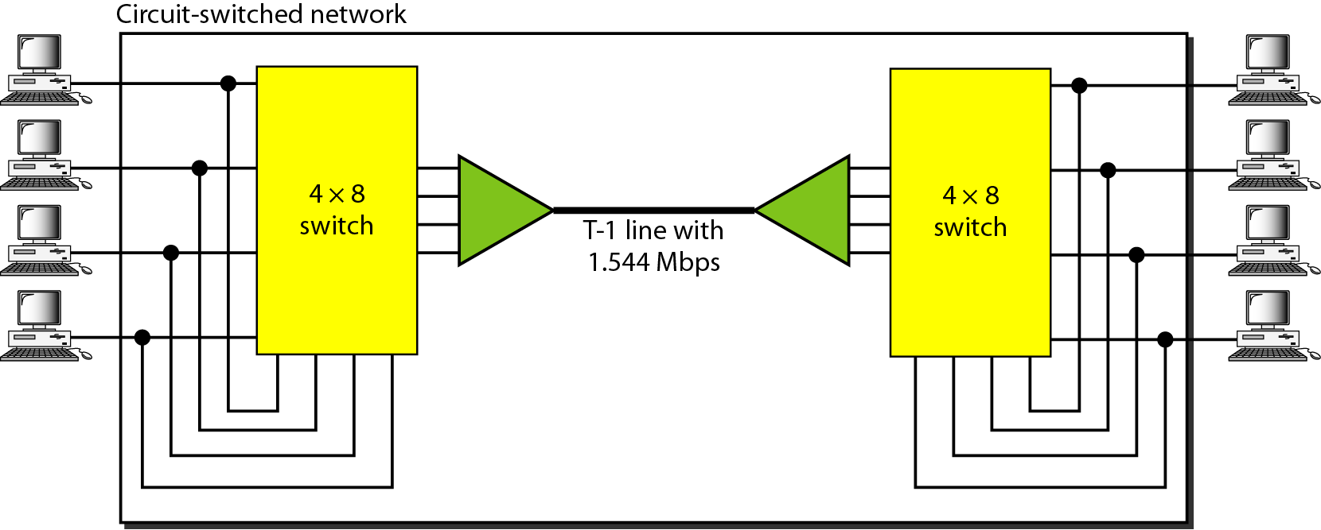
Circuit-Switched Network: Example 2
8-6

Slide 7
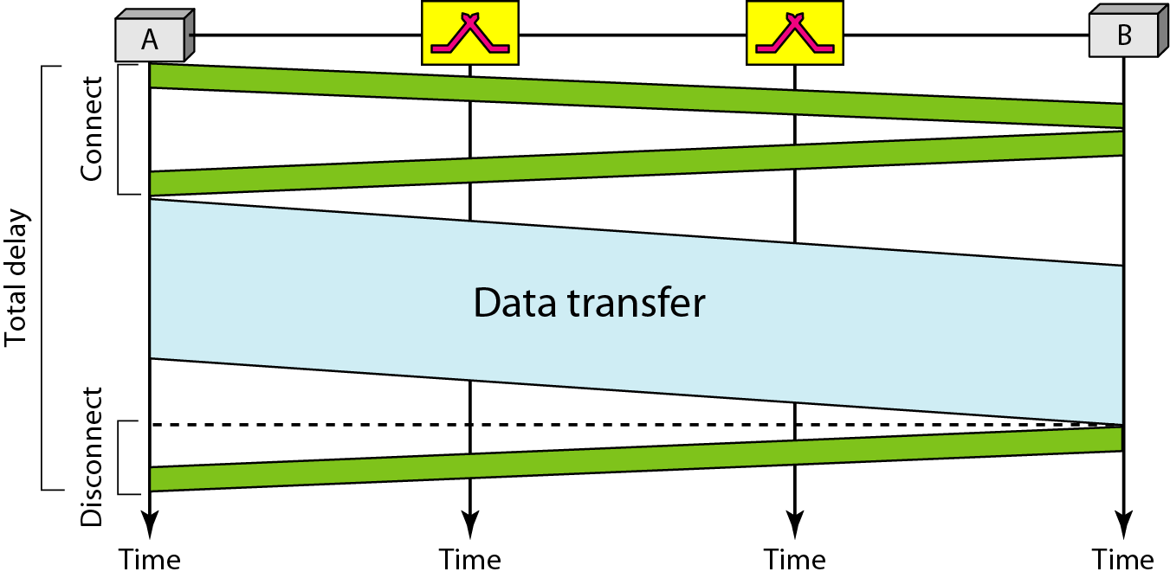
Circuit Switching
8-7
Three phases
Setup phase, data transfer phase, teardown phase
Delay in a circuit-switched network

Slide 8
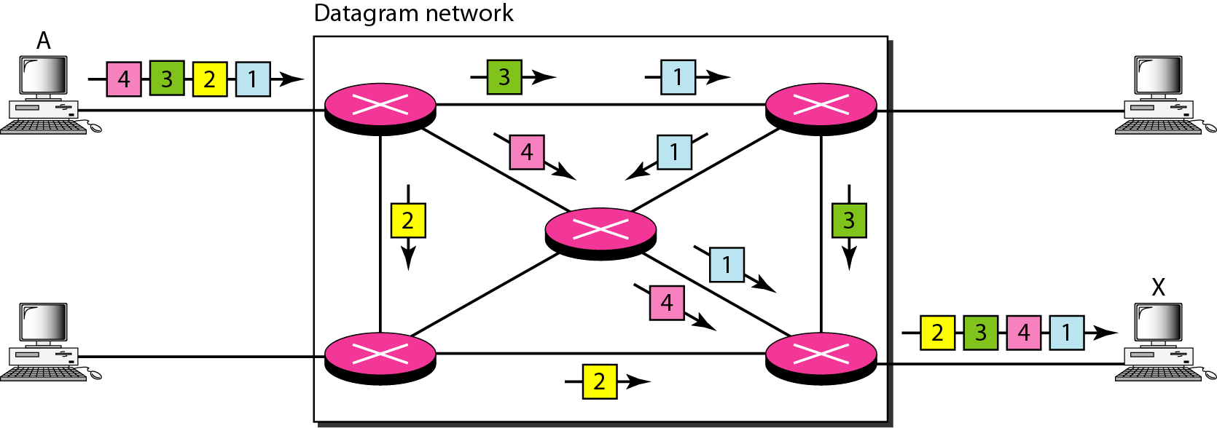
Datagram Networks
8-8
In a packet-switched network, there is no resource reservation; resources are allocated on demand
In a datagram network, each packet is treated independently of all others. Sometimes referred to as connectionless networks

Slide 9
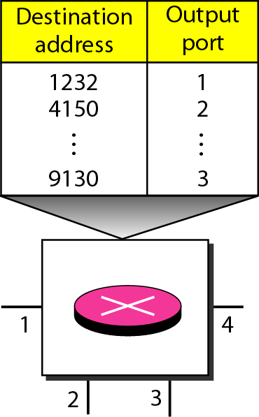
Routing Table
8-9
A switch in a datagram networks uses a routing table that is based on the destination address
The destination address in the header of a packet in a datagram network remains the same during the entire journey of the packet

Slide 10
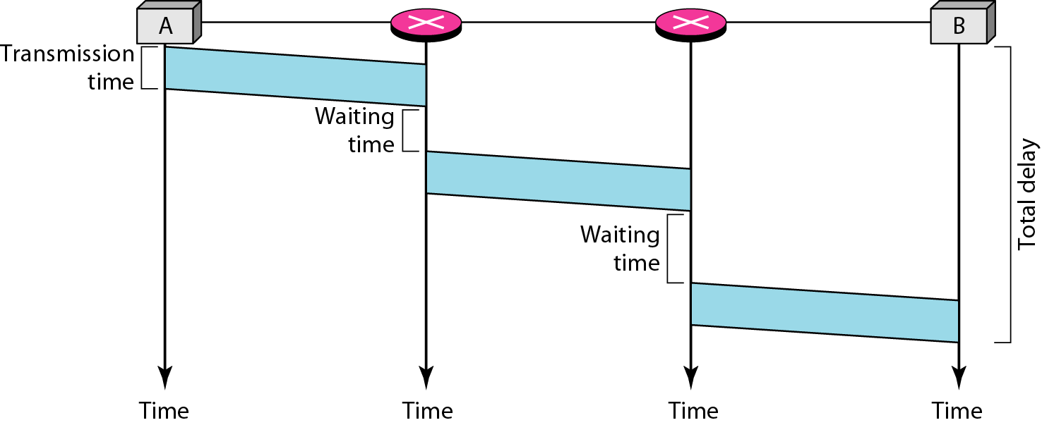
Delay in a Datagram Network
8-10
Datagram network may have greater delay than a virtual-circuit network even though no setup and teardown phase
Delay is not uniform

Slide 11
Virtual-Circuit Networks
8-11
Setup, data transfer, and teardown phases as in a circuit-switched network (CSN)
Resource allocated during setup phase, as in a CSN, or on demand as in a datagram network (DN)
As in DN, data are packetized and each packet carries an address in the header. The address has local jurisdiction, not end-to-end jurisdiction.
As in CSN, all packets follow the same path established during the connection
VCN is normally implemented in the data link layer, while CSN is in physical layer and DN in the network layer

Slide 12
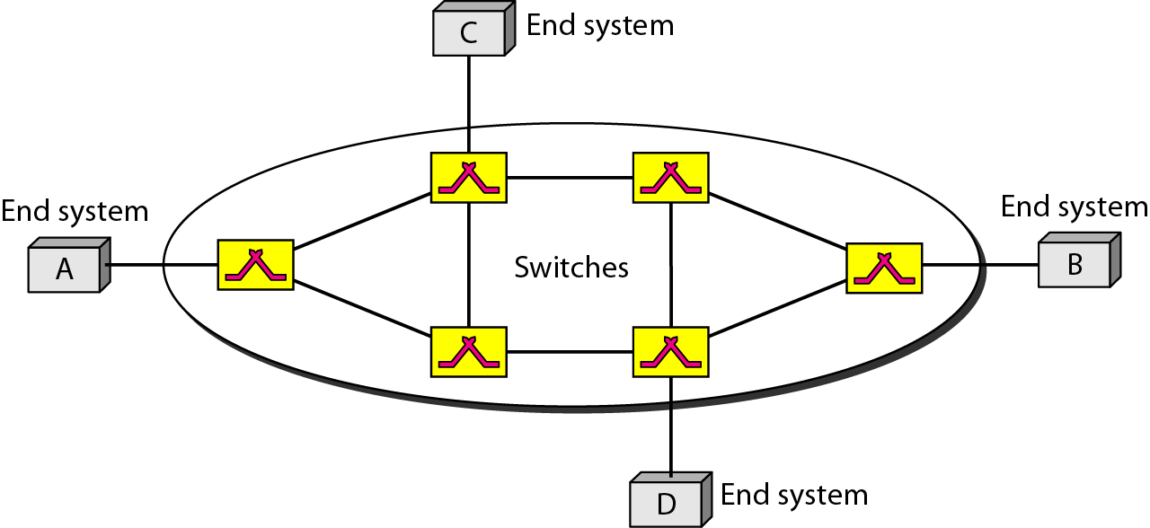
Virtual-Circuit Network
8-12

Slide 13
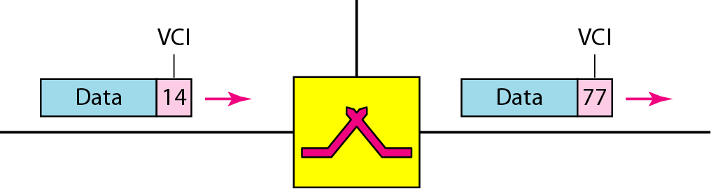
Addressing
8-13
Two types of addressing in a virtual-circuit network: global and local (virtual-circuit identifier: VCI)
Global address is used only to create a VCI
Virtual Circuit Identifier

Slide 14
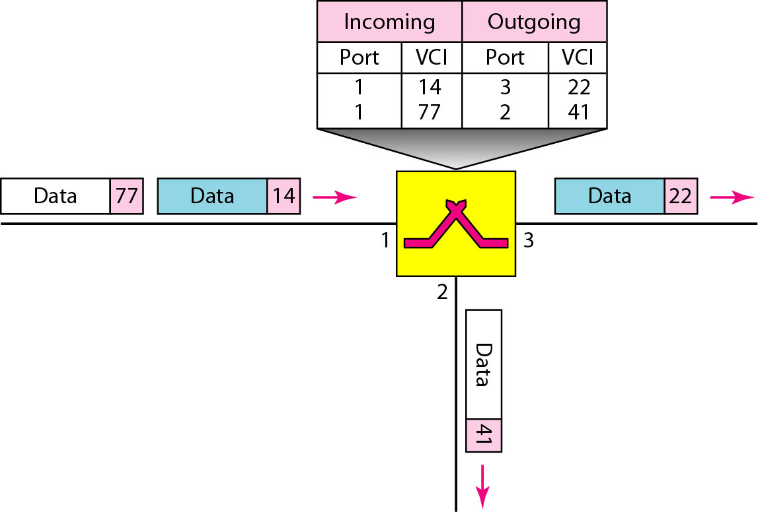
Three Phases
8-14
Data transfer phase, setup phase, teardown phase
Switch and tables in a virtual-circuit network

Slide 15
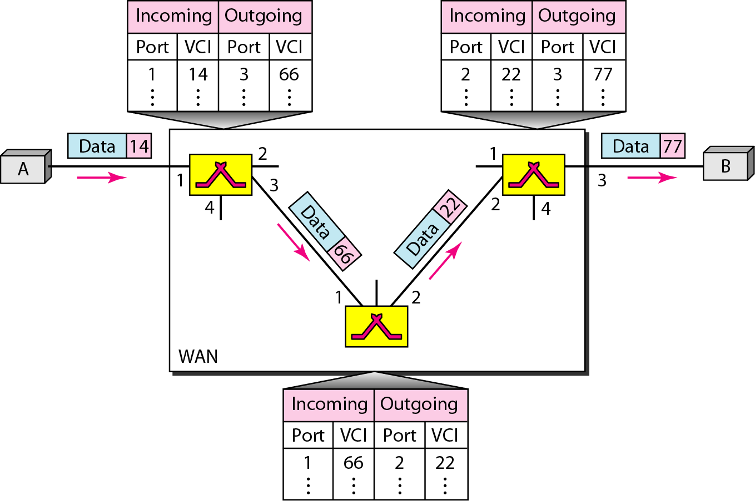
Data Transfer Phases
8-15
Source-to-destination data transfer in a virtual-circuit network

Slide 16
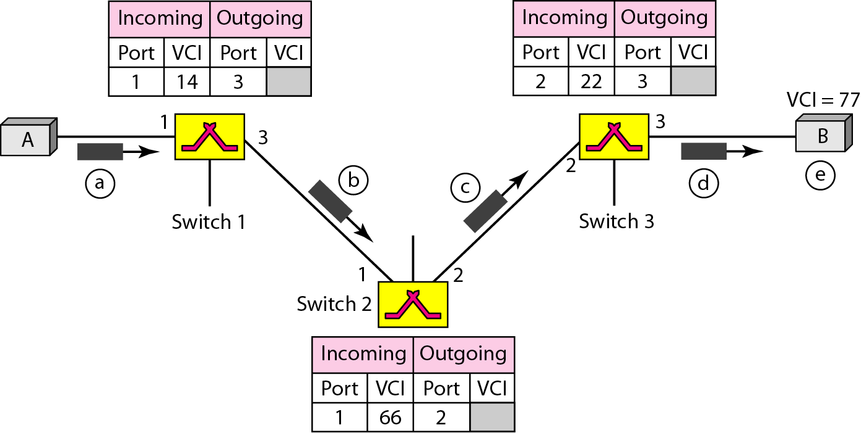
Setup Phases: Setup Request
8-16

Slide 17
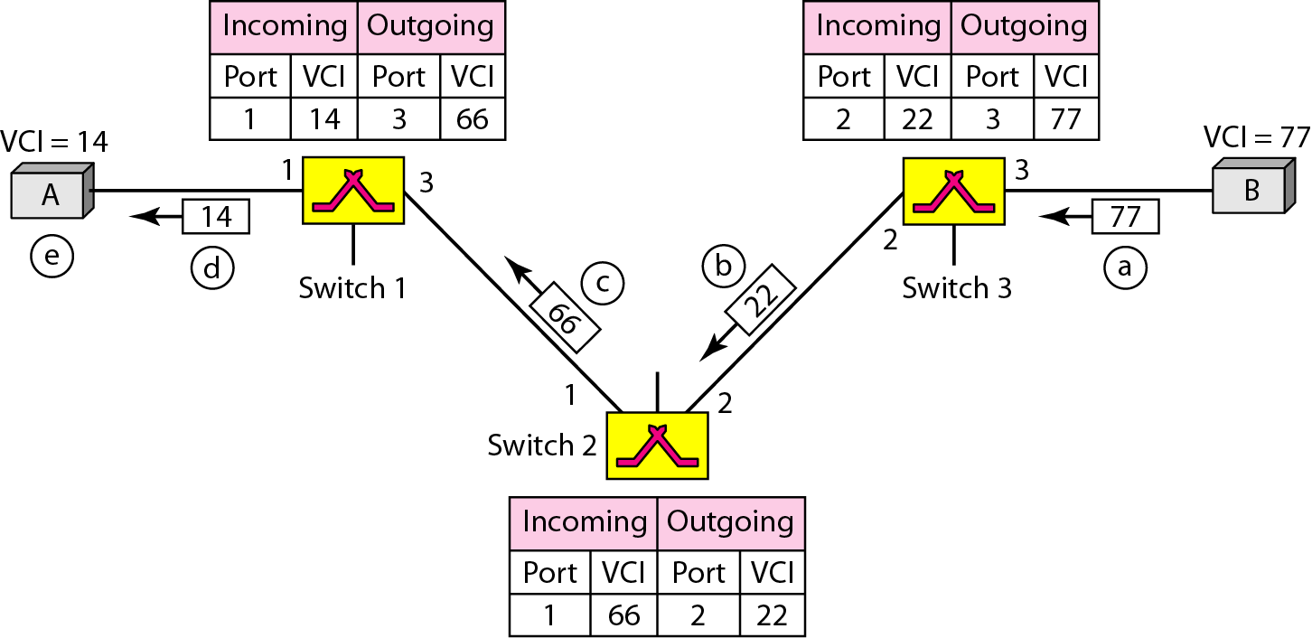
Setup Phases: Acknowledgement
8-17

Slide 18
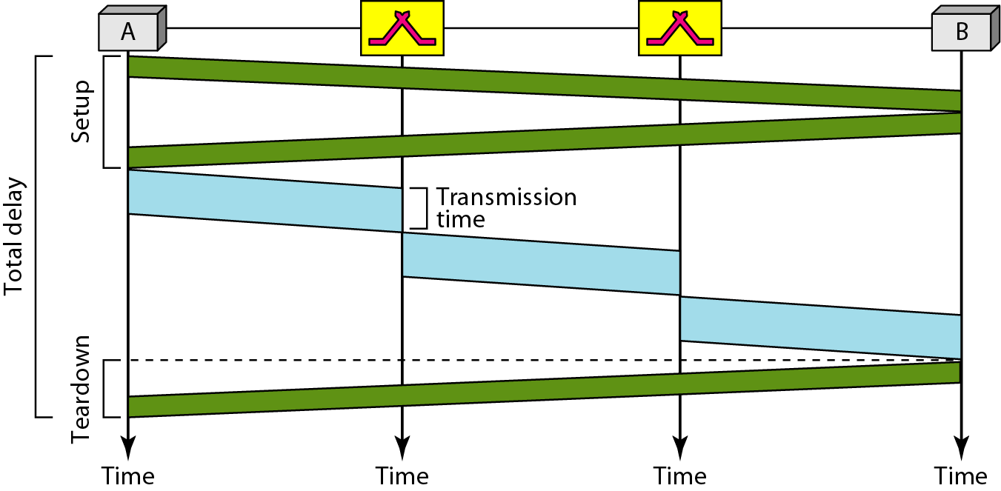
Delay in a Virtual-Circuit Network
8-18
In virtual-circuit switching, all packets belonging to the same source and destination travel the same path; but the packets may arrive at the destination with different delays if resource allocation is on demand.

Slide 19
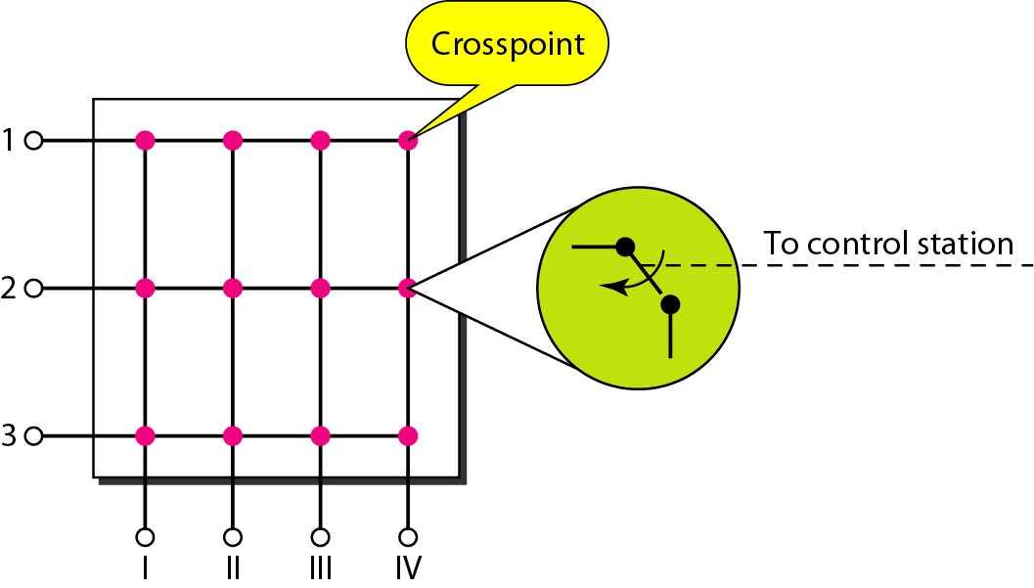
Structure of Circuit Switches
8-19
Space-division switch or time-division switch
Space-division: crossbar switch, multistage switch

Slide 20
Crossbar Switches: Problem
8-20
The number of switches is huge.
connect n inputs by m output -- require n * m crosspoint.
Ex : 1000 input, 1000 output → 1,000,000 crosspoint
Inefficient
fewer than 25% of the crosspoints are in use at a given time.

Slide 21
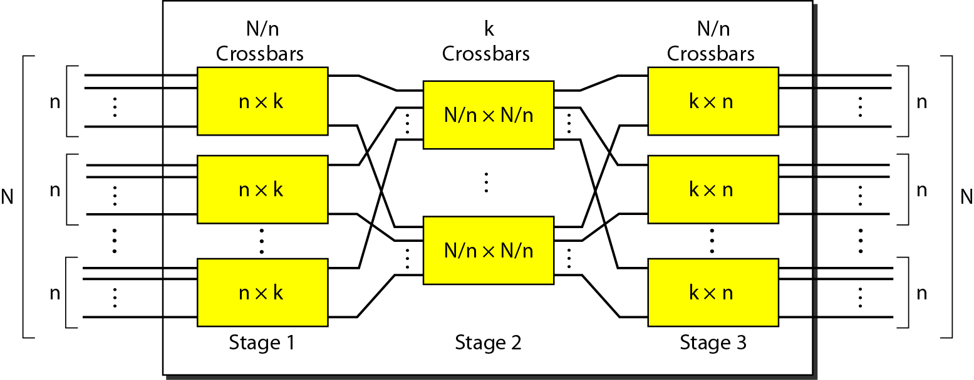
Multistage Switch
8-21
Solution to the limitation of the crossbar switch

Slide 22
Design of a Three-Stage Switch
8-22
Three steps
Divide the N input lines into groups, each of n lines. For each group, use one crossbar of size n x k, where k is the number of crossbars in the middle stage
Use k crossbars, each of size (N/n) x (N/n) in the middle stage
Use N/n crossbars, each of size k x n at the third stage
N/n(n x k) + k(N/n x N/n) + N/n(k x n) = 2kN + k(N/n)²
In a three-stage switch, the total number of crosspoints is 2kN + k(N/n)² which is much smaller than the number of crosspoints in a single-stage switch (N²).

Slide 23
Multistage Switch: Example 1
8-23
Design a three-stage, 200 × 200 switch (N = 200) with k = 4 and n = 20.
In the first stage we have N/n or 10 crossbars, each of size 20 × 4. In the second stage, we have 4 crossbars, each of size 10 × 10. In the third stage, we have 10 crossbars, each of size 4 × 20. The total number of crosspoints is 2kN + k(N/n)², or 2000 crosspoints. This is 5 percent of the number of crosspoints in a single-stage switch (200 × 200 = 40,000).

Slide 24
Multistage Switches: Blocking
8-24
Advantage: The number of crosspoints
Disadvantage: blocking
Clos criterion: condition of nonblocking
n = (N/2)^{1/2}
k ≥ 2n – 1
Crosspoints ≥ 4N [(2N)^{1/2} – 1]

Slide 25
Multistage Switch: Example 2
8-25
Redesign the previous three-stage, 200 × 200 switch, using the Clos criteria with a minimum number of crosspoints.
.
We let n = (200/2)^{1/2}, or n = 10. We calculate k = 2n − 1 = 19. In the first stage, we have 200/10, or 20, crossbars, each with 10 × 19 crosspoints. In the second stage, we have 19 crossbars, each with 10 × 10 crosspoints. In the third stage, we have 20 crossbars each with 19 × 10 crosspoints. The total number of crosspoints is 20(10 × 19) + 19(10 × 10) + 20(19 ×10) = 9500.

Slide 26
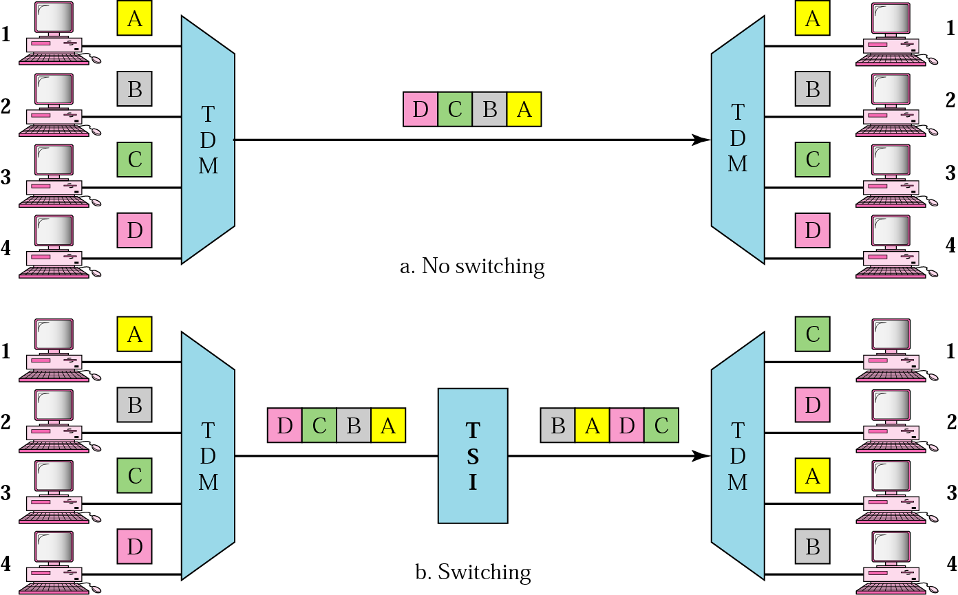
TDM, with and without TSI
8-26

Slide 27
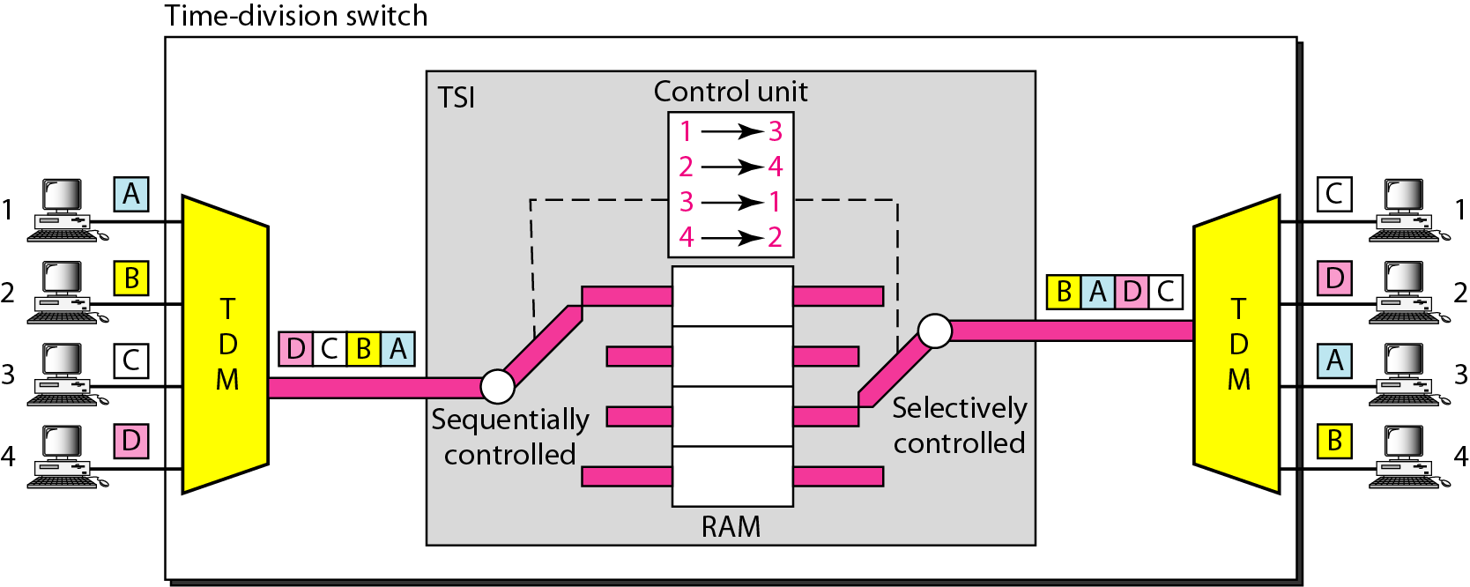
Time-Slot Interchange
8-27

Slide 28
Time- and Space-Division Switch Combination
8-28
Space division: instantaneous, crosspoints
Time division: no crosspoint, processing delay
Space-and time-division switching combinations take advantage of the best of both
TST(time-space-time)
TSST(time-space-space-time)
STTS(space-time-time-space)

Slide 29
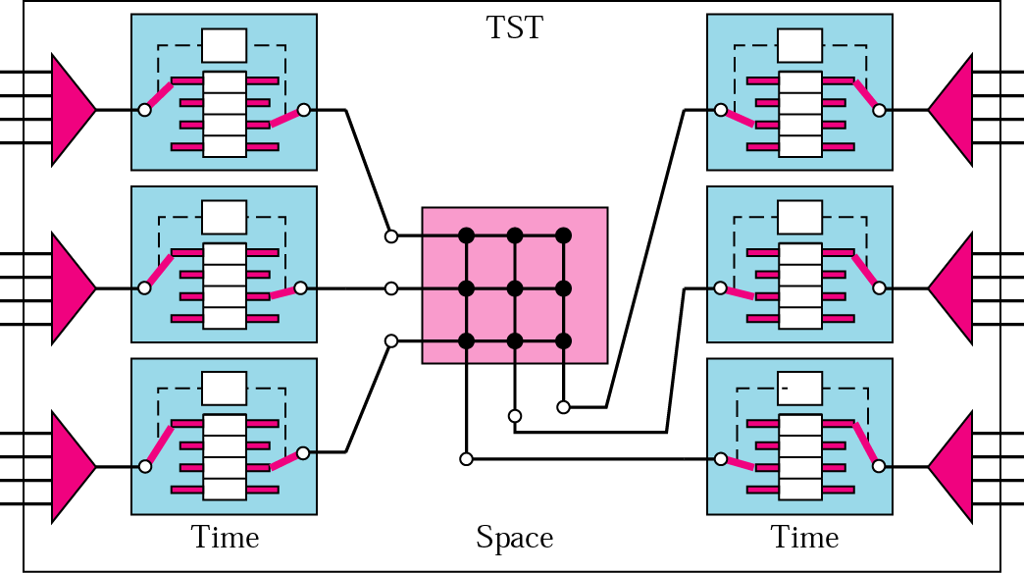
TST Switch
8-29

Slide 30
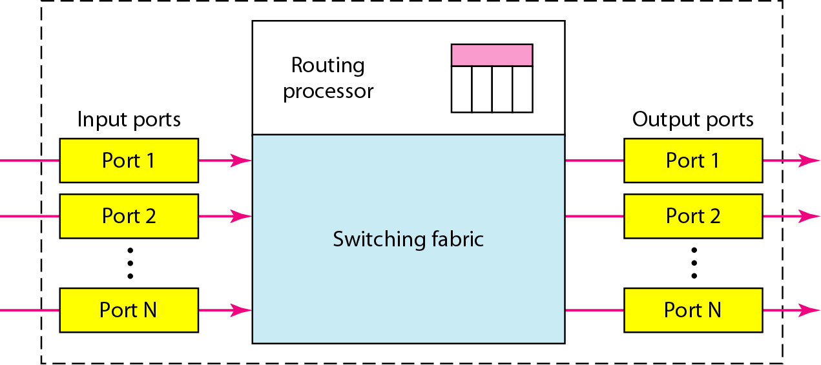
Structure of Packet Switch
8-30
Four components: input port, output port, routing processor, switching fabric

Slide 31
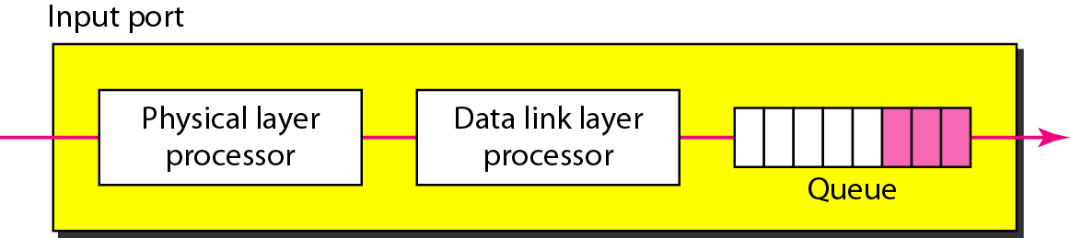
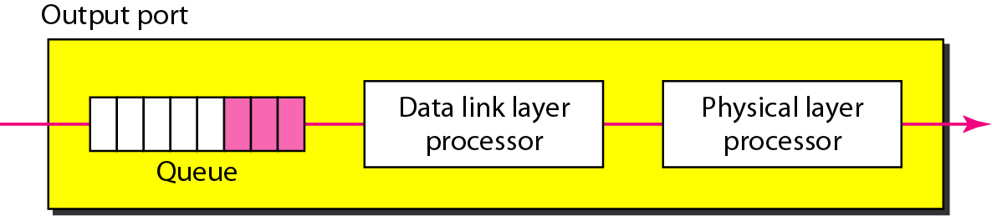
Input/Output Port
8-31

Slide 32
Structure of Packet Switch
8-32
Routing processor: network layer functions
Table lookup: searching the routing table by destination address
Switching Fabric
Crossbar switch
Banyan switch
Batcher-Banyan switch

Slide 33
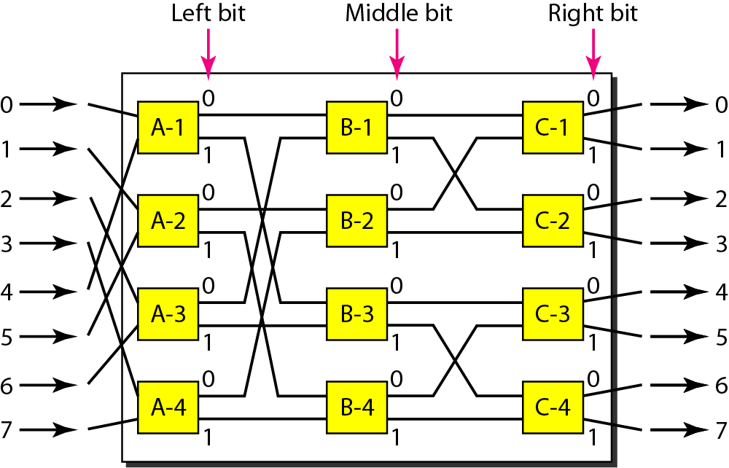
Banyan Switch
8-33
Multistage switch with microswitches at each stage that route the packets based on the output port represented as a binary string

Slide 34
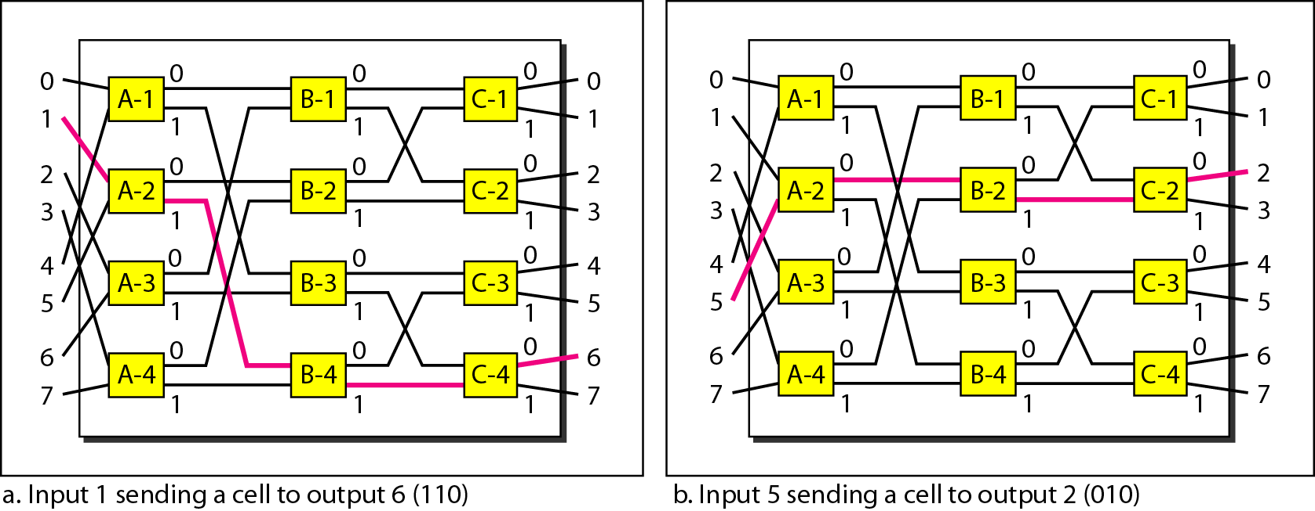
Example of Routing in a Banyan Switch
8-34

Slide 35
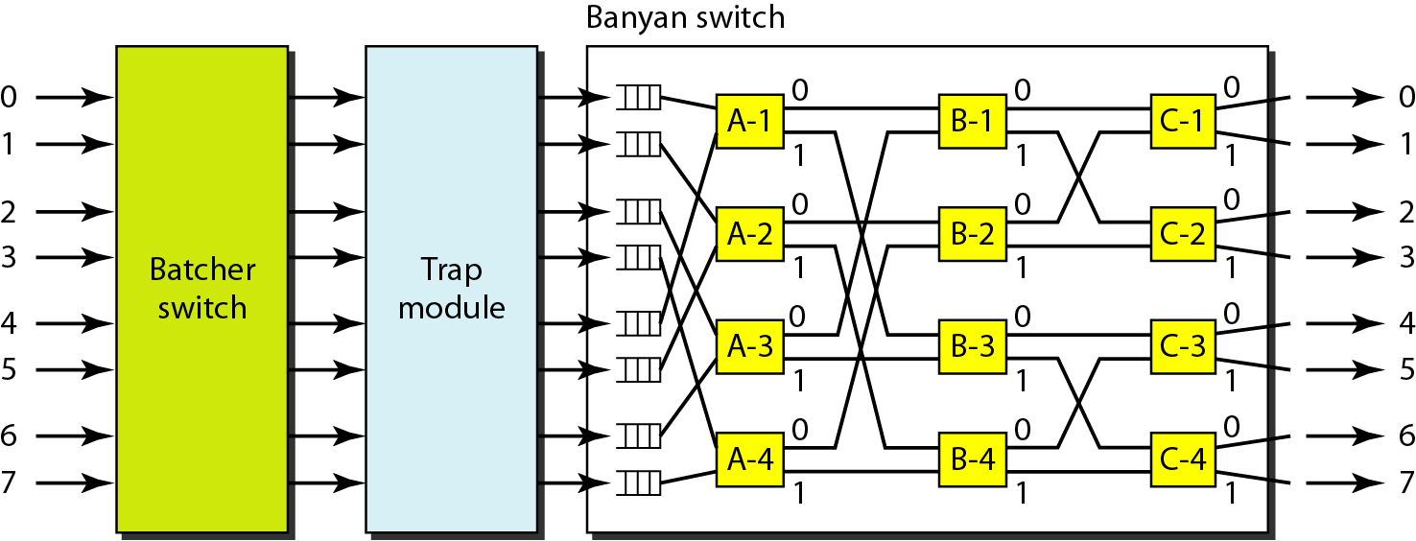
Batcher-Banyan Switch
8-35
Problem in Banyan switch: possibility of internal collision
Solve it by sorting the arriving packets based on their destination port

