Slide 1
Chapter 10 Error Detection and Correction
Introduction
Block Coding
Linear Block Codes
Cyclic Codes
Checksum

Slide 2
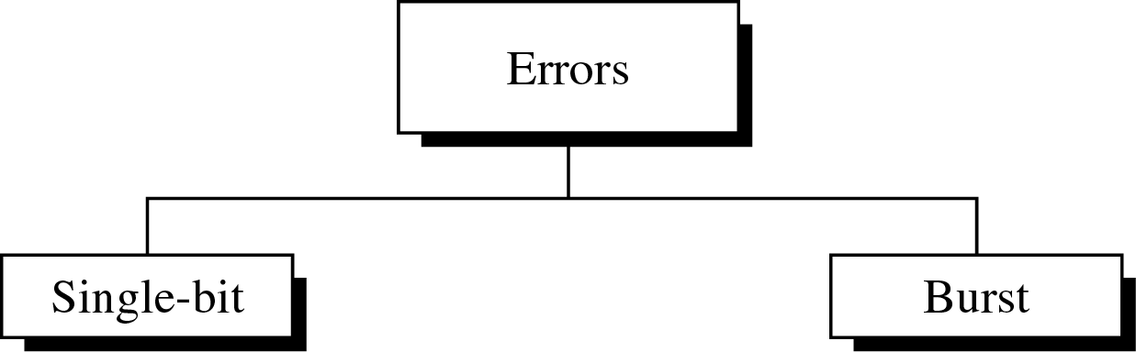
Type of Errors
10-2
An electromagnetic signal is subject to interference from heat, magnetism, and other forms of electricity
Single-bit error: 0 → 1 or 1 → 0
Burst error: 2 or more bits have changed

Slide 3
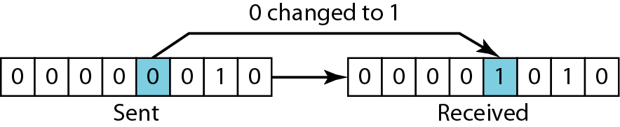
Single-Bit Error
10-3
Only one bit of a given data unit is changed
The least likely type of error in serial transmission
Single-bit error can happen in parallel transmission

Slide 4
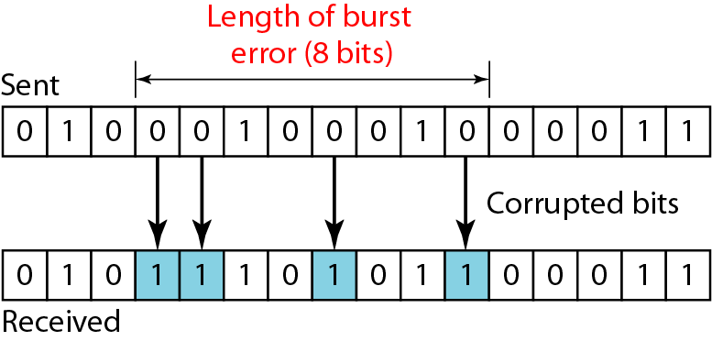
Burst Error
10-4
Two or more bits in the data unit have changed
Burst error does not necessarily mean that the errors occur in consecutive bits
Most likely to happen in a serial transmission
Number of bits affected depends on the data rate and duration of noise

Slide 5
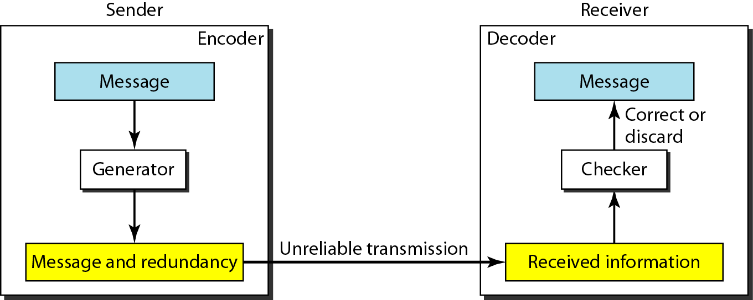
Redundancy
10-5
Error detection uses the concept of redundancy, which means adding extra (redundant) bits for detecting errors at the destination

Slide 6
Error Control
10-6
Detection Versus Correction
Detection: error ? yes or no
Correction: Need to know the exact number of bits that are corrupted, and their location in the message
Forward Error Correction Versus Retransmission
Retransmission (resending) : Backward error correction
Coding for redundancy
Block coding: discussed in our textbook
Convolution coding

Slide 7
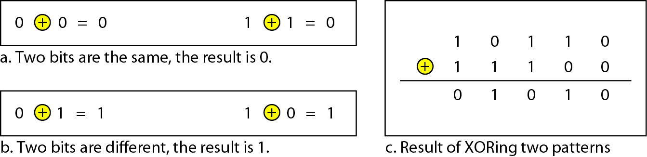
Modular Arithmetic
10-7
In modulo-N arithmetic, we use only the integers in the range 0 to N-1, inclusive.
Adding: 0 + 0 = 0 0 + 1 = 1 1 + 0 = 1 1 + 1 = 0
Subtracting: 0 – 0 = 0 0 – 1 = 1 1 – 0 = 1 1 – 1 = 0
XORing of two single bits or two words

Slide 8
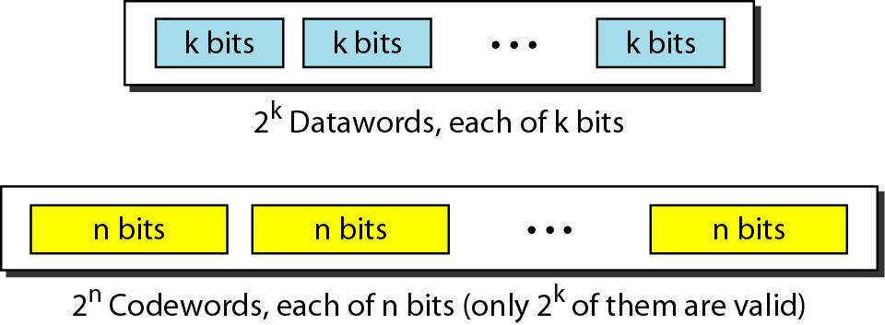
Block Coding
10-8
Divide the message into blocks, each of k bits, called datawords.
Add r redundant bits to each block to make the length n = k + r. The resulting n-bit blocks are called codewords
Example: 4B/5B block coding
k = 4 and n = 5.
2^{k} = 16 datawords and 2^{n} = 32 codewords.

Slide 9
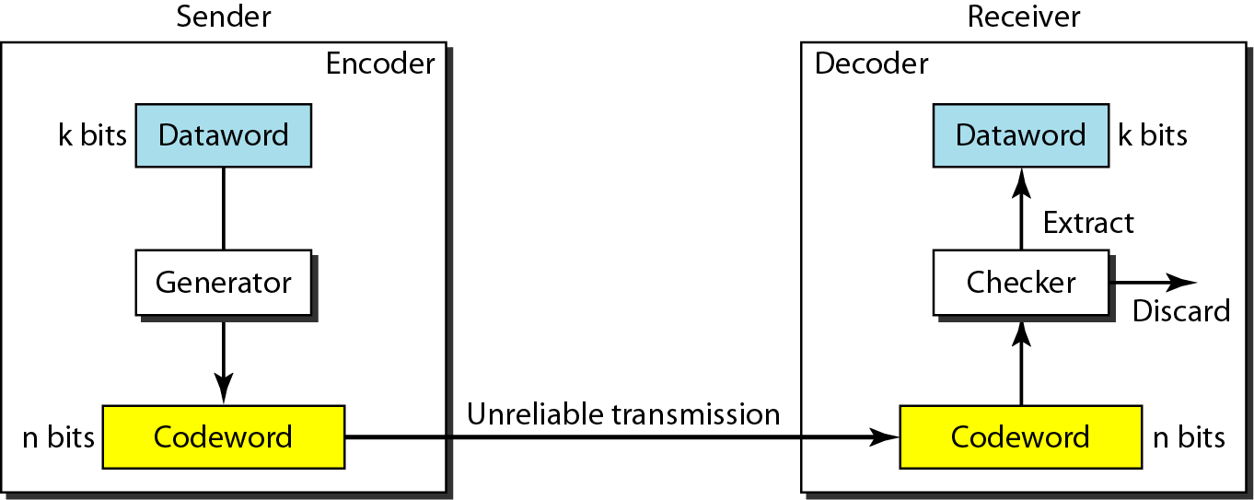
Error Detection in Block Coding
10-9
Example:
Assume that k = 2 and n = 3
(Table 10.1)

Slide 10
Error Detection: Example
10-10
Assume the sender encodes the dataword 01 as 011 and sends it to the receiver. Consider the following cases:
1. The receiver receives 011 which is a valid codeword. The receiver extracts the dataword 01 from it.
2. The codeword is corrupted during transmission, and 111 is received. This is not a valid codeword and is discarded.
3. The codeword is corrupted during transmission, and 000 is received. This is a valid codeword. The receiver incorrectly extracts the dataword 00. Two corrupted bits have made the error undetectable.
→ An error-detecting code can detect only the types of errors for which it is designed; other types of errors may remain undetected

Slide 11
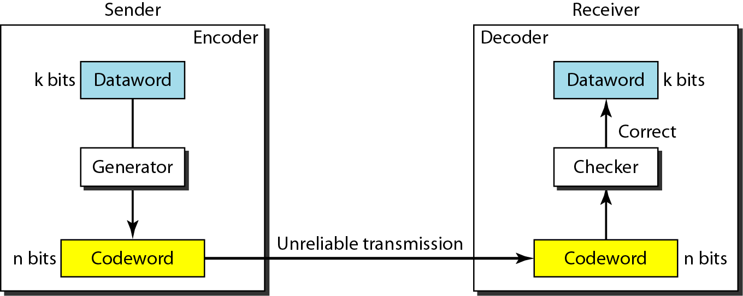
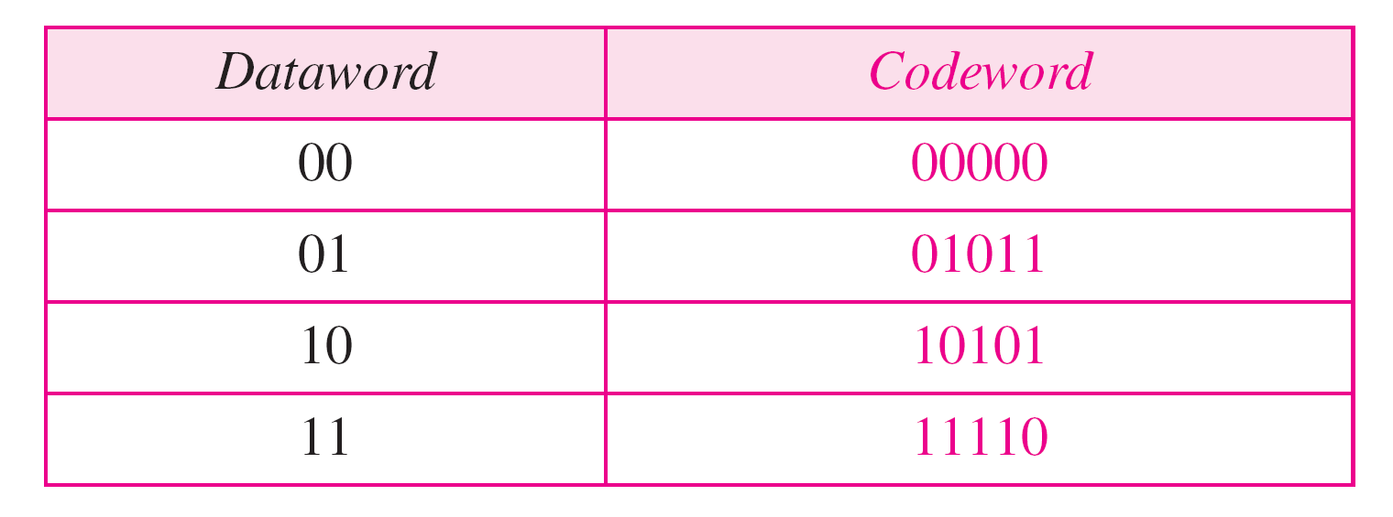
Error Correction in Block Coding
10-11
Example:
Assume that k = 2 and r = 3
n = 5 (Table 10.2)

Slide 12
Error Correction: Example
10-12
Assume the dataword is 01. The sender creates the codeword 01011. The codeword is corrupted during transmission, and 01001 is received. First, the receiver finds that the received codeword is not in the table. This means an error has occurred. The receiver, assuming that there is only 1 bit corrupted, uses the following strategy to guess the correct dataword
1. Comparing the received codeword with the first codeword in the table (01001 versus 00000), the receiver decides that the first codeword is not the one that was sent because there are two different bits. (the same for third or fourth one in the table)
2.. The original codeword must be the second one in the table because this is the only one that differs from the received codeword by 1 bit.

Slide 13
Hamming Distance
10-13
The Hamming distance between two words is the number of differences between corresponding bits.
Example: Hamming distance d(10101, 11110) is 3
The minimum Hamming distance is the smallest Hamming distance between all possible pairs in a set of words
Example for Table 10.1
- d_{min} = 2

Slide 14
Hamming Distance
10-14
Three parameters to define the coding schemes
Codeword size n
Dataword size k
The minimum Hamming distance d_{min}
Coding scheme C(n, k) with a separate expression for d_{min}
Hamming distance and error
Hamming distance between the received codeword and the sent codeword is the number of bits that are corrupted
Minimum distance for error detection
To guarantee the detection of up to s errors in all cases, the minimum Hamming distance in a block code must be
d_{min} = s + 1.

Slide 15
Minimum Hamming Distance: Example
10-15
The minimum Hamming distance in Table 10.1 is 2. This code guarantees detection of only a single error.
For example, if the third codeword (101) is sent and one error occurs, the received codeword does not match any valid codeword. If two errors occur, however, the received codeword may match a valid codeword and the errors are not detected.
In Table 10.2, it has d_{min} = 3. This code can detect up to two errors.
When any of the valid codewords is sent, two errors create a codeword which is not in the table of valid codewords. The receiver cannot be fooled. However, some combinations of three errors change a valid codeword to another valid codeword. The receiver accepts the received codeword and the errors are undetected.

Slide 16
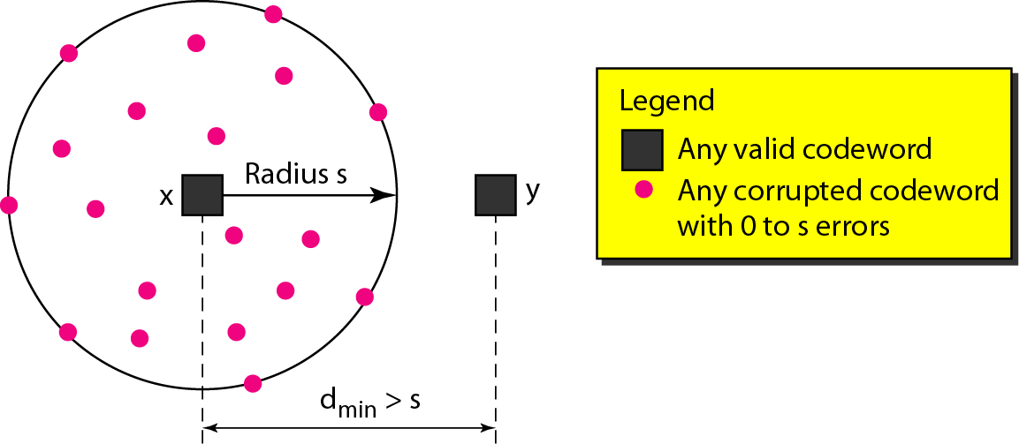
Geometric Concept for Finding d_{min} for Error Detection
10-16
d_{min} must be an integer greater than s: that is, d_{min} = s + 1.

Slide 17
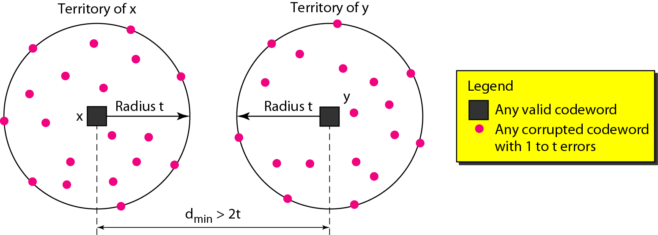
Geometric Concept for Finding d_{min} for Error Correction
10-17
To guarantee correction of up to t errors in all cases, the minimum Hamming distance in a block code must be d_{min} = 2t + 1

Slide 18
Linear Block Codes
10-18
Almost all block codes used today belong to a subset called linear block codes.
A linear block code is a code in which the exclusive OR (addition modulo-2) of two valid codewords creates another valid codeword
The minimum Hamming distance is the number of 1s in the nonzero valid codeword with the smallest number of 1s

Slide 19
Linear Block Code: Parity-Check Code
10-19
A simple parity-check code is a single-bit error-detecting code in which n = k + 1 with d_{min} = 2.

Slide 20
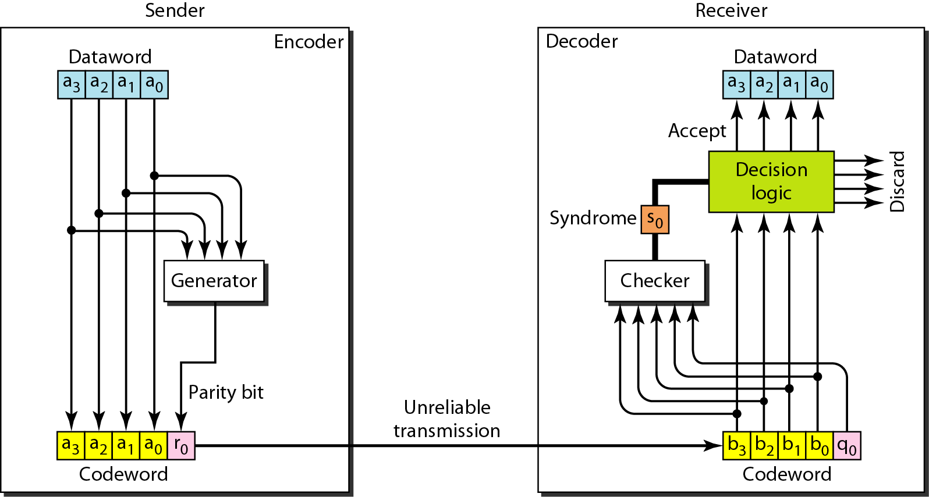
Encoder and Decoder for Parity-Check Code
10-20
The result of addition over all 5 bits: syndrome

Slide 21
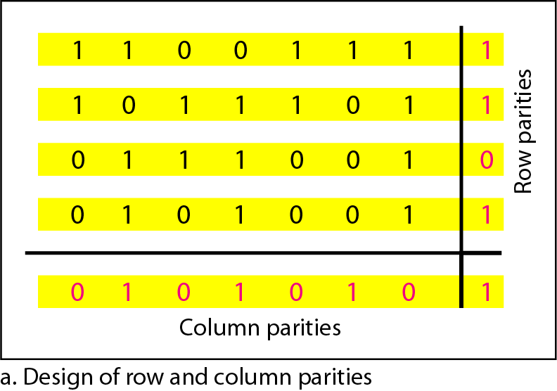
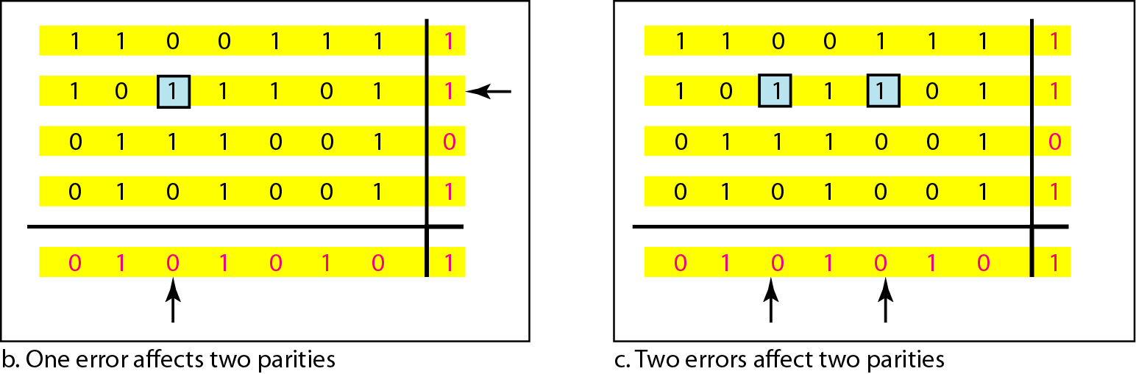
2 Dimensional Parity-Check Code
10-21

Slide 22
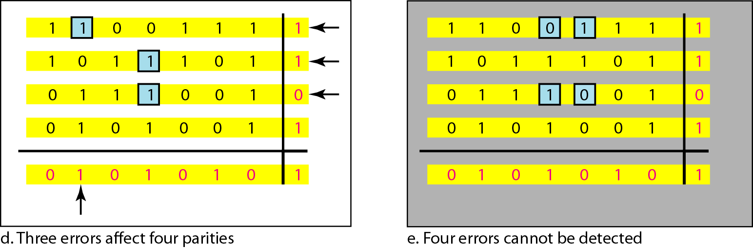
2 Dimensional Parity-Check Code
10-22

Slide 23
Linear Block Code: Hamming Code
10-23
All Hamming codes discussed in our textbook have d_{min} = 3.
An integer, m>=3, the relationship between m and n in these codes is n = 2^{m} − 1; k = n – m; check bits, r = m

Slide 24
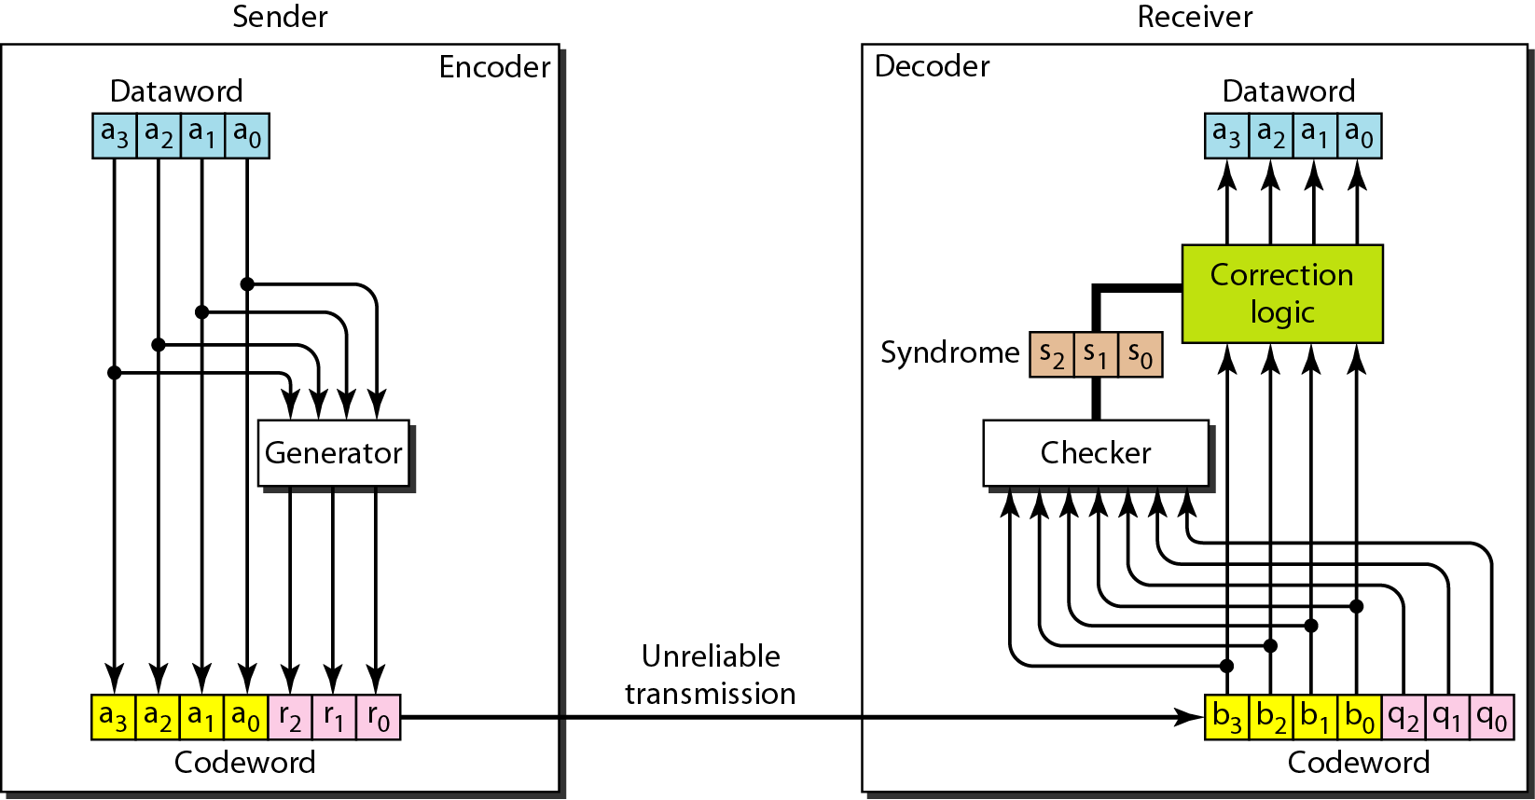
Encoder and Decoder for Hamming Code
10-24

Slide 25
Hamming Code
10-25
r₀ = a₂ + a₁ + a₀ modulo-2
r₁ = a₃ + a₂ + a₁ modulo-2
r₂ = a₁ + a₀ + a₃ modulo-2
s₀ = b₂ + b₁ + b₀ + q₀ modulo-2
s₁ = b₃ + b₂ + b₁ + q₁ modulo-2
s₂ = b₁ + b₀ + b₃ + q₂ modulo-2

Slide 26
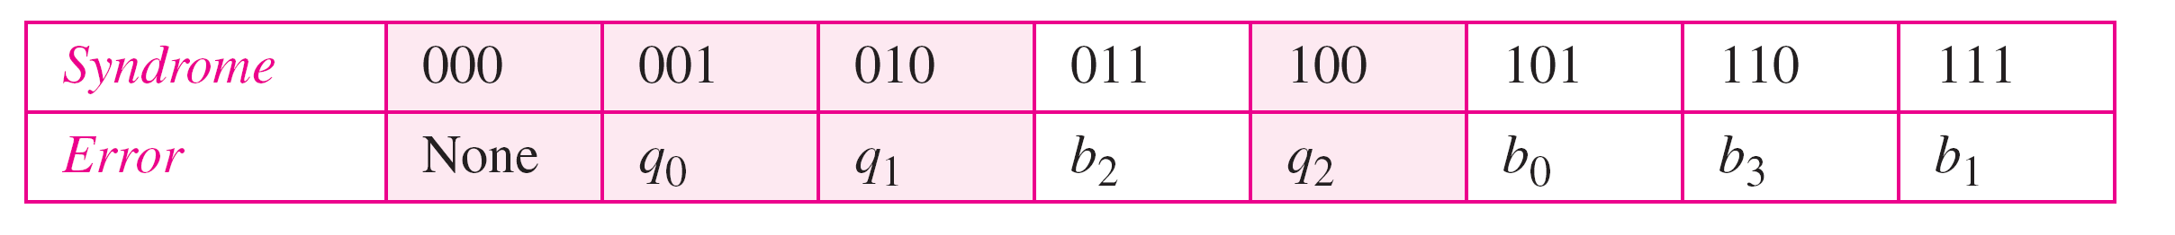
Logical Decision by Decoder
10-26
Let us trace the path of three datawords from the sender to the destination:
1 The dataword 0100 becomes the codeword 0100011. The codeword 0100011 is received. The syndrome is 000, the final dataword is 0100.
2. The dataword 0111 becomes the codeword 0111001. The codeword 0011001 received. The syndrome is 011. After flipping b₂ (changing the 1 to 0), the final dataword is 0111.
3. The dataword 1101 becomes the codeword 1101000. The codeword 0001000 received (two errors). The syndrome is 101. After flipping b₀, we get 0000, the wrong dataword. This shows that our code cannot correct two errors.

Slide 27
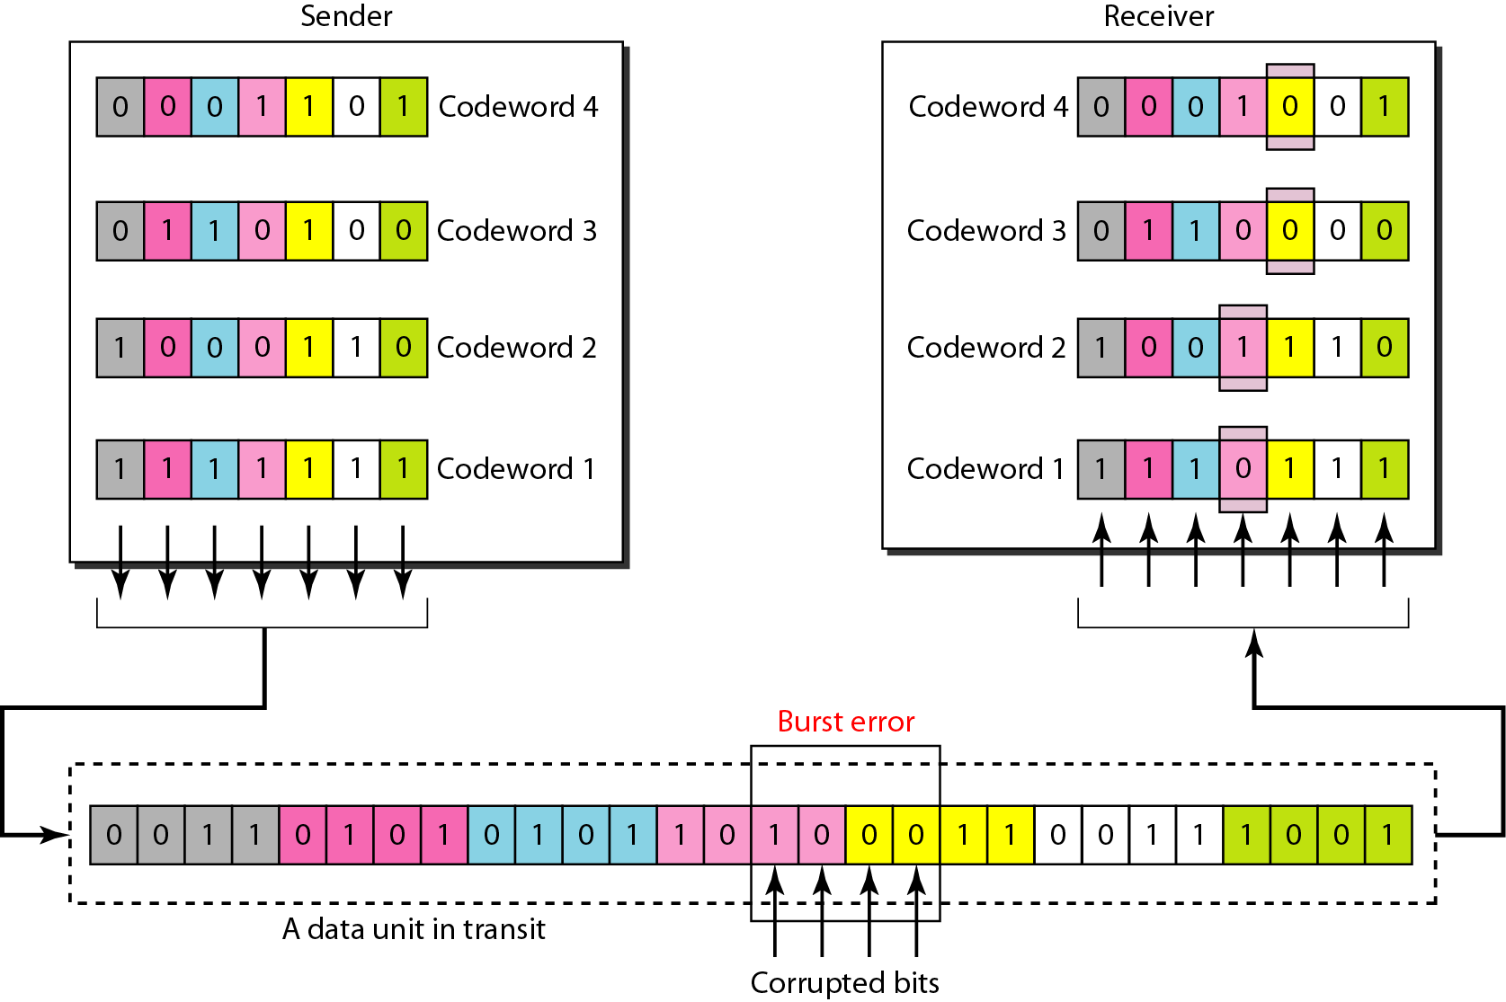
Burst Error Correction Using Hamming Code
10-27

Slide 28
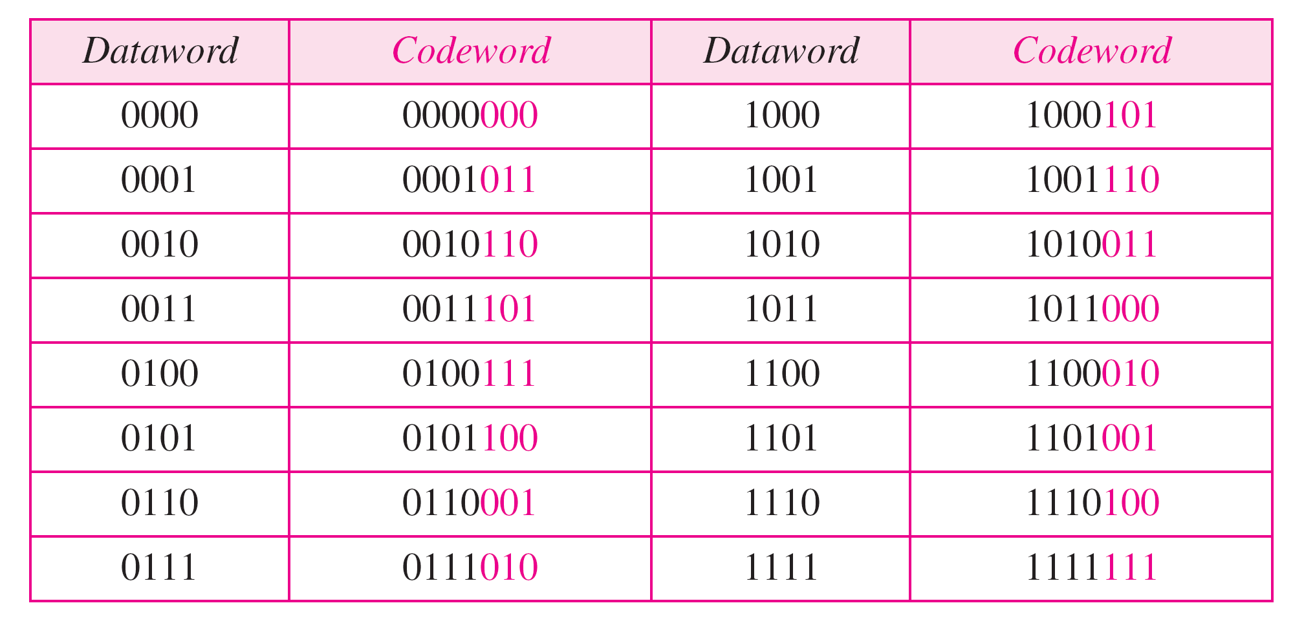
Cyclic Code: CRC
10-28
Cyclic codes are special linear block codes with one extra property.
If a codeword is cyclically shifted (rotated), the result is another codeword
Cyclic Redundancy Check (CRC)

Slide 29
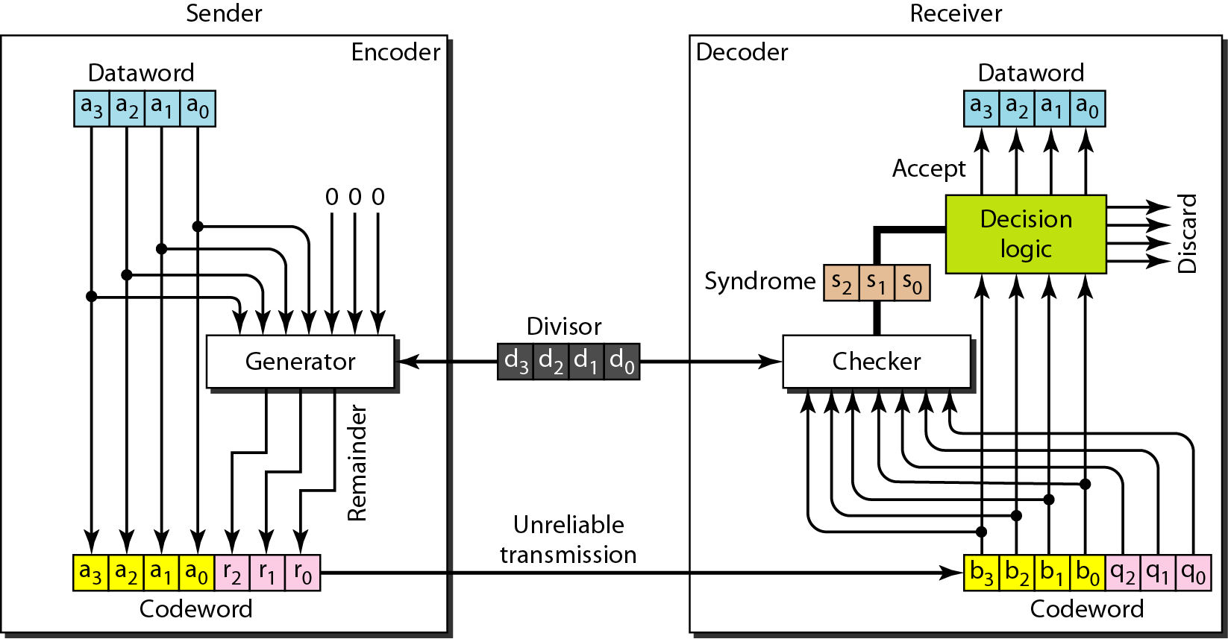
CRC Encoder and Decoder
10-29

Slide 30
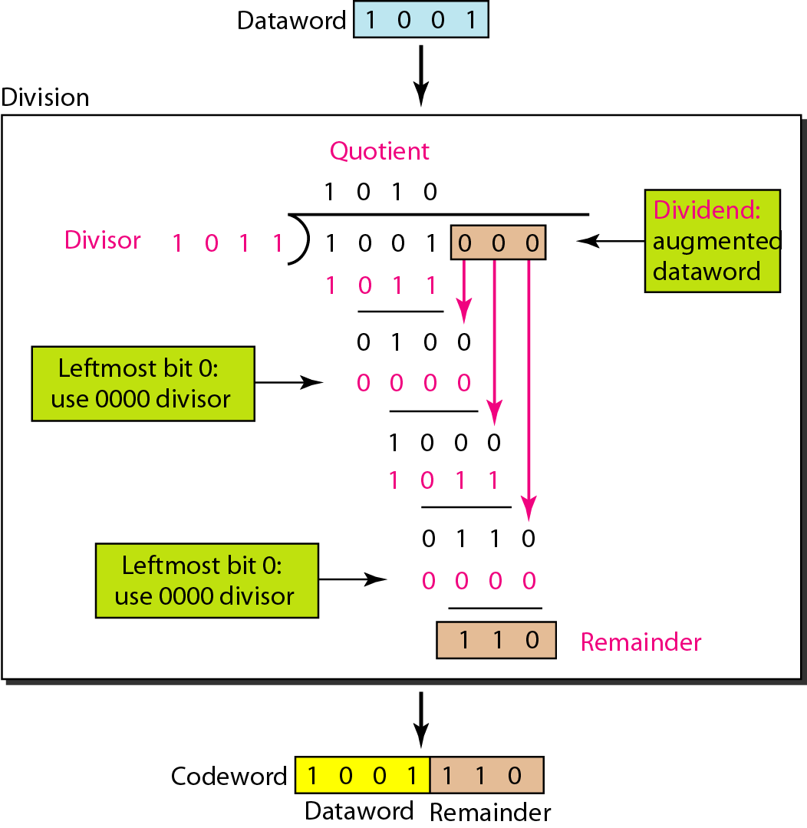
Division in CRC Encoder
10-30

Slide 31
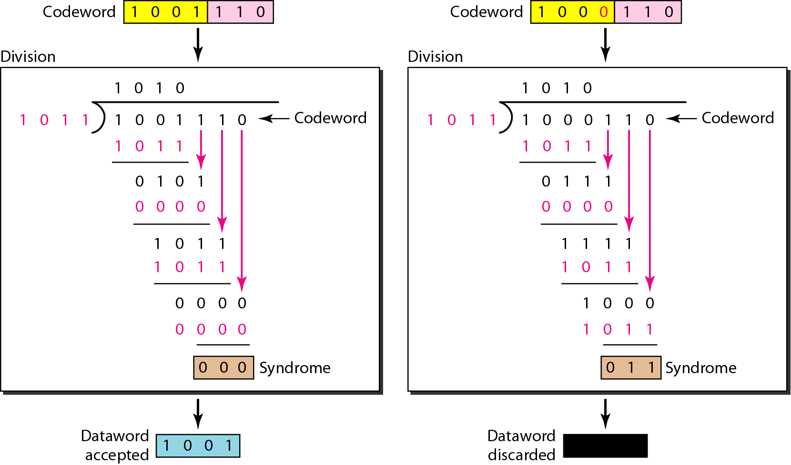
Division in CRC Decoder
10-31

Slide 32
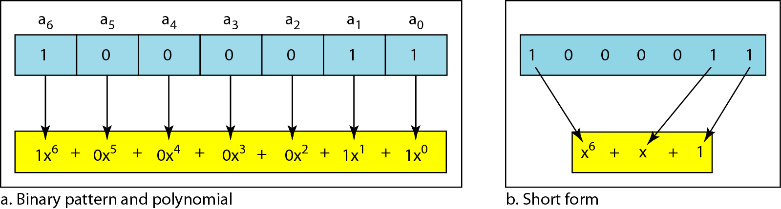
Polynomials
10-32
Degree of a polynomial: the highest power in the polynomial
Example: x⁶ + x + 1 → the degree ‘6’

Slide 33
Polynomial Operation
10-33
Adding and subtracting polynomials
(x⁵ + x⁴ + x²) + (x⁶ + x⁴ + x²) → x⁶ + x⁵
Multiplying two polynomials
(x⁵ + x³ + x² + x) (x² + x¹ + 1)
= x⁷ + x⁶ + x⁵ +x⁵ + x⁴ + x³ + x⁴ + x³ + x² + x³ + x² + x
⁼ x⁷ + x⁶ + x³ + x
Dividing one polynomial by another
Shifting
Shifting left 3 bits: 10011 becomes 10011000
Shifting right 3 bits: 10011 becomes 10 (x⁴ + x + 1, x )

Slide 34
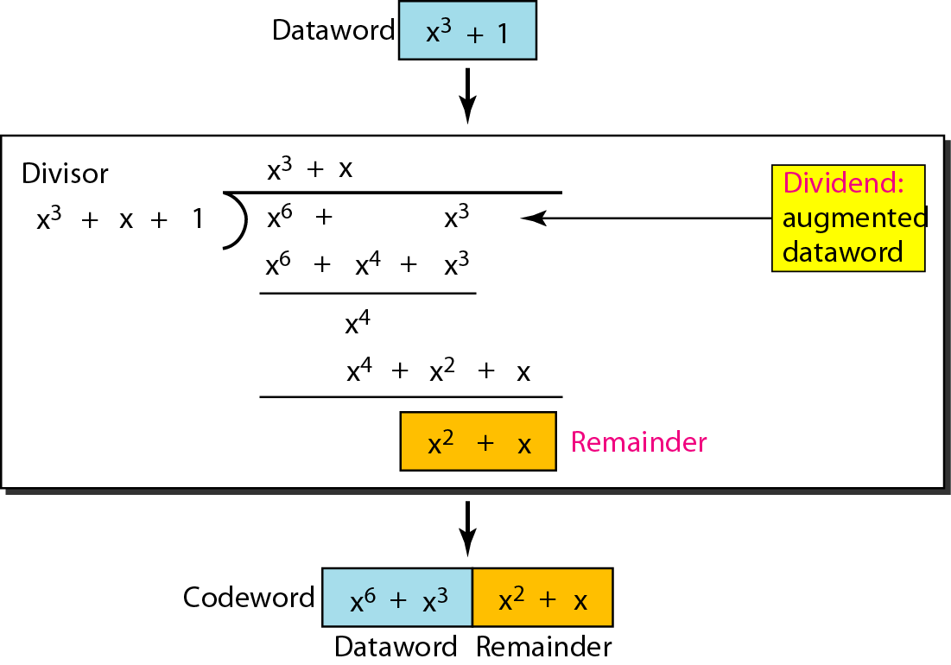
CRC Division Using Polynomials
10-34
The divisor in a cyclic code is normally called the generator polynomial or simply the generator.

Slide 35
Cyclic Code Analysis
10-35
f(x) is a polynomial with binary coefficients
Dataword: d(x) Codeword: c(x) Generator: g(x)
Syndrome: s(x) Error: e(x)
In a cyclic code,
If s(x) ≠ 0, one or more bits is corrupted.
If s(x) = 0, either a. No bit is corrupted. Or
b. Some bits are corrupted, but the decoder failed to detect them
Received codeword = c(x) + e(x)
Received codeword/g(x) = c(x)/g(x) + e(x)/g(x)
In a cyclic code, those e(x) errors that are divisible by g(x) are not caught

Slide 36
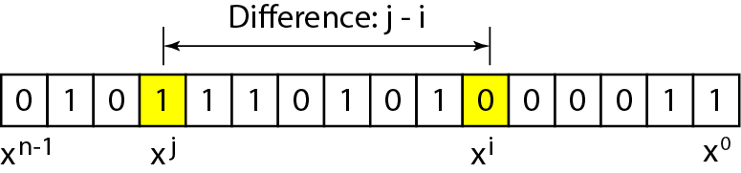
Error Detection
10-36
Single-bit error
If the generator has more than one term and the coefficient of x⁰ is 1, all single errors can be caught.
Two isolated single-bit error
If a generator cannot divide x^{t} + 1 (t between 0 and n – 1), then all isolated double errors can be detected

Slide 37
Example 1
10-37
Which of the following g(x) values guarantees that a single-bit error is caught? For each case, what is the error that cannot be caught?
a. x + 1 b. x³ c. 1
Solution
a. No xi can be divisible by x + 1. Any single-bit error can be caught.
b. If i is equal to or greater than 3, x^{i} is divisible by g(x). All single-bit errors in positions 1 to 3 are caught.
c. All values of i make xi divisible by g(x). No single-bit error can be caught. This g(x) is useless.

Slide 38
Example 2
10-38
Find the status of the following generators related to two isolated, single-bit errors.
a. x + 1 b. x⁴ + 1 c. x⁷ + x ⁶+ 1 d. x¹⁵ + x¹⁴ + 1
Solution
a. This is a very poor choice for a generator. Any two errors next to each other cannot be detected.
b. This generator cannot detect two errors that are four positions apart.
c. This is a good choice for this purpose.
d. This polynomial cannot divide x^{t} + 1 if t is less than 32,768. A codeword with two isolated errors up to 32,768 bits apart can be detected by this generator..

Slide 39
Error Detection
10-39
Odd numbers of errors
A generator that contains a factor of x + 1 can detect all odd-numbered errors
Burst errors
❏ All burst errors with L ≤ r will be detected.
❏ All burst errors with L = r + 1 will be detected with probability
1 – (1/2)^{r–1}.
❏ All burst errors with L > r + 1 will be detected with probability
1 – (1/2)^{r}.

Slide 40
Example 3
10-40
Find the suitability of the following generators in relation to burst errors of different lengths.
a. x⁶ + 1 b. x¹⁸ + x⁷ + x + 1 c. x³² + x²³ + x⁷ + 1
Solution
a. This generator can detect all burst errors with a length less than or equal to 6 bits; 3 out of 100 burst errors with length 7 will slip by; 16 out of 1000 burst errors of length 8 or more will slip by.
b. This generator can detect all burst errors with a length less than or equal to 18 bits; 8 out of 1 million burst errors with length 19 will slip by; 4 out of 1 million burst errors of length 20 or more will slip by.
c. This generator can detect all burst errors with a length less than or equal to 32 bits; 5 out of 10 billion burst errors with length 33 will slip by; 3 out of 10 billion burst errors of length 34 or more will slip by.

Slide 41
Summary and Standard Polynomials
10-41
A good polynomial generator needs to have the following characteristics:
1. It should have at least two terms.
2. The coefficient of the term x⁰ should be 1.
3. It should not divide x^{t} + 1, for t between 2 and n − 1.
4. It should have the factor x + 1.

Slide 42
Checksum
10-42
Tendency is to replace the checksum with a CRC
Not as strong as CRC in error-checking capability
One’s complement arithmetic
We can represent unsigned numbers between 0 and 2^{n} – 1 using only n bits
If the number has more than n bits, the extra leftmost bits need to be added to the n rightmost bits (wrapping)
A negative number can be represented by inverting all bits. It is the same as subtracting the number from 2^{n} – 1

Slide 43
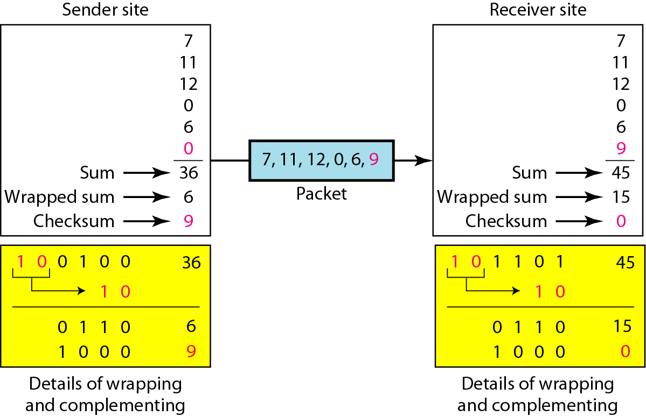
Checksum: Example
10-43
The sender initializes the checksum to 0 and adds all data items and the checksum. However, 36 cannot be expressed in 4 bits. The extra two bits are wrapped and added with the sum to create the wrapped sum value 6. The sum is then complemented, resulting in the checksum value 9 (15 − 6 = 9).

Slide 44
Internet Checksum
10-44
Sender site:
1. The message is divided into 16-bit words.
2. The value of the checksum word is set to 0.
3. All words including the checksum are added using one’s complement
addition.
4. The sum is complemented and becomes the checksum.
5. The checksum is sent with the data.
Receiver site:
1. The message (including checksum) is divided into 16-bit words.
2. All words are added using one’s complement addition.
3. The sum is complemented and becomes the new checksum.
4. If the value of checksum is 0, the message is accepted; otherwise, it is
rejected.

Slide 45
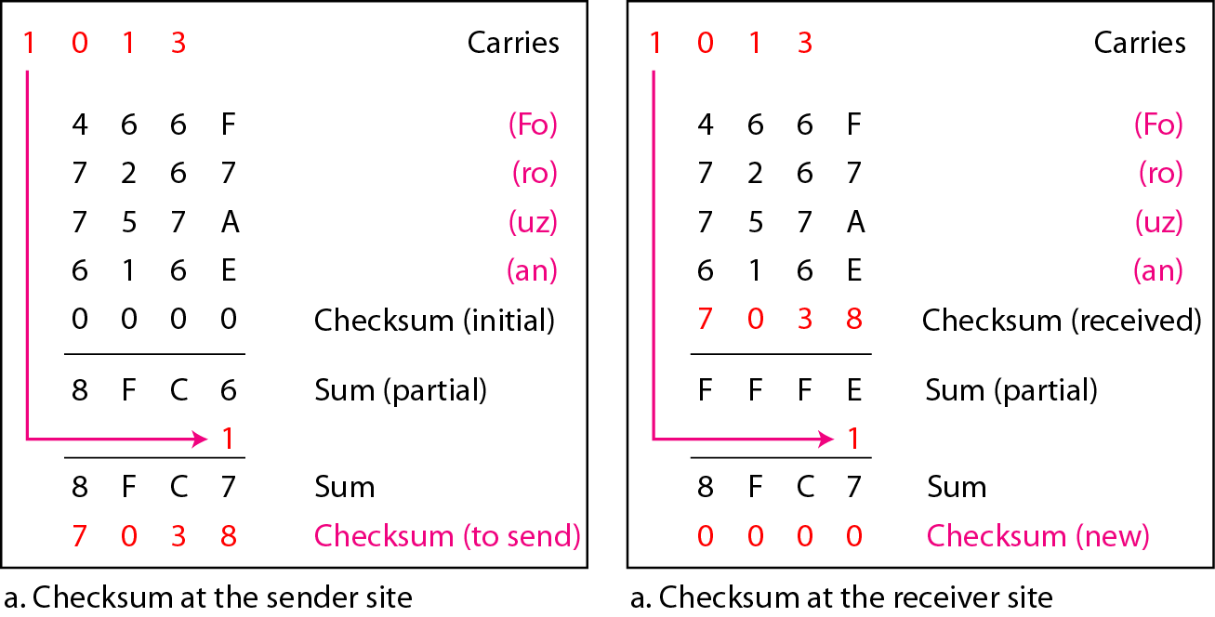
Internet Checksum: Example
10-45

