Slide 1
Chapter 3. Data and Signals
Analog and Digital
Periodic Analog Signals
Digital Signals
Transmission Impairment
Data Rate Limits
Performance

Slide 2
Analog and Digital
To be transmitted, data must be transformed to electromagnetic signals
Data can be analog or digital. Analog data are continuous and take continuous values. Digital data have discrete states and take on discrete values.
Signals can be analog or digital. Analog signals can have an infinite number of values in a range; digital signals can have only a limited number of values.

Slide 3
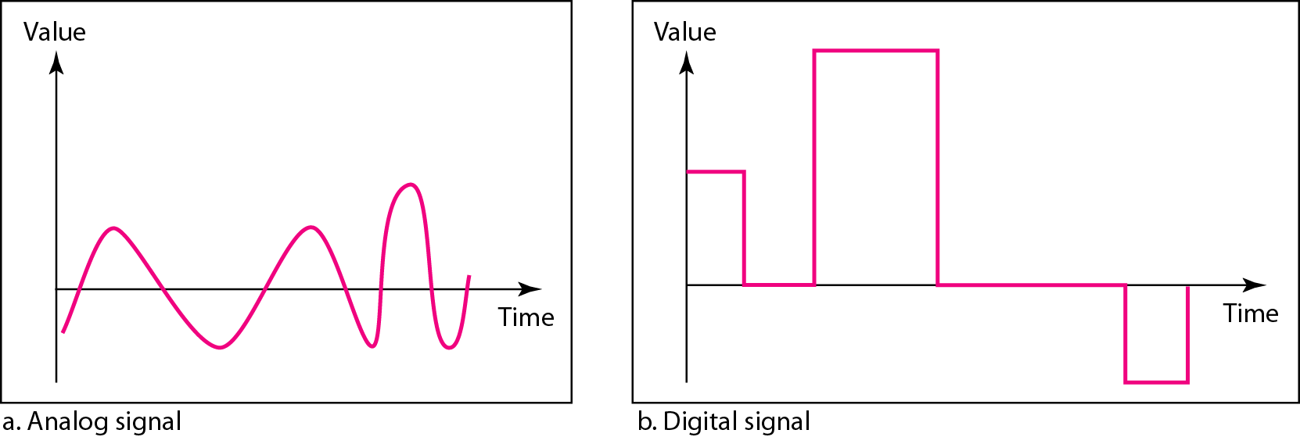
Analog and Digital Signals
3-3

Slide 4
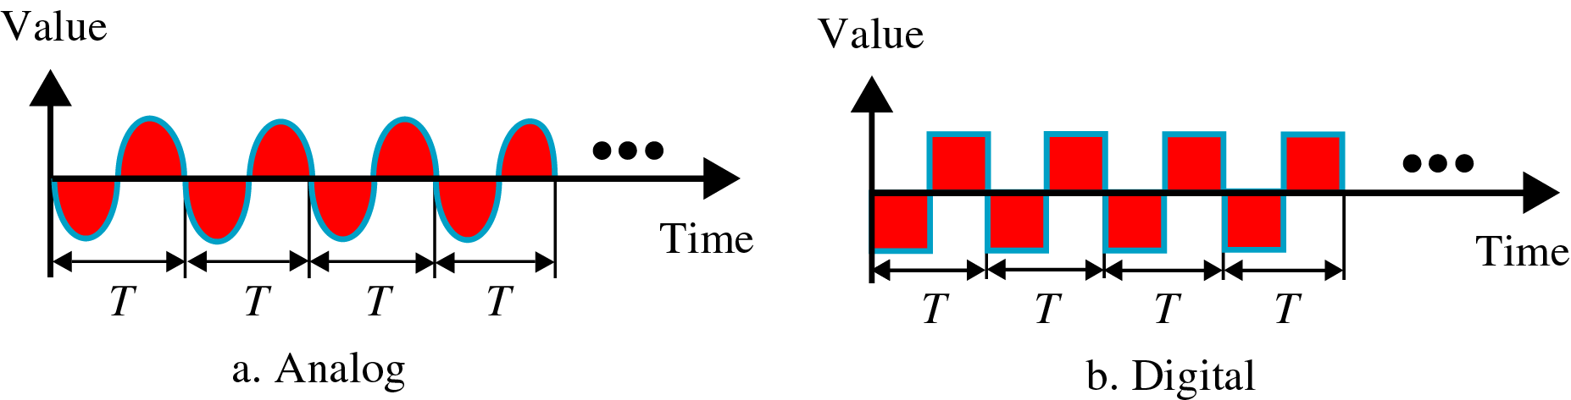
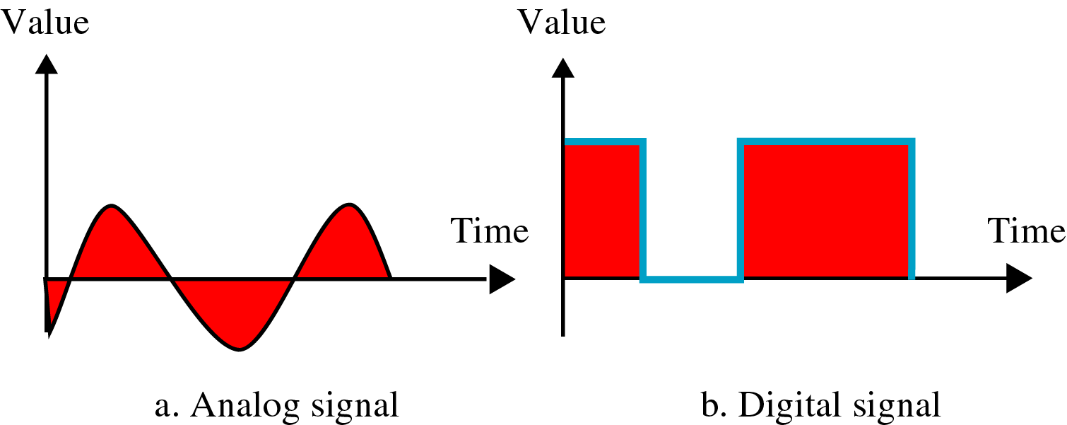
Periodic and Nonperiodic Signals
In data communication, we commonly use periodic analog signals and nonperiodic digital signals

Slide 5
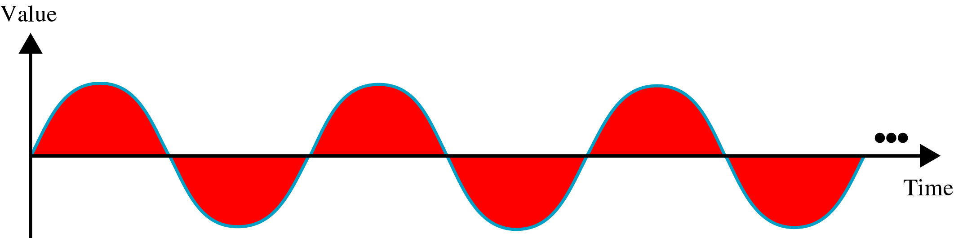
Periodic Analog Signals
3-5
Periodic analog signals can be classified as simple or composite.
A simple periodic analog signal, a sine wave, cannot be decomposed into simpler signals.
A composite periodic analog signal is composed of multiple sine waves
Sine wave is described by
Amplitude
Period (frequency)
phase

Slide 6
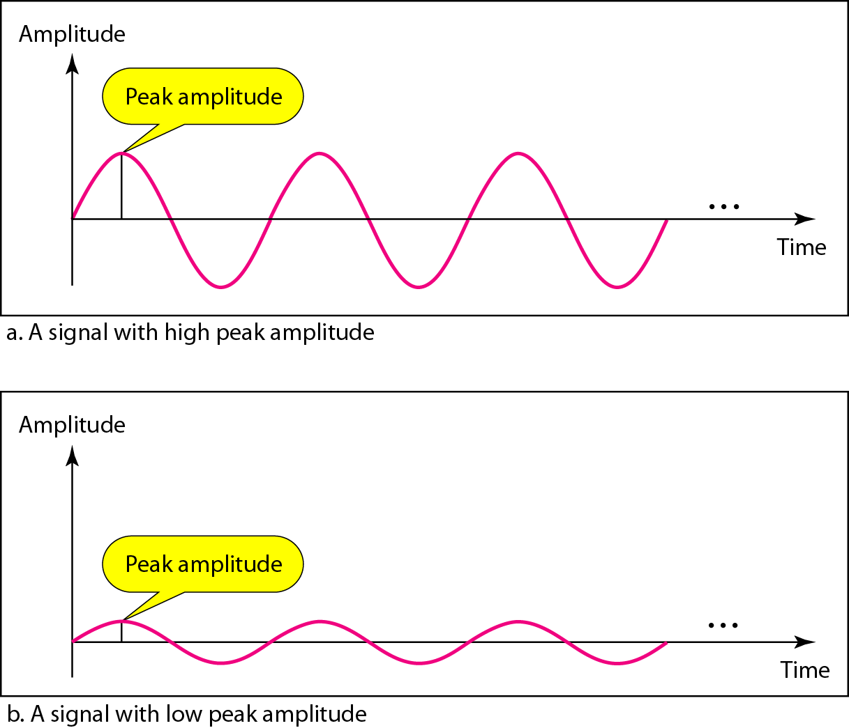
Amplitude
3-6

Slide 7
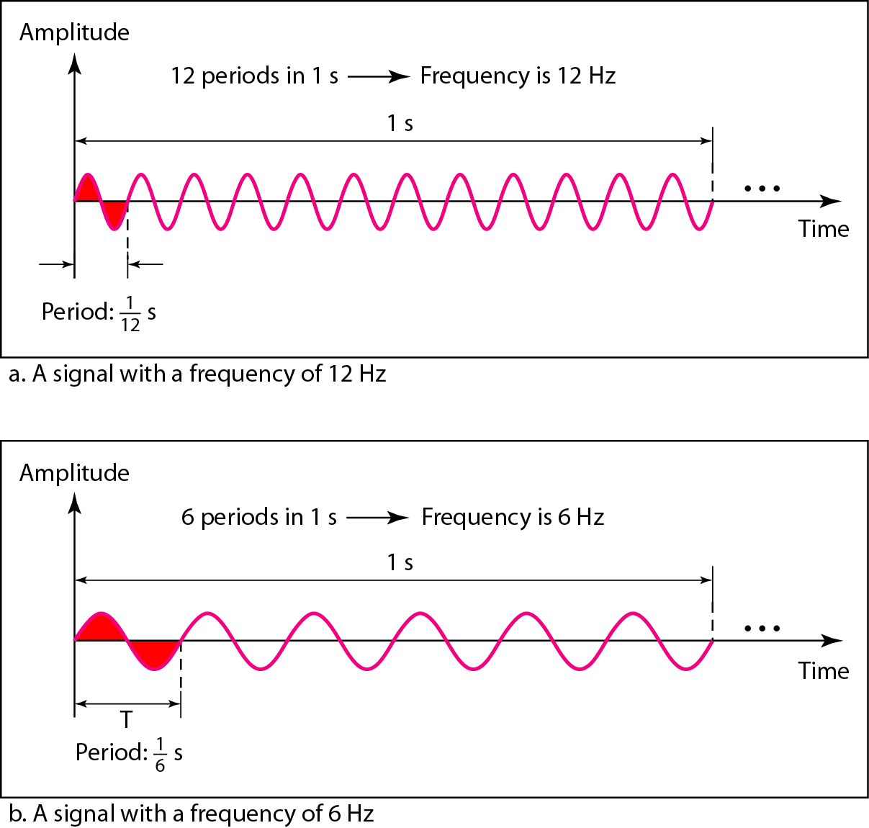
Period and Frequency
3-7
Frequency and period are the inverse of each

Slide 8
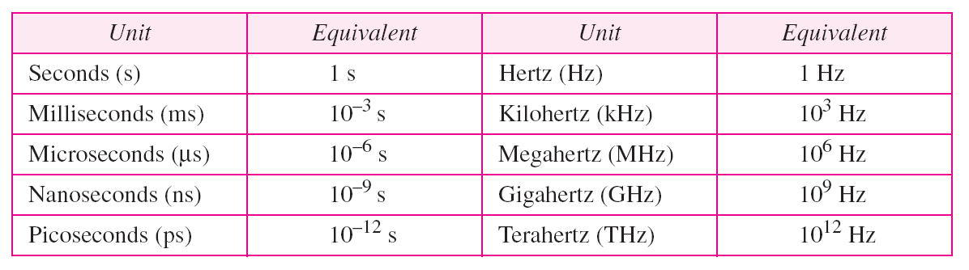
Units of Period and Frequency
3-8

Slide 9
Example 3.5
3-9
Express a period of 100 ms in microseconds, and express the corresponding frequency in kilohertz
From Table 3.1 we find the equivalent of 1 ms. We make the following substitutions:
100 ms = 100 × 10⁻³ s = 100 × 10⁻³ × 10⁶ μs = 10⁵ μs
Now we use the inverse relationship to find the frequency, changing hertz to kilohertz
100 ms = 100 × 10⁻³ s = 10⁻¹ s f = 1/10⁻¹ Hz = 10 × 10⁻³ KHz = 10⁻² KHz

Slide 10
More About Frequency
3-10
Another way to look frequency
Frequency is a measurement of the rate of changes
Change in a short span of time means high frequency
Change over a long span of time means low frequency
Two extremes
No change at all ⇒ zero frequency
Instantaneous changes ⇒ infinite frequency

Slide 11
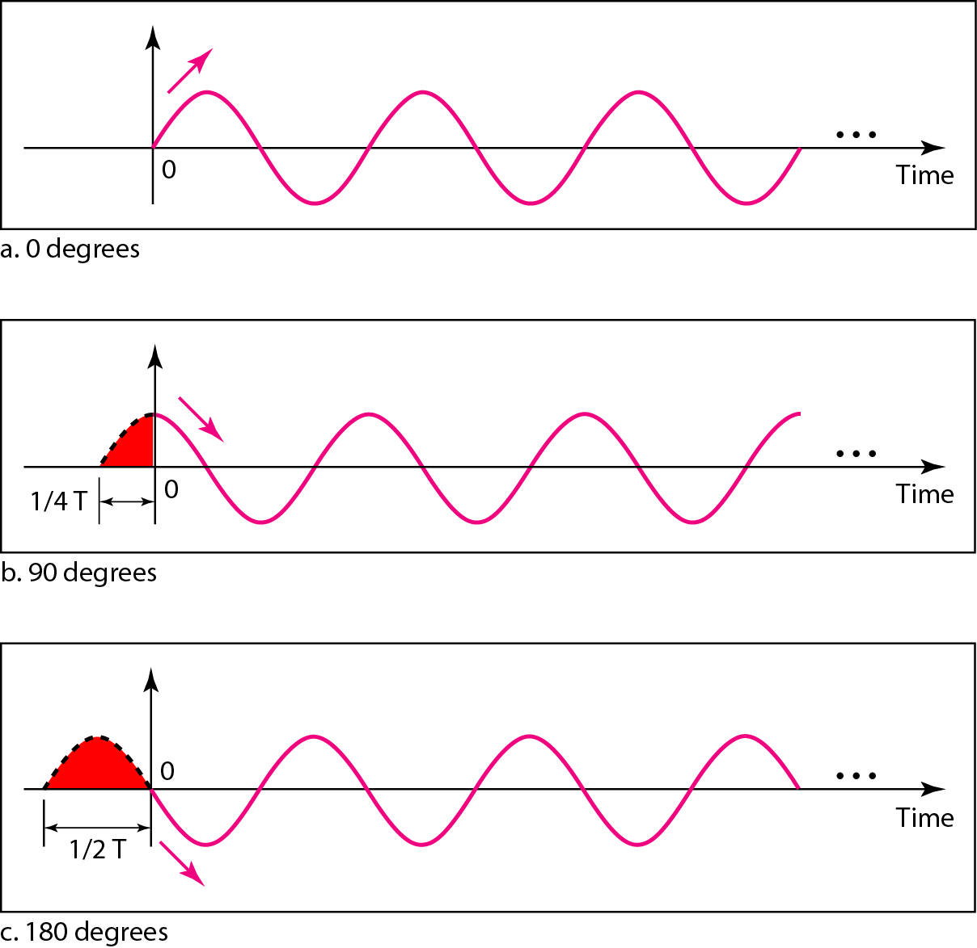
Phase
3-11
Phase describes the position of the waveform relative to time zero

Slide 12
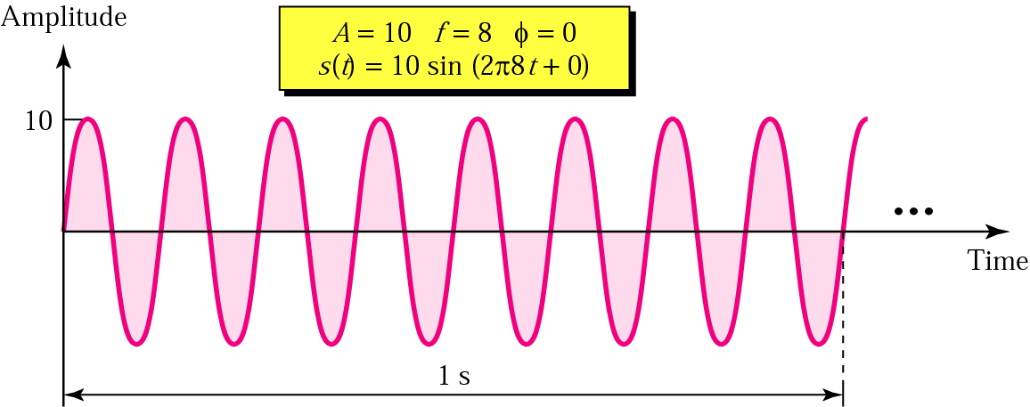
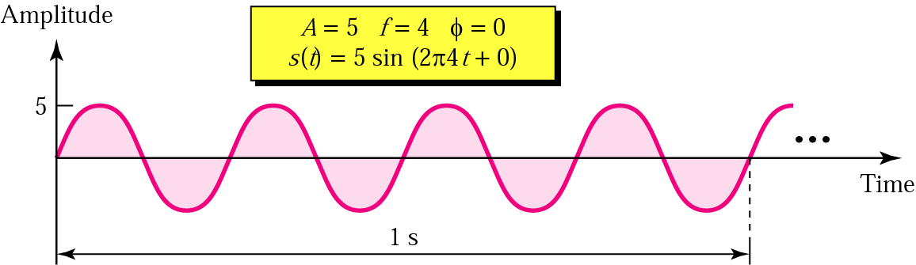
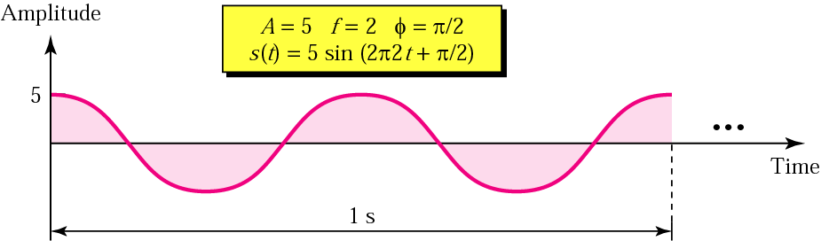
Sine Wave Examples
3-12

Slide 13
Example 3.6
3-13
A sine wave is offset one-sixth of a cycle with respect to time zero. What is its phase in degrees and radians?
We know that one complete cycle is 360 degrees.
Therefore, 1/6 cycle is
(1/6) 360 = 60 degrees = 60 x 2π /360 rad = 1.046 rad

Slide 14
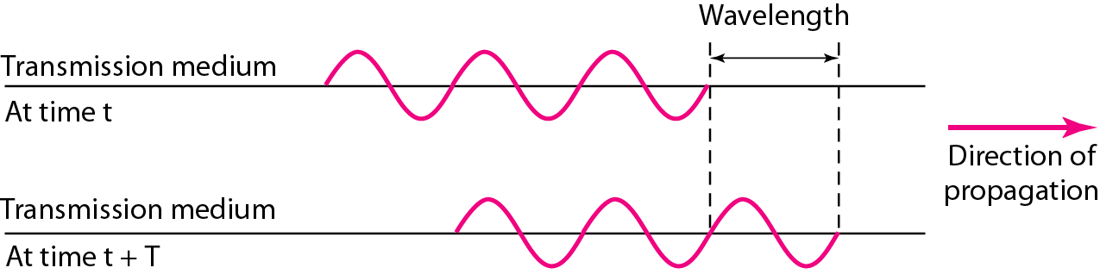
Wavelength
3-14
Another characteristic of a signal traveling through a transmission medium
Binds the period or the frequency of a simple sine wave to the propagation speed of the medium
Wavelength = propagation speed x period
= propagation speed/frequency

Slide 15
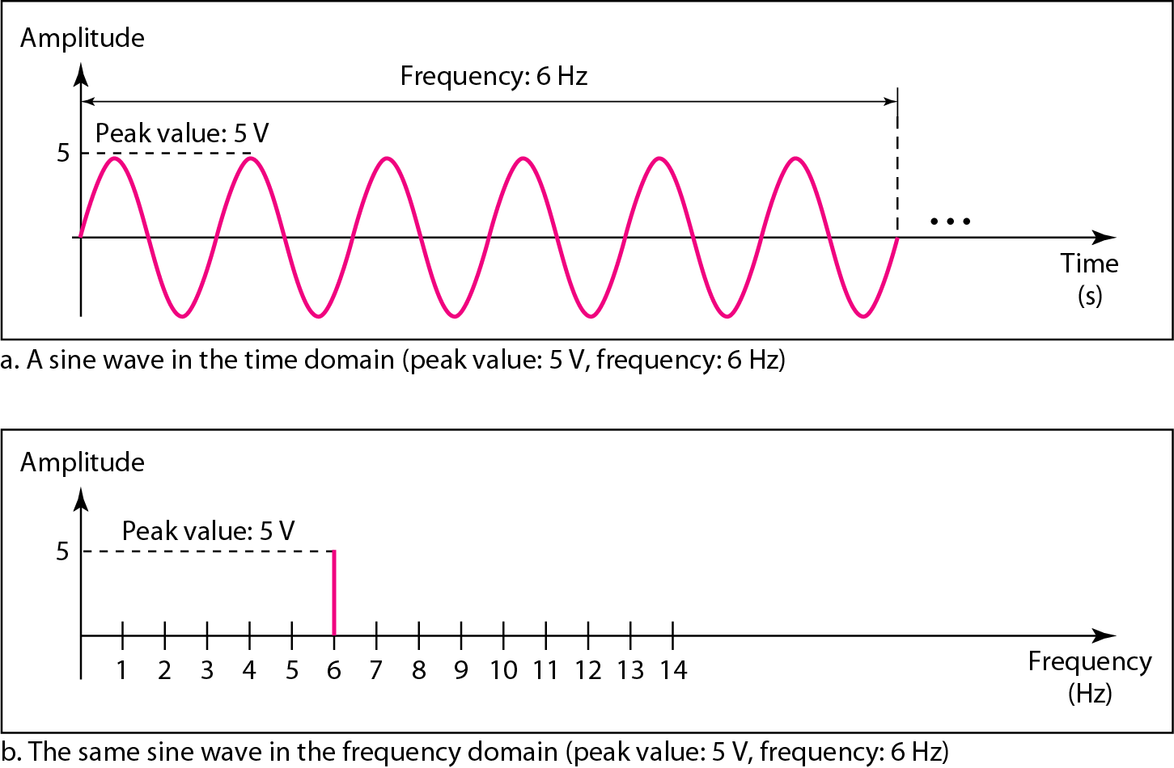
Time and Frequency Domains
3-15
A complete sine wave in the time domain can be represented by one single spike in the frequency domain.

Slide 16
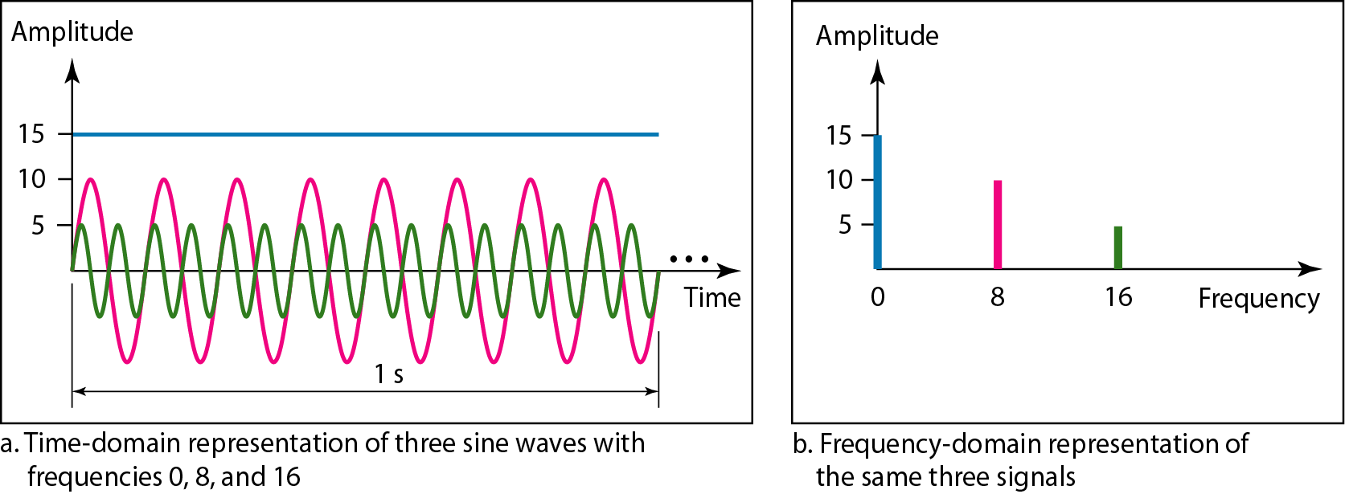
Example 3.7
3-16
Time domain and frequency domain of three sine waves with frequencies 0, 8, 16
Frequency domain is more compact and useful when we are dealing with more than one sine waves.

Slide 17
Composite Signals
3-17
A single-frequency sine wave is not useful in data communications; we need to send a composite signal, a signal made of many simple sine waves
When we change one or more characteristics of a single-frequency signal, it becomes a composite signal made of many frequencies
According to Fourier analysis, any composite signal is a combination of simple sine waves with different frequencies, phases, and amplitudes
If the composite signal is periodic, the decomposition gives a series of signals with discrete frequencies; if the composite signal is nonperiodic, the decomposition gives a combination of sine waves with continuous frequencies.

Slide 18
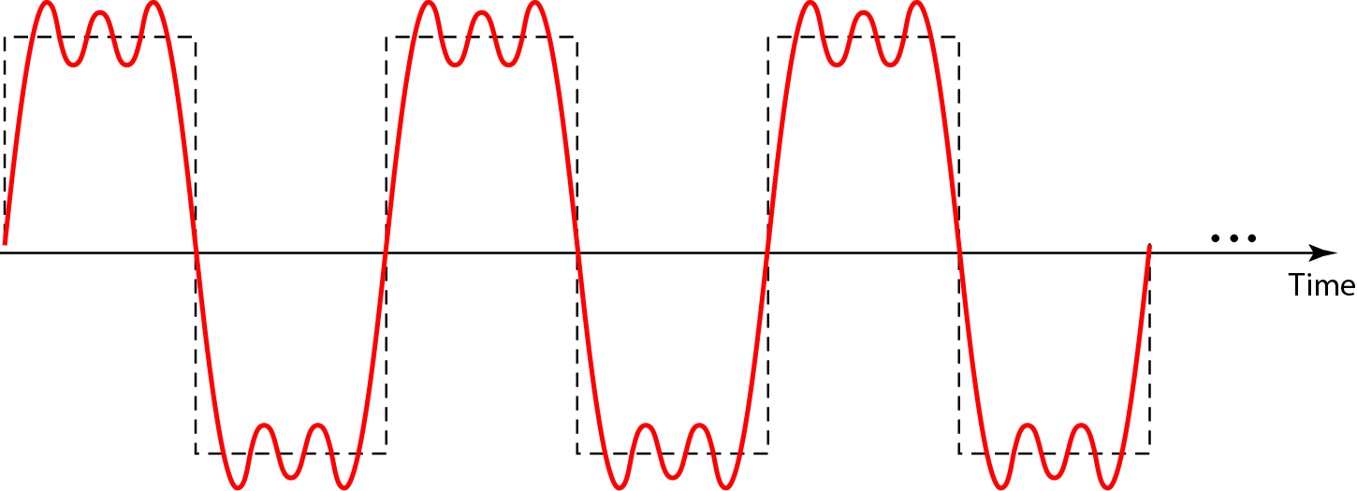
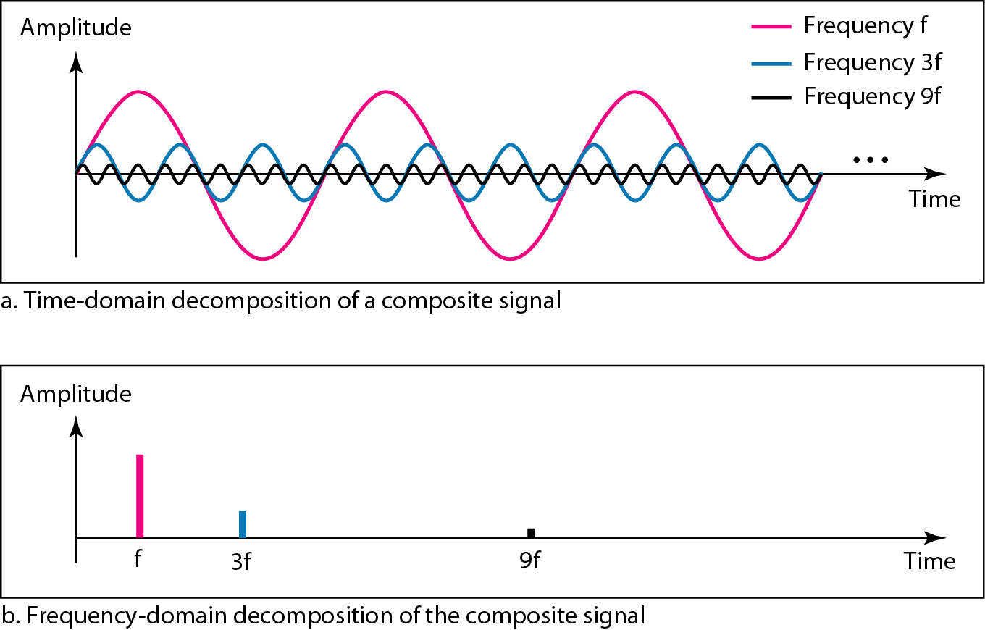
Composite Periodic Signal
3-18

Slide 19
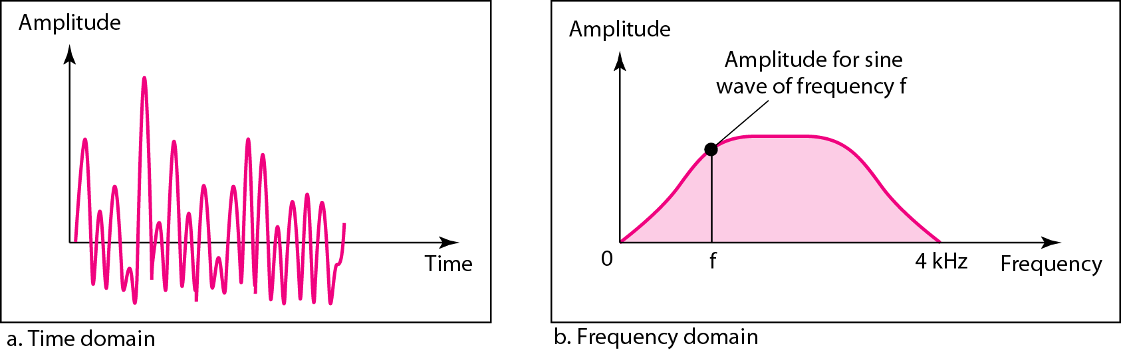
Composite Nonperiodic Signal
3-19

Slide 20
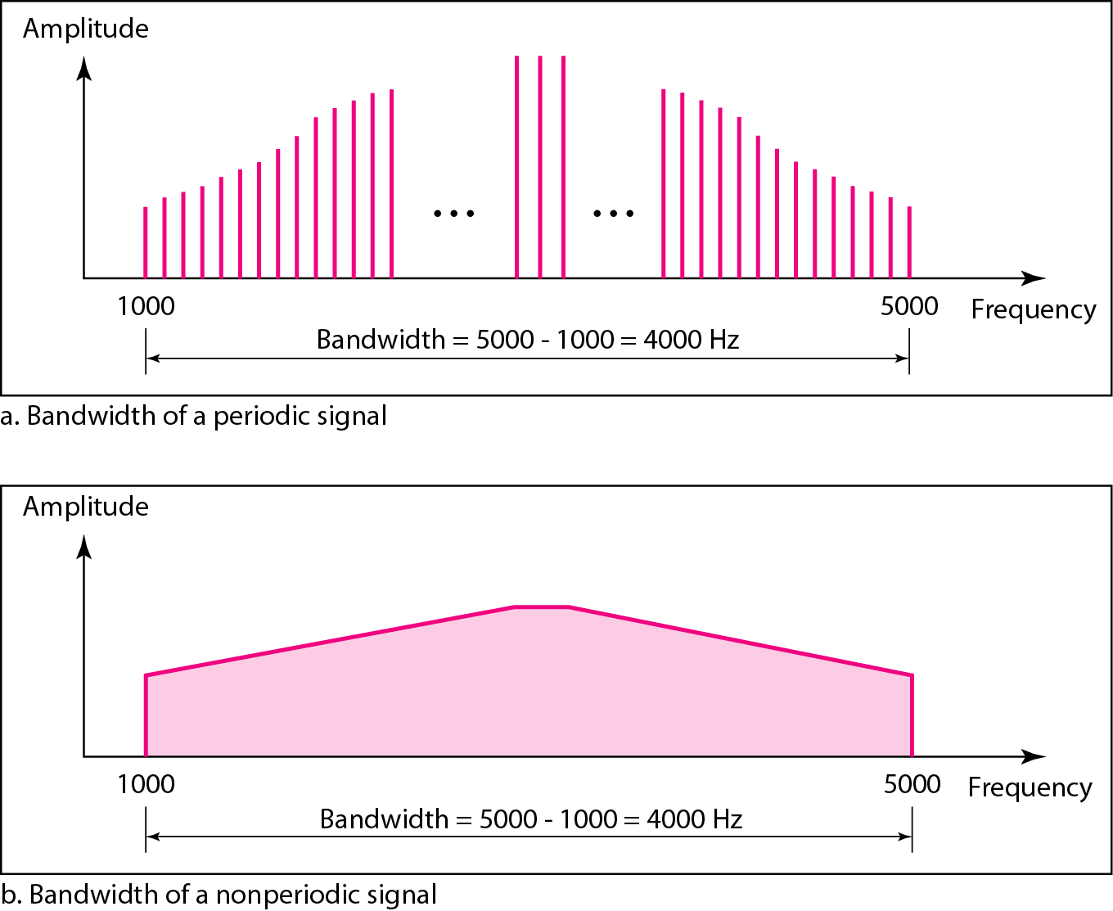
Bandwidth
3-20
The bandwidth of a composite signal is the difference between the highest and the lowest frequencies contained in that signal

Slide 21
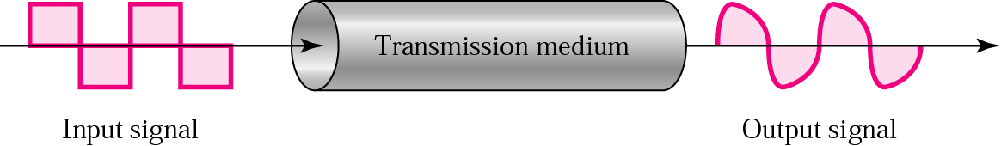
Signal Corruption
3-21

Slide 22
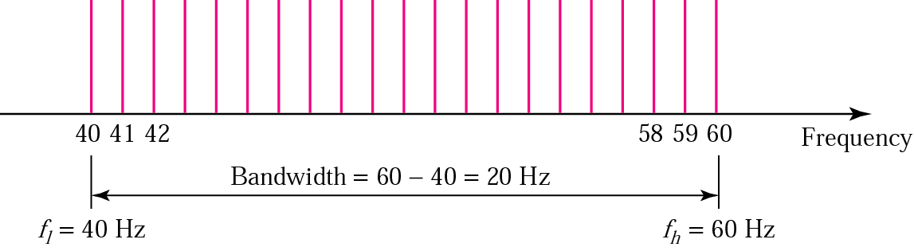
Example 3.11
3-22
A signal has a bandwidth of 20 Hz. The highest frequency is 60 Hz. What is the lowest frequency? Draw the spectrum if the signal contains all integral frequencies of the same amplitude
B = f_{h} - f_{l}, 20 = 60 – f_{l}, f_{l} = 60 - 20 = 40 Hz

Slide 23
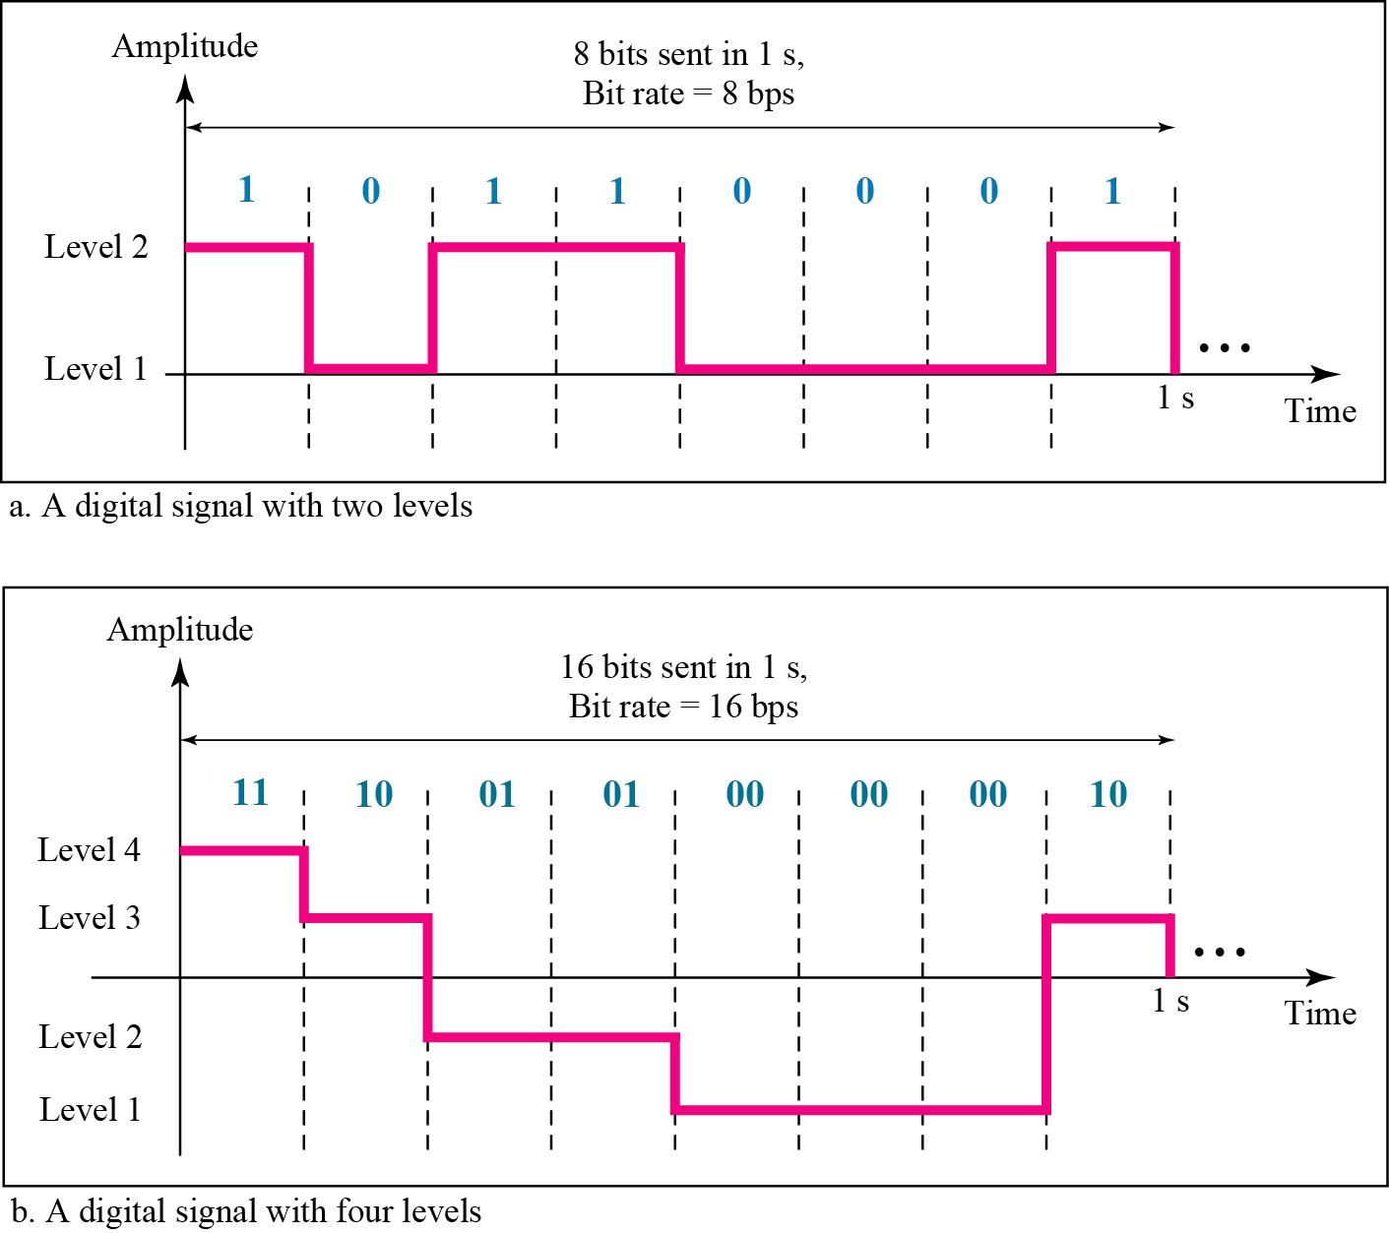
Digital Signals
3-23

Slide 24
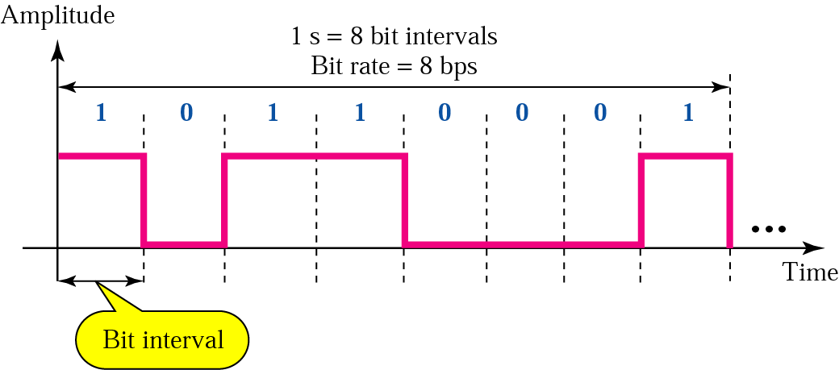
Bit Rate and Bit Interval
3-24

Slide 25
Example 3.18
3-25
Assume we need to download text documents at the rate of 100 pages per minute. What is the required bit rate of the channel?
Solution
A page is an average of 24 lines with 80 characters in each line. If we assume that one character requires 8 bits, the bit rate is

Slide 26
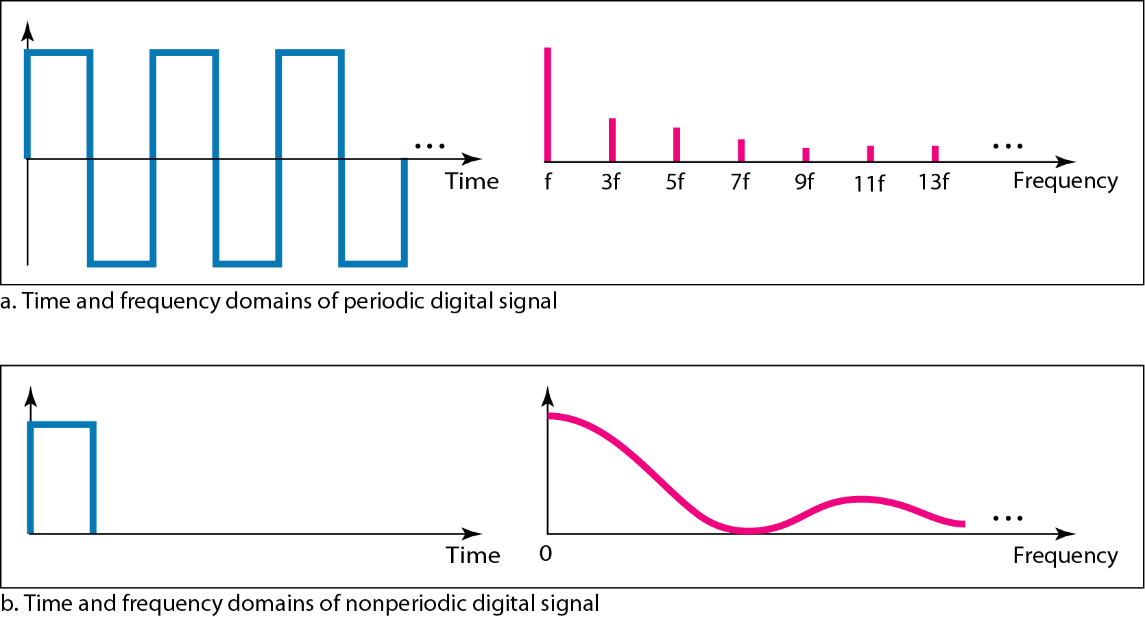
Digital Signal as a Composite Analog Signal
3-26

Slide 27
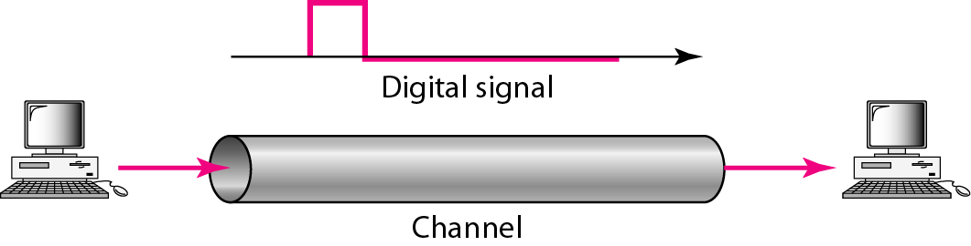
Transmission of Digital Signals
3-27
A digital signal is a composite analog signal with an infinite bandwidth
Baseband transmission: Sending a digital signal without changing into an analog signal

Slide 28
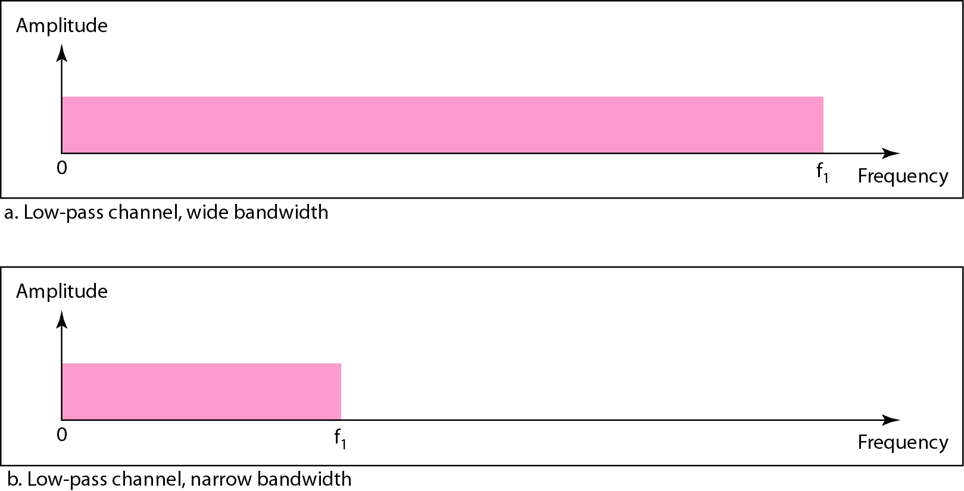
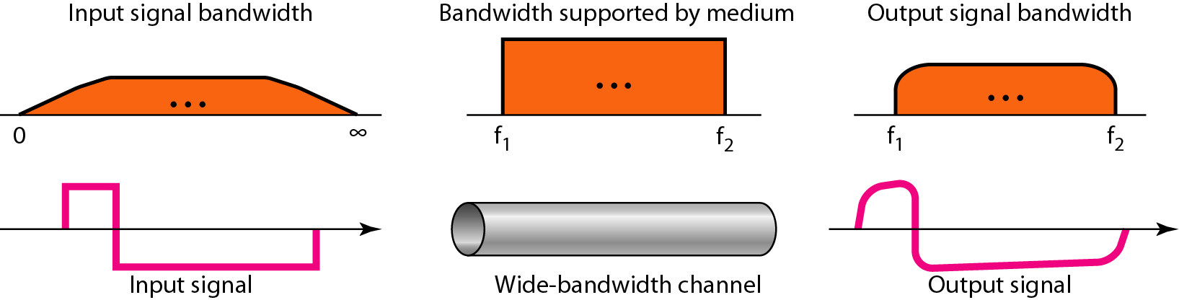
Low-Pass Channel with Wide Bandwidth
3-28
Baseband transmission of a digital signal that preserves the shape of the digital signal is possible only if we have a low-pass channel with infinite or very wide bandwidth

Slide 29
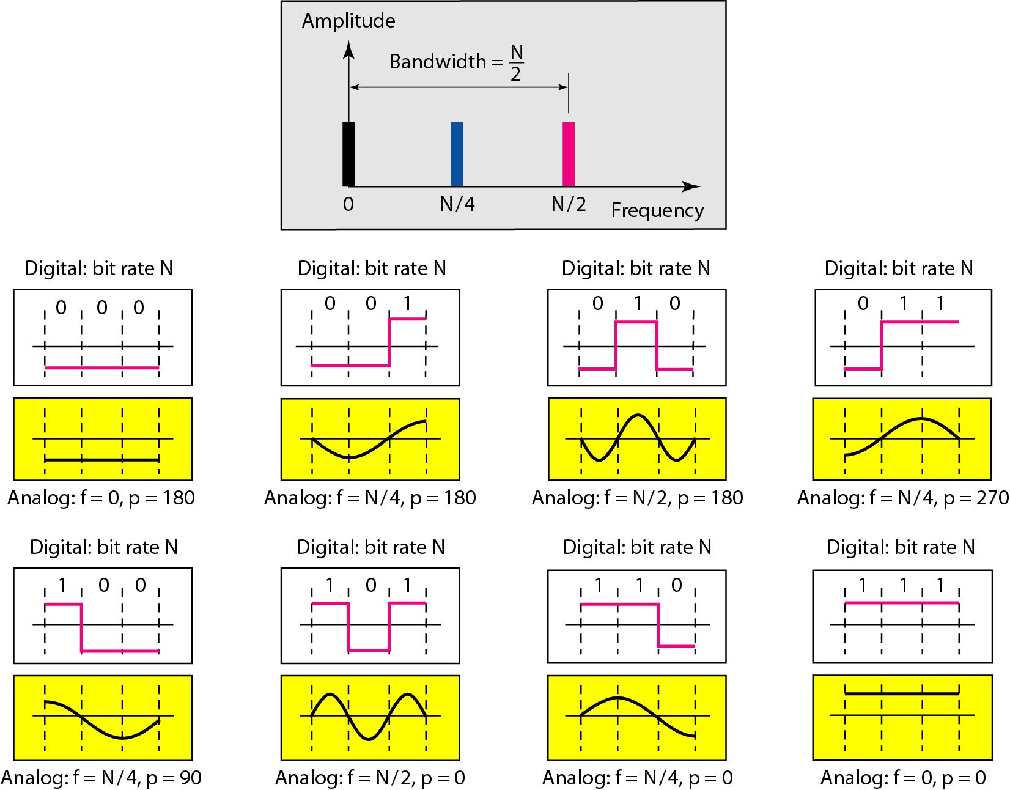
Low-Pass Channel with Limited Bandwidth
3-29
Rough approximation

Slide 30
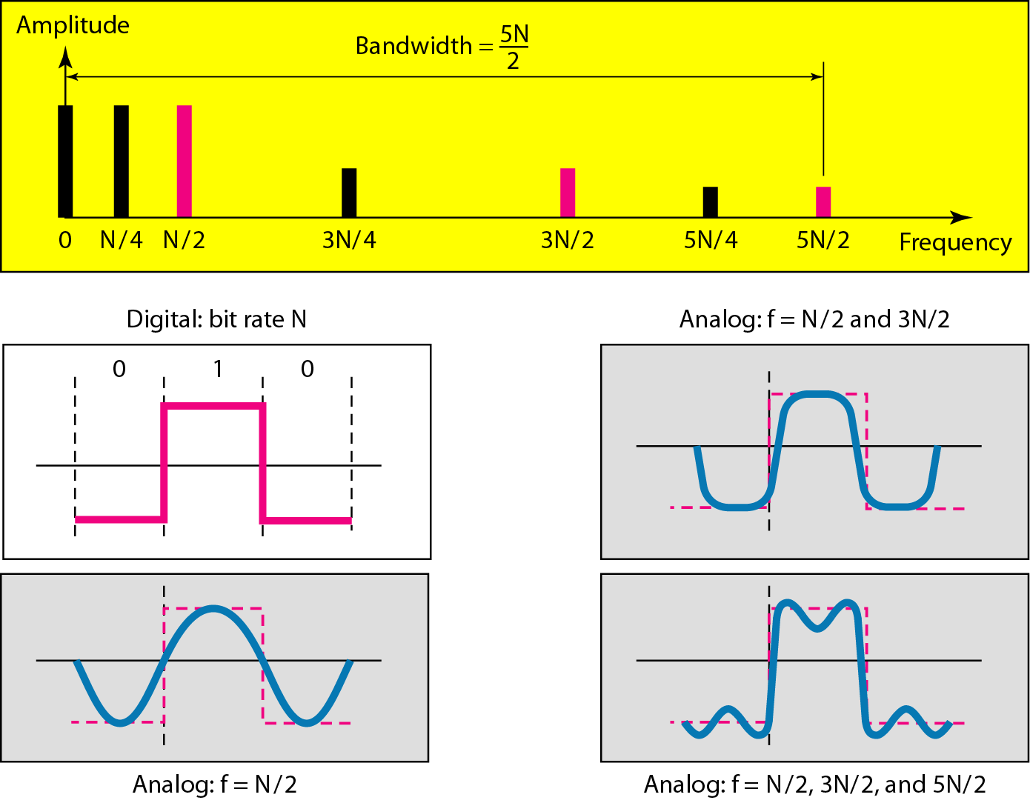
Low-Pass Channel with Limited Bandwidth
3-30
Better approximation

Slide 31
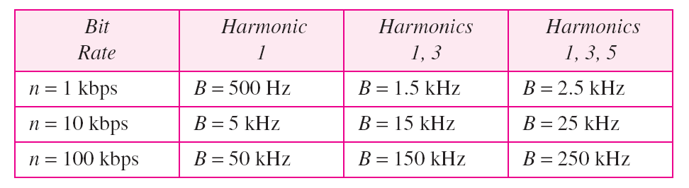
Bandwidth Requirement
3-31
In baseband transmission, the required bandwidth is proportional to the bit rate; if we need to send bits faster, we need more bandwidth

Slide 32
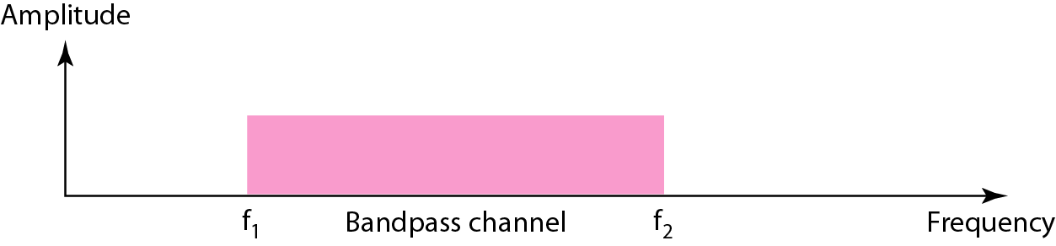
Broadband Transmission (Using Modulation)
3-32
Modulation allows us to use a bandpass channel
If the available channel is a bandpass channel, we cannot send the digital signal directly to the channel; we need to convert the digital signal to an analog signal before transmission.

Slide 33
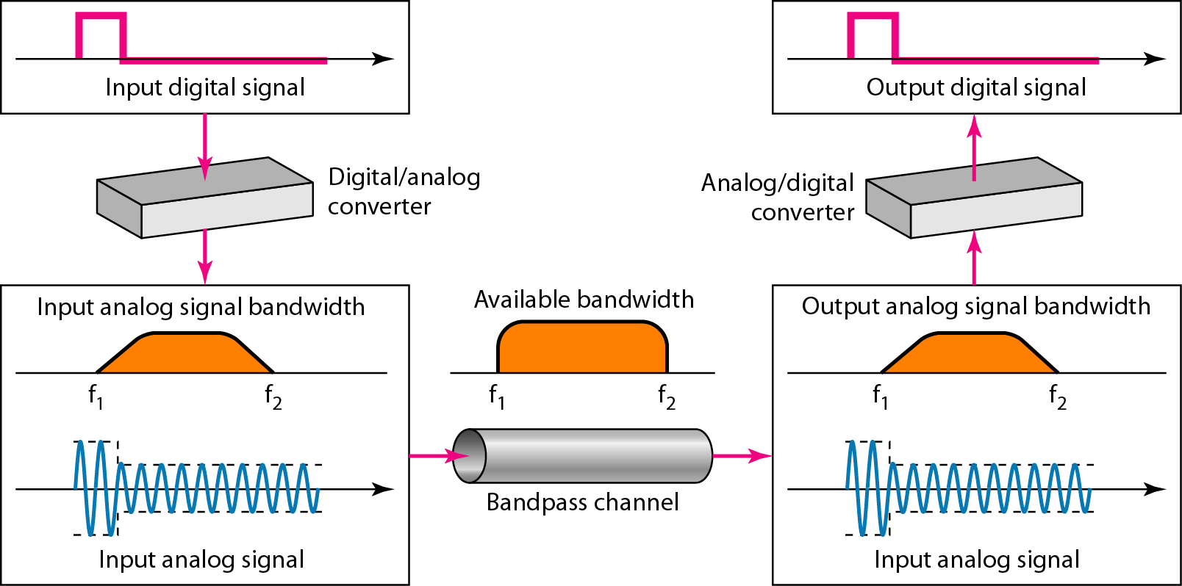
Modulation for Bandpass Channel
3-33

Slide 34
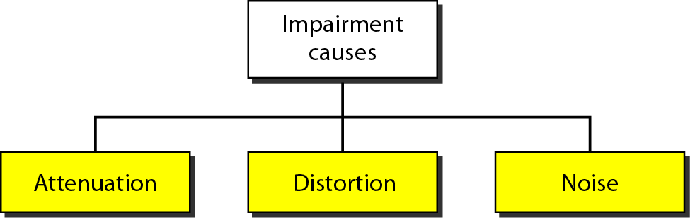
Transmission Impairment
3-34

Slide 35
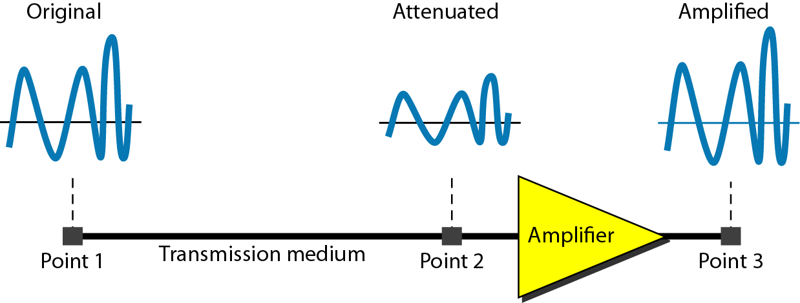
Attenuation
3-35
Loss of energy to overcome the resistance of the medium: heat

Slide 36

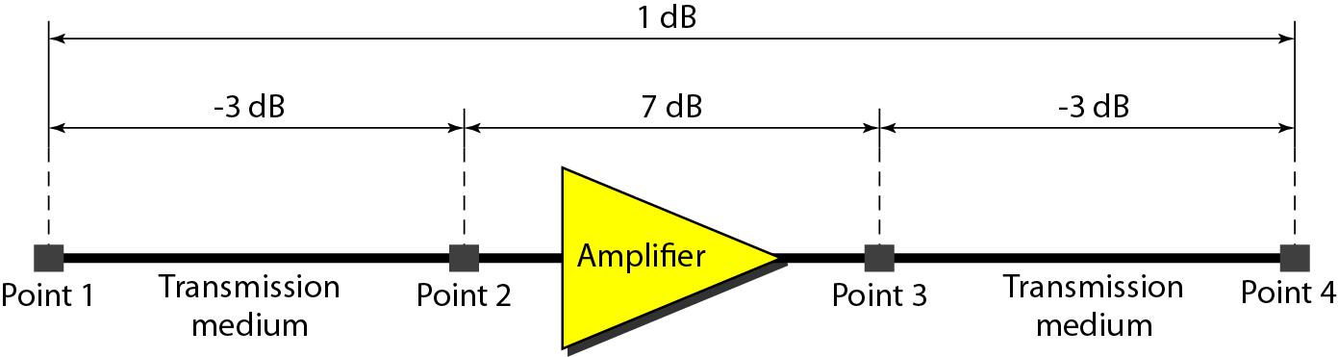
Decibel
3-36
Example 3.26: Suppose a signal travels through a transmission medium and its power is reduced to one-half. This means that P₂ is (1/2)P₁. In this case, the attenuation (loss of power) can be calculated as
Example 3.28

Slide 37
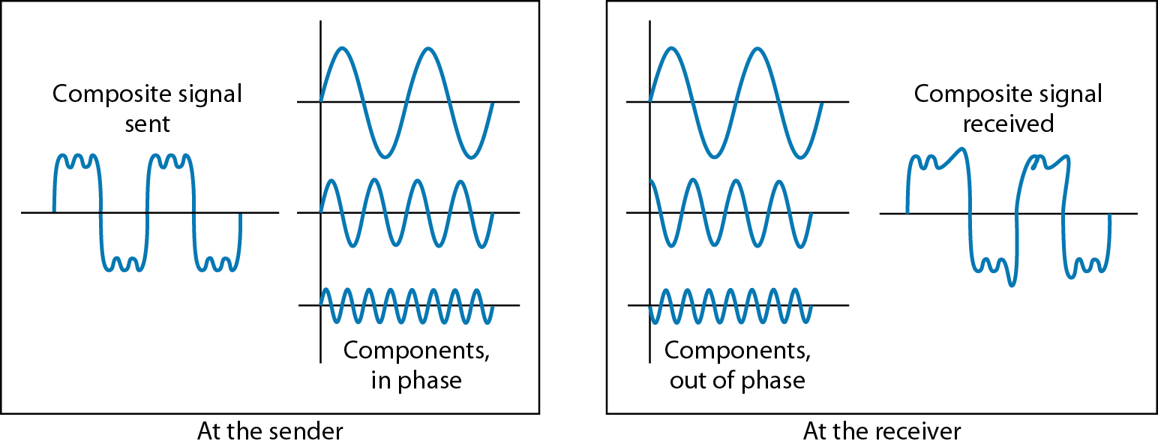
Distortion
3-37
The signal changes its form or shape
Each signal component in a composite signal has its own propagation speed
Differences in delay may cause a difference in phase

Slide 38
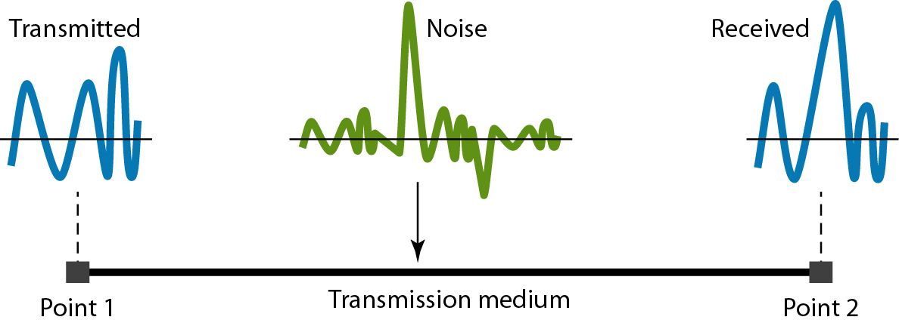
Noise
3-38
Several types of noises, such as thermal noise, induced noise, crosstalk, and impulse noise, may corrupt the signal
Thermal noise is the random motion of elections in a wire which creates an extra signal not originally sent by the transmitter.

Slide 39
Signal-to-Noise Ratio (SNR)
3-39
To find the theoretical bit rate limit
SNR = average signal power/average noise power
SNR_{dB} = 10 log₁₀ SNR
Example 3.31: The power of a signal is 10 mW and the power of the noise is 1 μW; what are the values of SNR and SNR_{dB} ?
Solution:

Slide 40
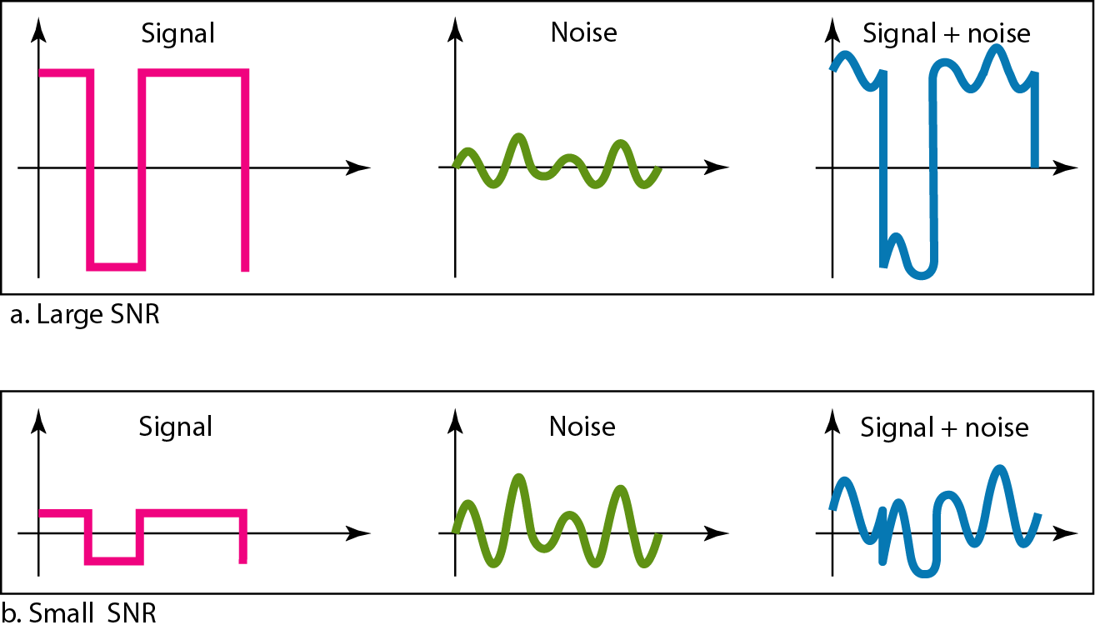
Two Cases of SNRs
3-40

Slide 41
Data Rate Limits
3-41
Data rate depends on three factors:
Bandwidth available
Level of the signals we use
Quality of the channel (the noise level)
Noiseless channel: Nyquist Bit Rate
Bit rate = 2 * Bandwidth * log₂L
Increasing the levels may cause the reliability of the system
Noisy channel: Shannon Capacity
Capacity = Bandwidth * log₂(1 + SNR)

Slide 42
Nyquist Bit Rate: Examples
3-42
Consider a noiseless channel with a bandwidth of 3000 Hz transmitting a signal with two signal levels. The maximum bit rate can be calculated as
Bit Rate = 2 × 3000 × log₂ 2 = 6000 bps
Consider the same noiseless channel, transmitting a signal with four signal levels (for each level, we send two bits). The maximum bit rate can be calculated as:
Bit Rate = 2 x 3000 x log₂ 4 = 12,000 bps

Slide 43
Shannon Capacity: Examples
3-43
Consider an extremely noisy channel in which the value of the signal-to-noise ratio is almost zero. In other words, the noise is so strong that the signal is faint. For this channel the capacity is calculated as
C = B log₂ (1 + SNR) = B log₂ (1 + 0) = B log₂ (1) = B × 0 = 0
We can calculate the theoretical highest bit rate of a regular telephone line. A telephone line normally has a bandwidth of 3000 Hz (300 Hz to 3300 Hz). The signal-to-noise ratio is usually 3162. For this channel the capacity is calculated as
C = B log₂ (1 + SNR) = 3000 log₂ (1 + 3162) = 3000 log₂ (3163)
C = 3000 × 11.62 = 34,860 bps

Slide 44
Using Both Limits
3-44
The Shannon capacity gives us the upper limit; the Nyquist formula tells us how many signal levels we need.
Example: We have a channel with a 1 MHz bandwidth. The SNR for this channel is 63; what is the appropriate bit rate and signal level?
First, we use the Shannon formula to find our upper limit
C = B log₂ (1 + SNR) = 106 log₂ (1 + 63)
= 106 log₂ (64) = 6 Mbps
Then we use the Nyquist formula to find the
number of signal levels
4 Mbps = 2 × 1 MHz × log₂ L ➔ L = 4

Slide 45
Performance
3-45
Bandwidth (in two contexts)
Bandwidth in hertz, refers to the range of frequencies in a composite signal or the range of frequencies that a channel can pass.
Bandwidth in bits per second, refers to the speed of bit transmission in a channel or link.
Throughput
Measurement of how fast we can actually send data through a network
Latency (Delay)
Define how long it takes for an entire message to completely arrive at the destination from the time the first bit is sent out from the source
Latency = propagation time + transmission time + queuing time + processing delay
Propagation time = Distance/Propagation speed
Transmission time = Message size/Bandwidth
Jitter

Slide 46
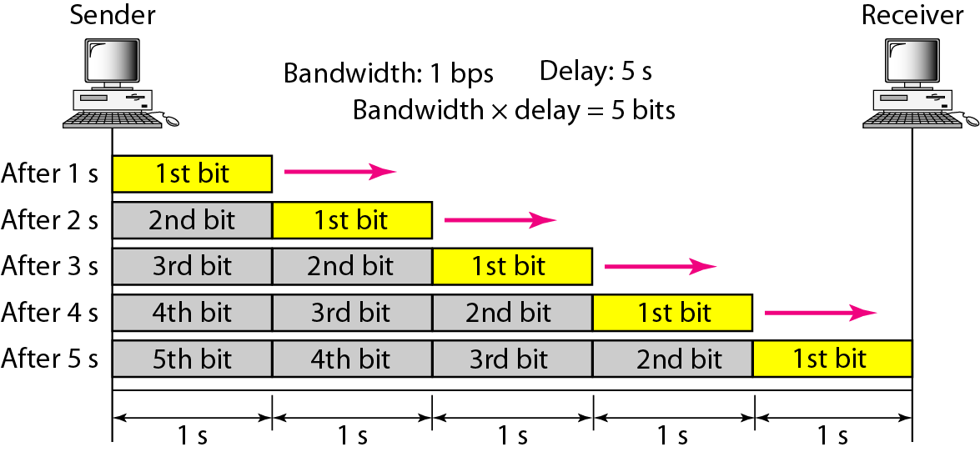
Bandwidth-Delay Product
3-46
The bandwidth-delay product defines the number of bits that can fill the link

Slide 47
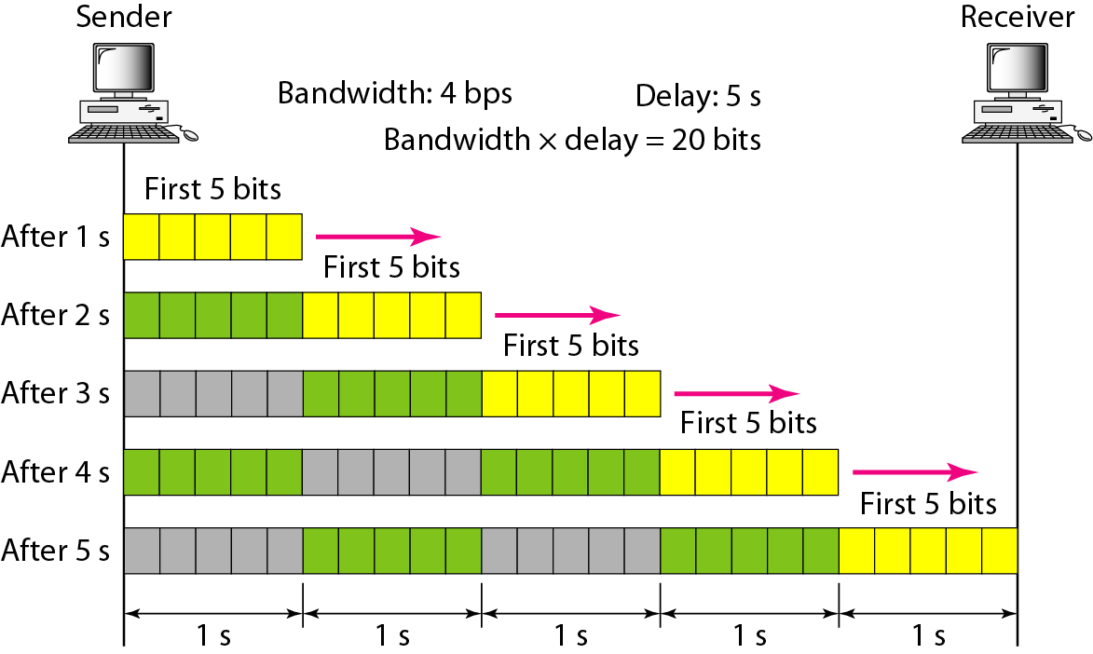

Bandwidth-Delay Product
3-47
Bandwidth-delay product concept

