Slide 1
Chapter 4. Digital Transmission
Digital-to-Digital Conversion
Analog-to-Digital Conversion
Transmission Mode

Slide 2
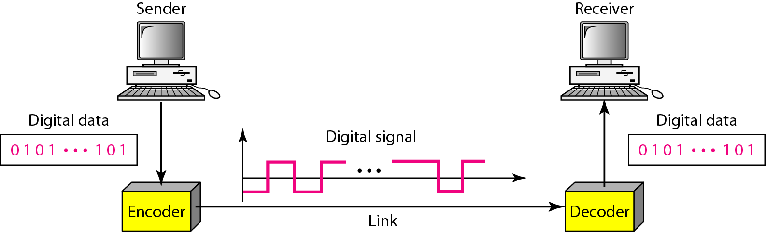
Digital-to-Digital Conversion
3-2
Involves three techniques:
Line coding (always needed), block coding, and scrambling
Line coding: the process of converting digital data to digital signals

Slide 3
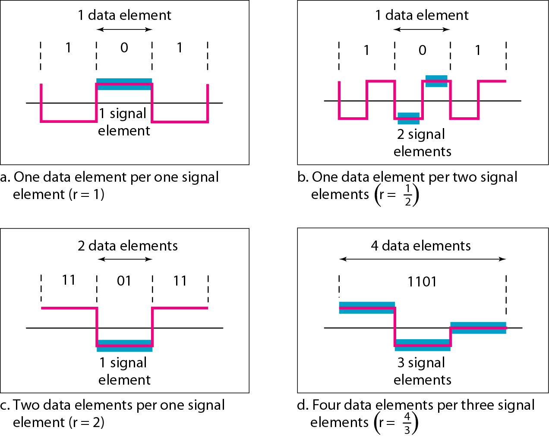
Signal Element and Data Element
3-3
Data elements are what we need to send; signal elements are what we can send

Slide 4
Data Rate Versus Signal Rate
3-4
Data rate defines the number of data elements (bits) sent in 1s: bps
Signal rate is the number of signal elements sent in 1s: baud
Data rate = bit rate, signal rate = pulse rate, modulation rate, baud rate
S = c x N x 1/r, where N is the date rate; c is the case factor, S is the number of signal elements; r is the number of data elements carried by each signal element
Although the actual bandwidth of a digital signal is infinite, the effective bandwidth is finite
The bandwidth is proportional to the signal rate (baud rate)
The minimum bandwidth: B_{min} = c x N x 1/r
The maximum data rate: N_{max} = 1/c x B x r

Slide 5
Design Consideration for Line Coding Scheme
3-5
Baseline wandering
Long string of 0s and 1s can cause a drift in the baseline
DC components
DC or low frequencies cannot pass a transformer or telephone line (below 200 Hz)
Self-synchronization
Built-in error detection
Immunity to noise and interference
Complexity

Slide 6
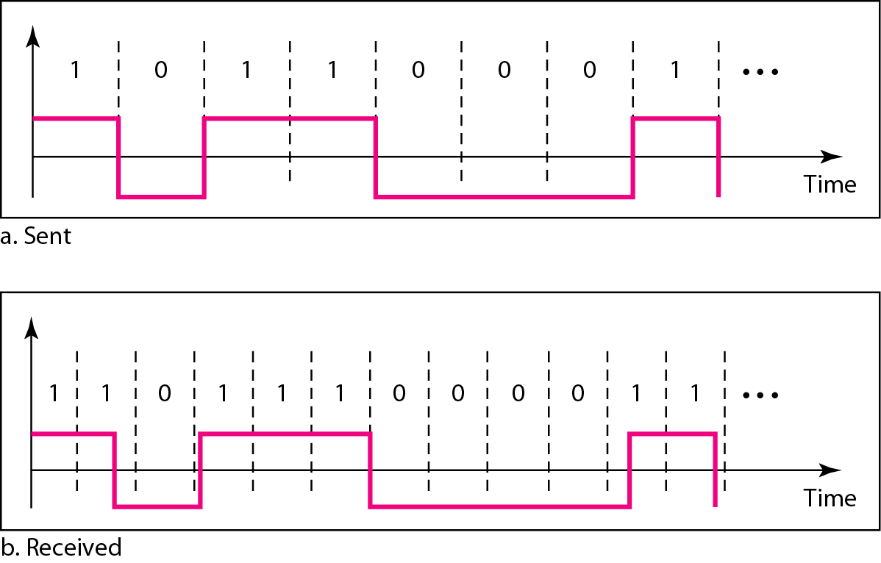
Lack of Synchronization
3-6

Slide 7
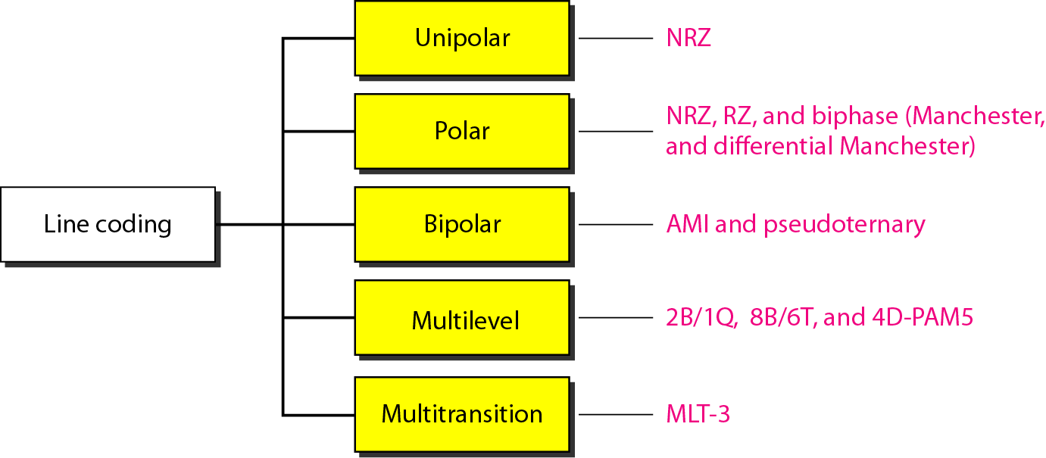
Line Coding Schemes
3-7

Slide 8
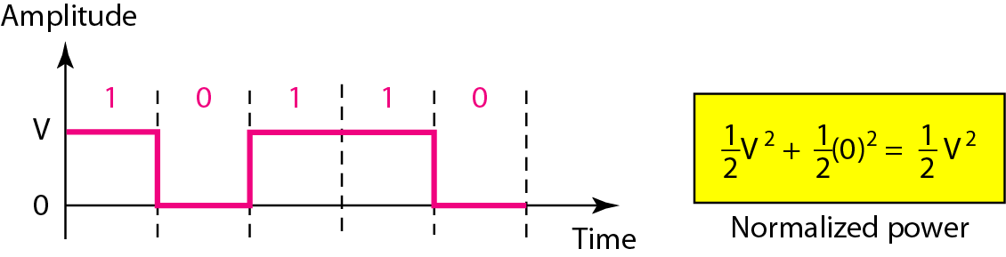
Unipolar Scheme
3-8
One polarity: one level of signal voltage
Unipolar NRZ (None-Return-to-Zero) is simple, but
DC component : Cannot travel through microwave or transformer
Synchronization : Consecutive 0’s and 1’s are hard to be synchronized → Separate line for a clock pulse
Normalized power is double that for polar NRZ

Slide 9
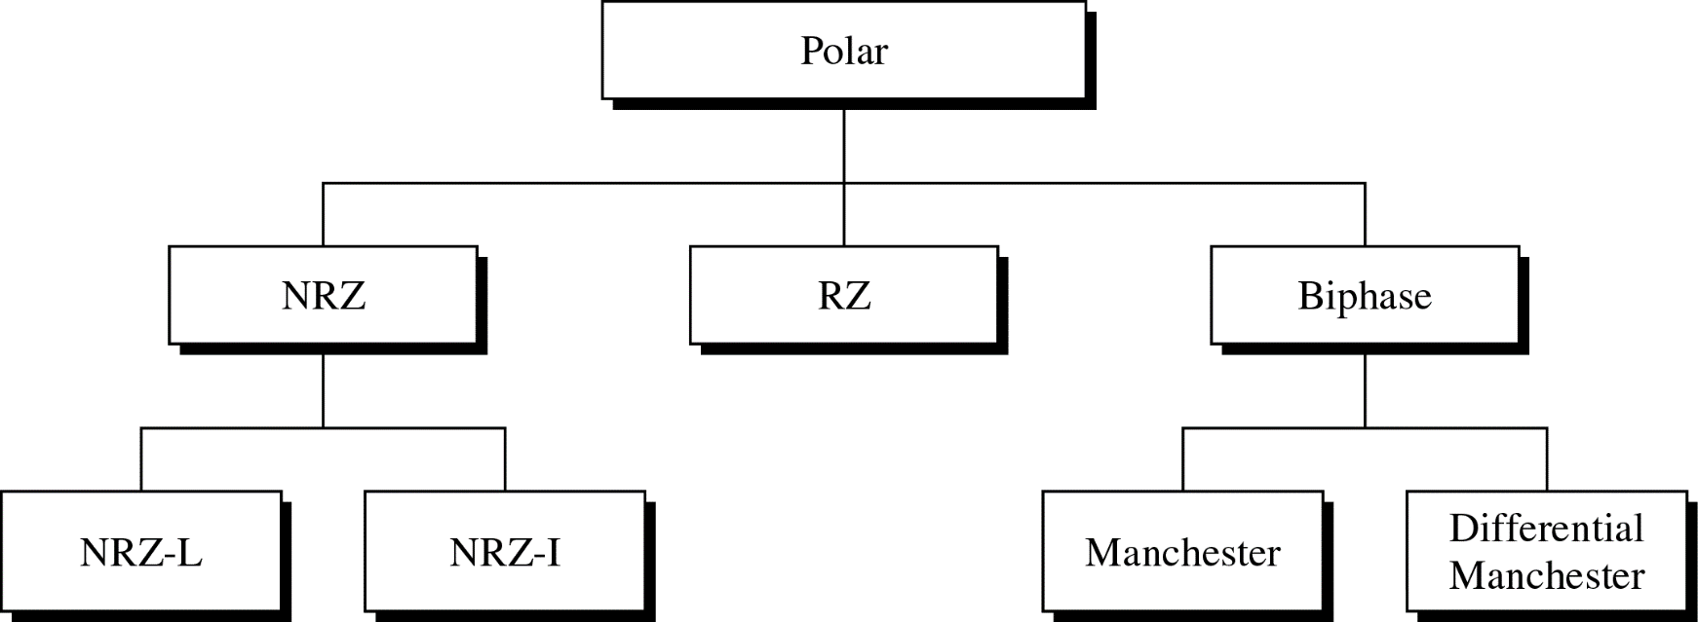
Polar Scheme
3-9
Two polarity: two levels of voltage
Problem of DC component is alleviated (NRZ,RZ) or eliminated (Biphaze)

Slide 10
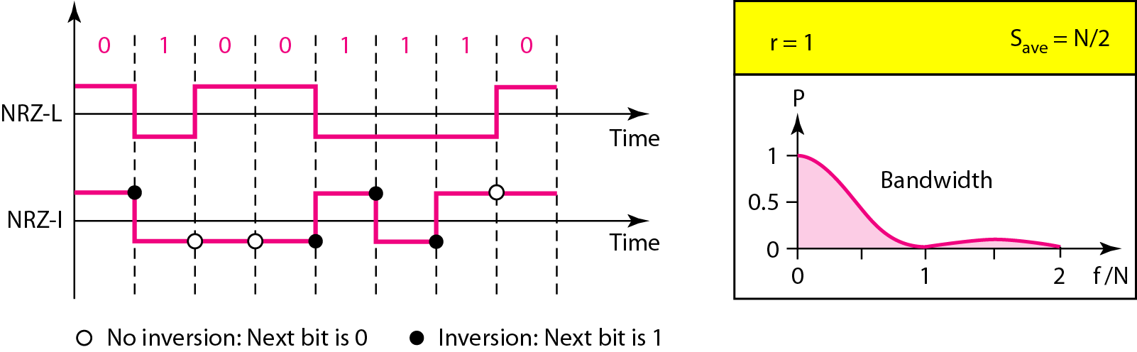
Polar NRZ
3-10
NRZ-L (Non Return to Zero-Level)
Level of the voltage determines the value of the bit
NRZ-I (Non Return to Zero-Invert)
Inversion or the lack of inversion determines the value of the bit

Slide 11
Polar NRZ: NRZ-L and NRZ-I
3-11
Baseline wandering problem
Both, but NRZ-L is twice severe
Synchronization Problem
Both, but NRZ-L is more serious
NRZ-L and NRZ-I both have an average signal rate of N/2 Bd
Both have a DC component problem

Slide 12
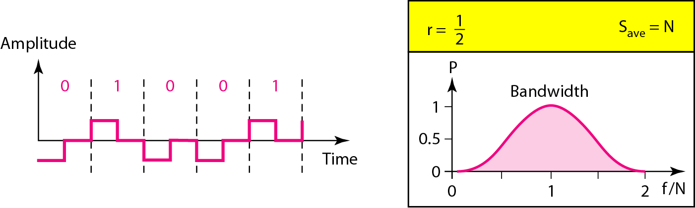
RZ
3-12
Provides synchronization for consecutive 0s/1s
Signal changes during each bit
Three values (+, -, 0) are used
Bit 1: positive-to-zero transition, bit 0: negative-to-zero transition

Slide 13
Biphase
3-13
Combination of RZ and NRZ-L ideas
Signal transition at the middle of the bit is used for synchronization
Manchester
Used for Ethernet LAN
Bit 1: negative-to-positive transition
Bit 0: positive-to-negative transition
Differential Manchester
Used for Token-ring LAN
Bit 1: no transition at the beginning of a bit
Bit 0: transition at the beginning of a bit

Slide 14
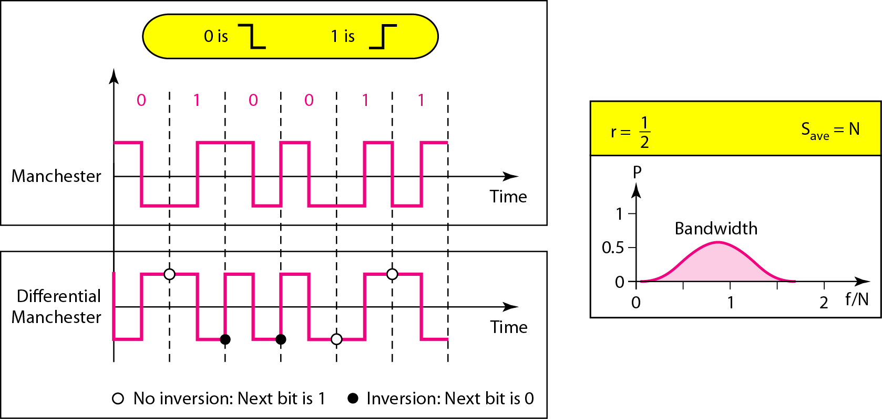
Polar Biphase
3-14
Minimum bandwidth is 2 times that of NRZ

Slide 15
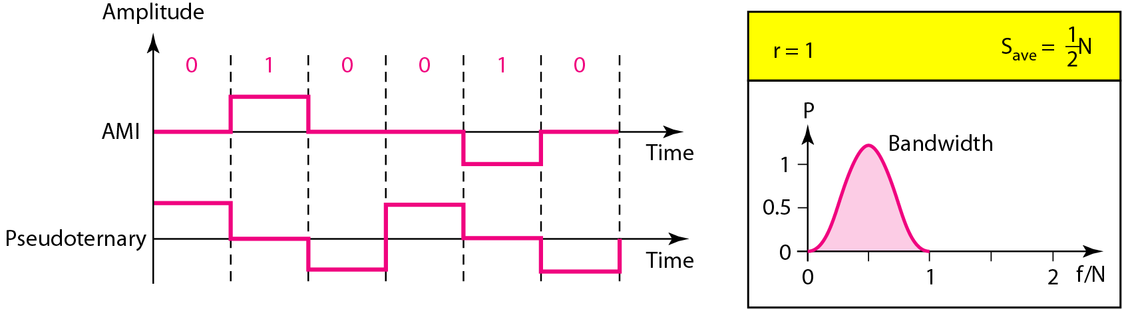
Bipolar Scheme
3-15
Three levels of voltage, called “multilevel binary”
Bit 0: zero voltage, bit 1: alternating +1/-1
(Note) In RZ, zero voltage has no meaning
AMI (Alternate Mark Inversion) and pseudoternary
Alternative to NRZ with the same signal rate and no DC component problem

Slide 16
Multilevel Scheme
3-16
To increase the number of bits per baud by encoding a pattern of m data elements into a pattern of n signal elements
In mBnL schemes, a pattern of m data elements is encoded as a pattern of n signal elements in which 2^{m} ≤ L^{n}
2B1Q (two binary, one quaternary)
8B6T (eight binary, six ternary)
4D-PAM5 (four-dimensional five-level pulse amplitude modulation)

Slide 17
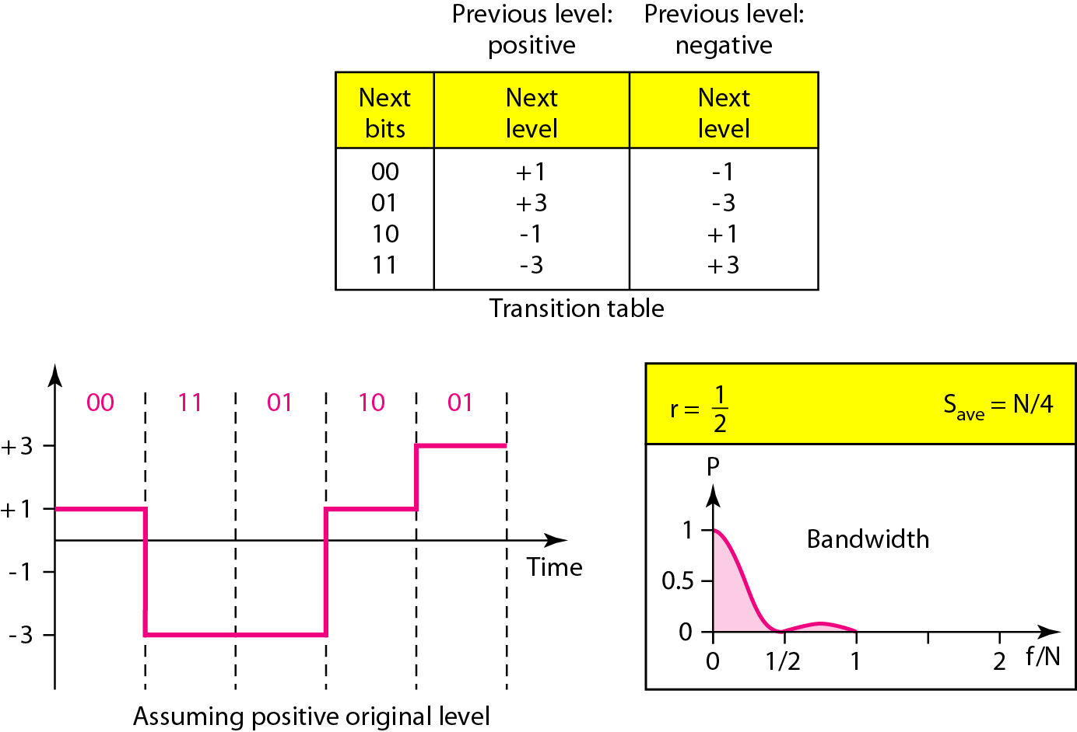
2B1Q: for DSL
3-17

Slide 18
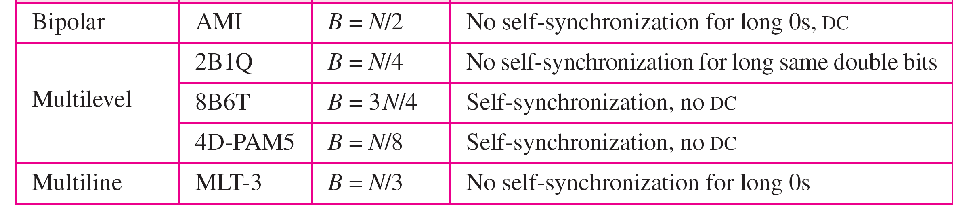
Summary of Line Coding Schemes
3-18

Slide 19
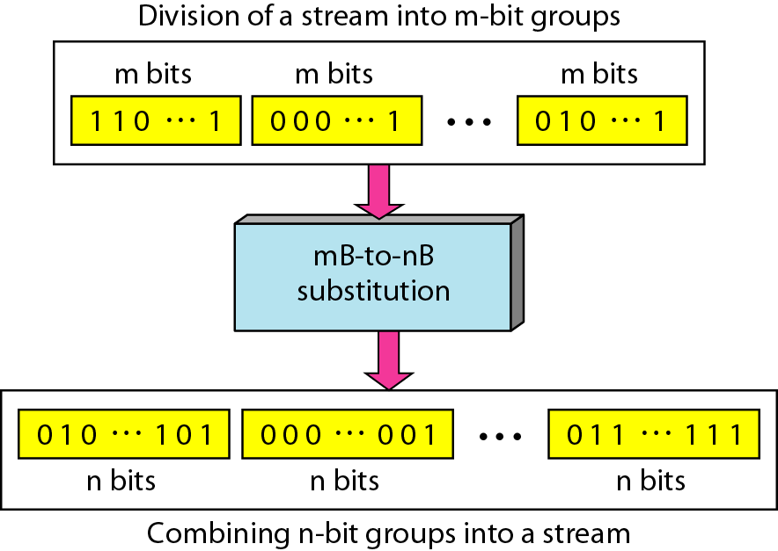
Block Coding
3-19
Block coding is normally referred to as mB/nB coding; it replaces each m-bit group with an n-bit group

Slide 20
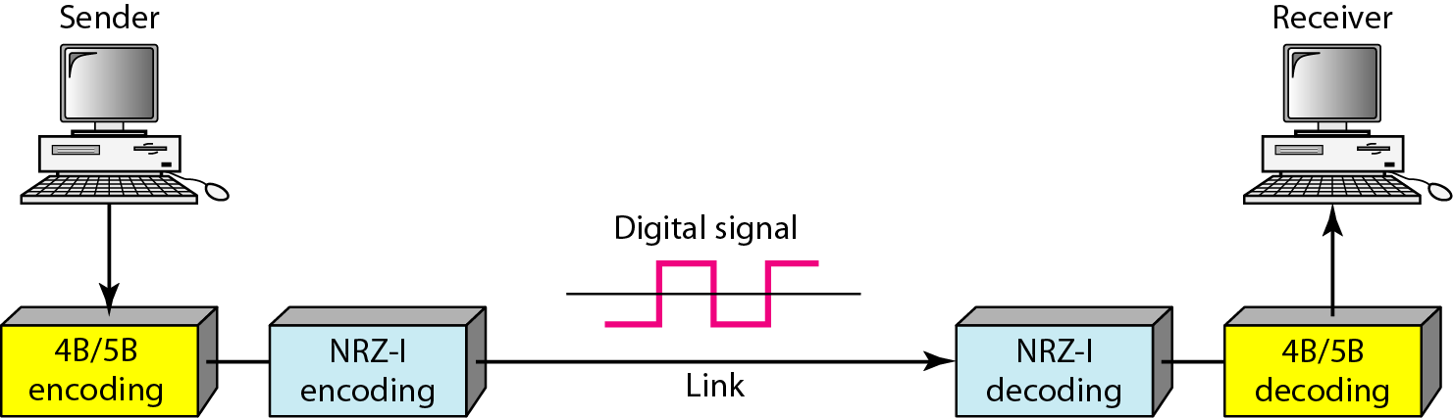
4B/5B
3-20
Solve the synchronization problem of NRZ-I
20% increase the signal rate of NRZ-I (Biphase scheme has the signal rate of 2 times that of NRZ-I
Still DC component problem

Slide 21
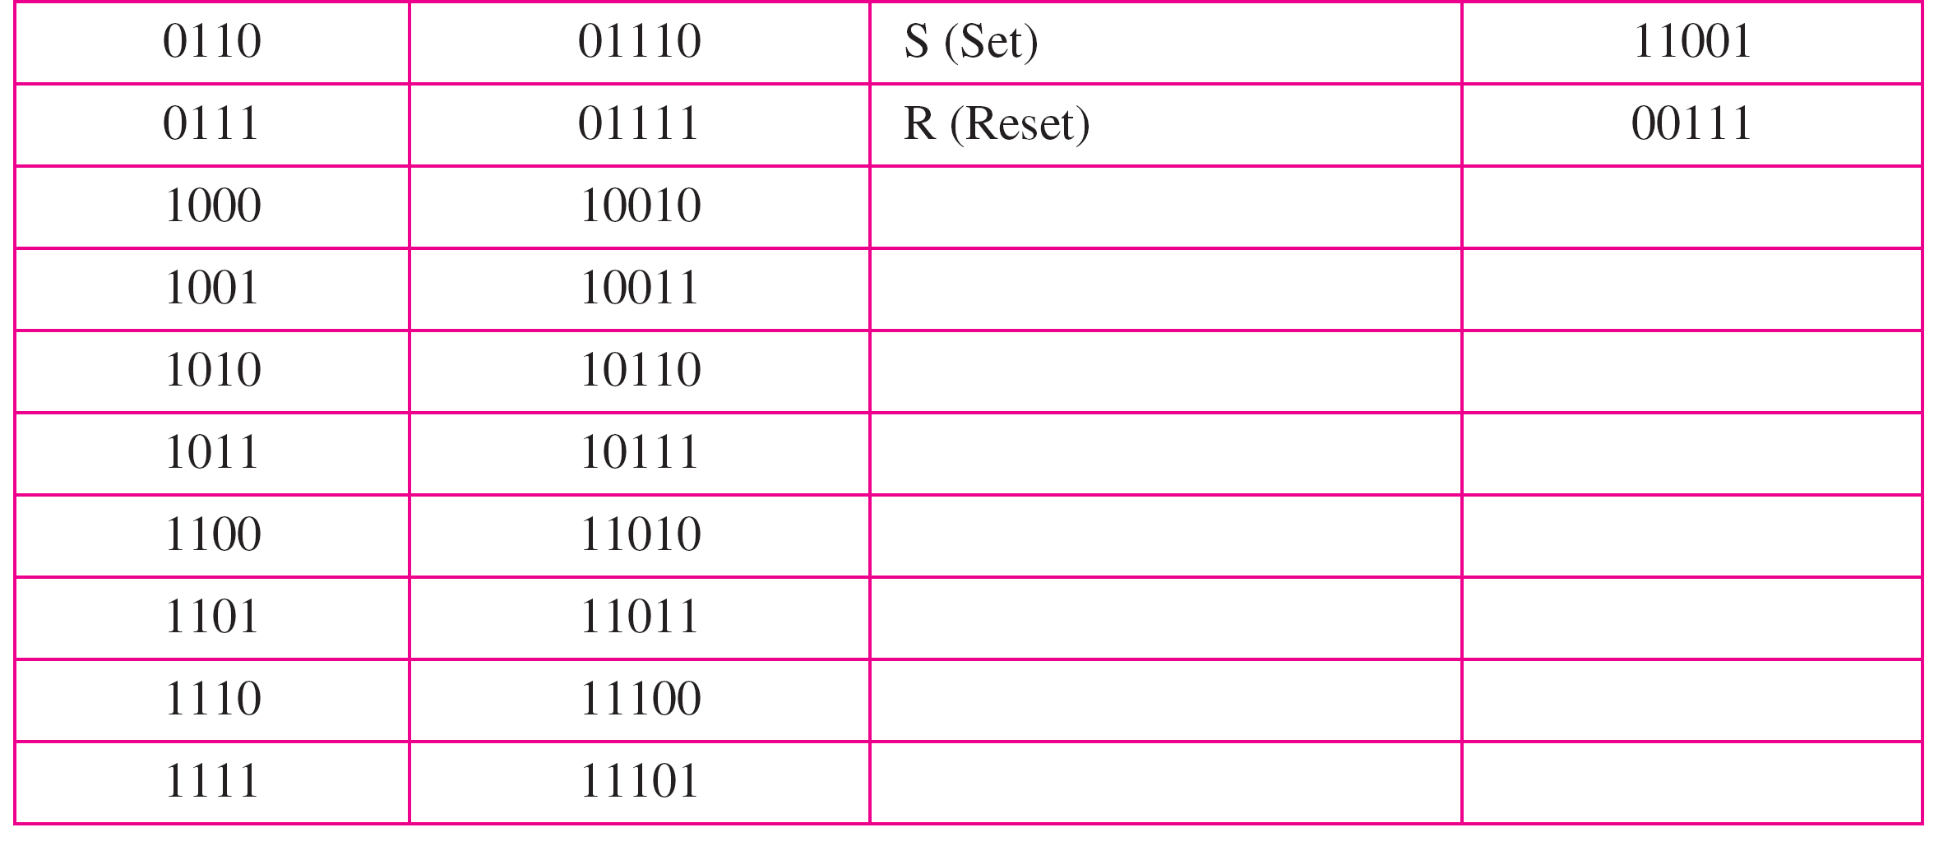
4B/5B Mapping Codes
3-21

Slide 22
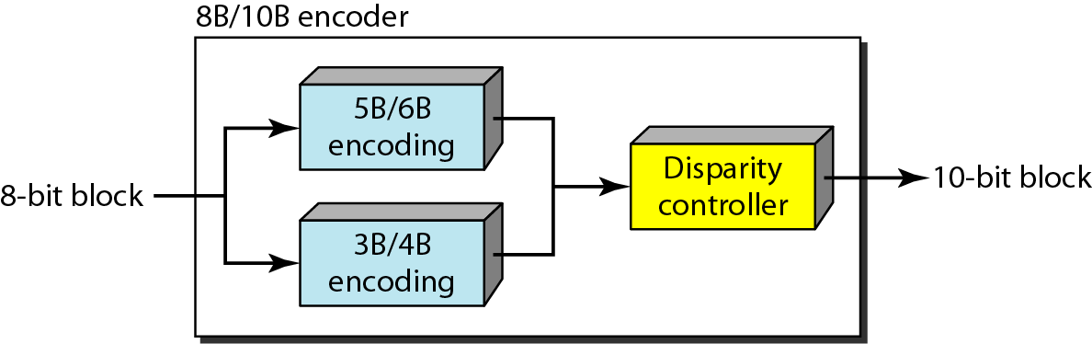
8B/10B
3-22
2¹⁰ – 2⁸ = 768 redundant groups used for disparity checking and error detection

Slide 23
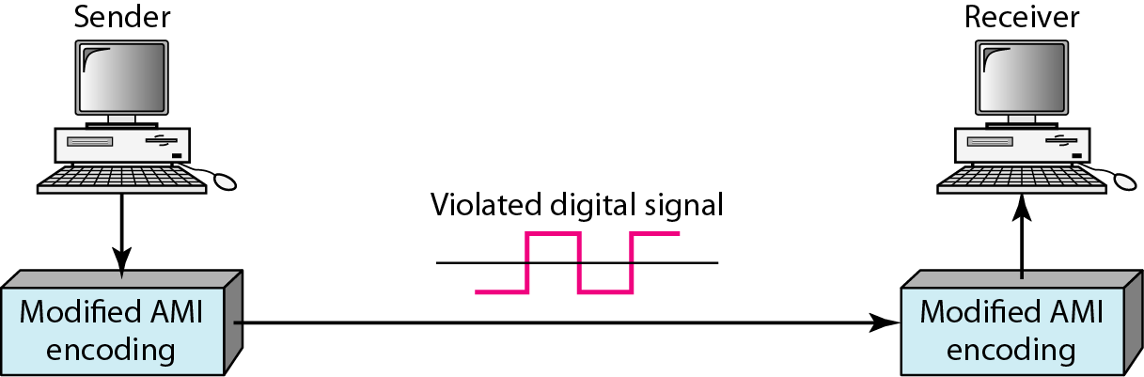
Scrambling
3-23
Biphase : not suitable for long distance communication due to its wide bandwidth requirement
Combination of block coding and NRZ: not suitable for long distance encoding due to its DC component problem
Bipolar AMI: synchronization problem → Scrambling

Slide 24
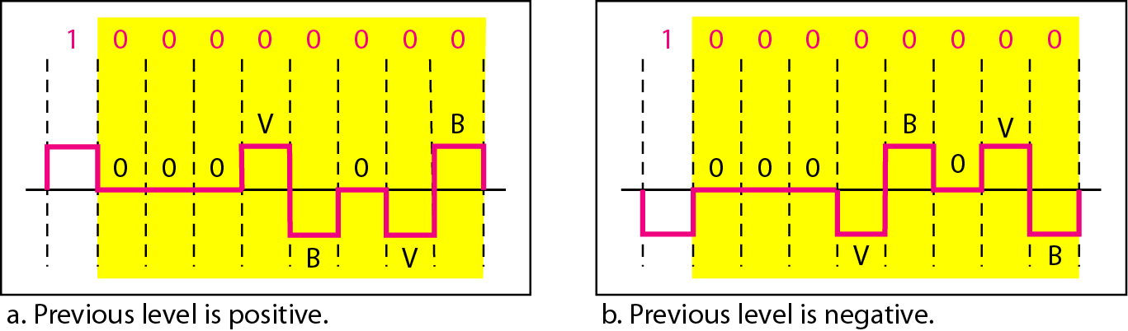
B8ZS
3-24
Commonly used in North America
Updated version of AMI with synchronization
Substitutes eight consecutive zeros with 000VB0VB
V denotes “violation”, B denotes “bipolar”

Slide 25
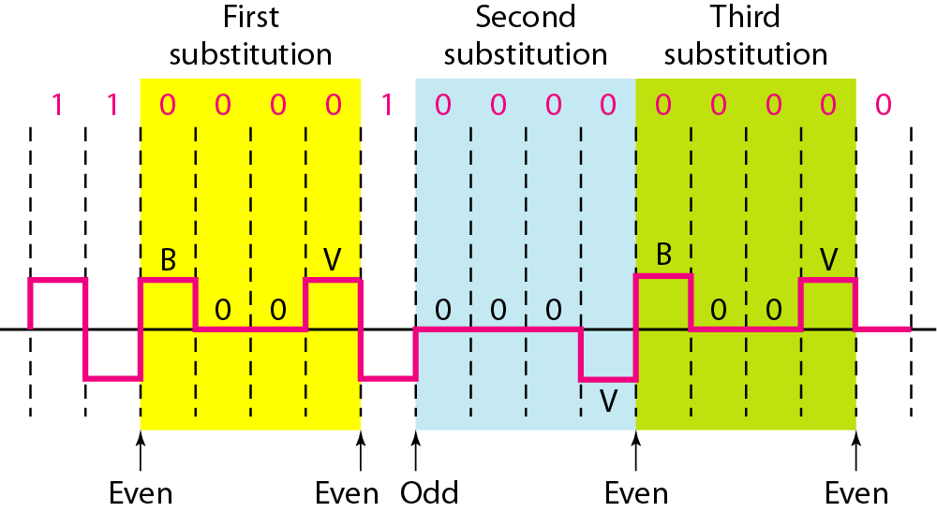
HDB3
3-25
High-density bipolar 3-zero
Commonly used outside of North America
HDB3 substitutes four consecutive zeros with 000V or B00V depending on the number of nonzero pulses after the last substitution

Slide 26
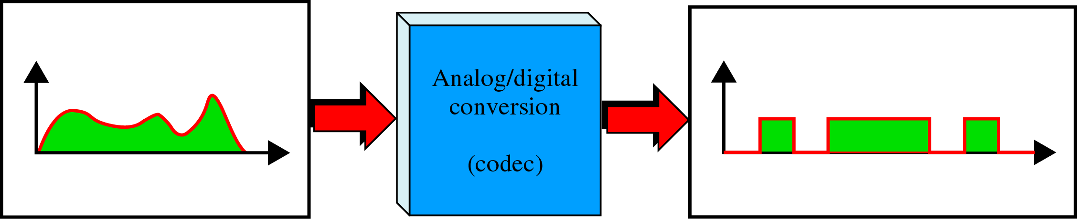
Sampling: Analog-to-Digital Conversion
3-26
Analog information (e.g., voice) → digital signal (e.g., 10001011…)
Codec(Coder/Decoder): A/D converter

Slide 27
PCM
3-27
Pulse Code Modulation
Three processes
The analog signal is sampled
The sampled signal is quantized
The quantized values are encoded as streams of bits
Sampling: PAM (Pulse amplitude Modulation)
According to the Nyquist theorem, the sampling rate must be at least 2 times the highest frequency contained in the signal.

Slide 28
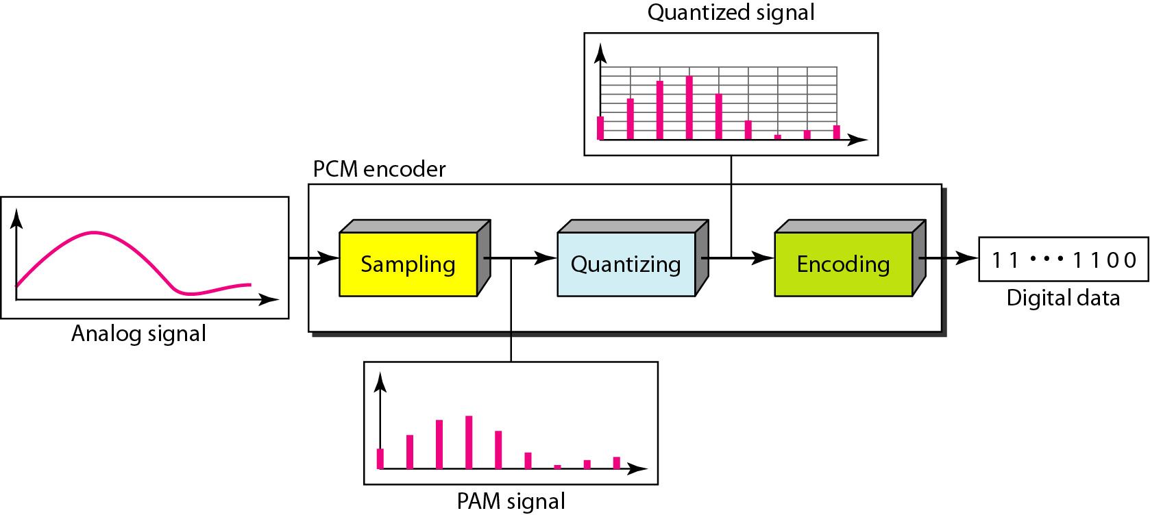
Components of PCM Encoder
3-28

Slide 29
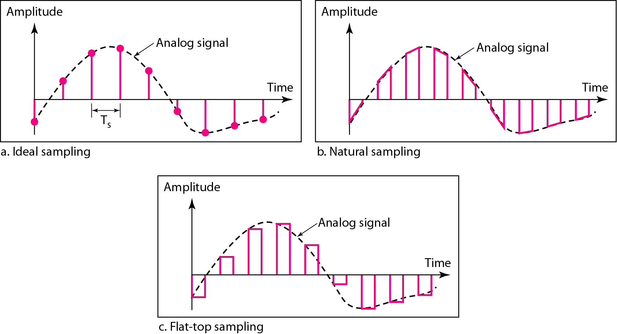
Different Sampling Methods for PCM
3-29

Slide 30
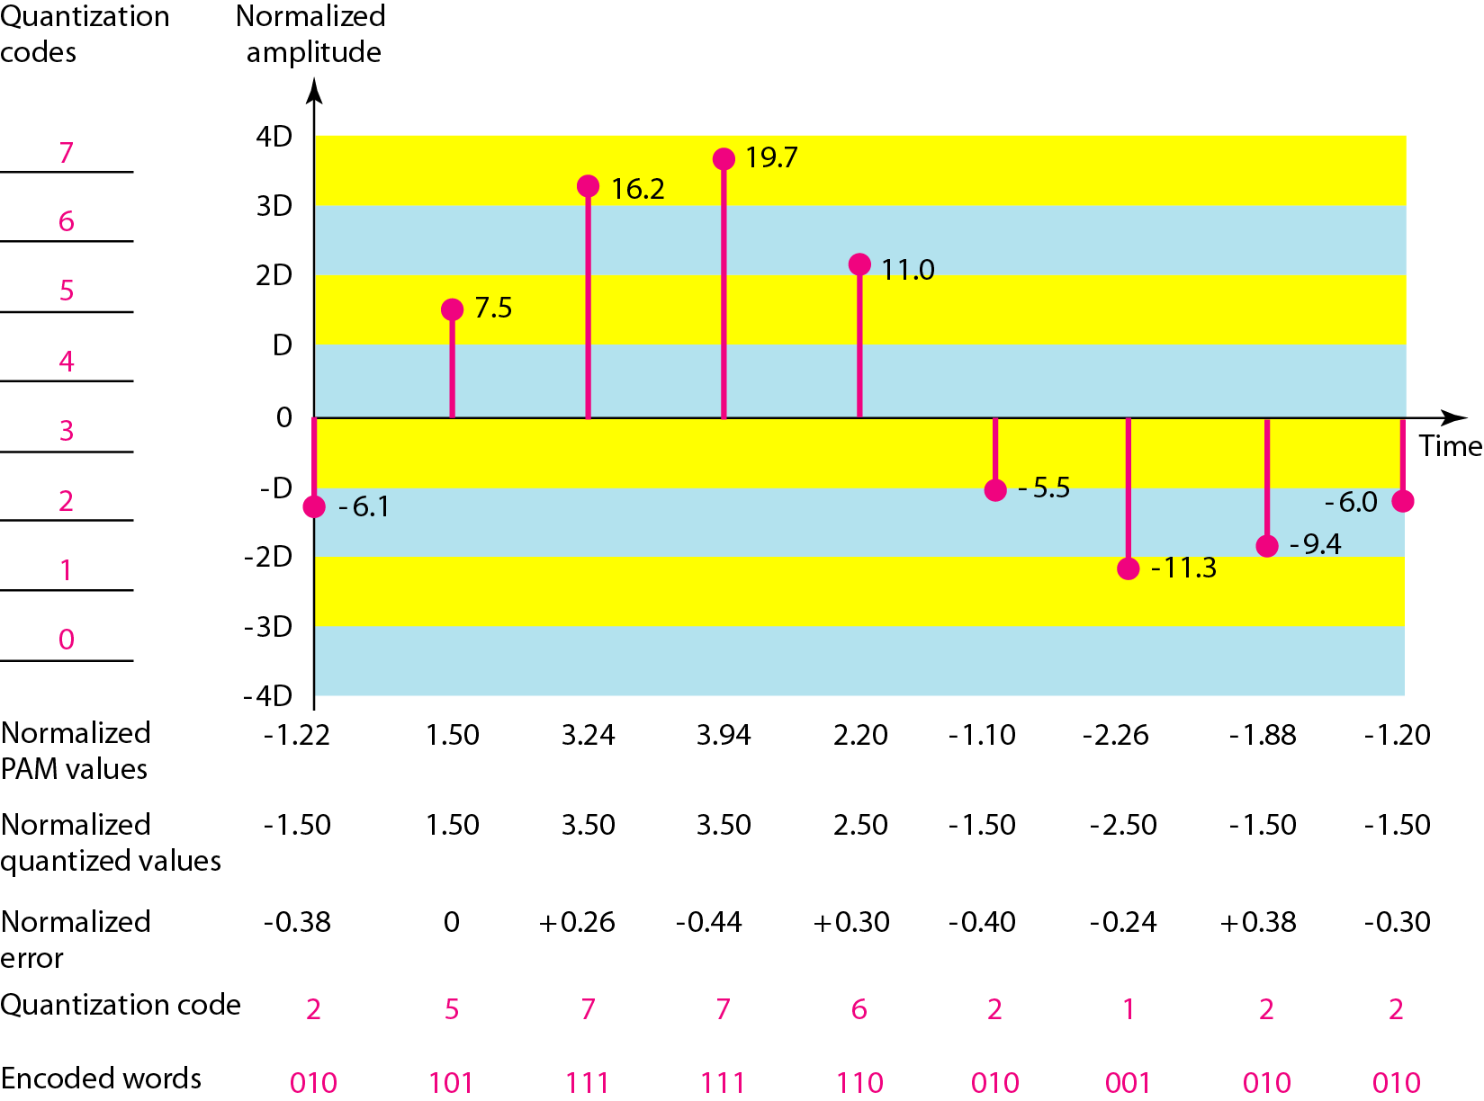
Quantization
3-30
Dr. Md. Abdur Razzaque
Green Networking Research Group
Dept. of Computer Science and Engineering, University of Dhaka

Slide 31
Quantization
3-31
Quantization level (L)
Quantization error : depending on L (or n_{b} )
SNR_{dB} = 6.02n_{b} + 1.76 dB
Nonuniform quantization:
Companding and expanding
Effectively reduce the SNR_{dB}

Slide 32
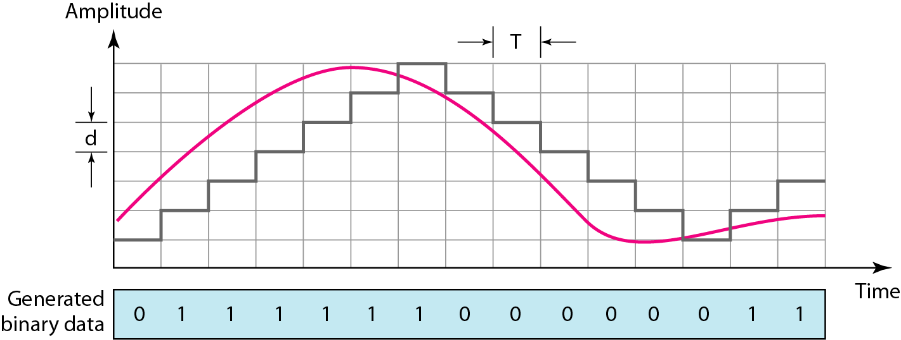
Delta Modulation
3-32
To reduce the complexity of PCM

Slide 33
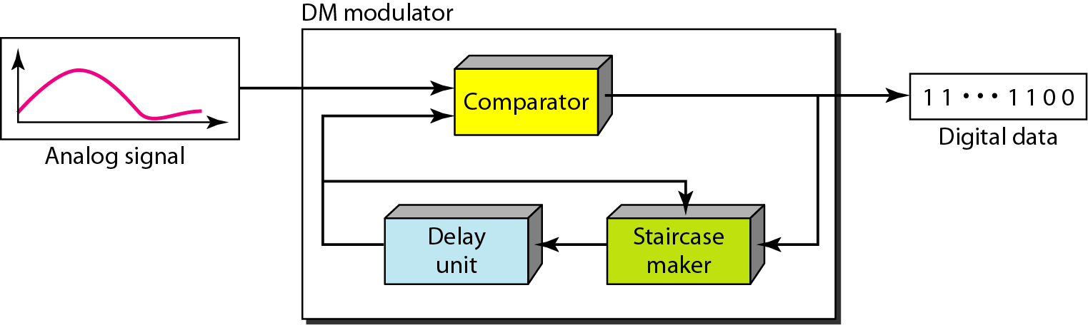
Delta Modulation Components
3-33

Slide 34
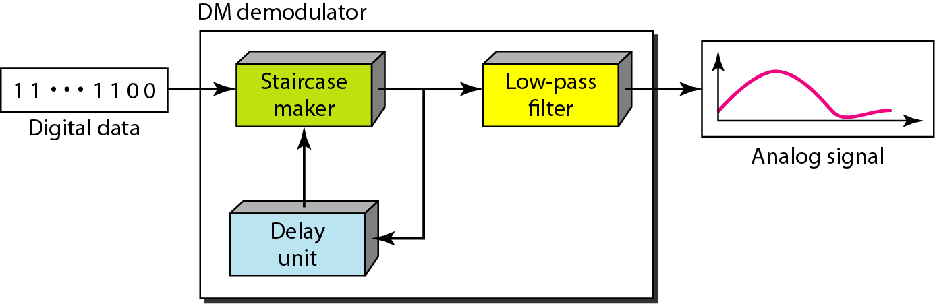
Delta Demodulation Components
3-34

Slide 35
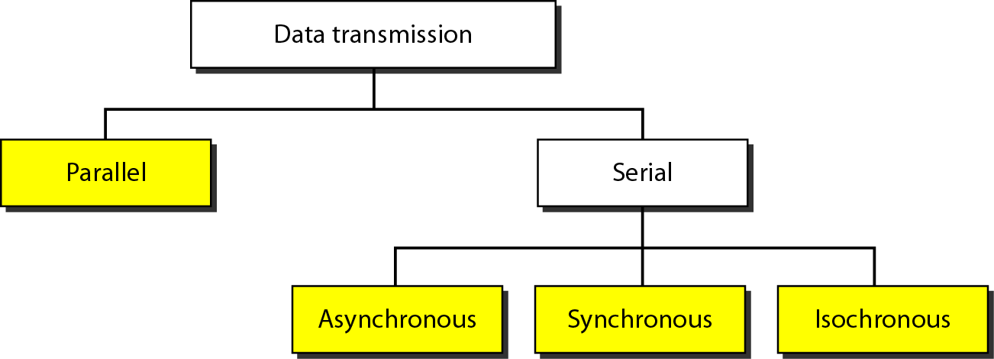
Transmission Modes
3-35

Slide 36
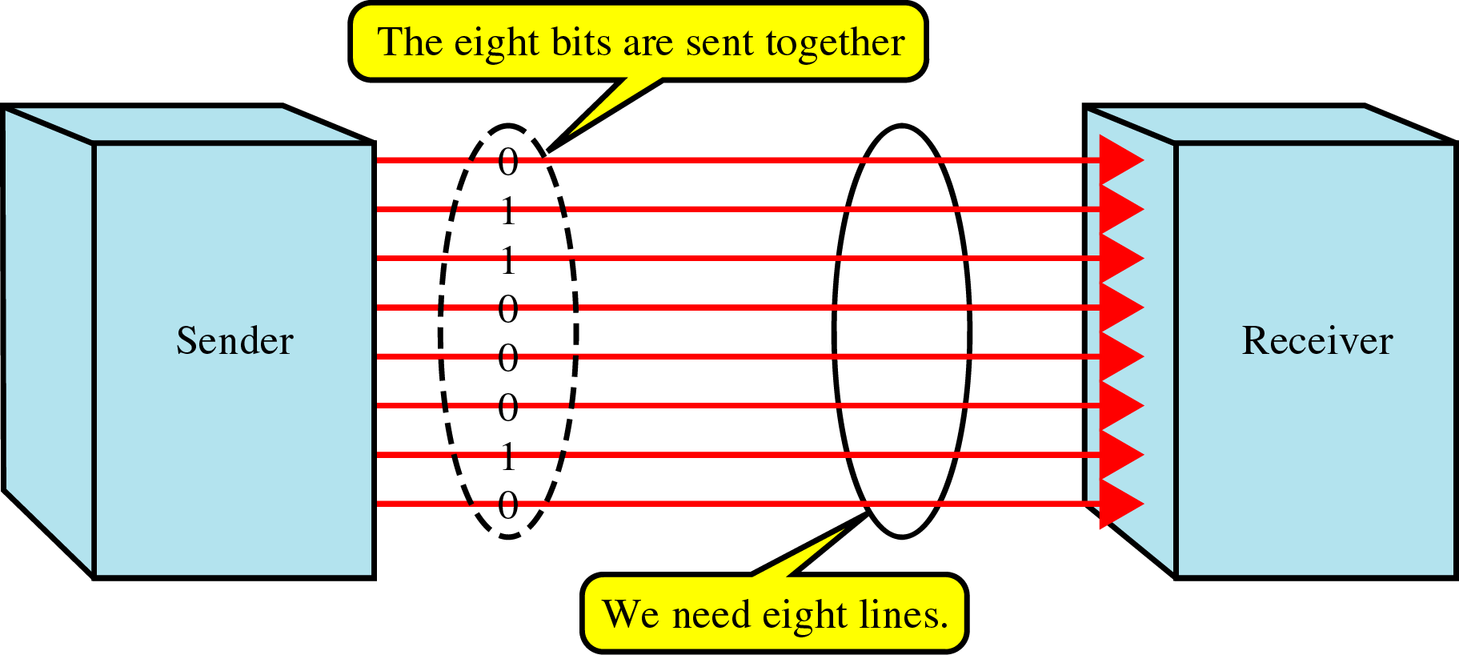
Parallel Transmission
3-36
Use n wires to send n bits at one time synchronously
Advantage: speed
Disadvantage: cost ⇒ Limited to short distances

Slide 37
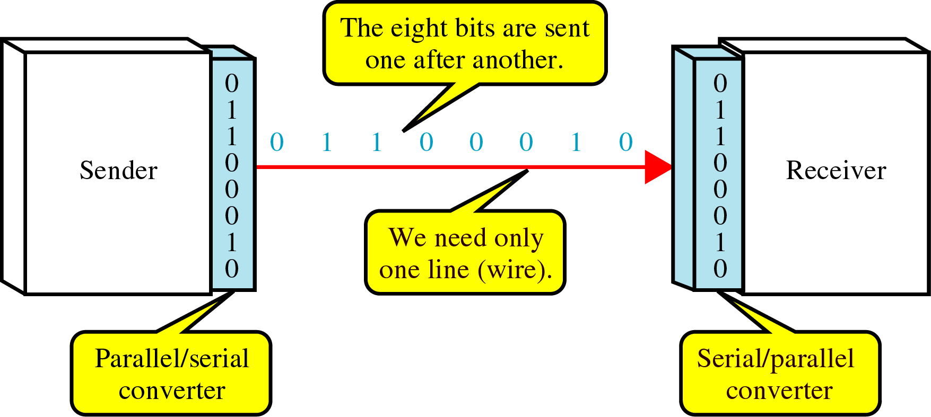
Serial Transmission
3-37
On communication channel
Advantage: reduced cost
Parallel/serial converter is required
Three ways: asynchronous, synchronous, or isochronous

Slide 38
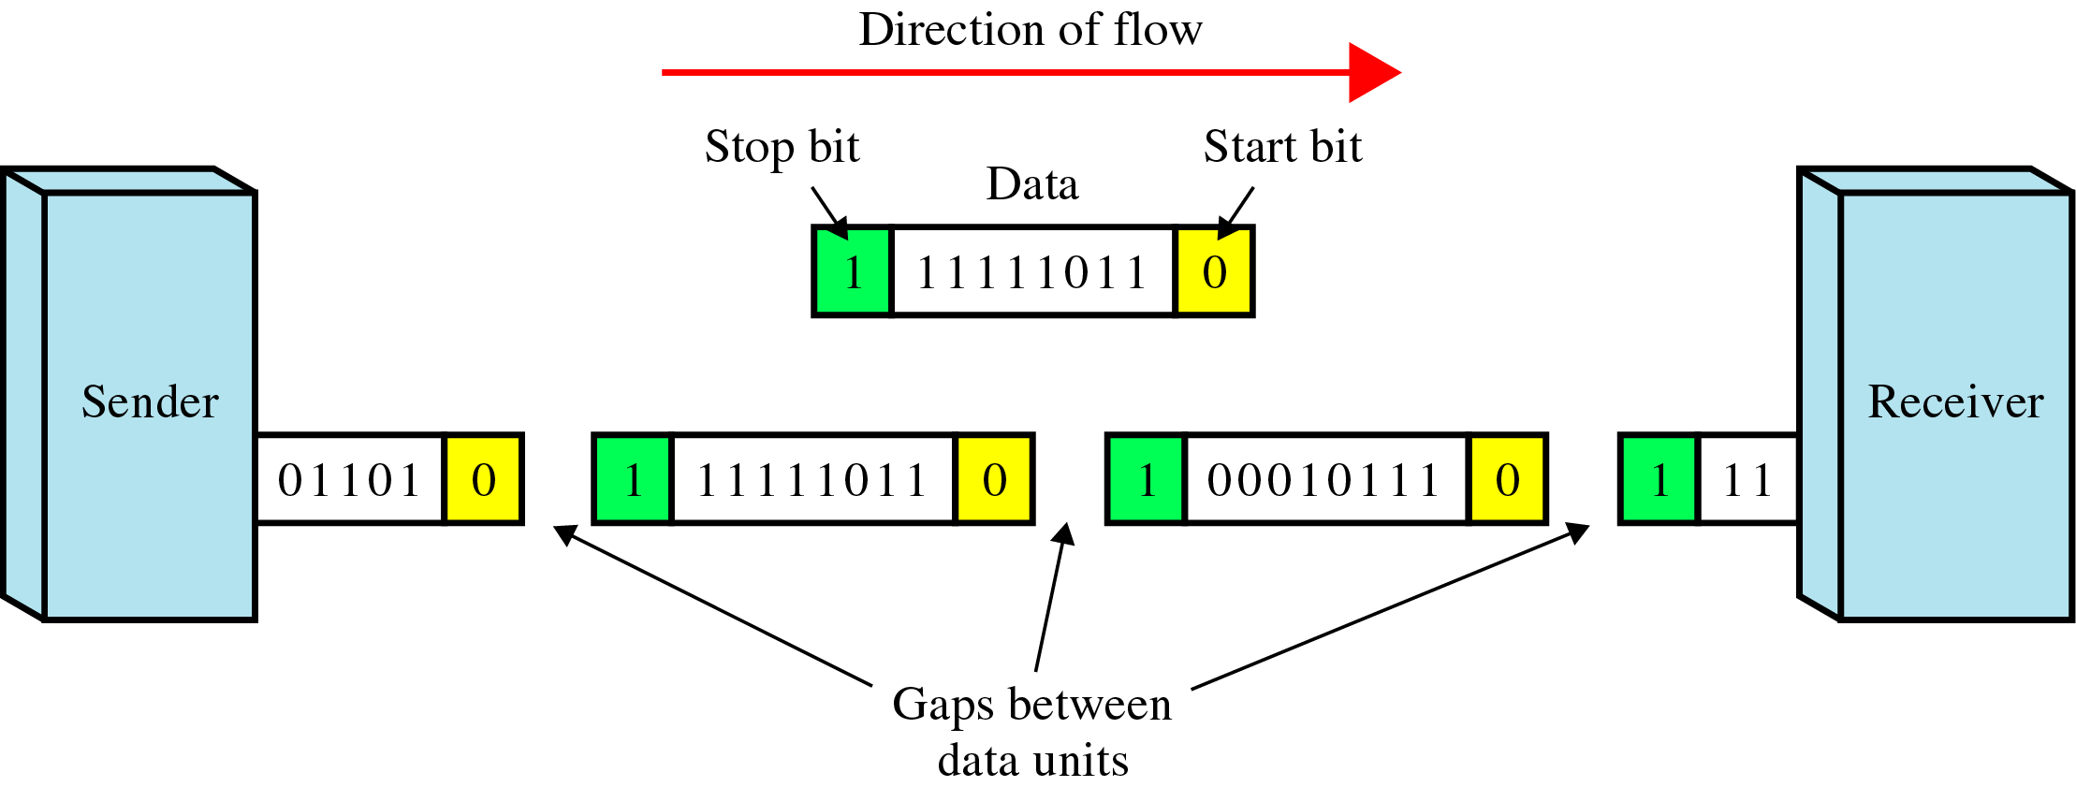
Asynchronous Transmission
3-38
Use start bit (0) and stop bits (1s)
A gap between two bytes: idle state or stop bits
It means asynchronous at byte level
Must still be synchronized at bit level
Good for low-speed communications (terminal)

Slide 39
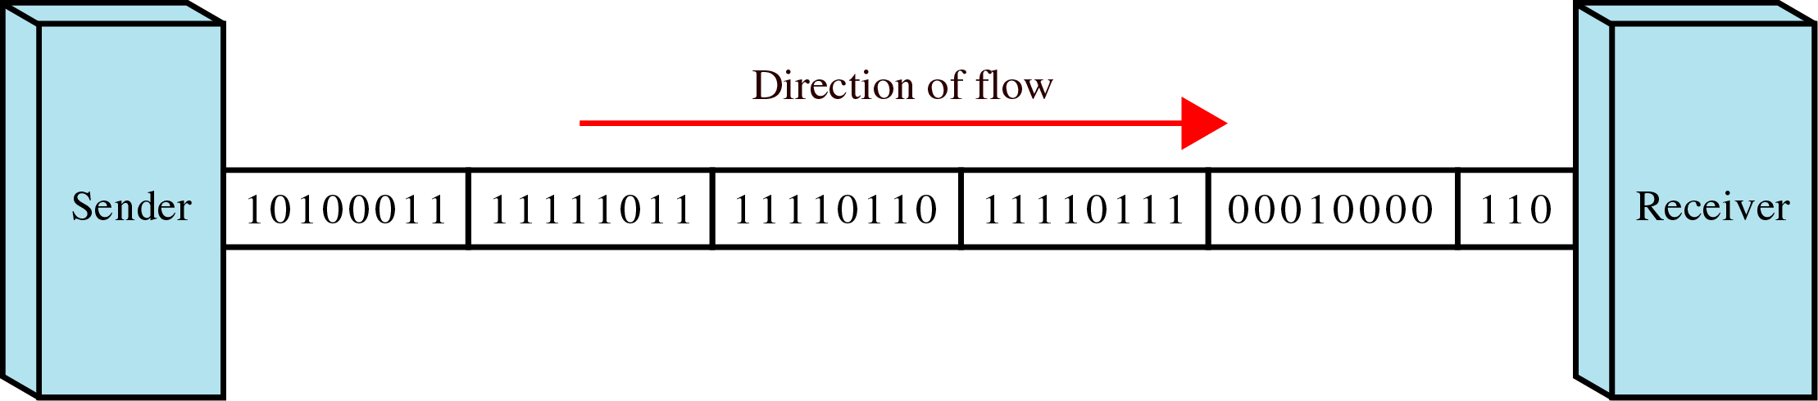
Synchronous Transmission
3-39
Bit stream is combined into “frames”
Special sequence of 1/0 between frames: No gap
Timing is important in midstream
Byte synchronization in the data link layer
Advantage: speed ⇒ high-speed transmission

