Slide 1
Chapter 6. Bandwidth Utilization: Multiplexing and Spreading
Multiplexing
Spread Spectrum

Slide 2
Bandwidth Utilization
6-2
Bandwidth utilization is the wise use of available bandwidth to achieve specific goals.
Two categories: multiplexing and spreading
Efficiency can be achieved by multiplexing
Privacy and anti-jamming can be achieved by spreading.

Slide 3
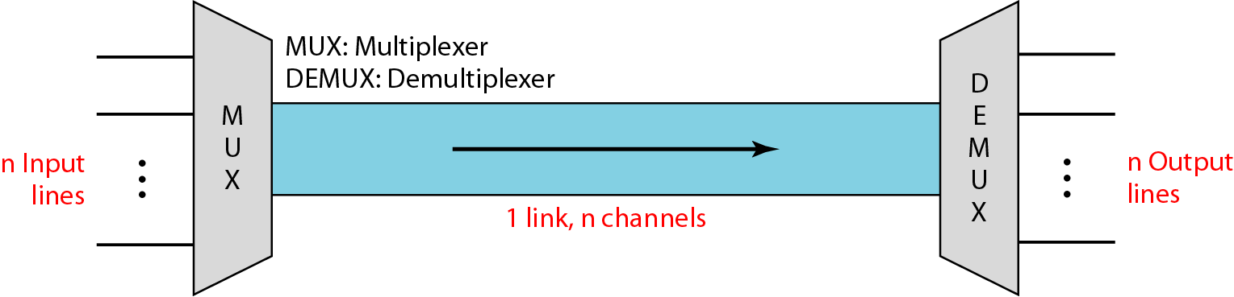
Multiplexing
6-3
Whenever the bandwidth of a medium linking two devices is greater than the bandwidth needs of the devices, the link can be shared.
Multiplexing is the set of techniques that allows the simultaneous transmission of multiple signals across a single data link.

Slide 4
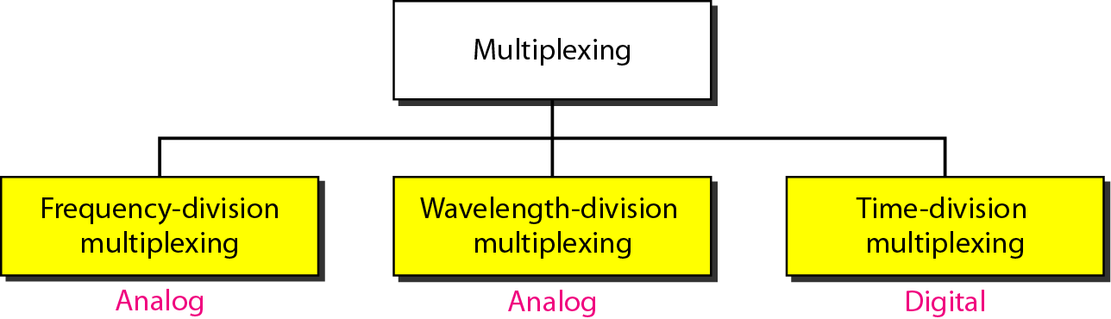
Categories of Multiplexing
6-4

Slide 5
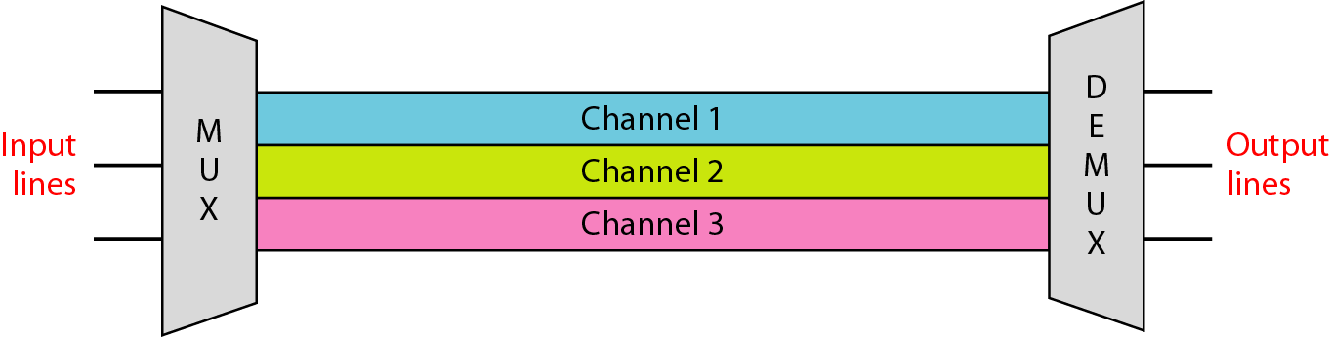
Frequency Division Multiplexing
6-5
FDM is an analog multiplexing technique that combines analog signals
Signals modulate different carrier frequencies
Modulated signals are combined into a composite signal
Channel - Bandwidth range to accommodate a modulated signal
Channels can be separated by strips of unused bandwidth (guard band) to prevent overlapping

Slide 6
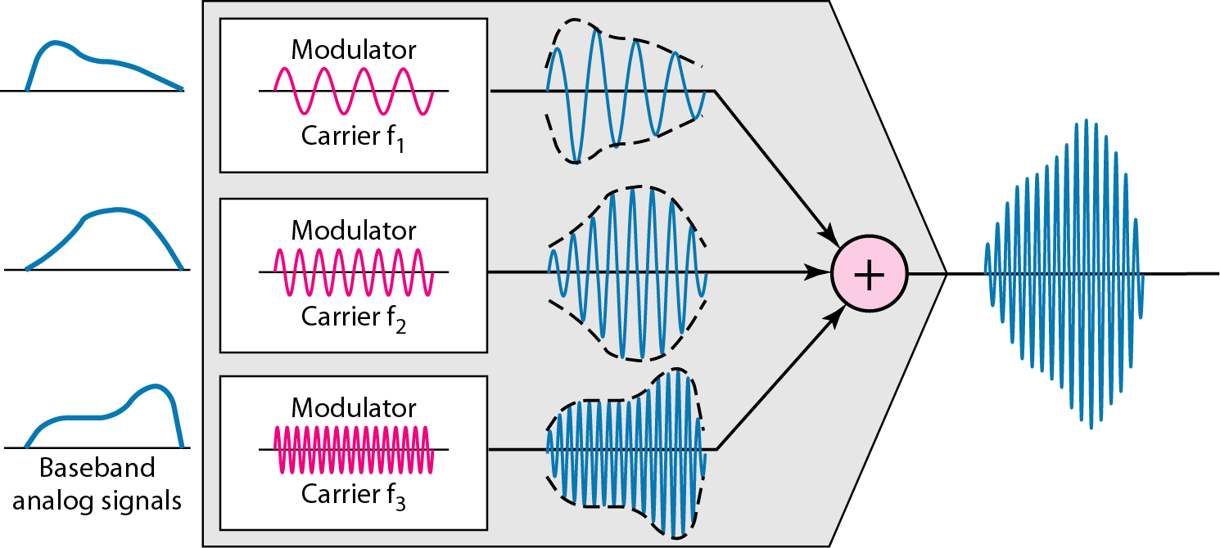
FDM Process
6-6

Slide 7
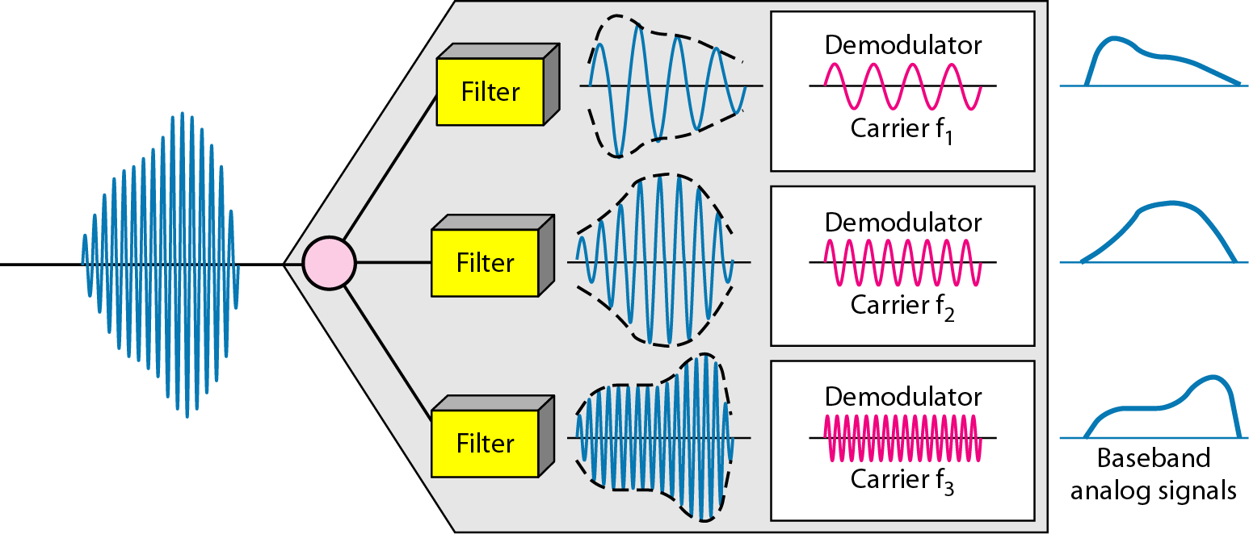
FDM Demultiplexing Example
6-7

Slide 8
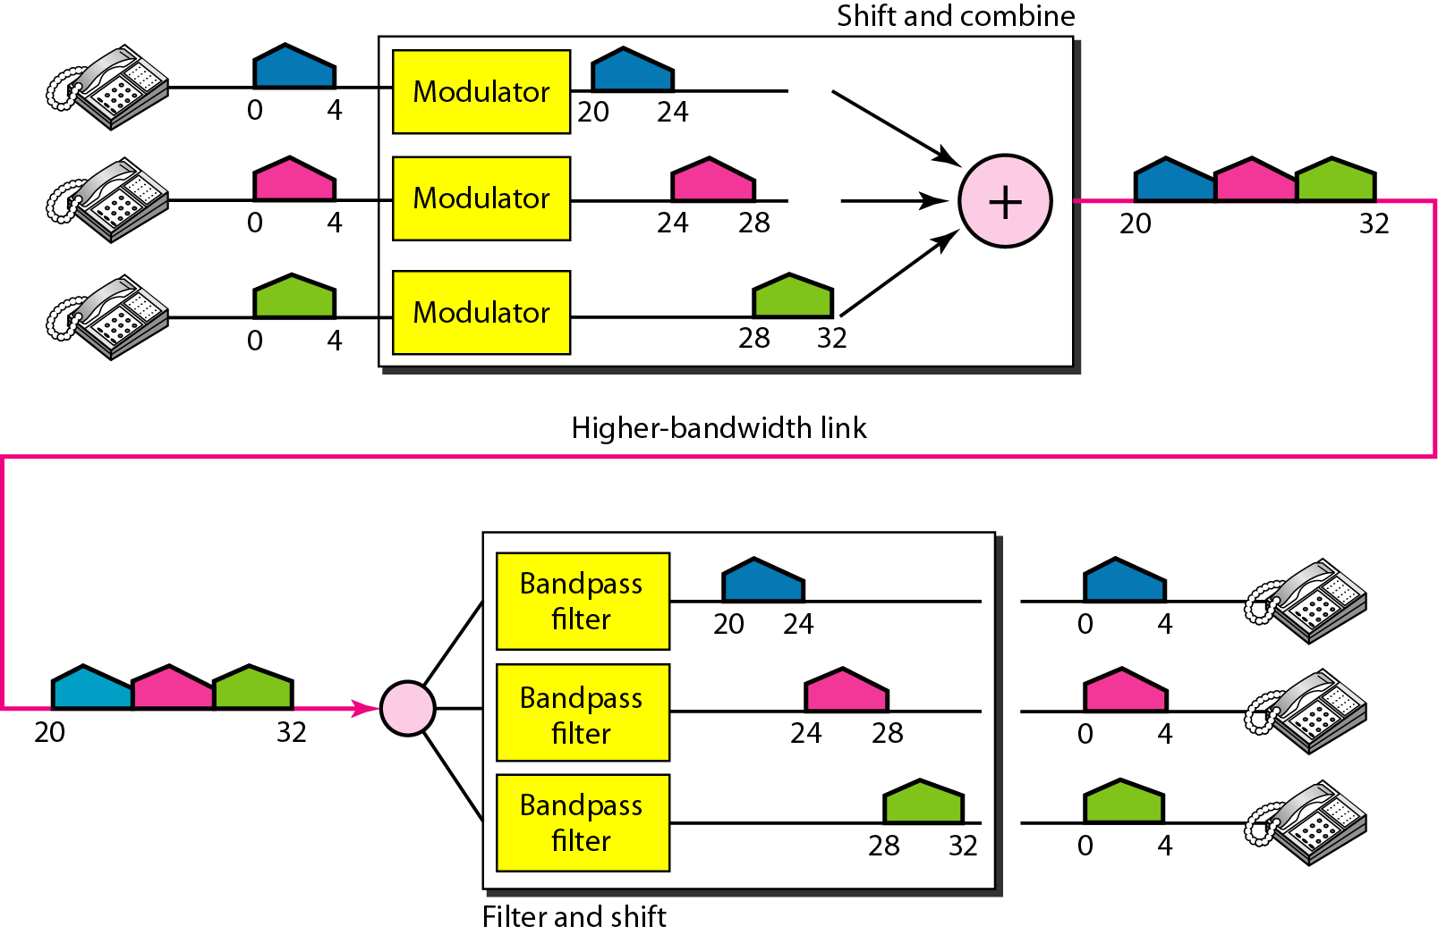
FDM: Example 1
6-8

Slide 9
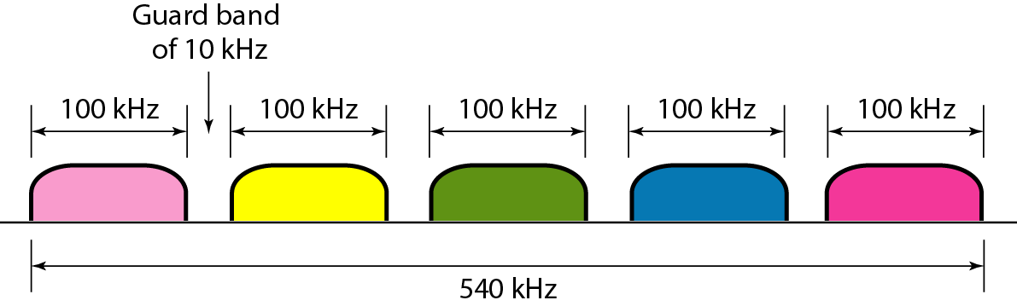
FDM: Example 2
6-9

Slide 10
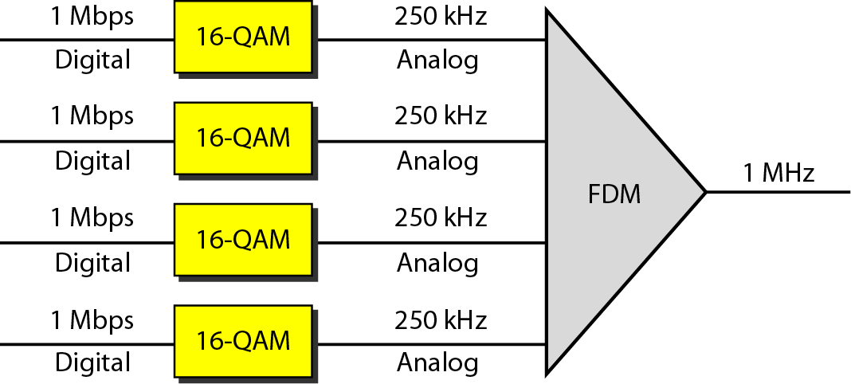
FDM: Example 3
6-10

Slide 11
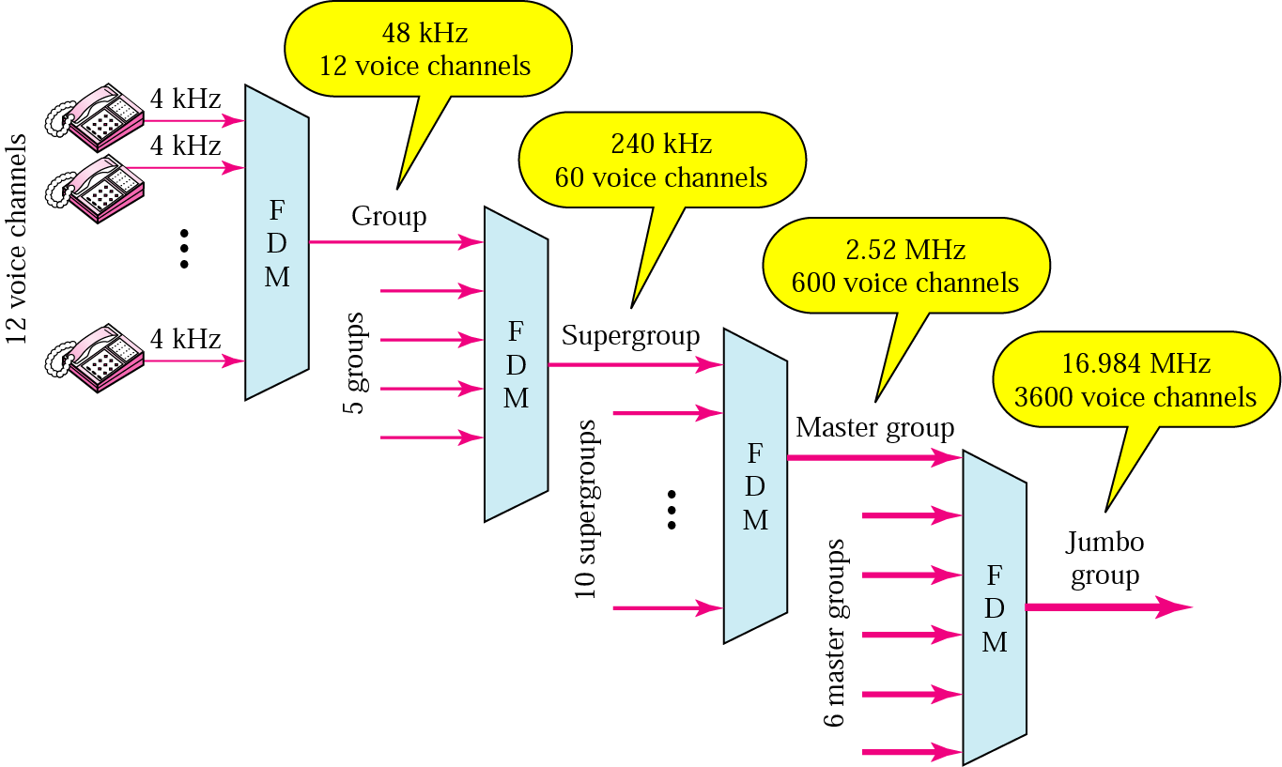
Analog Hierarchy
6-11
Hierarchical system used by AT&T

Slide 12
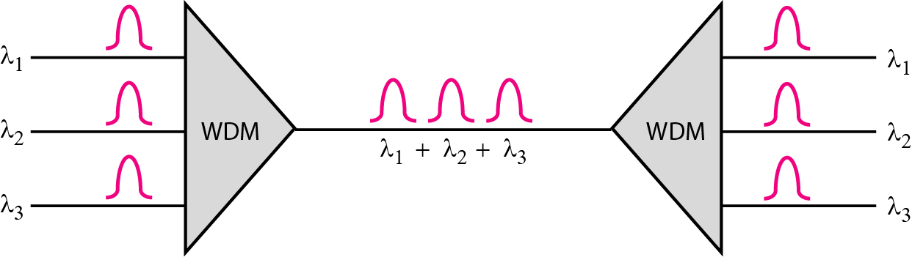
Wave Division Multiplexing
6-12
Analog multiplexing technique to combine optical signals
Conceptually the same as FDM
Light signals transmitted through fiber optic channels
Combining different signals of different frequencies (wavelengths)

Slide 13
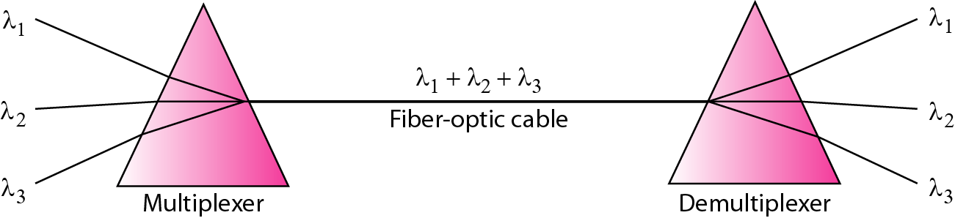
Prisms in WDM
6-13
Combining and splitting of light sources are easily handled by a prism
Prism bends a light beam based on the incidence angle and the frequency

Slide 14
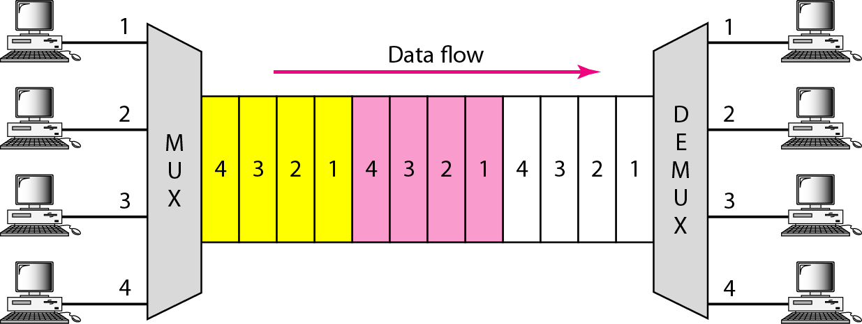
Time Division Multiplexing
6-14
Digital multiplexing technique for combining several low-rate channels into one high-rate one

Slide 15
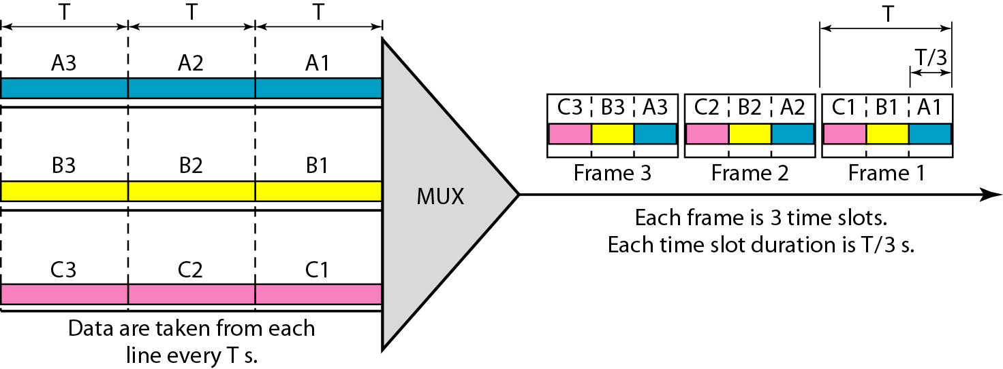
TDM: Time Slots and Frames
6-15
In synchronous TDM, the data rate of the link is n times faster, and the unit duration is n times shorter

Slide 16
TDM: Example 1
6-16
Four 1-Kbps connections are multiplexed together. A unit is 1 bit. Find (a) the duration of 1 bit before multiplexing, (b) the transmission rate of the link, (c) the duration of a time slot, and (d) the duration of a frame?
a) The duration of 1 bit is 1/1 Kbps, or 0.001 s (1 ms).
b) The rate of the link is 4 Kbps.
c) The duration of each time slot 1/4 ms or 250 μs.
d) The duration of a frame 1 ms.

Slide 17
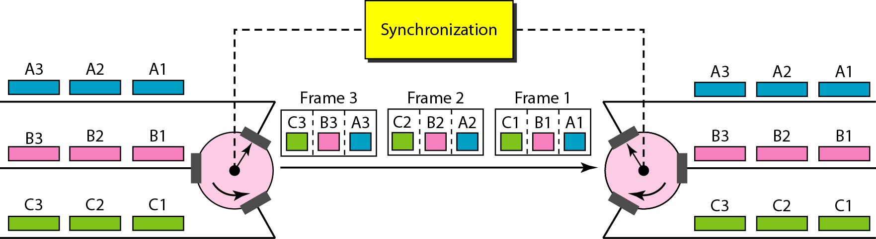
Interleaving
6-17
Interleaving can be done by bit, by byte, or by any other data unit
The interleaved unit is of the same size in a given system

Slide 18
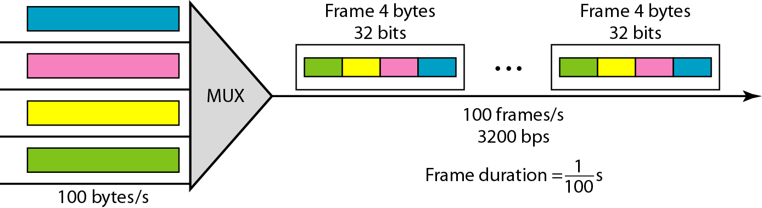
TDM: Example 2
6-18

Slide 19
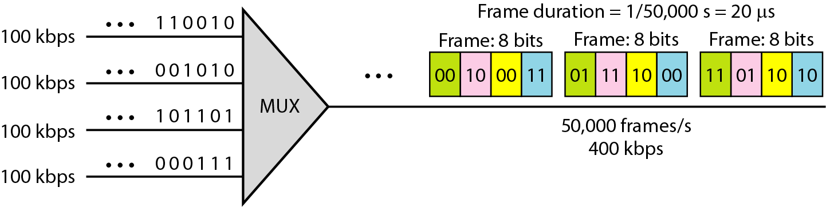
TDM: Example 3
6-19

Slide 20
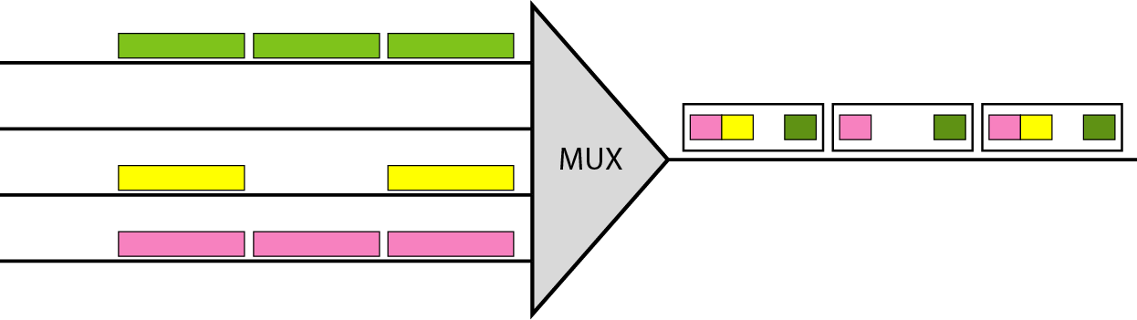
Empty Slots
6-20
Synchronous TDM is not efficient in many cases
Statistical TDM can improve the efficiency by removing the empty slot from the frame

Slide 21
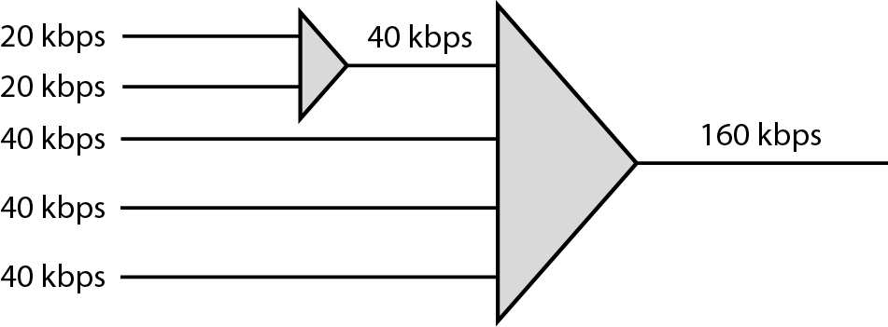
Data Rate Management
6-21
To handle a disparity in the input data rates
Multilevel multiplexing, multiple-slot allocation and pulse stuffing
Multilevel multiplexing

Slide 22
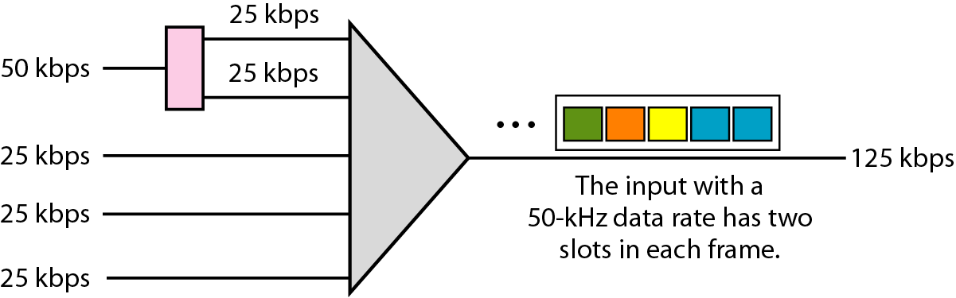
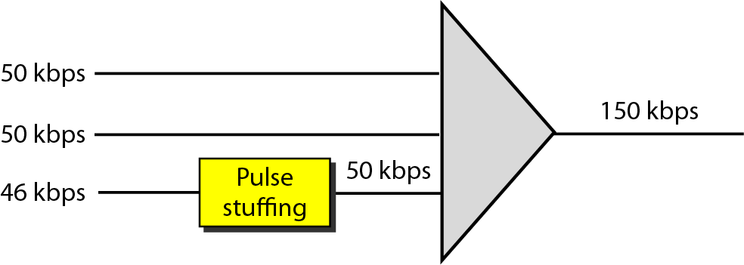
Data Rate Management
6-22
Multiple-slot allocation / Pulse stuffing

Slide 23
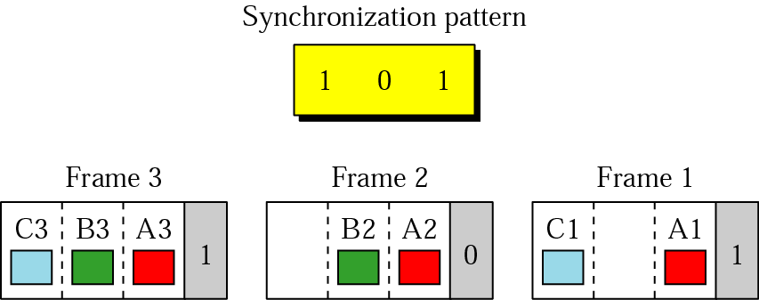
Frame Synchronizing
6-23
Synchronization between the multiplexing and demultiplexing is a major issue in TDM

Slide 24
TDM: Example 4
6-24
We have four sources, each creating 250 characters per second. If the interleaved unit is a character and 1 synchronizing bit is added to each frame, find (a) the data rate of each source, (b) the duration of each character in each source, (c) the frame rate, (d) the duration of each frame, (e) the number of bits in each frame, and (f) the data rate of the link.
1. The data rate of each source is 2000 bps = 2 Kbps.
2. The duration of a character is 1/250 s, or 4 ms.
3. The link needs to send 250 frames per second.
4. The duration of each frame is 1/250 s, or 4 ms.
5. Each frame is 4 x 8 + 1 = 33 bits.
6. The data rate of the link is 250 x 33, or 8250 bps

Slide 25
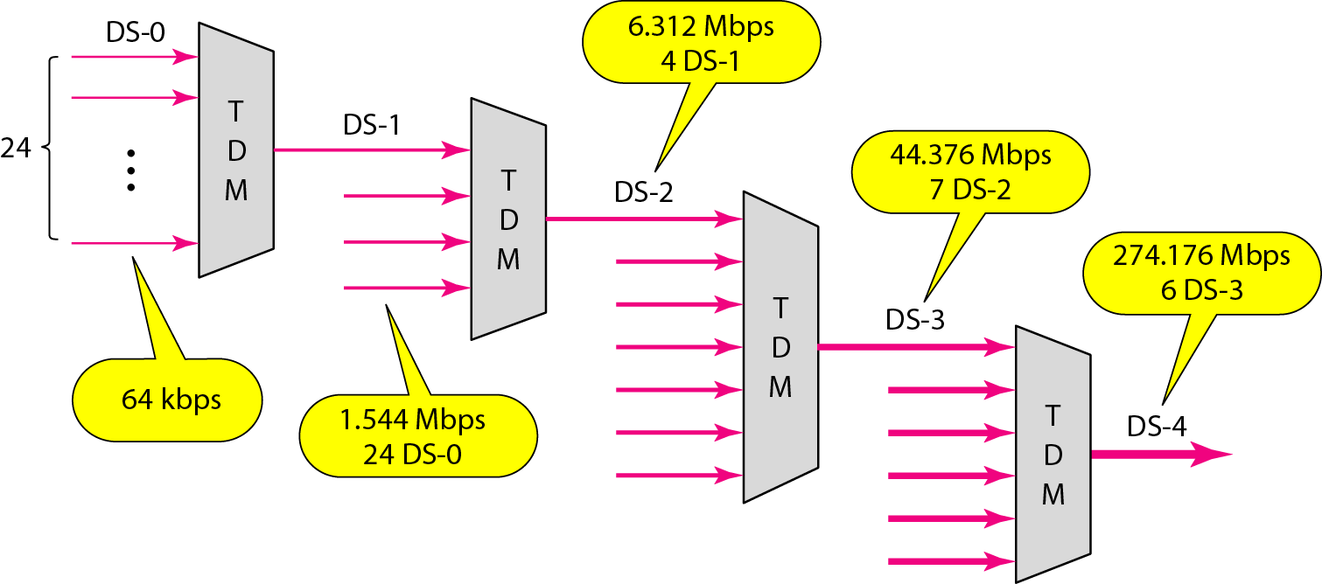
Digital Hierarchy
6-25

Slide 26
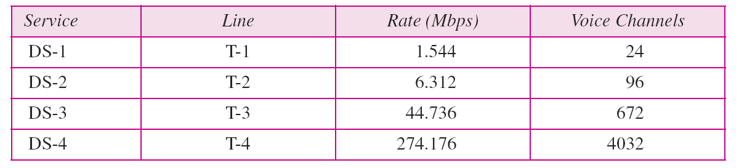
DS and T Line Rates
6-26

Slide 27
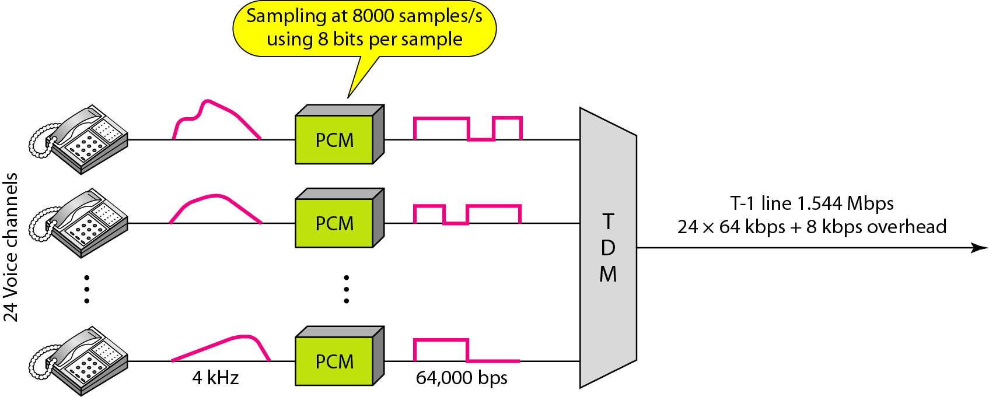
T-1 Line for Multiplexing Telephone Lines
6-27

Slide 28
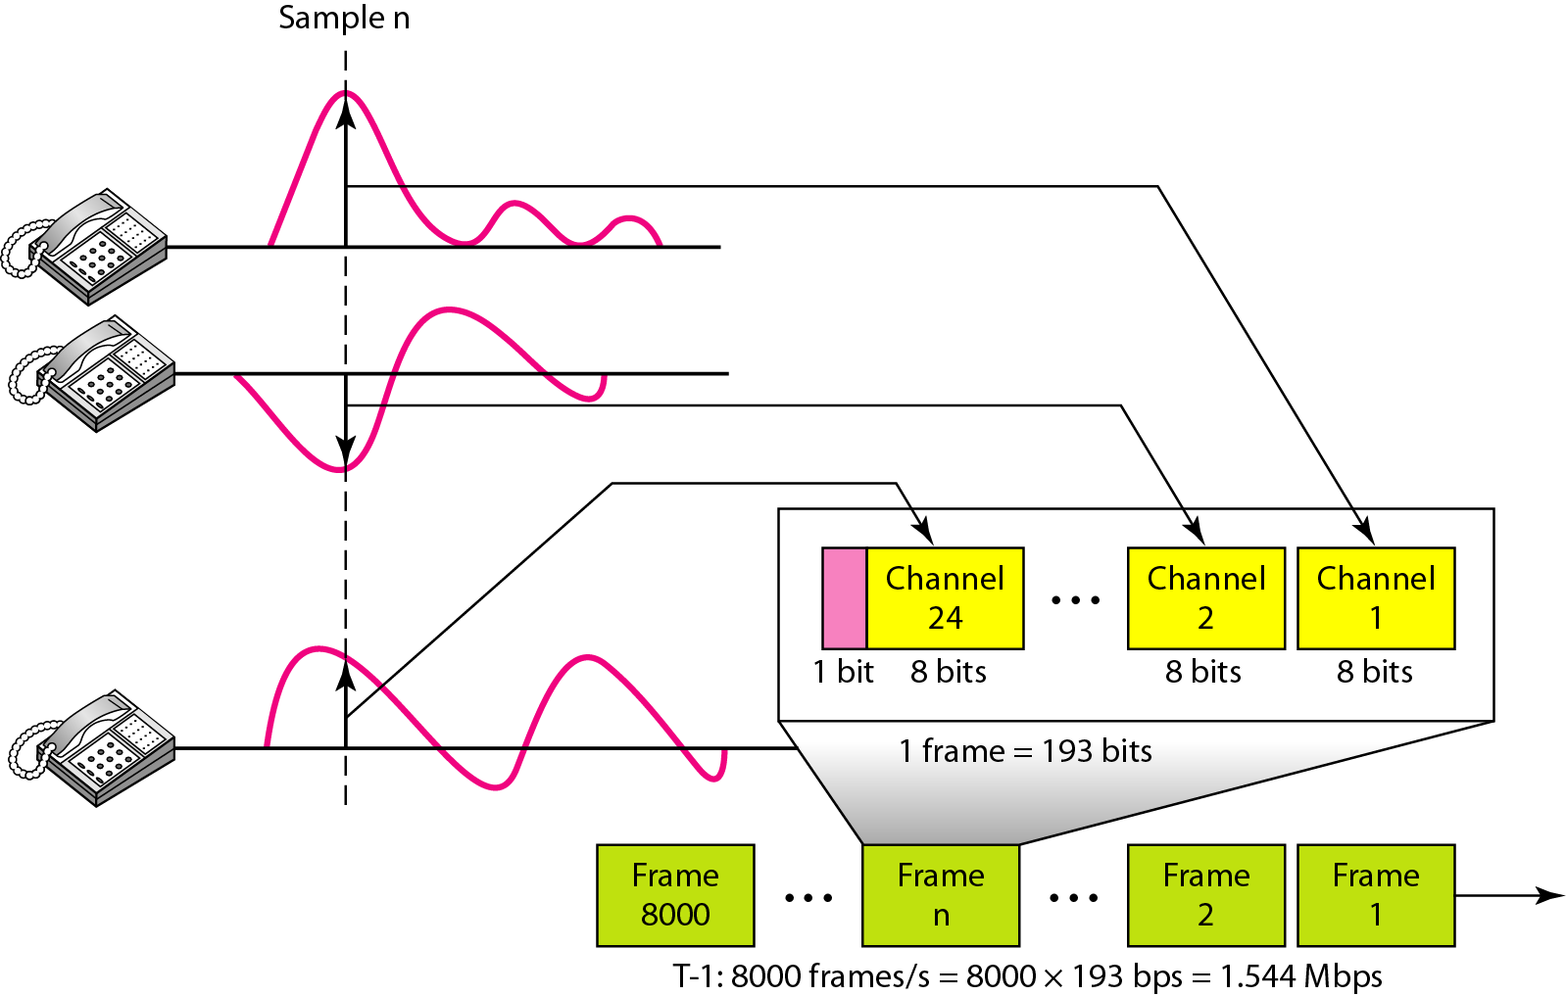
T-1 Frame Structure
6-28

Slide 29
E Line Rates
6-29
European use a version of T lines called E lines

Slide 30
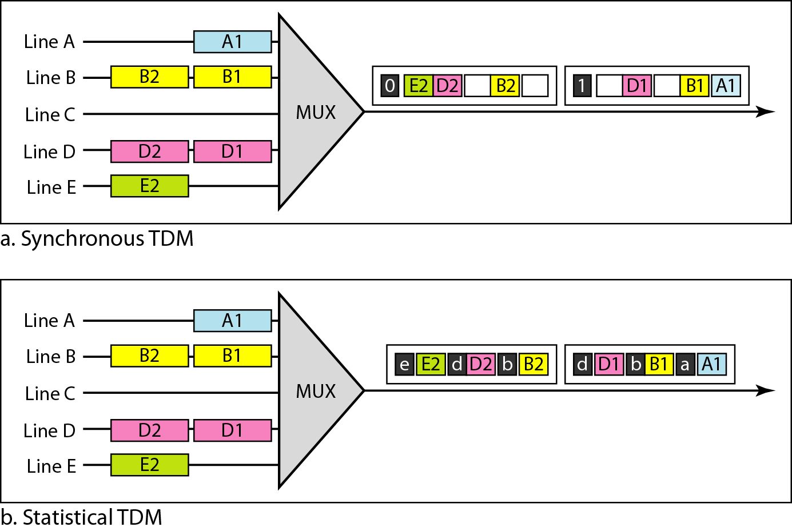
Statistical TDM
6-30

Slide 31
Statistical TDM
6-31
Addressing is required in Statistical TDM
Slot size: the ratio of the data size to address size must be reasonable to make transmission efficient
No synchronization bit: no need for frame-level sync.
Bandwidth: normally less than the sum of the capacities of each channel

Slide 32
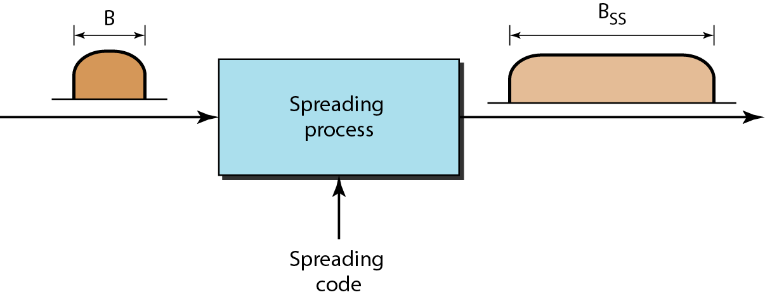
Spread Spectrum
6-32
Combine signals from different sources to fit into a larger bandwidth to prevent eavesdropping and jamming by adding redundancy

Slide 33
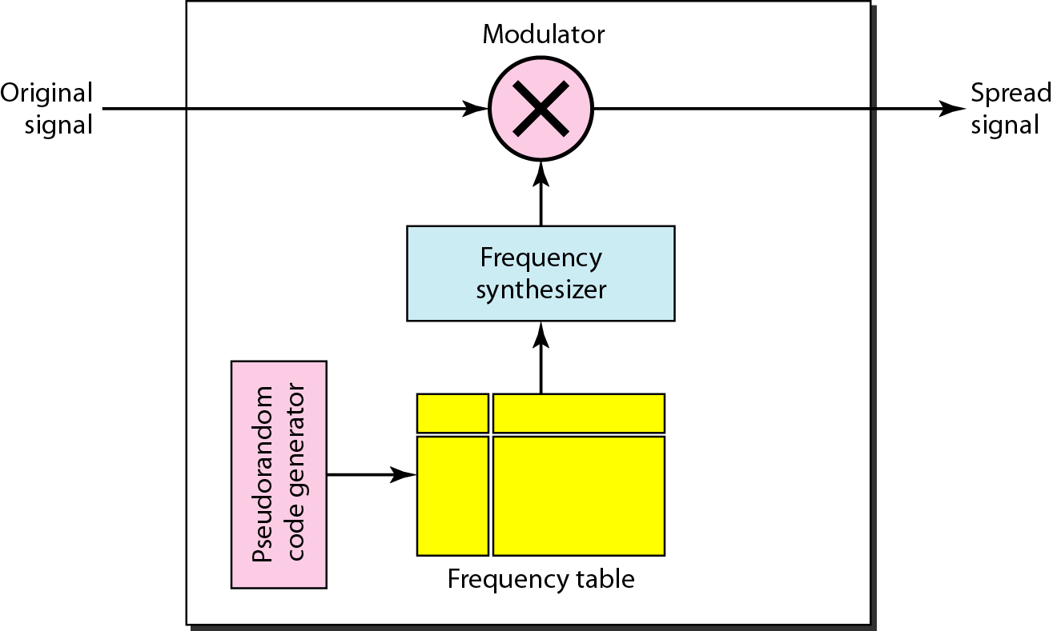
FHSS
6-33
Frequency Hopping Spread Spectrum (FHSS)

Slide 34
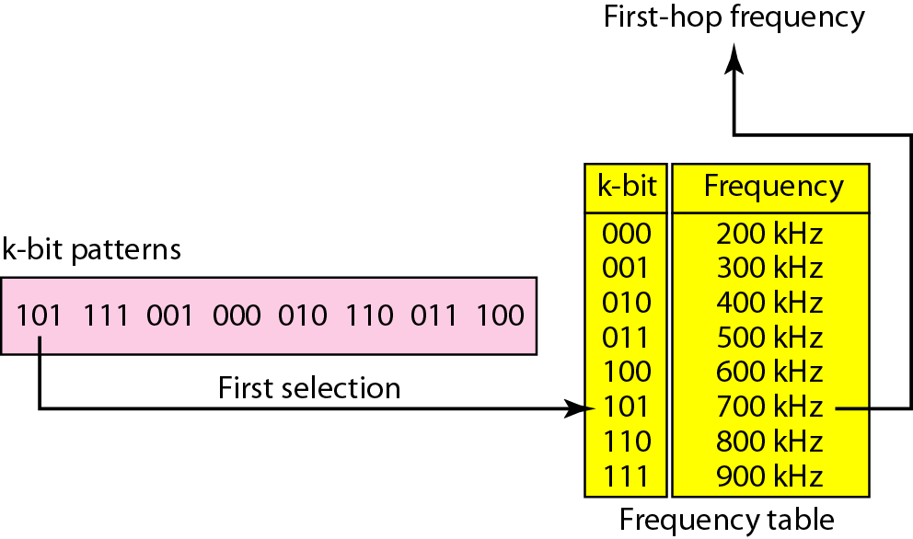
Frequency Selection in FHSS
6-34

Slide 35
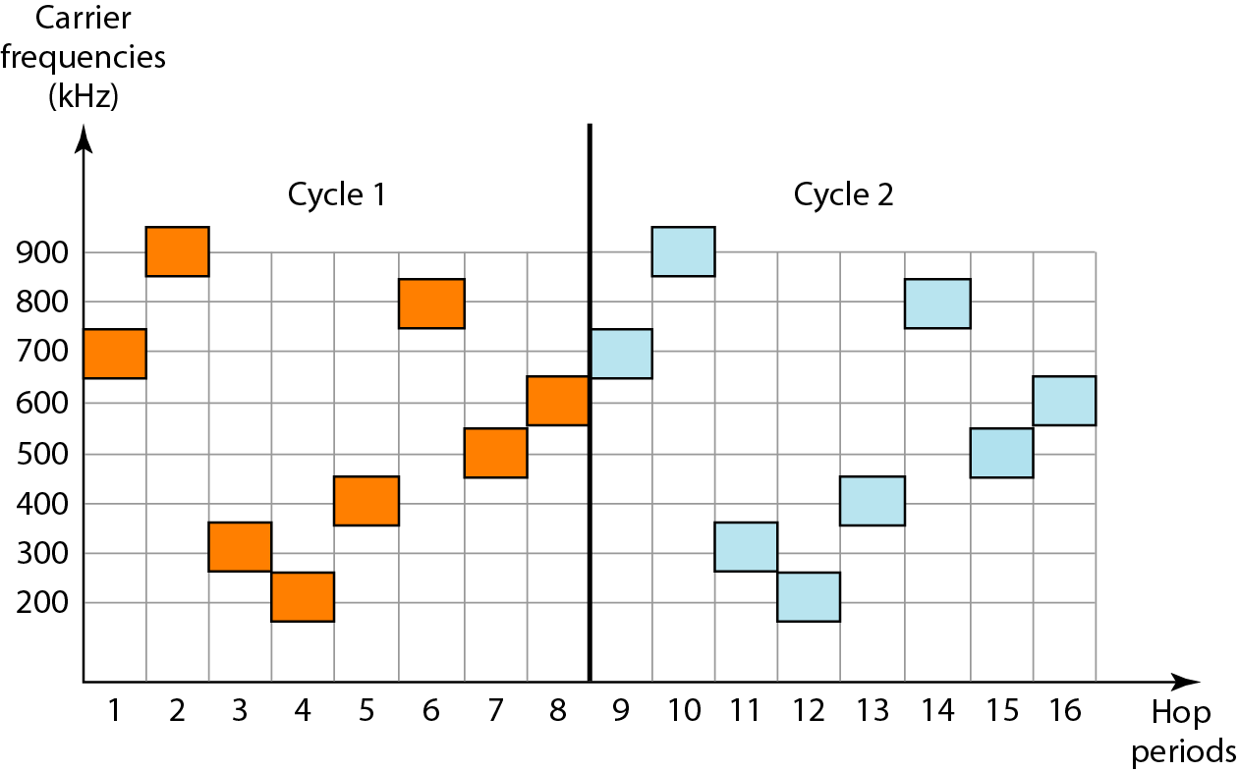
Frequency Cycles
6-35

Slide 36
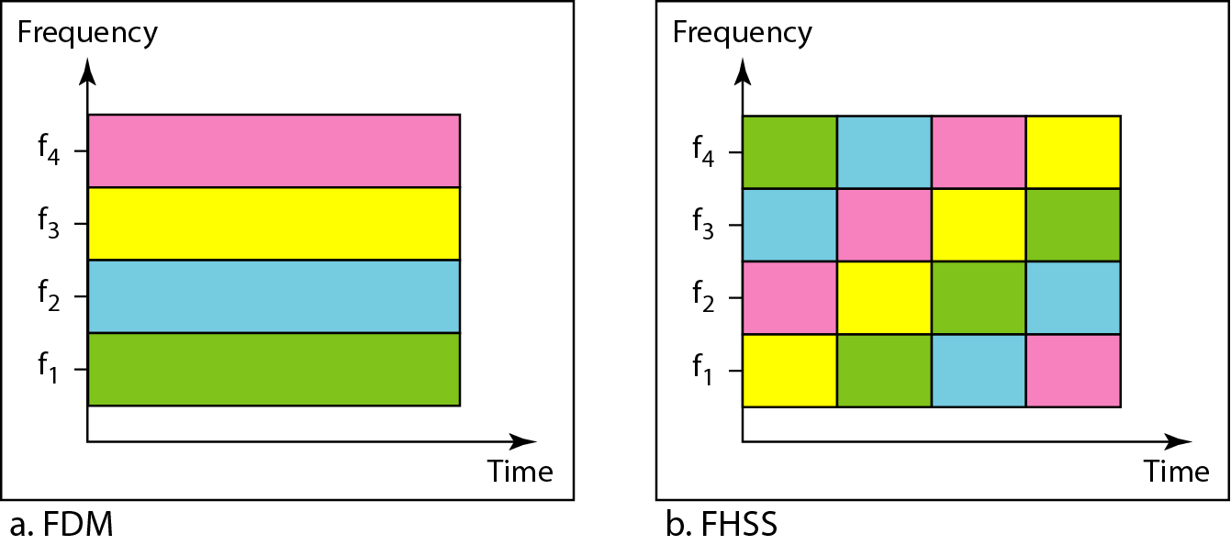
Bandwidth Sharing
6-36

Slide 37
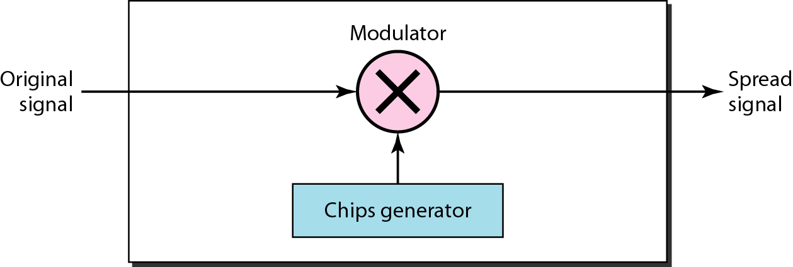
DSSS
6-37
Direct Sequence Spread Spectrum (DSSS)
Replace each data bit with n bits using a spreading code
Each bit is assigned a code of n bits called chips

Slide 38
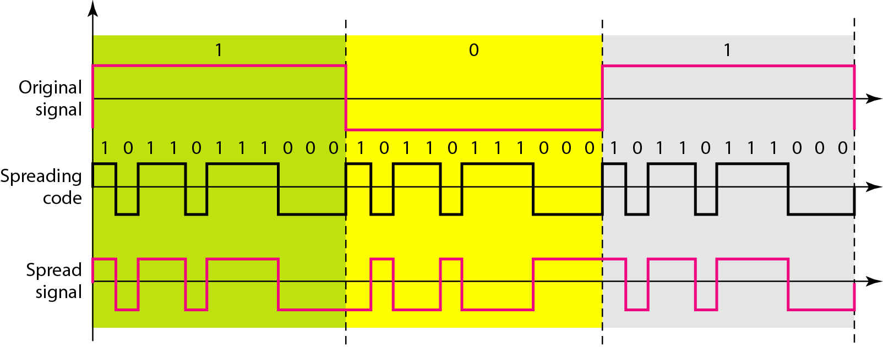
DSSS Example
6-38

