Slide 1
Chapter 7. Transmission Media
Guided Media
Unguided Media: Wireless

Slide 2
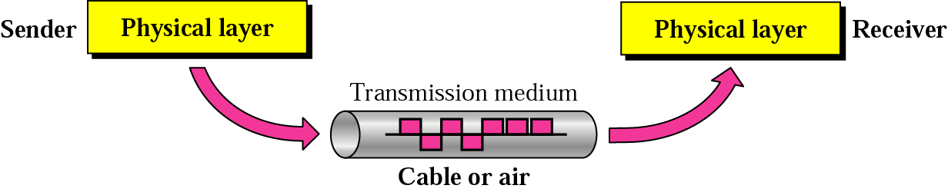
Transmission Medium & Physical Layer
7-2

Slide 3
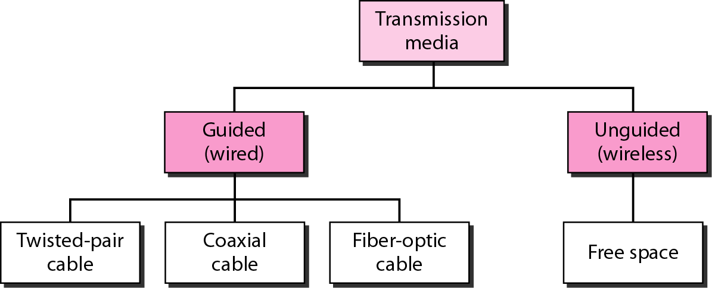
Classes of Transmission Media
7-3

Slide 4
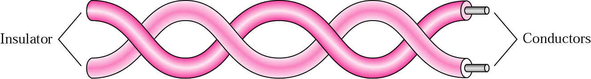
Twisted-pair Cable
7-4

Slide 5
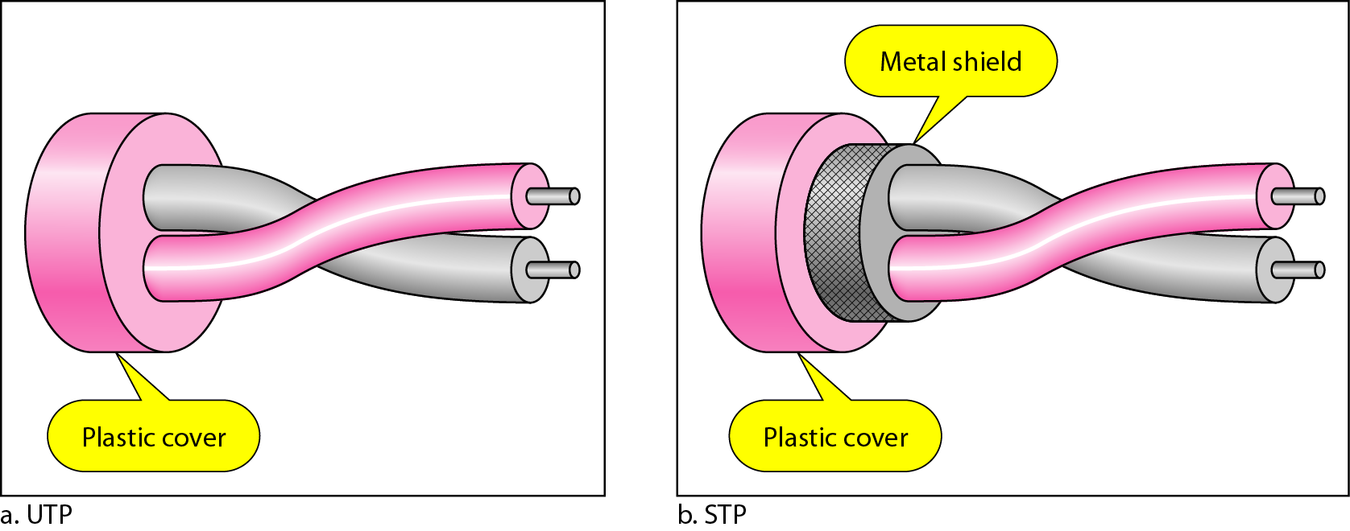
UTP and STP Cables
7-5

Slide 6
Categories of UTP Cables
7-6

Slide 7
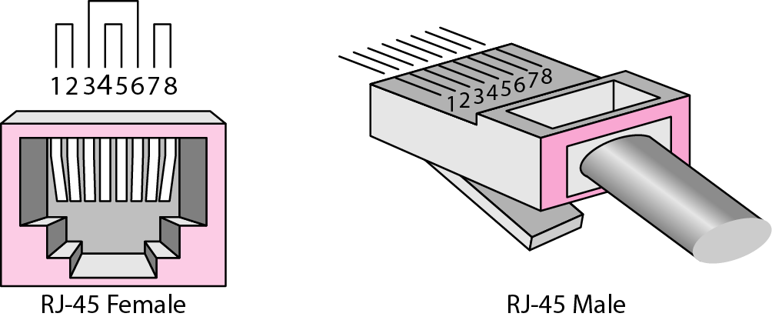
UTP Connector
7-7
RJ45 (RJ stands for registered jack)

Slide 8
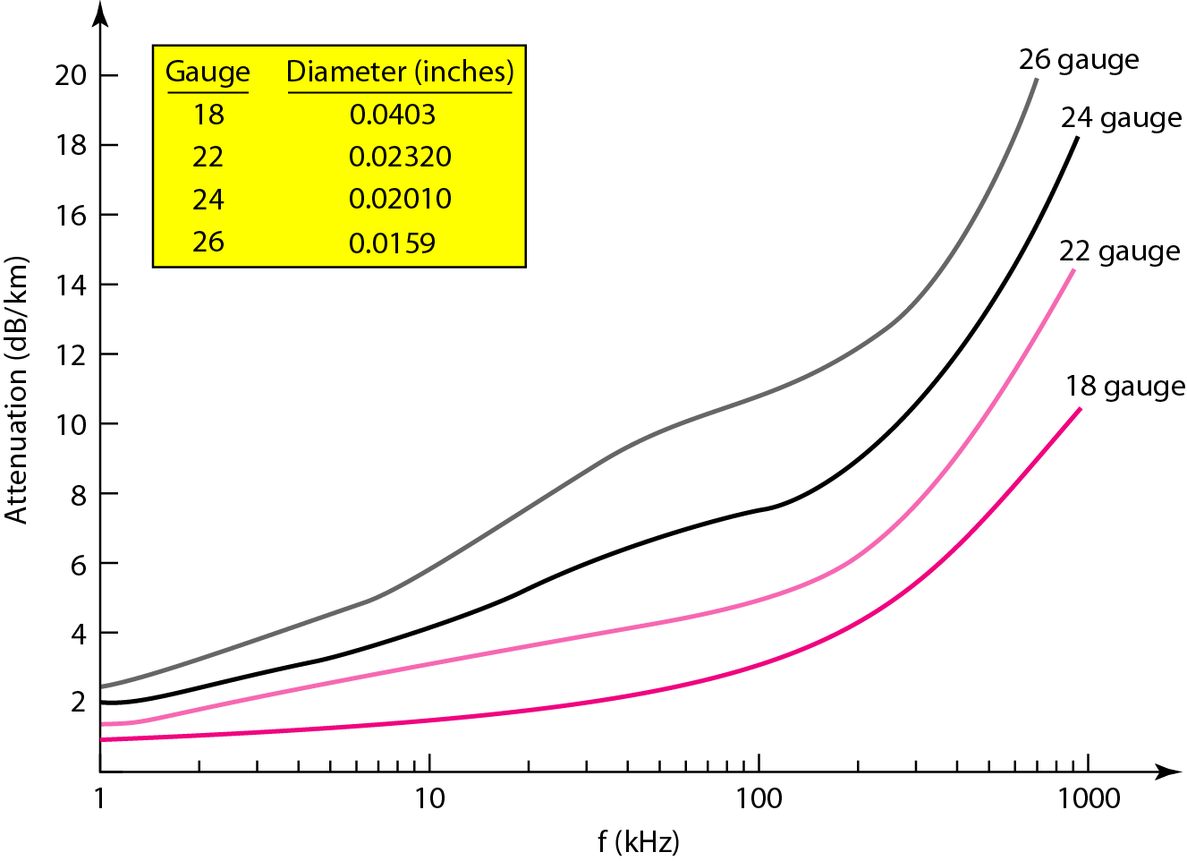
UTP Performance
7-8

Slide 9
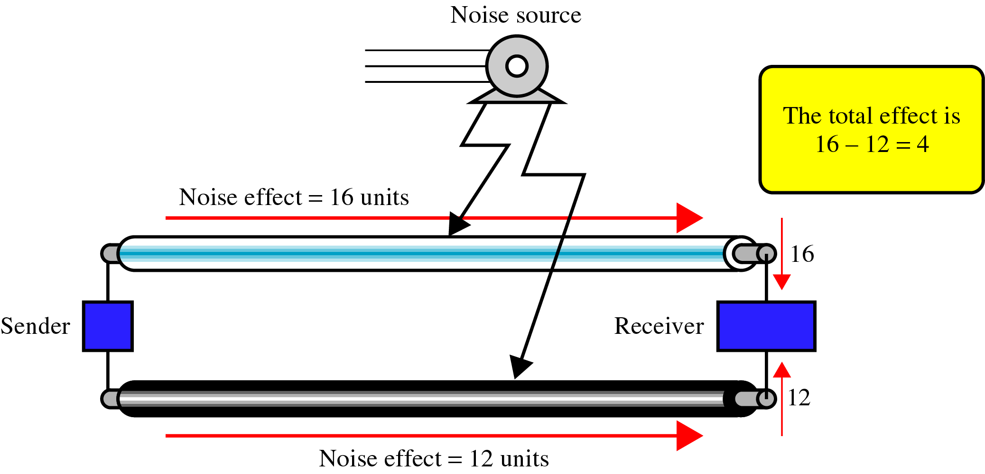
Parallel Flat Wire
7-9
Electromagnetic interference can create noise
The noise over parallel wires results in an uneven load and a damaged signal

Slide 10
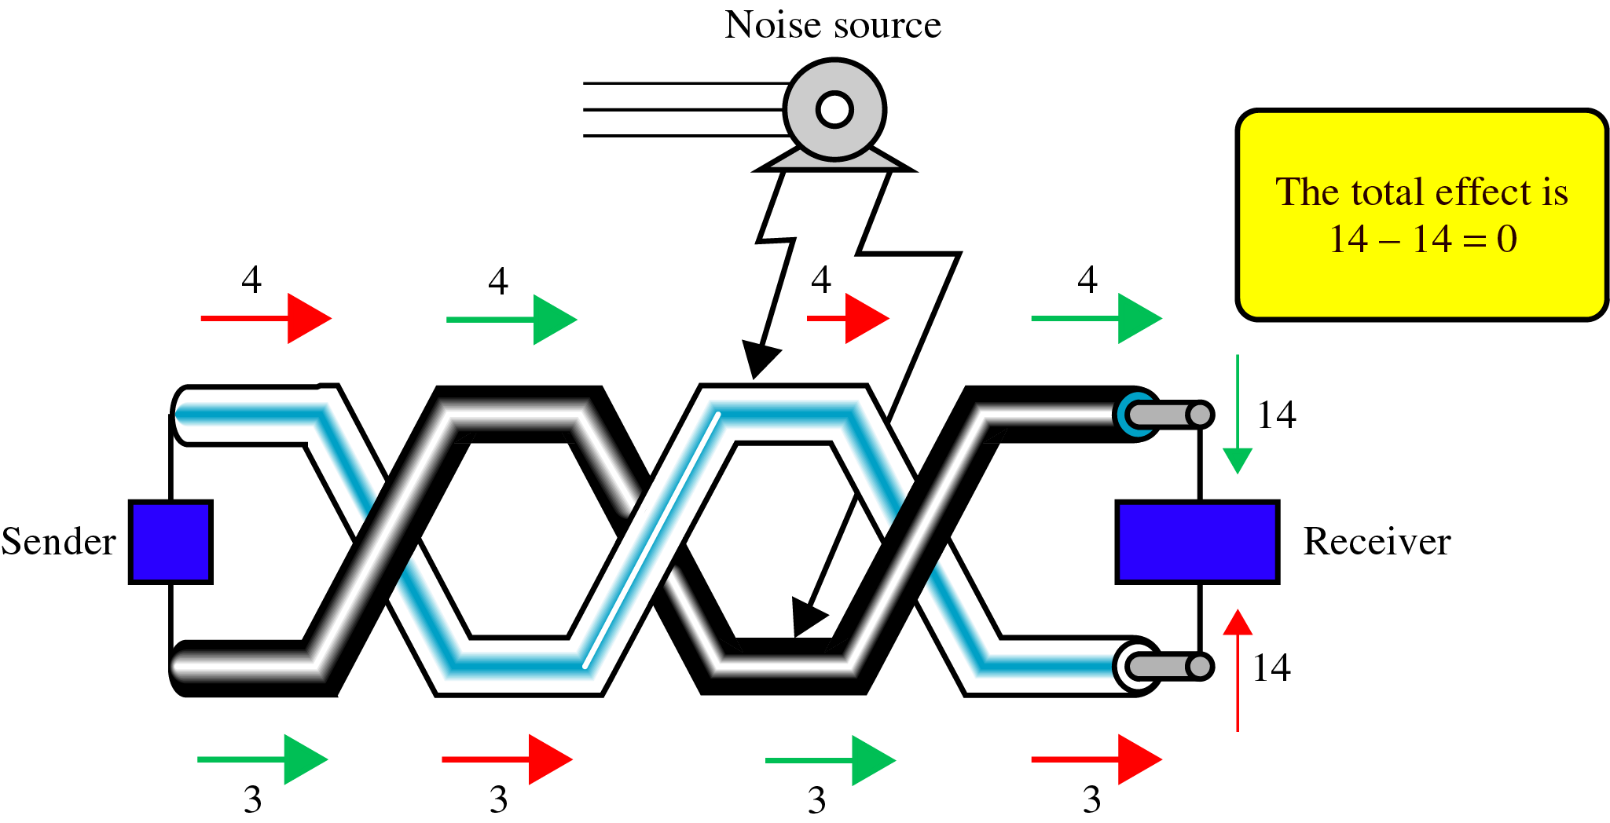
Noise Effect on Twisted-Pair
7-10
Cumulative effect of noise is equal on both sides
Twisting does not always eliminate the noise, but does significantly reduce it

Slide 11
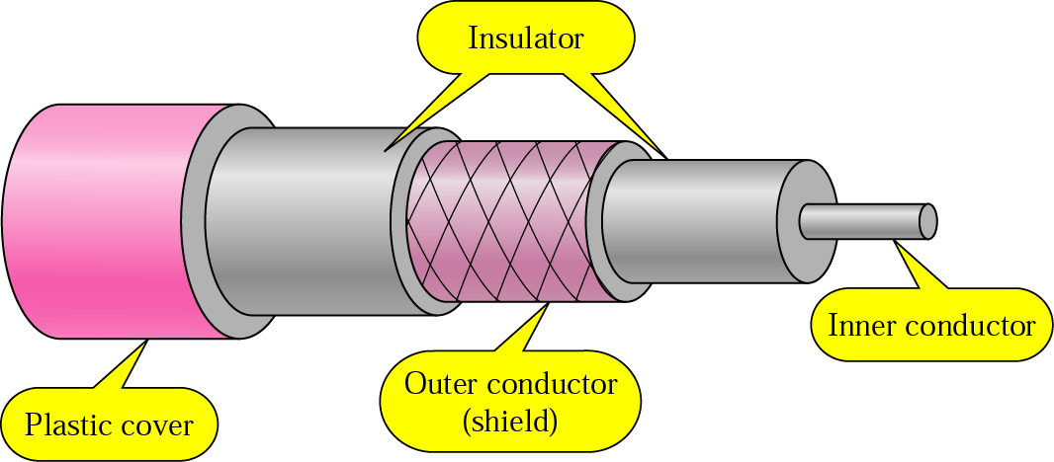
Coaxial Cable
7-11
Carries signals of higher frequency ranges than those in twisted-pair cable

Slide 12
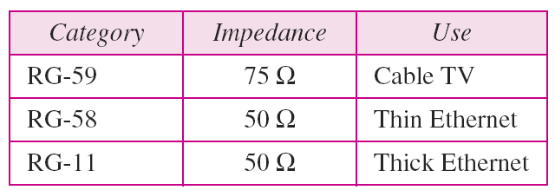
Categories of Coaxial Cables
7-12

Slide 13
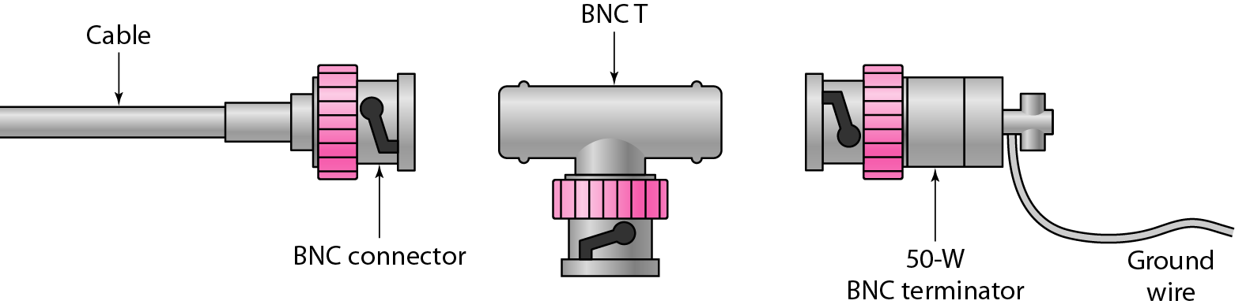
BNC Connectors
7-13
Bayone-Neil-Concelman (BNC) connector

Slide 14
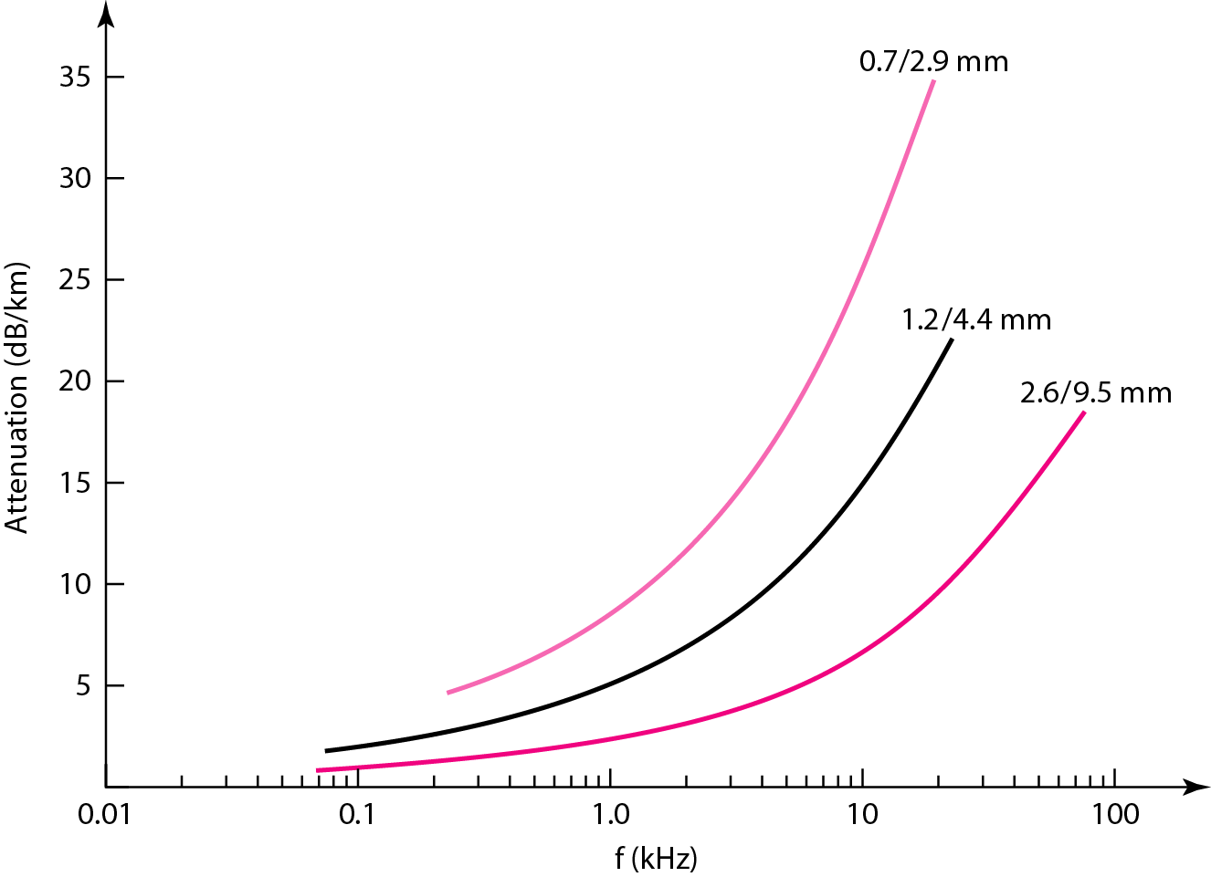
Coaxial Cable Performance
7-14

Slide 15
Optical Fiber
7-15
Optical fiber is made of glass or plastic
It transmits signals in the form of light
The Nature of Light
The speed of light
300,000 Km/sec in a vacuum
Depends on the density of the medium through which it is traveling
Other properties of light
Refraction, Critical angle, Reflection

Slide 16
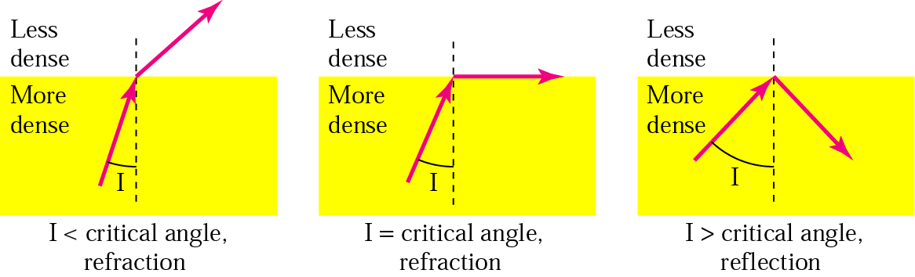
Bending of Light Ray
7-16

Slide 17
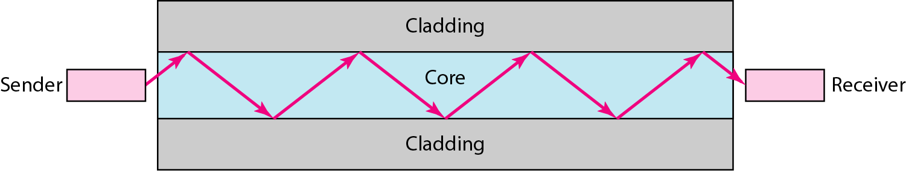
Optical Fiber
7-17

Slide 18
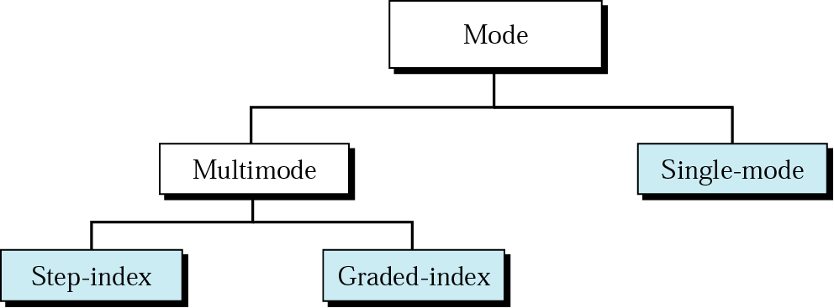
Propagation Modes
7-18

Slide 19
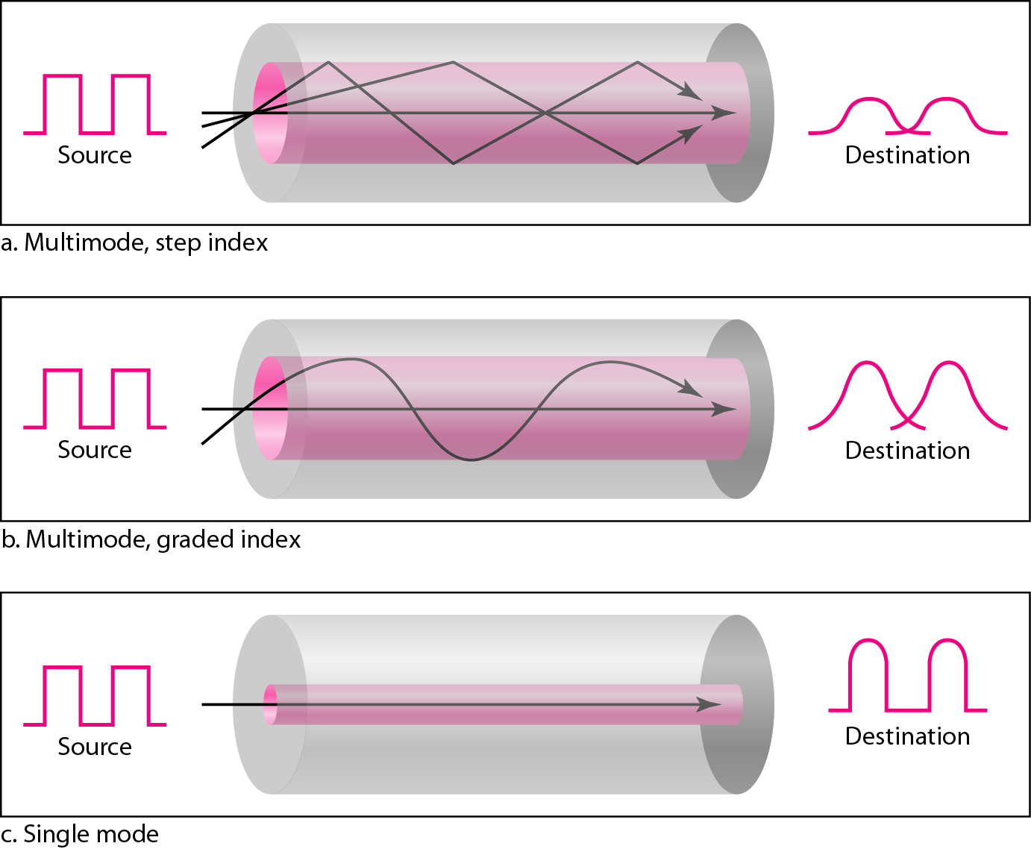
Modes
7-19

Slide 20
Fiber Types
7-20

Slide 21
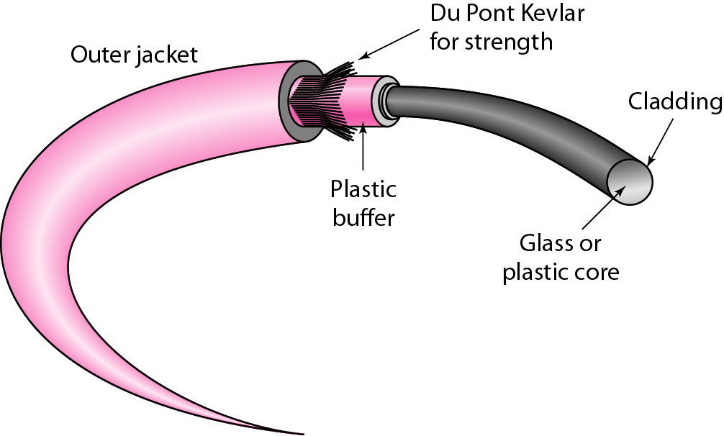
Fiber Construction
7-21

Slide 22
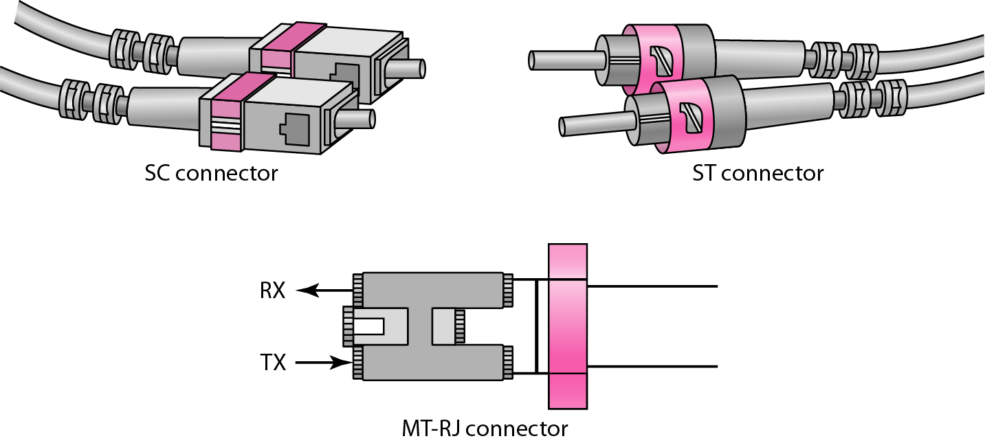
Fiber-optic Cable Connectors
7-22
SC (subscriber channel) connector used for cable TV. It uses push/pull locking system
ST (straight-tip) connector used for connecting cable to networking device. It uses a reliable bayonet locking system
MT-RJ is the same size as RJ45

Slide 23
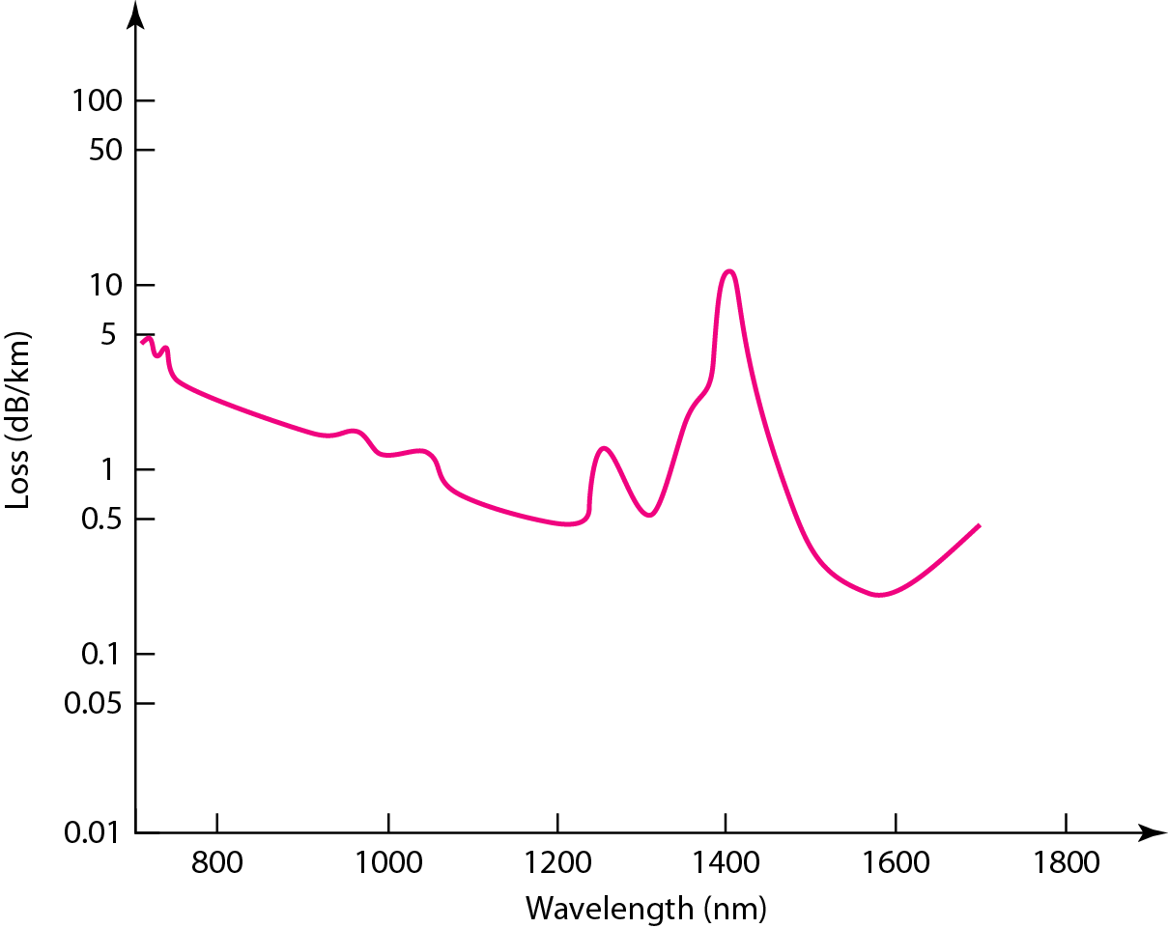
Optical Fiber Performance
7-23

Slide 24
Advantages/Disadvantages of Optical Fiber
7-24
Advantages
Higher bandwidth
Less signal attenuation
Immunity to electromagnetic interference
Resistance to corrosive materials
Light weight
Greater immunity to tapping
Disadvantages
Installation and maintenance
Unidirectional light propagation
Cost

Slide 25
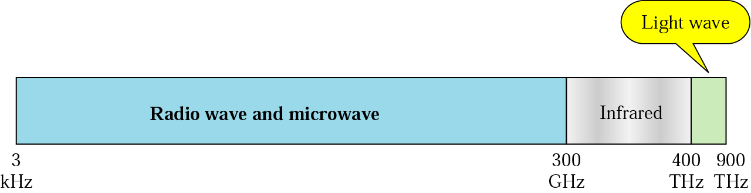
Electromagnetic Spectrum for wireless
7-25

Slide 26
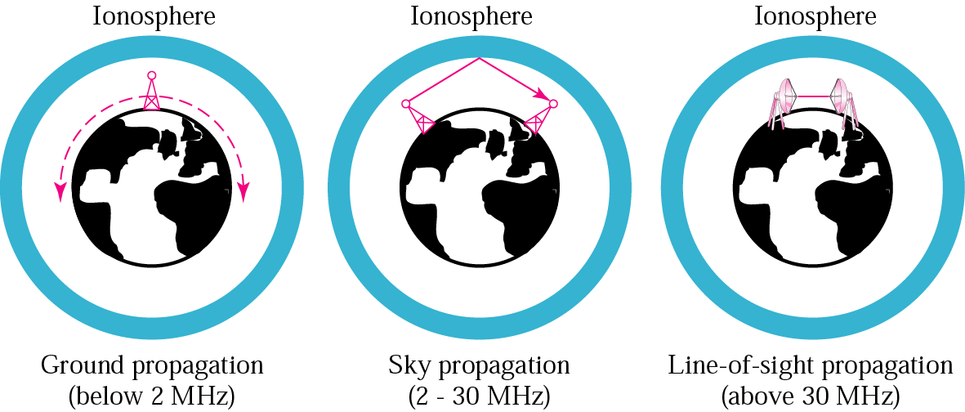
Propagation Methods
7-26

Slide 27
Bands
7-27

Slide 28
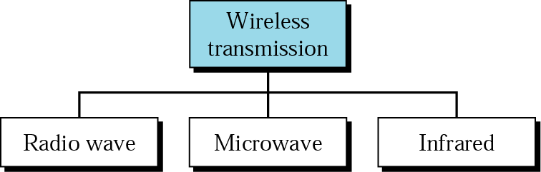
Wireless Transmission Waves
7-28

Slide 29
Wireless Transmission Waves
7-29
Radio waves are used for multicast communications, such as radio and television, and paging systems
Microwaves are used for unicast communication such as cellular telephones, satellite networks, and wireless LANs
Infrared signals can be used for short-range communication in a closed area using line-of-sight propagation

Slide 30
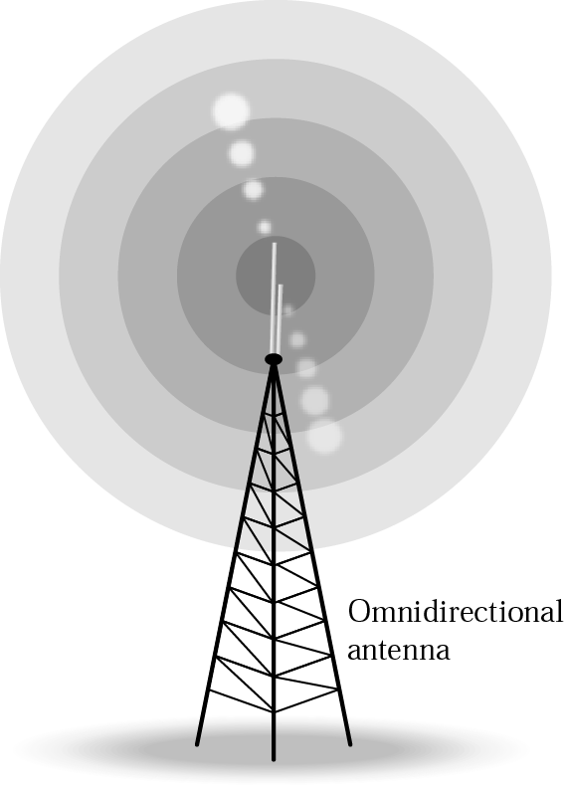
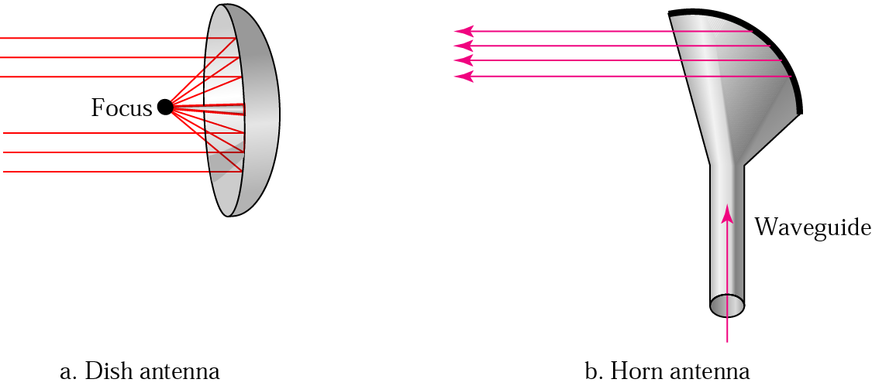
Omnidirectional & Unidirectional Antennas
7-30

Slide 31
Infrared
7-31
Infrared waves with frequencies from 300 GHz to 400 THz for short-range communication in a closed area using line-of-sight propagation
Having high frequencies, it cannot penetrate walls
IrDA (Infrared Data Association) for standards
Example: IrDA port for wireless keyboard
Originally defined a data rate of 75 kbps for a distance up to 8 m
Recent standard for a data rate of 4 Mbps

