Slide 1
C Programming
Lecture 7 : Control Structures

Slide 2
Control Structures
Conditional statement : if, switch
  Determine a block of statements to execute depending on whether the condition is true or false
Repetition statement : for, while, do-while
  Loop : repeat a block of statements a number of times
  Conditional loop : repeat while the condition is true
Other control structures : goto, …

Slide 3
if
. . .
if (num1 >= num2)
diff = num1 – num2;
. . .
true
num1 >= num2
diff = num1 – num2
false

Slide 4
if-else
true
num1 >= num2
diff = num1 – num2
?
false
diff = num2 – num1
. . .
if (num1 >= num2)
diff = num1 – num2;
else
diff = num2 – num1;
. . .

Slide 5
if-else
if ( grade >= 90 ) // 90 and above
printf("A“);
else if ( grade >= 80 ) // 80-89
printf("B“);
else if ( grade >= 70 ) // 70-79
printf("C“);
else if ( grade >= 60 ) // 60-69
printf("D“);
else // less than 60
printf("F“);

Slide 6
if example
#include <stdio.h>
int main ( )
{
int num1, num2, num3, min = 0;
printf (“input three integers : ");
scanf("%d %d %d", &num1, &num2, &num3);
if (num1 < num2)
if (num1 < num3)
min = num1;
else
min = num3;
else
if (num2 < num3)
min = num2;
else
min = num3;
printf (“min value: %d", min);
return 0;
}

Slide 7
Compound statement
block : enclosed by { }
Example
  if ( num1 >= num2 )
  {
  printf(“num1 is greater than num2\n“);
  printf(“The difference is: %d\n”, num1- num2);
  } else {
  printf(“num2 is greater than or equal to num1\n”;
  printf(“The difference is: %d\n”, num2 – num1);
  }

Slide 8
Ternary conditional operator ?:
Example
printf(“Enter two integers :”);
scanf(“%d %d”,&num1, &num2);
printf(“%d\n”, ((num1 >= num2)? num1–num2: num2-num1));
true
false
num1 >= num2
print num1-num2
Print num2-num1

Slide 9
Dangling Else Problem
if a then if b then s1 else s2

Slide 10
switch
The value in switch statement has many cases.
int main()
{
int value;
scanf(“%d”,&value);
switch (value) {
case 1 :
printf(“1 received\n”);
break;
case 2 :
printf(“2 received\n”);
break;
default :
printf(“ values except 1 and 2 were received.\n”);
break;
}
return 0;
}

Slide 11
while
num = 1;
Sum = 0;
true
sum = sum + num;
num = num + 1;
num <= 10
num = 1;
sum = 0;
while (num <= 10) {
sum = sum + num;
num = num + 1;
}
false

Slide 12
do-while
The body (block) of do-while statement is executed at least once.
num = 1;
Sum = 0;
sum = sum + num;
num = num + 1;
num = 1;
sum = 0;
do {
sum = sum + num;
num = num + 1;
} while (n <= 10)
num <= 10
true
false

Slide 13
while example
#include <stdio.h>
int main ()
{
int total = 0, score, count = 0;
float average;
printf (“score input (quit:0): \n");
scanf("%d",&score);
while (score != 0) {
total += score;
count++;
scanf("%d",&score);
}
if (count == 0)
printf (“No input received!");
else {
average = (float) total / count;
printf (“total: %d \n", total);
printf (“average: %5.2f \n", average);
}
return 0;
}

Slide 14
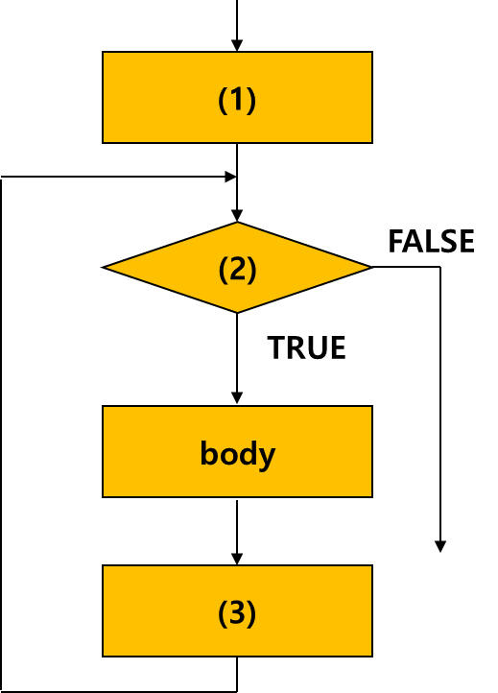
for
Repetition
  control variable initialization
  Test Conditon
  Modification of control variable value
order : (1) (2) body (3) (2) body (3) (2) body … body (3) (2)
* Example
for(counter = 1; counter <= 10; counter++ )
printf(“%d\n”,counter);
for ( (1); (2); (3) )
{ // for-repetition body
. . . .
. . . . // {} is not necessary
// if there is only one statement in body
}

Slide 15
for example
#include <stdio.h>
int main ()
{
int total = 0, score, count;
float average;
printf (“score input (quit:0): ");
scanf("%d",&score);
for (count=0; score != 0; count++) {
total += score;
scanf("%d",&score);
}
if (count == 0)
printf (“No input received!");
else {
average = (float) total / count;
printf (“total: %d \n", total);
printf (“avarage: %5.2f \n", average);
}
return 0;
}

Slide 16
break
break in loop
  Go out of the loop block and execute next to the loop
  example
  while (1) {
  scanf("%d",&j)
  if (j == 0)
  break;
  result = i/j;
  }

Slide 17
continue
continue in loop
  Go to condition test of the loop
  Example
  for (i = 0, sum = 0; i <= n; i++) {
  if (i % 2 == 0)
  continue;
  sum += i;
  }

Slide 18
Nested Loop
loop in a loop
int main ()
{
int i, j;
for (i=1; i<10; i++) {
printf ("%d-th iteration \n", i);
for (j = 1; j < 10; j++)
printf("%d X %d = %d\n", i, j, i*j);
printf ("\n", i);
}
return 0;
}

Slide 19
Infinite Loop
If the condition of the loop is always TRUE, the body of the loop is executed infinitely
example
while(1) {
i=0;
i++;
printf(“%d”,i);
}
  int count = 1;
  while (count != 100)
  count += 2;

