Slide 1
Lecture 8 :
Programming
Notes:
© 우균, 창병모

Slide 2
Programming Language
Language for programming computer processing
  Machine readable language designed to express computations that can be performed by a computer
  Specify behavior of machine, express algorithms
  Human-Computer Communications
Machine language
  Binary code
1001 0001 store value at address 0001 into accumulator
1100 0010 add value at address 0010 into accumulator
Assembly Language
  Symbolization of machine language binary code
LOAD Y
ADD Z
Notes:
© 우균, 창병모

Slide 3
Programming Language
High level language
  Easy to use (read and write) , human friendly
  Programmer does not need to know details of machine control.
  More portable (machine independent)
  X = Y + Z
example
  FORTRAN, COBOL, BASIC, C, C++, Java
Notes:
© 우균, 창병모

Slide 4
High Level Programming Language
FORTRAN(FORmula TRANslation)
  Created in 1957 by John Backus (IBM)
  General purpose PL especially suited For scientific computation
COBOL(COmmon Business Oriented Language)
  Created in early 1960s
  Primarily used for business, finance in companies and govenment
BASIC(Beginner's All-purpose Symbolic Instruction Code)
  Easy to learn and use for beginners
Notes:
© 우균, 창병모

Slide 5
High Level Programming Language
C
  Made by Dennis Ritchie (AT&T Bell Lab)
  made for developing UNIX OS (1970s)
  High level language with low level language properties (pointers,…)
C++
  Made by B. Stroustrup (AT&T Bell Lab)
  OOPL(Object Oriented Programming Language) extending C
Java
  Made by James Gosling (Sun Microsystems, 1990s)
  Platform independent OOPL
Notes:
© 우균, 창병모

Slide 6
Software Development Process
Requirement analysis
Design
Implementation
Testing
Maintenance

Slide 7
Programming and Execution
Programming Tool
  Editor, Compiler, Interpreter, Debugger, and etc
  Integrated Development Environment (IDE)
Program Edit
Error
Compile
Error
Execution
Notes:
© 우균, 창병모

Slide 8
Error
compile-time error
  Error occurring during compilation
  Grammar check
  Cannot execute if there is compile error
logical error
  Grammar is OK but logical error
run-time error
  Abnormal termination owing to unexpected reasons during program execution
  Ex) divided by zero, illegal memory access
Notes:
© 우균, 창병모

Slide 9
Debugging
debugging
  Bug : program error
  Debugging : bug correction
Notes:
© 우균, 창병모

Slide 10
Compiler / Interpreter
Compiler
  Convert high level language to low level language
  (occur at compile-time)
Interpreter
  Compile and execute the program line by line
  (occur at run-time)
Comparison?
Notes:
© 우균, 창병모

Slide 11

C Programming Language
Designed by Dennis Ritchie (1972)
  used for developing UNIX OS
C features
  Structured programming , modular programming
  Highly portable
  Efficient (fast)
  C has the features of high level language and low level language
Dennis Ritchie

Slide 12
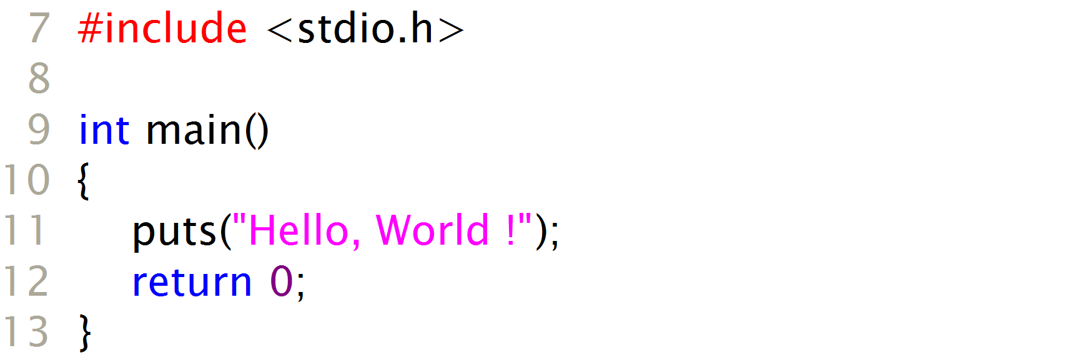
First Program simple C program (hello.c)
output:
Hello, World !

Slide 13
C compiler
compiler?
  Programmer can use high level language such as C
  CPU knows machine language (assembly language)
C compiler
  Commercial compiler: Microsoft Visual C/C++ (ver. 6.0)
  Free compiler: gcc
C program
int main…
Compiler
Machine
language
010101…

Slide 14
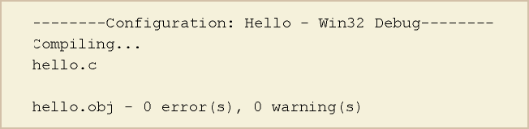
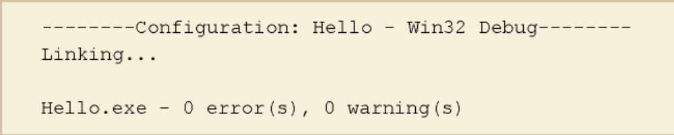
Compile & Build
compile → Compile hello.c
  Object file (.obj) is created
Build → Build Hello.exe
  Link : link object files and create a executable file (.exe)

Slide 15
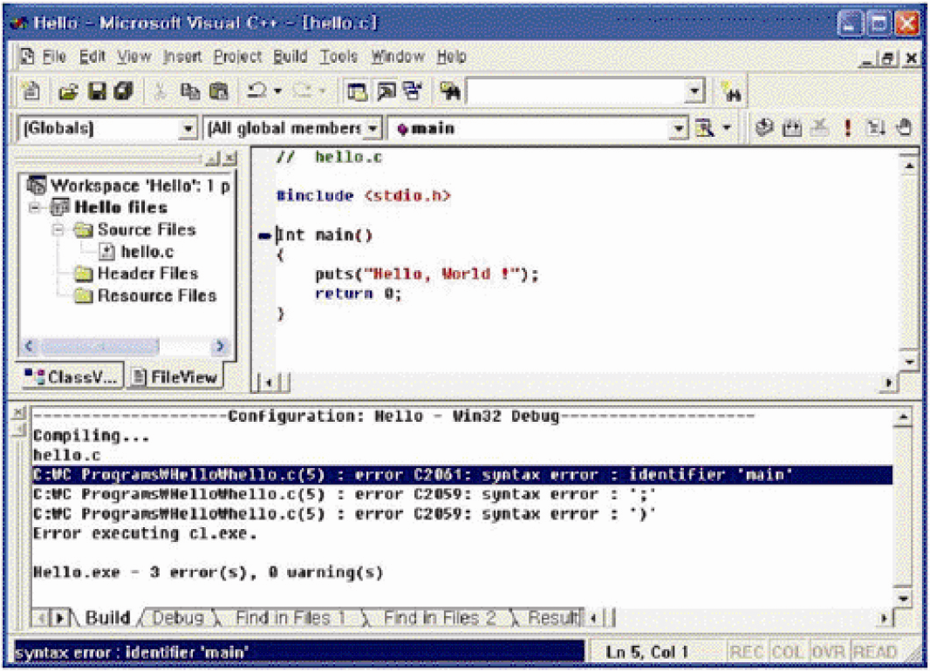
Compile-time error
  Grammar error. Object file can not be created
  Double click error message line

Slide 16
Programming Process
Source files (.c)
preprocessor
temporary program texts
compiler
Object files
library files
linker
Executable file (.exe)

Slide 17
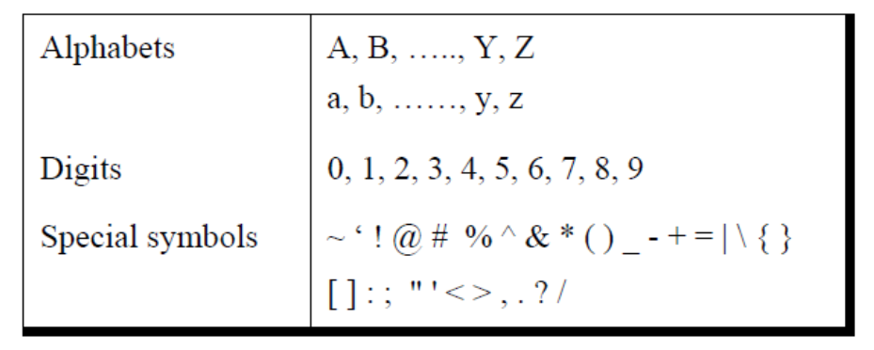
Character set
A character denotes any alphabet, digit or special symbol used to represent information. Valid alphabets, numbers and special symbols allowed in C are

Slide 18
Identifiers
Identifiers are user defined word used to name of entities like variables, arrays, functions, structures etc. Rules for naming identifiers are:
1) name should only consists of alphabets (both upper and lower case), digits and underscore (_) sign.
2) first characters should be alphabet or underscore
3) name should not be a keyword
4) since C is a case sensitive, the upper case and lower case considered
differently, for example code, Code, CODE etc. are different identifiers.
5) identifiers are generally given in some meaningful name such as value,
net_salary, age, data etc. An identifier name may be long, some implementation recognizes only first eight characters, most recognize 31 characters.
ANSI standard compiler recognize 31 characters. Some invalid identifiers are 5cb, int, res#, avg no etc.

Slide 20
#include <stdio.h>
int main()
{
/* My first program */
printf("Hello World! \n");
return 0;
}
Output :
Hello World!
C is case sensitive.
End of each statement must be marked with a semicolon (;).
Multiple statements can be on the same line.
White space (e.g. space, tab, enter, …) is ignored.

Slide 21
First Program
#include <stdio.h>
int main()
{
/* My first program */
printf("Hello World! \n");
return 0;
}
The C program starting point : main().
main() {} indicates where the program actually starts and ends.
In general, braces {} are used throughout C to enclose a block of statements to be treated as a unit.
COMMON ERROR: unbalanced number of open and close curly brackets!
Output :
Hello World!

Slide 22
First Program
#include <stdio.h>
int main()
{
/* My first program */
printf("Hello World! \n");
return 0;
}
#include <stdio.h>
  Including a header file stdio.h
  Allows the use of printf function
  For each function built into the language, an associated header file must be included.
printf() is actually a function (procedure) in C that is used for printing variables and text
Output :
Hello World!

Slide 23
First Program
#include <stdio.h>
int main()
{
/* My first program */
printf("Hello World! \n");
return 0;
}
Comments
  /* My first program */
  Comments are inserted between “/*” and “*/”
  Or, you can use “//”
  Primarily they serve as internal documentation for program structure and function.
Output :
Hello World!

Slide 24
Why use comments?
Documentation of variables, functions and algorithms
Ex) for each function, explain input and output of the function, and what the function does.
Describes the program, author, date, modification changes, revisions,…

Slide 25
Header Files
Header files contain definitions of functions and variables
Preprocessor #include insert the codes of a header file into the source code.
Standard header files are provided with each compiler
To use any of the standard functions, the appropriate header file should be included.
  Ex) to use printf() function , insert #include <stdio.h>
In UNIX, standard header files are generally located in the /usr/include subdirectory

Slide 26
Header Files
#include <string.h>
#include <math.h>
#include “mylib.h”
The use of brackets <> informs the compiler to search the compiler’s include directories for the specified file.
The use of the double quotes “” around the filename informs the compiler to start the search in the current directory for the specified file.

Slide 27
C Programming: Variables , Data Types
Lecture notes : courtesy of Ohio Supercomputing Center, science and technolgy support

Slide 28
Second Program
#include <stdio.h>
#define TAXRATE 0.10
int main () {
float balance;
float tax=0.0; /* declaration + initialization */
char rate=‘A’;
int credit_no=1;
balance = 72.10;
tax = balance * TAXRATE;
printf("The tax on %.2f is %.2f\n",balance, tax);
printf(“CREDIT RATE : %d/%c\n”, credit_no, rate);
return 0;
}
Output :
The tax on 72.10 is 7.21
CREDIT RATE : 1/A

Slide 29
Names in C
Identifiers (variable name)
  Must begin with a character or underscore(_)
  May be followed by any combination of characters, underscores, or digits(0-9)
  Case sensitive
  Ex) summary, exit_flag, i, _id, jerry7
Keywords
  Reserved identifiers that have predefined meaning to the C compiler. C only has 29 keywords.
  Ex) if , else, char, int, while

Slide 30
Symbolic Constants
Names given to values that cannot be changed.
Use preprocessor directive #define
Symbols which occur in the C program are replaced by their value before actual compilation
#define N 3000
#define FALSE 0
#define PI 3.14159
#define FIGURE "triangle"

Slide 31
Declaring Variables
Variable
  Named memory location where data value is stored
  Each variable has a certain type (e.g. int, char, float, …)
  Contents of a variable can change
  Variables must be declared before use in a program
  Declaration of variables should be done at the opening brace of a function in C. ( it is more flexible in C++ )
Basic declaration format
  data_type var1, var2, …;
  Examples)
  int i,j,k;
  float length, height;

Slide 32
Data Types
char : 1 byte, capable of holding one character (ascii code)
int : 4 byte (on 32bit computer) integer
float : single-precision floating point
double : double-precision floating point
type | size | min value | max value
char | 1byte | -2⁷ = -128 | 2⁷-1 = 127
short | 2byte | -2¹⁵ = -32,768 | 2¹⁵-1 = 32,767
int | 4byte | -2³¹ = -2,147,483,648 | 2³¹-1 = 2,147,483,647
long | 4byte | -2³¹ = -2,147,483,648 | 2³¹-1 = 2,147,483,647
Min/Max values are defined in <limit.h> header file

Slide 33
unsigned type
Use when representing only positive numbers
Data type | size | min | max
unsigned char | 1byte | 0 | 2⁸-1 = 255
unsigned short | 2 byte | 0 | 2¹⁶-1 = 65,535
unsigned int | 4byte | 0 | 2³²-1 = 4,294,967,295

Slide 34
Negative integer representation
signed
first bit represents the sign of a number
Rest of bits represent the value of a number
Negative integer number
  Represented as 2’s complement
number | Bit representation
+5 | 00000101
1’s complement of 5 | 11111010
2’s complement of 5 | 11111011
-5 | 11111011

Slide 35
floating point
real number : significant number + position of decimal point
Decimal point(.) can be placed anywhere relative to the significant digits of the number
This position is indicated separately in the internal representation
Advantage of floating point representation
  Support much wider range of values
  Representing 314159265358979.3 vs 3.141592653589793
type | size | min | max
float | 4 byte | (7 significant numbers) -1.0E+38 | (7 significant numbers) 1.0E+38
double | 8 byte | (15 significant numbers) -1.0E+308 | (15 significant numbers) 1.0E+308

Slide 36
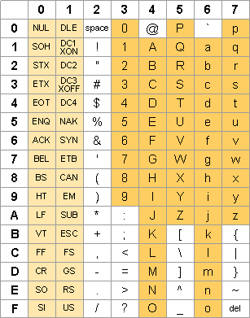
Ascii Code

Slide 37
Escape character
Starts with backslash(\)
Indicate special meaning and interpretation
Escape character | meaning
\b | backspace
\t | tab
\n | newline
\r | formfeed
\" | double quote
\' | single quote
\\ | back slash

Slide 38
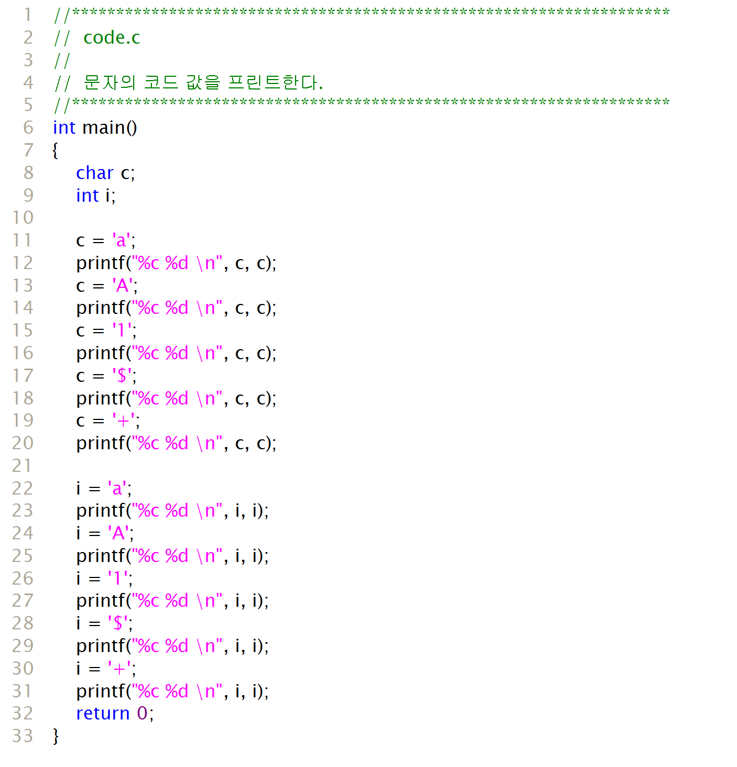
code.c
output:
a 97
A 65
1 49
$ 36
+ 43
a 97
A 65
1 49
$ 36
+ 43

Slide 39
getchar() , putchar()
int getchar()
  Defined in <stdio.h>,
  Get one character input from keyboard and return the ascii value
int putchar(int c)
  Defined in <stdio.h>
  prints one character provided as a parameter
#include <stdio.h>
int main()
{
int c;
printf(“keyboard input (one character?)”);
c=getchar();
printf(“character input : %c\n”,c);
printf(“ascii code : %d\n”, c);
return 0;
}
Output :
character input : A
ascii code : 65

Slide 40
korea.c
#include <stdio.h>
int main()
{
short no_univ = 276;
int population = 48295000;
long budget = 237000000000000L;
printf(“korea info\n”);
printf(“univ no : %d\n”, no_univ);
printf(“population : %d\n”, population);
printf(“budget : %d\n”, budget);
return 0;
}
Output :
korea info
univ no : 276
putpulation: 48295000
budget: -590360576

Slide 41
Overflow?
(integer type) overflow
  occurs when storing a value that is bigger than what can be stored.
  Ex) 2,147,483,647 (= 2³¹-1) + 1 = ?
01111111 11111111 11111111 11111111
+ 00000000 00000000 00000000 00000001
--------------------------------------------------
10000000 00000000 00000000 00000000
#include <stdio.h>
int main()
{
int a=2147483647;
printf("%d,%d\n",a,a+1);
return 0;
}

