Slide 1
Recursion

Slide 2
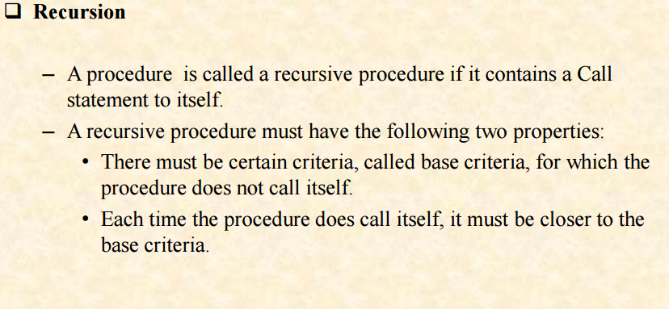

Slide 3
Recursive Thinking: The General Approach
A function is defined recursively if it has the following two parts:
An anchor or base case
The function is defined for one or more specific values of the parameter(s)
An inductive or recursive case
The function's value for current parameter(s) is defined in terms of previously defined function values and/or parameter(s)
Notes:
How would you normally write a powers – OK let’s say you can’t use the powers operator…use a loop with so that it can be variable!!

Slide 4
Recursive Thinking: The General Approach
if problem is “small enough”
solve it directly
else
break into one or more smaller subproblems
solve each subproblem recursively
combine results into solution to whole problem

Slide 5
Requirements for Recursive Solution
At least one “small” case that you can solve directly
A way of breaking a larger problem down into:
One or more smaller subproblems
Each of the same kind as the original
A way of combining subproblem results into an overall solution to the larger problem

Slide 6
Recursive Factorial
n! = 1 x 2 x …x n, for n > 0
n! = (n – 1)! X n
5! = 5 x 4! 120
4! = 4 x 3! 24
3! = 3 x 2! 6
2! = 2 x 1! 2
1! = 1 1
Notes:
This is born to be used for recursion…see if you can construct the function to perform this recursively??
How would this be written conventionally??
int fact(int n)
{
if (n==1) return 1;
return n * fact(n – 1);
}

Slide 7
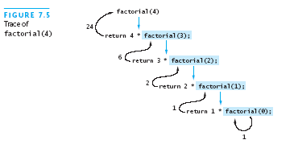
Recursive Definitions: Factorial
0! = 1
n! = n x (n-1)!
If a recursive function never reaches its base case, a stack overflow error occurs

Slide 8
Recursive Definitions: Factorial Code
public static int factorial (int n) {
if (n == 0) // or: throw exc. if < 0
return 1;
else
return n * factorial(n-1);
}

Slide 9
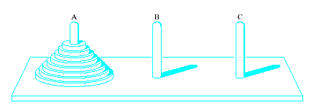
Problem Solving with Recursion: Towers of Hanoi
Think Recursive algorithm
Task
Move disks from left peg to right peg
When disk moved, must be placed on a peg
Only one disk (top disk on a peg) moved at a time
Larger disk may never be placed on a smaller disk

Slide 10
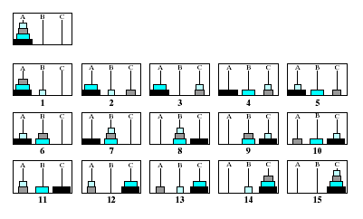
Towers of Hanoi
Note the graphical steps to the solution
Notes:
Stopped 2/27/06

Slide 11
Towers of Hanoi: Recursion Structure
move(n, src, dst, tmp) =
if n == 1: move disk 1 from src to dst
otherwise:
move(n-1, src, tmp, dst)
move disk n from src to dst
move(n-1, tmp, dst, src)

Slide 12
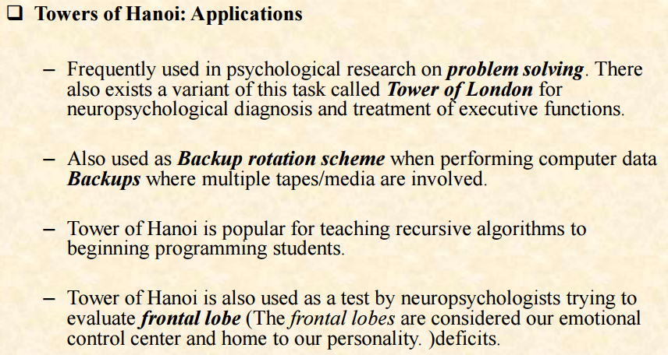

Slide 13
More recursive problems
Finding GCD, power, palindrome
Fibonacci numbers
finding length of a string
Counting Cells in a Blob
etc.

Slide 14
Recursive Data Structures
Computer scientists often define data structures recursively
Trees are defined recursively
Linked lists can also be defined recursively
Recursive methods are very natural in processing recursive data structures
The first language developed for artificial intelligence research was a recursive language called LISP

