Slide 1

University of Asia Pacific
Transducers
Md. Khairul Alam
Lecturer, EEE, UAP

Slide 2
CONTENTS
WHAT IS TRANSDUCER
ELECTRICAL TRANSDUCER
CLASSIFICATION OF TRANSDUCERS
SELECTION CRITERIA OF THE TRANSDUCERS
BASIC CONSTRUCTION OF TRANSDUCERS
RESISTANCE TEMPERATURE DETECTOR
STRAIN GUAGE
APPLICATIONS,ADVATAGES AND DISADVANTAGES

Slide 3
WHAT IS TRANSDUCER
A transducer is an electronic device that converts energy from one form to another (mechanical, visual, acoustic, electrical, thermal, chemical).
Example:
Microphones,
Loudspeakers,
Thermometers

Slide 4
TRANSDUCER
Sensors (transducer which converts a measurable quantity (sound pressure level, optical intensity, magnetic field, etc) to an electrical voltage or an electrical current).
Actuators (transducer which converts an electrical signal into another form of energy, such as sound, pressure, light, mechanical movement).

Slide 5
Transducers specifications
Range
Span
Error
Accuracy
Sensitivity
Nonlinearity
Resolution
Stability
Dead band/time
Response time

Slide 6
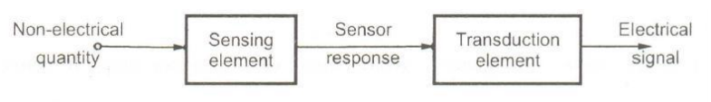
Sensing Element: The physical quantity or its rate of change is sensed and responded to by this part of the transistor.
Transduction Element: The output of the sensing element is passed on to the transduction element. This element is responsible for converting the non-electrical signal into its proportional electrical signal.

Slide 7
ELECTRICAL TRANSDUCERS
The electrical transducers is one which converts the non-electrical quantity into the equivalent electrical quantity.
Non-electrical quantity such as force, displacement, stress, temperature.
Electrical quantity such as current , voltage

Slide 8
CLASSIFICATION OF TRANSDUCERS
On the basis of transduction form used.
As primary and secondary transducers.
As passive and active transducers.
As analog and digital transducers.
As transducers and inverse transducers

Slide 9
ON THE BASIS OF TRANSDUCTION FORM USED
Resistive Transducers.
Photoconductive Cell
Thermistor
Capacitive Transducers.
Capacitor microphone
Dielectric gauge
Inductive Transducers.
Magnetic circuit transducer
Voltage and current Generating Transducers.
Hall effect pickup

Slide 10
Passive and Active Transducers
If transducers derive the power require for transduction from an power source, then this kind of transducer are known as passive transducer
Example:
(1) LDR
(2) FSR
When there is no need for any source then these type of transducers are Active transducers
Example :
(1)Thermocouple
(2)Piezoelectric crystal

Slide 11
Inverse Transducers
These type of transducers convert a electrical quantity into non-electrical quantity
Example
Piezoelectric crystal
Analog ammeter
Voltmeter

Slide 12
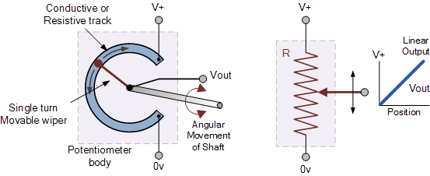
Potentiometer
Angular and
Linear Position

Slide 13
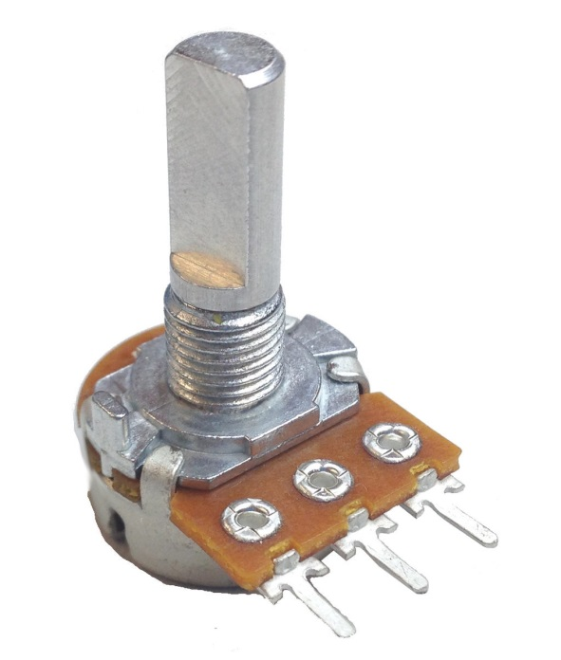
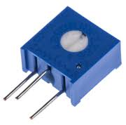
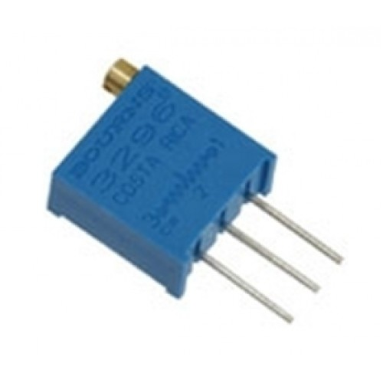
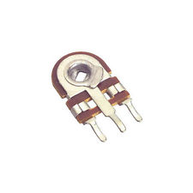
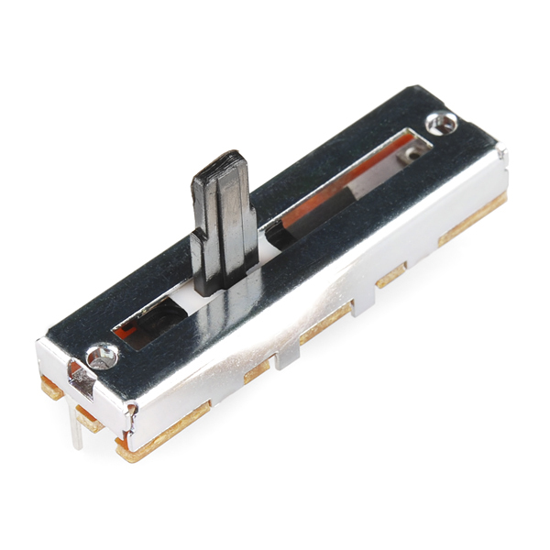
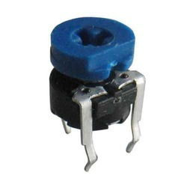

Slide 14
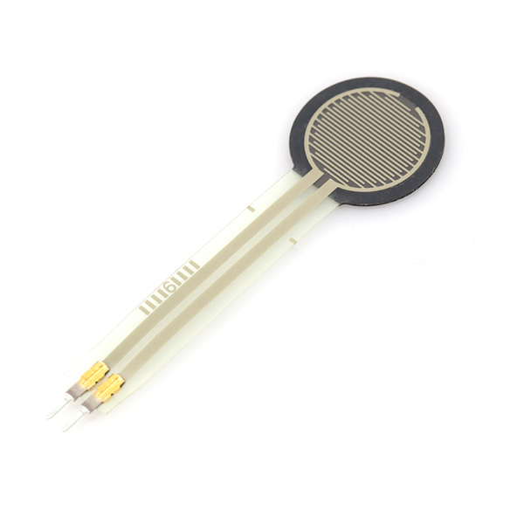
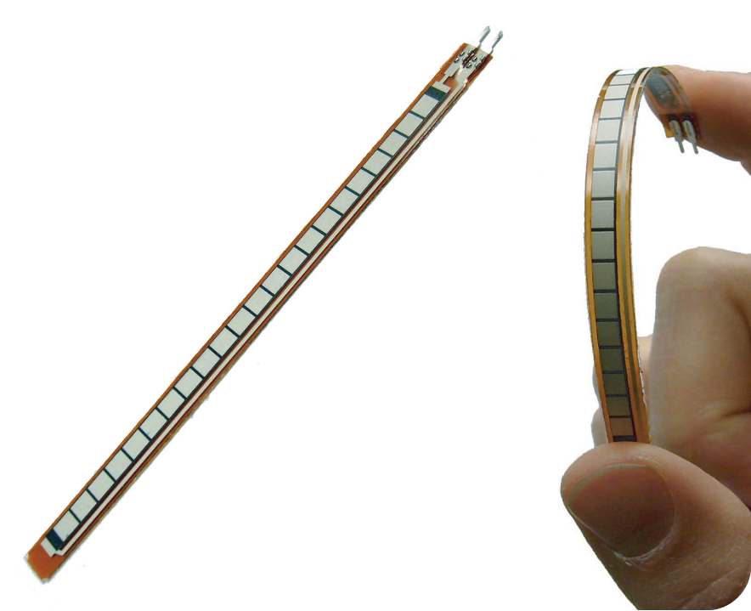
Strain Gauge
Convert physical deformation in the shape to resistance.

Slide 15
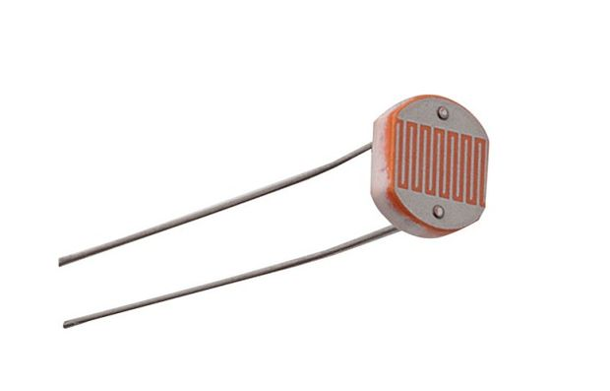
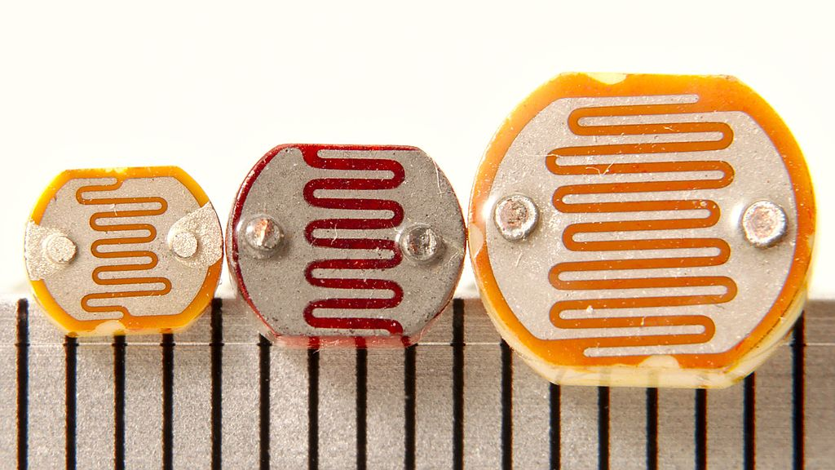
Photoresistor

Slide 16
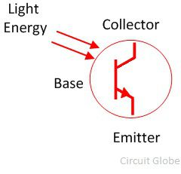
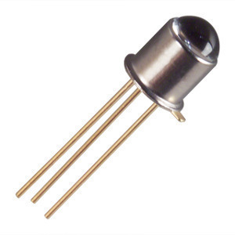
Phototransistor

Slide 17
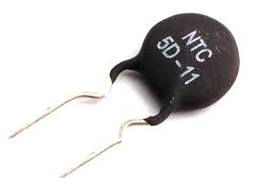
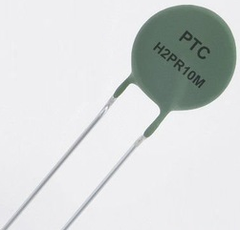
Thermistors

Slide 18
Thermoelectric sensors
Seebeck effect (When two dissimilar metal wires are connected at one end forming a junction, and that junction is heated, a voltage is generated across the junction (see the figure below).
Peltier effect (electrical current would produce heating or cooling at the junction of two dissimilar metals)

Slide 19
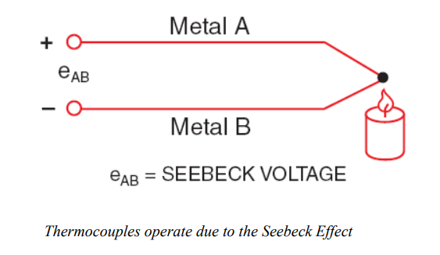
Thermocouple

Slide 20
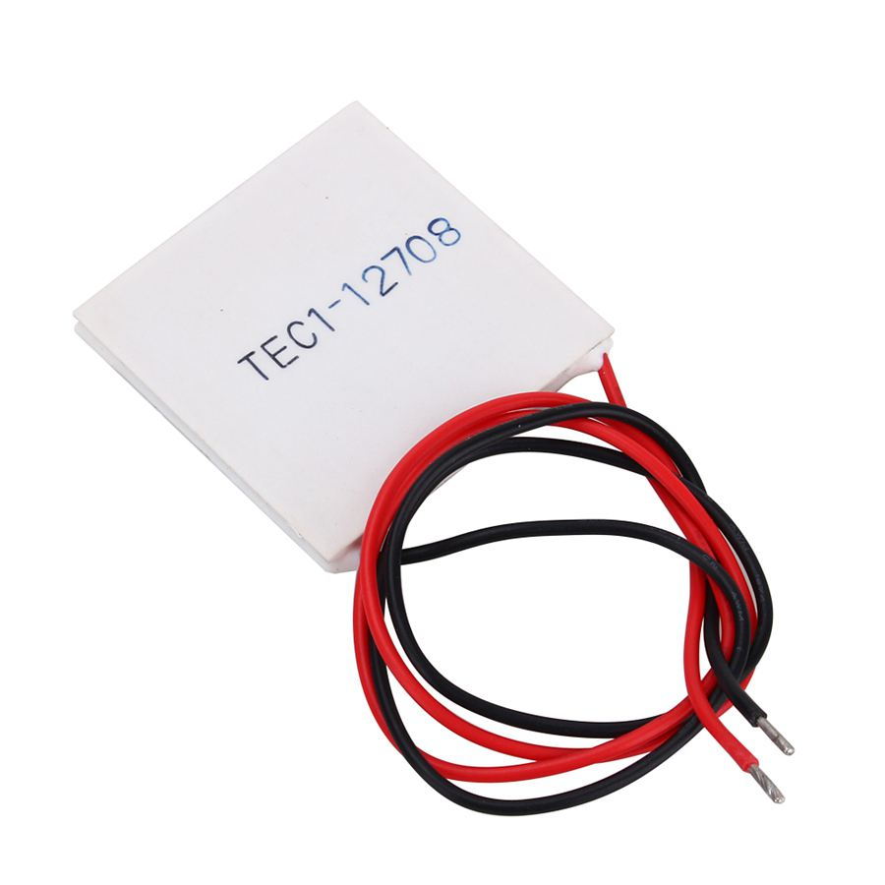
Peltier plate

Slide 21
SELECTION CRITERIA OF THE TRANSDUCERS
Operating principle
Sensitivity
Operating range
Accuracy
Errors
Environmental capability
Insensitive to unwanted Signal
Stability

Slide 22
APPLICATION
Audio/video equipment
Pressure indication
Measurement of displacement
Alarms

Slide 23
Thank You

