Slide 1

Periodic Table and periodic variation of properties
A nautilus’s shell, with its recurring and increasing chambers, is an analogy for the increasing numbers of electrons in the energy levels of an atom. Recurring patterns of electrons within atoms correlate with recurring chemical behavior of the elements.

Slide 2
Electron Configurations & Periodicity
Electronic Structure of Atoms
Electron Spin and the Pauli Exclusion Principle
Building-Up Principle and the Periodic Table
Writing Electron Configurations Using the Periodic Table
Orbital Diagrams of Atoms; Hund’s Rule
Periodicity of the Elements
Mendeleev’s Predictions from the Periodic Table
Some Periodic Properties

Slide 3
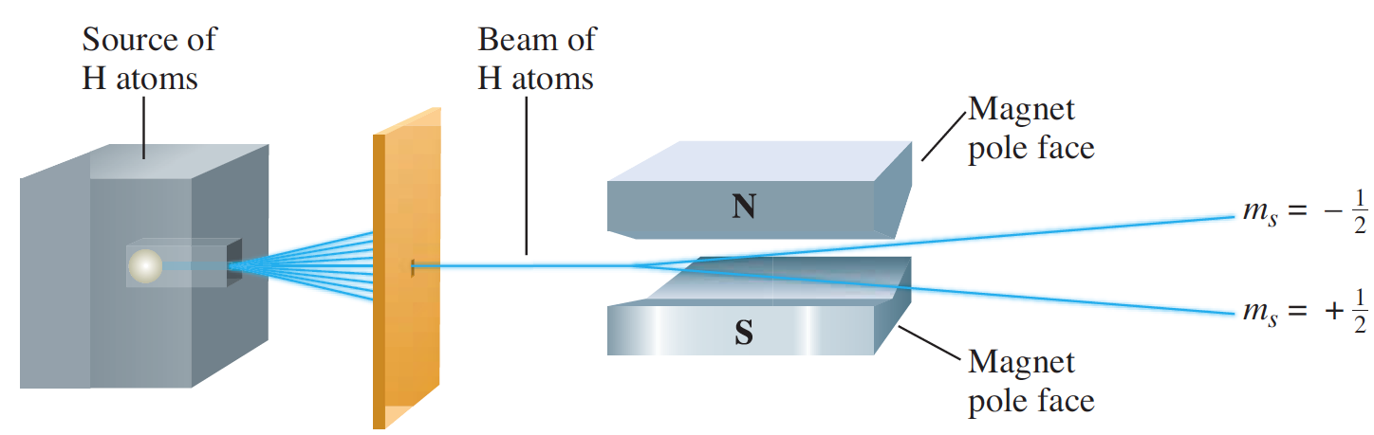
Electron Spin
The Stern–Gerlach experiment
A beam of hydrogen atoms (shown in blue) is split into two by a nonuniform magnetic field. One beam consists of atoms each with an electron having m_{s} = +1/2; the other beam consists of atoms each having an electron with m_{s} = -1/2.

Slide 4
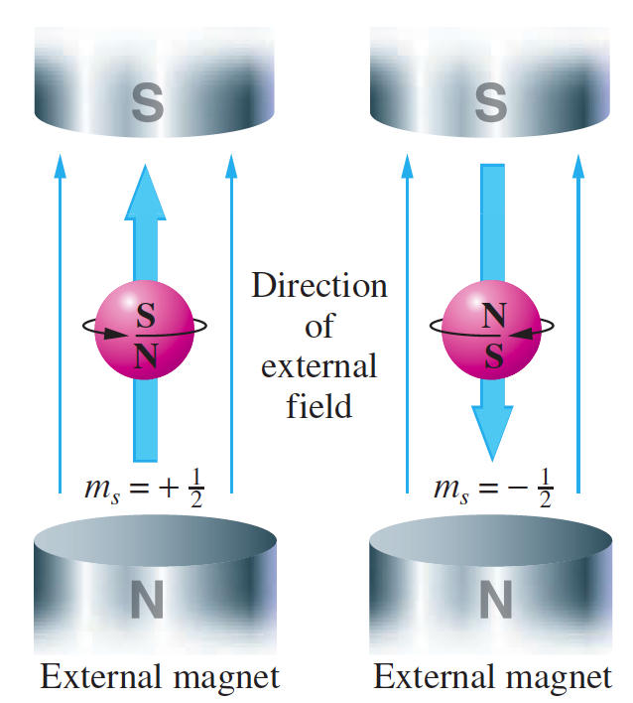
Electron Spin
A representation of electron spin
The two possible spin orientations are indicated by the models
By convention, the spin direction is given as shown by the large arrow on the spin axis
Electrons behave as tiny bar magnets

Slide 5
Pauli Exclusion Principle
The Pauli exclusion principle, which summarizes experimental observations, states that no two electrons in an atom can have the same four quantum numbers.
If one electron in an atom has the quantum numbers n = 1, l = 0, m_{l} = 0, and m_{s} = -1/2, no other electron can have these same quantum numbers.
In other words, you cannot place two electrons with the same value of m_{s} in a 1s orbital.
Each subshell holds a maximum of twice as many electrons as the number of orbitals in the subshell.

Slide 6
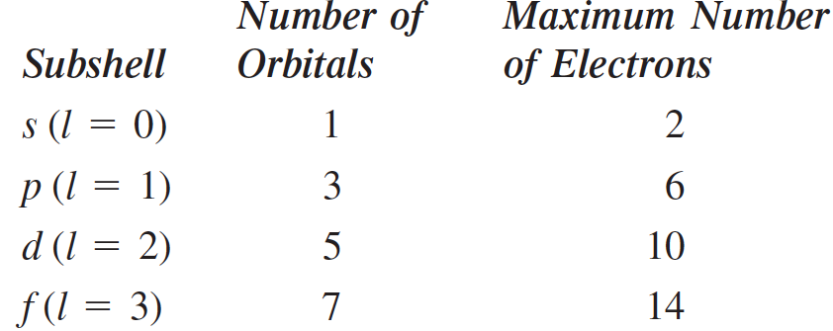
Pauli Exclusion Principle
Pauli exclusion principle: An orbital can hold at most two electrons, and then only if the electrons have opposite spins.

Slide 7
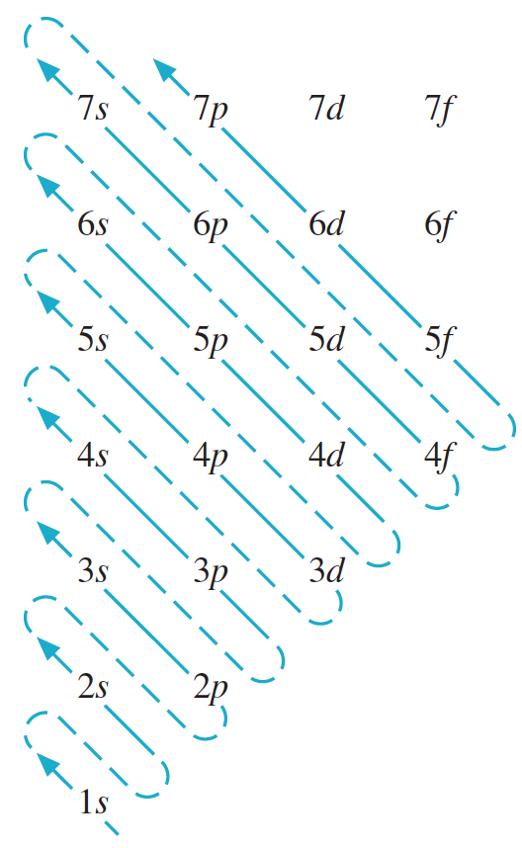
Building-Up Principle
Building-up principle (or Aufbau principle) is a scheme used to reproduce the electron configurations of the ground states of atoms by successively filling subshells with electrons in a specific order (the building-up order).

Slide 8
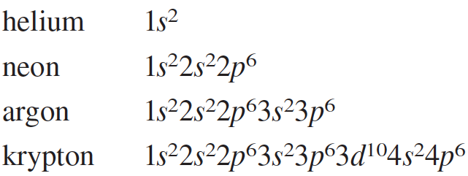
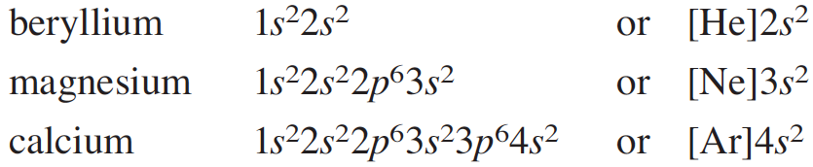
Electron Configurations
Each of these configurations consists of a noble-gas core, that is, an inner-shell configuration corresponding to one of the noble gases, plus two outer electrons with an ns² configuration.

Slide 9
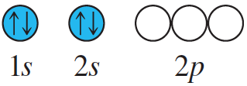
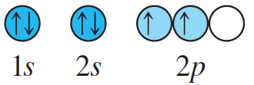
Electron Configurations
Hund’s rule states that the lowest-energy arrangement of electrons in a subshell is obtained by putting electrons into separate orbitals of the subshell with the same spin before pairing electrons.
Ground-state configuration of carbon atom is 1s²2s²2p².
The first four electrons go into the 1s and 2s orbitals.
The next two electrons go into separate 2p orbitals, with both electrons having the same spin, following Hund’s rule.

Slide 10
Magnetic Properties of Atoms
A paramagnetic substance is a substance that is weakly attracted by a magnetic field, and this attraction is generally the result of unpaired electrons.
Sodium vapor has been found experimentally to be paramagnetic. The vapor consists primarily of sodium atoms, each containing an unpaired electron (electron configuration is [Ne]3s¹.)
A diamagnetic substance is a substance that is not attracted by a magnetic field or is very slightly repelled by such a field. This
property generally means that the substance has only paired electrons.
Mercury vapor is found experimentally to be diamagnetic. Mercury vapor consists of mercury atoms (electron configuration [Xe]4f ¹⁴5d¹⁰6s²), which have only paired electrons.

Slide 11
Electron Configurations & Periodicity
Noble-gas core, that is, an inner-shell configuration corresponding to one of the noble gases
The noble-gas core together with (n - 1)d¹⁰ electrons is often referred to as a pseudo-noble-gas core, because these electrons usually are not involved in chemical reactions
An electron in an atom outside the noble-gas or pseudo-noble-gas core is called a valence electron. Such electrons are primarily involved in chemical reactions, and similarities among the configurations of valence electrons (the valence-shell configurations) account for similarities of the chemical properties among groups of elements.

Slide 12
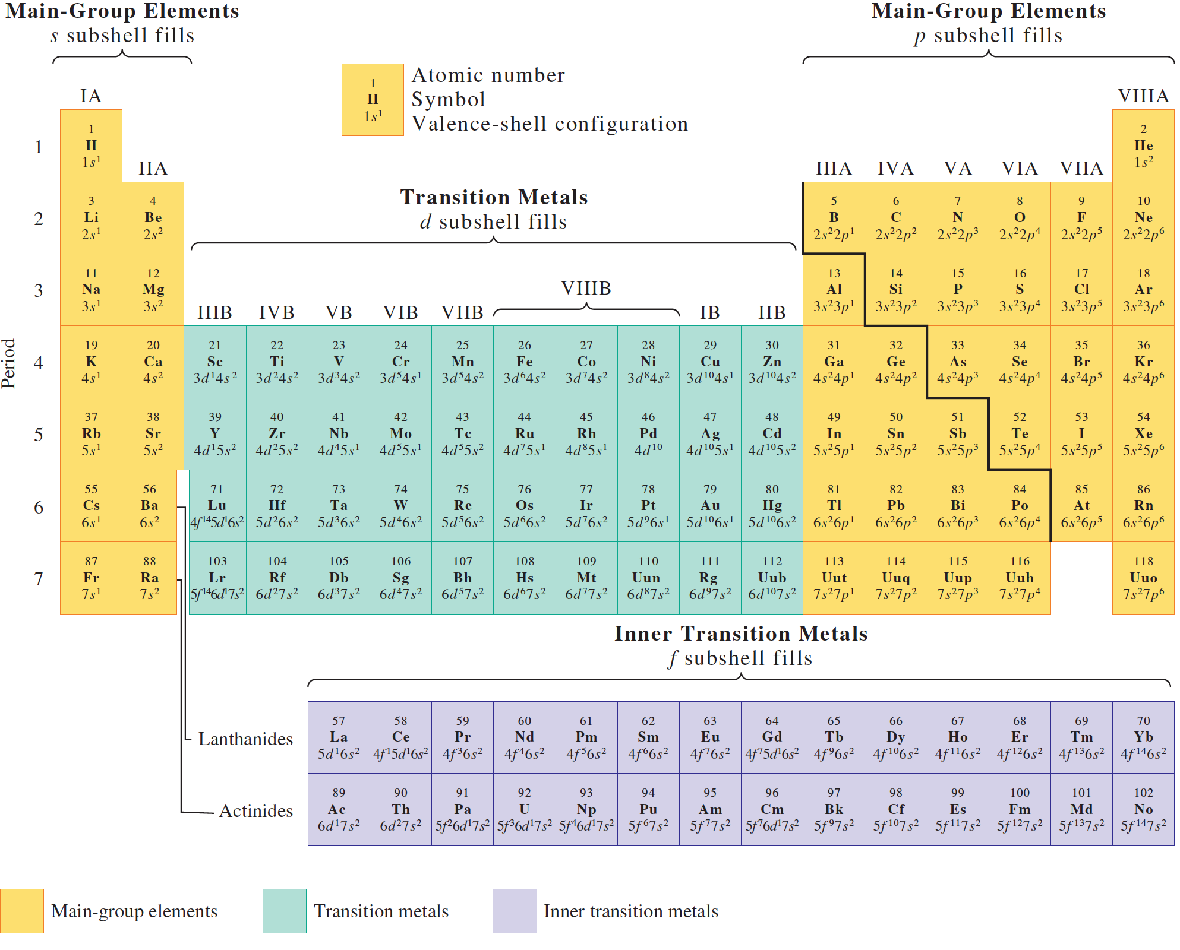

Slide 13
Exceptions to the Building-Up Principle
The building-up principle reproduces most of the ground-state
configurations correctly.
There are some exceptions.
Chromium (Z = 24) is one example. The building-up principle predicts the configuration [Ar]3d⁴4s²
The correct one is found experimentally to be [Ar]3d⁵4s¹
Copper (Z = 29) is another exception to the building-up principle, which predicts the configuration [Ar]3d⁹4s²
Although experiment shows the ground-state configuration to
be [Ar]3d¹⁰4s¹

Slide 14
Some Periodic Properties
The electron configurations of the atoms display a periodic variation with increasing atomic number (nuclear charge)
The periodic law states that when the elements are arranged by atomic number, their physical and chemical properties vary periodically.
Such periodic properties are:
Atomic Radius
Ionization Energy
Electron Affinity

Slide 15
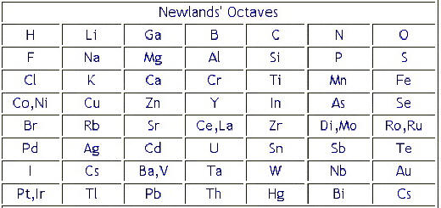
Historical background
Early 19th –according to molecular mass
In 1864 the English chemist John Newlands-law of octaves
Seems valid up to Ca
No position for inert gases
Placement of gas and metals are in same group

Slide 16
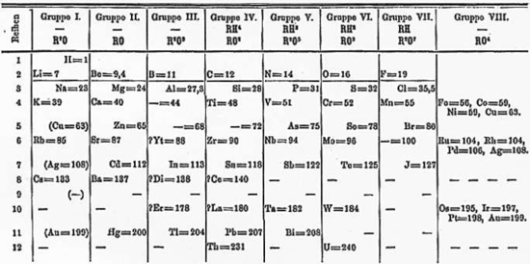
In 1872-the Russian chemist Dmitri Mendeleev and the German chemist Lother Meyer
*The position of hydrogen was not correctly defined
*In some cases Mendeleev placed elements according to their similarities in properties and not in increasing order of their atomic masses. Thus, the position of these elements was not justified e.g. cobalt (atomic mass 58.9) was placed before nickel (atomic mass 58.6). *Isotopes were not given separate places in the periodic table although Mendeleev's classification is based on the atomic masses. *Some similar elements were grouped separately while some dissimilar elements were grouped together. For example copper and mercury are similar in their properties but were placed separately. Copper was placed in group I although it did not resemble the elements of this group. *Mendeleev could not explain the cause of periodicity in the elements. *The position for lanthanides and actinides were not included in this table.

Slide 17
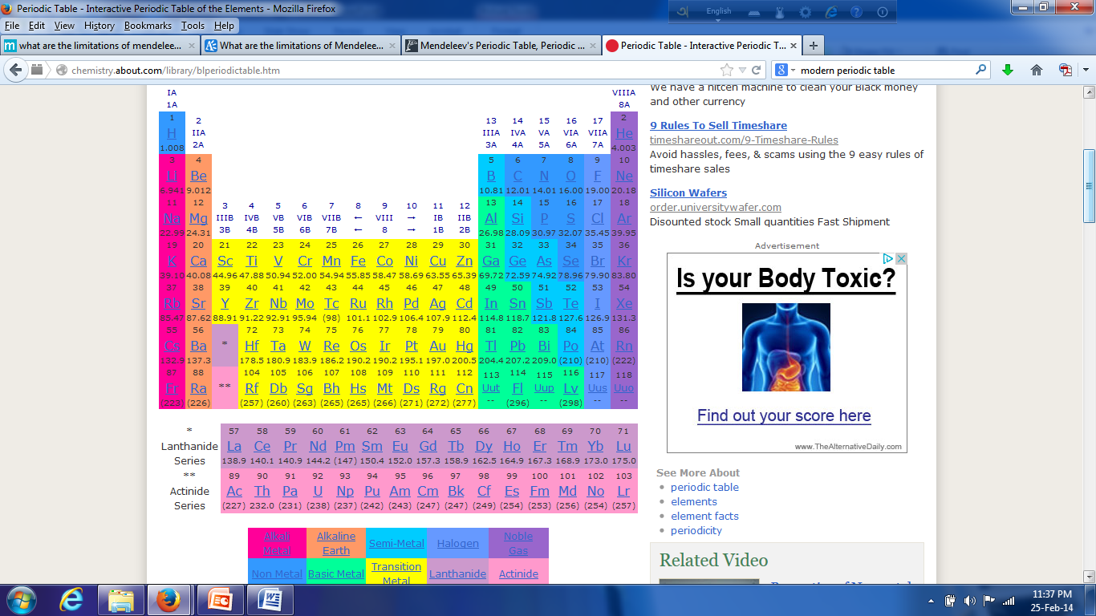
Periodic Law
The periodic law states that when the elements are arranged by atomic number, their physical and chemical properties vary periodically.

Slide 18
Classification of elements
a) The representative elements, b) The noble gases, c) The transition elements (d block elements) and d) The inner transition elements (f block elements)
The representative elements
These elements are the elements in Groups 1A through 7A, all of which have incompletely filled s or p sub-shells of the highest principal quantum number.
The noble gases or the inert gases
The zero group or 8A group elements have been placed at the end of each period in the periodic table. It appears that these elements having S²P⁶ electronic arrangements in the outermost level are very stable.
The transition elements
These elements are generally heavy metals of sub group B and contain incomplete energy levels because of building up of the d electrons. The chemical properties of these elements depend upon the electrons from the two outermost levels (s and d electrons).
*Electropositive and heavy metal with high melting point * almost same atomic and ionic size * variable oxidation state * color compounds * Catalytic activities * complex compounds
The inner transition elements
The elements in which the electron is added on increasing the atomic number in f orbital is classified as inner transition elements.

Slide 19
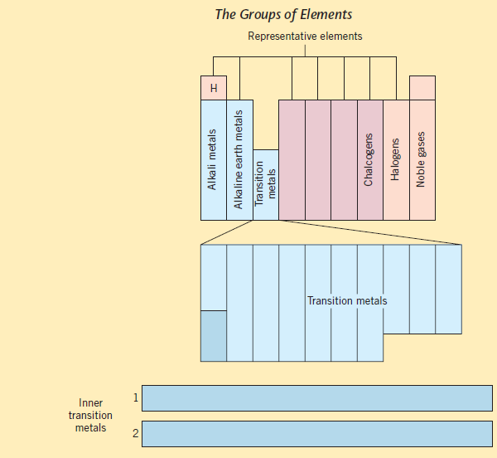

Slide 20
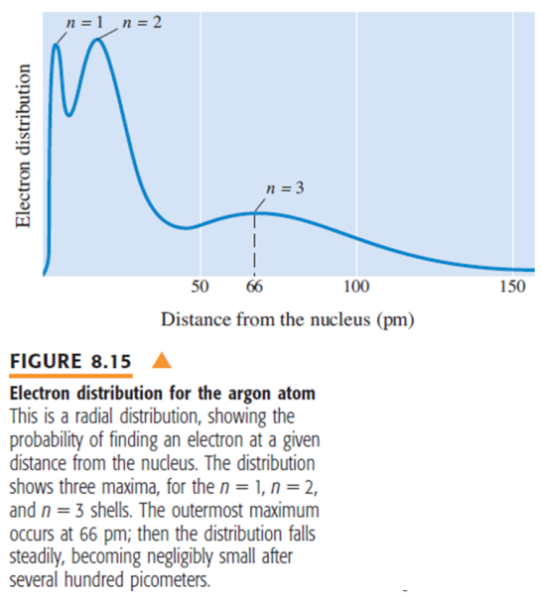
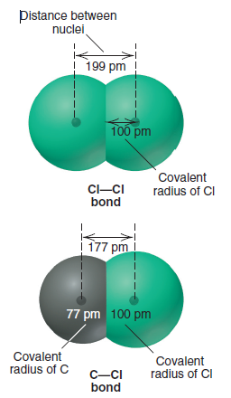
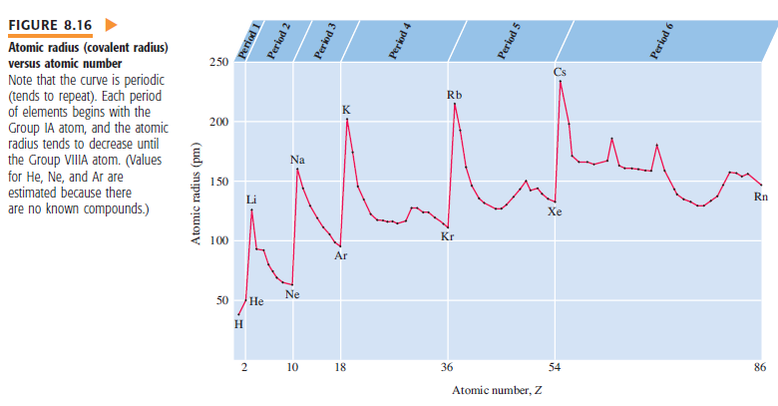
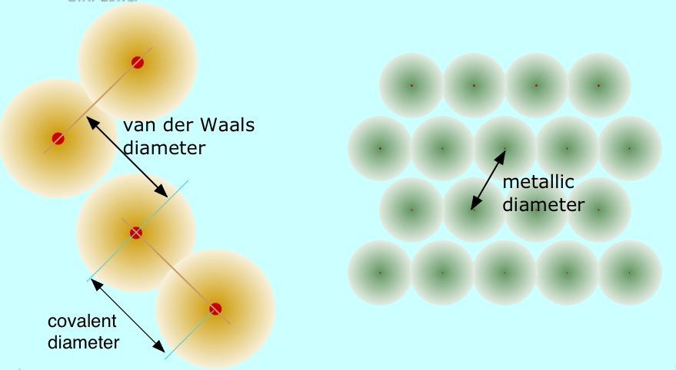
Atomic Radius
Metallic radius is half the distance between nuclei in a metallic crystal.
Covalent radius is half the distance between like atoms that are bonded together in a molecule.
van der Waals radius is the effective radius of adjacent atoms which are not chemically bonded in a solid, but are presumably in "contact". An example would be the distance between the iodine atoms of adjacent I₂ molecules in crystalline iodine.

Slide 21
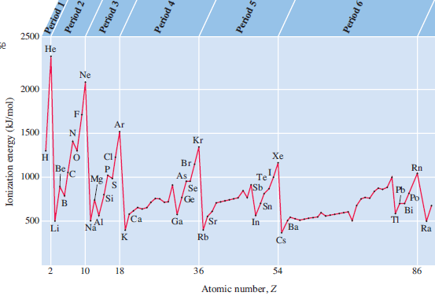
Ionization Energy
Ionization energy is the minimum energy (in kJ/mol) required to remove an electron from a gaseous atom in its ground state
Energy + X(g) → X⁺(g) +1e
In the equation, X represents an atom of any element and e is an electron. The second ionization energy (I₂) and the third ionization energy (I₃) are shown in the following equations:
Energy + X⁺(g) →X²⁺(g) + 1e Second ionization Energy
Energy + X²⁺(g) →X³⁺(g) +1e Third ionization Energy

Slide 22
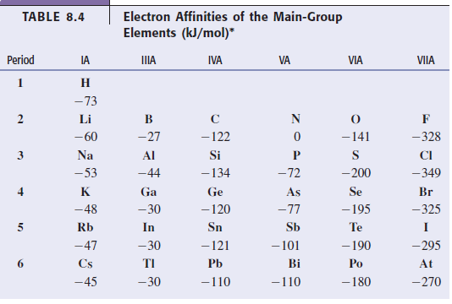
Electron affinity
The electron affinity is the energy change for the process of adding an electron to a neutral atom in the gaseous state to form a negative ion.

