Slide 1
Doubly Linked Lists

Slide 2
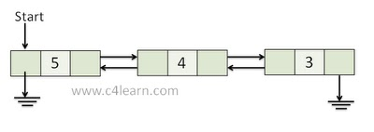
Doubly Linked Lists
A doubly linked list is a list that contains links to next and previous nodes.
Unlike singly linked lists where traversal is only one way, doubly linked lists allow traversals in both ways.

Slide 3
Node data
info: the user's data
next, prev: the address of the next and previous node in the list
.back
.info
.next

Slide 4
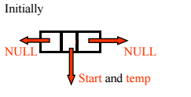
Node data (Cont.)
struct Node {
int data;
struct node* next;
struct node* prev;
};
struct Node* newNode=(struct Node*) malloc (sizeof(struct Node));

Slide 5
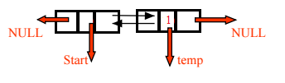
Insert Node
InsertAtTail(1)

Slide 6

Insert Node
InsertAtTail(2)

Slide 7

Insert Node
InsertAtTail(5)

Slide 8
Inserting New Node
//Creates a new Node and returns pointer to it.
struct Node* GetNewNode(int x) {
struct Node* newNode = (struct Node*)malloc(sizeof(struct
Node));
newNode->data = x;
newNode->prev = NULL;
newNode->next = NULL;
return newNode;
}
//Inserts a Node at head of doubly linked list
void InsertAtHead(int x) {
struct Node* newNode = GetNewNode(x);
if(head == NULL) {
head = newNode;
return;
}
head->prev = newNode;
newNode->next = head;
head = newNode;
}

Slide 9
Inserting New Node (Cont.)
//Inserts a Node at tail of Doubly linked list
void InsertAtTail(int x) {
struct Node* temp = head;
struct Node* newNode = GetNewNode(x);
if(head == NULL) {
head = newNode;
return;
}
while(temp->next != NULL)
temp = temp->next;
// Go To last Node
temp->next = newNode;
newNode->prev = temp; }

Slide 10
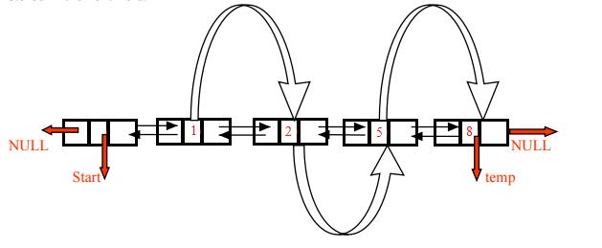
Print Linked List
Print(start)

Slide 11
Print Linked List(cont.)
//Prints all the elements in linked list in forward traversal order
void Print() {
struct Node* temp = head;
while(temp != NULL) {
printf("%d ",temp->data);
temp = temp->next;
}
}
/ /Prints all elements in linked list in reverse traversal order
void ReversePrint() {
struct Node* temp = head;
if(temp == NULL) return; // empty list, exit
while(temp->next != NULL) { // Going to last Node
temp = temp->next; }
// Traversing backward using prev pointer
while(temp != NULL) {
printf("%d ",temp->data);
temp = temp->prev;
}}

Slide 12
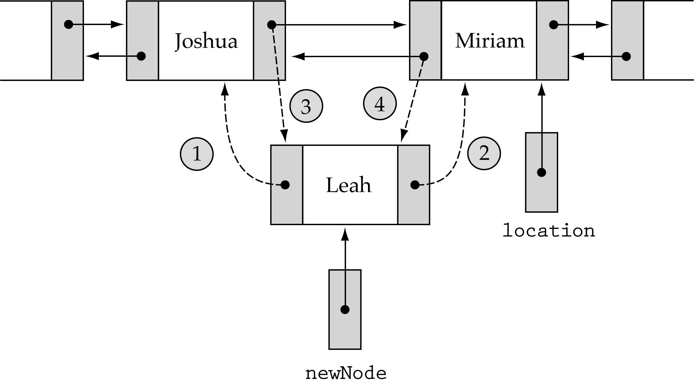
Inserting into a Doubly Linked List
1. newNode->back = location->back; 3. location->back->next=newNode;
2. newNode->next = location 4. location->back = newNode;

Slide 13

Inserting to a Doubly Linked Lists (cont.)
Newnode->next = current->next;
Current->next = newnode;
Newnode->prev = current;
(newnode->next)->prev = newnode;

Slide 14
Inserting to a Doubly Linked List (cont.)
//insert a node after given index
struct Node* insert_after(int value, int index) {
if (index < 0) return NULL;
int currIndex = 1;
struct Node* currNode = head;
while (currNode!=NULL && index > currIndex) {
currNode = currNode->next;
currIndex++;
}
if (index > 0 && currNode == NULL) return NULL;
struct Node* newNode = (struct Node *)malloc(sizeof(struct Node));
newNode->data = value;
if (index == 0) {
head = newNode;
head->prev = NULL;
head->next = NULL;
}
else {
newNode->next = currNode->next;
currNode->next = newNode;
newNode->prev = currNode;
(newNode->next)->prev = newNode;
}
return newNode;
}

Slide 15
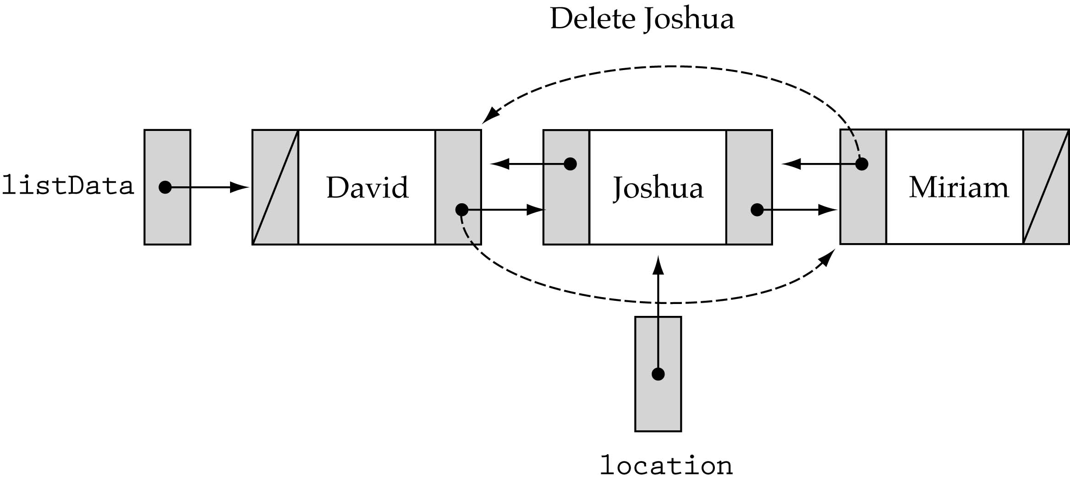
Deleting from a Doubly Linked List
Be careful about the end cases!!

Slide 16

Deleting a Node
prevNode=current->prev;
prevNode->next=current->next;
(current->next)->prev=prevNode;

Slide 17
Finding a Node
//finding position of a node
int FindNode(int x) {
struct Node* currNode = head;
int currIndex = 1;
while (currNode!=NULL && currNode->data != x) {
currNode = currNode->next;
currIndex++;
}
if (currNode!=NULL) return currIndex;
else return 0;
}

Slide 18
Deleting a Node (cont.)
void DeleteNode(int x) {
struct Node* prevNode = NULL;
struct Node* currNode = head;
int currIndex = 1;
while (currNode!=NULL && currNode->data != x) {
currNode = currNode->next;
currIndex++;
}
prevNode=currNode->prev;
if (currNode!=NULL) {
if (prevNode) {
prevNode->next = currNode->next;
if(currNode->next!=NULL){
(currNode->next)->prev=prevNode;
}
delete currNode;
}
else {
head = currNode->next;
head->prev=NULL;
delete currNode;
}
}}
}

