Slide 1
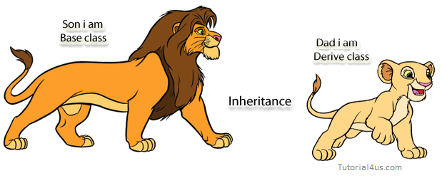
Inheritance

Slide 2
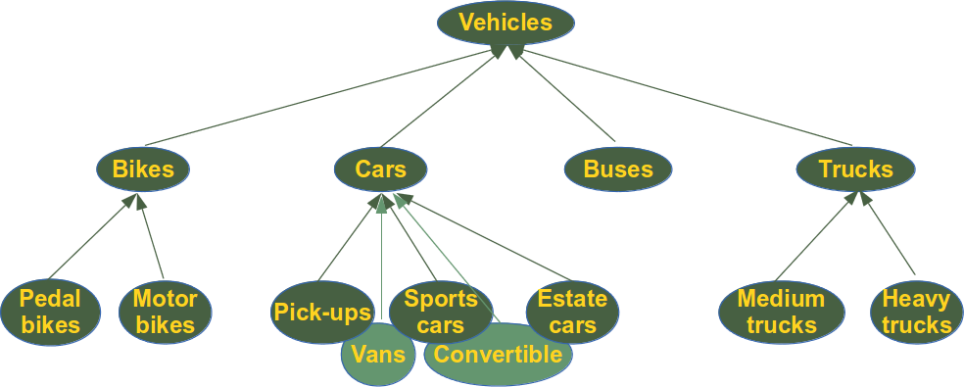
Inheritance

Slide 3
Definition
Inheritance is a mechanism in which one class acquires the property of another class.
For example, a child inherits the traits of his/her parents. With inheritance, we can reuse the fields and methods of the existing class.

Slide 4
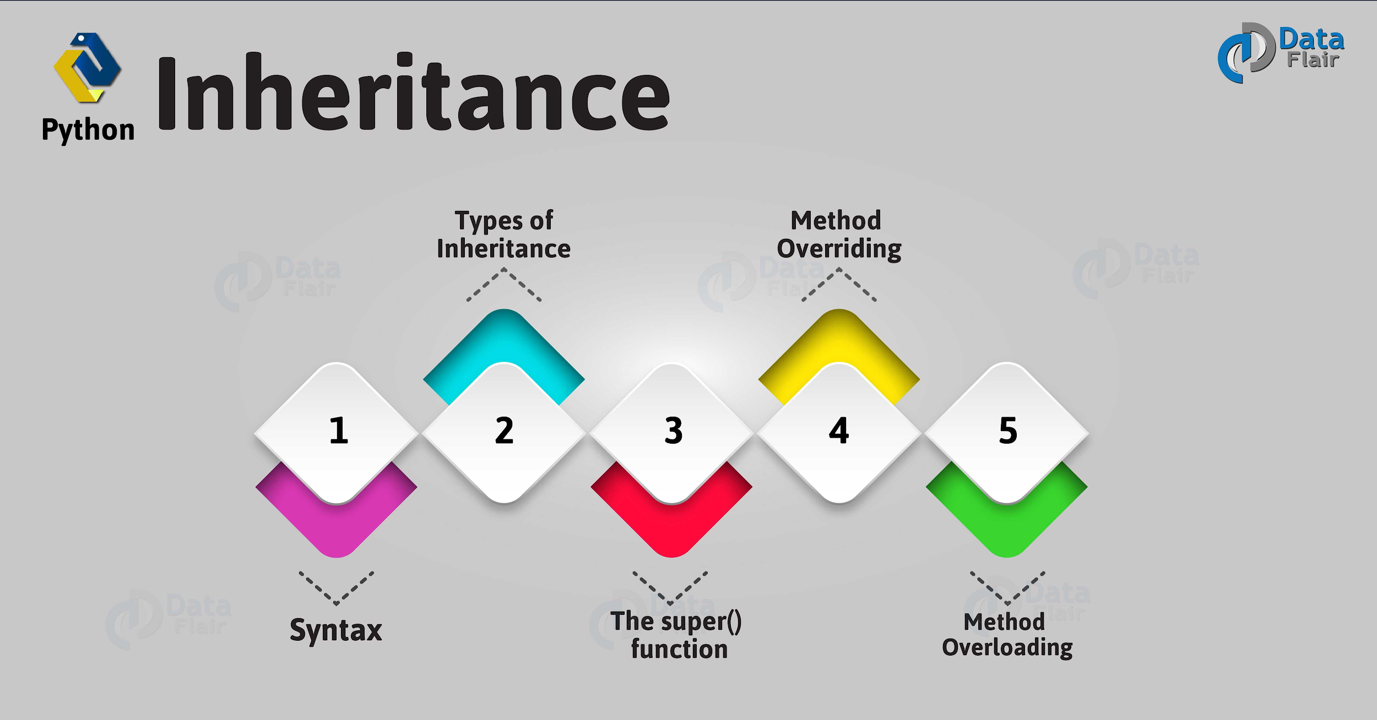

Slide 5
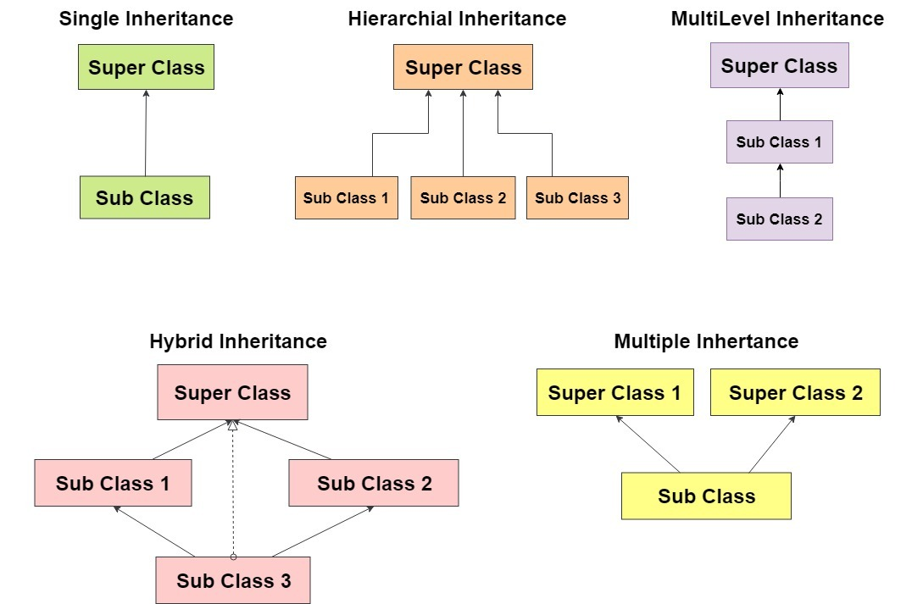
Types
Of
Inheritance

Slide 6
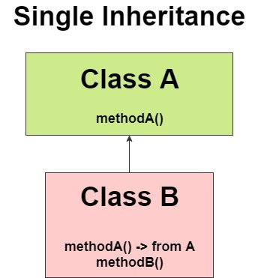
Single Inheritance Structure

Slide 7
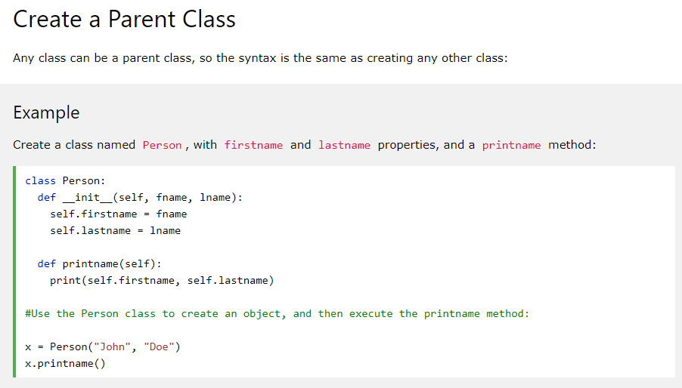

Slide 8
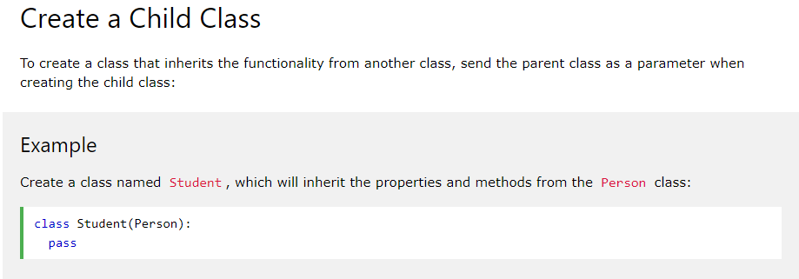
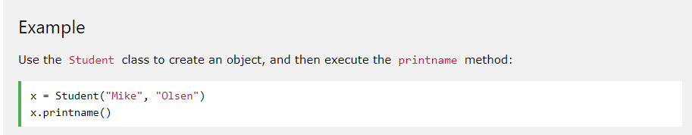

Slide 9
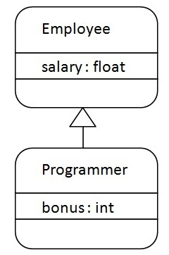
Single Inheritance Example

Slide 10
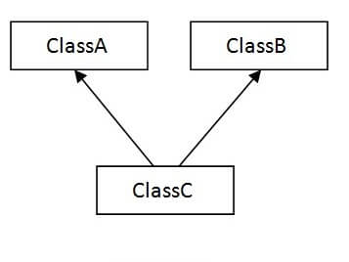
Multiple inheritance Structure

Slide 11
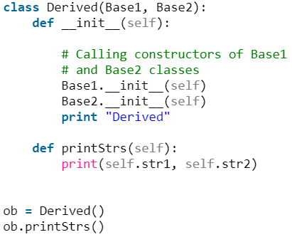
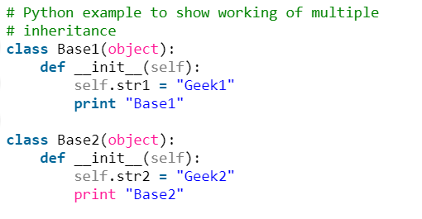
Multiple inheritance Example

Slide 12
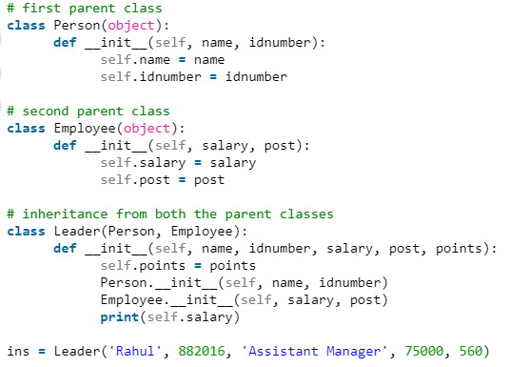

Slide 13
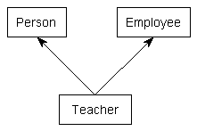
Multiple inheritance Example

Slide 14
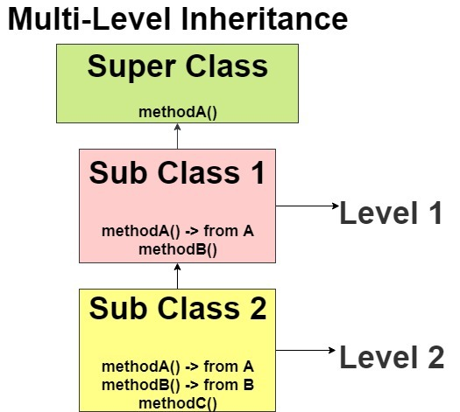
Multilevel inheritance Structure

Slide 15
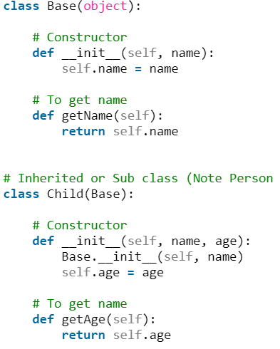
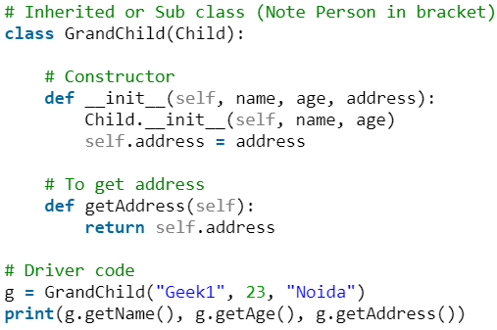
Multilevel inheritance Example

Slide 16
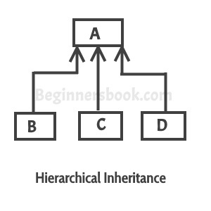
Hierarchical Inheritance Structure

Slide 17
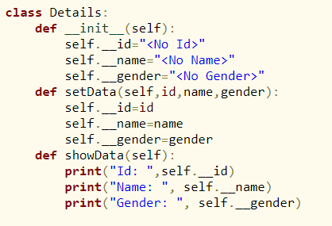
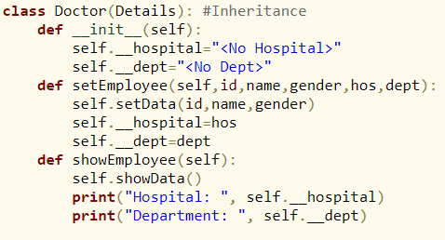
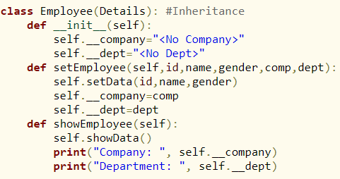
Hierarchical Inheritance
Example

Slide 18
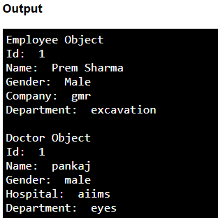
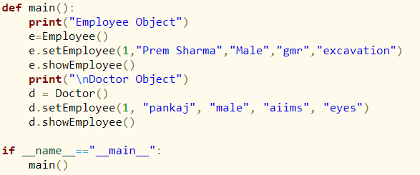
Hierarchical Inheritance Example

Slide 19

Overriding Methods Definition
In Python method overriding occurs simply defining in the child class a method with the same name of a method in the parent class. When you define a method in the object you make the latter able to satisfy that method call, so the implementations of its ancestors do not come in play.

Slide 20
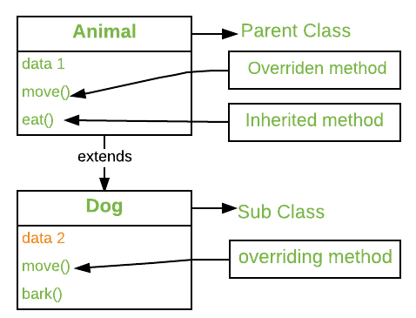
Overriding Methods Example

Slide 21
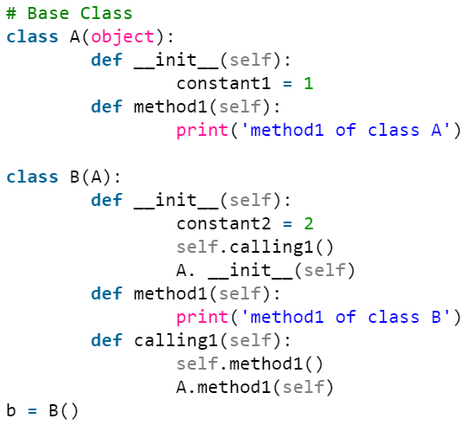
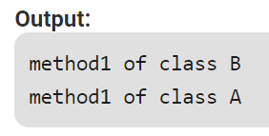
Overriding Methods
Example

Slide 22
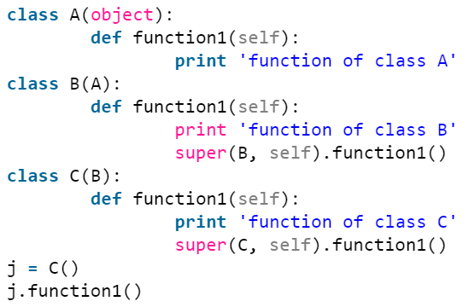
Overriding Methods Example

Slide 23
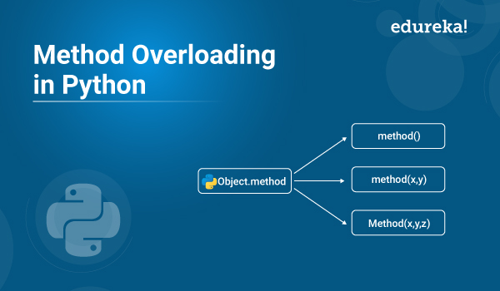

Slide 24
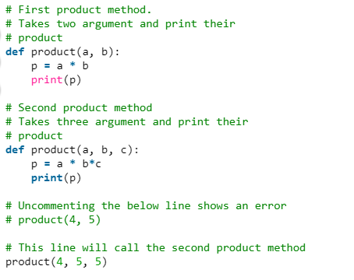
Methods
Overloading

Slide 25
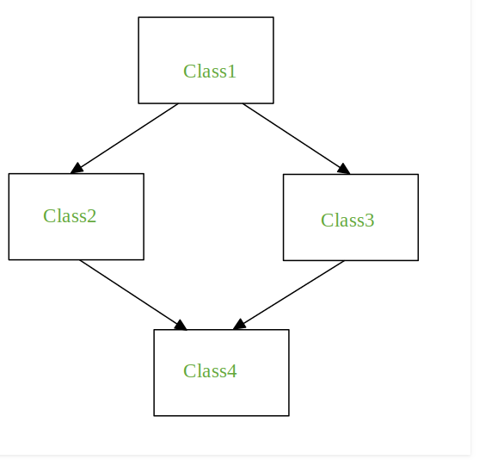
Hybrid Inheritance Structure

Slide 26
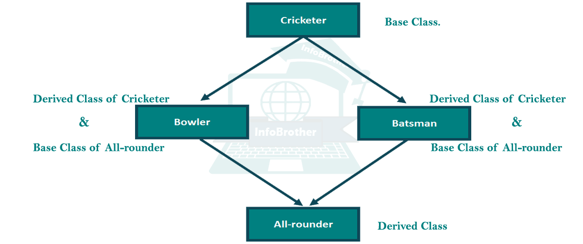
Hybrid Inheritance Example

Slide 27
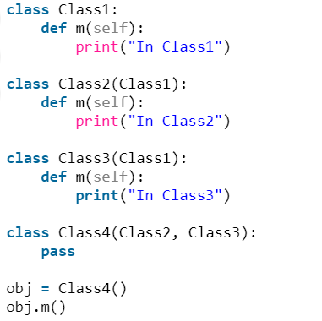
Case 1

Slide 28
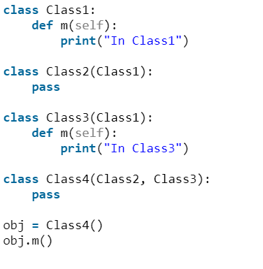
Case 2

Slide 29
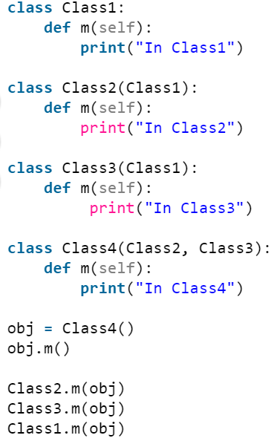
Case 3

Slide 30
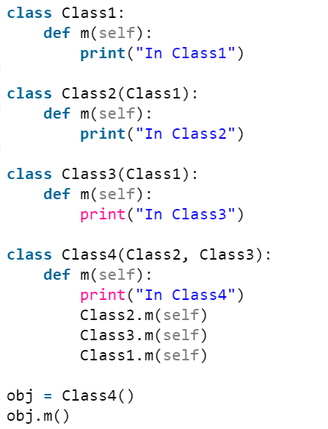
Case 4

Slide 31
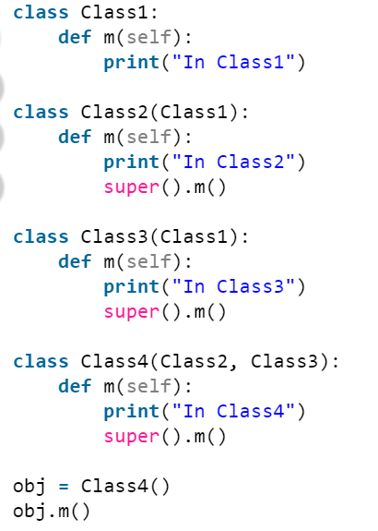
Case 5

Slide 32
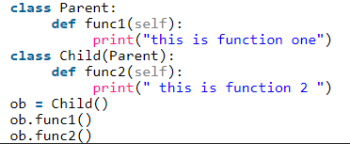
Which type of Inheritance??

Slide 33
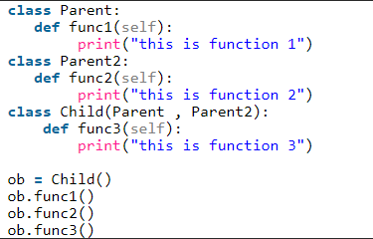
Which type of Inheritance??

Slide 34
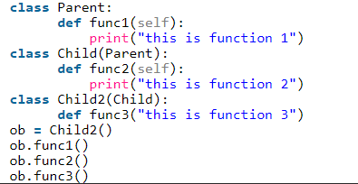
Which type of Inheritance??

Slide 35
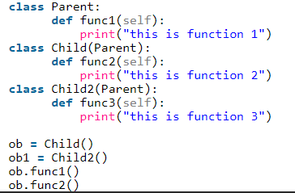
Which type of Inheritance??

Slide 36
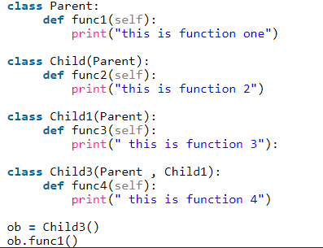
Which type of Inheritance??

Slide 37
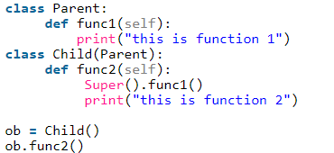
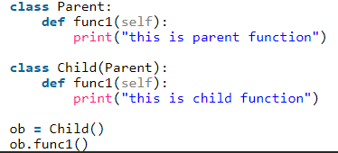
Which type of
Inheritance??

Slide 38


Slide 39
Thanks to the References
https://www.geeksforgeeks.org/object-oriented-programming-in-python-set-2-data-hiding-and-object-printing/
https://www.edureka.co/blog/object-oriented-programming-python/
https://www.w3schools.com/python/python_inheritance.asp
https://realpython.com/inheritance-composition-python/
https://www.programiz.com/python-programming/inheritance
https://www.edureka.co/blog/inheritance-in-python/
https://data-flair.training/blogs/python-inheritance/
https://techvidvan.com/tutorials/python-inheritance/

Slide 40
Thank you
QA

