Slide 1
Design and Implementation of Simple As Possible Computer (SAP-1)
Engr. Rashid Farid Chishti
Lecturer, Faculty of Engineering & Technology
International Islamic university Islamabad.
E-mail: chishti@iiu.edu.pk
http://sites.google.com/site/chishti

Slide 2
SAP-1 Introduction
SAP-1 is the first stage in the evolution towards modern computers.
The main purpose of SAP is to introduce all the crucial ideas behind computer operations.
Being a simple computer, SAP-1 also covers many advanced concepts.
SAP-1 is a bus organized computer. All registers are connected to the W bus with the help of tri-state buffers.

Slide 3
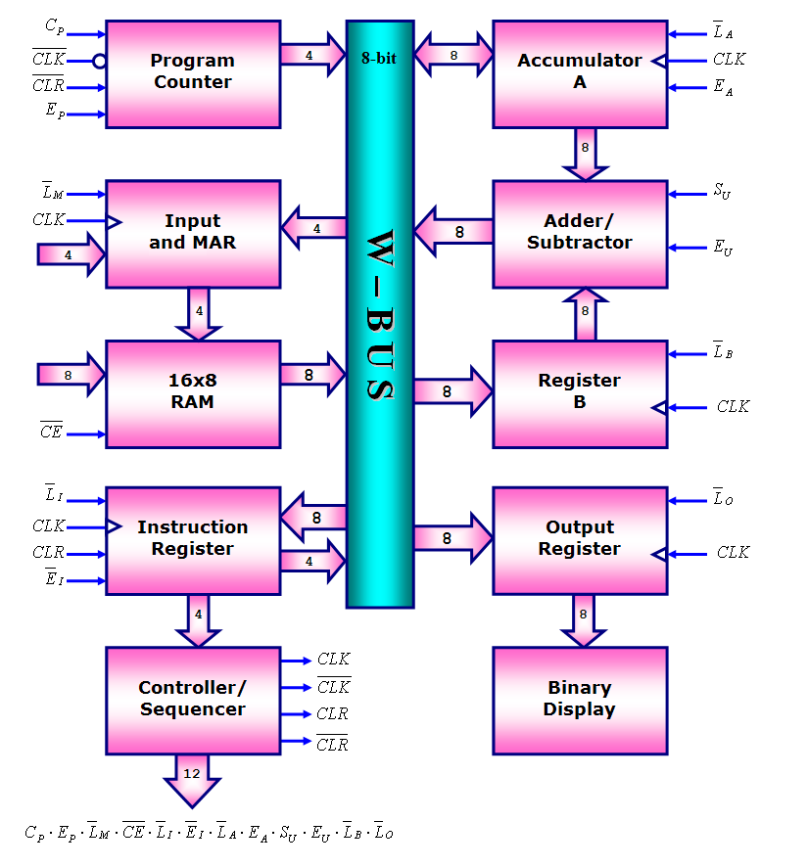
SAP-1
Block Diagram

Slide 4
Main Features
Simple-As-Possible.
One output device with 8 LEDs
16 bytes of read only memory.
5 instructions
3 with 1 operand,
2 with implicit operands.
Accumulator Architecture
Accumulator, Out Register,
B Register, Memory Address Register (MAR)
Instruction Register (IR).

Slide 5
Architecture
8-bit "W" bus.
4-bit program counter, only counts up, it starts counting from 0 and counts up to 15.
4-bit Memory Address Register (MAR).
16 Byte Memory.
8-bit (1 Byte) Instruction Register (IR).
6-cycle controller with 12-bit microinstruction word.
8-bit Accumulator.
8-bit B Register.
8-bit adder/subtractor.
8-bit Output Register.

Slide 6
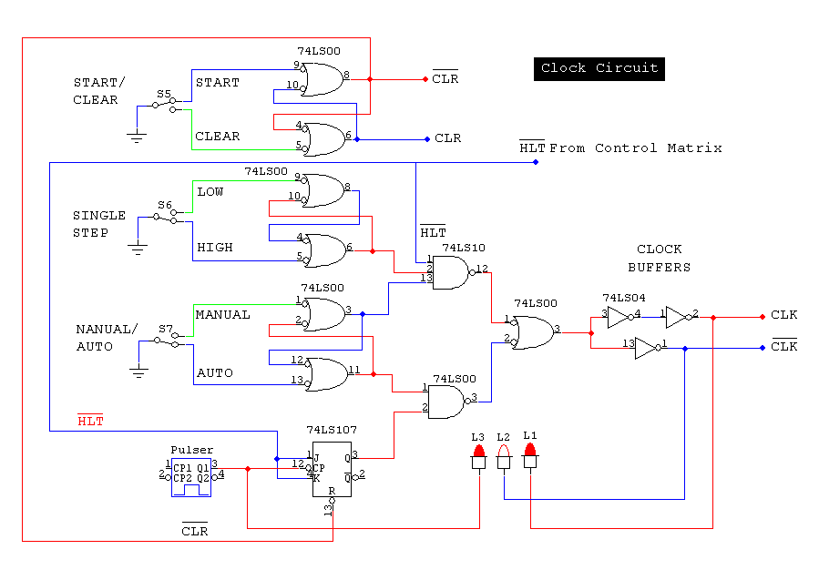

Slide 7
Program Counter
Instructions to be executed are placed at the starting addresses of memory, e.g. the first instruction of a program will be placed at binary address 0000. the second at address 0001.
Now to execute one instruction, first step is to generate the address at which this instruction is placed in memory.
So this address is generated by (4-bit) Program Counter, that counts from 0000 to 1111 (for total of 16 memory locations).
If the value of program counter is 0100, then the instruction at address at 4 will be executes next.
program counter is like a pointer register; it points to the address of next instruction to be executed.

Slide 8
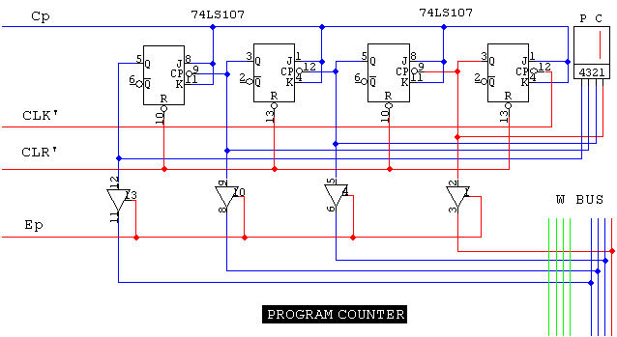
Program Counter
Back to Block Diagram

Slide 9
Input and Memory Address Register (MAR)
The MAR stores the (4-bit) address of data and instruction which are placed in memory.
When SAP-1 is Running Mode, the (4-bit) address is generated by the Program Counter which is then stored into the MAR through W bus.
A bit later, the MAR applies this 4-bit address to the RAM, where Data or instruction is read from RAM.
In Simulation we are using first 16 locations (0 to 15) of a 32x8 PROM.

Slide 10
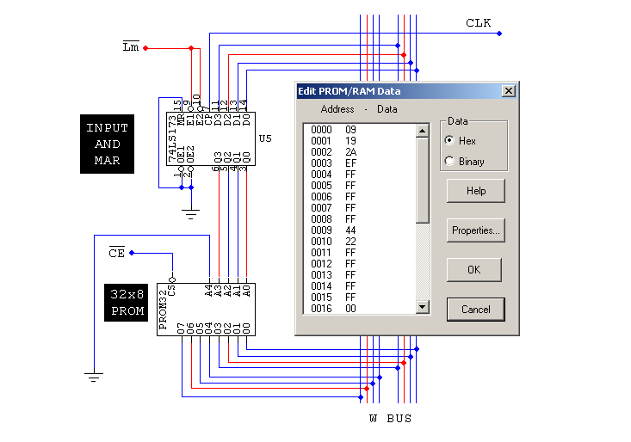
Back to Block Diagram

Slide 11
The RAM
In initial design, the RAM is a 16 x 8 static TTL RAM. It means there are 16 memory locations (from 0 to 15) and each location contains an 8-bit of data/instruction.
You can program the RAM by means of the switches to be used for address and data. This allows you to store a program and data in the memory before a computer run.
During a computer run, the RAM receives 4-bit addresses from the MAR and a read operation is performed,
in this way, the instruction or data stored in the RAM is placed on the W bus for use in some other part of the computer.

Slide 12
Intruction Register
When the instruction is placed at W-bus from memory, the Instruction Register stores this instruction on the next positive clock edge.
The contents of the instruction register are split into two nibbles.
The upper nibble is a two-state output that goes directly to the block labeled "Controller-sequencer“
The lower nibble is a three-state output that is read onto the W bus when needed.

Slide 13
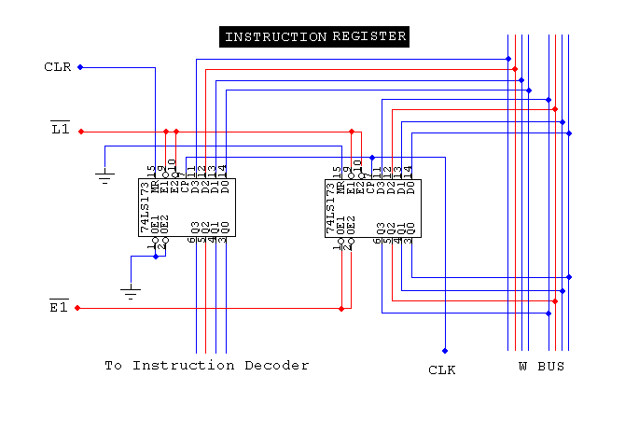
Back to Block Diagram

Slide 14
Adder/Subtractor
SAP-1 uses a 2's complement adder-subtractor. When input S_{u} is low (logic 0), the sum is:
S = A + B
When S_{u} is high (logic 1), the sum is:
S = A + B’ + 1
The Adder-subtractor is asynchronous and its contents change as soon as the input changes.
When E_{U} is high, these contents appear on the W bus.

Slide 15
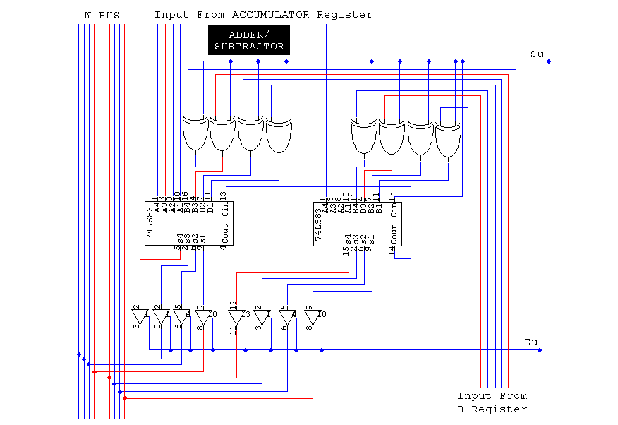
Back to Block Diagram

Slide 16
Accumulator
To add/sub two 8-bit numbers A and B, the accumulator register stored the number A.
The Accumulator has two outputs.
One output goes to the adder/subtractor
The other goes to the W through tri-state buffers.
It also stores the (answer of two values) output of adder/subtractor through w-bus, when L_{A} is low.
It’s value is appeared on w-bus when E_{A} is high, which can then be read by output register.

Slide 17
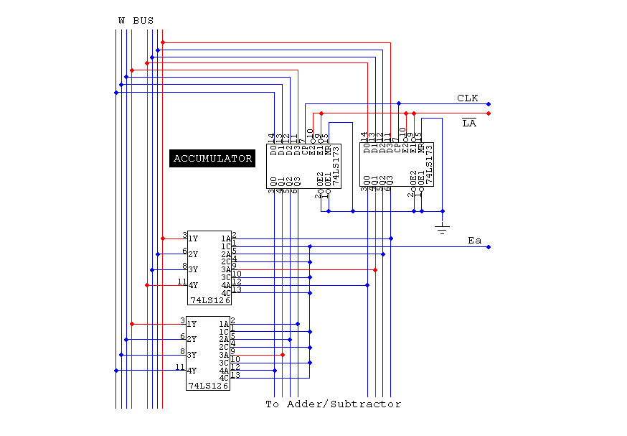
Back to Block Diagram

Slide 18
B Register
To add/sub two 8-bit numbers A and B, the B register stored the number B.
It supplies the number to be added or subtracted from the contents of accumulator to the adder/subtractor.
When data is available at W-bus and L_{b} goes low, at the positive clock edge, B register loads that data.

Slide 19
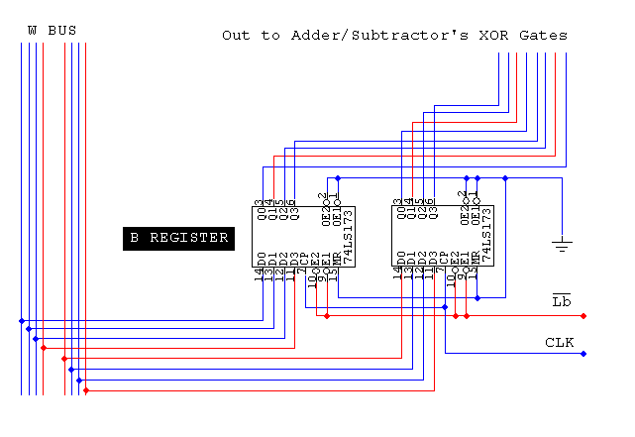
Back to Block Diagram

Slide 20
Output Register
At the end of an arithmetic operation the accumulator contains the word representing the answer,
Then answer stored in the accumulator register is then loaded into the output register through W-bus.
This is done in the next positive clock edge when E_{A} is high and L_{O} is low.
Now this value can be displayed to the outside world with the help of LEDs or 7 Segments.

Slide 21
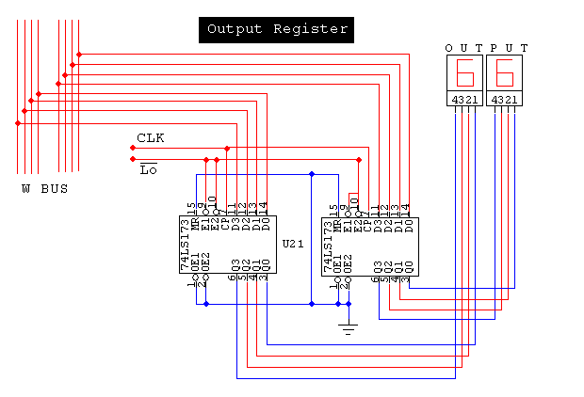
Back to Block Diagram

Slide 22
Binary Display
The binary display is a row of eight light-emitting diodes (LEDs).
Because each LED connects to one flip-flop of the output port, the binary display shows us the contents of the output port.
Therefore, after we've transferred an answer from the accumulator to the output port, we can see the answer in binary form.
But we are using 7-segments in simulation.

Slide 23
Controller Sequencer
The 12 bits coming out of the Controller Sequencer form a word that controls the rest of the computer. Before each operation a Clear (CLR) signal resets the computer.
The 12 wires carrying the control word are called the Control Bus. The control word has the format:
This word determines how the registers will react to the next positive clock (CLK) edge. For instance a high and a low means that the contents of Program Counter are latched into MAR on the next positive clock edge. As another example, a low and a low mean that the addressed RAM word will be transferred to the accumulator on the next positive clock edge.

Slide 24
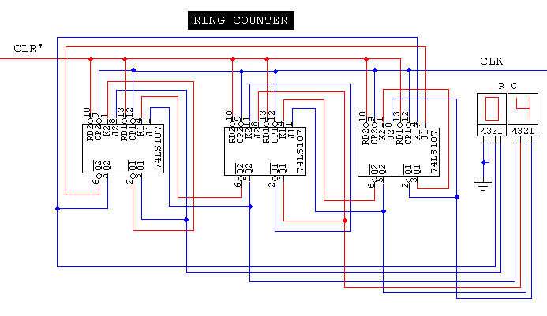
Ring Counter
T₁
T₆
T₅
T₄
T₃
T₂
T₁
Back to Block Diagram

Slide 25
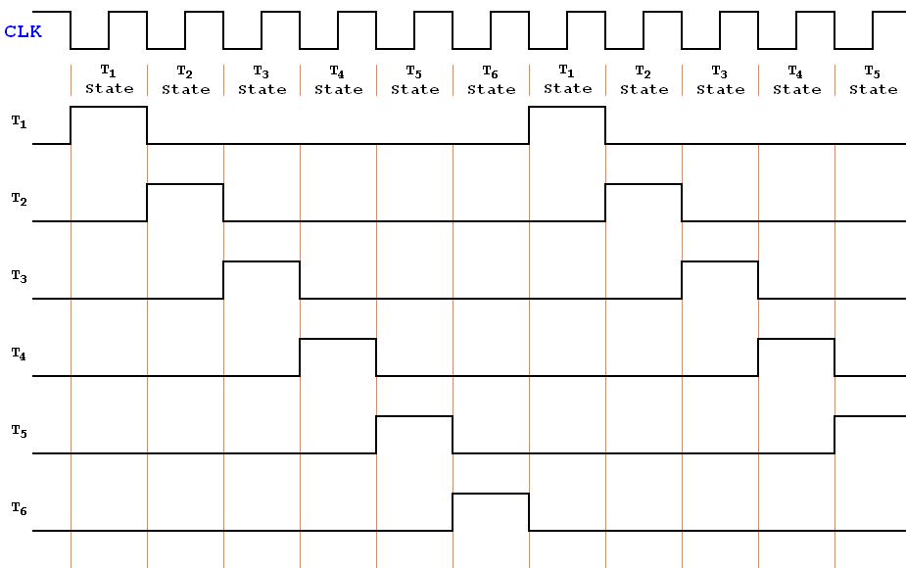
Ring Counter Timing Diagram

Slide 26
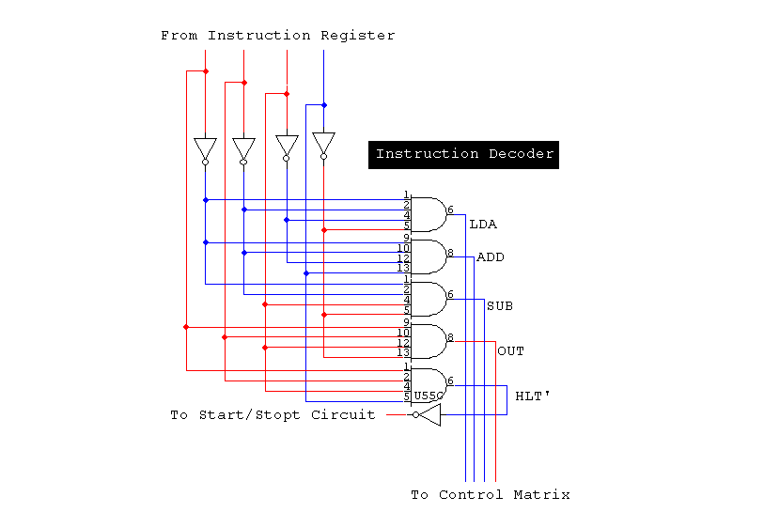
Back to Block Diagram

Slide 27
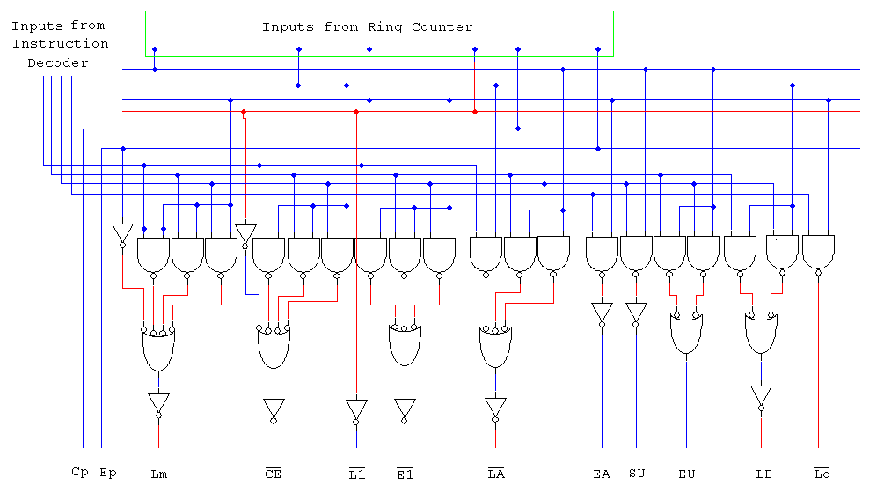
Control Matrix
Back to Block Diagram

Slide 28
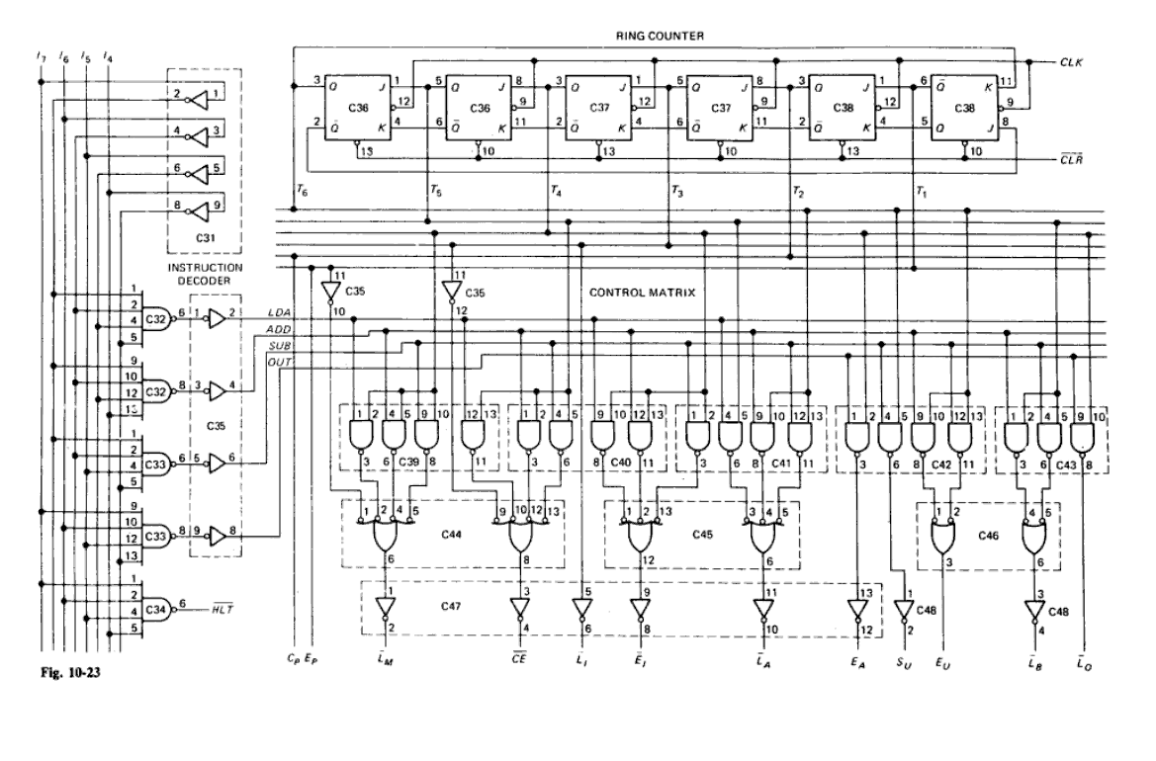
Control Matrix
Back to Block Diagram

Slide 29
Instruction Set
Computer is a useless hardware until it is programmed
This means loading step-by-step instructions into the memory before the start of a computer run.
Before you can program a computer, however, you must learn its instruction set, the basic operations it can perform. The SAP-1 instruction set follows.
SAP-1 INSTRUCTION SET
Mnemonics | Operation | Description
LDA | ACC ← RAM[MAR] | Load RAM data into accumulator
ADD | ACC ← ACC + B | Add RAM data to accumulator
SUB | ACC ← ACC – B | Subtract RAM data from accumulator
OUT | OUT ← ACC | Load accumulator data into output register
HLT | CLK ← 0 | Stop processing

Slide 30
LDA Instruction
LDA stands for "load the accumulator," A complete LDA instruction includes the hexadecimal address of the data to be loaded.
For example, LDA 8H means “load the accumulator with the contents of memory location 8H.”
Therefore, given RAM[8] = 1111 0000
The execution of LDA 8H results in ACC = 1111 0000
Similarly. LDA FH means "load the accumulator with the contents of memory location FH.

Slide 31
ADD Instruction
ADD 9H means “add the data of memory location 9H with data of accumulator and save the result in accumulator.
Suppose No. 2 is in the accumulator and No.3 is in memory location 9H. Then ACC =0000 0010, RAM[9] = 0000 0011
During the execution of ADD 9H,
First data at RAM address 9 is loaded into the B register to get B = 0000 0011 and instantly the adder/subtracter forms the sum of A and B SUM = 0000 0101
Second, this sum is loaded into the accumulator to get ACC = 0000 0101
Similarly, the execution of ADD FH adds data at RAM address 15 to the accumulator and save the answer back in accumulator overwriting the previous value.
The negative numbers are stored in 2’s complement form.

Slide 32
SUB Instruction
SUB 9H means “subtract the data of memory location 9H from data of accumulator and save the result in accumulator.
Suppose No. 3 is in the accumulator and No.2 is in memory location 9H. Then ACC =0000 0011, RAM[9] = 0000 0010
During the execution of SUB 9H,
First data at RAM address 9 is loaded into the B register to get B = 0000 0010 and instantly the adder/subtracter forms the diff. of A and B Diff. = 0000 0001
Second, this diff. is loaded into the accumulator to get ACC = 0000 0001
Similarly, the execution of SUB FH subtracts data at RAM address 15 from the accumulator and save the answer back in accumulator overwriting the previous value.

Slide 33
OUT Instruction
The instruction OUT tells the SAP-1 computer to transfer the accumulator contents to the output port.
After OUT has been executed, you can see the answer to the problem being solved on LEDs display.
OUT is complete by itself; that is, you do not have to include an address when using OUT because the instruction does not involve data in the memory.

Slide 34
HLT Instruction
HLT stands for halt. This instruction tells the computer to stop processing data so it stops the clock.
HLT marks the end of a program, similar to the way a period marks the end of a sentence.
You must use a HLT instruction at the end of every SAP-1 program; otherwise, you get computer trash (meaningless answers caused by runaway processing).
HLT is complete by itself; you do not have to include a RAM word when using HLT because this instruction does not involve the memory.

Slide 35
Memory Reference Instructions
LDA, ADD, and SUB are called memory-reference instructions because they use data stored in the memory.
OUT and HLT, on the other hand, are not memory reference instructions because they do not involve the data stored in the memory.
Mnemonics
LDA, ADD, SUB, OUT, and HLT are the instruction set for SAP-1. Abbreviated instructions like these are called mnemonics (memory aids). Mnemonics are popular in computer work because they remind you of the operation that will take place when the instruction is executed.

Slide 36
Op Codes of SAP-1
To load instruction and data words into the SAP-1 memory , we have to use some kind of code that the computer can interpret.
The number 0000 stands for LDA, 0001 for ADD, 0010 for SUB, 0000 for OUT, and 1111 for HLT.
Because this code tells the computer which operation to perform, it is called an operation code (op code).
Assembly language involves working
with mnemonics when writing a
program.
Machine language involves
working with strings of 0s and 1s.
TABLE 2, SAP-1 OP CODES
Mnemonics | Op Code
LDA | 0000
ADD | 0001
SUB | 0010
OUT | 1110
HLT | 1111

Slide 37
Program in Assembly
Address | Contents
0H | LDA 9H
1H | ADD AH
2H | ADD CH
3H | SUB BH
4H | OUT
5H | HLT
6H | FFH
7H | FFH
8H | FFH
9H | 10H
AH | 18H
BH | 14H
CH | 20H
DH | FFH
EH | FFH
FH | FFH
Program in Machine Language
Address | Contents in Binary | Contents in Hexadecimal
0000 | 0000 1001 | 09H
0001 | 0001 1010 | 1AH
0010 | 0001 1100 | 1CH
0011 | 0010 1011 | 2BH
0100 | 1110 1111 | EFH
0101 | 1111 1111 | FFH
0110 | 1111 1111 | FFH
0111 | 1111 1111 | FFH
1000 | 1111 1111 | FFH
1001 | 0001 0000 | 10H
1010 | 0001 1000 | 18H
1011 | 0001 0100 | 14H
1100 | 0010 0000 | 20H
1101 | 1111 1111 | FFH
1110 | 1111 1111 | FFH
1111 | 1111 1111 | FFH

Slide 38
The 8080 and 8085 Microprocessors
The 8080 was the first widely used microprocessor.
It has 72 instructions. The 8085 is an enhanced version of the 8080 with essentially the same instruction set (both are designed by Intel Corp.).
The SAP-1 instructions are upward compatible with the 8080/8085 instruction set.
In other words, the SAP-1 instructions LDA, ADD, SUB, OUT, and HLT are 8080/8085 instructions.
Learning SAP instructions is getting you ready for the 8080 and 8085, two widely used microprocessors.

Slide 39
Fetch Cycle
The control unit is the key to a computer's automatic operation. The control unit generates the control words that fetch and execute each instruction.
While each instruction is fetched and executed, the computer passes through different timing states (T states), time intervals during which register contents change.
Ring Counter has an output of
T = T₆T₅T₄T₃T₂T₁
At the beginning of a computer run, the ring word is
T = 00 0001 = T₁
Successive clock pulses produce, ring words of

Slide 40
Ring Counter
Successive clock pulses produce, ring words of
T = 000010 = T₂
T = 000100 = T₃
T = 001000 = T₄
T = 010000 = T₅
T = 100000 = T₆
Then, the ring counter resets to 00 00 01, and the cycle repeats.
Each ring word represents one T state.
The initial state T₁ starts with a negative clock edge and ends with the next negative clock edge.

Slide 41
Ring Counter
During this T state, the T₁ bit out of the ring counter is high.
During the next state, T₂ is high; the following state has a high T₃; then a high T₄; and so on.
The ring counter produces six T states. Each instruction is fetched and executed during these six T states.
A positive CLK edge occurs midway through each T state.

Slide 42
Address State (T = 00 0001 = 1 = T₁)
The T₁ state is called the address state because the address in the program counter (PC) is transferred to the memory address register (MAR) during this state.
During the address state, E_{P} and L'_{M} are active; all other control bits are inactive. This means that the controller-sequencer is sending out a control word of 5E3H during this state
= 0 1 0 1 1 1 1 0 0 0 1 1
= 5 E 3

Slide 43
Increment State (T = 00 0010 = 2 = T₂)
The T₁ state is called the increment state because the program counter is incremented.
During the increment state, the controller-sequencer is producing a control word of BE3H
Only the C_{P} bit is active in this state.
= 1 0 1 1 1 1 1 0 0 0 1 1
= B E 3

Slide 44
Memory State (T = 00 0100 = 4 = T₃)
The T₃ state is called the memory state because the addressed RAM instruction is transferred from the memory to the instruction register.
The only active control bits during this state are CE' and L_{I} , and the word out of the controller-sequencer is 263H
= 0 0 1 0 0 1 1 0 0 0 1 1
= 2 6 3

Slide 45
Fetch Cycle
The address, increment, and memory states are called the fetch cycle of SAP-l.
During the address state, E_{P} and L_{M} arc active; this means that the program counter sets up the MAR via the W bus.
A positive clock edge occurs midway through the address state; this loads the MAR with the contents of the PC.
During the increment state, C_{P} is the only active control bit.
This sets up the program counter to count positive clock edges. Halfway through the increment state, a positive clock edge hits the program counter and advances the count by 1.
During the memory state, CE' and L'_{I} are active. The addressed RAM word sets up the instruction register via the W bus. Midway through the memory state, a positive clock edge loads the instruction register with the addressed RAM word.

Slide 46
Execution Cycle
The next three states (T₄, T₅, and T₆) are the execution cycle of SAP-1.
The register transfers during the execution cycle depend on the particular instruction being executed.
For instance. LDA 9H requires different register transfers than ADD BH.
What follows are the control routines for different SAP-1 instructions.

Slide 47
Micro Instructions
The controller-sequencer sends out control words, on during each T state or clock cycle.
These words are like directions telling the rest of the computer what to do.
Because it produces a small step in the data processing, each control word is called a micro-instruction.

Slide 48
Macro Instructions
The instructions we have been programming with (LDA, ADD, SUB, . . .) are sometimes called macro-instructions to distinguish them from micro-instructions.
Each SAP-1 macroinstruction is made up of three microinstructions. For example, the LDA macroinstruction consists of the three microinstructions shown in the next Table.
This table shows the SAP-1 macro-instruction and the micro-instructions needed to carry it out.

Slide 49
Fetch and Execute Cycle of SAP-1
Macro Inst. | T State | Micro Operation | Active | CON
All Instructions | T₁ | MAR ← PC | L'_{M}, E_{P} | 5E3H
 | T₂ | PC← PC+1 | C_{P} | BE3H
 | T₃ | IR ← RAM[MAR] | CE', L‘_{I} | 263H
LDA | T₄ | MAR ← IR(3…0) | L'_{M}, E‘_{I} | 1A3H
 | T₅ | ACC ← RAM[MAR] | CE', L'_{A} | 2C3H
 | T₆ | None | None | 3E3H
ADD | T₄ | MAR ← IR(3…0) | L'_{M}, E‘_{I} | 1A3H
 | T₅ | B ← RAM[MAR] | CE', L'_{B} | 2E1H
 | T₆ | ACC ← ACC+B | L'_{A}, E_{U} | 3C7H
SUB | T₄ | MAR ← IR(3…0) | L'_{M}, E‘_{I} | 1A3H
 | T₅ | B ← RAM[MAR] | CE', L'_{B} | 2E1H
 | T₆ | ACC ← ACC – B | L'_{A}, S_{U}, E_{U} | 3CFH
OUT | T₄ | OUT ← ACC | E_{A}, L'_{O} | 3F2H
 | T₅ | None | None | 3E3H
 | T₆ | None | None | 3E3H
HLT | T₄ | None | HLT ' | 263H

Slide 50
SAP-1
0000
0001
0010
0011
0100
0000 1000
Simulation of Program
LDA 9H
ADD AH
OUT
HLT
0000 1000
1111 1111
0000 1001
0000 0101
0001 1010
0000 0011
1110 1111
1010
1001
0000
0001
1110
1111
08
T₁
T₂
T₃
T₄
T₅
T₆
T₁
T₂
T₃
T₄
T₅
T₆
T₁
T₂
T₃
T₄
T₅
T₆
T₁
T₂
T₃
Computer Halted

Slide 51
That’s all

