Slide 1
Trees

Slide 2
Binary Search Tree
Consider the following ordered list of integers
Examine middle element
Examine left, right sublist (maintain pointers)
Examine left, right sublists
13
28
35
49
62
66
80

Slide 3
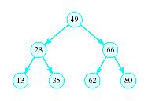
Binary Search Tree
Redraw the previous structure so that it has a treelike shape – a binary tree

Slide 4
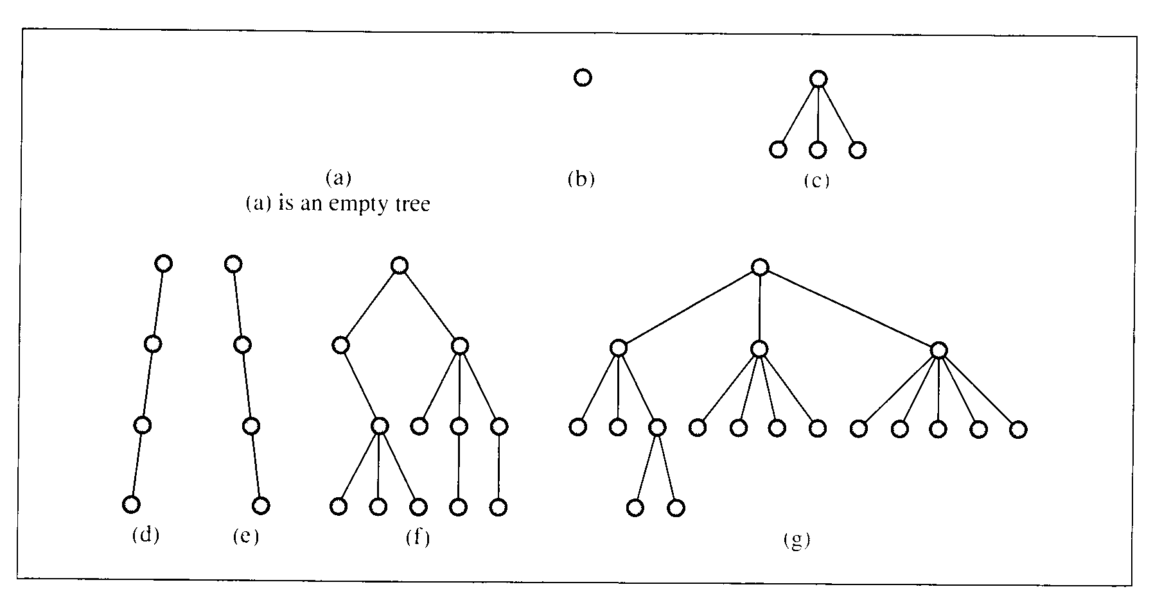
Trees
A data structure which consists of
a finite set of elements called nodes or vertices
a finite set of directed arcs which connect the nodes

Slide 5
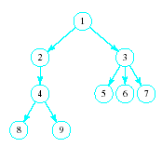
Trees
Tree terminology
Root node
Children of the parent (3)
Leaf nodes

Slide 6
Binary Trees
Each node has at most two children
Useful in modeling processes where
a comparison or experiment has exactly two possible outcomes
the test is performed repeatedly
Example
multiple coin tosses
encoding/decoding messages in dots and dashes such as Mores code

Slide 7
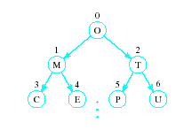

Array Representation of Binary Trees
Store the i^{th} node in the i^{th} location of the array

Slide 8
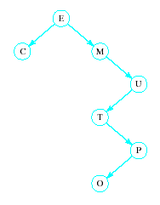
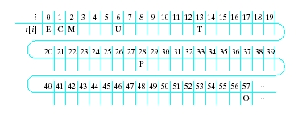
Array Representation of Binary Trees
Works OK for complete trees, not for sparse trees

Slide 9
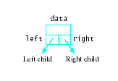

Linked Representation of Binary Trees
Uses space more efficiently
Provides additional flexibility
Each node has two links
one to the left child of the node
one to the right child of the node
if no child node exists for a node, the link is set to NULL

Slide 10
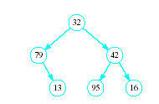
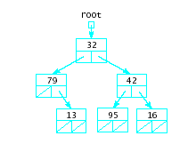
Linked Representation of Binary Trees
Example

Slide 11
Binary Trees as Recursive Data Structures
A binary tree is either empty …
or
Consists of
a node called the root
root has pointers to two disjoint binary (sub)trees called …
right (sub)tree
left (sub)tree
Anchor
Inductive step
Which is either empty … or …
Which is either empty … or …

Slide 12
Tree Traversal is Recursive
If the binary tree is empty then do nothing
Else N: Visit the root, process data L: Traverse the left subtree R: Traverse the right subtree
The "anchor"
The inductive step

Slide 13
ADT Binary Search Tree (BST)
Collection of Data Elements
binary tree
each node x,
value in left child of x value in x in right child of x
Basic operations
Construct an empty BST
Determine if BST is empty
Search BST for given item

Slide 14
ADT Binary Search Tree (BST)
Basic operations
Insert a new item in the BST
Delete an item from the BST
Traverse the BST
Visit each node exactly once
The inorder traversal must visit the values in the nodes in ascending order

Slide 15
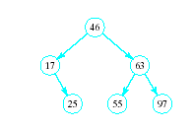

BST Searches
Search begins at root
If that is desired item, done
If item is less, move down left subtree
If item searched for is greater, move down right subtree
If item is not found, we will run into an empty subtree

Slide 16
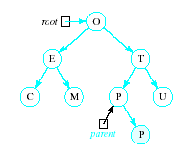
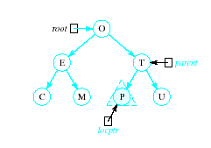
Inserting into a BST
Insert function
Uses modified version of search to locate insertion location or already existing item
Pointer parent trails search pointer locptr, keeps track of parent node
Thus new node can be attached to BST in proper place
R

Slide 17
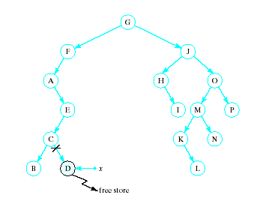
Recursive Deletion
Three possible cases to delete a node, x, from a BST
1. The node, x, is a leaf

Slide 18
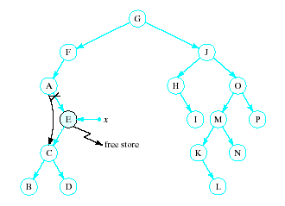
Recursive Deletion
2. The node, x has one child

Slide 19
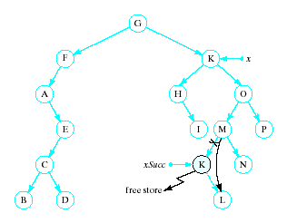
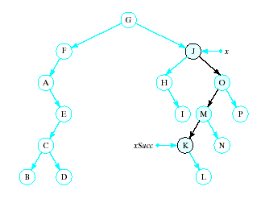
Recursive Deletion
x has two children
Delete node pointed to by xSucc as described for cases 1 and 2
Replace contents of x with inorder successor
K

Slide 20
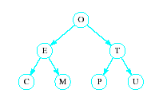
Tree can be balanced
each node except leaves has exactly 2 child nodes

Slide 21
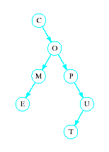
Trees can be unbalanced
not all nodes have exactly 2 child nodes

Slide 22
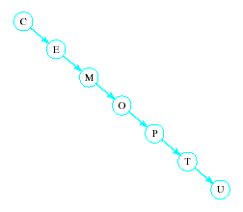
Trees can be totally lopsided
Suppose each node has a right child only
Degenerates into a linked list
Processing time affected by "shape" of tree

Slide 23


Hash Tables
Recall order of magnitude of searches
Linear search O(n)
Binary search O(log₂n)
Balanced binary tree search O(log₂n)
Unbalanced binary tree can degrade to O(n)

Slide 24
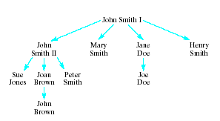
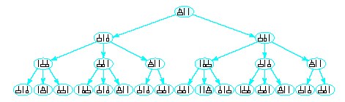
Non Binary Trees
Some applications require more than two children per node
Genealogical tree
Game tree

