Slide 1
Group and Ring

Slide 2
Groups, rings, and fields are the fundamental elements of a branch of mathematics known as abstract algebra, or modern algebra.
Let S be a nonempty set. An operation on S is a function ∗ from S × S into S is denoted as (S, ∗).
Let us define a set with operator • as: ( {a, b, c, d}, •) and the operation as shown in Table below.

Slide 3
Next we list a number of important properties of our operations.
Associative Law:
An operation ∗ on a set S is said to be associative or to satisfy the Associative Law if, for any elements a, b, c in S, we have
(a ∗ b) ∗ c = a ∗ (b ∗ c)
Commutative Law:
An operation ∗ on a set S is said to be commutative or satisfy the Commutative Law if, for any elements a, b in S, a ∗ b = b ∗ a

Slide 4
EXAMPLE 1
Consider the set Z of integers. Addition and multiplication of integers are associative and commutative. On the other hand, subtraction is non associative.
For example, (8 − 4) − 3 = 1 but 8 − (4 − 3) = 7
Moreover, subtraction is not commutative since,
for example, 3 − 7 = 7 − 3.
(b) Consider the operation of matrix multiplication on the set M of n-square matrices. One can prove that matrix multiplication is associative. On the other hand, matrix multiplication is not commutative. For example,

Slide 5
Identity Element:
Consider an operation ∗ on a set S. An element e in S is called an identity element for ∗ if, for any element a in S,
a ∗ e = e ∗ a = a
More generally, an element e is called a left identity or a right identity according as e ∗ a = a or a ∗ e = a where a is any element in S.
Inverses:
Suppose an operation ∗ on a set S does have an identity element e. The inverse of an element a in S is an element b such that
a ∗ b = b ∗ a = e

Slide 6
EXAMPLE 2
Consider the rational numbers Q. Under addition, 0 is the identity element, and − 3 and 3 are (additive) inverses since (−3) + 3 = 3 + (−3) = 0
On the other hand, under multiplication, 1 is the identity element, and −3 and −1/3 are (multiplicative) inverses since
(−3)(−1/3) = (−1/3)(−3) = 1
Note 0 has no multiplicative inverse.

Slide 7
SEMIGROUPS
Let S be a nonempty set with an operation. Then S is called a semigroup if the operation is associative. If the operation also has an identity element, then S is called a monoid.
Example 3
Consider the positive integers N. Then (N, +) and (N, ×) are semigroups since addition and multiplication on N are associative. In particular, (N, ×) is a monoid since it has the identity element 1. However, (N, +) is not a monoid since addition in N has no zero element.

Slide 8
Groups
A group , sometimes denoted by {G, *} , is a set of elements with a binary operation denoted by * that associates to each ordered pair (a, b) of elements in an element (a *b) in G, such that the following axioms are obeyed.
(A1) Closure: If a and b belong to G, then a *b is also in G.
(A2) Associative: a *(b *c) = (a *b) *c for all a, b, c in G.
(A3) Identity element: There is an element e in such
that a *e = e *a = a for all a in G.
(A4) Inverse element: For each in , there is an element in
such that a *a´ = a ´*a = e.

Slide 9
Example 4
If R is a set of real numbers then, (R,+) is a group.
We know already that addition is a binary operation on R, so ‘closure’ holds.
We know addition of real numbers is associative.
What is the identity element? We want an element e ε R so that a + e = e + a = a for all a ε R. It is clear that e = 0 works and is the only possible choice.
Moreover, the (additive) inverse of a is -a: a + (-a) = (-a) + a = 0 =
e.

Slide 10
Example 5
All the groups we have met so far are infinite. Here is an example of a finite group. Let A = {+1,-1}. Then (A, *) is a group (where the operator * is multiplication).
Example 6
Let B = {1, i ,-1,-i }, where i =√(-1). Then (B, *) is another example of a finite group.
Example 7
Let C = {1, i }. Then (C, *) is not a group since it isn’t closed; for example i * i = -1 ε C.

Slide 11
Abelian Groups
We say that a group (G, ○) is abelian if (in addition to the defining properties (i)–(iv) of a group) it also satisfies:
(v) (commutativity) for all a, b ε G, a ○ b = b ○ a.

Slide 12

EXAMPLE 8
The nonzero rational numbers Q\{0} form an abelian group under multiplication. The number 1 is the identity element and q/p is the multiplicative inverse of the rational number p/q.
(b) Let S be the set of 2 × 2 matrices with rational entries under the operation of matrix multiplication. Then S is not a group since inverses do not always exist.
However, let G be the subset of 2 × 2 matrices with a nonzero determinant. Then G is a group under matrix multiplication. The identity element is

Slide 13
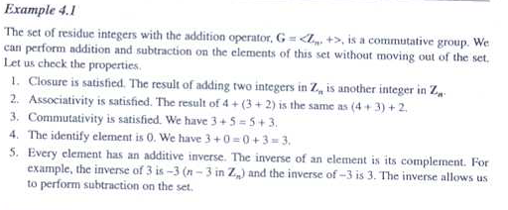

Slide 15
Example-9
Consider the set Q of rational numbers, and let ∗ be the operation on Q defined by: a ∗ b = a + b − ab
(a) Find: (i) 3 ∗ 4; (ii) 2 ∗ (−5); (iii) 7 ∗ (1/2).
(b) Is (Q, ∗) a semigroup? Is it commutative?
(c) Find the identity element for ∗.
(d) Do any of the elements in Q have an inverse? What is it?
Ans.
a) (i) 3 ∗ 4 = 3 + 4 − 3(4) = 3 + 4 − 12 = −5
(ii) 2 ∗ (−5) = 2 + (−5) + 2(−5) = 2 − 5 + 10 = 7
(iii) 7 ∗ (1/2) = 7 + (1/2) − 7(1/2) = 4

Slide 16
(b) We have:
(a ∗ b) ∗ c
=(a + b − ab) ∗ c
= (a + b − ab) + c − (a + b − ab)c
=a + b − ab + c − ac − bc + abc
= a + b + c − ab − ac − bc + abc
a ∗ (b ∗ c)
= a ∗ (b + c − bc) = a + (b + c − bc) − a(b + c − bc)
= a + b + c − bc − ab − ac + abc
Hence ∗ is associative and (Q, ∗) is a semigroup. Also
a ∗ b = a + b − ab = b + a − ba = b ∗ a
(Hence (Q, ∗) is a commutative semigroup.

Slide 17
(c) An element e is an identity element if a ∗ e = a for every a ∈ Q. Compute as follows:
a ∗ e = a, a + e − ae = a, e − ea = 0, e(1 − a) = 0, e= 0
Accordingly, 0 is the identity element.
(d) In order for a to have an inverse x, we must have a ∗ x = 0 since 0 is the identity element by Part (c).
Compute as follows:
a ∗ x = 0, a + x − ax = 0, a = ax − x, a = x(a − l), x = a/(a − l)
Thus if a ≠ 1, then a has an inverse and it is a/(a − 1).

Slide 18
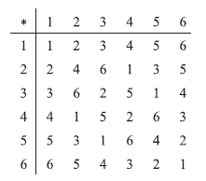
Example 10
Consider the group G = {1, 2, 3, 4, 5, 6, *} under multiplication modulo 7.
(a) Find the multiplication table of G. (b) Find 2⁻¹, 3⁻¹, 6⁻¹.
Ans.
(a) To find a ∗ b in G, find the remainder when the product ab is divided by 7.
For example, 5・6 = 30 which yields a remainder of 2 when divided by 7; hence 5 ∗6 = 2 in G. The multiplication table of G appears in Fig. below.
(b) Note first that 1 is the identity element of G. Recall that a⁻¹ is that element of G such that aa⁻¹ =1. Hence 2⁻¹ = 4, 3⁻¹ = 5 and 6⁻¹ = 6.

Slide 19

Symmetric Group S_{n}
A one-to-one mapping σ of the set S = {1, 2, …, n} onto itself is called a permutation. Such a permutation may be denoted as follows where j_{i} = σ(i):
The set of all such permutations is denoted by S_{n}, and there are n! possible elements of set S_{n}. The composition and inverses of permutations in S_{n} belong to S_{n}, and the identity function ε belongs to S_{n}. Thus S_{n} forms a group (S_{n}, ◊) called the symmetric group of degree n and order n!.

Slide 20
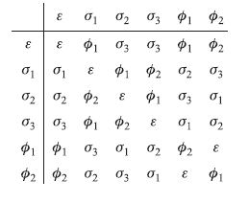
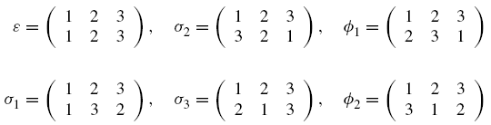
Let us consider a set, S = {1, 2, 3}.
The symmetric group S₃ has 3! = 6 elements as follows:
The multiplication table of S₃ appears in Fig. below
({ε,σ₁,Φ₂} ,◊), ({ε,σ₃,Φ₁} ,◊), ({ε,σ₂} ,◊) etc are all permutation group of degree 3 and order 6.
({ε,σ₁, σ₂ ,σ₃, Φ₁, Φ₂} ,◊), is symmetric group of degree 3 and order 6.

Slide 21
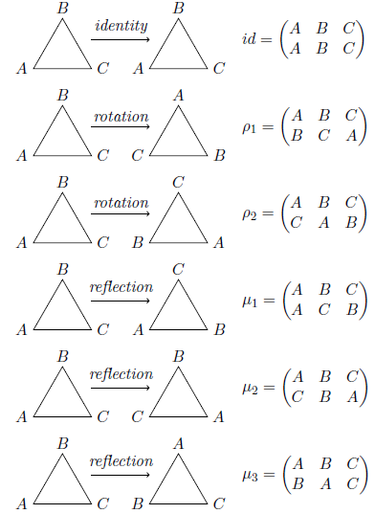
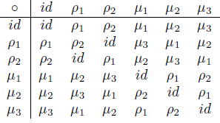
By considering the symmetries of regular polygons we obtain certain other permutation groups called dihedral group. For this purpose, let us first consider an equilateral triangle whose vertices are denoted as A, B and C. Now consider all possible rotation and reflections which leave the final position of the triangle unchanged from its original position except for the renaming of vertices. Thus the dihedral group is (D₃, ◊) obtained from rotation and reflection of a triangle.
Multiplication table of S₃

Slide 22
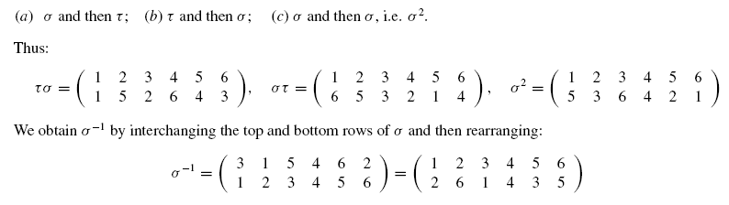
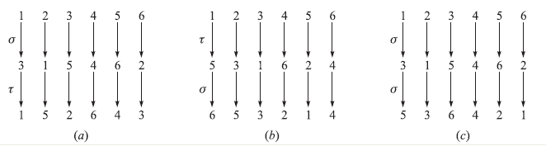

Example 11

Slide 23
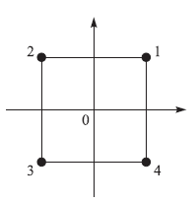
Example-12
Let S be the square in Fig. below, with its center at the origin 0. Note that the vertices of S are numbered counterclockwise from 1 to 4.
Determine 8 elements of D₄ by rotation and reflection.
There are eight symmetries as follows. For α = 0◦, 90◦, 180◦, 270◦, let σ(α) be the symmetry obtained by rotating S about its center α degrees, and let τ(α) be the symmetry obtained by reflecting S about the y-axis and then rotating S about its center α degrees.

Slide 24

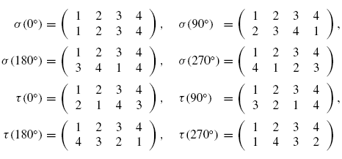
Now D₄ = {σ(0⁰), σ(90⁰), σ(180⁰), σ(270⁰), τ(0⁰), τ(90⁰), τ(180⁰), τ(270⁰)}
Therefore (D₄, ◊) is a group of order 8 and degree 4.

Slide 25
Rings
A ring , sometimes denoted by {R, +, *}, is a set of elements with two binary operations, called addition and multiplication such that for all a, b, c in R the following axioms are obeyed.
(A1–A5) is an abelian group with respect to addition; that is, satisfies axioms A1 through A5. For the case of an additive group, we denote the identity element as 0 and the inverse of a as –a.
(M1) Closure under multiplication: If a and b belong to R, then ab is also in R.
(M2) Associativity of multiplication: a(bc) = (ab)c for all a, b, c in R.
(M3) Distributive laws: a(b + c) = ab + ac for all a, b, c in R.
(a + b)c = ac + bc for all a, b, c in R.

Slide 26
A ring is said to be commutative if it satisfies the following additional condition:
(M4) Commutativity of multiplication: ab = ba for all a, b in R.

