Slide 1
Counting
Counting problems arise throughout mathematics and computer science. For example, we must count the successful outcomes of experiments and all the possible outcomes of these experiments to determine probabilities of discrete events. We need to count the number of operations used by an algorithm to study its time complexity.

Slide 2

PERMUTATIONS
Any arrangement of a set of n objects in a given order is called a permutation of the object (taken all at a time). Any arrangement of any r ≤ n of these objects in a given order is called an “r- permutation” or “a permutation of the n objects taken r at a time.”
EXAMPLE 1 Find the number m of permutations of six objects, say, A, B, C, D, E, F, taken three at a time.
Ans. P(6, 3) = 6 ・ 5 ・ 4 = 120

Slide 3

EXAMPLE 2 Find the number m of seven-letter words that can be formed using the letters of the word “BENZENE.”
We seek the number of permutations of 7 objects of which 3 are alike (the three E’s), and 2 are alike (the two N’s)
EXAMPLE 3 How many permutations of the letters ABCDEFGH contain the string ABC ?
Solution: Because the letters ABC must occur as a block, we can find the answer by finding the number of permutations of six objects, namely, the block ABC and the individual letters D, E, F, G, and H. Because these six objects can occur in any order, there are 6! = 720 permutations of the letters ABCDEFGH in which ABC occurs as a block.

Slide 4
Example 4
A class contains 8 students. Find the number n of samples of size 3:(a)With replacement; (b)Without replacement.
(a) Each student in the ordered sample can be chosen in 8 ways; hence, there are n = 8.8 .8 = 83 = 512 samples of size 3 with replacement.
(b) The first student in the sample can be chosen in 8 ways, the second in 7 ways, and the last in 6 ways. Thus, there are n = 8 .7 .6 = 336 samples of size 3 without replacement.

Slide 5
Ordered Samples
Many problems are concerned with choosing an element from a set S, say, with n elements. When we choose one element after another, say, r times, we call the choice an ordered sample of size r. We consider two cases.
(1) Sampling with replacement
Here the element is replaced in the set S before the next element is chosen. Thus, each time there are n ways to choose an element (repetitions are allowed). The Product rule tells us that the number of such samples is:
n・ n ・ n ・ ・ ・ n ・ n(r factors) = n^{r}

Slide 6
(2) Sampling without replacement
Here the element is not replaced in the set S before the next element is chosen. Thus, there is no repetition in the ordered sample. Such a sample is simply an r-permutation. Thus the number of such samples is:
P(n, r) = n(n − 1) (n − 2) ・ ・ ・ (n − r + 1) = n!/(n − r)!

Slide 7
EXAMPLE 5
Three cards are chosen one after the other from a 52-card deck. Find the number m of ways this can be done: (a) with replacement; (b) without replacement.
(a) Each card can be chosen in 52 ways. Thus m = 52(52)(52) = 140 608.
(b) Here there is no replacement. Thus the first card can be chosen in 52 ways, the second in 51 ways, and the third in 50 ways. Therefore: m = P(52, 3) = 52(51)(50) = 132 600

Slide 8
COMBINATIONS
Let S be a set with n elements. A combination of these n elements taken r at a time is any selection of r of the elements where order does not count. Such a selection is called an r-combination; it is simply a subset of S with r elements. The number of such combinations will be denoted by
C(n, r) (other texts may use _{n}C_{r}, C_{n,r} , or C^{n}_{r} ).

Slide 9
EXAMPLE 6
A farmer buys 3 cows, 2 pigs, and 4 hens from a man who has 6 cows, 5 pigs, and 8 hens. Find the number m of choices that the farmer has.
Ans.
The farmer can choose the cows in C(6, 3) ways, the pigs in C(5, 2) ways, and the hens in C(8, 4) ways.
Thus the number m of choices follows:

Slide 10


Example 7
A class contains 10 students with 6 men and 4 women. Find the number n of ways to:
(a) Select a 4-member committee from the students.
(b) Select a 4-member committee with 2 men and 2 women.
(c) Elect a president, vice president, and treasurer.
Ans.
(a) This concerns combinations, not permutations, since order does not count in a committee. There are “10 choose 4” such committees. That is:
(b) The 2 men can be chosen from the 6 men in C(6, 2) ways, and the 2 women can be chosen from the 4 women in
C(4, 2) ways. Thus, by the Product Rule:
(c) This concerns permutations, not combinations, since order does count. Thus,
n = P(6, 3) = 6 ・ 5 ・ 4 = 120

Slide 11
Example-8
Suppose that there are 9 faculty members in the mathematics department and 11 in the computer science department. How many ways are there to select a committee to develop a discrete mathematics course at a school if the committee is to consist of three faculty members from the mathematics department and four from the computer science department?
Solution: By the product rule, the answer is the product of the number of 3-combinations of a set with nine elements and the number of 4-combinations of a set with 11 elements. By Theorem 2, the number of ways to select the committee is:
C(9, 3) · C(11, 4) = 27,720.

Slide 12
EXAMPLE 9
How many ways are there to distribute hands of 5 cards to each of four players from the standard
deck of 52 cards?
Solution: We will use the product rule to solve this problem. To begin, note that the first player can be dealt 5 cards in C(52, 5) ways. The second player can be dealt 5 cards in C(47, 5) ways,
because only 47 cards are left. The third player can be dealt 5 cards in C(42, 5) ways. Finally, the fourth player can be dealt 5 cards in C(37, 5) ways. Hence, the total number of ways to deal four players 5 cards each is
C(52, 5)C(47, 5)C(42, 5)C(37, 5) = 52!/(5! 5! 5! 5! 32! ).

Slide 13
Example-10
Find the number m of committees of 5 with a given chairperson that can be selected from 12 people.
Ans.
The chairperson can be chosen in 12 ways and, following this, the other 4 on the committee can be chosen from the 11 remaining in C(11, 4) ways. Thus m = 12·C(11, 4) = 12·330 = 3960.

Slide 14
Example-11
A box contains 8 blue socks and 6 red socks. Find the number of ways two socks can be drawn from the
box if:
(a) They can be any color. (b) They must be the same color.
Ans.
(a) There are “14 choose 2” ways to select 2 of the 14 socks. Thus:
n = C(14, 2) = 14.13/(2 .1) = 91
(b) There are C(8, 2) = 28 ways to choose 2 of the 8 blue socks, and C(6, 2) = 15 ways to choose 2 of the 4 red socks. By the Sum Rule, n = 28 + 15 = 43.

Slide 15
THE INCLUSION–EXCLUSION PRINCIPLE
Let A and B be any finite sets then,
n(A ∪ B) = n(A) + n(B) − n(A ∩ B)
In other words, to find the number n(A∪B) of elements in the union of A and B, we add n(A) and n(B) and then we subtract n(A ∩ B); that is, we “include” n(A) and n(B), and we “exclude” n(A ∩ B). This follows from the fact that, when we add n(A) and n(B), we have counted the elements of (A ∩ B) twice.
The above principle holds for any number of sets. We first state it for three sets.
Theorem : For any finite sets A, B, C we have
n(A ∪ B ∪ C) = n(A) + n(B) + n(C) − n(A ∩ B) − n(A ∩ C) − n(B ∩ C) + n(A ∩ B ∩ C)

Slide 16
EXAMPLE 10
Find the number of mathematics students at a college taking at least one of the languages
French, German, and Russian, given the following data:
65 study French, 20 study French and German,
45 study German, 25 study French and Russian,
42 study Russian, 15 study German and Russian, 8 study all three languages.
We want to find n(F ∪ G ∪ R) where F, G, and R denote the sets of students studying French, German, and Russian, respectively.
By the Inclusion–Exclusion Principle,
n(F ∪ G ∪ R) = n(F ) + n(G) + n(R) − n(F ∩ G) − n(F ∩ R) − n(G ∩ R) + n(F ∩ G ∩ R)
= 65 + 45 + 42 − 20 − 25 − 15 + 8 = 100
Namely, 100 students study at least one of the three languages.

Slide 17
Example 11
Suppose among 32 people who save paper or bottles (or both) for recycling, there are 30 who save paper and 14 who save bottles. Find the number m of people who:
(a) save both; (b) save only paper; (c) save only bottles.
Ans.
Let P and B denote the sets of people saving paper and bottles, respectively. Then:
(a) m = n(P ∩ B) = n(P ) + n(B) − n(P ∪ B) = 30 + 14 − 32 = 12
(b) m = n(P \B) = n(P ) − n(P ∩ B) = 30 − 12 = 18
(c) m = n(B\P) = n(B) − n(P ∩ B) = 14 − 12 = 2

Slide 18
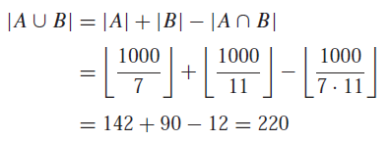
EXAMPLE 12
How many positive integers not exceeding 1000 are divisible by 7 or 11?
Ans.

Slide 19
EXAMPLE 13
Suppose that there are 1807 freshmen at your school. Of these, 453 are taking a course in computer science, 567 are taking a course in mathematics, and 299 are taking courses in both computer science and mathematics. How many are not taking a course either in computer science or in mathematics?
Solution: Let A be the set of all freshmen taking a course in computer science, and let B be the set of all freshmen taking a course in mathematics. It follows that |A| = 453, |B| = 567, and |A ∩ B| = 299. The number of freshmen taking a course in
either computer science or mathematics is
|A ∪ B| = |A| + |B| − |A ∩ B| = 453 + 567 − 299 = 721.
Consequently, there are 1807 − 721 = 1086 freshmen who are not taking a course in computer science or mathematics.

Slide 20
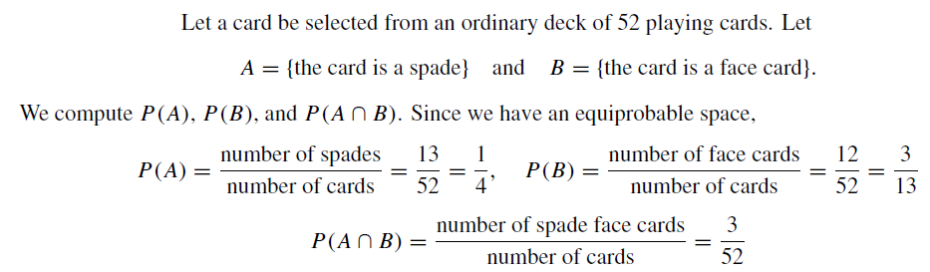
Example-14

Slide 21
CONDITIONAL PROBABILITY
Suppose E is an event in a sample space S with P(E) > 0. The probability that an event A occurs once E has occurred or, specifically, the conditional probability of A given E. written P(A|E), is defined as follows:
P(A|E) = P(A ∩ E)/P(E)

Slide 22
EXAMPLE 15
A pair of fair dice is tossed. The sample space S consists of the 36 ordered pairs (a, b), where a and b can be any of the integers from 1 to 6. Thus the probability of any point is 1/36 . Find the probability that one of the dice is 2 if the sum is 6. That is, find P(A|E) where:
E = {sum is 6} and A = {2 appears on at least one die}.
Ans.
Now E consists of 5 elements and A ∩ E consists of two elements; namely
E = {(1, 5), (2, 4), (3, 3), (4, 2), (5, 1)} and A ∩ E = {(2, 4), (4, 2)}
By Theorem 7.5, P(A|E) = 2/5.
On the other hand A itself consists of 11 elements, that is,
A = {(2, 1), (2, 2), (2, 3), (2, 4), (2, 5), (2, 6), (1, 2), (3, 2), (4, 2), (5, 2), (6, 2)}
Since S consists of 36 elements, P(A) = 11/36.

Slide 23
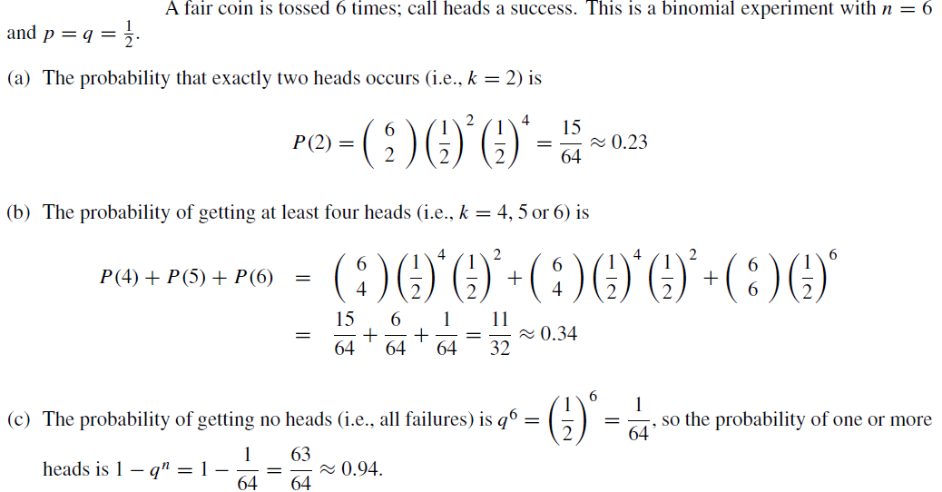
Example-16

Slide 24
Example-17
Suppose A and B are events with P(A) = 0.6, P(B) = 0.3, and P(A ∩ B) = 0.2. Find the probability
that:
(a) A does not occur; (c) A or B occurs;
(b) B does not occur; (d) Neither A nor B occurs.
Ans.
(a) P(not A) = P(A^{C}) = 1 − P(A) = 0.4.
(b) P(not B) = P(B^{C}) = 1 − P(B) = 0.7.
(c) By the Addition Principle,
P(A or B) = P(A ∪ B) = P(A) + P(B) − P(A ∩ B)
= 0.6 + 0.3 − 0.2 = 0.7
(d) Recall (DeMorgan’s Law) that neither A nor B is the complement of A ∪ B. Thus:
P(neither A nor B) = P((A ∪ B)^{C}) = 1 − P(A ∪ B) = 1 − 0.7 = 0.3

Slide 25
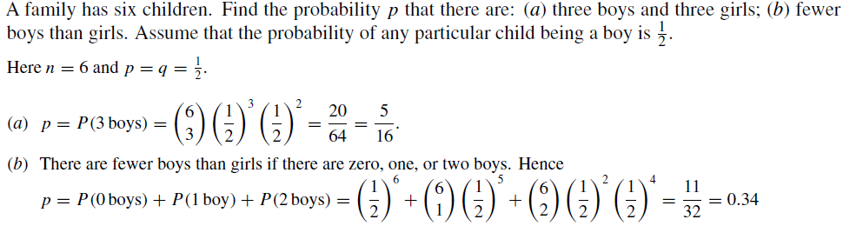
Example-18

Slide 26
Example-19
A bit string of length four is generated at random so that each of the 16 bit strings of length four is equally likely. What is the probability that it contains at least two consecutive 0s, given that
its first bit is a 0? (We assume that 0 bits and 1 bits are equally likely.)
Solution: Let E be the event that a bit string of length four contains at least two consecutive 0s, and let F be the event that the first bit of a bit string of length four is a 0.
Because E ∩ F = {0000, 0001, 0010, 0011, 0100}, we see that p(E ∩ F) = 5/16. Because there are eight bit strings of length four that start with a 0, we have p(F) = 8/16 = 1/2.
Consequently,
p(E | F) = (5/16)/(1/2) = 5/8

Slide 27
Example-20
What is the conditional probability that a family with two children has two boys, given they have at least one boy? Assume that each of the possibilities BB, BG, GB, and GG is equally likely, where B represents a boy and G represents a girl. (Note that BG represents a family with an older boy and a younger girl while GB represents a family with an older girl and a younger boy.)
Solution: Let E be the event that a family with two children has two boys, and let F be the event that a family with two children has at least one boy. It follows that E = {BB}, F = {BB, BG, GB}, and E ∩ F = {BB}. Because the four possibilities are equally likely, it follows that p(F) = 3/4 and p(E ∩ F) = 1/4.
We conclude that, p(E | F) = p(E ∩ F)/p(F) = (1/4)/(3/4) = 1/3.

