Slide 1
Discrete Mathematics CSE 157

Slide 2
Discrete mathematics is the part of mathematics devoted to the study of discrete objects. (Here discrete means consisting of distinct or unconnected elements.)
The kinds of problems solved using discrete mathematics include:
What is the probability of winning a lottery?
Is there a link between two computers in a network?
How can I encrypt a message so that no unintended recipient can read it?
What is the shortest path between two cities using a transportation system?
How can a list of integers be sorted so that the integers are in increasing order?
How many steps are required to do such a sorting?
How can a circuit that adds two integers be designed?
How many valid Internet addresses are there?

Slide 3
WHY STUDY DISCRETE MATHEMATICS?
There are several important reasons for studying discrete mathematics.
First, through this course you can develop your mathematical maturity: that is, your ability to understand and create mathematical arguments.
Second, discrete mathematics provides the mathematical foundations for many computer science courses including data structures, algorithms, database theory, automata theory, formal languages, compiler theory, computer security, and operating systems. Students find these courses much more difficult when they have not had the appropriate mathematical foundations from discrete math.
It is not possible to arrange each of the topic as a separate course organized by mathematics department

Slide 4
Sets
Sets are used to group objects together. Often, but not always, the objects in a set have similar properties.
For instance, all the students who are currently enrolled in your school make up a set. Likewise, all the students currently taking a course in discrete mathematics at any school make up a set.
In addition, those students enrolled in your school who are taking a course in discrete mathematics form a set that can be obtained by taking the elements common to the first two collections.

Slide 5
DEFINITION 1
A set is an unordered collection of objects, called elements or members of the set. A set is said to contain its elements. We write a ∈ A to denote that a is an element of the set A. The Notation ∈ denotes that a is not an element of the set A.
The set V of all vowels in the English alphabet can be written as
V = {a, e, i, o, u}.

Slide 6
Some notations
N = {0, 1, 2, 3, . . .}, the set of natural numbers
Z = {. . . ,−2,−1, 0, 1, 2, . . .}, the set of integers
Z+ = {1, 2, 3, . . .}, the set of positive integers
Q = {p/q | p ∈ Z, q ∈ Z, and q ≠0}, the set of rational numbers
R, the set of real numbers
R+, the set of positive real numbers
C, the set of complex numbers.
O = {x | x is an odd positive integer less than 10},
or,
O = {x ∈ Z+ | x is odd and x < 10}.

Slide 7
List the elements of each set where N = {1, 2, 3, …}.
(a) A = {x ∈ N| 3 < x < 9}
(b) B = {x ∈ N| x is even, x < 11}
(c) C = {x ∈ N| 4 + x = 3}
(a) A consists of the positive integers between 3 and 9; hence A = {4, 5, 6, 7, 8}.
(b) B consists of the even positive integers less than 11; hence B = {2, 4, 6, 8, 10}.
(c) No positive integer satisfies 4 + x = 3; hence C = ∅, the empty set.
Let A = {2, 3, 4, 5}.
(a) Show that A is not a subset of B = {x ∈ N| x is even}.
(b) Show that A is a proper subset of C = {1, 2, 3, . . ., 8, 9}.
(a) It is necessary to show that at least one element in A does not belong to B. Now 3 ∈ A and, since B consists of even numbers, 3 B; hence A is not a subset of B.
(b) Each element of A belongs to C so A ⊆ C. On the other hand, 1 ∈ C but 1 A. Hence A ≠ C. Therefore A is a proper subset of C.

Slide 8
DEFINITION 2
Two sets are equal if and only if they have the same elements. Therefore, if A and B are sets, then A and B are equal if and only if ∀x(x ∈ A ↔ x ∈ B).We write A = B if A and B are equal sets.
DEFINITION 3
The set A is a subset of B if and only if every element of A is also an element of B. We use the notation A ⊆ B to indicate that A is a subset of the set B.
We see that A ⊆ B if and only if the quantification
∀x(x ∈ A → x ∈ B) is true.

Slide 9
Given a set S, the power set of S is the set of all subsets of the set S. The power set of S is denoted by P(S).
Q1. What is the power set of the set {0, 1, 2}?
Solution: The power set P({0, 1, 2}) is the set of all subsets of {0, 1, 2}. Hence,
P({0, 1, 2}) = {∅, {0}, {1}, {2}, {0, 1}, {0, 2}, {1, 2}, {0, 1, 2}}.
Q.2 What is the power set of the empty set? What is the power set of the set {∅}?
Solution: The empty set has exactly one subset, namely, itself. Consequently,
P(∅) = {∅}.
The set {∅} has exactly two subsets, namely, ∅ and the set {∅} itself. Therefore,
P({∅}) = {∅, {∅}}.

Slide 10
Determine the power set P(A) of A = {a, b, c, d}.
The elements of P(A) are the subsets of A. Hence
P(A) = [A, {a, b, c}, {a, b, d}, {a, c, d}, {b, c, d}, {a, b}, {a, c}, {a, d}, {b, c}, {b, d}, {c, d}, {a}, {b}, {c}, {d}, ∅]

Slide 11
Let A and B be sets. The Cartesian product of A and B, denoted by:
A × B, is the set of all ordered pairs (a, b), where a ∈ A and b ∈ B. Hence,
A × B = {(a, b) | a ∈ A ∧ b ∈ B}.
Q3. What is the Cartesian product of A = {1, 2} and B = {a, b, c}?
Solution: The Cartesian product A × B is
A × B = {(1, a), (1, b), (1, c), (2, a), (2, b), (2, c)}.
Q4. Show that the Cartesian product B × A is not equal to the Cartesian product A × B.
Solution: The Cartesian product B × A is
B × A = {(a, 1), (a, 2), (b, 1), (b, 2), (c, 1), (c, 2)} ≠ A × B .

Slide 12
Q.5 What is the Cartesian product A × B × C, where A = {0, 1}, B = {1, 2}, and C = {0, 1, 2} ?
Solution: The Cartesian product A × B × C consists of all ordered triples (a, b, c), where a ∈ A,
b ∈ B, and c ∈ C. Hence,
A × B × C = {(0, 1, 0), (0, 1, 1), (0, 1, 2), (0, 2, 0), (0, 2, 1), (0, 2, 2),
(1, 1, 0), (1, 1, 1), (1, 1, 2), (1, 2, 0), (1, 2, 1), (1, 2, 2)}.
If A = Ø and B = {2, 4}. Find A × B and B × A
Ans. A × B = B × A = Ø

Slide 13
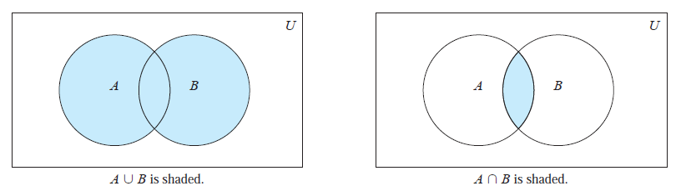
Let A and B be sets. The union of the sets A and B, denoted by A ∪ B, is the set that contains those elements that are either in A or in B, or in both.
The union of the sets {1, 3, 5} and {1, 2, 3} is the set {1, 2, 3, 5}; that is,
{1, 3, 5} ∪ {1, 2, 3} = {1, 2, 3, 5}.
Let A and B be sets. The intersection of the sets A and B, denoted by A ∩ B, is the set containing those elements in both A and B.
The intersection of the sets {1, 3, 5} and {1, 2, 3} is the set {1, 3}; that is,
{1, 3, 5} ∩ {1, 2, 3} = {1, 3}.

Slide 14
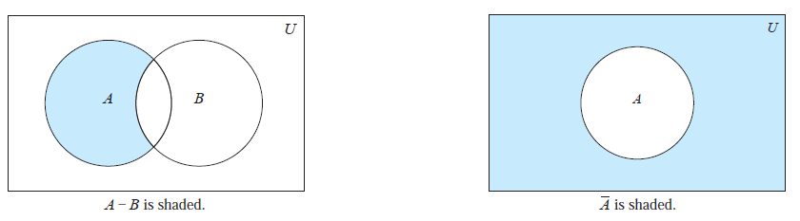
Let A = {1, 3, 5, 7, 9} and B = {2, 4, 6, 8, 10}. Because A ∩ B = ∅, A and B are disjoint.
Let A and B be sets. The difference of A and B, denoted by A − B, is the set containing those elements that are in A but not in B. The difference of A and B is also called the complement of B with respect to A.
Let U be the universal set. The complement of the set A, denoted by A^{c}, is the complement of A with respect to U. Therefore, the complement of the set A is U − A.

Slide 15
Let A = {a, e, i, o, u} (where the universal set is the set of letters of the English alphabet). Then
A^{c} = {b, c, d, f, g, h, j, k, l,m, n, p, q, r, s, t, v, w, x, y, z}.
Let A be the set of positive integers greater than 10 (with universal set the set of all positive integers).
Then
A^{c} = {1, 2, 3, 4, 5, 6, 7, 8, 9, 10}.

Slide 16
Let U = {1,2, …, 9} be the universal set, and let
A = {1, 2, 3, 4, 5}, C= {5, 6, 7, 8, 9}, E= {2, 4, 6, 8},
B = {4, 5, 6, 7}, D= {1, 3, 5, 7, 9}, F = {1, 5, 9}.
Find: (a) A ∪ B and A ∩ B; (b) A ∪ C and A ∩ C; (c) D ∪ F and D ∩ F.
Recall that the union X∪Y consists of those elements in either X or Y (or both), and that the intersection X∩Y consists of those elements in both X and Y .
(a) A ∪ B = {1, 2, 3, 4, 5, 6, 7} and A ∩ B = {4, 5}
(b) A ∪ C = {1, 2, 3, 4, 5, 6, 7, 8, 9} = U and A ∩ C = {5}
(c) D ∪ F = {1, 3, 5, 7, 9} = D and D ∩ F = (1, 5, 9) = F

Slide 17
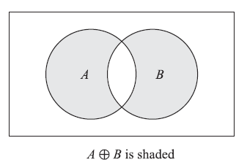
The symmetric difference of sets A and B, denoted by A ⊕ B, consists of those elements which belong to A or B but not to both. That is,
A ⊕ B = (A ∪ B)\(A ∩ B) or A ⊕ B = (A\B) ∪ (B\A)
Figure below is a Venn diagram in which A ⊕ B is shaded.

Slide 18
Suppose U = N = {1, 2, 3, . . .} is the universal set.
Let
A = {1, 2, 3, 4}, B = {3, 4, 5, 6, 7}, C = {2, 3, 8, 9}, E = {2, 4, 6, . . .}
(Here E is the set of even integers.) Then:
A^{C} = {5, 6, 7, . . .}, B^{C} = {1, 2, 8, 9, 10, . . .}, E^{C} = {1, 3, 5, 7, . . .}
That is, E^{C} is the set of odd positive integers. Also:
A\B = {1, 2}, A\C = {1, 4}, B\C = {4, 5, 6, 7}, A\E = {1, 3},
B\A = {5, 6, 7}, C\A = {8, 9}, C\B = {2, 8, 9}, E\A = {6, 8, 10, 12, . . .}.
Furthermore:
A ⊕ B = (A\B) ∪ (B\A) = {1, 2, 5, 6, 7}, B⊕ C = {2, 4, 5, 6, 7, 8, 9},
A ⊕ C = (A\C) ∪ (B\C) = {1, 4, 8, 9}, A⊕ E = {1, 3, 6, 8, 10, . . .}.

Slide 19
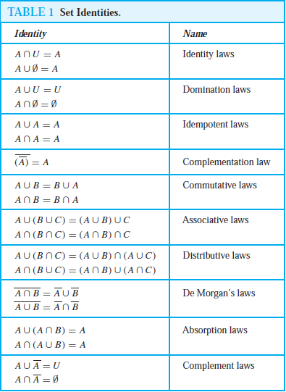

Slide 20
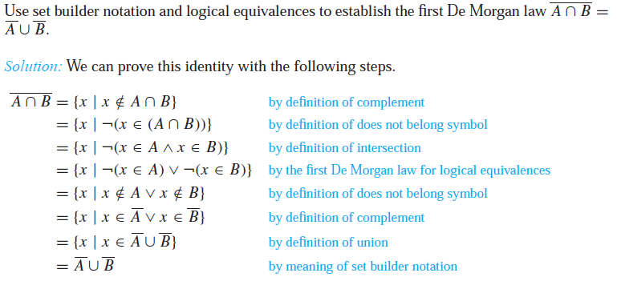

Slide 21
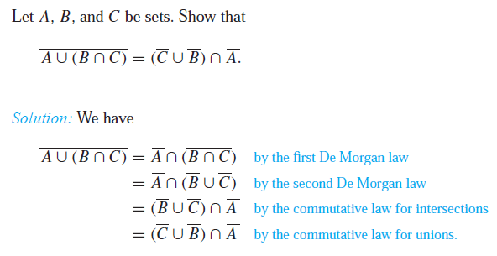

Slide 22
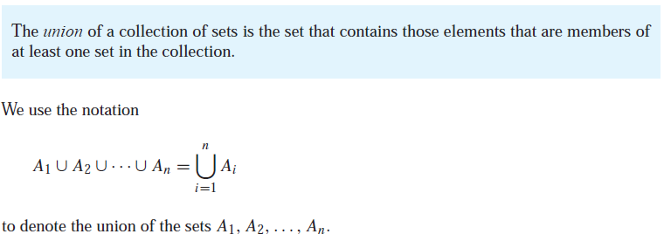
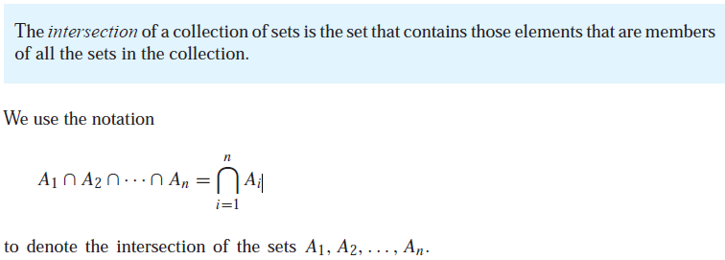

Slide 23
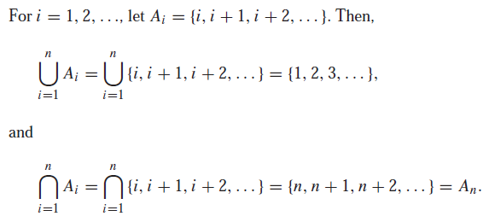
Example

Slide 24
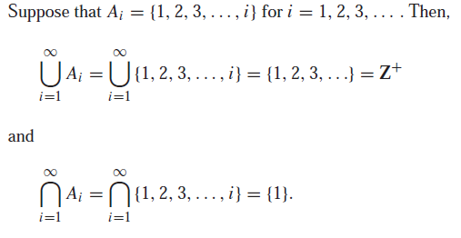
Example

Slide 25
Example
Given, A₁={1, 5}, A₂ = {1,2,4,6}, A₃ = {3, 4,7}, B = {2,4} and
I = {1, 2,3}. Determine the following sets.

Slide 26
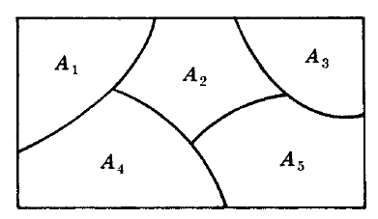
Partitions
Let S be a nonempty set. A partition of S is a subdivision of S into nonoverlapping, nonempty subsets.
Precisely, a partition of S is a collection {A_{i} } of nonempty subsets of S such that:
(i) Each subset in S belongs to one of the A_{i} .
(ii) The sets of {A_{i}} are mutually disjoint; that is, if A_{j} ≠ A_{k} then A_{j} ∩ A_{k} = ∅
The subsets in a partition are called cells. Figure shown below is a Venn diagram of a partition of the rectangular set S of points into five cells, A₁, A₂,A₃,A₄,A₅.

Slide 27
EXAMPLE
Consider the following collections of subsets of S = {1, 2, . . ., 8, 9}:
(i) [{1, 3, 5}, {2, 6}, {4, 8, 9}]
(ii) [{1, 3, 5}, {2, 4, 6, 8}, {5, 7, 9}]
(iii) [{1, 3, 5}, {2, 4, 6, 8}, {7, 9}]
Then (i) is not a partition of S since 7 in S does not belong to any of the subsets. Furthermore, (ii) is not a partition of S since {1, 3, 5} and {5, 7, 9} are not disjoint. On the other hand, (iii) is a partition of S.

Slide 28
Example
Let S = {a, b, c, d, e, f , g}. Determine which of the following are partitions of S:
(a) P₁ = [{a, c, e}, {b}, {d, g}], (c) P₃ = [{a, b, e, g}, {c}, {d, f }],
(b) P₂ = [{a, e, g}, {c, d}, {b, e, f }], (d) P₄ = [{a, b, c, d, e, f , g}].
Ans.
(a) P₁ is not a partition of S since f ∈ S does not belong to any of the cells.
(b) P₂ is not a partition of S since e ∈ S belongs to two of the cells.
(c) P₃ is a partition of S since each element in S belongs to exactly one cell.
(d) P₄ is a partition of S into one cell, S itself.

Slide 29
Example
Find all partitions of S = {a, b, c, d}.
Note first that each partition of S contains either 1, 2, 3, or 4 distinct cells. The partitions are as follows:
(1) [{a, b, c, d}]
(2) [{a}, {b, c, d}], [{b}, {a, c, d}], [{c}, {a, b, d}], [{d}, {a, b, c}],
[{a, b}, {c, d}], [{a, c}, {b, d}], [{a, d}, {b, c}]
(3) [{a}, {b}, {c, d}], [{a}, {c}, {b, d}], [{a}, {d}, {b, c}],
[{b}, {c}, {a, d}], [{b}, {d}, {a, c}], [{c}, {d}, {a, b}]
(4) [{a}, {b}, {c}, {d}]
There are 15 different partitions of S.

Slide 30
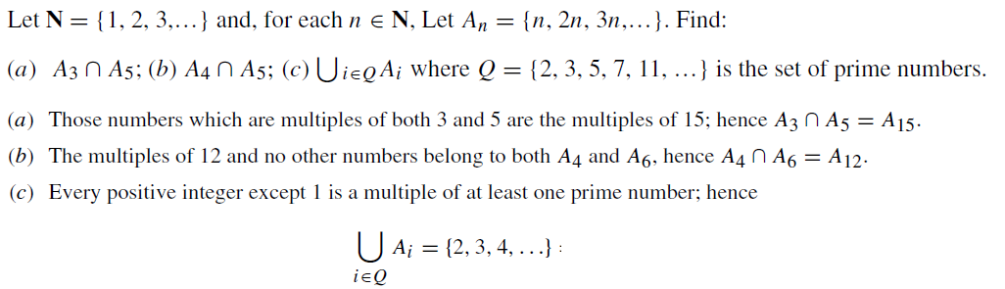

Slide 31
Counting Elements in Finite Sets
The notation n(S) or |S| will denote the number of elements in a set S. (Some texts use #(S) or card(S) instead of n(S).) Thus n(A) = 26, where A is the letters in the English alphabet, and n(D) = 7, where D is the days of the week. Also n(∅) = 0 since the empty set has no elements.
The following lemma applies.
Lemma 1: Suppose A and B are finite disjoint sets. Then A ∪ B is finite and
n(A ∪ B) = n(A) + n(B)

Slide 32
Corollary 1: Let A and B be finite sets. Then
n(A\B) = n(A) − n(A ∩ B)
For example, suppose an art class A has 25 students and 10 of them are taking a biology class B. Then the number of students in class A which are not in class B is:
n(A\B) = n(A) − n(A ∩ B) = 25 − 10 = 15
Corollary 2: Let A be a subset of a finite universal set U. Then
n(A^{C}) = n(U) − n(A)
For example, suppose a class U with 30 students has 18 full-time students. Then there are 30−18 = 12 part-time students in the class U.

Slide 33
Inclusion–Exclusion Principle
There is a formula for n(A ∪ B) even when they are not disjoint, called the Inclusion–Exclusion Principle.
Suppose A and B are finite sets. Then A ∪ B and A ∩ B are finite and
n(A ∪ B) = n(A) + n(B) − n(A ∩ B)
That is, we find the number of elements in A or B (or both) by first adding n(A) and n(B) (inclusion) and then subtracting n(A ∩ B) (exclusion) since its elements were counted twice.
We can apply this result to obtain a similar formula for three sets:
n(A ∪ B ∪ C) = n(A) + n(B) + n(C) − n(A ∩ B) − n(A ∩ C) − n(B ∩ C) + n(A ∩ B ∩ C)

Slide 34
EXAMPLE Suppose a list A contains the 30 students in a mathematics class, and a list B contains the 35 students in an English class, and suppose there are 20 names on both lists. Find the number of students:
only on list A, (b) only on list B, (c) on list A or B (or both), (d) on exactly one list.
(a) List A has 30 names and 20 are on list B; hence 30 − 20 = 10 names are only on list A.
(b) Similarly, 35 − 20 = 15 are only on list B.
(c) We seek n(A ∪ B). By inclusion–exclusion,
n(A ∪ B) = n(A) + n(B) − n(A ∩ B) = 30 + 35 − 20 = 45.
In other words, we combine the two lists and then cross out the 20 names which appear twice.
(d) By (a) and (b), 10 + 15 = 25 names are only on one list; that is, n(A ⊕ B) = 25.

Slide 35
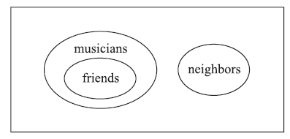
Example
Determine the validity of the following argument:
S₁: All my friends are musicians.
S₂: John is my friend.
S₃: None of my neighbours are musicians.
____________________________
S : John is not my neighbour.
The premises S₁ and S₃ lead to the Venn diagram in Fig. below. By S₂, John belongs to the set of friends which is disjoint from the set of neighbors. Thus S is a valid conclusion and so the argument is valid.

Slide 36
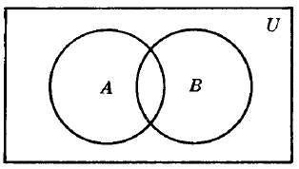
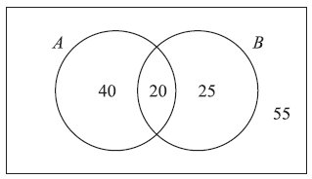
Example
Each student in Philosophy at Jahangirngar University requires to complete Science indicated as: A and Mathematics as B.
A poll of 140 students shows that:
60 completed A, 45 completed B, 20 completed both A and B.
Use a Venn diagram to find the number of students who have completed:
(a) At least one of A and B; (b) exactly one of A or B; (c) neither A nor B.
Ans.
Let us translating the above data into set notation yields:
n(A) = 60, n(B) = 45, n(A ∩ B) = 20, n(U) = 140
Corresponding Venn diagram of sets A and B is shown below.
Now we get,
20 completed both A and B, so n(A ∩ B) = 20.
60 − 20 = 40 completed A but not B, s on(A\B) = 40.
45 − 20 = 25 completed B but not A, so n(B\A) = 25.
140 − 20 − 40 − 25 = 55 completed neither A nor B.
By the Venn diagram:
(a) 20+ 40 + 25 = 85 completed A or B. Alternately, by the Inclusion–Exclusion Principle:
n(A ∪ B) = n(A) + n(B) − n(A ∩ B) = 60 + 45 − 20 = 85
(b) 40+ 25 = 65 completed exactly one requirement. That is, n(A ⊕ B) = 65.
(c) 55 completed neither requirement, i.e. n(AC ∩ BC) = n[(A ∪ B)C] = 140 − 85 = 55.

Slide 37
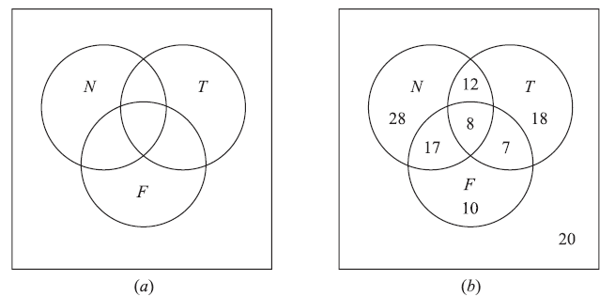
Example
In a survey of 120 people, it was found that:
65 read Newsweek magazine, 20 read both Newsweek and Time,
45 read Time, 25 read both Newsweek and Fortune,
42 read Fortune, 15 read both Time and Fortune,
8 read all three magazines.
(a) Find the number of people who read at least one of the three magazines.
(b) Fill in the correct number of people in each of the eight regions of the Venn diagram in Fig. a where N, T , and F denote the set of people who read Newsweek, Time, and Fortune, respectively.
(c) Find the number of people who read exactly one magazine.

Slide 38
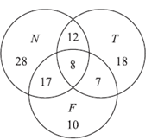
(a) We want to find n(N ∪ T ∪ F).
n(N ∪ T ∪ F)= n(N) + n(T ) + n(F ) − n(N ∩ T ) − n(N ∩ F) − n(T ∩ F) + n(N ∩ T ∩ F)
= 65 + 45 + 42 − 20 − 25 − 15 + 8 = 100
(b) The required Venn diagram in Fig. b is obtained as follows:
8 read all three magazines,
20 − 8 = 12 read Newsweek and Time but not all three magazines,
25 − 8 = 17 read Newsweek and Fortune but not all three magazines,
15 − 8 = 7 read Time and Fortune but not all three magazines,
65 − 12 − 8 − 17 = 28 read only Newsweek,
45 − 12 − 8 − 7 = 18 read only Time,
42 − 17 − 8 − 7 = 10 read only Fortune,
120 − 100 = 20 read no magazine at all.
(c) 28+ 18 + 10 = 56 read exactly one of the magazines.

