Slide 1
Chomsky Hierarchy
Grammatical formalisms can be classified by their generative capacity: the set of languages they can represent.
Noam Chomsky (1957) describes four classes of grammatical formalisms that differ only in the form of the rewrite rules.
The classes can be arranged in a hierarchy, where each class can be used to describe all the languages that can be described by a less powerful class, as well as some additional languages.
This hierarchy of grammars is known as Chomsky hierarchy.

Slide 2
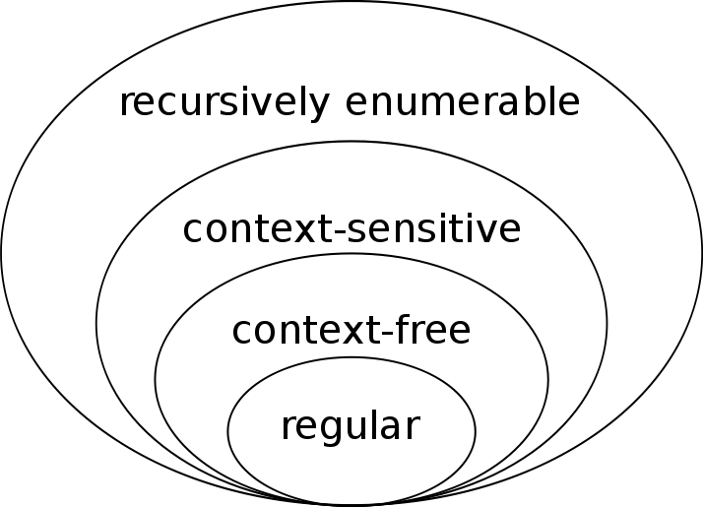
Chomsky Hierarchy

Slide 3
Chomsky Hierarchy
Type-0 grammars (recursively enumerable or unrestricted grammars) include all formal grammars.
They generate exactly all languages that can be recognized by a Turing machine.
These languages are also known as the recursively enumerable languages.

Slide 4
Chomsky Hierarchy
Type-1 grammars (context-sensitive grammars) generate the context-sensitive languages.
These grammars have rules of the form αAβ → αγβ with A a nonterminal and α, β and γ strings of terminals and nonterminals. The strings α and β may be empty, but γ must be nonempty. The rule S → ε is allowed if S does not appear on the right side of any rule.
The languages described by these grammars are exactly all languages that can be recognized by a linear-bounded Turing machine.

Slide 5
Chomsky Hierarchy
Type-2 grammars (context-free grammars) generate the context-free languages.
These are defined by rules of the form A → γ with A a nonterminal and γ a string of terminals and nonterminals.
These languages are exactly all languages that can be recognized by a pushdown automaton.
Context-free languages are the theoretical basis for the syntax of most programming languages.

Slide 6
Chomsky Hierarchy
Type-3 grammars (regular grammars) generate the regular languages.
Such a grammar restricts its rules to a single nonterminal on the left-hand side and a right-hand side consisting of a single terminal, possibly followed (or preceded, but not both in the same grammar) by a single nonterminal.
The rule S → ε is also allowed here if S does not appear on the right side of any rule.
These languages are exactly all languages that can be decided by a finite state automaton. Additionally, this family of formal languages can be obtained by regular expressions.
Regular languages are commonly used to define search patterns and the lexical structure of programming languages.

Slide 7
Chomsky Hierarchy
The following table summarizes each of Chomsky's four types of grammars, the class of language it generates, the type of automaton that recognizes it, and the form its rules must have.

Slide 8
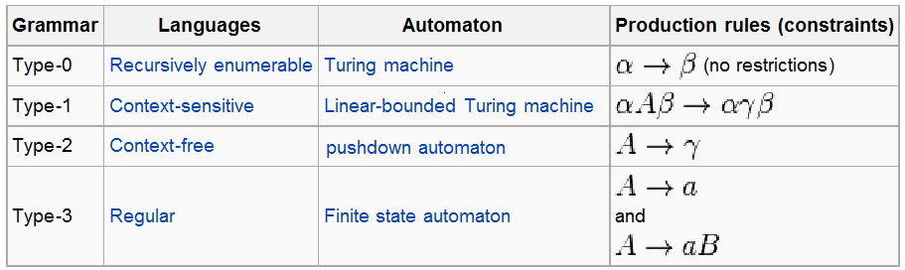
Chomsky Hierarchy

