Slide 1
CSE 401 Mathematics for Computer Science

Slide 2
Course Instructor
Name: Mahathir Monjur (MMR) Designation: Lecturer, Computer Science and Engineering,
University of Asia Pacific
E-mail: mahathir@uap-bd.edu
Contact No: 01781461842
Office: 7th floor, UAP

Slide 3
Google Classroom
Contents will be available at Google Classroom
Join Code: sgvcv7w
Please use your UAP given mail address to join

Slide 4
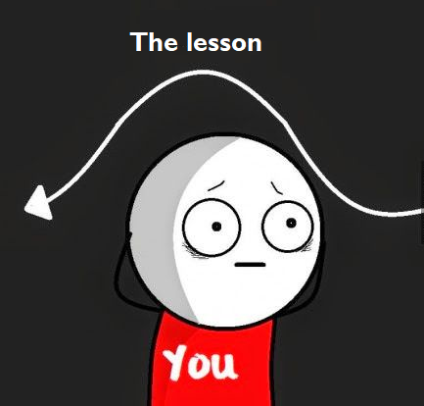
Ground Rules
Ask any topic related question during the class
Please keep your phone in silent mode during the class
This is kind of a math course, so be attentive in the class
If you miss any class/Quiz due to valid reasons, just give me an application signed by your adviser
Ask me to pause when you are feeling like this:

Slide 5
Reference Books
Concrete Mathematics: A Foundation for Computer Science by Ronald Graham, Donald Knuth, and Oren Patashnik. 2nd Edition, Addison-Wesley Professional (Available at google classroom)
Introduction to Probability Models by Seldon M. Ross, 11th Edition, Academic Press (Available at google classroom)

Slide 6
Additional Reference
The Art of Computer Programming, Volume 1 and 2 by Donald E. Knuth, Third Edition, Addison-Wesley.
Google

Slide 7
Brief Syllabus
Recurrent Problems
Manipulation of Sums
Integer functions
Number Theory
Probability
Random Variable
Conditional Probability
Markov Chain
Queuing Theory

Slide 8
Assessment Methods
Assessment Method | (%)
Quiz (Best 2 out of 3) | 10
Class attendance | 10
Assignment (Best 1 out of 2) | 10
Midterm Exam | 20
Final Exam | 50

