Slide 1
CSE 401 Mathematics for Computer Science
Course Instructor: Mahathir Monjur Lecturer, Computer Science and Engineering,
University of Asia Pacific
E-mail: mahathir@uap-bd.edu Contacct No.: +880-1781461842

Slide 2

Chapter 1: Recurrent Problems

Slide 3
Tower of Hanoi

Slide 4
Rules of Game
Only top disc can be moved
One disk can be moved at a time
Larger disk can not be placed on smaller disk
A
B
C

Slide 5
Example with n=1
Disk No. | Move
1 | A -> C
A
B
C

Slide 6
Example with n=2
A
B
C

Slide 7
Example with n=2
Disk No. | Move
1 | A -> B
A
B
C

Slide 8
Example with n=2
Disk No. | Move
1 | A -> B
2 | A -> C
A
B
C

Slide 9
Example with n=2
Disk No. | Move
1 | A -> B
2 | A -> C
1 | B ->C
A
B
C

Slide 10
Generalization
Total number of moves for 2 disks, T₂ = 3
Total number of moves for 1 disks, T₁ = 1
Total number of moves for 0 disks, T₀ = 0
...
...
...
Total number of moves for n disks, T_{n} = ?

Slide 11
Steps
Transfer (n-1) smallest disks to the auxiliary peg
Transfer the largest disk to the destination peg
Transfer (n-1) smallest disks back onto the largest disk
T_{n-1} moves
1 move
T_{n-1} moves

Slide 12
Recurrence Formula
T_{n} <= 2 * T_{n-1} + 1 ; for n > 0
T_{n} >= 2 * T_{n-1} + 1 ; for n > 0
Recurrence solution: T₀ = 0 T_{n} = 2 * T_{n-1} + 1 ; for n > 0
…………….. (1)

Slide 13
Solve of Recurrence: Guessing
T₀ = 0 = 2⁰ - 1
T₁ = 2 * T₀ + 1 = 2 * 0 + 1 = 1 = 2¹ – 1
T₂ = 2 * T₁ + 1 = 2 * 1 + 1 = 3 = 2² – 1
T₃ = 2 * T₂ + 1 = 2 * 3 + 1 = 7 = 2³ – 1
…
…
…
T_{n} = 2 * T_{n-1} + 1 = 2^{n} – 1 … … … … …(2)

Slide 14
Mathematical Proof: Induction
Trivial Basis: T₀ = 2⁰ – 1 = 0
Suppose equation (2) holds for (n-1). So, T_{n-1} = 2^{n-1} – 1 holds
Now, T_{n} = 2 * T_{n-1} + 1 = 2 * (2^{n-1} – 1) + 1 = 2^{n} – 2 + 1 = 2^{n} – 1
Hence equation (2) holds for n as well

Slide 15
Solve of Recurrence: Without Inductive Leap
Recurrence solution: T₀ = 0 T_{n} = 2 * T_{n-1} + 1 ; for n > 0 T₀ + 1 = 1 T_{n} + 1 = 2 * T_{n-1} + 2 ; for n > 0
Now, if we let, U_{n}= T_{n} + 1, then we have U₀ = 1
U_{n} = 2 * U_{n-1} ; for n > 0
U_{n} = 2^{n} ; hence T_{n} = 2^{n} - 1
…………….. (1)
…………….. (2)

Slide 16
The Josephus Problem

Slide 17
Problem Statement
n people numbered 1 to n around a circle
Eliminate every second person
Last person ALIVE!!
1
10
2
3
9
8
4
7
6
5

Slide 18
Generalization
J(10) = 5
J(10) = 10/2 = 5
J(2) = 2/2 = 1
So……………… J(n) = n/2 ??

Slide 19
Generalization
n | J(n)
1 | 1
2 | 1
3 | 3
4 | 1
5 | 3
6 | 5

Slide 20
Generalization: Even Case
J(n) is always odd
If n is an even number, we arrive at a situation similar to what we began with…..only half as many people
Suppose, we start with 2n people. After 1st iteration, we get:
1
2n - 1
3
2n - 3
5
…………………………

Slide 21
Generalization: Even Case
Same situation as starting with n people, except…
J(2n) = 2 J(n) – 1 ; for n>=1
J (20) = 2 J(10) – 1 = 2 * 5 – 1 = 10 – 1 = 9

Slide 22
Generalization: Odd Case
With (2n + 1) people, person #1 is eliminated just after person #2n
We are left with:
3
2n + 1
5
2n - 1
7
………………..
So, J (2n + 1) = 2 J(n) + 1; for n >=1

Slide 23
Generalization
J (1 ) = 1
J (2n) = 2 * J(n) – 1 ;for n >= 1
J(2n + 1) = 2 * J(n) + 1 ; for n >= 1
……………….. (3)

Slide 24
Generalization
n | J(n)
1 | 1
2 | 1
3 | 3
4 | 1
5 | 3
6 | 5
7 | 7
8 | 1
9 | 3
10 | 5
11 | 7
12 | 9
13 | 11
14 | 13
15 | 15
16 | 1

Slide 25
The Josephus Problem: Solution
J (2^{m} + p) = 2 * p + 1; for m >= 0 and 0 <= p < 2^{m}
Let, n = 2^{m} + p
So we get, J(n) = 2* p + 1; where n = 2^{m} + p
Proof???

Slide 26
Lines in the Plane

Slide 27
Problem Statement
What is the maximum number of regions (L_{n}) defined by n lines in a plane?
Start by looking at small cases-
1 1 1
2 2 3
4
L₀ = 1 L₁ = 2 L₂ = 4

Slide 28
Generalization
So, L_{n} = 2^{n} ???
What happens when we add a third line? (Orange)
1 2a 3a
4a
L₃ = 4 + 3 = 7
3b
2b
4b

Slide 29
Generalization
So how many new regions for the n^{th} line?
Number of intersection + 1
The n^{th} line will intersect the previous (n-1) line (at most)
Number of intersections = n – 1
So number of new regions = n – 1 + 1 = n
1
2
3
4
5

Slide 30
Generalization
L_{n} = L_{n-1} + n
So recursive formula:
L₀ = 1
L_{n} = n + L_{n-1}
= n + (n-1) + L_{n-2}
= n + (n-1) + (n-2) + L_{n-3}
= n + (n-1) + (n-2) + …… + 1 + L₀
= n(n+1)
2
+ 1

Slide 31
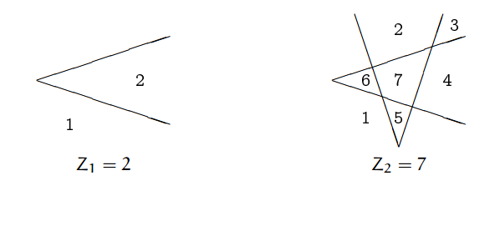
Problem Statement: Zig
What is the maximum number of regions (Z_{n}) defined by n bent lines (zig) in a plane?
Start by looking at small cases-

Slide 32
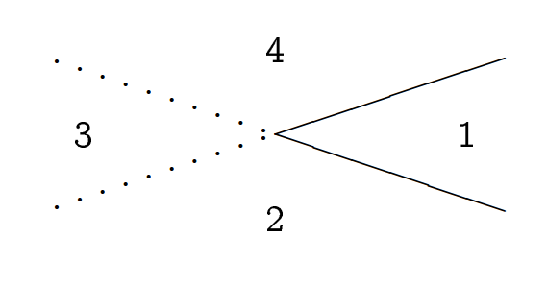
Generalization
Z_{n} = L_{2n} – 2n
How??

Slide 33
Approximation
Z_{n} = L_{2n} – 2n
= 2n² – n + 1
2n²
L_{n} n² / 2

Slide 34
Assignment
Find out the maximum number of regions (ZZ_{n}) defined by n Zig-zag lines in a plane?
ZZ₂ = 12

