Slide 1
Merge Sort
October 29, 2019

Slide 2
Merge Sort and Divide & Conquer Technique
Divide step is trivial – just split the list into two equal parts
Work is carried out in the conquer step by merging two sorted lists

Slide 3
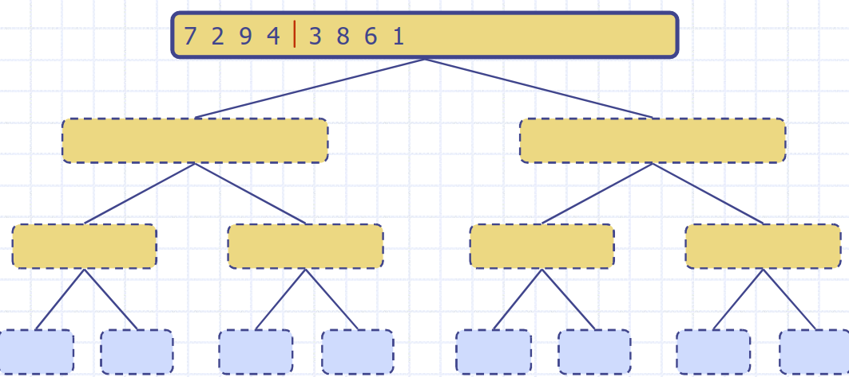
Merge Sort: Example

Slide 4
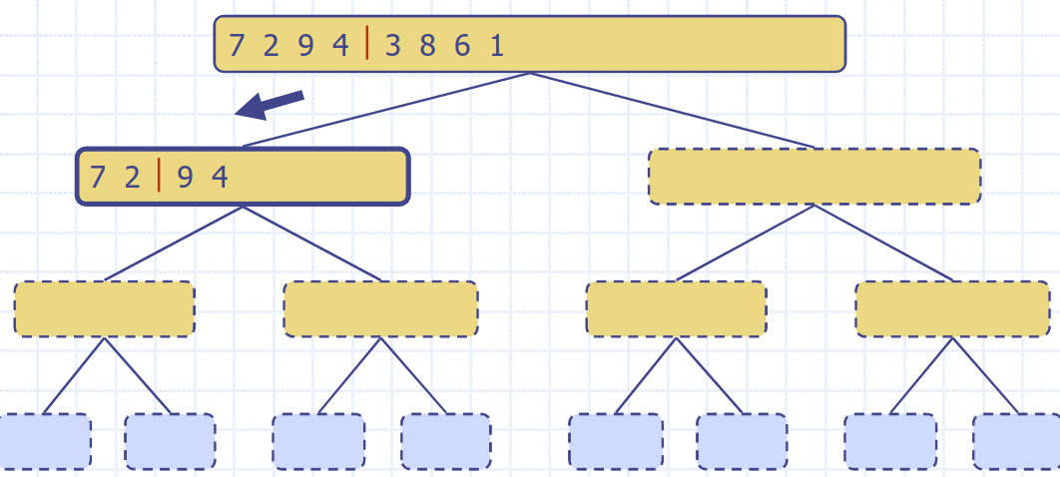
Merge Sort: Example

Slide 5
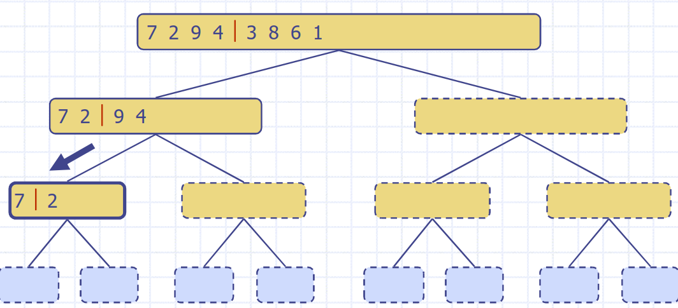
Merge Sort: Example

Slide 6
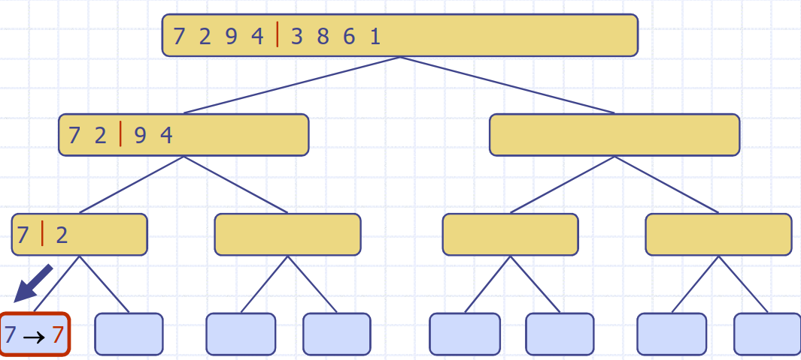
Merge Sort: Example

Slide 7
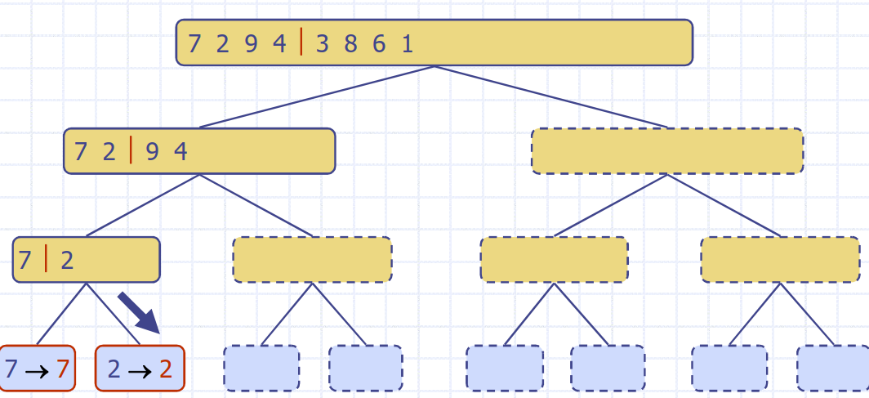
Merge Sort: Example

Slide 8
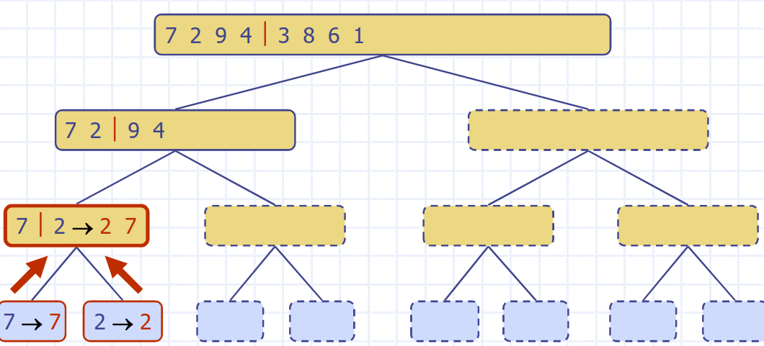
Merge Sort: Example

Slide 9
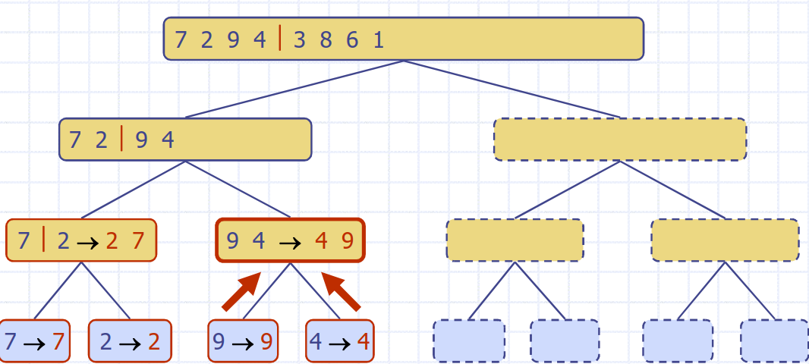
Merge Sort: Example

Slide 10
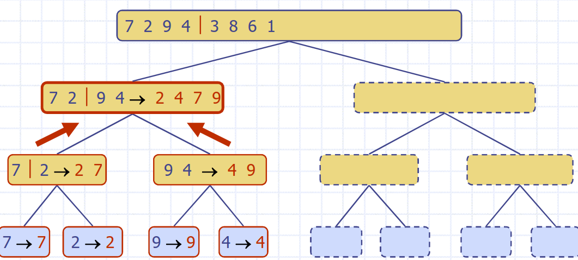
Merge Sort: Example

Slide 11
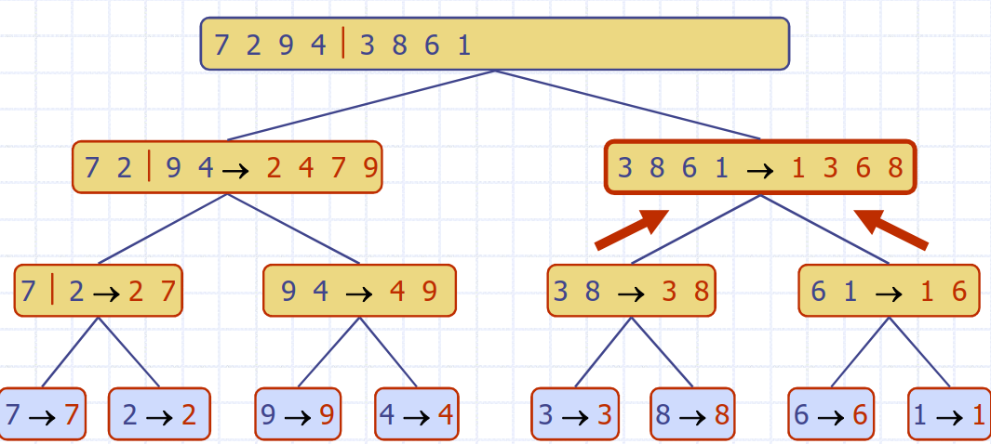
Merge Sort: Example

Slide 12
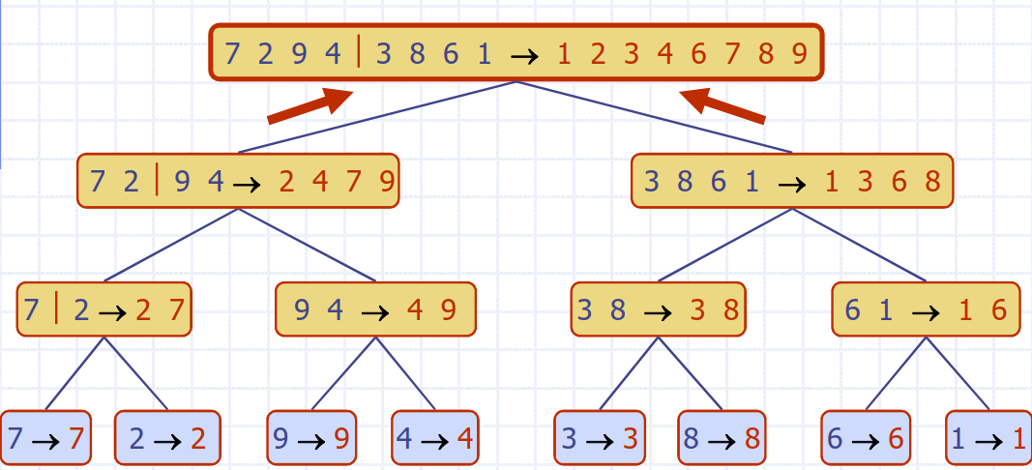
Merge Sort: Example

Slide 13
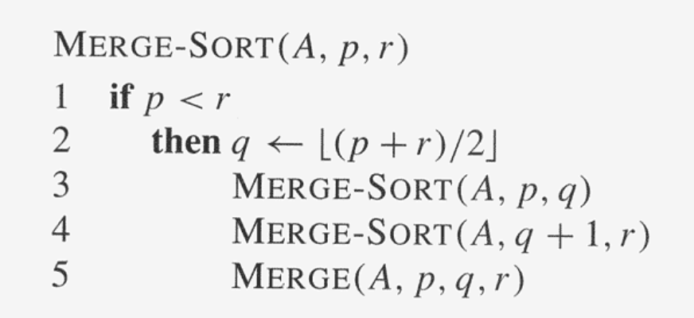
Merge Sort: Algorithm

Slide 14
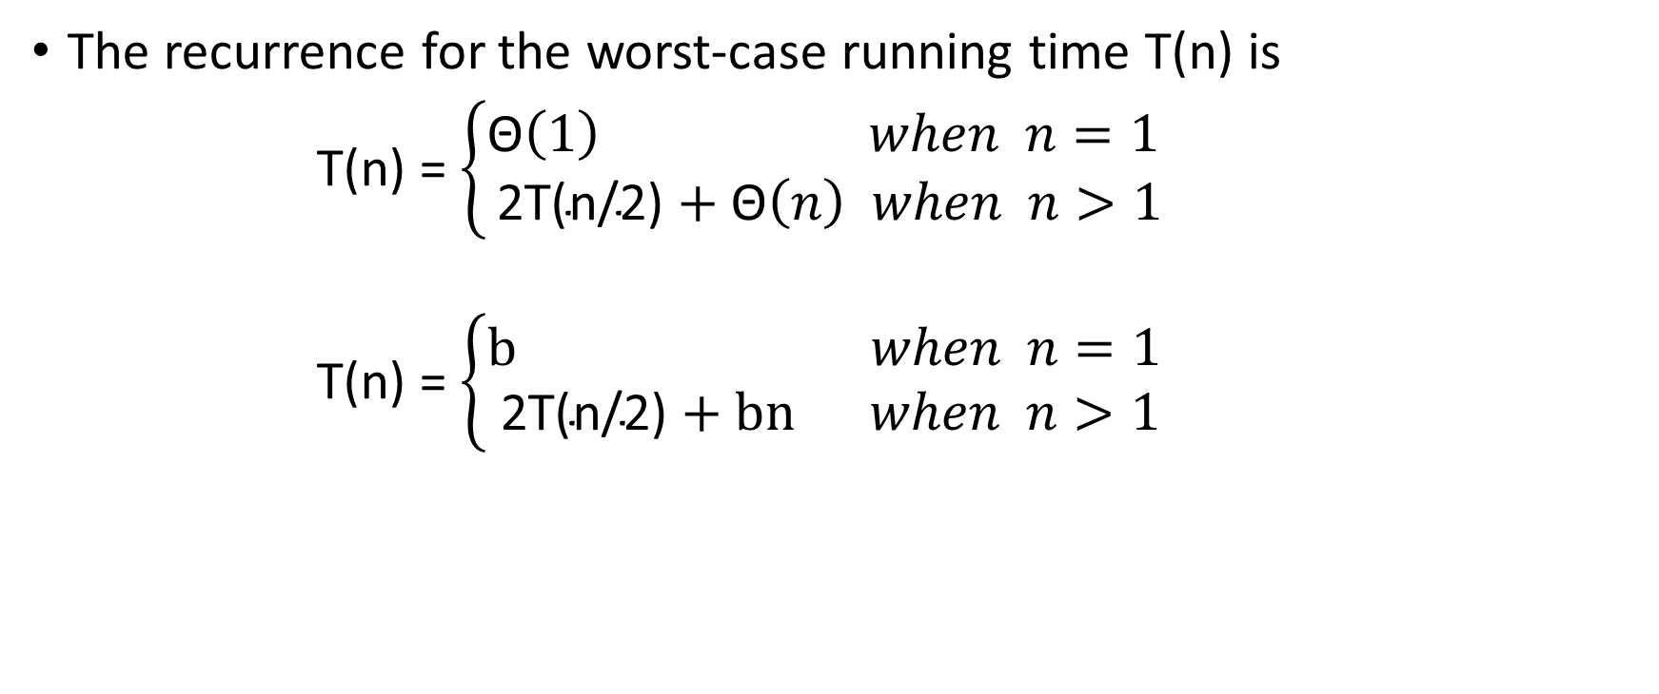
Merge Sort: Running Time
The recurrence for the worst-case running time T(n) is
T(n) = $\left\{\begin{aligned}\text{Θ}\left(1\right) when n=1 \\ \text{2}\text{T}\text{(}\text{n}\text{/2)}+\text{Θ}\left(n\right) when n>1\end{aligned}\right.$
T(n) = $\left\{\begin{aligned}\text{b} when n=1 \\ \text{2}\text{T}\text{(}\text{n}\text{/2)}+\text{bn} when n>1\end{aligned}\right.$

Slide 15

Merge Sort: Running Time (Iterative Expansion)
T(n) = $\text{2}\text{T}\text{(}\text{n}\text{/2)}+\text{bn}$
= $\text{2(2}\text{T}\text{(}\text{n}\text{/}2^{2}\text{)+}\text{b}\text{(}\text{n}\text{/2))}+\text{bn}$
=${ 2}^{2}\text{T}\text{(}\text{n}\text{/}2^{2}\text{)+2}\text{bn}$
=${ 2}^{3}\text{T}\text{(}\text{n}\text{/}2^{3}\text{)+3}\text{bn}$
= …….
=${ 2}^{i}\text{T}\text{(}\text{n}\text{/}2^{i}\text{)+}\text{i}\text{bn}$
Let, ${ 2}^{i}$=n and i = log(n)
T(n) = bn + bnlog(n)
Therefore, T(n) is O(nlogn)

Slide 16
Thank You

