Slide 1
Introduction to OOP using Java
Tanjina Helaly

Slide 2
What is Programming
Instruction to computer/device to perform task.
Computer understands only 0 and 1. Nothing else.
So, we need to send the instruction in the form of 0, 1
Do you write program with just 0 and 1?

Slide 3
Classification/Evolution Of Programming
Machine level programming
Send instruction in binary format
Assembly Programming
send code instead of binary code.
Need assembler to convert to binary
High level programming
Code is close to English Language
Need Compiler to convert to binary
3 types
Non structured
Structured/Procedural
Object Oriented Programming

Slide 4
Classification/Evolution Of Programming
Non structured
Generate spaghetti code
Sequential and has GoTo
COBOL, BASIC, FORTRAN
Structured/Procedural
Use Subroutine/Function
improving the clarity, quality, and development time
C, PASCAL
Object Oriented Programming
Object-oriented programming (OOP) is a programming language model organized around objects rather than "actions" and data rather than logic.
Historically, a program has been viewed as a logical procedure that takes input data, processes it, and produces output data.
Java, C++, C#

Slide 5
Programming Language
A programming language is a formal constructed language designed to communicate instructions to a machine, particularly a computer.

Slide 6
Platform
Programming languages can be platform dependent or independent.
What is platform?
Platform means the different types of computer that we use. For example :
Windows
Mac (Apple)
Linux
C, C++, Java, Python works on all these platforms
C# works only on Windows
Objective C programs works only on Mac

Slide 7
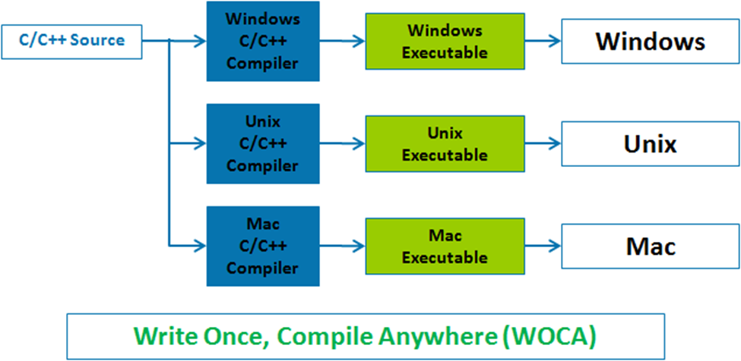
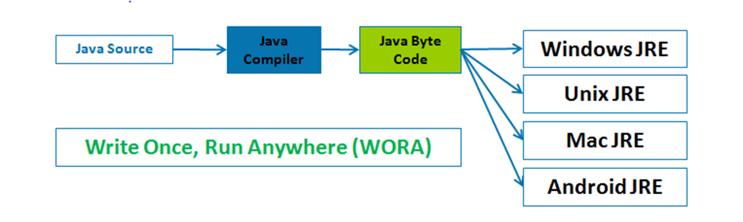
Regular Programming Languages vs. Java
Regular Programming Languages
Java

Slide 8
Our Goal Learn Object Oriented Programming using Java

Slide 9
What is Java
A simple, object-oriented, distributed, interpreted, robust, secure, architecture neutral, portable, high-performance, multithreaded, and dynamic language!
Originally , it was targeted for digital cable television to make it interactive.
Worked fabulous for Internet.
Now it is everywhere.

Slide 10
Java’s Lineage
Java is related to C++, which is a direct descendent of C.
Much of the character of Java is inherited from these two languages.
From C, Java derives its syntax.
Many of Java’s object-oriented features were influenced by C++.

Slide 11
Java - Characteristics
Uses C/C++ basic syntax and basic data types -int, char, float, double, long, short, byte etc.
Uses standard C/C++ control structures
“Pure” OO language
No stand alone functions -All code is part of a class
No explicit pointers - uses references
Uses garbage collection
Java is strongly typed
Java is normally compiled to a bytecode.
Java bytecode is a machine language for an abstract machine
Makes Java secure and Portable
Each platform (or browser) that runs Java has a Java Virtual Machine (JVM) . The JVM executes Java bytecodes

Slide 12
Java – The Platform
Java has a large API (application programming interface) covering a wide range of areas .
Java Foundation Classes (JFC) – GUI
JDBC Database Access
Java Web Server
JavaBean
EmbeddedJava - Java on embedded devices
Notes:
A software platform that encompasses all the necessary components, applicationprogramming interfaces and libraries required by programmers and developers to author, compile, debug and execute language-specific applications. Programming platforms are typically accompanied with development tools that enable effortless application development.

Slide 13
Why Java
Platform Independent - Code once run anywhere
Byte code
Easy to learn
Secure
Byte code & VM
Free

Slide 14
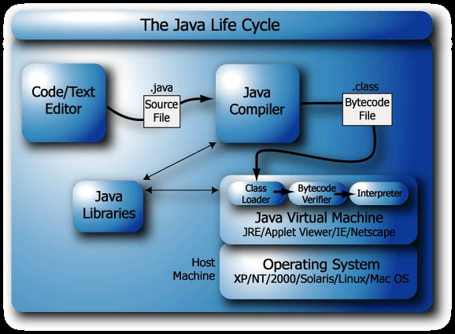
Java Life Cycle

Slide 15
Byte Code
Java bytecode is the instruction set of the Java virtual machine.

Slide 16
JVM
JVM (Java Virtual Machine) is an abstract machine. It is a specification that provides runtime environment in which java bytecode can be executed.
JVMs are available for many hardware and software platforms. JVM, JRE and JDK are platform dependent because configuration of each OS differs. But, Java is platform independent.
The JVM performs following main tasks:
Loads code
Verifies code
Executes code
Provides runtime environment

Slide 17
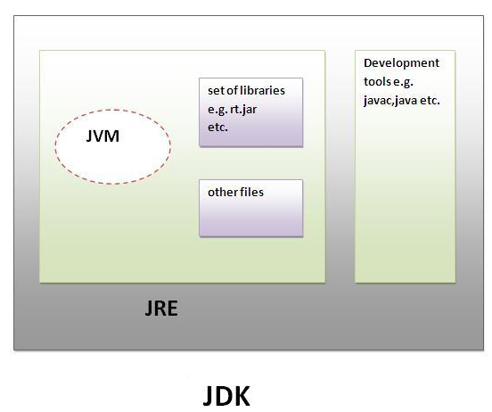
JRE and JDK
JRE:
JRE is an acronym for Java Runtime Environment.
It is used to provide runtime environment.
It is the implementation of JVM.
It physically exists. It contains set of libraries + other files that JVM uses at runtime.
JDK
JDK is an acronym for Java Development Kit.
It physically exists.
It contains JRE + development tools

Slide 18
Java Editions
Java Standard Edition:
used for developing desktop applications and networking applications
Java Enterprise Edition
used for developing large scale, distributed networking applications and web-based applications
Java Micro Edition
used for developing applications for resource-constrained embedded devices

Slide 19
Compile & Run Java Application

Slide 20
Without IDE
Using JDK you can compile and run java program from command line.
c:> javac HelloWorld. Java
compiling here and
it will produce HelloWorld.class i.e. bytecode.
c:>java HelloWorld
It runs java byte code on native machine

Slide 21
JAVA IDE
Creating, Compiling, Debugging and Execution for these four steps JDK is not user friendly. IDE is provided for that. A list of IDEs are:
Eclipse
Netbeans.
IntelliJ IDEA
In most of the IDE, the file will be compiled as soon as we update the file.
Each IDE has menu, button and shortcut to run the application.

Slide 22
An Example HelloWorld
public class HelloWorldExample
{
public static void main( String args[] )
{
System.out.println("Hello World");
}
}

Slide 23
Java Source Code Naming Conventions
All java source file should end with .java
Each .java file can contain only one public class
The name of the file should be the name of the public class plus ".java"
Do not use abbreviations in the name of the class
If the class name contains multiple words then capitalize the first letter of each word ex. HelloWorld.java

Slide 24
Naming Convention
Class Naming
Uses Capitalized word(s) i.e. Title case
Examples:- HelloWorld, MyList, StudentMark
Variable and method names
starts with a lowercase letter and after that use Title case
Examples:- variableAndMethodNames, aFloat, studentName
Names of constants
All are capital letters and separated by underscore.
Example: NAMES_OF_CONSTANTS

Slide 25
Java Identifiers Rules
Identifier is a name given to a variable, class, or method.
Java identifier rules
Can contain letter, number, underscore ( ), or dollar sign ($).
Cannot start with number. [Ex. 211csi (compile error)]
Identifiers are case sensitive. [test and Test are 2 different identifier]
have no maximum length.
cannot be a keyword, but it can contain a keyword as part of its name. [public- wrong but publicVar - OK]

