Slide 1
CLASS & OBJECT
Tanjina Helaly

Slide 2
CONTENT
Class & Object.
Initializing Fields/Instance variables.
Scope & Lifetime of Variable.
Arrays
Parameter Passing
Garbage Collection
Package
Access Modifier
Recursion
Variable Argument - vararg

Slide 3
TWO PARADIGMS IN OOP
All computer programs consist of two elements:
  code and data.
A program can be conceptually organized around its code or around its data.
That is, some programs are written around “what is happening” and others are written around “who is being affected.”
These are the two paradigms that govern how an OOP program is constructed.
In Procedural language data and operation/code are separate
Example (using C)
  Student – 4 fields: name, id, cgpa, creditCompleted
  Update cgpa – need a function to calculate the new cgpa

Slide 4
CLASS & OBJECT
Object
  An object is a software bundle of related state and behavior.
  Software objects are often used to model the real-world objects that you find in everyday life.
Class
  A class is a blueprint or prototype from which objects are created.
  It defines what should be in each object and how each object should behave.

Slide 5
WHAT IS CLASS
the class is the basis for object-oriented programming in Java.
it defines a new data type.
Once defined, this new type can be used to create objects of that type.
  Thus, a class is a template for an object,
  and an object is an instance of a class.
  Because an object is an instance of a class, you will often see the two words object and instance used interchangeably

Slide 6
CLASS MEMBERS
Class contains the following 2 members
  instance variables(fields/properties/attributes)
    each instance of the class (that is, each object of the class) contains its own copy of these variables.
    Thus, the data for one object is separate and unique from the data for another.
  Methods(action/behavior)
    The code is contained within methods
    In most classes, the instance variables are acted upon and accessed by the methods defined for that class.
    Thus, as a general rule, it is the methods that determine how a class’ data can be used.

Slide 7
THE GENERAL FORM OF A CLASS
class classname {
  datatype instance-variable1;
  datatype instance-variable2;
  // ...
  datatype instance-variableN;
  retyrntype methodname1(parameter-list) {
  // body of method
  }
  returntype methodname2(parameter-list) {
  // body of method
  }
  // ...
  returntype methodnameN(parameter-list) {
  // body of method
  }
}

Slide 8
A SIMPLE CLASS
public class BankAccount {
  // Instance variables
  public String name;
  public String id;
  public double balance;
  // Methods
  public void deposit(double amount){
  balance = balance + amount;
  }
  public void withdraw(double amount){
  if (amount<balance)
  balance -= amount;
  }
}

Slide 9
CREATE OBJECT AND ACCESS MEMBERS
Creating objects – use new keyword
  ClassName refVariable = new ClassName(parameter-list);
To access instance variables and methods - use dot operator(.)
  Accessing instance variables
    refVariable.instance_variable = value;
    Or
    datatype value = refVariable.instance_variable;
  Calling methods
    refVariable.methodName(parameter-list);

Slide 10
CREATE OBJECT AND ACCESS MEMBERS
public class TestBankAccount {
  public static void main(String[] args) {
    // Creating objects
    BankAccount account = new BankAccount();
    // Assigning values to instance variables
    account.name = "Rashid";
    account.id = “1000500”;
    account.balance = 1000;
    // Print balance
    System.out.println(“Balance before deposit: " + account.balance);
    // Calling methods
    account.deposit(2000);
    // Print balance
    System.out.println(“Balance after deposit: " + account.balance);
  }
}
Output:
Balance before deposit: 1000.0
Balance after deposit: 3000.0

Slide 11
CREATE OBJECT AND ACCESS MEMBERS
public class TestBankAccount {
  public static void main(String[] args) {
    // Creating objects
    BankAccount account = new BankAccount();
    // Assigning values to instance variables
    account.name = "Rashid";
    account.id = “1000500”;
    account.balance = 1000;
    // Print balance
    System.out.println(“Balance before deposit: " + account.balance);
    // Calling methods
    account.deposit(2000);
    // Print balance
    System.out.println(“Balance after deposit: " + account.balance);
  }
}
Output:
Balance before deposit: 1000.0
Balance after deposit: 3000.0
Use “new” keyword to create object
Use “dot operator” (.) to access attributes and methods.

Slide 12
REFERENCE VARIABLE
BankAccount account;
account = new BankAccount();
account.name = “Rashid”;
account.id = “1000500”;
account.balance = 1000;
account
name = null
id = null
balance = 0.0
account
reference
name = Rashid
id = 1000500
balance = 1000
account
reference

Slide 13
CREATE OBJECT AND ACCESS MEMBERS
public class TestBankAccount {
  public static void main(String[] args) {
    // Creating objects
    BankAccount accountR = new BankAccount();
    BankAccount accountK = new BankAccount();
    // Assigning values to instance variables
    accountR.name = "Rashid";
    accountR.balance = 1000;
    accountK.name = "Kashem";
    accountK.balance = 1000;
    // Calling methods
    accountK.deposit(2000);
    // Print balance of both account
    System.out.println("Kashem's balance: " + accountK.balance);
    System.out.println("Rashid's balance: " + accountR.balance);
  }
}
Output:
  Kashem's balance: 3000.0
  Rashid's balance: 1000.0

Slide 14
REFERENCE VARIABLE
Before deposit
After deposit:
name = Rashid
id = null
balance = 1000.0
accountR
reference
name = Kashem
id = null
balance = 1000.0
accountK
reference
name = Rashid
id = null
balance = 1000.0
accountR
reference
name = Kashem
id = null
balance = 3000.0
accountK
reference

Slide 15
INITIALIZING FIELDS/INSTANCE VARIABLES

Slide 16
INITIALIZING FIELDS
There are three ways in Java to give a field an initial value:
  Direct Assignment
  Instance Initialization Block
  Constructors

Slide 17
1.DIRECT ASSIGNMENT
public class BankAccount {
  // Instance variables
  public String name;
  public String id;
  public double balance = 100.0; // direct assignment
  // Methods
  public void deposit(double amount){
  balance = balance + amount;
  }
  public void withdraw(double amount){
  if (amount<balance)
  balance -= amount;
  }
}

Slide 18
2.INSTANCE INITIALIZATION BLOCK
Instance initialization blocks are indicated by blocks of code inside the class, but outside any method.
Whenever an object is created from a class the code in each instance initialization block is executed.
If there is more than one instance initialization block they are executed in order, from top to bottom of the class.
Use initialization blocks when the initialization cannot be done in a simple assignment and needs no extra input parameters.
Direct assignment and constructors are used far more often than initialization blocks.

Slide 19
2.INSTANCE INITIALIZATION BLOCK
public class BankAccount {
  // Instance variables
  public String name;
  public String id;
  public double balance;
  // Methods
  public void deposit(double amount){
  balance = balance + amount;
  }
  public void withdraw(double amount){
  if (amount<balance)
  balance -= amount;
  }
  { // Instance Initialization Block
    id = new Random().nextInt(99999) + "";
    balance = 100.0;
  }
}

Slide 20
3.CONSTRUCTOR
A constructor
  Allocate space for instance variables.
  initializes an object(its instance variables) immediately upon creation.
Syntax:
  It has the same name as the class.
  syntactically similar to a method.
    Except has no return type. Not even void.
      This is because the implicit return type of a class’ constructor is the class type itself.

Slide 21
3.CONSTRUCTOR
When called:
  No explicit call
  It is automatically called when the object is created, before the new operator completes.
What should go inside Constructor
  Normally the instance variables are initialized inside the constructor.
  Or
  any set-up code

Slide 22
3.CONSTRUCTOR - EXAMPLE
import java.util.Random;
public class BankAccount {
  // Instance variables
  public String name;
  public String id;
  public double balance;
  // Constructor without parameter
  public BankAccount(){
  id = new Random().nextInt(99999) + "";
  // name and balance will get default value
  }
  // Constructor with parameter
  public BankAccount(String _name, String _id, double _balance){
    name = _name;
    id = _id;
    balance = _balance;
  }
  public static void main(String[] args)
  {
  BankAccount ba = new BankAccount(“Rashid”, “1000500”, 1000.0);
  }
}

Slide 23
3.DEFAULT CONSTRUCTOR
When you do not explicitly define a constructor for a class,
  then Java creates a default constructor for the class.
  This is why the first BankAccount class code worked even though that did not define a constructor.
The default constructor automatically initializes all instance variables to their default values,
  Default value
    Boolean -> false;
    All primitive except boolean -> 0 (zero)
    Reference type -> null
Once you define your own constructor, the default constructor is no longer used.

Slide 24
“THIS”KEYWORD
refer to the current object.
That is, this is always a reference to the object on which the method was invoked.
You can use this anywhere a reference to an object of the current class’ type is permitted.

Slide 25
CONSTRUCTOR - EXAMPLE
import java.util.Random;
public class BankAccount {
  // Instance variables
  public String name;
  public String id;
  public double balance;
  // Constructor without parameter
  public BankAccount(){
  id = new Random().nextInt(99999) + "";
  // name and balance will get default value
  }
  // Constructor with parameter
  public BankAccount(String _name, String _id, double _balance){
    name = _name;
    id = _id;
    balance = _balance;
  }
  public static void main(String[] args)
  {
  BankAccount ba = new BankAccount(“Rashid”, “1000500”, 1000.0);
  }
}

Slide 26
CONSTRUCTOR - EXAMPLE
import java.util.Random;
public class BankAccount {
  // Instance variables
  public String name;
  public String id;
  public double balance;
  // Constructor without parameter
  public BankAccount(){
  id = new Random().nextInt(99999) + "";
  // name and balance will get default value
  }
  // Constructor with parameter
  public BankAccount(String name, String id, double balance){
    name = name;
    id = id;
    balance = balance;
  }
  public static void main(String[] args)
  {
  BankAccount ba = new BankAccount(“Rashid”, “1000500”, 1000.0);
  }
}

Slide 27
CONSTRUCTOR - EXAMPLE
import java.util.Random;
public class BankAccount {
  // Instance variables
  public String name;
  public String id;
  public double balance;
  // Constructor without parameter
  public BankAccount(){
  id = new Random().nextInt(99999) + "";
  // name and balance will get default value
  }
  // Constructor with parameter
  public BankAccount(String name, String id, double balance){
    name = name;
    id = id;
    balance = balance;
  }
  public static void main(String[] args)
  {
  BankAccount ba = new BankAccount(“Rashid”, “1000500”, 1000.0);
  }
}
Variable on left is the same as right
What are we doing here
Which variables we are referring to

Slide 28
CONSTRUCTOR - EXAMPLE
import java.util.Random;
public class BankAccount {
  // Instance variables
  public String name;
  public String id;
  public double balance;
  // Constructor without parameter
  public BankAccount(){
  id = new Random().nextInt(99999) + "";
  // name and balance will get default value
  }
  // Constructor with parameter
  public BankAccount(String name, String id, double balance){
    this.name = name;
    this.id = id;
    this.balance = balance;
  }
  public static void main(String[] args)
  {
  BankAccount ba = new BankAccount(“Rashid”, “1000500”, 1000.0);
  }
}

Slide 29
SCOPE & LIFETIME OF VARIABLES

Slide 30
SCOPE OF VARIABLE
What is scope?
  A scope determines what variable are visible to other parts of your program. Or where the variable is accessible?
  It also determines the lifetime of those variable.
A block defines a scope.
  the statements between opening and closing curly braces.
As a general rule, variables declared inside a scope are not visible (that is, accessible) to code that is defined outside that scope.
Within a block, variables can be declared at any point, but are valid only after they are declared.
  Thus, if you define a variable at the start of a method, it is available to all of the code within that method.
  Conversely, if you declare a variable at the end of a block, it is effectively useless, because no code will have access to it.

Slide 31
SCOPE OF VARIABLE - EXAMPLE
public void calculateInterest(double balance)
{
  if(balance > 10000)
  {
  float interest = 0.05f; // Scope of this variable is only inside the if block
  }
  else
  {
  interest = 0.02f; // compiler error. interest is declared inside the if block, hence can't access in else block
  }
}
To make “interest” accessible to both if and else block it has to be declared outside of the block.

Slide 32
SCOPE OF VARIABLE - EXAMPLE
public void calculateInterest(double balance)
{
  float interest; // accessible to anywhere inside the method.
  if(balance > 10000)
  {
  interest = 0.05f; // Ok
  }
  else
  {
  interest = 0.02f; // OK
  }
}

Slide 33
SCOPE OF VARIABLE
Many other computer languages define two general categories of scopes:
  global and local.
However, these traditional scopes do not fit well with Java’s strict, object-oriented model.
In Java, the two major scopes are
  those defined by a class and
  those defined by a method.

Slide 34
WHEN CAN 2 VARIABLES HAVE SAME NAME
Instance variable and Local variable.
Local variable in 2 different methods.
2 Local variables in the same methods but only after the death of one Local variable.
OK | Wrong
public void calculateInterest(double balance) { if(balance > 10000){ float interest = 0.05f; // OK } else { float interest = 0.02f; // OK } } | public void calculateInterest(double balance) { float interest; if(balance > 10000){ float interest = 0.05f; // Compiler error } else { interest = 0.02f; // OK } }

Slide 35
ARRAYS

Slide 36
ARRAY AGAIN
What is the “new” keyword during array creation.
Is Array variable reference type?
      int[] sampleArray = new int[10];

Slide 37
ARRAY AGAIN
What is the “new” keyword during array creation.
Is Array variable reference type?
      int[] sampleArray = new int[10];
0
0
0
0
0
0
0
0
0
0
0
1
simpleArray
reference
8
9

Slide 38
ARRAY AGAIN
When an array is created, each element will be initialized to its default value.
What is the initial value for each of the element of the arrays below.
  int[] sampleArray = new int[10];
  Student[] students = new Student[10];

Slide 39
REFERENCE TYPE WITH NOT NULL
Student student = new Student(“Rashid”, “011153001”, 3.0f, 50);
What value will you get when you access the following attributes of student reference variable/object.
  student.name
  student.id
  student.cgpa
  student.creditCompleted
name = Rashid
id = 011153001
cgpa= 3.0f
creaditCompleted = 50
student
reference

Slide 40
REFERENCE TYPE WITH NULL
Student student = null;
What value will you get when you access the following attributes of student reference variable/object.
  student.name
  student.id
  student.cgpa
  student.creditCompleted
student
null

Slide 41
REFERENCE TYPE WITH NULL
We cant access any member via the reference variable when no object is created.
Accessing the member will throw NullPointerException.

Slide 42
REFERENCE TYPE ARRAY
Example
  Student[] students = new Student[3];
  System.out.println(students[0].cgpa); // What would be the output of this line.
null
null
null
students
reference

Slide 43
REFERENCE TYPE ARRAY
Need to initialize the element before accessing.
Example
  Student[] students = new Student[3];
  students[0] = new Student(“Rashid”, “011153001”, 3.0f, 50);
  students[1] = new Student(“Zaman”, “011153021”, 3.0f, 50);
  students[2] = new Student(“Lubna”, “011153031”, 3.5f, 50);
  System.out.println(students[0].cgpa); // What would be the output of this line.
name = Rashid
id = 011153001
cgpa= 3.0f
creaditCompleted = 50
Ref
Ref
Ref
name = Zaman
id = 011153021
cgpa= 3.0f
creaditCompleted = 50
students
reference
name = Lubna
id = 011153031
cgpa= 3.5f
creaditCompleted = 50

Slide 44
PARAMETER PASSING

Slide 45
PARAMETER PASSING
2 different ways
  Pass By Value
  Pass By Reference
In Java all parameters are passed by value

Slide 46
PASS BY REFERENCE – NOT APPLICABLE FOR JAVA
Send the location of the parameter.
Original value chage
C, C++, php
  main() {
  int i = 10, j = 20;
  cout << i << " " << j << endl;
  swapThemByRef(i, j);
  cout << i << " " << j << endl; // displays 20 10 ...
  }
  void swapThemByRef(int& num1, int& num2) {
  int temp = num1;
  num1 = num2;
  num2 = temp;
  }
Output:
  10 20
  20 10

Slide 47
PASS BY REFERENCE
At the beginning of function call
After the function execution.
i
10
20
j
num1
num2
temp
i
20
10
j
num1
num2
10
temp

Slide 48
PASS BY VALUE
Send a copy of the original parameter.
Original value does not change
Example:
  main() {
  int i = 10, j = 20;
  cout << i << " " << j << endl;
  swapThemByVal(i, j);
  cout << i << " " << j << endl; // displays 20 10 ...
  }
  void swapThemByVal(int num1, int num2) {
  int temp = num1;
  num1 = num2;
  num2 = temp;
  }
Output:
  10 20
  10 20

Slide 49
PASS BY VALUE
At the beginning of method call
After the method execution.
i
10
20
j
num1
10
20
num2
temp
i
10
20
j
num1
20
10
num2
10
temp

Slide 50
PASS BY VALUE
Java Example:
  public class PassByValue {
    public static void main(String[] args) {
      int a=10, b=20;
      System.out.printf("a-%d:b-%d\n", a, b);
      swapThemByVal(a, b);
      System.out.printf("a-%d:b-%d\n", a, b);
    }
    static void swapThemByVal(int num1, int num2) {
    int temp = num1;
    num1 = num2;
    num2 = temp;
    }
  }
Output:
  a-10:b-20
  a-10:b-20

Slide 51
PASS BY VALUE
At the beginning of method call
After the method execution.
i
10
20
j
num1
10
20
num2
temp
i
10
20
j
num1
20
10
num2
10
temp

Slide 52
PASS BY VALUE – WITH OBJECT
When an object is passed to a method, the situation changes dramatically,
Java will pass by value but the effect will be like pass-by-reference.
Why?
  When we create a variable of a class type, it will store the reference to an object.
  Thus, when the value of the variable will be passed to a method, it will pass the reference of the same object.
  This effectively means that objects act as if they are passed to methods by use of pass-by-reference.
  Changes to the object inside the method do affect the object used as an argument.

Slide 53
PASS BY VALUE – WITH OBJECT
public class Test{
  String testName;
  float score;
  Test(String n, float s){
    testName = n;
    score = s;
  }
  void display(){
  System.out.printf("TestName: %s ; Score: %.2f\n", testName, score);
  }
}

Slide 54
PASS BY VALUE – WITH OBJECT
public class PassByValue {
  public static void main(String[] args) {
    Test t = new Test("CT1", 10);
    t.display();
    updateScore(t, 15.0f);
    System.out.println("After Update:");
    t.display();
  }
  static void updateScore(Test test, float newScore) {
  test.score = newScore;
  }
}
Output:
  TestName: CT1 ; Score: 10.00
  After Update:
  TestName: CT1 ; Score: 15.00

Slide 55
PASS BY VALUE – WITH OBJECT
t
Object
Before the method call
At the beginning of method call
  Both “t” and “test” are referring to the same object.
  Updating the object using any variable will be reflected in the other one.
Just at the end of method execution – before exiting the method
reference
testName= “CT1”
score = 10.0f;
t
reference
testName= “CT1”
score = 10.0f;
test
reference
t
reference
testName= “CT1”
score = 15.0f;
test
reference

Slide 56
GARBAGE COLLECTION

Slide 57
GARBAGE COLLECTION
when no references to an object exist, that object is assumed to be no longer needed, and the memory occupied by the object can be reclaimed.
Garbage collection only occurs sporadically (if at all) during the execution of your program.
Different Java run-time implementations will take varying approaches to garbage collection,
but for the most part, you should not have to think about it while writing your programs.

Slide 58
GARBAGE COLLECTION – SCENARIO#1
BankAccount accountR = new BankAccount(“Rashid”, “1000500” , 1000.0);
BankAccount accountK = new BankAccount((“Kashem”, “1000501” , 10000.0);
Heap
Stack
name = Rashid
id = 1000500
balance = 1000.0
accountR
reference
name = Kashem
id = 1000501
balance = 10000.0
accountK
reference

Slide 59
GARBAGE COLLECTION – SCENARIO#1
BankAccount accountR = new BankAccount(“Rashid”, “1000500” , 1000.0);
BankAccount accountK = new BankAccount((“Kashem”, “1000501” , 10000.0);
accountR = accountK;
// Rashid’s object can no longer be accessed and is eligible for garbage collection
Heap
Stack
name = Rashid
id = 1000500
balance = 1000.0
accountR
reference
name = Kashem
id = 1000501
balance = 10000.0
accountK
reference

Slide 60
GARBAGE COLLECTION – SCENARIO#2
BankAccount accountR = new BankAccount(“Rashid”, “1000500” , 1000.0);
BankAccount accountK = new BankAccount((“Kashem”, “1000501” , 10000.0);
Heap
Stack
name = Rashid
id = 1000500
balance = 1000.0
accountR
reference
name = Kashem
id = 1000501
balance = 10000.0
accountK
reference

Slide 61
GARBAGE COLLECTION – SCENARIO#2
BankAccount accountR = new BankAccount(“Rashid”, “1000500” , 1000.0);
BankAccount accountK = new BankAccount((“Kashem”, “1000501” , 10000.0);
accountR = null;
// Rashid’s object can no longer be accessed and is eligible for garbage collection
Heap
Stack
name = Rashid
id = 1000500
balance = 1000.0
accountR
null
name = Kashem
id = 1000501
balance = 10000.0
accountK
reference

Slide 62
GARBAGE COLLECTION – SCENARIO#3
public class TestMain{
  public static void main(String[] args) {
    updateScore(new Test("CT1", 10), 15.0f);
  }
  static void updateScore(Test test, float newScore) {
  test.score = newScore;
  }
}
public class Test{
  String testName;
  float score;
  Test(String n, float s){
    testName = n;
    score = s;
  }
}

Slide 63
GARBAGE COLLECTION – SCENARIO#3
At the beginning of method call
After exiting the method.
  “test” variable will no longer be available.
  The Test object can no longer be accessed and is eligible for garbage collection
test
testName= “CT1”
score = 10.0f;
Heap
reference
testName= “CT1”
score = 15.0f;
Heap

Slide 64
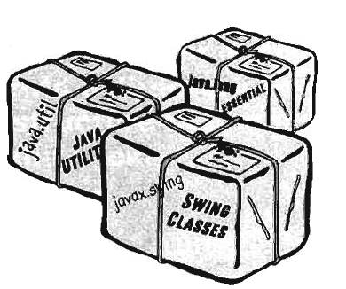
PACKAGE

Slide 65
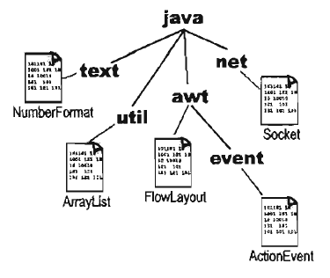
WHAT IS PACKAGE?
Packages are used to group related classes.
A package is a namespace that organizes a set of related classes and interfaces.
Conceptually you can think of packages as being similar to different folders on your computer.

Slide 66
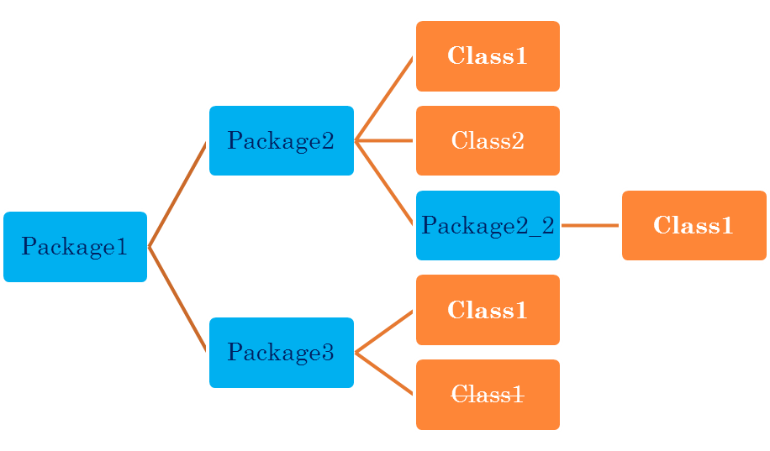
WHAT IS PACKAGE?
Classes in same package can not have duplicate name.
Classes in different packages can have the same name.
Not Allowed

Slide 67

WHAT IS PACKAGE?
Classes in same package can not have duplicate name.
Classes in different packages can have the same name.

Slide 68
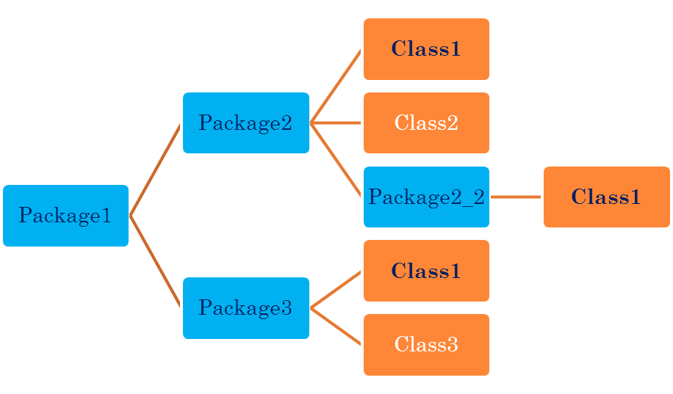
WHAT IS PACKAGE?
Classes in same package can not have duplicate name.
Classes in different packages can have the same name.

Slide 69
HOW TO CREATE PACKAGE?
To create a package is quite easy:
  simply include a package command as the first statement in a Java source file.
  package pkg;
  Any classes declared within that file will belong to the specified package.
  Java uses file system directories to store packages.
You can create a hierarchy of packages.
  Use period/dot to separate each package name from the one above it.
  package pkg1.pkg2.pkg3;

Slide 70
PACKAGE -EXAMPLE
Example:
    package uiu.cse;
    public class Test{
      public void display() {
      System.out.println( "Hello for Test class." );
    }
    }
  The class must be in a file named “Test.java"
  Place the file “Test.java" in a directory called “cse"
  Place directory “cse" in a directory called “uiu”.
  The directory “cse" can be placed anywhere, but you need to set the classpath.

Slide 71
PACKAGE -EXAMPLE
If you use IDE,
  1-3 will be done automatically and “cse” will be placed under the “src” folder.
  If no package is specified the file will be placed in a default package which maps to “src” folder

Slide 72
BENEFITS OF USING PACKAGE
The package is both a naming and a visibility control mechanism.
Packages are important for three main reasons.
  First, they help the overall organization of a project or library.
    Can organize code in a logical manner
    makes large software projects easier to manage

Slide 73
BENEFITS OF USING PACKAGE
Second, packages give you a name scoping, to help prevent collisions.
  What will happen if you and 12 other programmers in your company all decide to make a class with the same name.
Third, packages provide a level of security,
  Can define classes inside a package that are not accessible by code outside that package.
  can also define class members that are exposed only to other members of the same package.

Slide 74
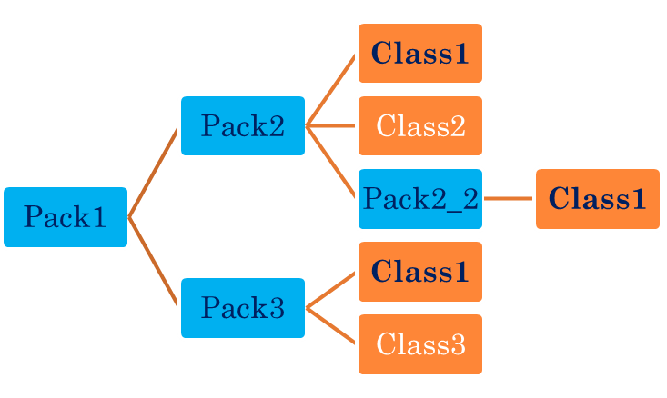
CLASS’S FULL NAME
A class has a full name, which is a combination of the package name and the class name.
Full Name: Pack1.Pack2.Class1
Full Name: Pack1.Pack2.Pack2_2.Class1
Full Name: Pack1.Pack3.Class3

Slide 75
HOW TO ACCESS CLASS
To use a class in same package, you can use the class name (short name).
To use a class in a different package, you must tell Java the full name of the class.
  You use either an Import statement at the top of your source code, and use short name or
  you can type the full name every place you use the class in your code.
java.lang.* package is always implicitly get imported by Java. [ explicit import is not needed for this package]

Slide 76
CLASS IN SAME PACKAGE
Test Class
    package uiu.cse;
    public class Test{
      public void display() {
      System.out.println( "Hello for Test class." );
    }
    }
Main Class
    package uiu.cse;
    public class TestMain {
      public static void main(String[] args) {
      Test test = new Test();
      test.display();
    }
    }

Slide 77
CLASS IN DIFFERENT PACKAGE – FULL NAME
Test Class
    package uiu.cse;
    public class Test{
      public void display() {
      System.out.println( "Hello for Test class." );
    }
    }
Main Class
    package uiu.cse.test; // any package other than uiu.cse
    public class TestMain {
      public static void main(String[] args) {
      uiu.cse.Test test = new uiu.cse.Test(); // use Full name
      test.display();
    }
    }

Slide 78
CLASS IN DIFFERENT PACKAGE - IMPORT
Test Class
    package uiu.cse;
    public class Test{
      public void display() {
      System.out.println( "Hello for Test class." );
    }
    }
Main Class
    import uiu.cse.Test; // Need to import the class.
    public class TestMain {
      public static void main(String[] args) {
      Test test = new Test(); // use Short name
      test.display();
    }
    }
  To import all classes under a package we need to use * after the package name. Example:
  import uiu.cse.*;

Slide 79
ACCESS CONTROL/ACCESS MODIFIER
How a member can be accessed is determined by the access modifier attached to its declaration.
4 types
  public
  Protected
  Default/Package Access – No modifier
  Private
Outer class can only be declared as public or default.

Slide 80
PRIVATE
Members declared private are accessible only in the class itself
Example:
    class Private {
      private String name = "Private";
      public void print() {
      System.out.println( name );
      }
    }
    class PrivateExample {
      public static void main( String[] args ) {
        Private pr = new Private();
        pr.print(); // OK
        System.out.println( pr.name ); // Compile error
      }
    }

Slide 81
DEFAULT/PACKAGE ACCESS
When no access modifier is specified
Accessible in the package that contains the class
Not accessible outside the package that contains the class.
  Not even child class.

Slide 82
DEFAULT/PACKAGE ACCESS - EXAMPLE
Class that will be accessed from other classes
package test;
class Default{
  String name = “Default“;
}
Class under different package
package test1;
class DefaultExample {
  public static void main( String[] args ) {
    Default dfl= new Default();
    System.out.println( dfl.name ); // Compile error
  }
}
Class under same package
package test;
class DefaultExample1 {
  public static void main( String[] args ) {
    Default dfl = new Default();
    System.out.println( dfl.name ); // OK
  }
}

Slide 83
DEFAULT/PACKAGE ACCESS - EXAMPLE
Child Class under different package
package test1;
class DefaultChild extends Default {
  public DefaultChild() {
  name = “Child”; // Compile error
  }
}
Child Class under same package
package test;
class DefaultChild1 extends Default {
  public DefaultChild1() {
  name = “Child”; // OK
  }
}

Slide 84
PROTECTED
Members declared protected are directly accessible to any subclasses,
  Even if the child is in different package
directly accessible by code in the same package.

Slide 85
PROTECTED - EXAMPLE
Class that will be accessed from other classes
package test;
class Protected {
  protected String name = "Protected“;
}
Class Under Different Package
package test1;
class ProtectedExample {
  public static void main( String[] args ) {
    Protected pr = new Protected();
    System.out.println( pr.name ); // Compile error
    }}
Class Under Same Package
package test;
class ProtectedExample1 {
  public static void main( String[] args ) {
    Protected pr = new Protected();
    System.out.println( pr.name ); // OK
  }}

Slide 86
PROTECTED - EXAMPLE
Child Class Under Different Package
package test1;
class ProtectedChild extends Protected {
  public ProtectedChild() {
  pr.name = “Child”; // OK
  }
}
Child Class Under Same Package
package test;
class ProtectedChild1 extends Protected {
  public ProtectedChild1() {
  pr.name = “Child”; // OK
  }
}

Slide 87
PUBLIC
Members declared public are accessible anywhere the class is accessible
All the scenario described in other 3 types of access modifier won’t give any compile error

Slide 88
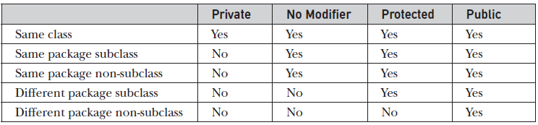
ACCESS MODIFIER CHART

Slide 89
RECURSION
It is the process of a method calling itself. A recursion has two parts
  stop condition
  call itself
Recursion is an expensive procedure and it is better to avoid recursion if you do not need.
Example: Factorial, Fibonacci
    public class MyMathLibrary {
      public static int factorial(int n){
        if (n <= 0)
        return 1; // stop condition
        return n * factorial(n-1); // call itself
      }
      public static void main( String[] args ){
      System.out.print("Factorial of 5 is: " + factorial(5));
      System.out.print("Factorial of 6 is: " + factorial(6));
      }
    }

Slide 90
VARIABLE ARGUMENT

Slide 91
VARIABLE ARGUMENT – OLD APPROACH
// Use an array to pass a variable number of arguments to a method.
// This is the old-style approach to variable-length arguments.
class PassArray {
  static void vaTest(int v[]) {
    System.out.print("Number of args: " + v.length + " Contents: ");
    for(int x : v)
    System.out.print(x + " ");
    System.out.println();
  }
  public static void main(String args[]) {
    // Notice how an array must be created to hold the arguments.
    int n1[] = { 10 };
    int n2[] = { 1, 2, 3 };
    int n3[] = { };
    vaTest(n1); // 1 arg
    vaTest(n2); // 3 args
    vaTest(n3); // no args
  }
}
Output:
Number of args: 1 Contents: 10
Number of args: 3 Contents: 1 2 3
Number of args: 0 Contents:

Slide 92
VARIABLE ARGUMENT – NEW APPROACH
Introduced in Java 5.
Can pass variable number of argument.
This feature is called varargs - short for variable-length arguments.
A method that takes a variable number of arguments is called a variable-arity method, or simply a varargs method.
A variable-length argument is specified by three periods (…).
Example : static void vaTest(int ... v) {
The argument v act as an array

Slide 93
VARARG - EXAMPLE
// Demonstrate variable-length arguments.
class VarArgs {
  // vaTest() now uses a vararg.
  static void vaTest(int ... v) {
    System.out.print("Number of args: " + v.length + " Contents: ");
    for(int x : v)
    System.out.print(x + " ");
    System.out.println();
  }
  public static void main(String args[]) {
    // Notice how vaTest() can be called with a
    // variable number of arguments.
    vaTest(10); // 1 arg
    vaTest(1, 2, 3); // 3 args
    vaTest(); // no args
  }
}
Output: Same as before

Slide 94
VARIABLE ARGUMENT
A method can have “normal” parameters along with a variable-length parameter.
However, the variable-length parameter must be the last parameter declared by the method.
For example,
  Following method declaration is perfectly acceptable:
  int doIt(int a, int b, double c, int ... vals) {
  Inacceptable method
  int doIt(int a, int b, double c, int ... vals, boolean stopFlag) { // Error!
  Can’t have more than one vararg parameter
  int doIt(int a, int b, double c, int ... vals, double ... morevals) { // Error!

Slide 95
REFERENCE
Java:Complete Reference Chapter 6,7,9

