Slide 1
OOP PRINCIPLES
CSI 211: OBJECT ORIENTED PROGRAMMING
Tanjina Helaly

Slide 2
3 PRINCIPLES
All object-oriented programming languages provide mechanisms that help you implement the object-oriented model.
  Inheritance
  Encapsulation
  Polymorphism

Slide 3
INHERITANCE

Slide 4
INHERITANCE
Inheritance is the process by which one object acquires the properties of another object.
It is a way to form new classes using classes that have already been defined.
The new classes (child classes), take over (or inherit) attributes and behavior of the pre-existing classes (parent classes).

Slide 5
INHERITANCE
Java uses “extends” keyword to show inheritance relationship. Example
class Child extends Parent{}
The class that is extended is a superclass
  Other terms: parent class, base class, ancestor class
The extended class is a subclass of its superclass
  Other terms: child class, extended class, derived class
An object created from the subclass has its own copy of all the nonstatic fields defined in its superclass

Slide 6
INHERITANCE
This is important because it supports the concept of hierarchical classification.
Inheritance provides a powerful and natural mechanism for organizing and structuring your software
It is intended to help reuse existing code with little or no modification.

Slide 7
INHERITANCE - EXAMPLE
class Parent {
  public int parentVariable = 10;
  public void parentMethod() {
  System.out.println( "Parent Method" );
  }
}
class Child extends Parent {
public int childVariable = 5;
  public void childMethod() {
  parentMethod();
  System.out.printf( "In Child ParentVariable=%d, ChildVariable=%d“, parentVariable, childVariable );
  }
}
class Inheritance {
  public static void main( String args[] ) {
    Child example = new Child();
    example.childMethod();
    example.parentMethod();
    System.out.println( example.parentVariable );
  }
}
Output
Parent Method
In Child ParentVariable=10, ChildVariable=5
Parent Method
10

Slide 8
INHERITANCE - EXAMPLE
Act like
Parent
parentVariable
parentMethod()
Child
childVariable
childMethod()
Parent
parentVariable
parentMethod()
Child
parentVariable childVariable
parentMethod() childMethod()

Slide 9
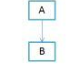
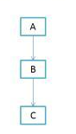
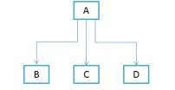
TYPES OF INHERITANCE
Single inheritance
  One parent-> One child
Multi level inheritance
  one can inherit from a derived class, thereby making this derived class the base class for the new class.
Hierarchical inheritance
  One parent – multiple children

Slide 10
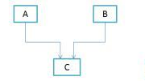
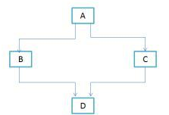
TYPES OF INHERITANCE
Multiple inheritance
  Multiple parents -> one child
Hybrid inheritance
  Is a combination of Single and Multiple inheritance
Java does not support multiple inheritance

Slide 11
INHERITANCE – SUPER KEYWORD
The super keyword in java is a reference variable that is used to refer immediate parent class object.
Whenever you create the instance of subclass, an instance of parent class is created implicitly i.e. referred by super reference variable.
Usage of java super Keyword
  super is used to refer immediate parent class member(instance variable & method).
  super() is used to invoke immediate parent class constructor.

Slide 12
SUPER – PARENT’S INSTANCE VARIABLE/METHOD
The super keyword can also be used to
  Access parent class’s instance variable if child has an instance variable with same name.
  invoke parent class’s method. It should be used in case subclass contains the same method as parent class.

Slide 13
SUPER – PARENT’S INSTANCE VARIABLE/METHOD
class Parent {
  String name;
  void message(){
  System.out.println("Welcome to Parent class."); }
}
// Create a subclass by extending class parent.
class Child extends Parent {
  String name; // this name hides the name in Parent
  public Child(String a, String b) {
    super.name = a; // name in A
    name = b; // name in B
  }
  void show() {
  System.out.println("superclass’s name: " + super.name + "; subclass’s name: " + name); }
  //method overriding
  void message(){
  System.out.println("Welcome to Child class."); }
  void display(){
    message();//will invoke current class message() method
    super.message();//will invoke parent class message() method
  }
}

Slide 14
SUPER – PARENT’S INSTANCE VARIABLE/METHOD
public class TestSuper {
  public static void main(String[] args) {
    Child s=new Child("Parent", "Child");
    s.show();
    s.display();
  }
}
Output:
superclass's name: Parent; subclass's name: Child
Welcome to Child class.
Welcome to Parent class.

Slide 15
SUPER-TO INVOKE PARENT CONSTRUCTOR.
The super keyword can also be used to invoke the parent class constructor as given below:
  class Vehicle{
    Vehicle(){
    System.out.println("Vehicle is created.");
    }
  }
  class Bike extends Vehicle{
    Bike(){
      super(); //will invoke Parent class's constructor
      System.out.println("Bike is created.");
    }
    public static void main(String[] args){
    Bike b = new Bike();
    }
  }
Output:
Vehicle is created
Bike is created

Slide 16
SUPER-TO INVOKE PARENT CONSTRUCTOR.
What would be the output of the program below:
  class Vehicle{
    Vehicle(){
    System.out.println("Vehicle is created.");
    }
  }
  class Bike extends Vehicle{
    Bike(){
    System.out.println("Bike is created.");
    }
    public static void main(String[] args){
    Bike b = new Bike();
    }
  }

Slide 17
SUPER-TO INVOKE PARENT CONSTRUCTOR.
What would be the output of the program below:
  class Vehicle{
    Vehicle(){
    System.out.println("Vehicle is created.");
    }
  }
  class Bike extends Vehicle{
    Bike(){
    System.out.println("Bike is created.");
    }
    public static void main(String[] args){
    Bike b = new Bike();
    }
  }
  If the constructor doesn’t have super(), compiler will provide super() as the first statement of the constructor.
Output:
Vehicle is created
Bike is created

Slide 18
SUPER-TO INVOKE PARENT CONSTRUCTOR.
Note:
super() should be the first statement of your constructor
If the constructor doesn’t have super(), compiler will provide super() as the first statement of the constructor.
  It will only work when Parent has no constructor or a parameter less constructor. See the next example.

Slide 19
SUPER-TO INVOKE PARENT CONSTRUCTOR.
What would be the output of the program below:
  class Vehicle{
    Vehicle(String name){
    System.out.printf("Vehicle %s is created.\n", name);
    }
  }
  class Bike extends Vehicle{
    Bike(){
    System.out.println("Bike is created.");
    }
    public static void main(String[] args){
    Bike b = new Bike();
    }
  }

Slide 20
SUPER-TO INVOKE PARENT CONSTRUCTOR.
What would be the output of the program below:
  class Vehicle{
    Vehicle(String name){
    System.out.printf("Vehicle %s is created.\n", name);
    }
  }
  class Bike extends Vehicle{
    Bike(){ // Implicit super constructor Vehicle() is undefined. Must explicitly invoke another constructor
    System.out.println("Bike is created.");
    }
    public static void main(String[] args){
    Bike b = new Bike();
    }
  }

Slide 21
SUPER-TO INVOKE PARENT CONSTRUCTOR.
So the fix is:
  class Vehicle{
    Vehicle(String name){
    System.out.printf("Vehicle %s is created.\n", name);
    }
  }
  class Bike extends Vehicle{
    Bike(){
    super("Bike");
    System.out.println("Bike is created.");
    }
    public static void main(String[] args){
    Bike b = new Bike();
    }
  }

Slide 22
WHEN CONSTRUCTORS ARE EXECUTED
When a class hierarchy is created, the constructors are executed in the order of the hierarchy.
For example: for the hierarchy above, constructor of A will be executed first, then B and then C.

Slide 23
WHEN CONSTRUCTORS ARE EXECUTED
// Create a super class.
class A {
  A() {
  System.out.println("Inside A's constructor."); }
}
// Create a subclass by extending class A.
class B extends A {
  B() {
  System.out.println("Inside B's constructor."); }
}
// Create another subclass by extending B.
class C extends B {
  C() {
  System.out.println("Inside C's constructor."); }
}
class CallingCons {
  public static void main(String args[]) {
  C c = new C();
  }
}
Output:
Inside A's constructor
Inside B's constructor
Inside C's constructor

Slide 24
OBJECT CLASS
All classes inherit directly or indirectly from java.lang.Object
  class Parent { int size; }
  class Parent extends Object { int size; }
The child class below is a grandchild of Object
  class Child extends Parent{ }
Having a common ancestor class allows java to provide standard members on all objects, like toString()
  class TestObject {
    public static void main( String args[] ) {
      Parent watchThis = new Parent();
      int myHash = watchThis.hashCode();
      System.out.println( myHash );
      // Where does hashCode come from?
    }
  }

Slide 25
OBJECT CLASS - METHODS
clone() - Creates a clone of the object.
equals(Object) - Compares two Objects for equality.
  Uses "==" to test for equality
  Note: If a class needs an implementation of equals, which differs from the default "equals", the class should override the method.
toString() - Returns a String that represents the value of this Object.

Slide 26
ENCAPSULATION

Slide 27
ENCAPSULATION
Encapsulation is the mechanism that binds together code and the data it manipulates and keeps both safe from outside interference and misuse.
One way to think about encapsulation is as a protective wrapper
  that prevents the code and data from being arbitrarily accessed by other code defined outside the wrapper.
the basis of encapsulation is the class.
  Use access modifier to provide encapsulation

Slide 28
ENCAPSULATION
Since the purpose of a class/encapsulation is to encapsulate complexity, there are mechanisms for hiding the complexity of the implementation inside the class.
  Use access modifier to specify which members should/ shouldn’t be accessed by outside world.
  the public interface should be carefully designed not to expose too much of the inner workings of a class

Slide 29
GETTER/SETTER METHOD
In encapsulation, the variables of a class will be hidden from other classes, and can be accessed only through the methods of their current class.
To achieve that in Java −
  Declare the variables of a class as private.
  Provide public setter and getter methods to modify and view the variables values.
  Example:
    private double balance;
    public void setBalance(double b) {
    balance = b;
    }
    public double getBalance() {
    return balance;
    }

Slide 30
BENEFIT OF ENCAPSULATION
Benefit
  Hide complexity from user.
  Implement logic while updating field
  Easy to maintain
  Make variable read-only or write only

Slide 31
POLYMORPHISM

Slide 32
POLYMORPHISM
Poly means many and morph means form. Thus, polymorphism refers to being able to use many forms of a type without regard to the details.
More generally, the concept of polymorphism is often expressed by the phrase “one interface, multiple methods.”
polymorphism refers to a programming language's ability to process objects differently depending on their data type or class.

Slide 33
POLYMORPHISM
3 types
  Method overriding
  Method overloading
  Subclass polymorphism

Slide 34
METHOD OVERRIDING
Means a child class is re-implementing a method of its super class. Or
A class replacing an ancestor's implementation of a method with an implementation of it own.
When overriding a method in child class
  Method Signature(name and argument list) and return type must be the same as the parent method.
  Child method could be equal or more accessible.

Slide 35
METHOD OVERRIDING
When an overridden method is called from within its subclass, it will always refer to the version of that method defined by the subclass.
  The version of the method defined by the superclass will be hidden.
To invoke parent method in child class, need to use “super” keyword.
Static methods can not be overridden
Dynamic binding

Slide 36
METHOD OVERRIDING - EXAMPLE
public class TestOverridding {
  public static void main(String[] args) {
    System.out.println("------Parent-----");
    Parent p = new Parent();
    p.display();
    System.out.println(“\n------Child-----");
    Child c = new Child();
    c.display();
  }
}
class Parent {
  public void display() {
  System.out.println( "Display in Parent" );
  }
}
class Child extends Parent {
  public void display() {
  System.out.println( "Display in Child" );
  }
}
Output:
------Parent-----
Display in Parent
------Child-----
Display in Child

Slide 37
METHOD OVERRIDING - EXAMPLE(SUPER KEYWORD)
public class TestOverridding {
  public static void main(String[] args) {
    System.out.println("------Parent-----");
    Parent p = new Parent();
    p.display();
    System.out.println(“\n------Child-----");
    Child c = new Child();
    c.display();
  }
}
class Parent {
  public void display() {
  System.out.println( "Display in Parent" );
  }
}
class Child extends Parent {
  public void display() {
  super.display(); // invoke the parent class’s method
  System.out.println( "Display in Child" );
  }
}
Output:
------Parent-----
Display in Parent
------Child-----
Display in Parent Display in Child

Slide 38
METHOD OVERLOADING
Two methods in the same class can have the same name with different signature. This is called method overloading and the methods are called overloaded method.
  The signature of a method is its name with number, type and order of its parameters.
  The return type is not part of the signature of a method.
Condition:
  Methods should be in the same class
  Same name
  Must have different argument.
  Return type could be same or different.

Slide 39
METHOD OVERLOADING
This called static binding because, which method to be invoked will be decided at the time of compilation

Slide 40
METHOD OVERLOADING - EXAMPLE
class OverloadDemo {
  void test() {
  System.out.println("No parameters"); }
  // Overload test for one integer parameter.
  void test(int a) {
  System.out.println("a: " + a); }
  // Overload test for a double parameter
  double test(double a) {
  System.out.println("double a: " + a);
  return a*a; }
}
class Overload {
  public static void main(String args[]) {
    OverloadDemo ob = new OverloadDemo();
    // call all versions of test()
    ob.test();
    ob.test(10);
    double result = ob.test(123.25);
    System.out.println("Result of ob.test(123.25): " + result);
  }
}
Output:
No parameters
a: 10
double a: 123.25
Result of ob.test(123.25): 15190.5625

Slide 41
CONSTRUCTOR OVERLOADING
In addition to overloading normal methods, you can also overload constructor methods.
In fact, for most real-world classes that you create, overloaded constructors will be the norm, not the exception.

Slide 42
CONSTRUCTOR OVERLOADING - EXAMPLE
public class Box {
  double width, height, depth;
  // constructor used when all dimensions specified
  Box(double w, double h, double d) {
    width = w;
    height = h;
    depth = d;
  }
  // constructor used when cube is created
  Box(double len) {
  width = height = depth = len;
  }
  // compute and return volume
  double volume() {
  return width * height * depth;
  }
  public static void main(String[] args){
    Box b = new Box(10, 8, 5);
    System.out.println("Volume of Box: " + b.volume());
    Box b1 = new Box(5);
    System.out.println("Volume of Cube: " + b1.volume());
  }
}
Output:
Volume of Box: 400.0
Volume of Cube: 125.0

Slide 43
INVOKING OVERLOADED CONSTRUCTORS -THIS( )
Sometimes it is useful for one constructor to invoke another.
  this is accomplished by using the this keyword.
  The general form is
    this(arg-list)
When this( ) is executed, the overloaded constructor that matches the parameter list specified by arg-list is executed.
The call to this( ) must be the first statement within the constructor.
  General rule: Constructor call must be the first statement in a constructor.

Slide 44
CONSTRUCTOR OVERLOADING - EXAMPLE
public class Box {
  double width, height, depth;
  // constructor used when all dimensions specified
  Box(double w, double h, double d) {
    width = w;
    height = h;
    depth = d;
  }
  // constructor used when cube is created
  Box(double len) {
  width = height = depth = len;
  }
  // compute and return volume
  double volume() {
  return width * height * depth;
  }
  public static void main(String[] args){
    Box b = new Box(10, 8, 5);
    System.out.println("Volume of Box: " + b.volume());
    Box b1 = new Box(5);
    System.out.println("Volume of Cube: " + b1.volume());
  }
}
Output:
Volume of Box: 400.0
Volume of Cube: 125.0

Slide 45
CONSTRUCTOR OVERLOADING – EXAMPLE WITH THIS()
public class Box {
  double width, height, depth;
  // constructor used when all dimensions specified
  Box(double w, double h, double d) {
    width = w;
    height = h;
    depth = d;
  }
  // constructor used when cube is created
  Box(double len) {
  this(len, len, len);
  }
  // compute and return volume
  double volume() {
  return width * height * depth;
  }
  public static void main(String[] args){
    Box b = new Box(10, 8, 5);
    System.out.println("Volume of Box: " + b.volume());
    Box b1 = new Box(5);
    System.out.println("Volume of Cube: " + b1.volume());
  }
}
Output:
Volume of Box: 400.0
Volume of Cube: 125.0

Slide 46
SUBCLASS POLYMORPHISM
A parent class reference is used to refer to a child class object.
Couple things to remember:
  The only possible way to access an object is through a reference variable.
  The type of the reference variable would determine the methods that it can invoke on the object.
Using subclass polymorphism we can call or execute the child-class overriding method by the parent-class object.

Slide 47
SUBCLASS POLYMORPHISM - EXAMPLE
public class TestPolymorphism {
  public static void main(String[] args) {
    Animal a = new Bird();
    a.sleep(); // sleep() method of animal class will be executed
    Animal h = new Horse();
    h.sleep(); // sleep() method of Horse class will be executed
  }
}
Animal
----------
Weight
Color
-----------
eat()
sleep()
Bird
----------
canFly
-----------
fly()
Horse
----------
-----------
sleep()

Slide 48
SUBCLASS POLYMORPHISM –COMPILE/RUN TIME
2 types of check
  reference variable would determine the methods that it can invoke on the object. Compile time check.
  object type (NOT reference variable type) determines which overridden method will be used at runtime.
  Consider the code below
      Animal a = new Bird();
      a.sleep();
    Can’t call a.sleep() if the sleep() method is not available in Animal class. Will produce compile error.
    During runtime the Horse’s sleep() method will be executed not Animal’s.

Slide 49
SUBCLASS POLYMORPHISM – ACCESS METHOD NOT AVAILABLE IN PARENT
public class TestPolymorphism {
  public static void main(String[] args) {
    Animal a = new Bird();
    a.fly(); // Compile error: The method fly() is undefined for the type Animal
  }
}
So what to do if need to call subclass method that is not available in Parent class?
  Casting
public class TestPolymorphism {
  public static void main(String[] args) {
    Animal a = new Bird();
        ((Bird)a).fly(); // OK
  }
}

Slide 50
CASTING AND CLASSES
An instance of a child class can be assigned to a variable (field) of the parent class.
variable references an subtype object can be cast down to its subclass type with an explicit cast.
A runtime error occurs when explicitly casting an object to a type that it is not.
  An object of type Parent cannot be cast to type Child.
In the code shown in next page, the cast "(Uncle) object" is a runtime error
  because at that time object holds an instance of the Child class, which is not of type (or subclass) of Uncle.

Slide 51
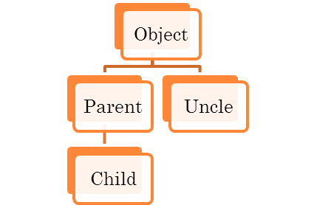
CASTING AND CLASSES
class Casting {
  public static void main( String args[] ) {
    Object object;
    Parent parent;
    Child child = new Child();
    Uncle uncle;
    parent = child;
    object = child;
    parent = (Parent) object; // explicit cast down
    child = (Child) object; // explicit cast down
    uncle = (Uncle) object; //Runtime exception
  }
}
Output
java.lang.ClassCastException: Child: cannot cast to Uncle
the cast "(Uncle) object" is a runtime error - because at that time object holds an instance of the Child class, which is not of type (or subclass) of Uncle.

Slide 52
PRECAUTION WHILE DOWN CASTING
We need to first check if the object is of that type.
How?
  The java instanceof operator is used to test whether the object is an instance of the specified type (class or subclass or interface).
  getClass() method return the “class [ClassName]”
  getClass().getName() return the class name.
Let’s revisit example of polymorphism.
public class TestPolymorphism {
  public static void main(String[] args) {
    Animal a = new Bird();
        if (a instanceof Bird) // can also use if (a.getClass().getName().equals("Bird"))
        ((Bird)a).fly(); // OK
  }
}

Slide 53
SUBCLASS POLYMORPHISM – BENEFITS – NEED TO UPDATE
Process objects differently based on their data type.
  The same invocation can produce “many forms” of results
  We can override method in subclasses and which implementation to be used is decided at runtime depending upon the situation (i.e., data type of the real object)
Can pass parent ref as method argument and handle all subclasses
Can return parent type and handle all subclasses.

Slide 54
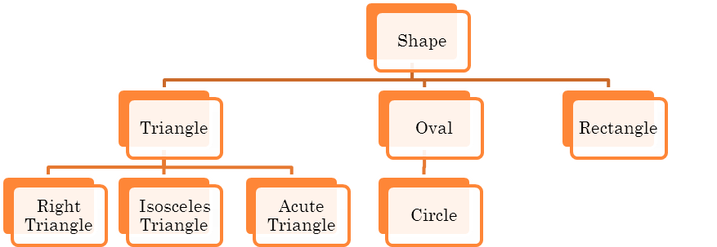
POLYMORPHISM – BENEFITS
Assume the above hierarchy.
Consider each class has a draw() method to draw the specific shape.
Also consider a method that will take a Shape reference variable (which can hold a shape object or any of its subclass’s object) as argument and call the draw method. E.g.
  static void drawShape(Shape shape){
  shape.draw();
  }

Slide 55
POLYMORPHISM – BENEFITS
What will happen if you call the method using a Triangle object or a Circle object.
drawShape(new Triangle()); // will call the draw method of Triangle class
drawShape(new Circle()); // will call the draw method of Circle class
  The same invocation can produce “many forms” of results
  We can override method in subclasses and which implementation to be used is decided at runtime depending upon the situation (i.e., data type of the real object)

Slide 56
POLYMORPHISM - BENEFITS
Polymorphism enables programmers to deal with generalities and
  let the execution-time environment handle the specifics.
Programmers can command objects to behave in manners appropriate to those objects,
  without knowing the types of the objects
  (as long as the objects belong to the same inheritance hierarchy).

Slide 57
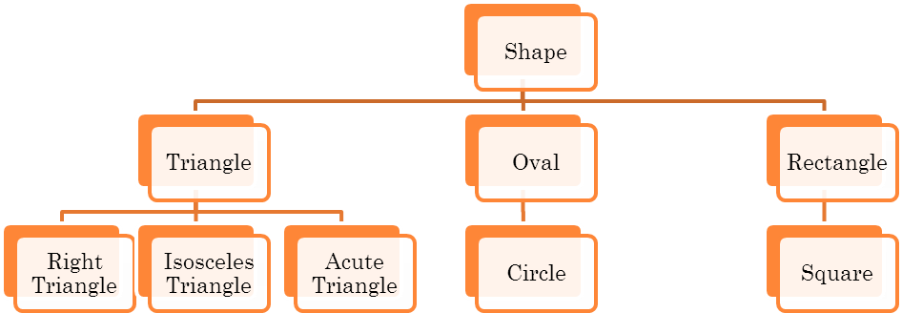
POLYMORPHISM - BENEFITS
Not think : - What need to change in the old hierarchy or drawShap(Shape shape) method, if you add a new subtype “Square” as shown below.

Slide 58
POLYMORPHISM - BENEFITS
Not think : - What need to change in the old hierarchy or drawShap(Shape shape) method, if you add a new subtype “Square” as shown below.
Polymorphism Promotes Extensibility
  New object types that can respond to existing method calls can be
    incorporated into a system without requiring modification of the base system.
    Only client code that instantiates new objects must be modified to accommodate new types.

Slide 59
STATIC & DYNAMIC BINDING
Association of method definition to the method call is known as binding.
2 types:
  static binding (also known as early binding).
  dynamic binding (also known as late binding).

Slide 60
STATIC BINDING
The binding which can be resolved at compile time by compiler is known as static. Or
When type of the object is determined at compiled time(by the compiler), it is known as static binding.
All the static, private and final methods have always been bonded at compile-time .
  Why?
    Compiler knows that all such methods cannot be overridden and will always be accessed by object of local class.
    Hence compiler doesn’t have any difficulty to determine object of class (local class for sure).
    That’s the reason binding for such methods is static.

Slide 61
DYNAMIC BINDING
When compiler is not able to resolve the call/binding at compile time, such binding is known as Dynamic or late Binding.
Example: Overriding
  in overriding both parent and child classes have same method.
  Thus while calling the overridden method, the compiler gets confused between parent and child class method.
  The method is decided during runtime.

Slide 62
REFERENCE
Java:Complete Reference Chapter 7,8
Online Reference:
  http://www.javatpoint.com/super-keyword
  https://www.tutorialspoint.com/java/
  https://docs.oracle.com/javase/tutorial/

