Slide 1




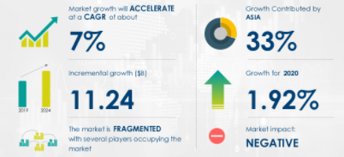


 | TITLE OF THE PROJECT: Driver Drowsiness Detection.
ABC Enterprise Ltd.
Your Company detail
Address
SAMKAARI ZAIN MOHAMMED ( ID: 1529704)
Business and Entrepreneur Project for Engineers,
Department of CSE, University of Asia Pacific
MD, CEO, Chairman, E-mail:zain@gmail.com
01
05
Background
Market/Business Opportunities
The interests in extending the reach of access network is becoming the main concern in the communication field. Passive optical network (PON) architecture is proposed using different Raman configurations to compensate for the fiber loss in the long-reach PON link. In this project, different Raman amplifier configurations for wavelength division multiplexing (WDM) was investigation and their effect on the maximum range and channel capacity has been evaluated using OptiSystem software. Some key parameters, including
Based on your industry visit or market survey, highlight all opportunities and point all recommendations from the industry.
Include your visiting picture here
02
Idea of the product
Raman amplifiers are widely used due to wide amplification bandwidth and good for in long-haul systems. Widening the channel capacity is the main concern that should be taking into account in designing a communication system.
In contrast, the new communication network created by WDM technology is greatly simplified compared to the network structure created by the existing multiplexing system of the electrical time division.
06
How it works/ System Design/ Methodology
Design the proposed system on OptiSystem
03
Product detail
Set the required parameters:
Fiber length-Pump power -Raman Amplifier Position-Number of users
To design a WDM system with Raman Amplifier using OptiSystem.
To investigate the characteristics of different Raman configuration for WDM system.
To analyze the performance of the system in terms of BER, maximum channel length, data rate and optimum effective power.
Simulate the system and observe the effects of the considered parameters on the system performance
Modify Parameters
Record and analyze the results
Final Report
04
06
Market Survey Report
Application /Advantages of the product
Product oriented real industries data/ Graph (very clear)
To successfully achieve the research outcomes, the methodology is outlined into three parts which are (i) Design system architecture (ii) simulation and (iii) validate the performance or BER calculation.
WHO WE ARE ?
To design a WDM system with Raman Amplifier using OptiSystem.
To design a WDM system with Raman Amplifier using OptiSystem.
To design a WDM system with Raman Amplifier using OptiSystem.
ACKNOWLEDGEMENT: BUS 402 Lab || Business and Entrepreneurship Colloquium @2022

