Slide 1
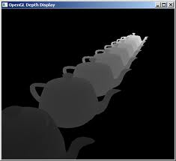
Computer Graphics
Hidden Surface Removal

Slide 2
Rendering Pipeline
transformation into world coordinates
placement of cameras and light sources
transformation into camera coordinates
modelling of geometry
projection
clipping w.r.t. view volume
backface culling
hidden surface removale (hsr)
rasterization
illumination and shading

Slide 3
Hidden Surface Removal

Slide 4
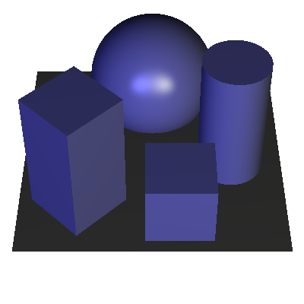


Hidden Surface Removal: Motivation
goals:
model parts independently processed
show visible parts only
parts facing the camera
parts not obscured by other objects

Slide 5
Back Face Culling
In a solid object, there are surfaces which are facing the viewer (front faces) and there are surfaces which are opposite to the viewer (back faces).
back faces:
polygons that do not ‘face’ the camera
(usually) not visible
remove (‘cull’) these
reduce polygon count by ~ ½ of the total polygon number (on average)

Slide 6
Back Face Culling
y_{v}
x_{v}
N=(A,B,C)
z_{v}
V_{view}
A polygon is a backface if
V_{view} . N >0

Slide 7
Back Face Culling
n₁·v = (2, 1, 2) · (-1, 0, -1)
= -2 – 2 = -4,
so n₁·v < 0
so n₁ front facing polygon
n₂ = (-3, 1, -2)
n₁ = (2, 1, 2)
n₂ ·v = (-3, 1, -2) · (-1, 0, -1)
= 3 + 2 = 5
so n₂ · v > 0
so n₂ back facing polygon
v = (-1, 0, -1)

Slide 8
Back Face Culling
Each surface has a normal vector. If this vector is pointing in the direction of the center of projection, it is a front face and can be seen by the viewer. If it is pointing away from the center of projection, it is a back face and cannot be seen by the viewer.
If the viewpoint is on the +z axis looking at the origin, we only need check the sign of the z component of the object’s normal vector
if n_{z} < 0, it is back facing
if n_{z} > 0 it is front facing
What if n_{z} = 0?
the polygon is parallel to the view direction, so we don’t see it

Slide 9
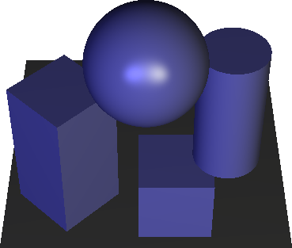
Back Face Culling
is back face culling enough?
no, when objects in the scene overlap partially
remaining front-facing polygons must be rendered in the ‘right’ order → need an extra HSR technique (see next)

Slide 10
HSR: Painter’s Algorithm
simulate the way actual painters work
draw scene from back to front
sort scenes polygons from back to front
start rendering polygons from the back
problems:
cyclic overlaps
sorting is O(n log n)
works only for polygons

Slide 11
z-Buffering
idea:
use advantages of painter’s algorithm (back to front rendering)
avoid its disadvantages (sorting polygons)
implementation:
trade memory (cheap) for speed (critical)
trade accuracy for speed (fast rendering, imperfect Z (depth) estimation)

Slide 12
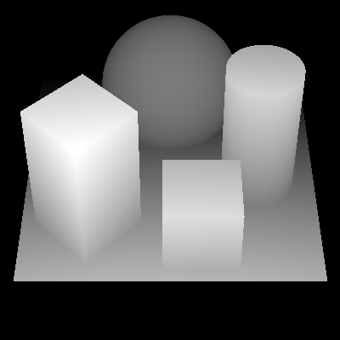
z-Buffering
introduce new per-pixel buffer: z-buffer (in addition to the image frame buffer)
z-buffer: stores z-values of pixels

Slide 13
z-Buffering
treat each primitive (triangle) individually: scene → objects → triangles → pixels
use z-buffer to check whether each pixel of each triangle is hidden or not
at any time, the polygons rendered so far are correctly ‘hidden’

Slide 14
z-Buffering: Algorithm
z-buffer = very small negative number //clear z-buffer
for each triangle T
project all vertices of T on camera plane
interpolate z-values at each pixel p (scan line)
if (z-buffer[p] < z(p)) //p not hidden
z-buffer[p] = z(p)
framebuffer[p] = desired color for p
The z-coordinates (depth values) are usually normalized to the range [0,1]
after scene processing z-buffer contains depth map of scene

Slide 15
z-Buffering: Example
−∞
−∞
−∞
−∞
−∞
−∞
−∞
−∞
-1
−∞
-1
-1
-1
−∞
−∞
−∞
-1
−∞
−∞
−∞
−∞
−∞
−∞
−∞
−∞
-2
-3
−∞
-2
-3
-3
-2
-2
−∞
+
=
-3
−∞
−∞
+
-3
-2
=
−∞
−∞
−∞
−∞
-3
-4
−∞
−∞
−∞
−∞
-3
-4
-5
−∞
-5
-4
-3
-3
−∞
-4
−∞
-5
−∞
-5
-4
-3
−∞
−∞
−∞
−∞
-4
-5
−∞
−∞
−∞
−∞
-4
-5
-6
-7
−∞
-7
-6
-5
-4
-4
−∞
-5
−∞
-6
−∞
-7
-7
-6
-5
-4
−∞
−∞
−∞
−∞
−∞
−∞
−∞
−∞
-1
-1
-1
−∞
−∞
−∞
−∞
-1
-1
−∞
−∞
−∞
-3
−∞
−∞
−∞
−∞
−∞
-3
-2
-2
-2
-3
−∞
−∞
−∞
−∞
+
=
+
=
-2
-3
-3
-2
−∞
−∞
-5
−∞
-4
−∞
−∞
−∞
−∞
−∞
-5
-4
-3
-3
-3
-4
-5
−∞
−∞
−∞
−∞
-3
-4
-5
-4
-3
−∞
-7
−∞
-6
−∞
-5
−∞
−∞
−∞
−∞
−∞
-7
-6
-5
-4
-4
-4
-5
-6
-7
−∞
−∞
−∞
−∞
-4
-5
-7
-6
-5
-4

Slide 16
z-Buffering
advantages
speed: direct hardware implementation
speed: no primitive sorting needed (only need to know distance to camera)
generality: can handle any primitive (works per-pixel, not per-primitive!)
disadvantages
needs memory to keep the z-values (e.g. 1024x1024x32 bit = 4MB)
cannot handle transparency properly

Slide 17
Other HSR Algorithms
hierarchical z-buffer
Appel’s algorithm (for lines)
Warnock's algorithm
Octrees
Binary Space Partitioning (BSP-trees)
A-buffer (with anti-alising)

