Slide 1

Computer Graphics
Illumination and Shading

Slide 2
Rendering Pipeline
transformation into world coordinates
placement of cameras and light sources
transformation into camera coordinates
modelling of geometry
projection
clipping w.r.t. view volume
backface culling
hidden surface removale (hsr)
rasterization
illumination and shading

Slide 3
Illumination and Shading
illumination models (the ‘theory’)
light sources
light interaction with surfaces
Phong illumination model
shading (the ‘implementation’)
using illumination models to render polygonal surfaces
variants: flat, Gouraud, Phong shading
efficiency vs. quality

Slide 4
Illumination and Shading
Shading is referred to as the implementation of the illumination model at the pixel points or polygon surfaces of the graphics objects.
Shading model is used to compute the intensities and colors to display the surface. The shading model has two primary ingredients:
properties of the surface and
properties of the illumination falling on it.

Slide 5
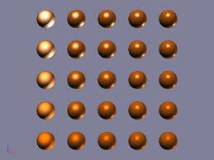
Illumination Models
General Introduction Phong Illumination Model

Slide 6
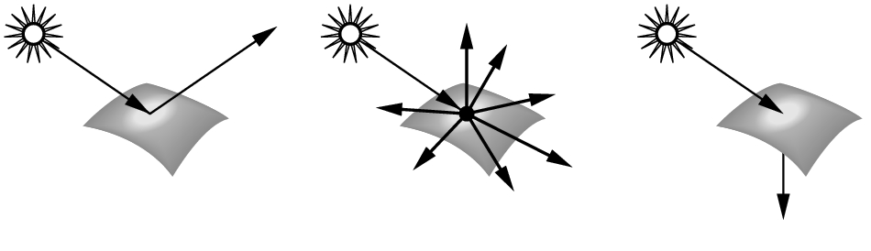
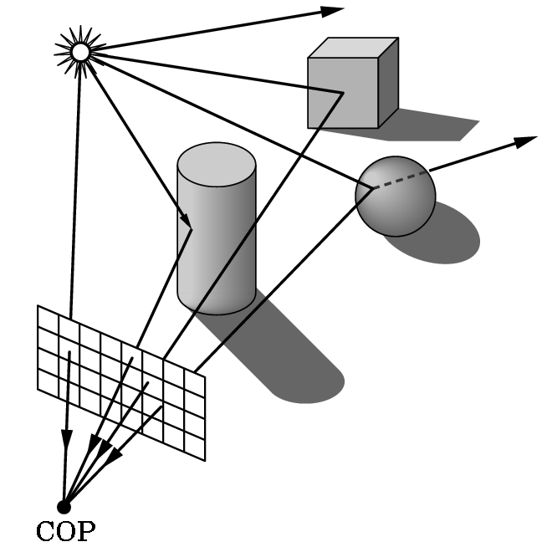
Illumination Models
real world:
surfaces emit, absorb, reflect, and scatter light
all above depend on surface position and orientation w.r.t. the light source
light can bounce several times between surfaces in a scene
different types of light sources
final intensity/color at a point = sum of all light paths ending at that point

Slide 7
Illumination Models
computer graphics world:
modeling reflection and refraction is very expensive (integral equation)
we need approximations (O(N) for N objects)
simplify light sources
simplify object materials
simplify light-vs-object interactions
hardware acceleration

Slide 8
Illumination Models
global illumination models:
consider inter-object light interactions (light can ‘bounce’ from object to object)
e.g., radiosity and raytracing
local illumination models:
only object-light interaction
Phong illumination model
implementation for polygonal objects

Slide 9
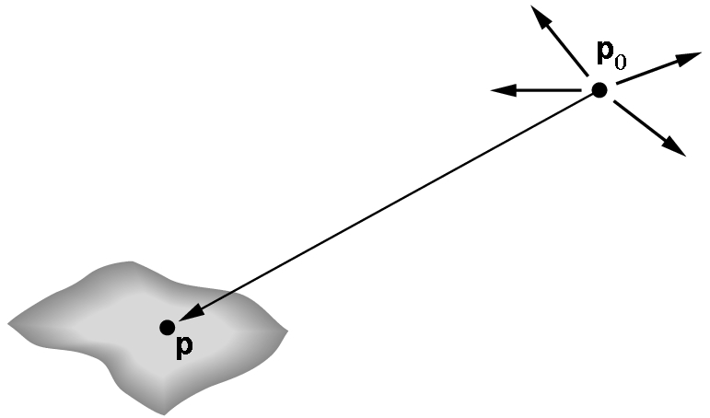
Light Sources in Computer Graphics
point light source:
has only position and no size
sends light equally in all directions
light ray
point light
illuminated surface

Slide 10
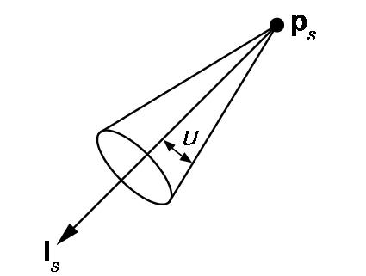
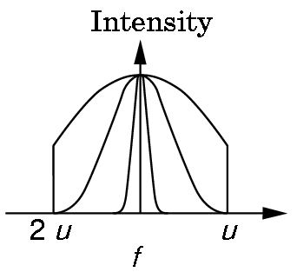
Light Sources in Computer Graphics
spot light source:
point light source emitting a light-cone with intensity decreasing towards cone border
light ray
light direction

Slide 11
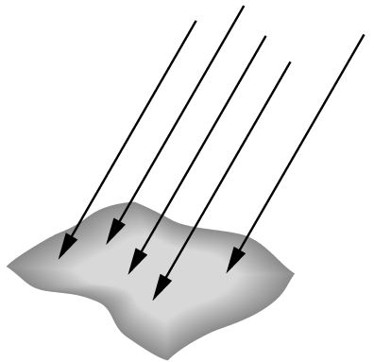
Light Sources in Computer Graphics
directional light source:
sends directed, parallel light rays,
has no position (or position is at infinity)

Slide 12
Light Sources in Computer Graphics
light attenuation
light intensity decreases with distance d
theoretically: I ~ 1/d²
CG: I ~ 1/(a+bd+cd²)
light color
modeled using RGB values
approximation because light behavior depends on wave length

Slide 13

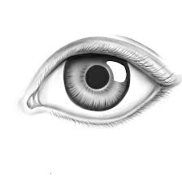
Light Interaction with Surfaces
light comes in at an angle θ (w.r.t. surface normal N)
light goes out around direction R
we look at surface from a direction V
Φ = angle(R,V) gives perceived brightness
maximal reflection if Φ = 0
reflection decreases if Φ > 0
this is called attenuation
N
θ
R
L
Φ
V
L – vector to light source N – surface normal vector
R – reflected light ray
V – vector to viewer/observer

Slide 14
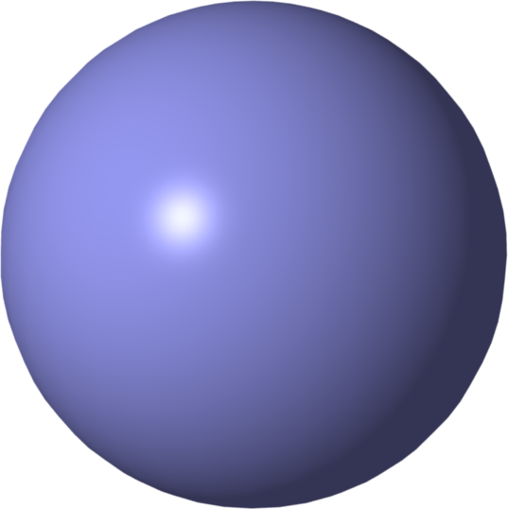
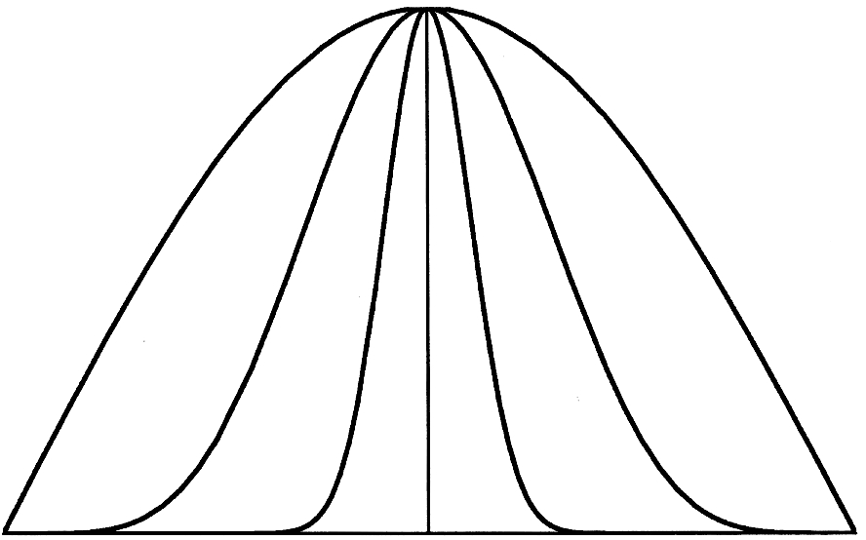
Light Interaction with Surfaces
directed (specular) reflection:
depends on Φ=angle(R,V)
model: I ~ cos^{e}(Φ)
metal surfaces: e ≈100..200
plastic surfaces: e ≈2..10
perfect mirror: e=∞
N
θ
R
L
Φ
V
e=1
e=2
L – vector to light source N – surface normal vector
R – reflected light ray
V – vector to viewer/observer
e=5

Slide 15
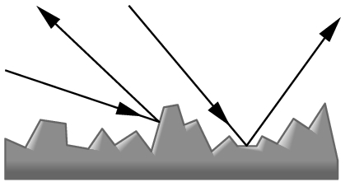
Light Interaction with Surfaces
diffuse reflection:
rough surfaces (e.g. wood, stone)
equal reflection in all directions Φ
perceived intensity depends only on θ
physical model: surface = collection of many randomly oriented micro-facets

Slide 16
Phong Illumination Model (1973)
most common CG model for illumination (by Bùi Tường Phong): I_{Phong} = I_{a} + I_{d} + I_{s}
ambient light:
Ambient light is the illumination of an object caused by reflected light from other surfaces.
needed since local illumination model does not consider ‘light bounces‘
diffuse light:
light from diffuse reflection
specular light:
light from directed reflection

Slide 17
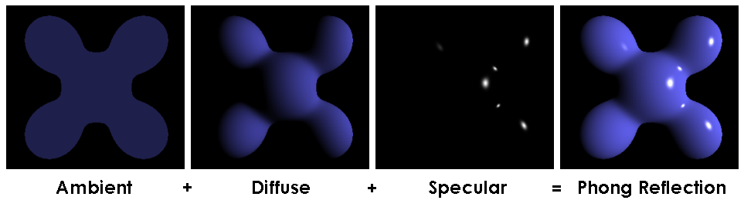
Phong Illumination Model (1973)
Visual illustration of the Phong equation: here the light is white, the ambient and diffuse colors are both blue, and the specular color is white, reflecting a small part of the light hitting the surface, but only in very narrow highlights. The intensity of the diffuse component varies with the direction of the surface, and the ambient component is uniform (independent of direction). A specular highlight is the bright spot of light that appears on shiny objects when illuminated

Slide 18
Phong Illumination Model
N
θ
R
L
Φ
V
L – vector to light source N – surface normal vector
R – reflected light ray
V – vector to viewer/observer
L_{a}, L_{d}, L_{s}: give weights of ambient, diffuse, specular light components
k_{a},k_{d},k_{s}: give color components for the light (Phong equation applied three times, once for R, then G, then B)

Slide 19
Phong Illumination Model
examples
L_{a}=0, L_{d}=0.2, L_{s}=0.8: strong specular lighting
L_{d}=0: no diffuse lighting
k_{a}^{R}=k_{a}^{G}=k_{a}^{B}: white ambient light
k_{a}^{R}=1,k_{a}^{G}=0,k_{a}^{B}=0: red ambient light
k_{d}^{R}=1, k_{d}^{G}=0.6, k_{d}^{B}=0: orange diffuse color
k_{s}^{R}=k_{s}^{G}=k_{s}^{B}=1: white specular highlight

Slide 20
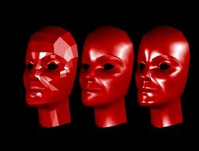
Shading Techniques
Flat, Gouraud, Phong Shading

Slide 21
Shading of Polygonal Models
status: we can compute color at a point
goal: we want to render the whole model
constraints: efficiency and quality
approach: shade all pixels of a polygon using color computation at vertices only
solutions:
flat shading
Gouraud shading
Phong shading (≠ Phong illumination)

Slide 22
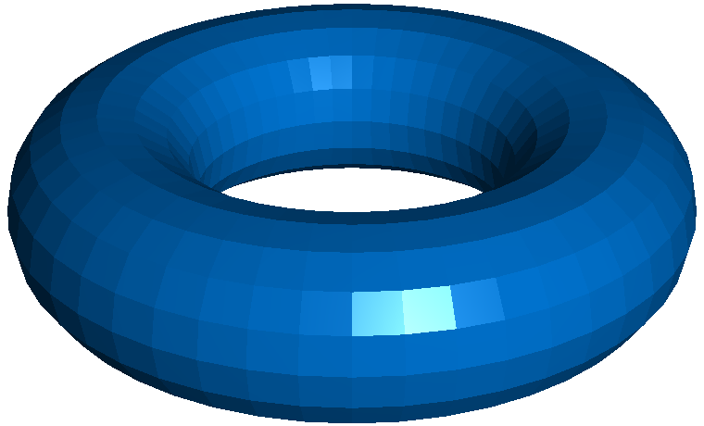
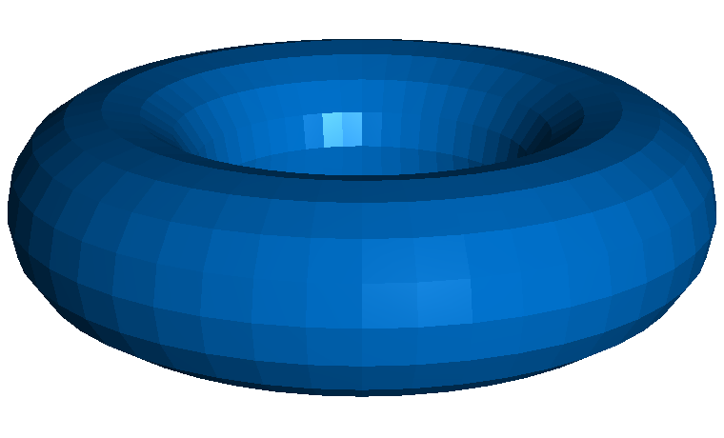
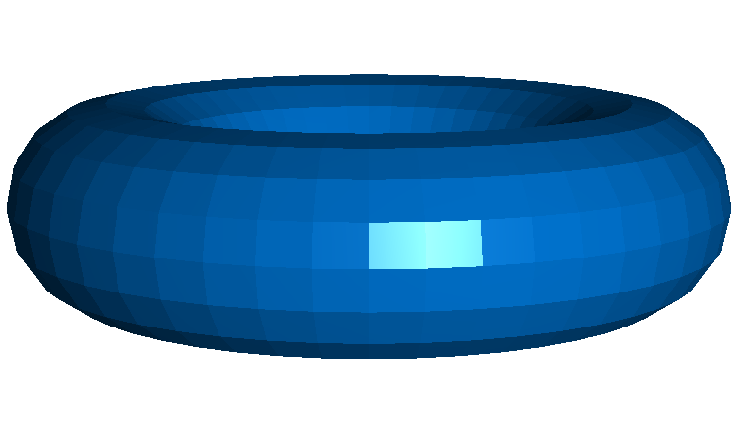
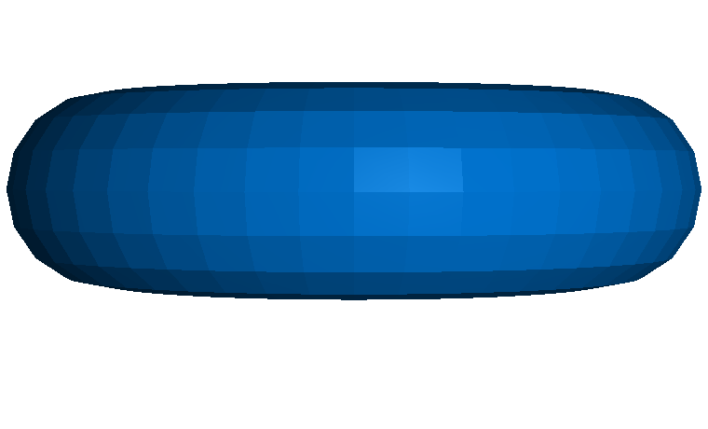
Flat Shading
polygon pixels: same color
no color interpolation
two methods:
one point per polygon
average of shading at polygon’s vertices
low quality: single primitives easily visible
fast computation
find center c of polygon
evaluate Phong illumination model at c
use resulting color for all polygon pixels

Slide 23

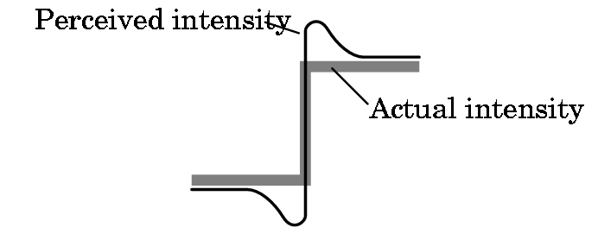
Flat Shading: Edge Perception
discontinuities easily visible and distracting
contrasts are enhanced by visual system
false ‘shading edges’ created in the process
Mach band effect

Slide 24
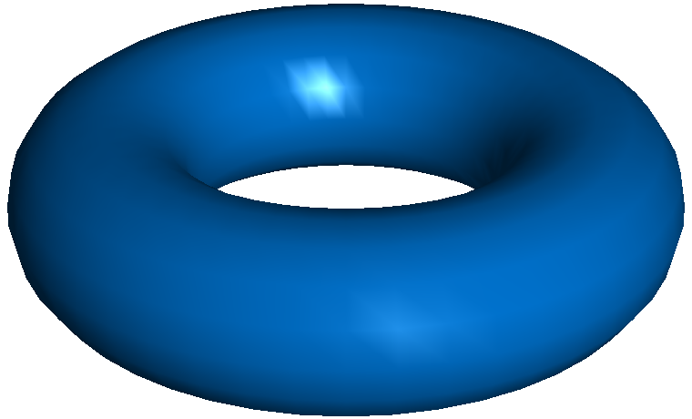
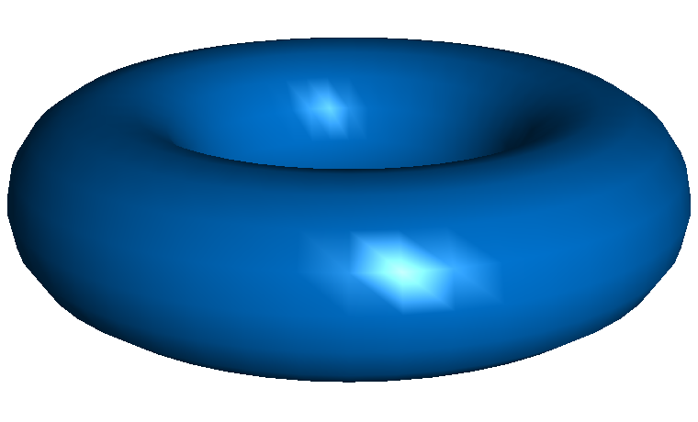
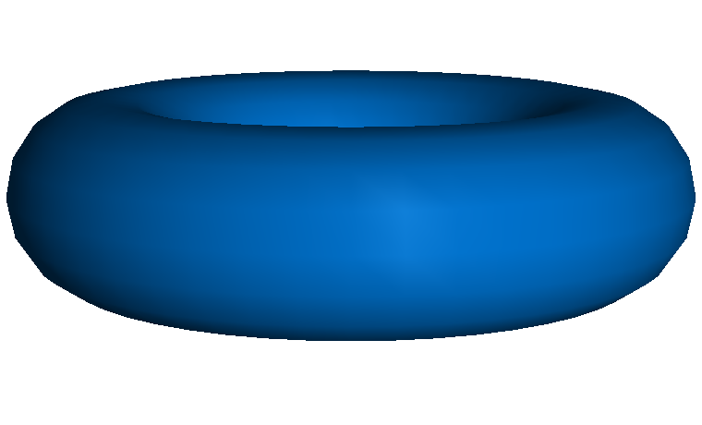
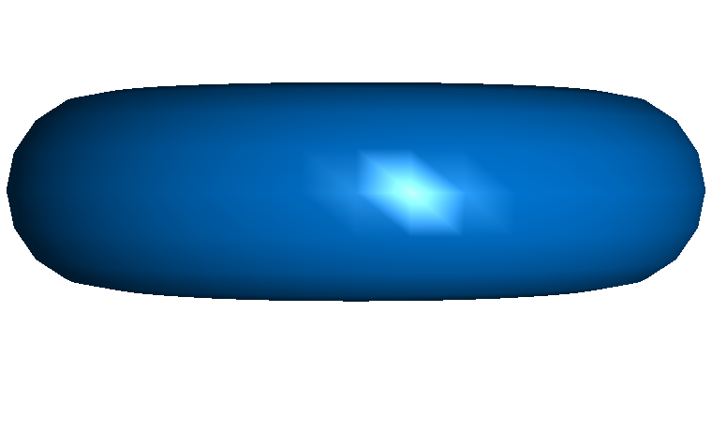
Gouraud Shading (1971)
compute Phong model at all polygon vertices
linearly interpolate resulting colors over polygon
Efficient implementation in graphics hardware:
together with the Z interpolation…
…also interpolate a RGB color
highlight problems:
highlight shapes are odd (show the polygon mesh)
highlights in the middle of polygons cannot be modeled
problem reason: our eyes are sensitive to the 2nd derivative of illumination, not just the 1st derivative

Slide 25
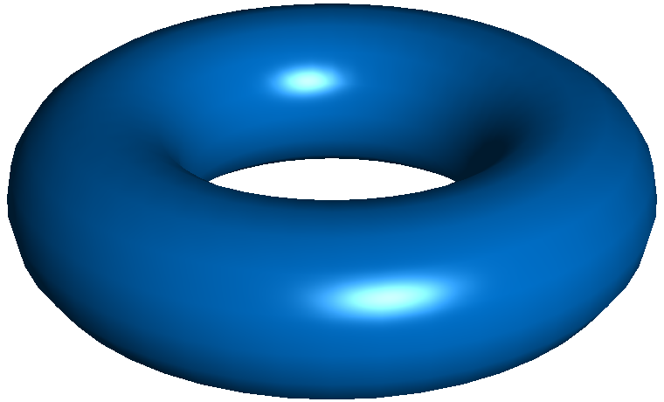
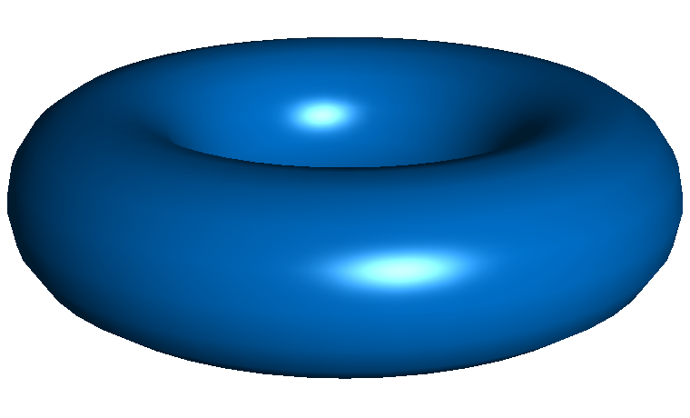
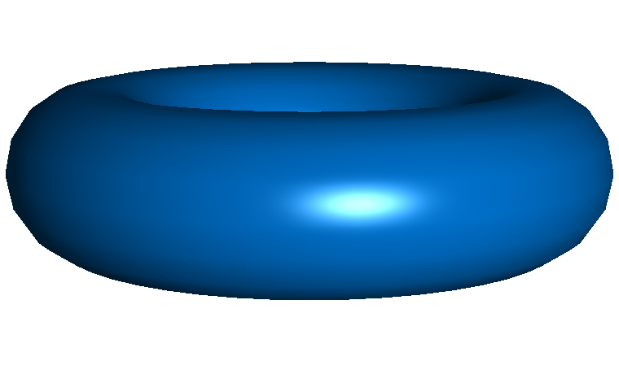
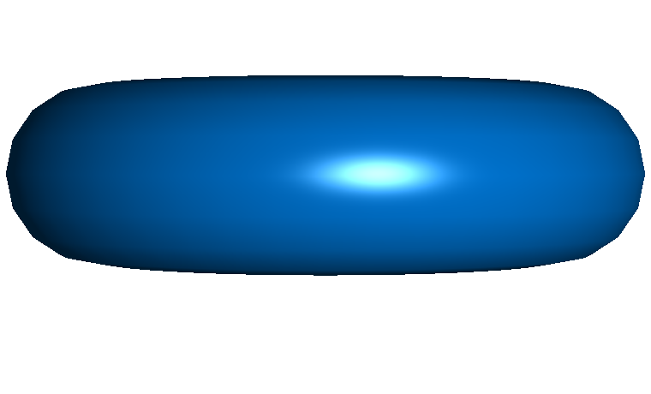
Phong Shading (1973)
linear interpolation of normals for each polygon pixel
apply Phong model at each pixel separately
best quality, highlights are shown correctly
computationally more expensive
normal (vector) interpolation
normalization at each pixel required (uses sqrt() function)
problems:
polygons still visible at object silhouettes
traditionally not implemented in graphics hardware (nowadays not a problem with pixel shaders)

Slide 26
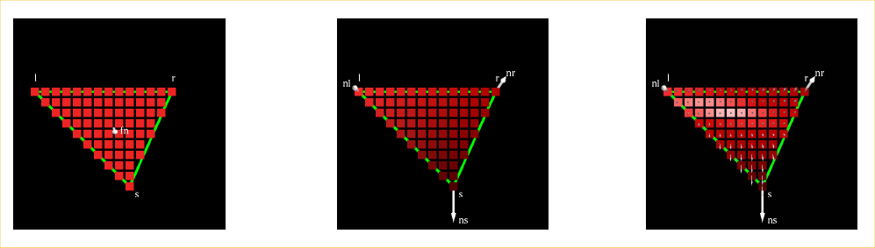
Polygonal Shading: Comparison
comparison on a by-pixel basis:
flat shading
Gouraud shading
Phong shading

Slide 27
Polygonal Shading: Comparison
Flat | Gouraud | Phong
one color value for entire polygon | one color value per vertex & interpolation inside the triangle | vertex normals interpolated and one color value per pixel
I₂
N₂
I₂
N₂
N
N₃
N₃
I
N₁
N₁
I₃
I₃
I₁
I₁

Slide 28
Summary
Phong illumination model: heuristic to compute color at one surface point
ambient, diffuse, and specular components
only computes direct (local) illumination
three shading methods to color polygons
flat, Gouraud, and Phong shading
not physically based
speed vs. quality tradeoff
illumination computation in world coordinates (before projection)!

