Slide 1
Chapter 10
Managing New Venture Formation and Entrepreneurship
Slides Prepared by:
M. Kashem
MIS Department
University of Dhaka

Slide 2
Learning Objectives
The Nature of Entrepreneurship
Types of Entrepreneurs
Why Become an Entrepreneur?
Are You Ready to Be an Entrepreneur?
Successful Entrepreneurs
Small Business- meaning and impact
Characteristics of Successful Entrepreneurs
What are the steps to take if you are starting your own business?
Key Elements of a Business Plan
Who are Angel Investors and have a Heavenly Deal with Angel Investors
Structure of Entrepreneurial Organizations
Reasons for Failure
Factors Driving the Entrepreneurial Trend
The Cultural Diversity of Entrepreneurship
The 10 Deadly Mistakes of Entrepreneurship and how to avoid them
Reasons for Success:

Slide 3
The Nature of Entrepreneurship
Entrepreneurship is the process of:
Planning
Organizing.
Operating.
Assuming the risk of a business venture.
Entrepreneur:
Someone who engages in entrepreneurship.

Slide 4
Entrepreneurs
People with vision, drive, and creativity who are willing to take the risk of starting and managing a business to make a profit, or greatly changing the scope and direction of an existing firm.
Intrapreneurs
Entrepreneurs who apply their creativity, vision, and risk- taking within a large corporation, rather than starting a company of their own.

Slide 5
Types of Entrepreneurs
Entrepreneurs fall into several categories:
Classic entrepreneurs
Growth-Oriented Entrepreneurs
Multipreneurs, and
Intrapreneurs.
Classic Entrepreneurs
Classic entrepreneurs are risk-takers who start their own companies based on innovative ideas. Some classic entrepreneurs are micropreneurs who start small and plan to stay small. They often start businesses just for personal satisfaction and the lifestyle.

Slide 6
.
Growth-Oriented Entrepreneur
growth-oriented entrepreneurs want their business to grow into a major corporation. Most high-tech companies are formed by growth-oriented entrepreneurs. Jeff Bezos recognized that with Internet technology he could compete with large chains of traditional book retailers. Bezos’s goal was to build his company into a high-growth enterprise—and he chose a name that reflected his strategy: Amazon.com.

Slide 7
Multipreneurs
Entrepreneurs who start a series of companies. They thrive on the challenge of building a business and watching it grow. In fact, over half of the chief executives at Inc. 500 companies say they would start another company if they sold their current one. Brothers Jeff and Rich Sloan are a good example of multipreneurs, having turned numerous improbable ideas into successful companies. Over the past 20-plus years, they have renovated houses, owned a horse breeding and marketing business, invented a device to prevent car batteries from dying, and so on. Their latest venture, a multimedia company called StartupNation, helps individuals realize their entrepreneurial dreams. And the brothers know what company they want to start next: yours.

Slide 8
Intrapreneurs
Some entrepreneurs don’t own their own companies but apply their creativity, vision, and risk-taking within a large corporation. Called intrapreneurs, these employees enjoy the freedom to nurture their ideas and develop new products, while their employers provide regular salaries and financial backing. Intrapreneurs have a high degree of autonomy to run their own minicompanies within the larger enterprise. They share many of the same personality traits as classic entrepreneurs, but they take less personal risk. According to Gifford Pinchot, who coined the term intrapreneur in his book of the same name, large companies provide seed funds that finance in-house entrepreneurial efforts. These include Intel, IBM, Texas Instruments (a pioneering intrapreneurial company), Salesforce.com, and Xerox.
.

Slide 9
Why Become an Entrepreneur?
Challenge of building a business
Desire to control own destiny
Financial Independence
The frustration of working for someone else
Feeling of personal satisfaction with work
Creating self-lifestyle
The opportunity for profit
Innovative Mindset
Visionary Mind
Courage to Risk Sharing
Need for Achievement

Slide 10
Are You Ready to Be an Entrepreneur?
Here are some questions would-be
entrepreneurs should ask themselves:
What is new and novel about your idea? Are you solving a problem or unmet need?
Are there similar products/services out there? If so, what makes yours better?
Who is your target market? How many people would use your product or service?
Have you talked with potential customers to get their feedback? Would they buy your product/service?
What about production costs? How much do you think the market will pay?
How defensible is the concept? Is there good intellectual property?
Is this innovation strategic to my business?
Is the innovation easy to communicate?
How might this product evolve over time? Would it be possible to expand it into a product line? Can it be updated/enhanced in future versions?
Where would someone buy this product/service?
How will the product/service be marketed? What are the costs to sell and market it?
What are the challenges involved in developing this product/service?

Slide 11
Successful Entrepreneurs
Name
and Age Company and Description
Philip Kimmey, 27
Kimmey’s dog-sitting and dog-walking network, Rover.com, raised almost $100 million in venture capital and was valued at $300 million in 2017.
Max Mankin, 27
Mankin cofounded Modern Electron and raised $10 million in venture capital to create “advanced thermionic energy converters” that will generate “cheap, scalable, and reliable electricity.” Modern Electron will turn every home into a power station.
Alexandra Cristin White, 28
In her early 20s, White founded Glam Seamless, which sells tape-in hair extensions. In 2016, her self-funded company grossed $2.5 million.
Steph Korey, 29; Jen
Rubio, 29
Korey and Rubio founded Away, selling “first-class luggage at a coach price” in 2015. They raised $31 million in funding and grossed $12 million in sales in 2016.
Allen Gannet, 26
Gannet founded TrackMaven, a web-marketing analytics company, in 2012; by 2016, his company was grossing $6.7 million a year.
Jake Kassan, 25;
Kramer
LaPlante, 25
Kassan and Kramer launched their company, MVMT, through Indiegogo, raising $300,000, and in 2016 grossed $60 million, selling primarily watches and sunglasses.
Brian Streem, 29
Streem’s company, Aerobo, provides drone services to the film industry, selling “professional aerial filming and drone cinematography.” Aerobo grossed $1 million in 2016, its first full year of business.
Natalya Bailey, 30; Louis
Perna, 29
Accion Systems began in 2014, raised $10 million in venture funding, and grossed $4.5 million in 2016, making tiny propulsion systems for satellites.

Slide 12
Characteristics of Successful Entrepreneurs
Ambitious: They are competitive and have a high need for achievement.
Independent: They are individualists and self-starters who prefer to lead rather than follow.
Self-confident: They understand the challenges of starting and operating a business and are decisive and confident in their ability to solve problems.
Risk-takers: Although they are not averse to risk, most successful entrepreneurs favor business opportunities that carry a moderate degree of risk where they can better control the outcome over highly risky ventures where luck plays a large role.
Visionary: Their ability to spot trends and act on them sets entrepreneurs apart from small-business owners and managers.
Creative: To compete with larger firms, entrepreneurs need to have creative product designs, bold marketing strategies, and innovative solutions to managerial problems.
Energetic: Starting and operating a business takes long hours. Even so, some entrepreneurs start their companies while still employed full-time elsewhere.
Passionate. Entrepreneurs love their work,
Committed. Because they are so committed to their companies, entrepreneurs are willing to make personal sacrifices to achieve their goals.
Ethical Choices Transform Family Business into International Brand

Slide 13
Small Business
What is a small business?
A business that is privately owned by one individual or a small group of individuals.
Do sales influence?
Small businesses sales and assets are not large enough to influence the environment.
A business with under 500 employees that is independently managed, is owned by an individual or a small group of investors, is based locally, and is not a dominant company in its industry.

Slide 14
The Economic Impact of Small Business
80% (approximately 23.8 million) of the nearly 29.7 million businesses have no employees (businesses run by individuals or small groups of partners, such as married couples).
89% (approximately 5.2 million) of the nearly 5.8 million businesses with employees have fewer than 20 employees.
99.6% (approximately 5.7 million) of all businesses have 0–99 employees—98% have 0–20 workers.
Approximately 5.8 million businesses have fewer than 500 employees.
Only about 19,000 businesses in the United States have more than 500 employees.
Companies with fewer than 50 employees pay more than 20% of America’s payroll.
Companies with fewer than 500 employees pay more than 41% of America’s payroll.
32.5 million people (1 employee in 4) work for businesses with fewer than 50 employees.
These businesses also pay tens of millions of owners, not included in employment statistics.

Slide 15
Snapshot of Small-Business Owners
Start-up activity has risen sharply over the last three years, from an all-time low of minus 0.87% in 2013 to positive 0.48% in 2016.
Between 1996 and 2011, the rate of business ownership dropped for both men and women; however, business ownership has increased every year since 2014.
The Kauffman Index of Startup Activity, an early indicator of new entrepreneurship in the United States, rose again slightly in 2016 following sharp increases two years in a row.
New entrepreneurs who started businesses to pursue opportunity rather than from necessity reached 86.3%, more than 12 percentage points higher than in 2009 at the height of the Great Recession.
For the first time, Main Street entrepreneurship activity was higher in 2016 than before the onset of the Great Recession. This increase was driven by a jump in business survival rates, which reached a three-decade high of 48.7%. Nearly half of new businesses are making it to their fifth year of operation.
47% of U.S. businesses have been in business for 11 or more years.
In 2016, about 25% of all employing firms had revenues over $1 million, but 2% had revenues under $10,000.

Slide 16
The Role of Entrepreneurship in Society
The majority of U.S. businesses employ:
Fewer than 100 people, and most U.S. workers are employed by small firms.
What percentage of workers are employed by firms with 1,000 or more employees?
Only 12.70%

Slide 17
The Importance of Small Business in the United States
What makes small business important in the U.S.?
Job creation.
Innovation.
Important to big business. (see Figure 10.1)

Slide 18
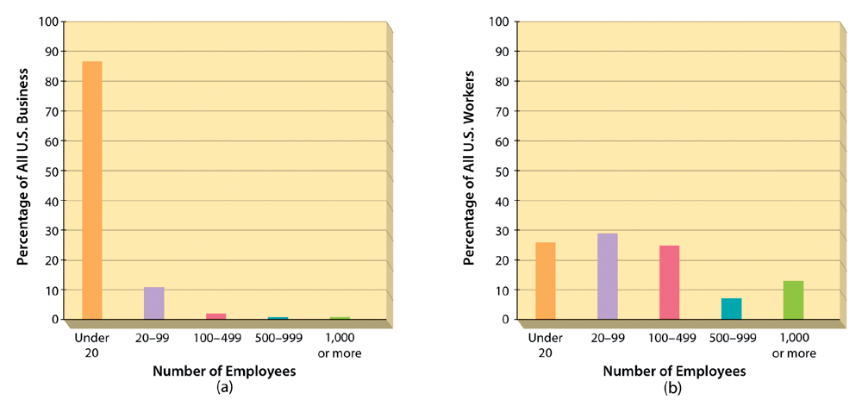
Figure 10.1: The Importance of Small Business in the United States

Slide 19
Job Creation
How many jobs did small business create in the 80’s?
8 of every 10 new jobs were created by small business.
In what industries are jobs created?
38% in technology.
New jobs are being created in small firms specializing in international business.
Small business accounts for 96% of all U.S. exports.

Slide 20
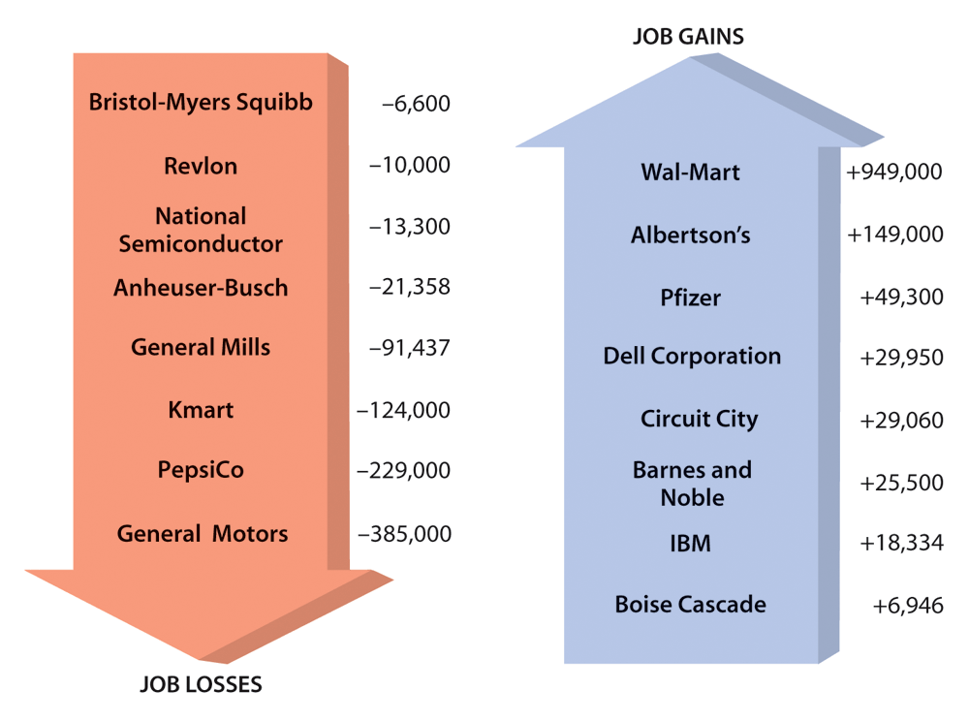
Figure 10.2: Representative Jobs Created and Lost by Big Business

Slide 21

Can You Name Innovations That Came from Small Business or Individuals?
Personal computer
Stainless-steel razor blades
Transistor radio
Photocopying
Jet engine
Self-developing photography
Helicopter
Power steering
Automatic trans
Air conditioning
Cellophane
The 19-cent ballpoint pen
Small businesses supply 55% of all innovations

Slide 22
Choosing an Industry
Small businesses are more common in some industries than in others. For the most part, these organizations have fewer than 20 employees.
Can you name the major industry groups that include successful new ventures? (See next slide Figure 10.3 for details)

Slide 23
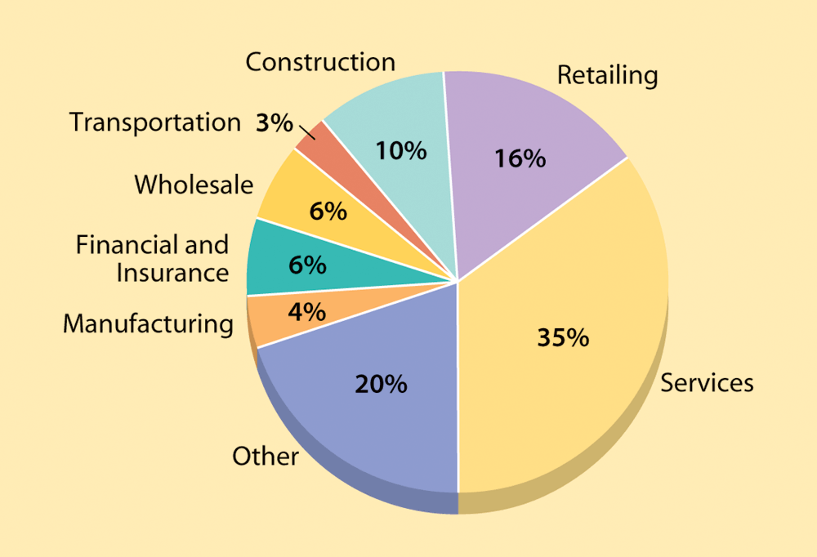
Figure 10.3: Small Businesses (Businesses with Fewer than 20 Employees) by Industry

Slide 24
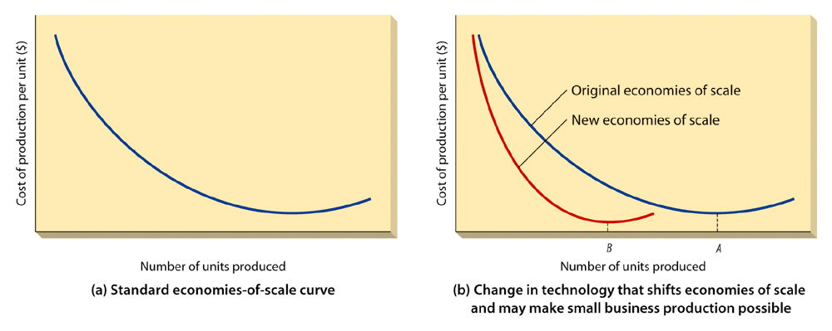
Figure 10.4: Economies of Scale in Small Business Organizations

Slide 25
Importance of Big Business
Who does big business sell its products to?
Most products made by big business are sold to consumers by small business.
Small businesses provide big business with:
Supplies.
Raw materials.

Slide 26
What are the steps to take if you are starting your own business?
Getting Started
self-assessment to determine whether you have the personal traits you need to succeed and, if so, what type of business would be best for you.
Finding Idea
Entrepreneurs get ideas for their businesses from many sources. It is not surprising that about 80 percent of Inc. 500 executives got the idea for their company while working in the same or a related industry.

Slide 27
Choosing a Form of Business Organization
sole proprietorship,
partnership,
corporation, or
limited liability company
Developing the Business Plan
Once you have the basic concept for a product or service, you must develop a plan to create the business

Slide 28
Financing the Business
to obtain financing to set up the company
Sources– self fund or equity, borrowed capital or debt.

Slide 29
Key Elements of a Business Plan
Executive summary provides an overview of the total business plan. Written after the other sections are completed, it highlights significant points and, ideally, creates enough excitement to motivate the reader to continue reading

Slide 30
Vision and mission statement
Concisely describe the intended strategy and business philosophy for making the vision happen. Company values can also be included in this section

Slide 31
Company Overview
Company overview explains the type of company, such as manufacturing, retail, or service; provides background information on the company if it already exists; and describes the proposed form of organization—sole proprietorship, partnership, or corporation.
This section should include:
company name and location,
Company objectives, nature and
primary product or service of the business,
current status (start-up, buyout, or expansion) and
legal form of organization.

Slide 32
Marketing Plan
Marketing plan shows who the firm’s customers will be and what type of competition it will face; outlines the marketing strategy and specifies the firm’s competitive edge; and describes the strengths, weaknesses, opportunities, and threats of the business. This section should offer the following descriptions:
analysis of target market and profile of target customer;
methods of identifying, attracting, and retaining customers;
a concise description of the value proposition;
selling approach, type of sales force, and distribution channels;
types of marketing and sales promotions, advertising, and projected marketing budget;
product and/or service pricing strategy; and
credit and pricing policies.

Slide 33
Management Plan
Management plan identifies the key players—active investors, management team, board members, and advisors— citing the experience and competence they possess. This section should offer the following descriptions:
management team,
outside investors and/ or directors and their qualifications,
outside resource people and their qualifications, and
plans for recruiting and training employees.

Slide 34
Operating Plan
Operating plan explains the type of manufacturing or operating system to be used and describes the facilities, labor, raw materials, and product-processing requirements. This section should offer the following descriptions:
operating or manufacturing methods, operating facilities (location, space, and equipment),
quality-control methods,
procedures to control inventory and operations,
sources of supply, and purchasing procedures.

Slide 35
Financial Plan
Financial plan specifies financial needs and contemplated sources of financing, as well as presents projections of revenues, costs, and profits. This section should offer the following descriptions:
historical financial statements for the last 3–5 years or as available;
pro forma financial statements for 3–5 years, including income statements, balance sheets, cash flow statements, and cash budgets (monthly for first year and quarterly for second year);
financial assumptions;
breakeven analysis of profits and cash flows; and planned sources of financing.

Slide 36
Appendix of Supporting Documents
Appendix of supporting documents provides materials supplementary to the plan. This section should offer the following descriptions:
management team biographies; the company’s values;
information about the company culture (if it’s unique and contributes to employee retention); and
any other important data that support the information in the business plan, such as detailed competitive analysis, customer testimonials, and research summaries.

Slide 37
Checklist for Starting a Business
Identify your reasons
Self-analysis
Personal skills and experience
Finding a niche
Conduct market research
Plan your start-up: write a business plan
Finances: how to fund your business

Slide 38
Who are Angel Investors
Angel investors are individual investors or groups of experienced investors who provide financing for start-up businesses by investing their own money, often referred to as “seed capital.” This gives the investors more flexibility on what they can and will invest in, but because it is their own money, angels are careful. Angel investors often invest early in a company’s development, and they want to see an idea they understand and can have confidence in

Slide 39
Making a Heavenly Deal
Show them something they understand, ideally a business from an industry they’ve been associated with.
Know your business details: Information important to potential investors includes annual sales, gross profit, profit margin, and expenses.
Be able to describe your business—what it does and who it sells to—in less than a minute. Limit PowerPoint presentations to 10 slides.
Angels can always leave their money in the bank, so an investment must interest them. It should be something they’re passionate about. And timing is important—knowing when to reach out to an angel can make a huge difference.

Slide 40
Making a Heavenly Deal
They need to see management they trust, respect, and like. Present a competent management team with a strong, experienced leader who can explain the business and answer questions from potential investors with specifics.
Angels prefer something they can bring added value to. Those who invest could be involved with your company for a long time or perhaps take a seat on your board of directors.
They are more partial to deals that don’t require huge sums of money or additional infusions of angel cash.
Emphasize the likely exits for investors and know who the competition is, why your solution is better, and how you are going to gain market share with an infusion of cash.

Slide 41
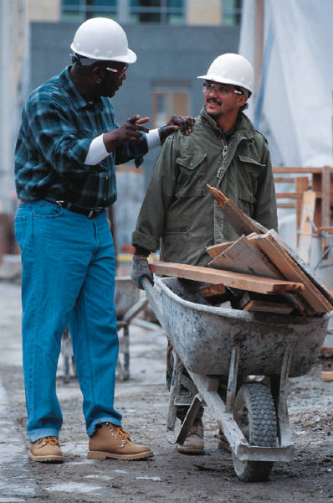
Strategy for Entrepreneurial Organizations
What are the successful new ventures and small businesses?
Services.
Retailing.
Construction.
Financial and insurance.
Wholesaling.
Transportation.
Manufacturing.
IT products
E-commerce

Slide 42
Better Survival Rates
More people are testing their skills as entrepreneurs.
In today’s marketplace there is a better chance for surviving.
See next slide (Figure 10.7) illustrating where women entrepreneurs gained skills and experiences.

Slide 43
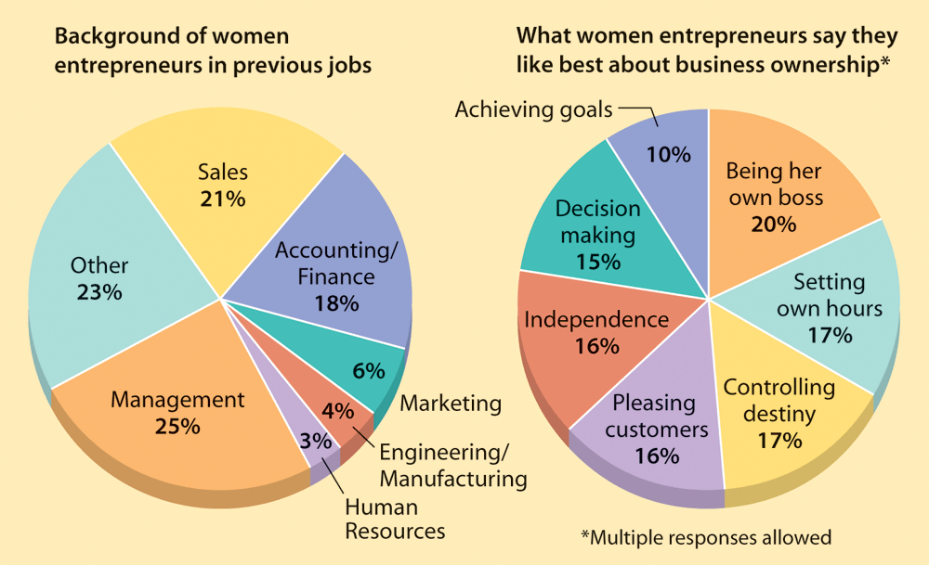
Figure 10.7: Where Women Entrepreneurs Come From and What They Like About Their Work

Slide 44
Emphasizing Distinctive Competencies
Established market: What is it?
A market in which several large firms compete according to relatively well-defined criteria.
Identifying niches is?
A segment of a market that is not currently being exploited.

Slide 45
How Do You Identify New Markets?
An entrepreneur can transfer a product or service in one geographic market to a second market.
An entrepreneur can sometimes create entire industries—can you name any?
Dry paper copying process.
The semiconductor.

Slide 46
What Is a First Mover Advantage?
Any advantage that comes to a firm because it exploits an opportunity before any other firm does.
What is a business plan?
A document that summarizes the business strategy and how that strategy is to be implemented.

Slide 47

Structure of Entrepreneurial Organizations
Starting the new business.
Buying an existing business.
Starting from scratch.
Financing the new business:
Personal resources.
Strategic alliances.
Lenders.
Venture capital companies.
Small-business investment companies.
SBA financial programs.

Slide 48
Sources of Management Advice
Advisory boards.
Management consultants.
The small business administration.
Networking.
Franchising: What is it?
Operation by an entrepreneur (the franchisee) under a license issued by a parent company.

Slide 49
Reasons for Failure
How many will fail?
63%.
Factors causing failure:
Managerial incompetence.
Neglect.
Weak control systems.
Insufficient funds.

Slide 50
Reasons for Failure
Uncertainty of Income
Risk of losing entire investment
Long hours and hard work
Lower quality of life until the business gets established:
High levels of stress
Complete responsibility
Discouragement

Slide 51
Factors Driving the Entrepreneurial Trend
Entrepreneurs as Heroes
Entrepreneurial Education
Demographic and Economic Factors
Shift to a Service Economy
Technological Advancements
International Opportunities
E-Commerce and the World Wide Web
Independent Lifestyle

Slide 52
The Cultural Diversity of Entrepreneurship
Young Entrepreneurs
Women Entrepreneurs:
Minority Entrepreneurs
Immigrant Entrepreneurs
Part-Time Entrepreneurs
Home-Based Businesses
Family Business
Copreneurs
Corporate Dropouts and Castoffs

Slide 53
The 10 Deadly Mistakes of Entrepreneurship
Management mistakes
Lack of experience
Poor financial control
Weak marketing efforts
Failure to develop a strategic plan
Uncontrolled growth:
Poor location
Improper inventory control
Incorrect pricing
Inability to Make the “entrepreneurial transition”:

Slide 54
How to Avoid the Mistakes
▪ Know your business in depth
▪ Develop a solid business plan
▪ Manage financial resources
▪ Understand financial statements
▪ Learn to Manage People Effectively
▪ Keep in tune with yourself

Slide 55

Reasons for Success:
Owner committed to success.
Careful analysis of market conditions.
Managerial competence.
Luck can contribute to success.

