Slide 1
1 Defining Marketing for the 21st Century
1

Slide 2
In This Chapter, We Will Address
the Following Questions
1. Why is marketing important?
2. What is the scope of marketing?
3. What are some core marketing concepts?
4. How has marketing management changed in recent years?
5. What are the tasks necessary for successful marketing management?

Slide 3
What is Marketing?
Marketing is an organizational function
and a set of processes for creating,
communicating, and delivering value
to customers and for managing
customer relationships in ways that
benefit the organization and its
stakeholders.
Notes:
Marketing is about identifying and meeting human and social needs. One of the shortest good definitions of marketing is “meeting needs profitably.”
The American Marketing Association offers the following formal definition: Marketing is the activity, set of institutions, and processes for creating, communicating, delivering, and exchanging offerings that have value for customers, clients, partners, and society at large.

Slide 4
What is Marketing Management?
Marketing management is the
art and science
of choosing target markets
and getting, keeping, and growing
customers through
creating, delivering, and communicating
superior customer value.
Notes:
Marketing management takes place when at least one party to a potential exchange thinks about the means of achieving desired responses from other parties.
Thus we see marketing management as the art and science of choosing target markets and getting, keeping, and growing customers through creating, delivering, and communicating superior customer value.

Slide 5
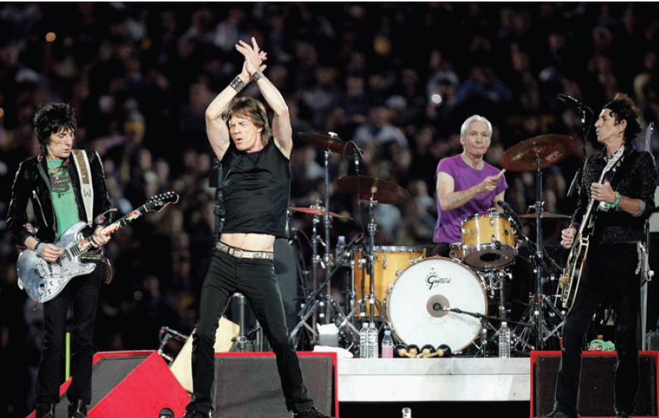
What is Marketed?
Goods (products)
Services
Events
Experiences
Persons
Places
Properties
Organizations
Information
Ideas
Notes:
Marketers market 10 main types of entities as shown on slides 1-5 and 1-6.

Slide 6

Marketing Can Promote Ideas

Slide 7
Who Markets?
MARKETERS AND PROSPECTS
A marketer is someone who seeks a response—attention, a purchase, a vote, a donation—from another party, called the prospect.
If two parties are seeking to sell something to each other, we call them both marketers.

Slide 8
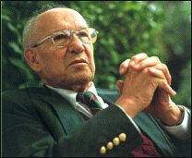
Selling is only the tip of the iceberg
“There will always be a need for
some selling. But the aim of marketing is to make selling superfluous. The aim of marketing is to know and understand the customer so well that the product or service fits him and sells itself. Ideally, marketing should result in a customer who is ready to buy. All that should be needed is to make the product or service available.”
Peter Drucker

Slide 9
Marketing is Demand Management
Eight demand states are possible:
1. Negative demand—Consumers dislike the product and may even pay to avoid it.
2. Nonexistent demand—Consumers may be unaware of or uninterested in the product.
3. Latent demand—Consumers may share a strong need that cannot be satisfied by an existing product.

Slide 10
4. Declining demand—Consumers begin to buy the product less frequently or not at all.
5. Irregular demand—Consumer purchases vary on a seasonal, monthly, weekly, daily, or even hourly basis.
6. Full demand—Consumers are adequately buying all products put into the marketplace.
7. Overfull demand—More consumers would like to buy the product than can be satisfied.
8. Unwholesome demand—Consumers may be attracted to products that have undesirable social
consequences

Slide 11
The Basic Profit Equation
Profit =
Notes:
Marketing is about identifying and meeting human and social needs. One of the shortest good definitions of marketing is “meeting needs profitably.”
The American Marketing Association offers the following formal definition: Marketing is the activity, set of institutions, and processes for creating, communicating, delivering, and exchanging offerings that have value for customers, clients, partners, and society at large.

Slide 12
The Basic Profit Equation
Profit = Revenues – Costs
Notes:
Marketing is about identifying and meeting human and social needs. One of the shortest good definitions of marketing is “meeting needs profitably.”
The American Marketing Association offers the following formal definition: Marketing is the activity, set of institutions, and processes for creating, communicating, delivering, and exchanging offerings that have value for customers, clients, partners, and society at large.

Slide 13
MARKETS
Traditionally, a “market” was a physical place where buyers and sellers gathered to buy
and sell goods.
Economists describe a market as a collection of buyers and sellers who transact over a particular product or product class (such as the housing market or the grain market).
Marketers use the term market to cover various groupings of customers.

Slide 14
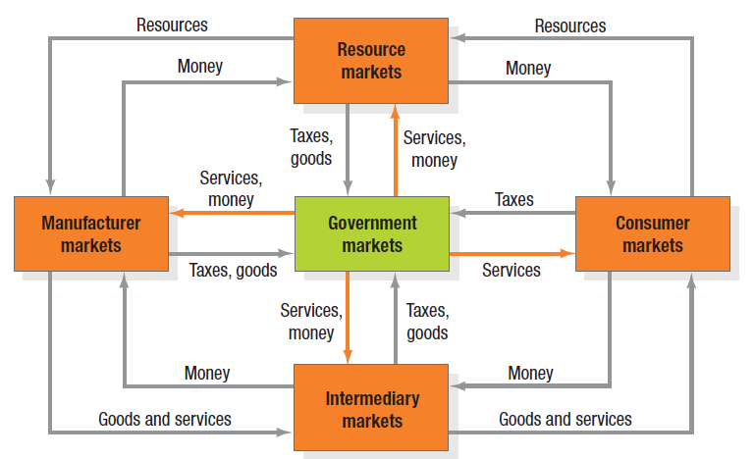
Figure 1.1 Structure of Flows in Modern Exchange Economy
Notes:
Traditionally, a “market” was a physical place where buyers and sellers gathered to buy and sell goods. Economists describe a market as a collection of buyers and sellers who transact over a particular product or product class (such as the housing market or the grain market).
Five basic markets and their connecting flows are shown in Figure 1.1.
Manufacturers go to resource markets (raw material markets, labor markets, money markets), buy resources and turn them into goods and services, and sell finished products to intermediaries, who sell them to consumers. Consumers sell their labor and receive money with which they pay for goods and services. The government collects tax revenues to buy goods from resource, manufacturer, and intermediary markets and uses these goods and services to provide public services. Each nation’s economy, and the global economy, consists of interacting sets of markets linked through exchange processes. Marketers use the term market to cover various groupings of customers. They view sellers as constituting the industry and buyers as constituting the market.

Slide 15
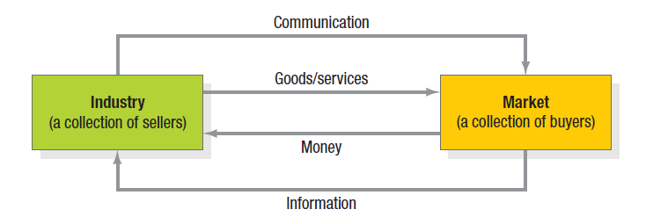
Figure 1.2 A Simple Marketing System A.K.A. The Exchange Process
Notes:
Figure 1.2 shows the relationship between the industry and the market. Sellers and buyers are connected by four flows. Sellers send goods and services and communications such as ads and direct mail to the market; in return they receive money and information such as customer attitudes and sales data. The inner loop shows an exchange of money for goods and services; the outer loop shows an exchange of information.

Slide 16
Core Concepts
Needs, wants, and demands
Target markets, positioning, segmentation
Offerings and brands
Value and satisfaction
Marketing channels
Supply chain
Competition
Marketing environment
Marketing planning
Notes:
This is a list of core marketing concepts. They will be discussed further on the coming slides.

Slide 17
Needs. Wants. Demands.
Needs - states of felt deprivation including physical needs for food, social needs for belonging and individual needs for self-expression.
i.e. I am thirsty.
Wants - form that a human need takes as
shaped by culture and individual personality.
i.e. I want a Coca-Cola.
Demands - human wants backed by buying power. i.e. I have money to buy a Coca-Cola.

Slide 18


Slide 19

Target Markets, Positioning & Segmentation
Notes:
Not everyone likes the same cereal, restaurant, college, or movie. Therefore, marketers start by dividing the market into segments. They identify and profile distinct groups of buyers who might prefer or require varying product and service mixes by examining demographic, psychographic, and behavioral differences among buyers.
After identifying market segments, the marketer decides which present the greatest opportunities— which are its target markets. For each, the firm develops a market offering that it positions in the minds of the target buyers as delivering some central benefit(s).

Slide 20
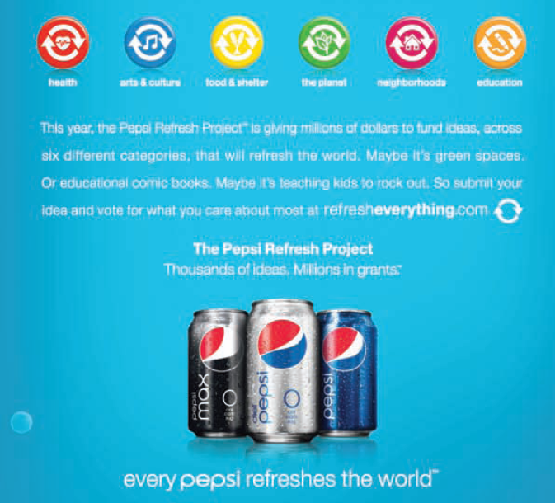
Offerings and Brands
Notes:
Companies address customer needs by putting forth a value proposition, a set of benefits that satisfy those needs. The intangible value proposition is made physical by an offering, which can be a combination of products, services, information, and experiences.
A brand is an offering from a known source. A brand name such as McDonald’s carries many associations in people’s minds that make up its image: hamburgers, cleanliness, convenience, courteous service, and golden arches. All companies strive to build a brand image with as many strong, favorable, and unique brand associations as possible.

Slide 21

Value and Satisfaction
Notes:
The buyer chooses the offerings he or she perceives to deliver the most value, the sum of the tangible and intangible benefits and costs to her. Value, a central marketing concept, is primarily a combination of quality, service, and price (qsp), called the customer value triad. Value perceptions increase with quality and service but decrease with price. We can think of marketing as the identification, creation, communication, delivery, and monitoring of customer value. Satisfaction reflects a person’s judgment of a product’s perceived performance in relationship to expectations. If the performance falls short of expectations, the customer is disappointed. If it matches expectations, the customer is satisfied. If it exceeds them, the customer is delighted. LL Bean consistently has high satisfaction ratings.

Slide 22
Marketing Channels
Communication
Distribution
Service
Notes:
To reach a target market, the marketer uses three kinds of marketing channels. Communication channels deliver and receive messages from target buyers and include newspapers, magazines, radio, television, mail, telephone, billboards, posters, fliers, CDs, audiotapes, and the Internet. Beyond these, firms communicate through the look of their retail stores and Web sites and other media. Marketers are increasingly adding dialogue channels such as e-mail, blogs, and toll-free numbers to familiar monologue channels such as ads.
The marketer uses distribution channels to display, sell, or deliver the physical product or service(s) to the buyer or user. These channels may be direct via the Internet, mail, or mobile phone or telephone, or indirect with distributors, wholesalers, retailers, and agents as intermediaries.
To carry out transactions with potential buyers, the marketer also uses service channels that include warehouses, transportation companies, banks, and insurance companies. Marketers clearly face a design challenge in choosing the best mix of communication, distribution, and service channels for their offerings.

Slide 23
Broad Marketing Environment
Demographic
Economic
Socio-cultural
Political-legal
Technological
Natural
Notes:
The marketing environment consists of the task environment and the broad environment. The task environment includes the actors engaged in producing, distributing, and promoting the offering.
These are the company, suppliers, distributors, dealers, and target customers. In the supplier group are material suppliers and service suppliers, such as marketing research agencies, advertising agencies, banking and insurance companies, transportation companies, and telecommunications companies.
Distributors and dealers include agents, brokers, manufacturer representatives, and others who facilitate finding and selling to customers.
The broad environment consists of six components: demographic environment, economic environment, social-cultural environment, natural environment, technological environment, and political- legal environment. Marketers must pay close attention to the trends and developments in these and adjust their marketing strategies as needed.

Slide 24
Company Orientations
Production
Product
Selling
Marketing
Notes:
The production concept is one of the oldest concepts in business. It holds that consumers prefer products that are widely available and inexpensive. Managers of production-oriented businesses concentrate on achieving high production efficiency, low costs, and mass distribution.
The product concept proposes that consumers favor products offering the most quality, performance, or innovative features.
The selling concept holds that consumers and businesses, if left alone, won’t buy enough of the organization’s products. It is practiced most aggressively with unsought goods—goods buyers don’t normally think of buying such as insurance and cemetery plots—and when firms with overcapacity aim to sell what they make, rather than make what the market wants. The marketing concept emerged in the mid-1950s41 as a customer-centered, sense-and respond philosophy. The job is to find not the right customers for your products, but the right products for your customers.

Slide 25
Company Orientation Toward the Marketplace
Production Concept
The production concept is one of the oldest concepts in business. It holds that consumers prefer products that are widely available and inexpensive. Managers of production-oriented businesses concentrate on achieving high production efficiency, low costs, and mass distribution

Slide 26
The Product Concept
The product concept proposes that consumers favor products offering the most quality, performance, or innovative features. However, managers are sometimes caught in a love affair with their products. They might commit the “better-mousetrap” fallacy, believing a better product will by itself lead people to beat a path to their door.

Slide 27
The selling concept
The selling concept holds that consumers and businesses, if left alone, won’t buy enough of the organization’s products. It is practiced most aggressively with unsought goods—goods buyers don’t normally think of buying such as insurance and cemetery plots—and when firms with overcapacity aim to sell what they make, rather than make what the market wants.

Slide 28
The marketing concept
The marketing concept emerged in the mid-1950s41 as a customer-centered, sense-and-respond philosophy. The job is to find not the right customers for your products, but the right products for your customers. Dell doesn’t prepare a perfect computer for its target market. Rather, it provides product platforms on which each person customizes the features he or she desires in the computer.

Slide 29
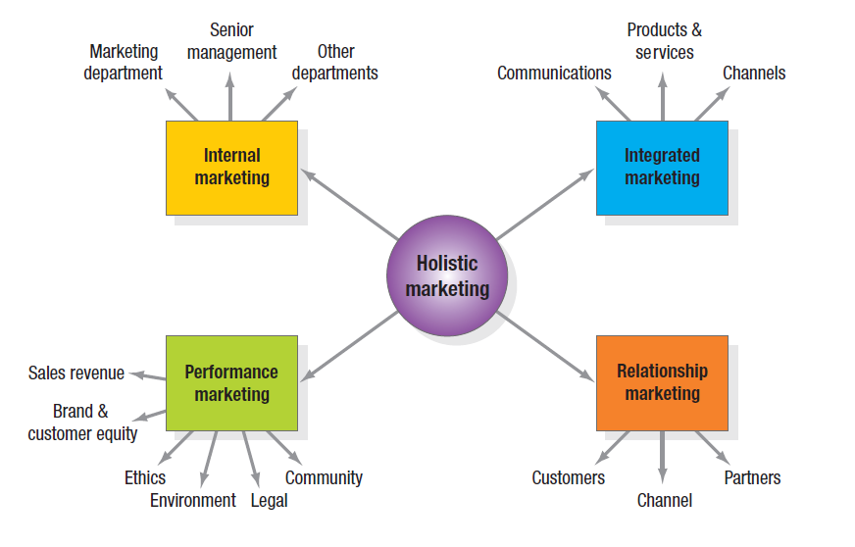
Holistic Marketing
Notes:
The holistic marketing concept is based on the development, design, and implementation of marketing programs, processes, and activities that recognize their breadth and interdependencies.
Holistic marketing acknowledges that everything matters in marketing—and that a broad, integrated perspective is often necessary. Figure 1.3 provides a schematic overview of four broad components characterizing holistic marketing: relationship marketing, integrated marketing, internal marketing, and performance marketing.

Slide 30
Relationship Marketing
Relationship marketing aims to build mutually satisfying long-term relationships with key constituents in order to earn and retain their business.

Slide 31
Integrated Marketing
Integrated marketing occurs when the marketer devises marketing activities and assembles marketing programs to create, communicate, and deliver value for consumers such that “the whole is greater than the sum of its parts.”

Slide 32
Performance Marketing
Financial
Accountability
Social Responsibility Marketing
Notes:
Performance marketing requires understanding the financial and nonfinancial returns to business and society from marketing activities and programs. Top marketers are increasingly going beyond sales revenue to examine the marketing scorecard and interpret what is happening to market share, customer loss rate, customer satisfaction, product quality, and other measures. They are also considering the legal, ethical, social, and environmental effects of marketing activities and programs.

Slide 33
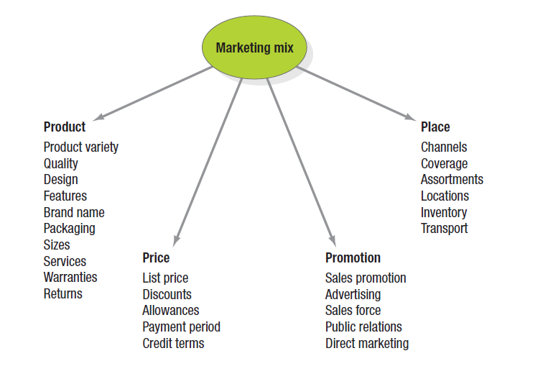
The Marketing Mix The Four Ps
Notes:
McCarthy classified various marketing activities into marketing-mix tools of four broad kinds, which he called the four Ps of marketing: product, price, place, and promotion. The marketing variables under each P are shown in Figure 1.4. Given the breadth, complexity, and richness of marketing, however—as exemplified by holistic marketing—clearly these four Ps are not the whole story anymore.

Slide 34
The New Four Ps
People
Processes
Programs
Performance
Notes:
If we update them to reflect the holistic marketing concept, we arrive at a more representative set that encompasses modern marketing realities: people, processes, programs, and performance, as in Figure 1.5.
People reflects, in part, internal marketing and the fact that employees are critical to marketing success.
Processes reflects all the creativity, discipline, and structure brought to marketing management. Programs reflects all the firm’s consumer-directed activities. It encompasses the old four Ps as well as a range of other marketing activities that might not fit as neatly into the old view of marketing.
We define performance as in holistic marketing, to capture the range of possible outcome measures that have financial and nonfinancial implications (profitability as well as brand and customer equity), and implications beyond the company itself (social responsibility, legal, ethical, and community related).

Slide 35
The New Marketing Realities
Network information technology.
Globalization
Deregulation
Privatization
Heightened competition.
Industry convergence
Retail transformation.
Disintermediation.
Consumer buying power.
Consumer information
Consumer participation
Consumer resistance.

Slide 36
New Company Capabilities
Marketers can use the Internet as a powerful information and sales channel
Marketers can collect fuller and richer information about markets, customers, prospects,and competitors.
Marketers can tap into social media to amplify their brand message.
Marketers can facilitate and speed external communication among customers.

Slide 37
4. send ads, coupons, samples, and information to customers
5. reach consumers on the move with mobile marketing
6. sell individually differentiated goods.
7. improve purchasing, recruiting, training, and internal and external communications
8. facilitate and speed up internal communication
9. improve their cost efficiency

Slide 38
Marketing Management Tasks
Develop market strategies and plans
Capture marketing insights
Connect with customers
Build strong brands
Shape market offerings
Deliver value
Communicate value
Create long-term growth
Notes:
With the holistic marketing philosophy as a backdrop, we can identify a specific set of tasks that make up successful marketing management and marketing leadership.

