Slide 1
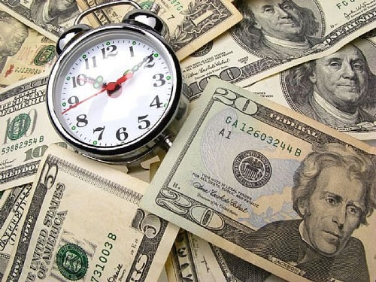

Slide 2
Decision Dilemma—Take a Lump Sum or Annual Installments
A couple Won a Lucky Draw.
They had to choose between a single lump sum $104 million, or $198 million paid out over 25 years (or $7.92 million per year).
The winning couple opted for the lump sum.
Did they make the right choice? What basis do we make such an economic comparison?

Slide 3
Opportunity Cost
Opportunity cost = Alternative use
The opportunity cost of money is the interest rate that would be earned by investing it.
It is the underlying reason for the time value of money
Any person with money today knows they can invest those funds to be some greater amount in the future.
Conversely, if you are promised a cash flow in the future, it’s present value today is less than what is promised!

Slide 4
Choosing from Investment Alternatives Required Rate of Return or Discount Rate
You have three choices:
$20,000 received today
$31,000 received in 5 years
$3,000 per year indefinitely
To make a decision, you need to know what interest rate to use.
This interest rate is known as your required rate of return or discount rate.

Slide 6
Time Value of Money
Money has a time value because it can earn more money over time (earning power).
Money has a time value because its purchasing power changes over time (inflation).
Time value of money is measured in terms of interest rate.
Interest is the cost of money—a cost to the borrower and an earning to the lender

Slide 7
The Time Value of Money
One of the most important principle in finance
$1 today
Relationship
$1 future
Present Value
Future Value
Interest is the factor contributing to Time Value of Money
Simple Interest= Principal x Interest rate x time period
= P_{o}(i)(n)

Slide 8
The Role of Time Value in Finance
Most financial decisions involve costs & benefits that are spread out over time.
Time value of money allows comparison of cash flows from different periods.
Question: Your father has offered to give you some money and asks that you choose one of the following two alternatives:
$1,000 today, or
$1,100 one year from now.
What do you do?

Slide 9

The Role of Time Value in Finance (cont.)
The answer depends on what rate of interest you could earn on any money you receive today.
For example, if you could deposit the $1,000 today at 12% per year, you would prefer to be paid today.
Alternatively, if you could only earn 5% on deposited funds, you would be better off if you chose the $1,100 in one year.

Slide 10
Future Value versus Present Value
Suppose a firm has an opportunity to spend $15,000 today on some investment that will produce $17,000 spread out over the next five years as follows:
Is this a wise investment?
To make the right investment decision, managers need to compare the cash flows at a single point in time.
Year | Cash flow
1 | $3,000
2 | $5,000
3 | $4,000
4 | $3,000
5 | $2,000

Slide 11
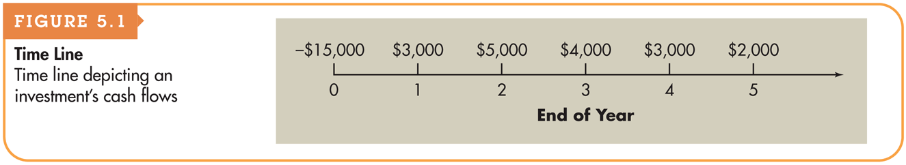
Figure 5.1 Time Line

Slide 12
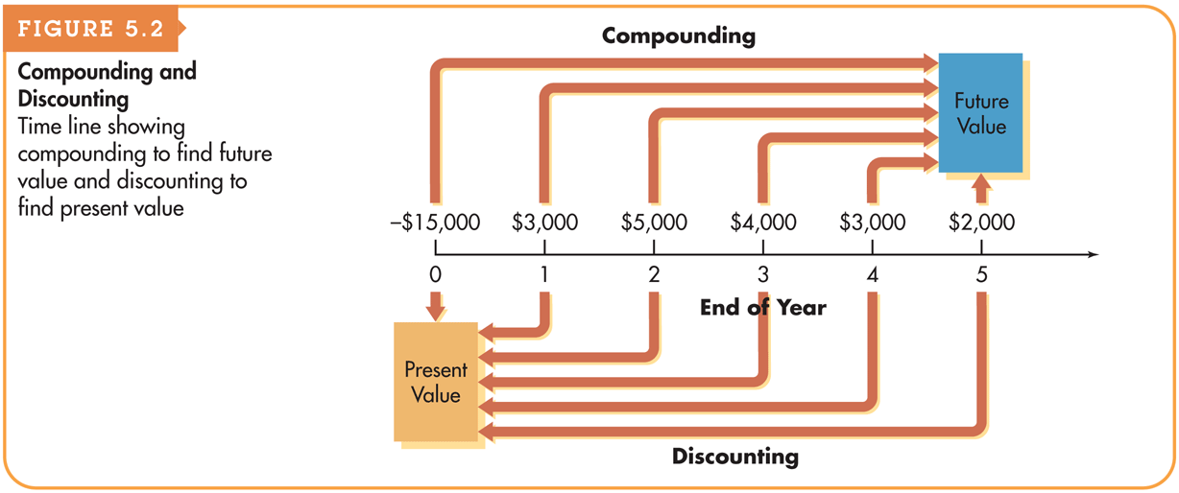
Figure 5.2 Compounding and Discounting

Slide 13
Computational Tools (cont.)
Electronic spreadsheets:
Like financial calculators, electronic spreadsheets have built-in routines that simplify time value calculations.
The value for each variable is entered in a cell in the spreadsheet, and the calculation is programmed using an equation that links the individual cells.
Changing any of the input variables automatically changes the solution as a result of the equation linking the cells.

Slide 14
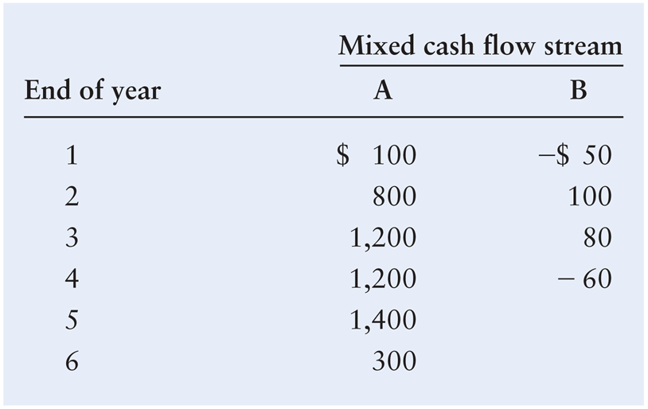
Basic Patterns of Cash Flow
The cash inflows and outflows of a firm can be described by its general pattern.
The three basic patterns include a single amount, an annuity, or a mixed stream:

Slide 15
Types of Interest
Simple Interest
Interest paid (earned) on only the original amount, or principal, borrowed (lent).
Compound Interest
Interest paid (earned) on any previous interest earned, as well as on the principal borrowed (lent).

Slide 16
Simple & Compound Interest Trends
8,000
7,000
6,000
5,000
4,000
3,000
2,000
1,000
0
Formula SI = P₀(i)(n)
SI: Simple Interest
P₀: Deposit today (t=0)
i: Interest Rate per Period
n: Number of Time Periods
DOLLARS
YEARS
1 2 3 4 5 6 7 8 9 10 11 12 13 14 15 16 17 18 19 20
Simple Compound

Slide 17
Simple Interest Future Value
Principal(P_{o})=$1000
Interest (i) = $10%
Time (n) = $5 Years
Interest =?
Future Value=?

Slide 18
Simple Interest Present Value
Future Value=$7500
Interest = $10%
Time = $5 Years
Interest =?
PRESENT Value=?

Slide 19
Simple Interest Present Value
P_{o}+(P_{o} *n*i)=7500
P_{o} +(0.5 P_{o})=7500
1.5 P_{o} =7500
P_{o} =7500/1.5
P_{o} =5000
Principal= 5000
Interest=Fv-Pv
Interest=7500-5000= 2500

Slide 20
Future Value of a Single Amount
Future value is the value at a given future date of an amount placed on deposit today and earning interest at a specified rate. Found by applying compound interest over a specified period of time.
Compound interest is interest that is earned on a given deposit and has become part of the principal at the end of a specified period.
Principal is the amount of money on which interest is paid.

Slide 21
Future Value of a Single Amount: The Equation for Future Value
We use the following notation for the various inputs:
FV_{n} = future value at the end of period n
PV = initial principal, or present value
r = annual rate of interest paid. (Note: On financial calculators, I is typically used to represent this rate.)
n = number of periods (typically years) that the money is left on deposit
The general equation for the future value at the end of period n is
FV_{n} = PV × (1 + r)^{n}

Slide 22
Using Future Value Tables
FV₂ = $1,000 (FVIF_{7%,2}) = $1,000 (1.145) = $1,145 [Due to Rounding]

Slide 23
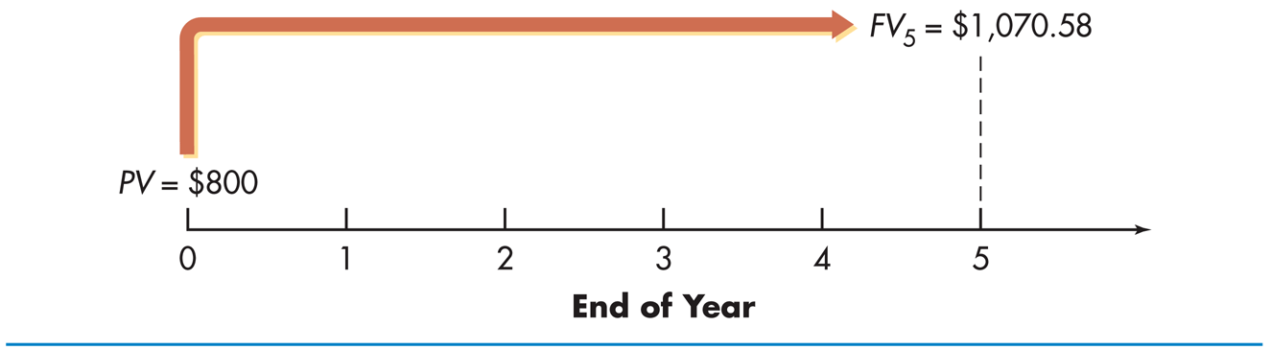
Future Value of a Single Amount: The Equation for Future Value
Jane Farber places $800 in a savings account paying 6% interest compounded annually. She wants to know how much money will be in the account at the end of five years.
This analysis can be depicted on a time line as follows:
FV₅ = $800 × (1 + 0.06)⁵ = $800 × (1.33823) = $1,070.58

Slide 24
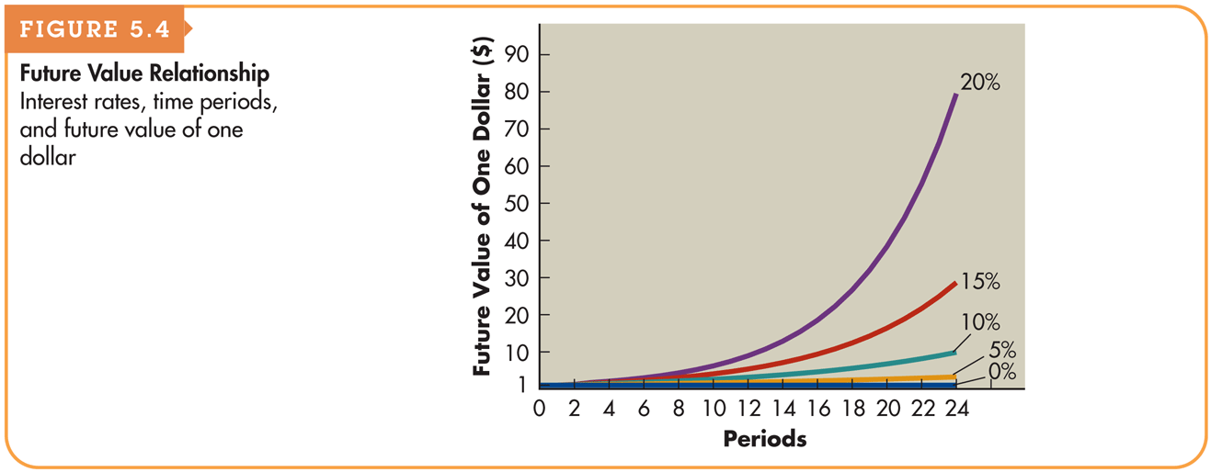
Figure 5.4 Future Value Relationship

Slide 25
Double Your Money!!!
Quick! How long does it take to double $5,000 at a compound rate of 12% per year (approx.)?
We will use the “Rule-of-72”.
Approx. Years to Double = 72 / i%
72 / 12% = 6 Years
[Actual Time is 6.12 Years]

Slide 26
Types of Compounding Problems
There are really only four different things you can be asked to find using this basic equation:
FV_{n}=PV₀ (1+k)^{n}
Find the initial amount of money to invest (PV₀)
Find the Future value (FV_{n})
Find the rate (k)
Find the time (n)

Slide 27
Types of Compounding Problems Solving for the Rate (k)
Your have asked your father for a loan of $10,000 to get you started in a business. You promise to repay him $20,000 in five years time.
What compound rate of return are you offering to pay?
This is an ex ante calculation.
FV_{t}=PV₀ (1+k)^{n}
$20,000= $10,000 (1+r)⁵
2=(1+r)⁵
2^{1/5}=1+r
1.14869=1+r
r = 14.869%

Slide 28
Types of Compounding Problems Solving for Time (n) or Holding Periods
You have $150,000 in your RRSP (Registered Retirement Savings Plan). Assuming a rate of 8%, how long will it take to have the plan grow to a value of $300,000?
This is an ex ante calculation
FV_{t}=PV₀(1+k)^{n}
$300,000= $150,000 (1+.08)^{n}
2=(1.08)^{n}
ln 2 =ln 1.08 × n
0.69314 = .07696 × n
t = 0.69314 / .076961041 = 9.00 years

Slide 29
Types of Compounding Problems Solving for Time (n) – using logarithms
You have $150,000 in your RRSP (Registered Retirement Savings Plan). Assuming a rate of 8%, how long will it take to have the plan grow to a value of $300,000?
This is an ex ante calculation.
FV_{t}=PV₀ (1+k)^{n}
$300,000= $150,000 (1+.08)^{n}
2=(1.08)^{n}
log 2 =log 1.08 × n
0.301029995 = 0.033423755 × n
t = 9.00 years

Slide 30
Types of Compounding Problems Solving for the Future Value (FV_{n})
You have $650,000 in your pension plan today. Because you have retired, you and your employer will not make any further contributions to the plan. However, you don’t plan to take any pension payments for five more years so the principal will continue to grow.
Assuming a rate of 8%, forecast the value of your pension plan in 5 years.
This is an ex ante calculation.
FV_{t}=PV₀ (1+k)^{n}
FV₅= $650,000 (1+.08)⁵
FV₅ = $650,000 × 1.469328077
FV₅ = $955,063.25

Slide 31
Types of Compounding Problems Finding the amount of money to invest (PV₀)
You hope to save for a down payment on a home. You hope to have $40,000 in four years time; determine the amount you need to invest now at 6%
This is a process known as discounting
This is an ex ante calculation
FV_{n}=PV₀ (1+k)^{n}
$40,000= PV₀ (1.1)⁴
PV₀ = $40,000/1.4641=$27,320.53

Slide 32
Present Value of a Single Amount
Present value is the current dollar value of a future amount—the amount of money that would have to be invested today at a given interest rate over a specified period to equal the future amount.
It is based on the idea that a dollar today is worth more than a dollar tomorrow.
Discounting cash flows is the process of finding present values; the inverse of compounding interest.
The discount rate is often also referred to as the opportunity cost, the discount rate, the required return, or the cost of capital.

Slide 33
Personal Finance Example
Paul Shorter has an opportunity to receive $300 one year from now. If he can earn 6% on his investments, what is the most he should pay now for this opportunity?
PV × (1 + 0.06) = $300
PV = $300/(1 + 0.06) = $283.02

Slide 34

Present Value of a Single Amount: The Equation for Present Value
The present value, PV, of some future amount, FV_{n}, to be received n periods from now, assuming an interest rate (or opportunity cost) of r, is calculated as follows:

Slide 35
Using Present Value Tables
PV₂ = $1,000 (PVIF_{7%,2}) = $1,000 (.873) = $873 [Due to Rounding]

Slide 36
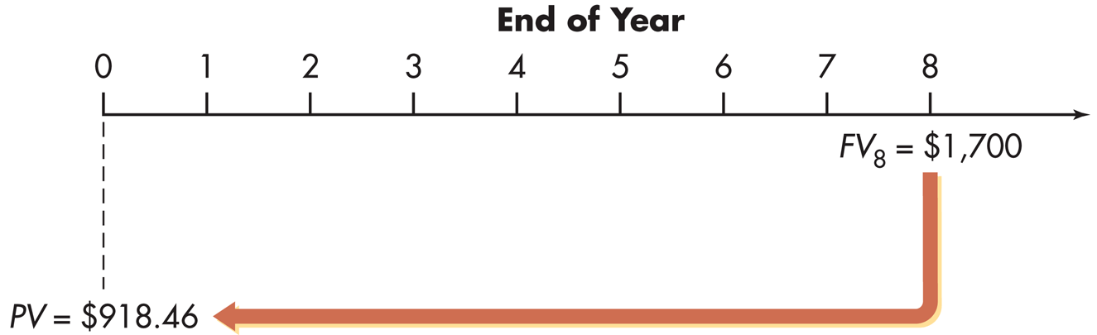
Present Value of a Single Amount: The Equation for Future Value
Pam Valenti wishes to find the present value of $1,700 that will be received 8 years from now. Pam’s opportunity cost is 8%.
This analysis can be depicted on a time line as follows:
PV = $1,700/(1 + 0.08)⁸ = $1,700/1.85093 = $918.46

Slide 37
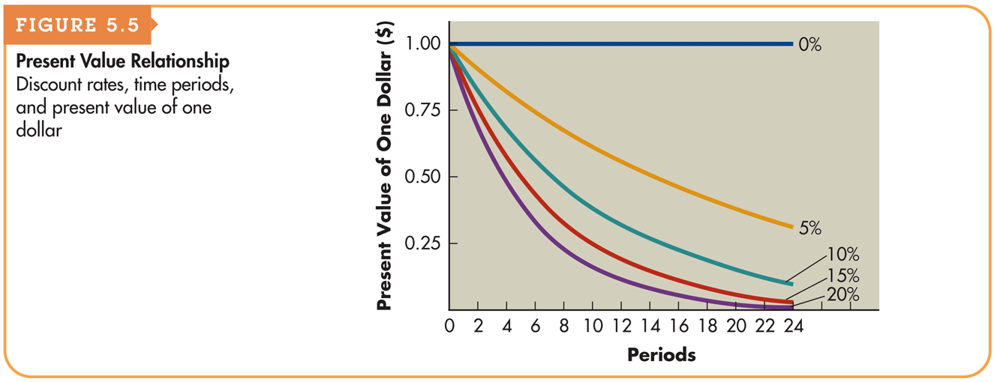
Figure 5.5 Present Value Relationship

Slide 38
Annuities
An annuity is a stream of equal periodic cash flows, over a specified time period. These cash flows can be inflows of returns earned on investments or outflows of funds invested to earn future returns.
An ordinary (deferred) annuity is an annuity for which the cash flow occurs at the end of each period
An annuity due is an annuity for which the cash flow occurs at the beginning of each period.
An annuity due will always be greater than an otherwise equivalent ordinary annuity because interest will compound for an additional period.

Slide 39
Personal Finance Example
Fran Abrams is choosing which of two annuities to receive. Both are 5-year $1,000 annuities; annuity A is an ordinary annuity, and annuity B is an annuity due. Fran has listed the cash flows for both annuities as shown in Table 5.1 on the following slide.
Note that the amount of both annuities total $5,000.

Slide 40
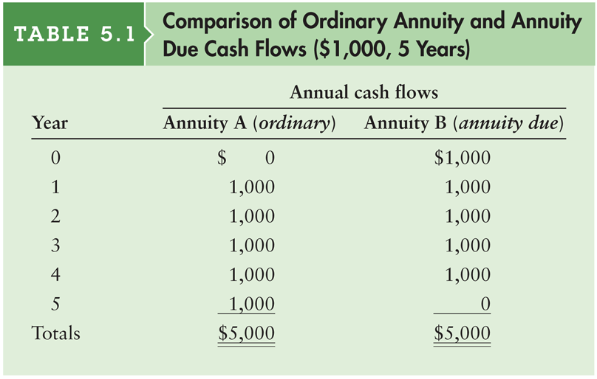
Table 5.1 Comparison of Ordinary Annuity and Annuity Due Cash Flows ($1,000, 5 Years)

Slide 41

Finding the Future Value of an Ordinary Annuity
You can calculate the future value of an ordinary annuity that pays an annual cash flow equal to CF by using the following equation:
As before, in this equation r represents the interest rate and n represents the number of payments in the annuity (or equivalently, the number of years over which the annuity is spread).

Slide 42

Finding the Present Value of an Ordinary Annuity
You can calculate the present value of an ordinary annuity that pays an annual cash flow equal to CF by using the following equation:
As before, in this equation r represents the interest rate and n represents the number of payments in the annuity (or equivalently, the number of years over which the annuity is spread).

Slide 43
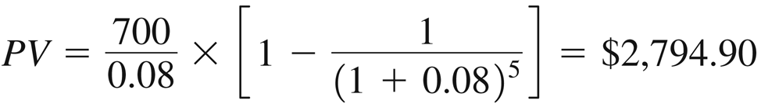
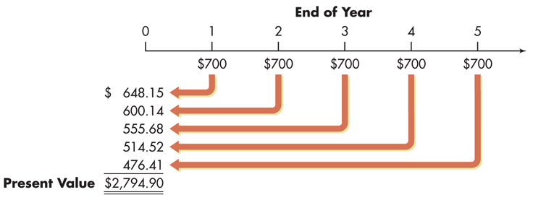
Finding the Present Value of an Ordinary Annuity (cont.)
Braden Company, a small producer of plastic toys, wants to determine the most it should pay to purchase a particular annuity. The annuity consists of cash flows of $700 at the end of each year for 5 years. The required return is 8%.
This analysis can be depicted on a time line as follows:

Slide 44
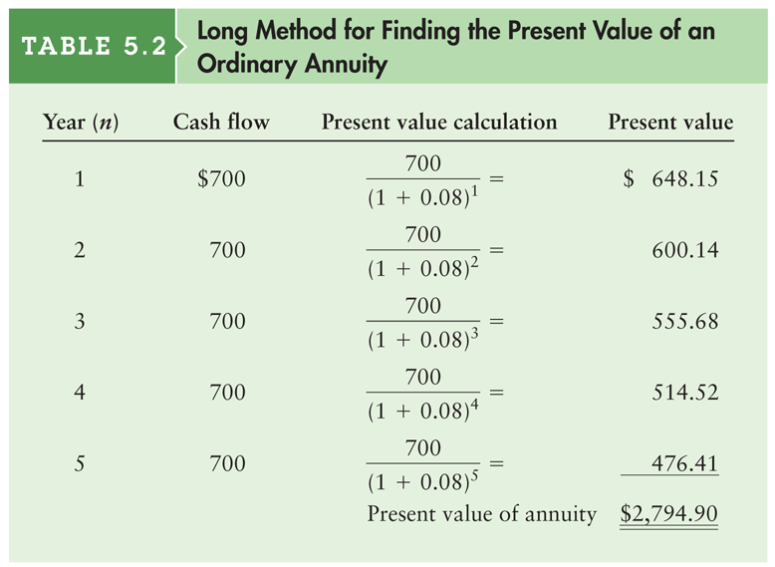
Table 5.2 Long Method for Finding the Present Value of an Ordinary Annuity

Slide 45

Finding the Future Value of an Annuity Due
You can calculate the present value of an annuity due that pays an annual cash flow equal to CF by using the following equation:
As before, in this equation r represents the interest rate and n represents the number of payments in the annuity (or equivalently, the number of years over which the annuity is spread).

Slide 46

Finding the Present Value of an Annuity Due
You can calculate the present value of an ordinary annuity that pays an annual cash flow equal to CF by using the following equation:
As before, in this equation r represents the interest rate and n represents the number of payments in the annuity (or equivalently, the number of years over which the annuity is spread).

Slide 47
Valuation Using Table III
FVAD_{n} = R (FVIFA_{i%,n})(1+i)
FVAD₃ = $1,000 (FVIFA_{7%,3})(1.07) = $1,000 (3.215)(1.07) = $3,440

Slide 48
Valuation Using Table IV
PVAD_{n} = R (PVIFA_{i%,n})(1+i)
PVAD₃ = $1,000 (PVIFA_{7%,3})(1.07) = $1,000 (2.624)(1.07) = $2,808

Slide 49
Finding the Present Value of a Perpetuity
A perpetuity is an annuity with an infinite life, providing continual annual cash flow.
If a perpetuity pays an annual cash flow of CF, starting one year from now, the present value of the cash flow stream is
PV = CF ÷ r

Slide 50
Personal Finance Example
Ross Clark wishes to endow a chair in finance at his alma mater. The university indicated that it requires $200,000 per year to support the chair, and the endowment would earn 10% per year. To determine the amount Ross must give the university to fund the chair, we must determine the present value of a $200,000 perpetuity discounted at 10%.
PV = $200,000 ÷ 0.10 = $2,000,000

Slide 51
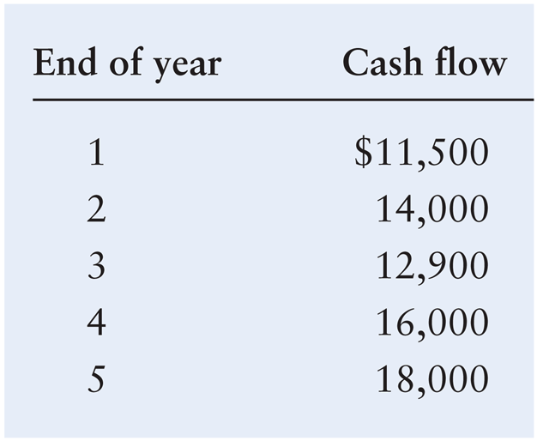
Future Value of a Mixed Stream
Shrell Industries, a cabinet manufacturer, expects to receive the following mixed stream of cash flows over the next 5 years from one of its small customers.

Slide 52
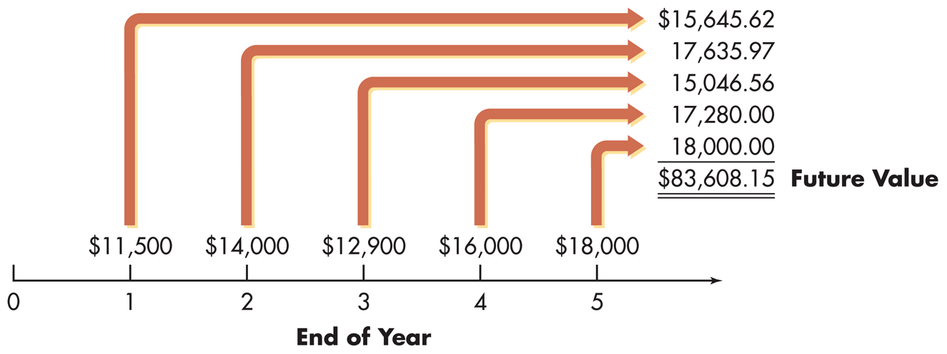
Future Value of a Mixed Stream
If the firm expects to earn at least 8% on its investments, how much will it accumulate by the end of year 5 if it immediately invests these cash flows when they are received?
This situation is depicted on the following time line.

Slide 53
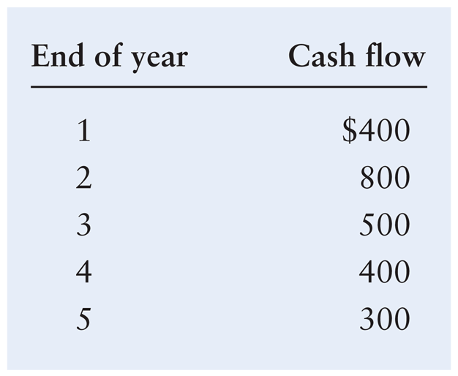
Present Value of a Mixed Stream
Frey Company, a shoe manufacturer, has been offered an opportunity to receive the following mixed stream of cash flows over the next 5 years.

Slide 54
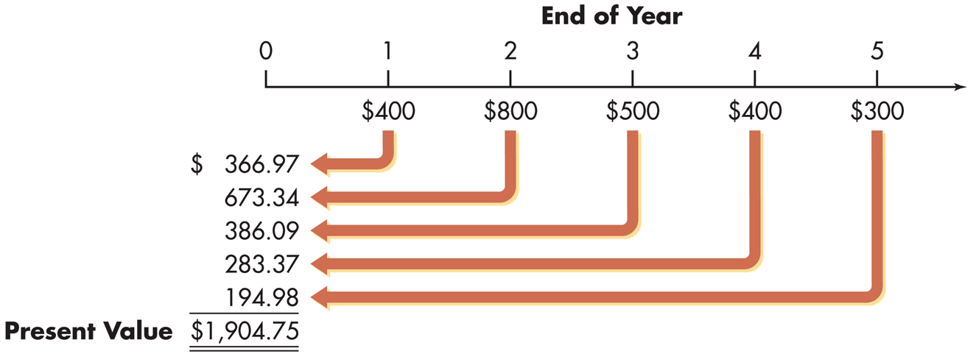
Present Value of a Mixed Stream
If the firm must earn at least 9% on its investments, what is the most it should pay for this opportunity?
This situation is depicted on the following time line.

Slide 55
Compounding Interest More Frequently Than Annually
Compounding more frequently than once a year results in a higher effective interest rate because you are earning on interest on interest more frequently.
As a result, the effective interest rate is greater than the nominal (annual) interest rate.
Furthermore, the effective rate of interest will increase the more frequently interest is compounded.

Slide 56
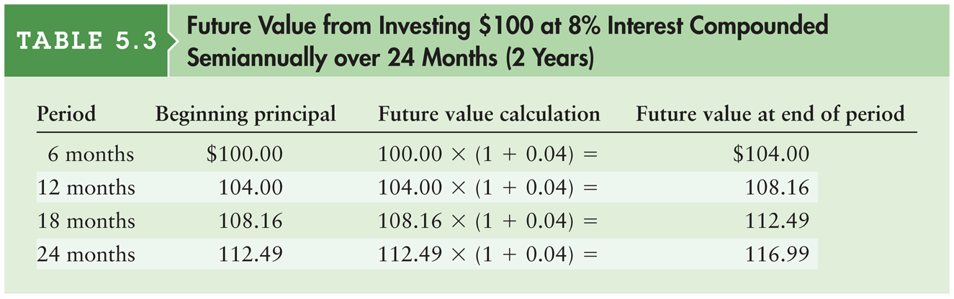
Table 5.3 Future Value from Investing $100 at 8% Interest Compounded Semiannually over 24 Months (2 Years)

Slide 57
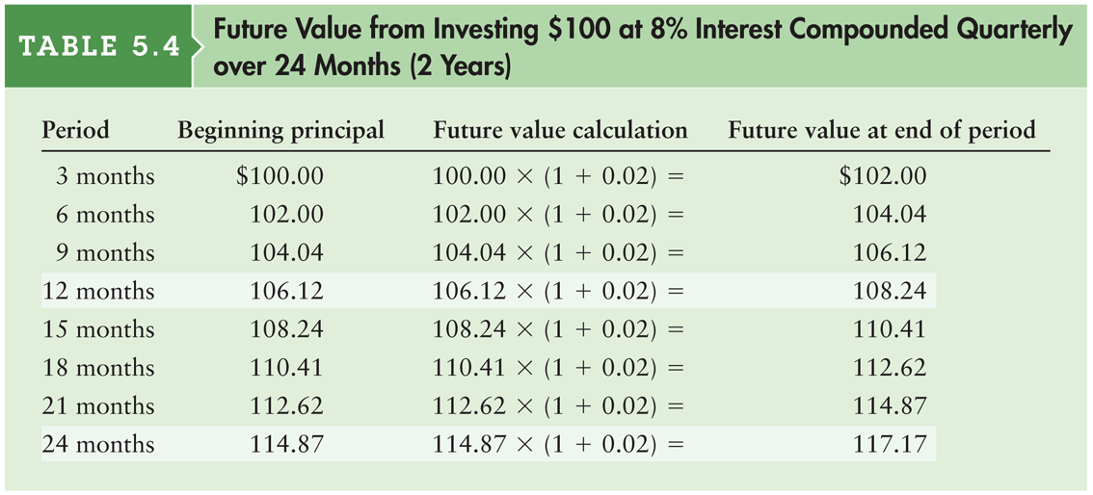
Table 5.4 Future Value from Investing $100 at 8% Interest Compounded Quarterly over 24 Months (2 Years)

Slide 58
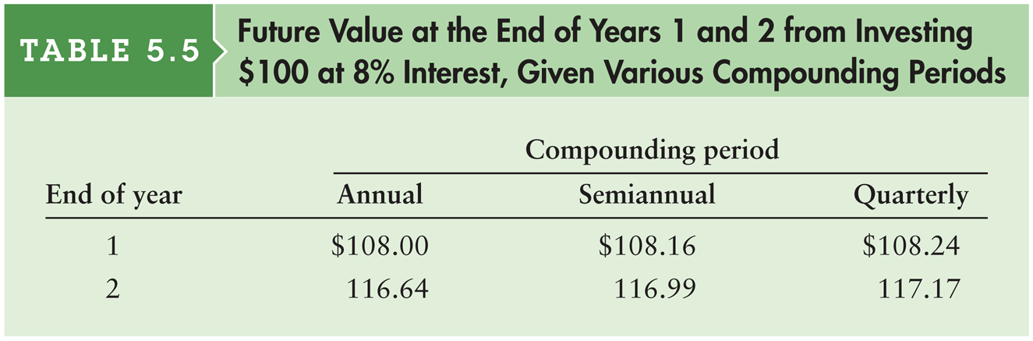
Table 5.5 Future Value from Investing $100 at 8% Interest Compounded Quarterly over 24 Months (2 Years)

Slide 59

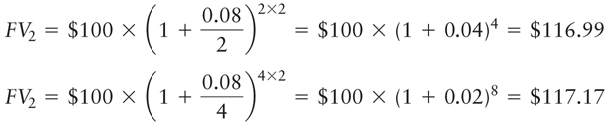
Compounding Interest More Frequently Than Annually (cont.)
A general equation for compounding more frequently than annually
Recalculate the example for the Fred Moreno example assuming (1) semiannual compounding and (2) quarterly compounding.

Slide 60

Continuous Compounding
Continuous compounding involves the compounding of interest an infinite number of times per year at intervals of microseconds.
A general equation for continuous compounding where e is the exponential function.

Slide 61
Personal Finance Example
Find the value at the end of 2 years (n = 2) of Fred Moreno’s $100 deposit (PV = $100) in an account paying 8% annual interest (r = 0.08) compounded continuously.
FV₂ (continuous compounding) = $100 × e^{0.08 × 2}
= $100 × 2.7183^{0.16}
= $100 × 1.1735 = $117.35

Slide 62
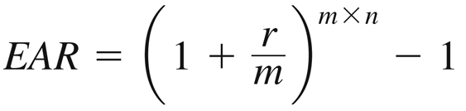
Nominal and Effective Annual Rates of Interest
The nominal (stated) annual rate is the contractual annual rate of interest charged by a lender or promised by a borrower.
The effective (true) annual rate (EAR) is the annual rate of interest actually paid or earned.
In general, the effective rate > nominal rate whenever compounding occurs more than once per year

Slide 63
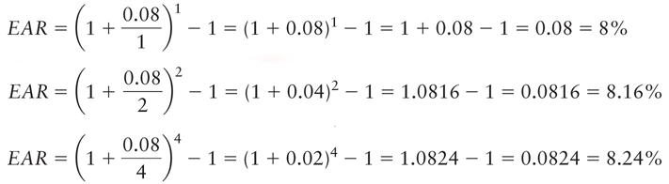
Personal Finance Example
Fred Moreno wishes to find the effective annual rate associated with an 8% nominal annual rate (r = 0.08) when interest is compounded (1) annually (m = 1); (2) semiannually (m = 2); and (3) quarterly (m = 4).

Slide 64

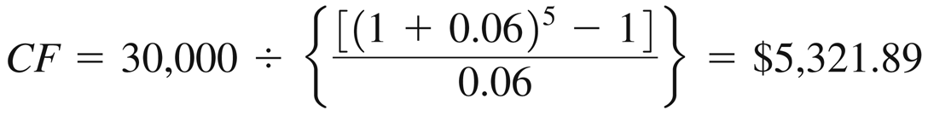
Special Applications of Time Value: Deposits Needed to Accumulate a Future Sum
The following equation calculates the annual cash payment (CF) that we’d have to save to achieve a future value (FV_{n}):
Suppose you want to buy a house 5 years from now, and you estimate that an initial down payment of $30,000 will be required at that time. To accumulate the $30,000, you will wish to make equal annual end-of-year deposits into an account paying annual interest of 6 percent.

Slide 65
Special Applications of Time Value: Loan Amortization
Loan amortization is the determination of the equal periodic loan payments necessary to provide a lender with a specified interest return and to repay the loan principal over a specified period.
The loan amortization process involves finding the future payments, over the term of the loan, whose present value at the loan interest rate equals the amount of initial principal borrowed.
A loan amortization schedule is a schedule of equal payments to repay a loan. It shows the allocation of each loan payment to interest and principal.

Slide 66

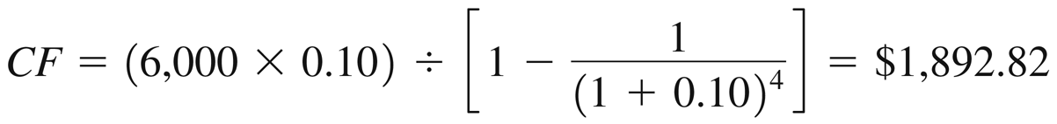
Special Applications of Time Value: Loan Amortization (cont.)
The following equation calculates the equal periodic loan payments (CF) necessary to provide a lender with a specified interest return and to repay the loan principal (PV) over a specified period:
Say you borrow $6,000 at 10 percent and agree to make equal annual end-of-year payments over 4 years. To find the size of the payments, the lender determines the amount of a 4-year annuity discounted at 10 percent that has a present value of $6,000.

Slide 67
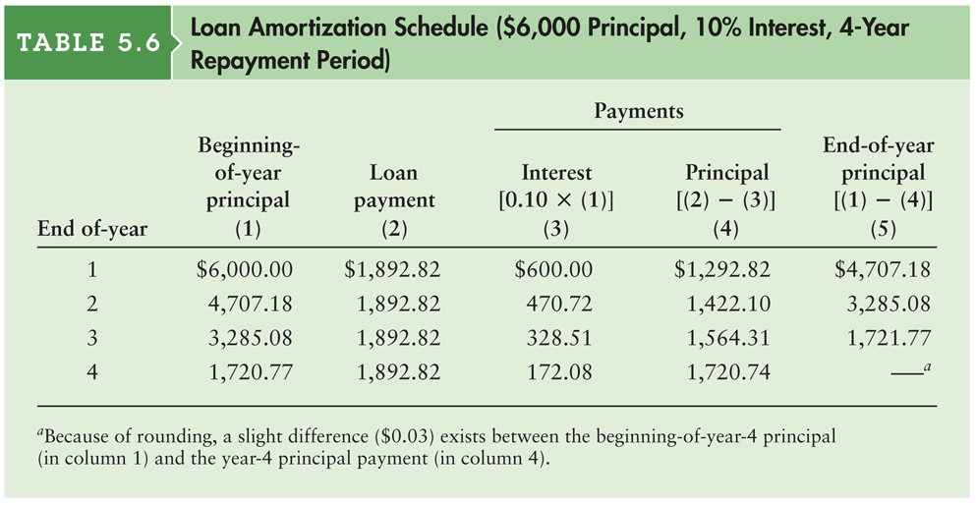
Table 5.6 Loan Amortization Schedule ($6,000 Principal, 10% Interest, 4-Year Repayment Period)

Slide 68

Special Applications of Time Value: Finding Interest or Growth Rates
It is often necessary to calculate the compound annual interest or growth rate (that is, the annual rate of change in values) of a series of cash flows.
The following equation is used to find the interest rate (or growth rate) representing the increase in value of some investment between two time periods.

Slide 69
Personal Finance Example
Ray Noble purchased an investment four years ago for $1,250. Now it is worth $1,520. What compound annual rate of return has Ray earned on this investment? Plugging the appropriate values into Equation 5.20, we have:
r = ($1,520 ÷ $1,250)^{(1/4)} – 1 = 0.0501 = 5.01% per year

Slide 70
Special Applications of Time Value: Finding an Unknown Number of Periods
Sometimes it is necessary to calculate the number of time periods needed to generate a given amount of cash flow from an initial amount.
This simplest case is when a person wishes to determine the number of periods, n, it will take for an initial deposit, PV, to grow to a specified future amount, FV_{n}, given a stated interest rate, r.

Slide 71
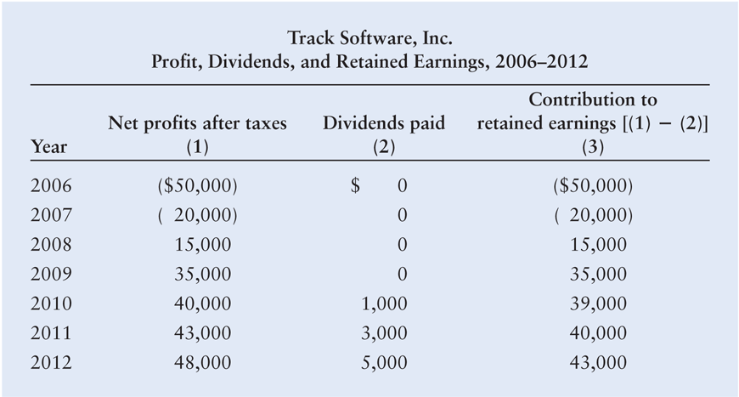
Integrative Case: Track Software, Inc.
Table 1: Track Software, Inc. Profit, Dividends, and Retained Earnings, 2006–2012

Slide 72
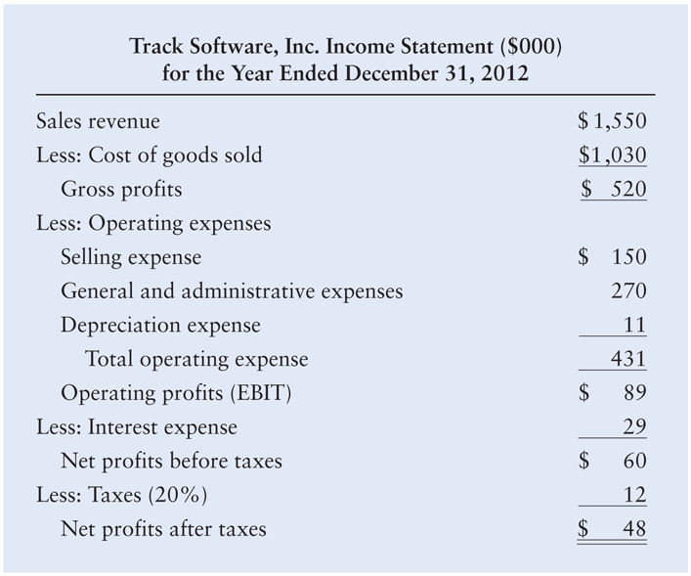
Integrative Case: Track Software, Inc.
Table 2: Track Software, Inc. Income Statement ($000)for the Year Ended December 31, 2012

Slide 73
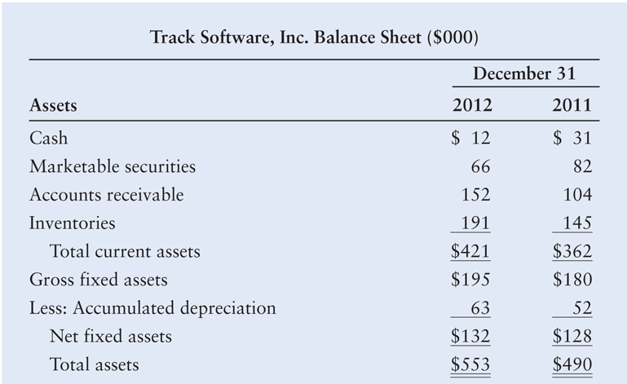
Integrative Case: Track Software, Inc.
Table 3a: Track Software, Inc. Balance Sheet ($000)

Slide 74
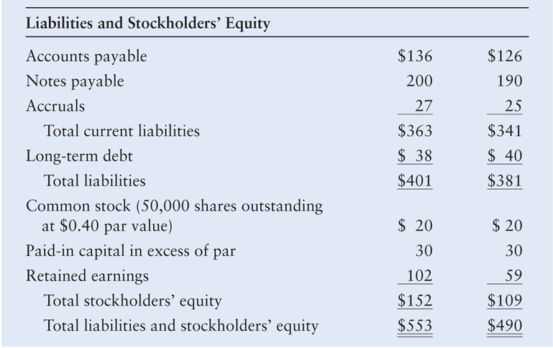
Integrative Case: Track Software, Inc.
Table 3b: Track Software, Inc. Balance Sheet ($000)

Slide 75
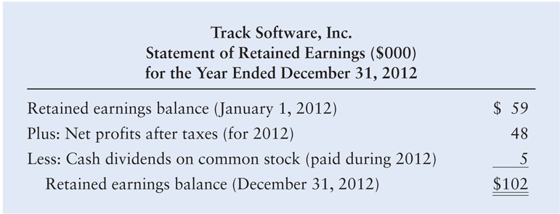
Integrative Case: Track Software, Inc.
Table 4: Track Software, Inc. Statement of Retained Earnings ($000) for the Year Ended December 31, 2012

Slide 76
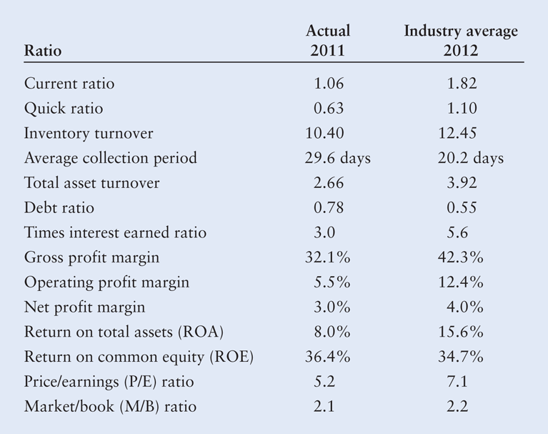
Integrative Case: Track Software, Inc.
Table 5: Track Software, Inc. Profit, Dividends, and Retained Earnings, 2006–2012

Slide 77
Integrative Case: Track Software, Inc.
Upon what financial goal does Stanley seem to be focusing? Is it the correct goal? Why or why not? Could a potential agency problem exist in this firm? Explain.
Calculate the firm’s earnings per share (EPS) for each year, recognizing that the number of shares of common stock outstanding has remained unchanged since the firm’s inception. Comment on the EPS performance in view of your response in part a.
Use the financial data presented to determine Track’s operating cash flow (OCF) and free cash flow (FCF) in 2012. Evaluate your findings in light of Track’s current cash flow difficulties.

Slide 78
Integrative Case: Track Software, Inc.
Analyze the firm’s financial condition in 2012 as it relates to (1) liquidity, (2) activity, (3) debt, (4) profitability, and (5) market, using the financial statements provided in Tables 2 and 3 and the ratio data included in Table 5. Be sure to evaluate the firm on both a cross-sectional and a time-series basis.
What recommendation would you make to Stanley regarding hiring a new software developer? Relate your recommendation here to your responses in part a.

Slide 79
Integrative Case: Track Software, Inc.
Track Software paid $5,000 in dividends in 2012. Suppose an investor approached Stanley about buying 100% of his firm. If this investor believed that by owning the company he could extract $5,000 per year in cash from the company in perpetuity, what do you think the investor would be willing to pay for the firm if the required return on this investment is 10%?
Suppose that you believed that the FCF generated by Track Software in 2012 could continue forever. You are willing to buy the company in order to receive this perpetual stream of free cash flow. What are you willing to pay if you require a 10% return on your investment?

