Slide 1
Solving problems by searching
Informed or Heuristic Search

Slide 2
Outline
Search strategy
Best-first search
Greedy best-first search
A* search
Local search algorithm or Hill-climbing search
Simulated annealing search
Genetic algorithms
Stochastic algorithms

Slide 3
Search Strategy
Uninformed search strategies can find solutions to problems by systematically generating new states and testing them against the goal. Unfortunately, these strategies are incredibly inefficient in most cases.
However, informed search strategies use problem specific knowledge can find more efficient solutions.
A tree-search strategy is defined by picking the order of node expansion.

Slide 4
Best-first search
It is an instance of the general tree-search or graph-search algorithm in which a node is selected for expansion based on an evaluation function.
Idea: use an evaluation function f(n) for each node expansion
Estimate "desirability"
Expand most desirable unexpanded node
Implementation:
Order the nodes in fringe in decreasing order of desirability based on f(n). In this algorithm, there are different evaluation functions. Typically, it uses a heuristic function h(n) that estimates the cost (the cheapest path cost from node n to a goal node) of a solution from n.
Special cases:
greedy best-first search
A* search

Slide 5
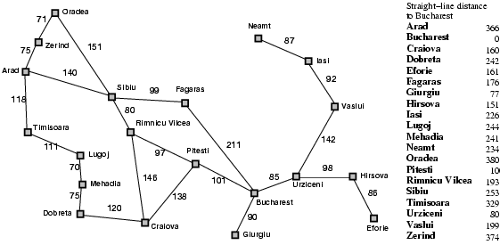
Romania with step costs in km

Slide 6
Greedy best-first search
Greedy best-first search expands the node that appears to be closest to goal, on the grounds that this is likely to lead to a solution quickly.
Thus, it evaluates nodes by using just the heuristic evaluation function f(n) = h(n)
= estimate of cost from n to goal
e.g., h_{SLD}(n) = straight-line distance (SLD) from n to goal (Bucharest)
Notice that h_{SLD} can not be directly computed from the problem description, it takes certain amount of experience and is, therefore, a useful heuristic.
It is not optimal, but is often efficient.

Slide 7

Greedy best-first search example

Slide 8
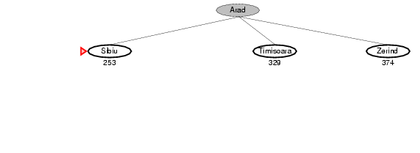
Greedy best-first search example

Slide 9
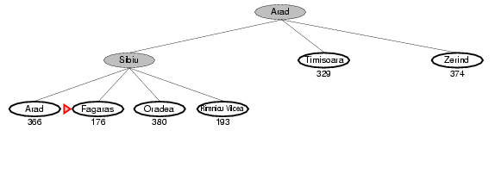
Greedy best-first search example

Slide 10
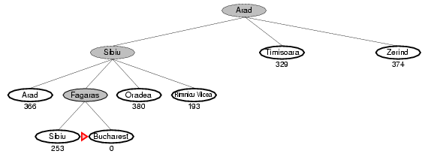
Greedy best-first search example

Slide 11
Properties of greedy best-first search
Complete? No – can get stuck in loops, e.g., Iasi → Neamt → Iasi → Neamt →
Time? O(b^{m}), but a good heuristic can give dramatic improvement
Space? O(b^{m}) -- keeps all nodes in memory
Optimal? No

Slide 12
A* (A-star) search
It is most widely-known form of best-first search.
Evaluation function f(n) = g(n) + h(n)
g(n) = cost so far to reach n
h(n) = estimated cost from n to goal
f(n) = estimated total cost of path through n to goal
Expand nodes with minimal f(n).
The strategy is reasonable if A* is complete and optimal.
A* is complete and optimal provided that we guarantee h(n) is admissible (for tree-search) or consistent (for graph-search).

Slide 13

A* search example

Slide 14
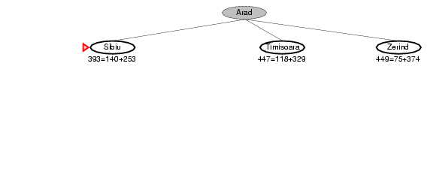
A* search example

Slide 15
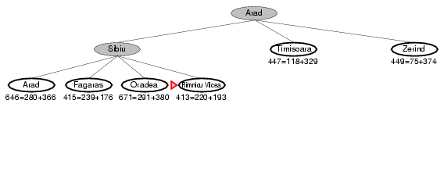
A* search example

Slide 16
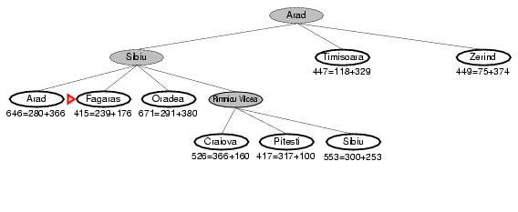
A* search example

Slide 17
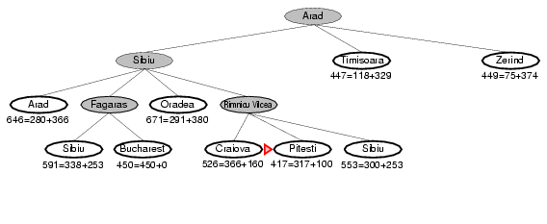
A* search example

Slide 18
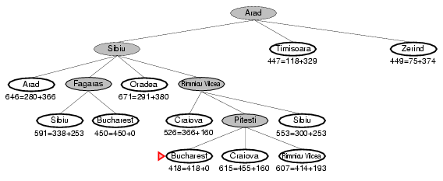
A* search example

Slide 19
Admissible heuristics
Theorem: A* is optimal if h(n) is admissible heuristic, which means h(n) never overestimates the cost to reach the goal.
More clearly, an admissible heuristic never overestimates the cost to reach the goal, i.e., it is optimistic.
A heuristic h(n) is admissible if for every node n,
h(n) ≤ h*(n), where h*(n) is the true cost to reach the goal state from n.
Example: h_{SLD}(n) (never overestimates the actual road distance).

Slide 20
Properties of A*
Complete? Yes (unless there are infinitely many nodes with f ≤ f(G) )
Time? Exponential
Space? Keeps all nodes in memory
Optimal? Yes

Slide 21
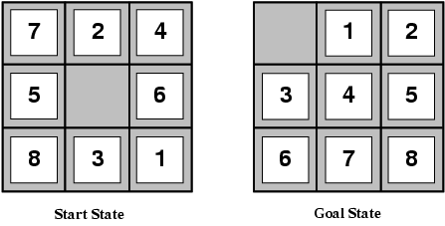
Admissible heuristics
For the 8-puzzle:
h₁(n) = number of misplaced tiles
h₂(n) = total Manhattan distance (city block distance), which indicates the sum of distances of the tiles from their goal positions.
h₁(S) = ?
h₂(S) = ?

Slide 22
Admissible heuristics
h₁(n) is an admissible heuristic, because it is clear that any tile that is out of place must be moved at least once.
h₂(n) is also admissible, because any move can do one step closer to the goal.
h₁(S) = ? 8
h₂(S) = ? 3+1+2+2+2+3+3+2 = 18
Neither of these h₁(n) and h₂(n) overestimates the true solution cost, which is 26.

Slide 23
Relaxed problems
A problem with fewer restrictions on the actions is called a relaxed problem
The cost of an optimal solution to a relaxed problem is an admissible heuristic for the original problem
If the rules of the 8-puzzle are relaxed so that a tile can move anywhere, then h₁(n) gives the shortest solution
If the rules are relaxed so that a tile can move to any adjacent square, then h₂(n) gives the shortest solution

Slide 24
Local search algorithms and optimization problems
In many optimization problems, the path to the goal is irrelevant; the goal state itself is the solution. For example, in the 8-queens problem, what matters is the final configuration of queens, not the order in which they are added.
This class of problems includes many important applications such as IC design, factory-floor layout, telecommunications network optimization, vehicle routing, and portfolio management.
Local search algorithms operate using a single current state (rather than multiple paths) and generally move only to neighbors of that state. Typically, the paths followed by the search are not retained.
Though local search algorithms are not systematic, however, it has two major advantages:
Use very little memory – usually a constant amount.
They often find reasonable solutions in large or infinite (continuous) state spaces for which systematic algorithms are not suitable.

Slide 25
Local search algorithms and optimization problems
In addition to finding goals, local search algorithms are useful for solving optimization problems, in which the aim is to find the best state according to an objective function.
For example, nature provides an objective function – reproductive fitness. In this case, Darwinian evolution (genetic algorithm) could be seen as attempting to optimize, but there is no “goal test” and no “path cost” for this problem.

Slide 26
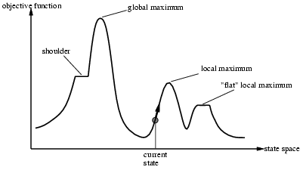
Local search algorithm
Consider state space landscape. A landscape has both “location” and “elevation”.
If elevation corresponds to cost function, then the aim is to find the lowest valley – a global minimum. If elevation corresponds to an objective function, the aim is to find the highest peak – a global maximum. Local search algorithms explore this landscape.
A complete local search algorithm always finds a goal if one exists; an optimal algorithm always finds a global minimum/maximum.

Slide 27

Example: n-queens
Put n queens on an n × n board with no two queens on the same row, column, or diagonal (that means no queen attacks any other; a queen attacks any piece in the same row, column or diagonal)
One queen per column.

Slide 28
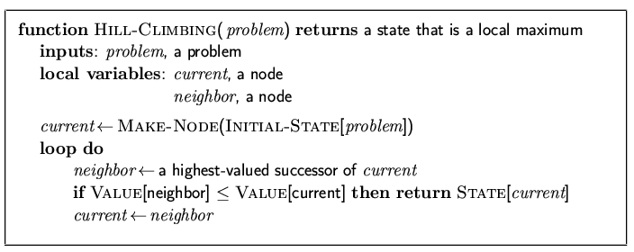
Hill-climbing search
"Like climbing Everest in thick fog with amnesia"
Amnesia: loss of memory

Slide 29
Hill-climbing search
Problem: depending on initial state, can get stuck in local maxima

Slide 30
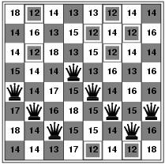
Hill-climbing search: 8-queens problem
Heuristic cost function, h = number of pairs of queens that are attacking each other, either directly or indirectly.
h = 17 for the above state
The global minimum of this function is zero, which occurs only at perfect solutions.
The values shows all of its successors, with best successors having h = 12

Slide 31
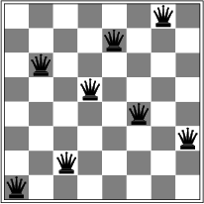
Hill-climbing search: 8-queens problem
A local minimum with h = 1

Slide 32
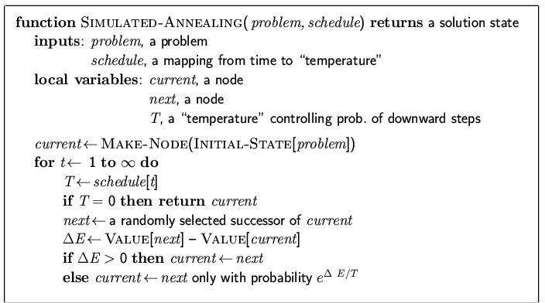
Simulated annealing search
Idea: escape local maxima by allowing some "bad" moves but gradually decrease their frequency.
Simulated annealing returns optimal solutions when given an appropriate cooling schedule.

Slide 33
Properties of simulated annealing search
One can prove: If T decreases slowly enough, then simulated annealing search will find a global optimum with probability approaching 1.
Widely used in VLSI layout, airline scheduling, etc.

Slide 34
Local beam search
Keep track of k states rather than just one
Start with k randomly generated states
At each iteration, all the successors of all k states are generated
If any one is a goal state, stop; else select the k best successors from the complete list and repeat.

Slide 35
Genetic algorithms
A successor state is generated by combining two parent states
Start with k randomly generated states (population)
A state is represented as a string over a finite alphabet (often a string of 0s and 1s)
Evaluation function (fitness function). Higher values for better states.
Produce the next generation of states by selection, crossover, and mutation

Slide 36
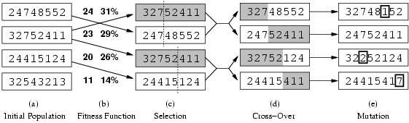
Genetic algorithms
Fitness function: number of non-attacking pairs of queens (min = 0, max = 8 × 7/2 = 28)
24/(24+23+20+11) = 31%
23/(24+23+20+11) = 29% etc

Slide 37
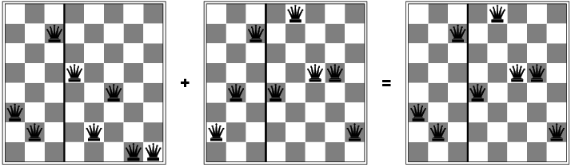
Genetic algorithms

