Slide 1
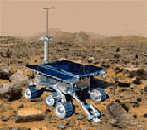

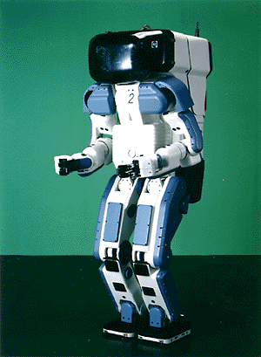

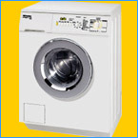
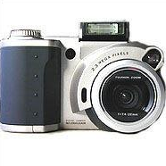

Why study AI?
Search engines
Science
Medicine/
Diagnosis
Labor
Appliances
What else?

Slide 2
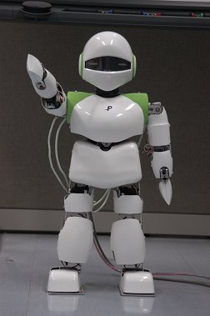
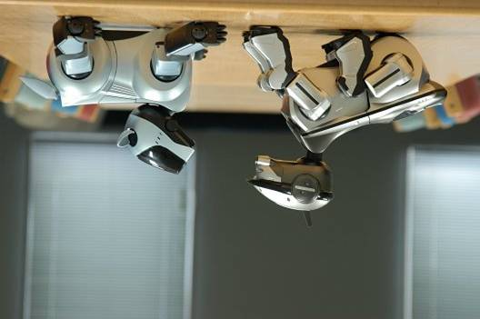
What is Artificial Intelligence?
Goal of AI: make machines do things that would require intelligence if done by humans.
AI is a branch of Computer Science concerned with the study and creation of computer systems that exhibit some form of intelligence
Learn new concepts
Reason and draw useful conclusions about the world
Understand a natural language or perceive and comprehend a visual scene
Perform other types of feats that require human types of intelligence

Slide 3
What is Artificial Intelligence?
AI is Discipline that systematizes and automates intellectual tasks to create machines to
Act like humans | Act rationally
Think like humans | Think rationally

Slide 4
Act Like Humans
The goal of AI is to create computer systems that perform functions that are assumed to require intelligence when done by humans
→ Methodology: Take a task at which people are better, e.g.:
Prove a theorem
Play chess
Plan a surgical operation
Diagnose a disease
Navigate in a building
and make a computer do it

Slide 5
Think Like Humans
How the computer performs functions does matter
Comparison of the traces of the reasoning steps (cognitive science)
But, do we want to duplicate human imperfections?
Role of explicit symbolic knowledge (lemmas, concepts, …)
Pattern recognition → Neural nets
Still a research topic: from signals to symbols

Slide 6
Think/Act Rationally
Always make the “best” decision given what is available (knowledge, time, resources)
“best” → maximizes the expected value of a utility function (≠ perfection)
Strong ties to economics (e.g., game theory), probabilistic modeling, and control theory
But, to some extent, the role of consciousness, emotions, or fear of dying on intelligence is ignored

Slide 7
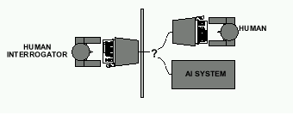
Intelligent Machine
Alan Turing's 1950 article Computing Machinery and Intelligence discussed conditions for considering a machine to be intelligent
“Can machines think?” ←→ “Can machines behave intelligently?”
The Turing test (The Imitation Game): Operational definition of intelligence. Can a computer convince a human interrogator that it is a human?
Computer needs to posses:Natural language processing, Knowledge representation, Automated reasoning, and Machine learning
Are there any problems/limitations to the Turing Test?

Slide 8
AI Prehistory
Philosophy Logic, methods of reasoning, mind as physical system foundations of learning, language, rationality
Mathematics Formal representation and proof algorithms, computation, (un)decidability, (in)tractability, probability
Economics Utility, decision theory
Neuroscience Physical substrate for mental activity
Psychology Phenomena of perception and motor control, experimental techniques
Computer Building fast computers engineering
Control theory Design systems that maximize an objective function over time
Linguistics Knowledge representation, grammar

Slide 9
AI History
The Birth of AI (1943-1956)
McCulloch and Pitts, A logical Calculus of Ideas Immanent in Nervous Activity, 1943 – Boolean Circuit Model of Brain.
Turing, Computing Machinery and Intelligence, 1950
Shannon, Programming a Computer for Playing Chess, 1950
The Rise of AI (1956-1969) and the Discovery of Expert Systems
(1970– 1985); Expert Systems Industry booms
The Dartmouth College Workshop on Machine Intelligence, 1956
LISP Developed by McCarthy, 1958
GA (Genetic Algorithm) by John Holland 1962
Fuzzy Logic by Lotfi Zadeh 1963
Robinson Developed Complete Algorithm for Logical Reasoning, 1965
GPS (General Problem Solver) by Newell and Simon 1969
DENDRAL - First knowledge based expert system supported by NASA to determine the molecular structure of Mars soil. (Buchanan - 1969)
Minsky, A framework for representing knowledge, 1975
MYCIN - to diagnose infectious blood disease. (1976)
PROSPECTOR for mineral exploration developed by Stanford University, (1979).
PROLOG – a Logic Programming Language (Colmerauer, Roussel and Kowalski –1970)

Slide 10
AI History
AI Winter (1885-1993)
Expert Systems Industry busts
The rebirth of AI (1990 - onwards)
Hopfield, Neural Networks
Kohonen, Self-Organized Maps (SOM)
Rumelhart Parallel Distributed Processing
Applications of GA and Fuzzy Logic in AI systems

Slide 11
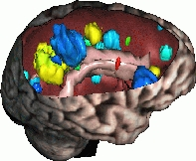
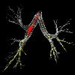

Predictions and Reality … (1/3)
In the 60’s, a famous AI professor from MIT said: “At the end of the summer, we will have developed an electronic eye”
As of 2004, there is still no general computer vision system capable of understanding complex dynamic scenes
But computer systems routinely perform road traffic monitoring, facial recognition, medical image analysis, part inspection, motion capture, …

Slide 12
Predictions and Reality … (2/3)
In 1958, Herbert Simon (CMU) predicted that within 10 years a computer would be Chess champion
This prediction became true in 1997.
Today, computers have won over world champions in several games, including Checkers, Othello, and Chess, but still do not do well in Go
AI techniques (search, planning, probabilistic reasoning) are used in many video games

Slide 13
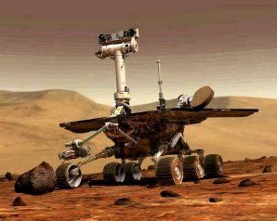
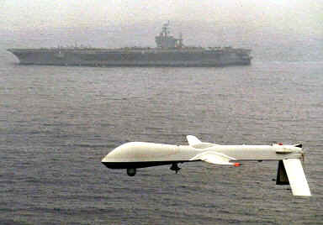
Predictions and Reality … (3/3)
In the 70’s, many believed that computer-controlled robots would soon be everywhere from manufacturing plants to home
Today, some industries (automobile, electronics) are highly robotized, but home robots are still a thing of the future
But robots have rolled (are rolling) on Mars, fly autonomously

Slide 14
AI – The Achievements
Robots make cars in all advanced countries.
Reasonable machine translation is available for a large range of foreign web pages.
Computers land 200 ton jumbo jets unaided every few minutes.
Search systems like Google are not perfect but provide very effective information retrieval
Robots cut slots for hip joints better than surgeons.
Medical expert systems can outperform doctors in many areas of diagnosis.

Slide 15
AI – The Achievements
Deep Blue defeated the reigning world chess champion Garry Kasparov in 1997.
No hands across America (driving autonomously 98% of the time from Pittsburgh to San Diego).
During the 1991 Gulf War, US forces deployed an AI logistics planning and scheduling program that involved up to 50,000 vehicles, cargo, and people.
NASA's on-board autonomous planning program controlled the scheduling of operations for a spacecraft.
Solves crossword puzzles better than most humans.

Slide 16
AI – A Comment
Despite all these achievements, one of the major philosophers of Cognitive Science wrote recently:
“… the failure of artificial intelligence to produce successful simulation of routine commonsense cognitive competences is notorious, not to say scandalous. We still don't have the fabled machine that can make breakfast without burning down the house; or the one that can translate everyday English into everyday Italian, or the one that can summarize texts..” (Jerry Fodor, The Mind doesn’t Work that Way, 2000, p.37).

Slide 17
AI Trend
Early AI concentrated on building intelligent machines that mimicked human behavior.
Present AI devoted to embedding AI algorithms and techniques (neural networks, genetic algorithms, fuzzy logic, and intelligent agents) into software to provide them with the ability to learn, optimize, and reason.

